Slide 1

Advanced Coaching
&
Mentoring
Notes:
https://www.youtube.com/watch?v=VV9TSa7XwA0

Slide 2
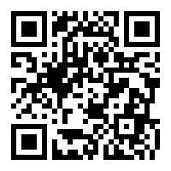
3 things I need to improve
Think about your coaching and identify 3 things you need to improve
Padlet feedback
Common themes to be discussed
Padlet Feedback- don’t put name – scan code

Slide 3
Aims-
1- A schedule for a 14 year old male athlete
2- Plan badminton, tennis and disability session
3- Reflect on your own coaching performance

Slide 4
14 Year old athlete
https://www.youtube.com/watch?v=If7Hrcf04Dw
https://www.youtube.com/watch?v=X_d33tTKzu8

Slide 5
A schedule for a 14 year old male / female athlete:
Task 3- Produce an annual schedule in a template format- an overview of the year (2017/18 or the 2018 year cycle) for a 14 year old male/female athlete. Has to be on one of the following sports:
Football, tennis, badminton, basketball, netball, rugby

Slide 6
Mentoring A 14 Year old
Task- 3 flip chart rotation
1-What are the factors to consider? What aspects do they need to improve and what needs to be planned into training?
2-What considerations for a 14 year old may need to be thought of carefully?
3-What might happen in a year of a 14 year old outside of sport?

Slide 7
A schedule for a 14 year old male / female athlete:
Template needs to include information on the year cycle and how the athletes development is planned under Technical, Tactical, Physical and Physiological perspective:
Consider the following- Season dates, school holidays / school week, competition / fixture dates, Pre season / in season training, volume of training, types of training, intensity of training
Template format don’t provide individual plans. See examples but do not copy! Research / devise your own

Slide 8
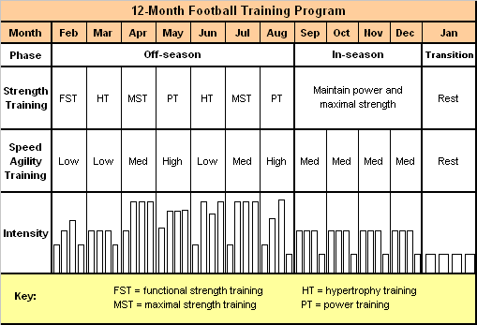

Slide 9
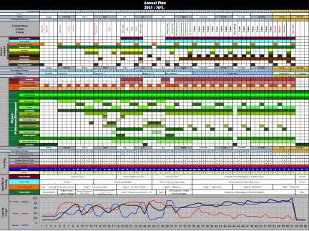

Slide 10
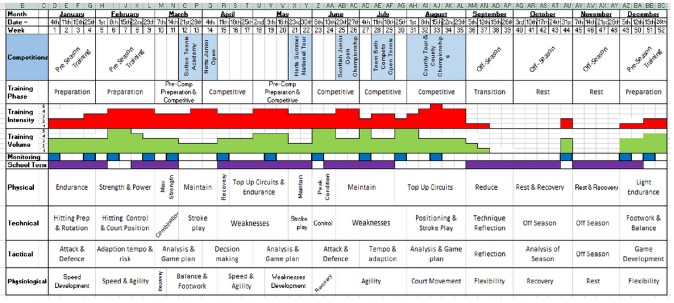

Slide 11
How to achieve your grade:
Task 3- Consider several academic journals in relation to the mentoring process, apply their relevance and link to the coaching pathway in your selected sport. (500-750 words) 20% of grade
Look at moodle and research, remember non sport theory can be used here. There is a lot on nurses / junior doctors that can be applied to coaching.
20% for this / 20% for the schedule (40%)

Slide 12
How to achieve your grade:
Task 1- Complete 5 mentee assessment forms (40%)
Task 2- Practical mentoring competency checklist (completed by your lecturer) demonstrate each of the competencies on at least 3 occasions (10%) a further (10%) awarded for reflection. (20 %)
Task 3- Consider several academic journals in relation to the mentoring process, apply their relevance and link to the coaching pathway in your selected sport. (500-750 words) (20%)
Task 4- Athlete development plan (20%)

Slide 13
The mentor assessment form
Make as many notes as possible in the first section
Set 2 or 3 attainment targets (if positive it can be to continue something)
From the targets pick 1 or 2 positives and 1 or 2 areas to improve to devise some SMART goals / an action plan.
Type the form there is a form on moodle
COMPLETE STRAIGHT AFTER THE SESSION!

Slide 14
BADMINTON
Today
1-How to coach a shot
2- Games to deal with bigger numbers

Slide 15
How to coach a shot?
Groups of 3
Select the shot
Learn some technical points
Design activity progressions
(you will have time today)

Slide 16
Shots today:
Forehand Overhead Clear
Smash
Net Shot
I will demo- backhand o/head clear

Slide 17
Technical points:
Why play the shot?
Breaking the technique down
Learn it- you will have to demo
4-6 small points to remember

Slide 18
Explaining the shot:
Silent Demonstration
Explanation and Demo
Demo with shuttle

Slide 19
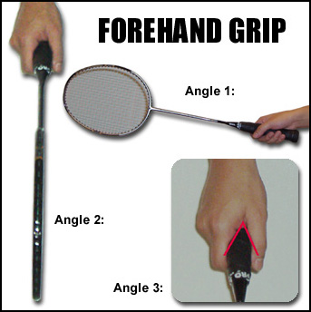
Grips

Slide 20
Grips

Slide 21
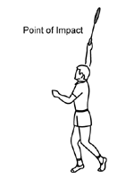
Forehand Overhead Clear:
Coaching Points
Usian Bolt position
Point non racket hand at the shuttle
Weight on the rear foot
Hit shuttle at the highest point possible
Straighten elbow as you hit
Whip the wrist
Transfer weight to front
Return to RP

Slide 22
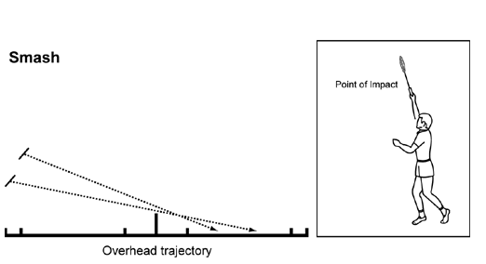
Smash:
Coaching Points
As the overhead clear
Contact shuttle sooner
Angle down at feet

Slide 23
Net Shot:
Coaching Points
Keep racket in front of the body
Racket face parallel to the floor
Lunge forward racket leg / Hand
Extend arm and keep racket high to hit as early as possible
Push back to RP

Slide 24
Activity progressions
Throwing- throw shuttles to a partner to mimic shot
Shadow- Coach shadows the shot without hitting
Shadow then hit- throw feed
Target practice- Mark an area for shuttles to land
Hit then hit- Serve - shot / start again
Conditioned rally – make sure it flows
Restricted court rally
Selected amount of shots to open a game
Notes:
Expectations- Must do a shadow, 1 other and definitely a conditioned rally

Slide 25
The Rules:
Court dimensions-
Singles- Thin and long at all times
Doubles- Serve- short and fat (during play full court)
Serving- shuttle must be hit below waist height- (lowest part of your ribcage) and across court.
Notes:
Expectations- Must do a shadow, 2 others and definitely a conditioned rally

Slide 26
Planning :
W/Up-Group- game sense / gamification games
(I will lead these in lecture rules / how to umpire)
Today- I will demo a quick session
You- will lead a coaching session (focus on one shot) with a partner 20 mins each (1 on 2 coaching)
Notes:
Expectations- Must do a shadow, 2 others and definitely a conditioned rally

Slide 27
Planning :
Form a small plan now, consider what you will do and in what order:
Throwing- throw shuttles to a partner to mimic shot
Shadow- Coach shadows the shot without hitting
Shadow then hit
Target practice- Mark an area for shuttles to land
Hit then hit- Serve - shot / start again
Conditioned rally – make sure it flows
Restricted court rally
Notes:
Expectations- Must do a shadow, 2 others and definitely a conditioned rally

Slide 28
NEXT WEEK:
Tennis- Plan needed
Week after-
Pen Y Bryn Special School
Plan needed

