Slide 1
Thermal Properties of Building Structures

Slide 2
“The first step in developing an integrated design is to establish the function of the building envelope as the primary climatic modifier. Good fabric design can minimise the need for services…”
Source: CIBSE Guide F

Slide 3
For thermal performance we need to consider issues such as:
• Reducing heat loss through the fabric
• Reducing the heat loss through infiltration
• Reducing solar gain
• Using the mass of the building to smooth peaks in temperature
• Carefully placing thermal insulation

Slide 4
Heat Loss
This is the amount of heat energy that travels from the warm inside, to the colder outside and must be replaced to maintain comfort conditions. It is dependant upon the following factors:-
• Actual external temperature
• Required internal temperature
• Size and shape of building (form factor)
• Building components U-values
• Air infiltration rate into the building

Slide 5
What is a U – Value?
U is the symbol used to represent the thermal transmittance of a building
envelope element.
It defines the ability of a given thickness of materials and airspaces to transmit heat under steady state conditions. It is a measure of the quantity of heat that will flow through 1m2, per one degree difference in temperate between either side of the element.

Slide 6
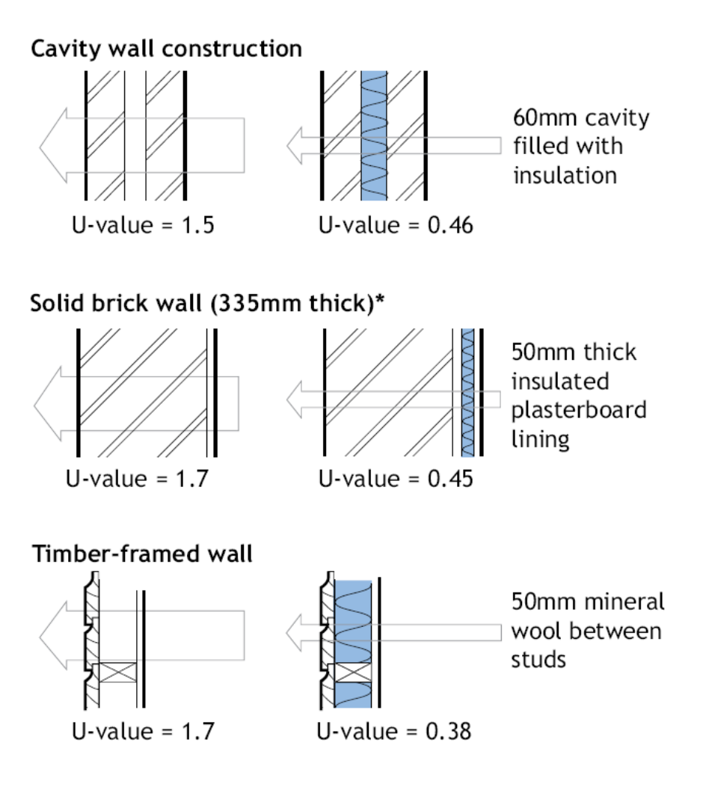
Some example U - Values

Slide 7
Insulation
A concept you are most likely very familiar with. Most likely acoustic or thermal. Insulation is a key element for making out buildings habitable.
But there are many other thermal forces we must consider when designing a new build or retrofit project.

Slide 8
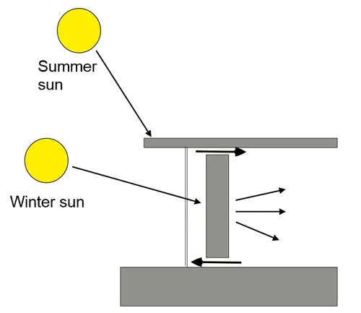
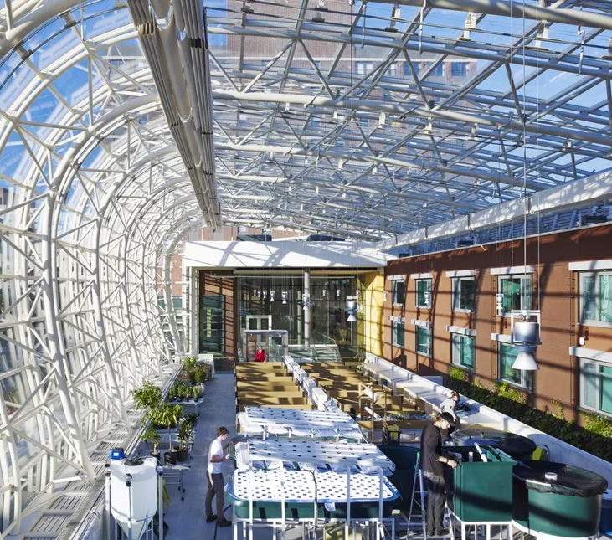
Solar Gains
Issues to consider:
• Orientation
• Proximity of other buildings
• Surrounding surfaces
• Glazing/shading
• Admittance?
• Operating hours

Slide 9
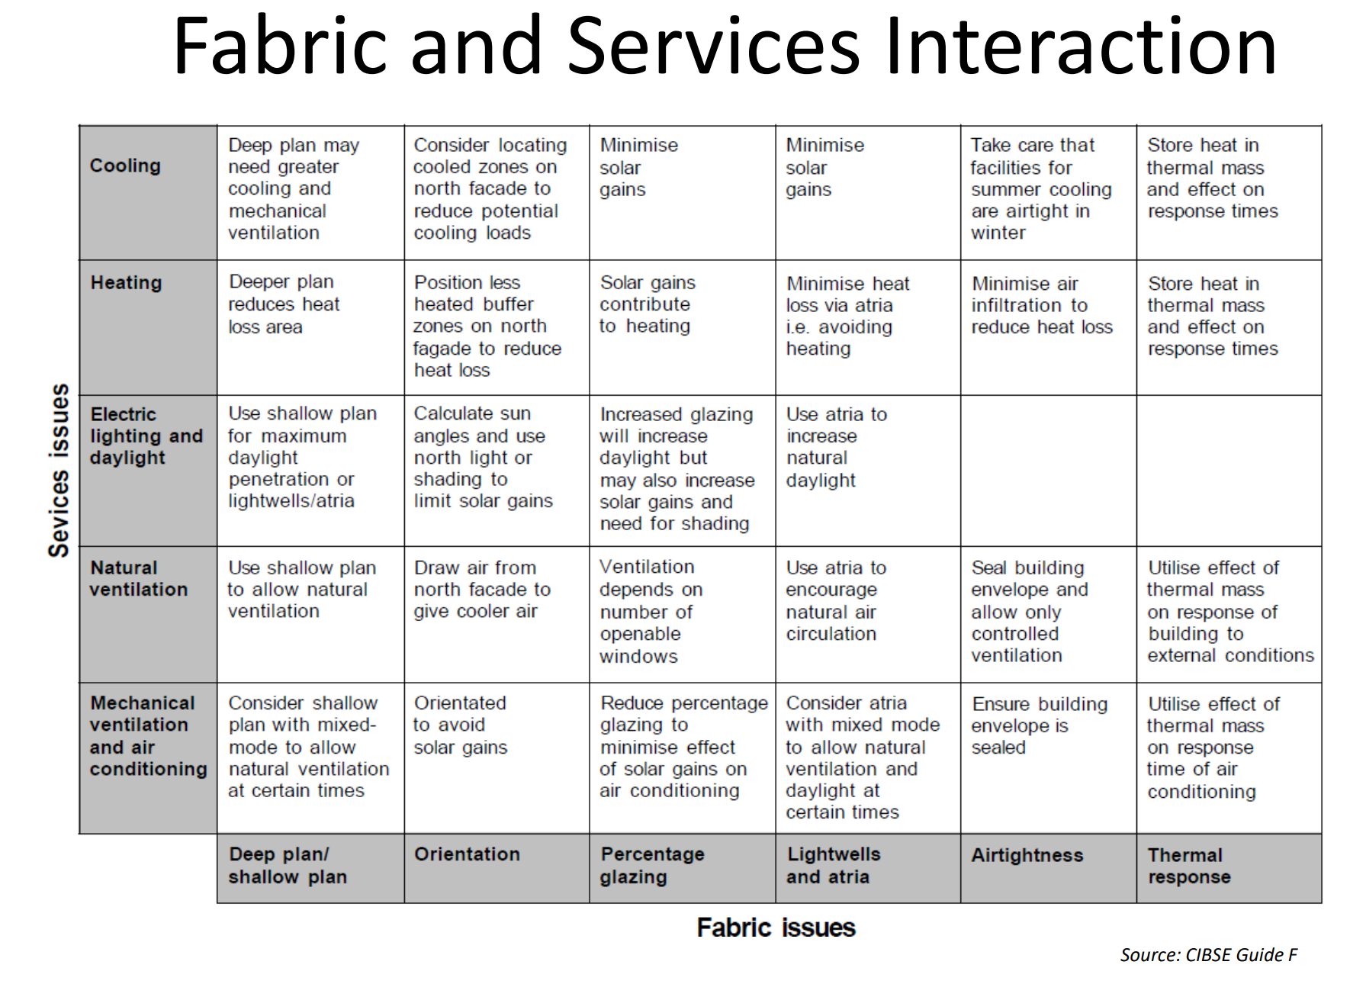

Slide 10
Thermal Mass
The ability of a material to absorb, store and release heat energy.
Can be used to even-out variations in internal and external conditions, absorbing heat as temperatures rise and releasing it as they fall.
In building design, this can be useful to even-out and delay extremes in thermal conditions, stabilising the internal environment and so reducing the demand for building services systems.

Slide 11
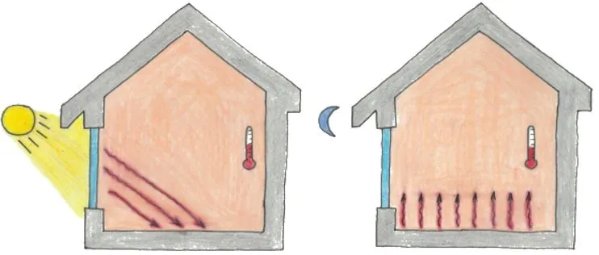
Useful for storing high thermal loads by absorbing heat introduced by external conditions, such as solar radiation, or by internal sources such as appliances and lighting, to be released when conditions are cooler. This can be beneficial both during the summer and the winter.

Slide 12
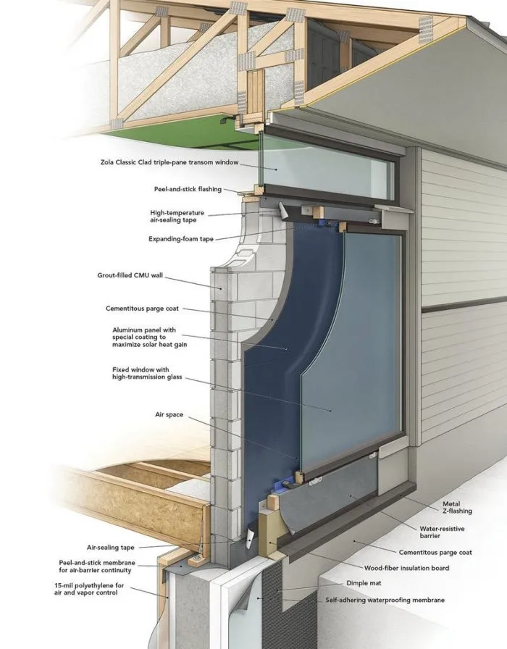
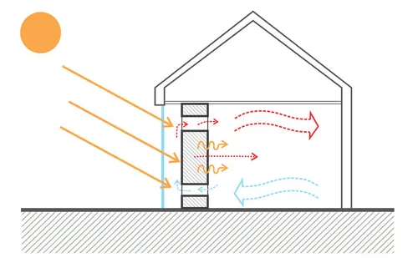
It can be introduced to store a specific aspect of thermal energy.
For example, a Trombe wall placed in front of a south-facing window will absorb solar radiation and then slowly re-release it into the enclosed space.

Slide 13
Trombe Walls
Typically 20-40 cm thick, made out of high heat capacity materials such as masonry or concrete (or even containers filled with water), with the absorbed heat taking up to 10 hours to conduct to the interior.
Installations can also include solar thermal systems to generate hot water.
The efficiency of trombe walls can be improved by the use of double glazing. Ideally, the glazing should have exterior insulation, shutters or blinds to prevent heat loss during the night.

Slide 14
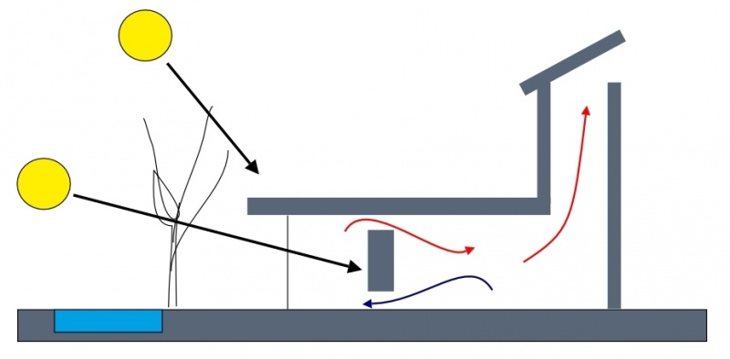
Trombe Walls
Can be utilised in Passive Building Design

Slide 15
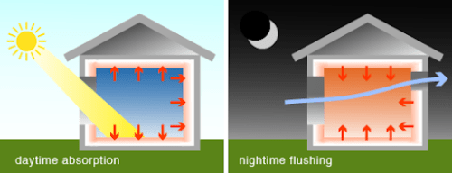
It can also be used in combination with ventilation strategies, for example, concrete floor slabs can be used to absorb heat gains during the day. This heat can then be vented to the outside during the night, leaving the mass available to absorb more heat the following day.
Also Knows As
Thermal Purging
Night-Time Purging

Slide 16
Night-time cooling, however, may require that buildings are unoccupied during the night, and so may be more suitable for an office building than for a hospital, and as the building regulations become more strict, so the performance differences between lightweight and heavyweight buildings are becoming more blurred.

Slide 17
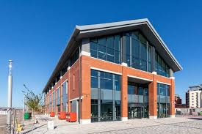
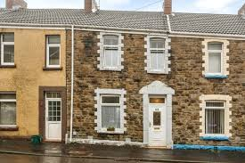
Typically suited to buildings with regular occupation, where internal conditions are stabilised by the thermal mass, and moderated by low-level building services inputs.

Slide 18
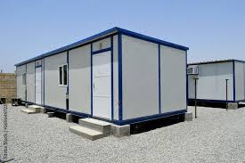
Lighter-weight, more highly-insulated buildings might be better suited to occasional use, where occupants return after some absence and at the flick of a switch, can activate building services systems that will quickly create comfortable conditions.

Slide 19
Design becomes more complex, as external conditions change throughout the seasons and time of day, meaning for example, that the building envelope may sometimes be required to contain heat, sometimes to capture it, and sometimes to reject it.
And the building fabric may have to do this at the same time as performing multiple, conflicting roles, such as allowing access, providing security and creating a suitable acoustic environment.

Slide 20
Thermal mass must be exposed to function efficiently. This means that it is commonly associated with exposed concrete floors, and walls, rather than conventional spaces which might include wall linings, suspended ceilings and raised floors.
This requires that a high-quality finish is achieved and that services are carefully routed. The effectiveness of thermal mass can, however, be enhanced by paint, selected to optimise the absorption and release of thermal radiation.
NB: The presence of exposed mass within buildings can cause problems with high acoustic reverberation.

Slide 21
Thermal mass is often used in association with a wider environmental design strategy, it may be ideally suited to narrow, open-plan buildings or open-plan buildings with atria allowing natural ventilation.
Care must be taken that there is no unwanted night-time cooling, leading to an increase in heating demand. This can be achieved by good insulation and good standards of workmanship to reduce infiltration.

Slide 22
Thermal Layrinth
A thermal labyrinth decouples thermal mass from the occupied space, usually by creating a high thermal mass concrete undercroft with a large surface area. Decoupling the thermal mass means it can be cooled to a lower temperature than if it was in the occupied space.

Slide 23
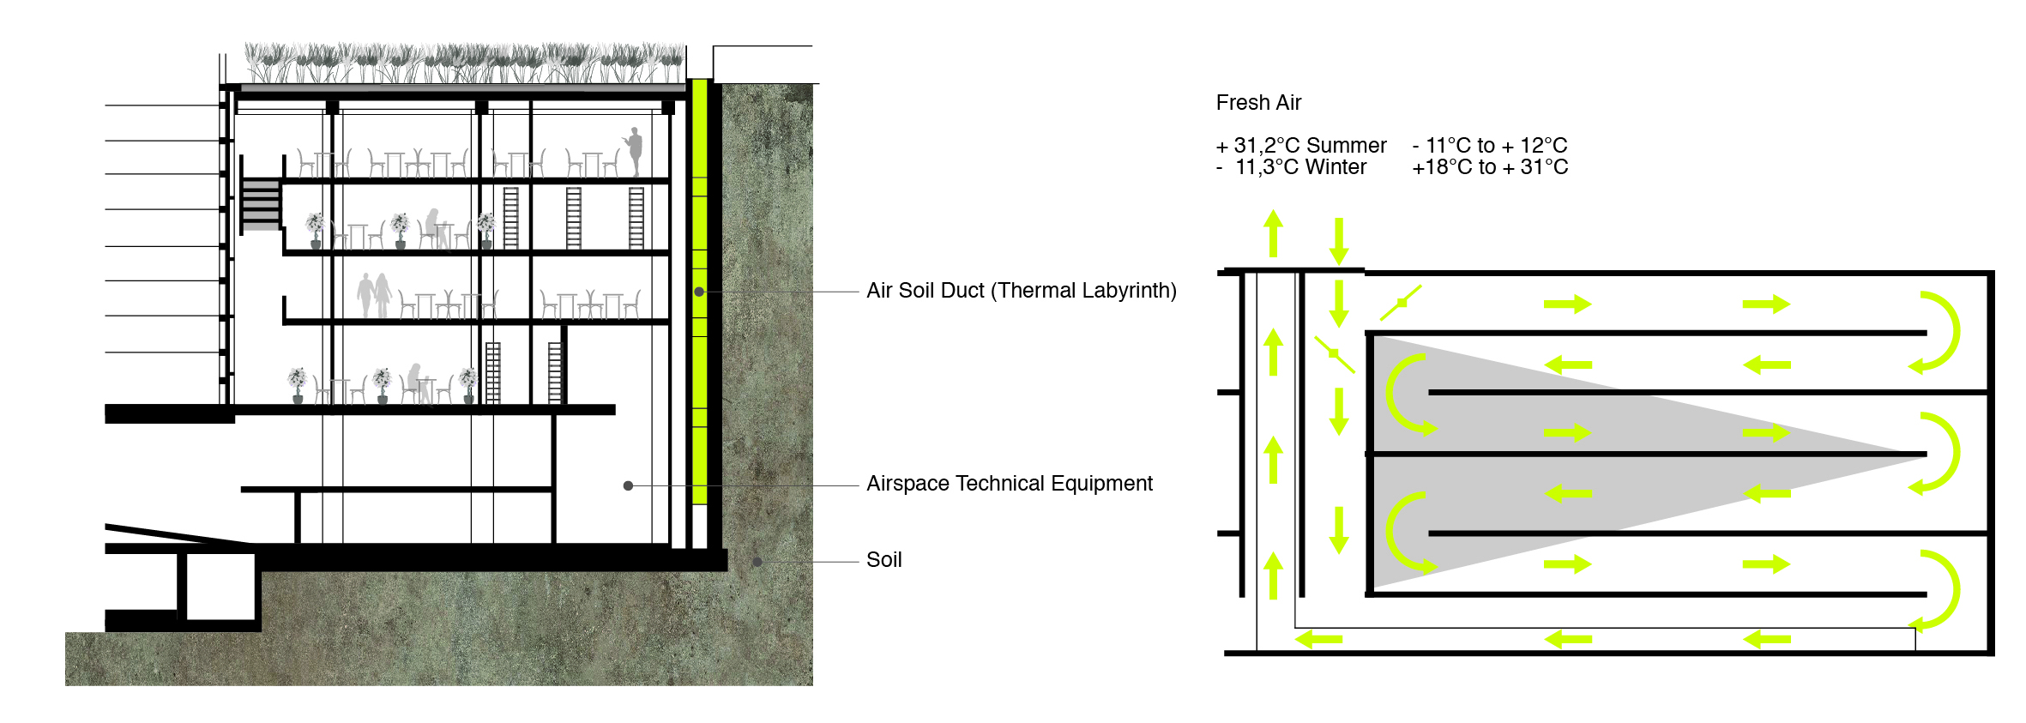
https://www.insideflows.org/project/ewha-campus-complex/

Slide 24
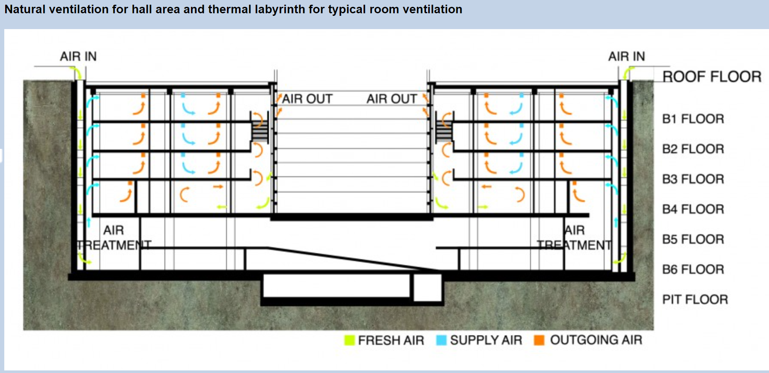
https://www.insideflows.org/project/ewha-campus-complex/

Slide 25
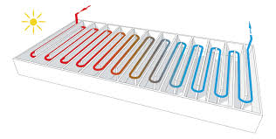
Thermal Labyrinths
Suited to new, mechanically-ventilated buildings with cooling demand that are located in climates with a large temperature difference between day and night.
Often constructed directly beneath a building, only the sides and floor of the labyrinth are in contact with the earth and the top of the labyrinth is directly coupled with the building. This means that the labyrinth needs to be well insulated from the building to prevent heat transfer.

Slide 26
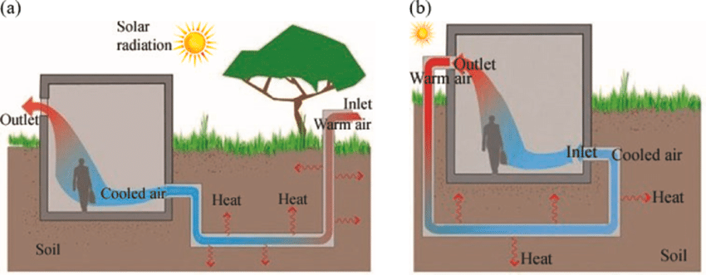
Earth to Air Heat Exchangers
(ground tubes)
This system draws ventilation supply air through buried ducts or tubes. As the temperature of the ground below 3m is practically constant, it substantially reduces ambient air temperature fluctuations.

Slide 27
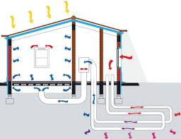
Earth to Air Heat Exchangers
It therefore provides space conditioning throughout the year, with the incoming air being heated in the winter and cooled in the summer by means of earth coupling.

Slide 28
Noteworthy
K – Value, a unit of measure for thermal conductivity of a material (sometimes confused with U-Value)
R – Value, The thermal resistance of a specific thickness of a material, an R-value can be calculated by dividing the thickness of the material (in metres) by its k-value.
U-Value – describes the thermal conductivity of an entire building element, including its internal and external surfaces.
K – (short for Kappa) value refers to the heat capacity per sq. m of a material, measured in kJ/m2K. This is used to quantify the thermal mass of building elements such as walls and floors.

