Slide 1
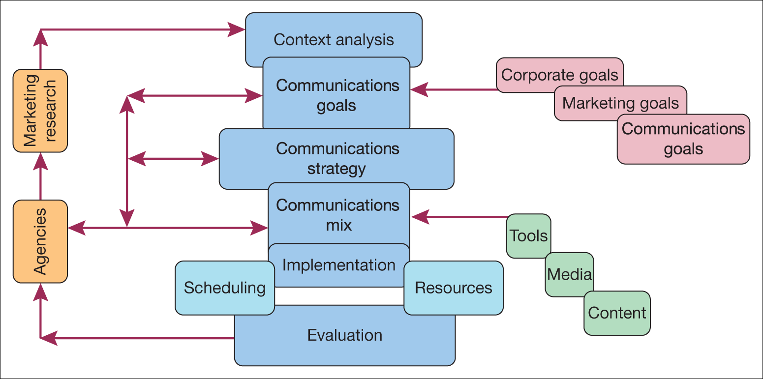
A marketing and sales planning framework

Slide 2
Assessment 2
Component A (50%) Sales Plan (1500 words) -/+10%
Bringing together all the relevant sales and marketing information you have gathered on your restaurant; you will propose a targeted strategy that will help drive the business forward. The purpose of this plan will be to increase both visibility/Profile and sales for the restaurant. You will develop a piece of digital marketing content as part of your plan (see Component B).
Consider what you are trying to achieve and to whom it is targeted. Has this been tried before and with what degree of success? How will you measure the success or otherwise of your project? For example, additional revenue streams, targeted promotions and staff training could be considered.

Slide 3
Component B (50%) Presentation (10 mins) -/+10%
Your presentation will focus on the piece of digital content you have created as part of your plan. You will play your content and then explain how it contributes to increasing both visibility and sales of the restaurant to a new market.
The presentation will be prepared using PowerPoint and must last for 10 minutes (this is a timed exercise, and you will not be permitted to go over the time, with marks potentially being deducted for a presentation that is very short or long).
Remember that you only have a short time to present, so keep the slides punchy and to the point. Remember, enthusiasm backed by data and a solid plan is the best way to sell to an audience.

Slide 4
Marketing communications: strategy and planning
‘a plan of action designed to achieve a long-term or overall aim’
production orientation v’s market orientation
A market orientation to strategy requires a consideration of the needs of the audience first and then a determination of the various messages, media and disciplines necessary to accomplish the strategy: an outside-in approach

Slide 5
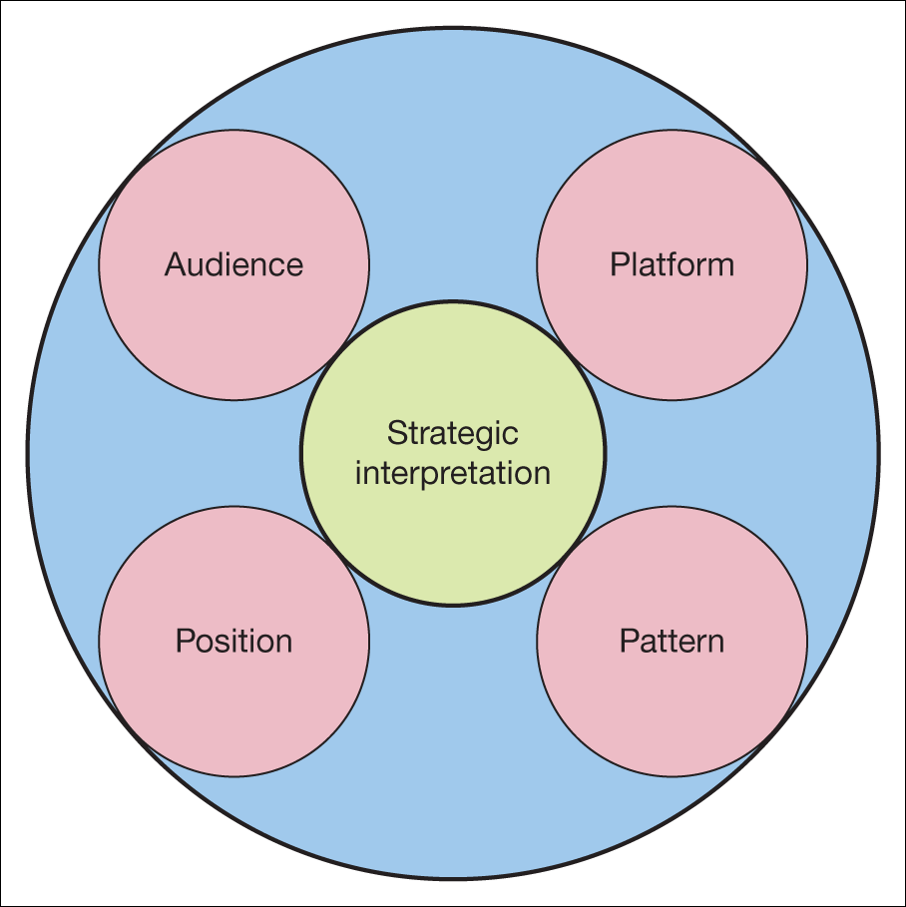
Four interpretations of marketing communications strategy
?
Marketing communications strategy concerns the overall approach used to realise marketing objectives, within an audience related context.

Slide 6
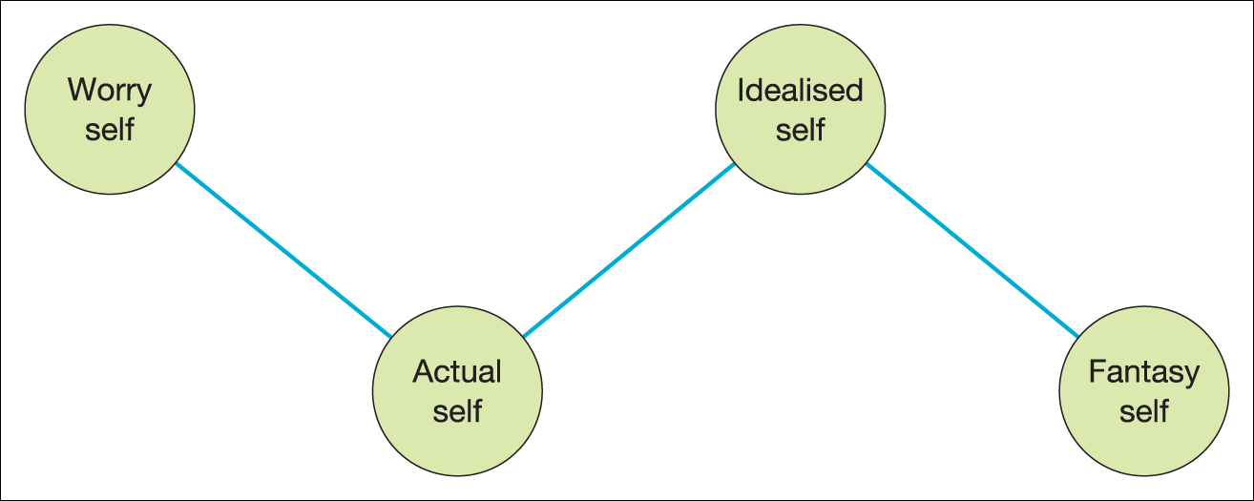

Positioning strategies
A journey of four emotional stages
Segmenting
Targeting
Positioning
‘a company with limited resources needs to pick only the best opportunities to pursue’
(Beane and Ennis, 1987)
Edwards, 2011

Slide 7
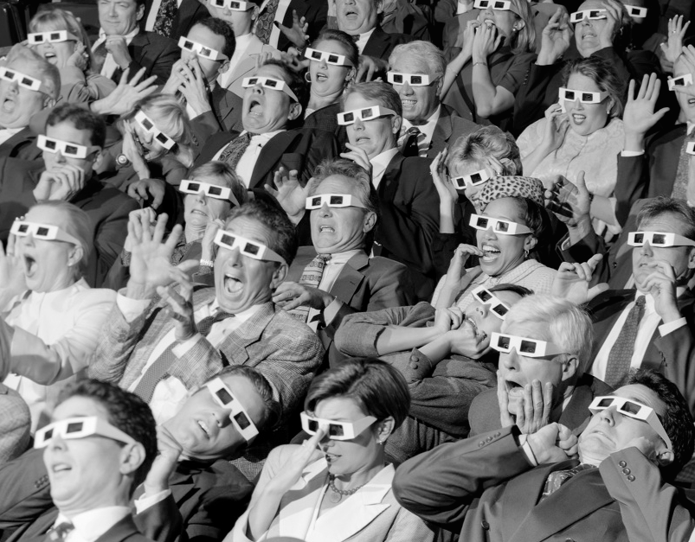
Audience strategies
3p’s

Slide 8
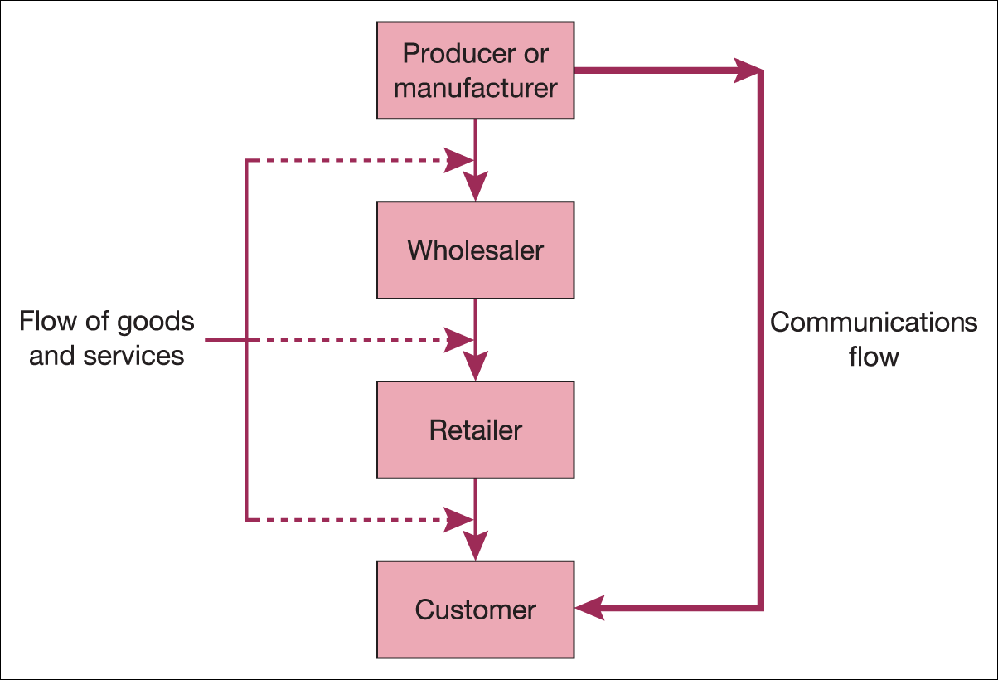
The Direction of a marketing communications pull strategy
Source: From Essentials of Marketing Communications, Pearson Education (Fill, C. 2011) figure 4.2, p. 99.

Slide 9
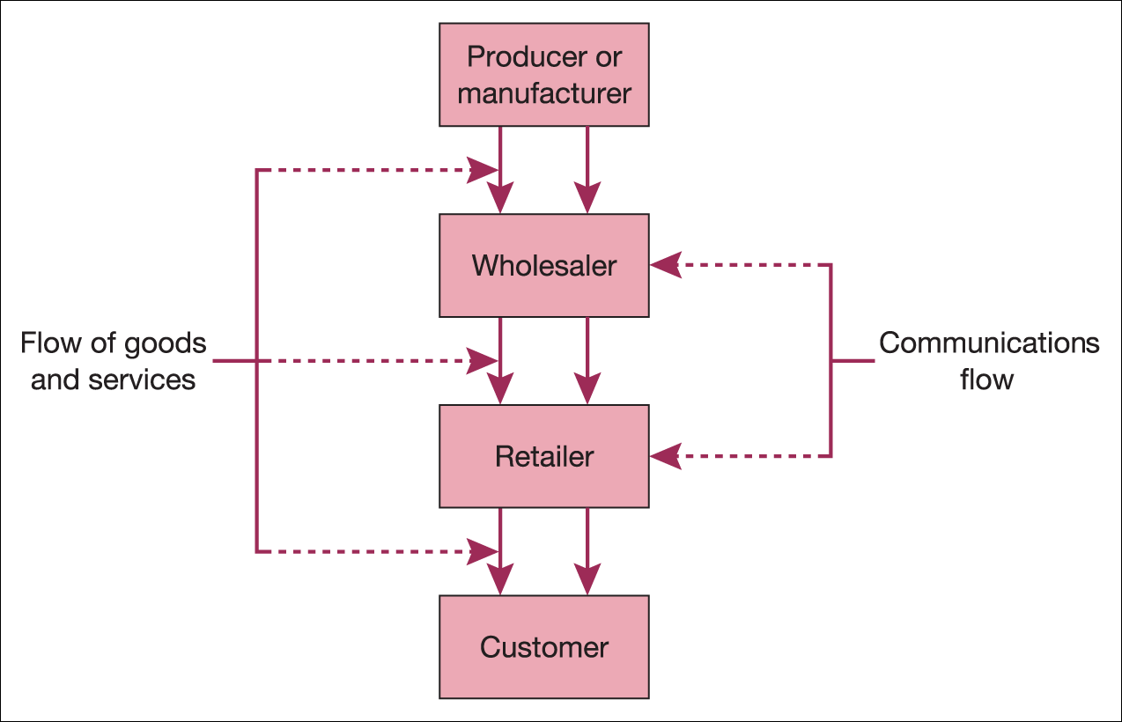
The direction of a marketing communications push strategy

Slide 10
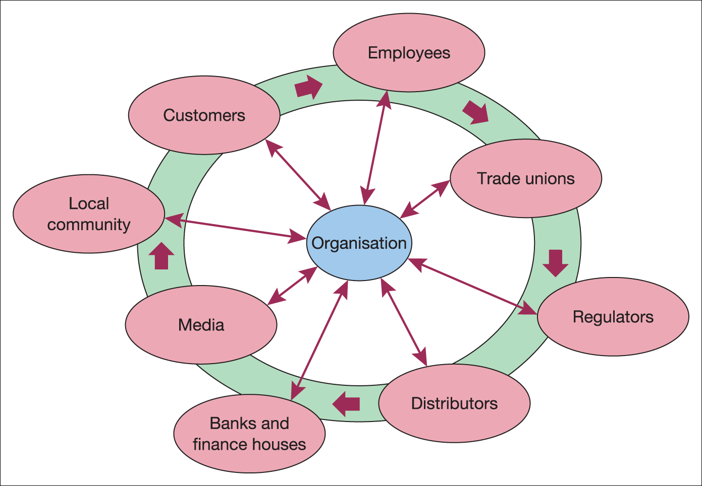
The direction of a marketing communications profile strategy
Source: From Essentials of Marketing Communications, Pearson Education (Fill, C. 2011) figure 4.4, p. 102.

Slide 11

A launch of a new shampoo product will involve a push strategy to get the product on the shelves of the appropriate retailers. The strategy would be to gain retailer acceptance of the new brand and to position it as a profitable new brand to gain consumer interest. Personal Selling supported by trade promotions will be the main marketing communications tool. A pull strategy to develop awareness about the brand will need to be created, accompanied by appropriate public relations work. The next step will be to create particular brand associations and thereby position the brand in the minds of the target audience. Messages may be primarily functional or expressive, but the use of incentives to encourage consumers to trial the product. To support the brand, care lines and a website will need to be put in place to provide credibility as well as a buyer reference point and an opportunity to interact with the brand.

Slide 12
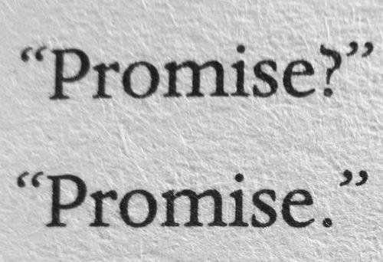
Platform strategies concerning the essence of the promise a brand makes to its customers.
Coca-cola ?
Volvo – cars?
Persil – washing powder?
Nike?
Duracell – batteries?
Aldi and Lidl – supermarkets?
Kia – cars?
Red Bull?

Slide 13
Sales/marketing plan
Context analysis – Marketing mix (from assessment 1) SWOT = what is wrong, where are the opportunities? Who are the customers (SparkTorro)
Communications Goals – SMART target
Comms strategy – What channels, what message?
Comms mix – which from the mix?
Implementation – Gannt chart
Evaluation – KPI’s

Slide 14
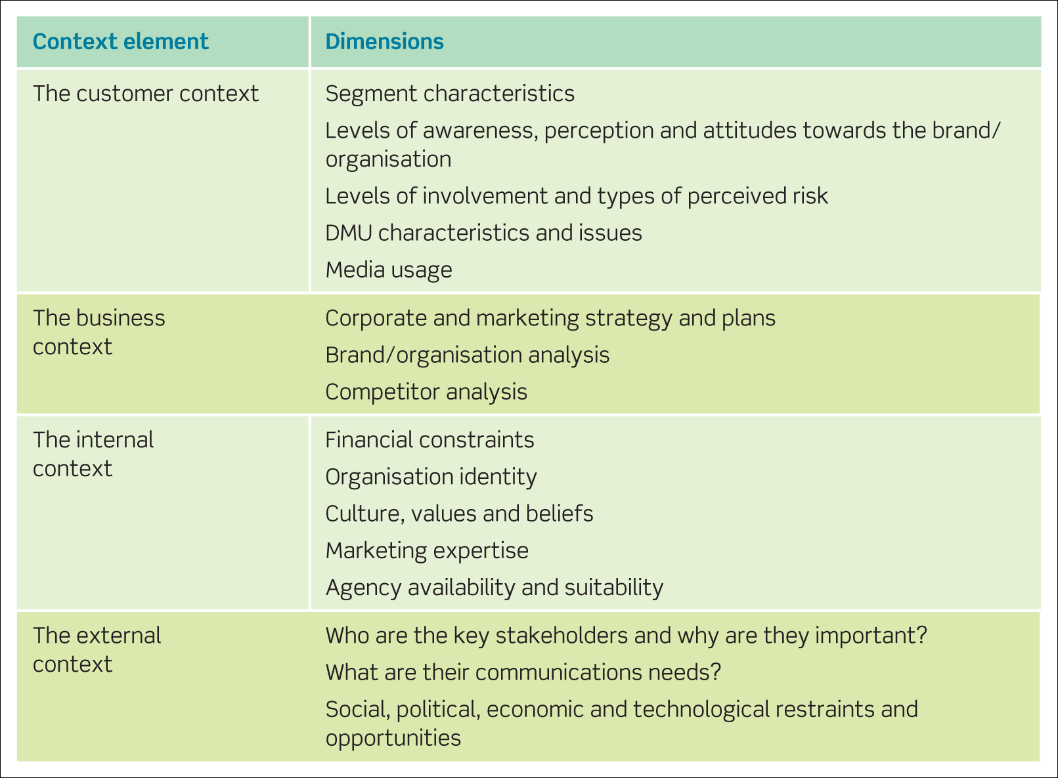
The main elements of the context analysis

Slide 15
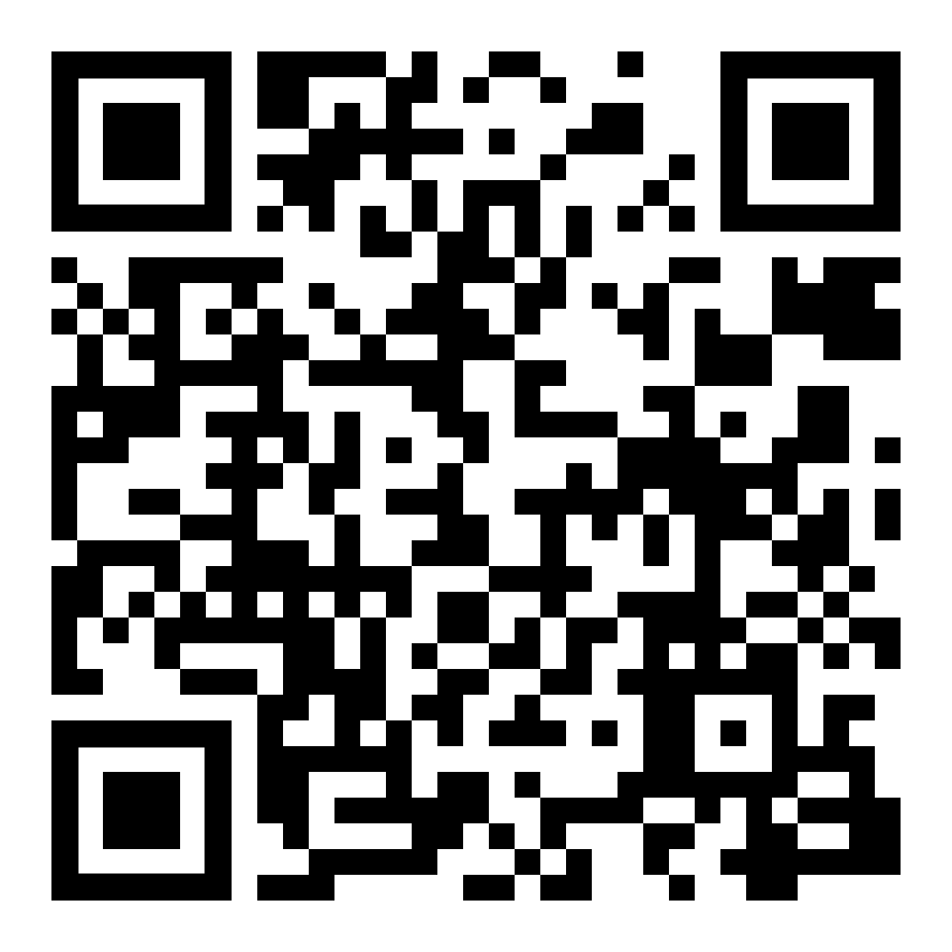
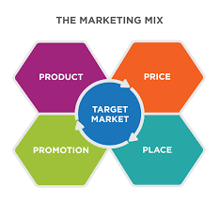
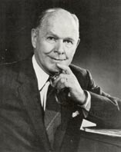

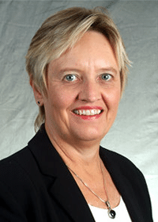
Context analysis
People
Process
Physical evidence
(McCarthy, 1960)
(Booms & Bitner, 1981)
Scan the QR code and scroll through answer the quiz at the end (15 mins)
Notes:
Mary Bitner, Bernard booms

Slide 16

Context analysis
What do we sell?
USP?
How do we differ from competitors?
What are our sources of competitive advantage?
What are our current goals?
Are we meeting customer needs?
Strengths
Weaknesses
Opportunities
Threats

Slide 17
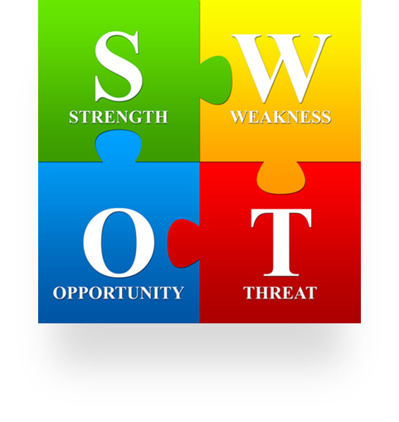
Strengths
Context analysis
What a Company does especially well.
This could be something intangible, such as the ‘BRAND’.
It could also be your people and your highly skilled and knowledgeable staff.
YOUR Customer Service.
Your LOCATION.
Strong leadership, or a great team!
Think of your placement and tell me something ‘specific’
that you feel they do better than anyone else and how you can prove it (evidence)? (10 mins)
Notes:
Remember strengths are internal so when you look for something specific that they do the reason why cant be “because of things happening around the world e.g economics/politics/war/famine etc, think, do they have the most skilled people, own their own supply chain (vertical integration) etc..

Slide 18
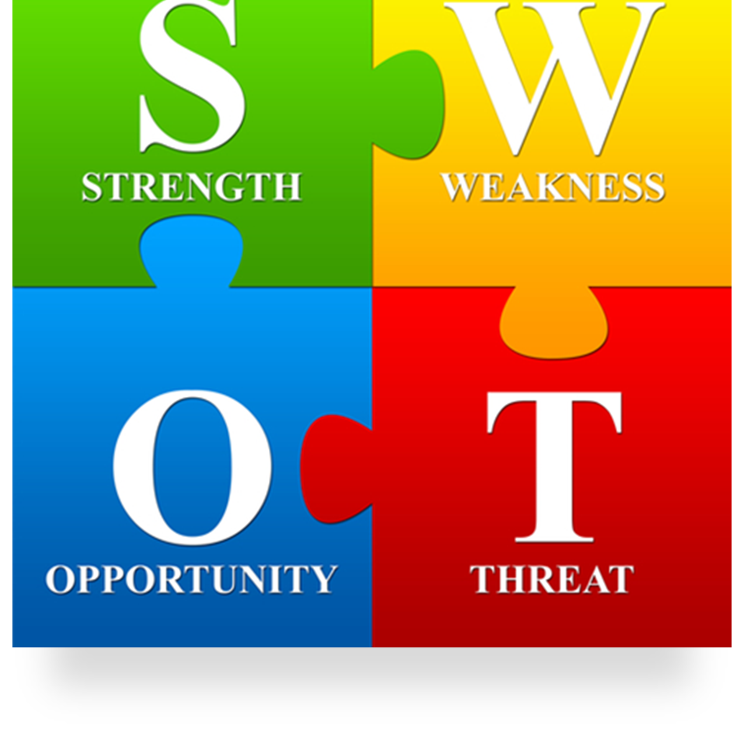
Weaknesses
Once you’ve figured out your strengths, it’s time to be critical and review your weaknesses
What’s holding your business or project back? shortage of skilled people and financial or budgetary limitations.
What does the company LACK?
Things your Competitors do better than you?
Resource Limitations
Unclear unique selling position.
For the same brand, what are their weakness (these can be hard to find as companies don’t like to advertise their weaknesses, a good place to look is reviews sites! Trip advisor, amazon product reviews, you tube/social media etc.. (10 mins)

Slide 19
Opportunities
Marketing team - That’s an opportunity.
Is your company developing an innovative new idea that will open up NEW markets or demographics? That’s another opportunity.
Press/MEDIA coverage of your company.
FEW competitors in your area.
A SWOT analysis covers everything you could do to grow as a company or advance your organization’s mission.
TOWS
Exploring strategy
Whittington, Etal
For the same brand, find an opportunity (Again a good place to look is reviews sites! Often a weakness and opportunity can be the same thing! Find a link which you think shows an opportunity (Not the same link as your weakness) and post in the chatbox with a short explanation of what the link says and explain what the opportunity is. (10 mins)
Notes:
Weakness and opportunity similarity example - if I have limited geographical range for my business like a local shop, there are many opportunities for growth and expansion, Deliveries, selling online, etc..

Slide 20
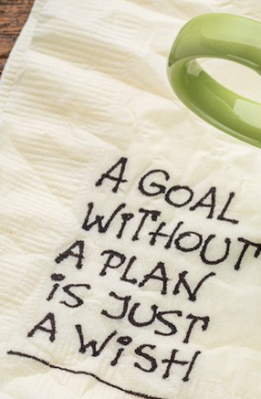
Communications goal?
We have identified from market research and our situational analysis where we want to go-
Lets be SMART!
Notes:
Why is it important to set goals?
e.g shared vison for all, keeps us on track, helps identify all areas that need to be considered, consistency etc...

Slide 21
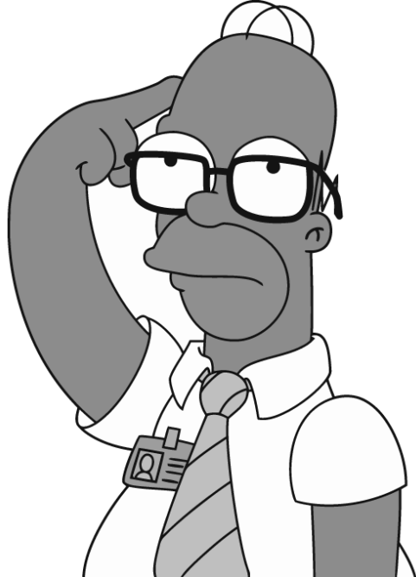
S.M.A.R.T. Goals are…
Measurable
Specific
- To determine if your goal is measurable, ask questions such as
  How much?
  How many?
  How will I know when it is accomplished?
- Specific goals answer the following questions:
Who: Who is involved?
What: What do I want to accomplish?
Where: Identify a location.
When: Establish a time frame.
Which: Identify requirements/constraints.
Why: Specific reasons, purpose or
benefits of accomplishing the goal.
Attainable
The goal is “do-able”
It is action-oriented
It is “within reach”
Realistic/
Relevant
The goal must be an objective toward which you are both willing and able to work.
Again, it must be “do-able”
People must believe it can be accomplished
Address the marketing objectives
Timely
You should establish a timeframe
The timeframe must be realistic
Everyone needs to know the timeframe…make it public
Notes:
Why is it important to set goals, e.g shared vison for all, keeps us on track, helps identify all areas that need to be considered, consistency etc...

Slide 22

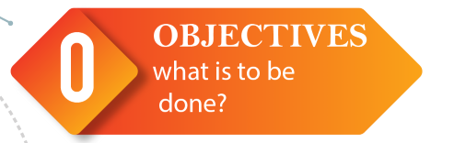
Objectives
For assessment 1:
Set objectives based on what you have found in the situational analysis and market research.
Specific - What are you going to do? (be specific, don’t be vague)
Measurable – what will be achieved? Quantitative metric.
Attainable – This is ‘Do-able’ because?
Realistic – what's the likely outcome?
Timely – What is the deadline?
“Manage a promotional campaign targeting (Customer segment/profile) addressing the concerns raised from examining customer feedback and reviews (Found from your situational analysis 5C’s)……”
“I will attract 100 customers and 1,000 online customer interactions over a 2 month campaign…….”
“ 100 new customers, 1,000 interactions over 2 months….”
“This will elevate customers concerns, raise brand awareness and attract a realistic return…….”
“By When?”
Notes:
For assessment 2 you have a selection of hotels you can choose from however the savvy amongst you will use the hotel selection from your 1st assessment as this will mean you already have a good idea of your hotels situation
From assessment 1 you can identify weaknesses or difficulties where the brand may not be performing as well as possible, you can use this to identify and create a SMART target
e.g moxy hotel caters to the young and trendy but under utilise social media which is a priority channel for their target consumer profiles
So a SMART target for them may be “ the brand will Aim to release marketing communications via Twitter Instagram and ticktock twice per day in order to achieve 100,000 online interactions over an 18 month campaign measured utilising the hubspot social media management tool”
You will need to include a SMART target as part of your assessment 2.
Hilton Hotel
JoandJoe
Grand Hyatt
Holiday Inn
Six Senses
Best Western
Raffles
Ibis

Slide 23
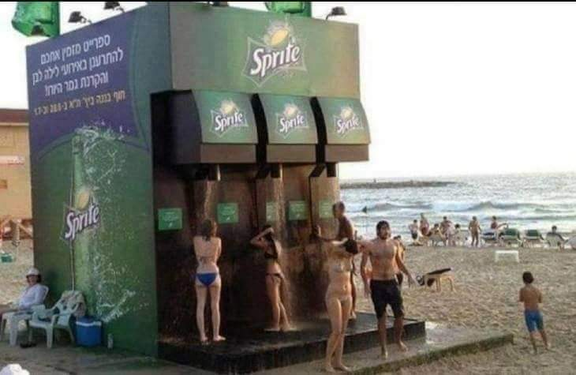

Communications strategy: Reaching the Audience
“A promotional campaign cannot be effective if it is not seen by sufficient number of interested consumers”
REACHING THE RIGHT AUDIENCE,
IN THE RIGHT CONTEXT,
AT THE RIGHT TIME
& AT AN ACCEPTABLE COST

Slide 24

Media Planning: Knowing the Audience
(suitability of the medium for the audience)
Optimize exposure through a combination of media
Match target audience’s media habits
At the lowest possible cost
You Need to know:
Target audience’s
profile media habits
e.g. Trying to plan media use for toothpaste:
Which media would you target for users mainly interested in
a. preventing cavities (health benefit) b. having white teeth (image benefit)?
PS:
Check data on circulated audience and media habits what's trending (google trends), what does similar web tell you?
Notes:
You need to consider – what media are our consumers reading/getting exposed to ? Eg Harrods guide and £1,500 toy car upcoming Christmas.
Examples in Katz 2003 The Media Handbook 2nd ed.

Slide 25
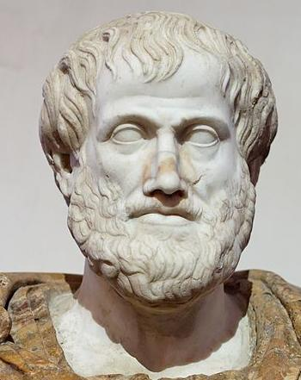
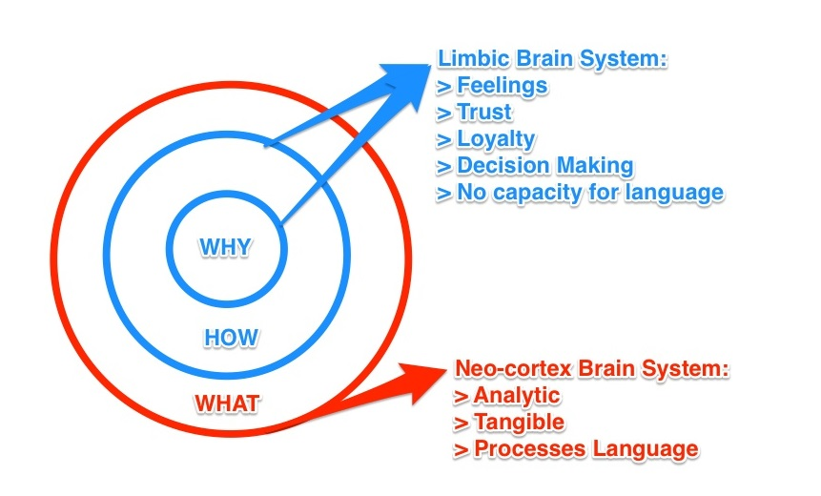
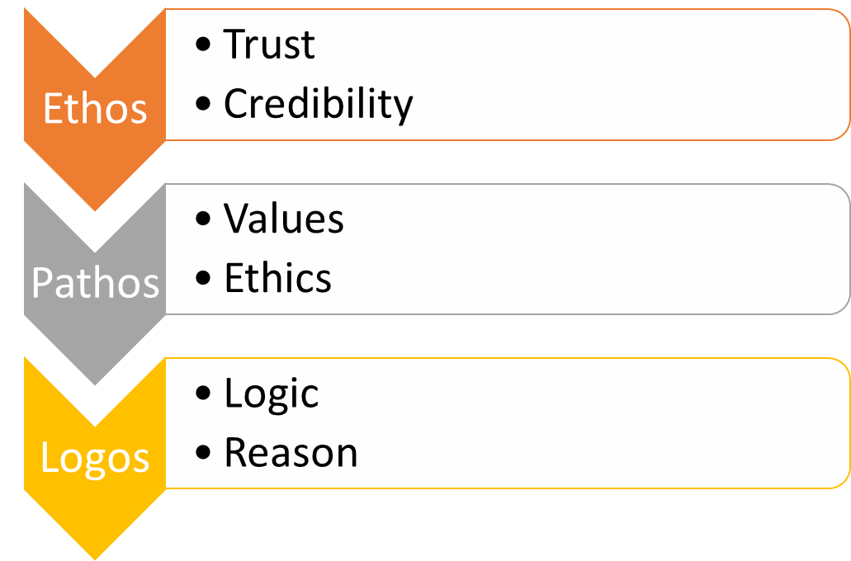
Notes:
Emotion always trumps reason

Slide 26
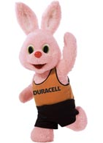
Message appeals in trying to persuade
A. Informational/Rational Based Appeals
Factual (‘the hard sell’ – lots of information)
Slice of life ( ‘They have had the same problem – their teeth hurt too!’ / to relate to the consumer)
Demonstration ( before and after / a solution to your problem) British Airways safety video - director's cut - YouTube
Comparative advertising (particularly for new entrants/followers to establish superiority) DURACELL BUNNY COMMERCIAL UK - YouTube

Slide 27
Message appeals (cont.)
B. Emotional Based Appeals (the ‘soft sell’)
Fear (e.g. DUI adverts)
Storytelling executions – contrast to ‘hard sell’ the product is more at the periphery Cannes Lion Award-Winning "Three Little Pigs advert" - YouTube
Humour (generally for low involvement) Haynes Baked Beans Astronaut Ad - YouTube
Animation ( provides interest to low involvement brands and presents clearer higher involvement guidelines)
Fantasy / surrealism (challenging consumers / engagement)

Slide 28
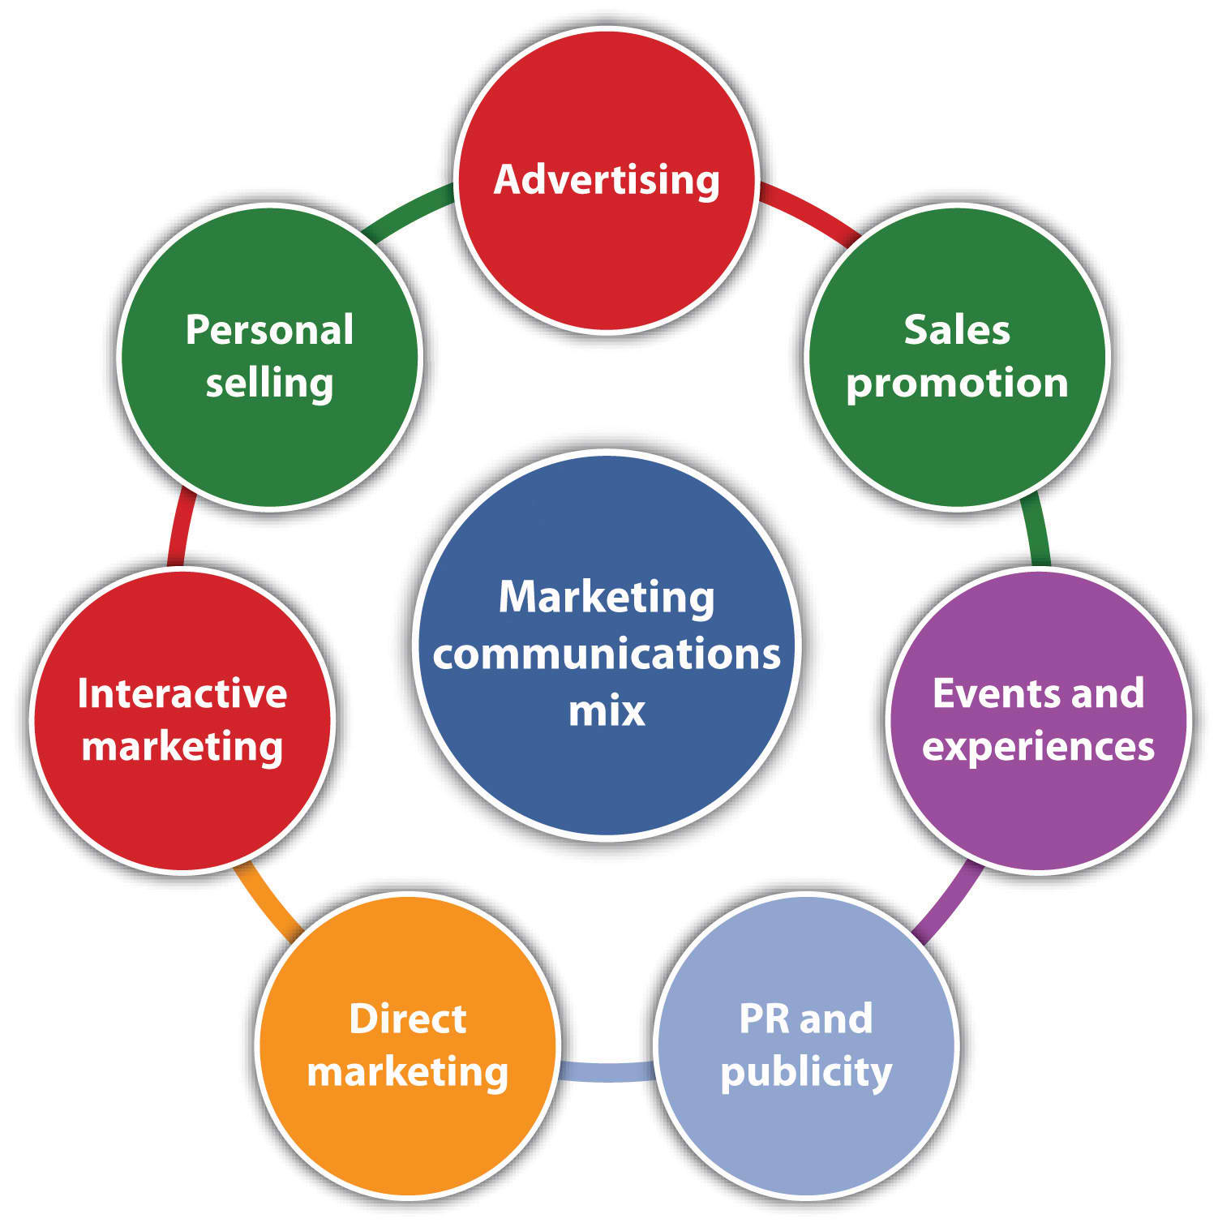
Coordinated communications mix
Rational?
Emotional?
Lot of copy or just little?
Is there to be a media blitz?
Consumer strategy / trade strategy and a distinct mix for the communications to reach the wider array of stakeholders
MESSAGE CONSISTENCY AND MEASURE OF INTEGRATION

Slide 29
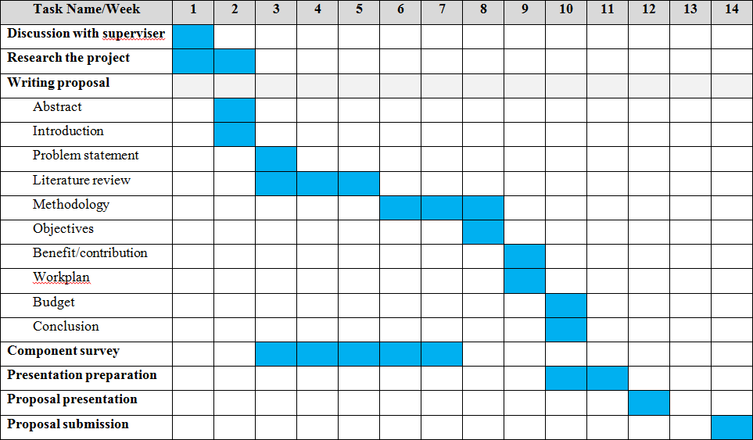
Resources
Time
Quality of available marketing expertise
%
Scheduling and implementation

Slide 30
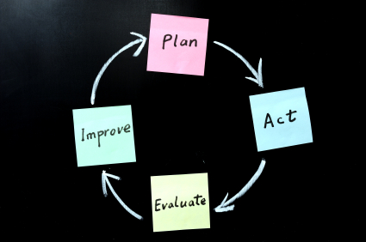
Evaluation and control
The most important measures are the communications objectives set in the first place. The success of a promotional strategy and the associated plan is the degree to which the objectives set are achieved.

Slide 31


