Slide 1

ECIE5010 Keeping Our Children Safe
SAFEGUARDING

Slide 2

ECIE5010
Safeguarding
What do you already know about safeguarding?
What is it?
Who is responsible for it?
How do we do it?

Slide 3
Key Messages
SAFEGUARDING IS EVERYONE’S RESPONSIBILITY
A child is anyone who has not yet reached their 18th birthday.
There is no ‘Data Protection’ when we deal with safeguarding.
We must share information –we all have a piece of the ‘jigsaw’.

Slide 4
What is
Safeguarding?
Safeguarding is concerned with:
protecting children and adults at risk from abuse and neglect and educating those around them to recognize the signs and dangers.
preventing impairment of their health or development; and
ensuring that they receive safe and effective care.
This is to enable children and adults to have optimum life chances.
(Wales Safeguarding Procedures 2020) https://www.safeguarding.wales/en/

Slide 5
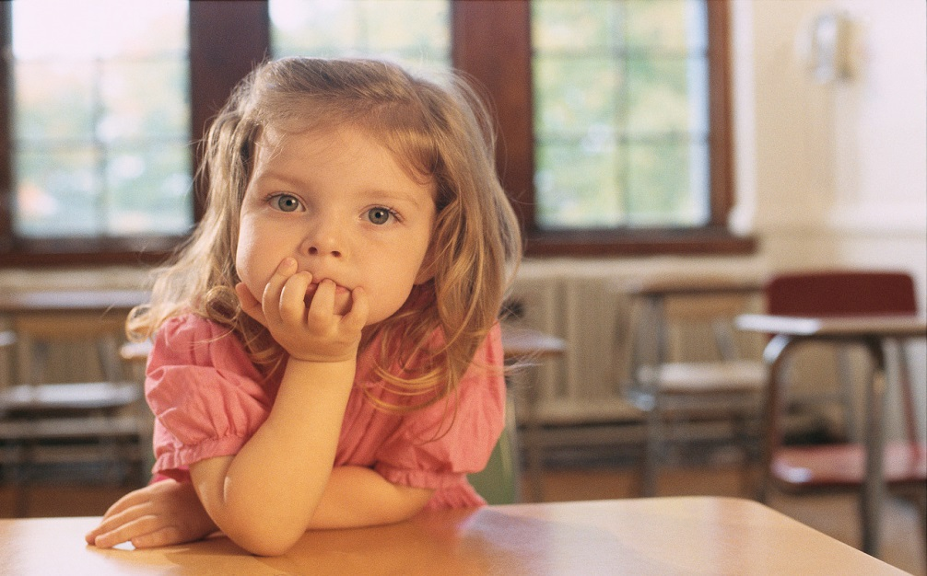
Safeguarding in Schools.
All schools have a statutory duty with regard to safeguarding and promoting the welfare of their learners.

Slide 6
Practice in schools and colleges
Each local authority must have a safeguarding single point of contact for people working with children. This helps everyone know where to go if they think a child is at risk
Each school or further education college must have a designated safeguarding person (DSP).
Everyone working in the school and college should:
      know who their local authority contact is
      know their DSP

Slide 7
Safeguarding
Safeguarding covers more than the contribution made to child protection in relation to individual children.
Safeguarding includes:
the safe recruitment, supervision, training and management of staff
how staff manage pupils’ behaviour
pupil health and safety
bullying
arrangements for meeting the needs of children with medical conditions
education around sex and relationships; drugs and substance misuse
It concerns the factors that contribute to promoting the welfare of children and young people.

Slide 8

Creating a Safe Environment in Schools
Creating and maintaining a safe learning environment
Identifying where there are child welfare concerns and taking action to address these, where appropriate, in partnership with other agencies
Developing children’s understanding, awareness and resilience through the curriculum

Slide 9

Creating a Safe Environment
Prevent unsuitable people from working with children and young people
Promote safe practice and challenge poor and unsafe practice
Identify instances in which there are grounds for concern about a child’s welfare, and initiate or take appropriate action to keep them safe
Contribute to effective multi-agency working between all those involved with providing services for children and young people

Slide 10
How?
Promoting self esteem
Promoting confidence
Good lines of communication between pupils and staff
An ethos where children feel safe- are encouraged to talk, and where we listen to them
Children can trust the adults in school if they are worried or in trouble.

Slide 11
Safeguarding in Practice
Every school and organisation must have a
Safeguarding policy
Child Protection and Procedure Policy
Whistleblowing policy
e.g.
WRU https://community.wru.wales/governance/policy-and-integrity/safeguarding/

Slide 12
Safeguarding in Practice
Schools also have:
Acceptable ICT Use Policy
Mobile Technology Policy
Positive Handling Policy
Make sure that you are familiar with these within your own organisations/settings.
Regular staff training is essential

Slide 13
Child Protection
Child protection is a part of safeguarding and promoting welfare.
Child protection refers to the activity which is undertaken to protect specific children who are suffering or are at risk of suffering significant harm as a result of abuse or neglect.
All Wales Child Protection Procedure (2020)

Slide 14
WHAT IS CHILD ABUSE?
Neglecting a child’s
educational or
medical needs
Hitting or hurting a
child to relieve
our own frustration
Breaking down the self
confidence of a child
Teasing a child
persistently
Not listening to a child
Forcing a child
to touch you
Not taking proper care
of a child,
e.g. not cleaning,
clothing or feeding a
child
Verbally abusing a child
Touching a child where
or when he/she doesn’t
want to be touched
Manipulating a Child

Slide 15
Signs and Symptoms of Abuse
Attendance Issues On going Health Issues/ Rundown
Inappropriate Language/Behaviour
Non-participation in P.E. Unexplained Injury Recurrent Injury
Withdrawn Tearful Aggression Self harm
Running Away
Substance Misuse Bizarre Behaviour
Emotionless
Notes:
All allegations against HT should – chair of GB should be informed Alex Beckham

Slide 16
Signs and Symptoms of Abuse
Over Affectionate Attention Seeking
Sexualised Behaviour
Fatigue Poor Performance
Missing Routine Appointments
Failure to Thrive
Unsupervised Dangerous Pastimes
Becoming Disengaged

Slide 17
Types of abuse and neglect
Physical abuse
Sexual abuse
Emotional abuse
Neglect
Psychological abuse

Slide 18
Other categories of abuse
Online abuse
Sexual Exploitation
Female genital mutilation (FGM)
Grooming
Child Trafficking
Harmful sexual behaviour

Slide 19
What is Physical Abuse?
Hitting, punching, slapping, kicking
Biting, shaking, throwing
Deliberate scalding or burning
Throttling or strangulation
Suffocation, drowning
Poisoning
Fabricated or induced illness

Slide 20
What is Sexual Abuse?
Forcing or enticing a child or young person to take part in sexual activities;
Whether or not they are aware of what is happening
May involve physical contact
Non-contact, involving children in looking at or making pornography, watching sexual activities, sexually inappropriate behaviour

Slide 21
Grooming is
defined by the Home Office as communication with a child where this is an intention to meet and commit a sex offence.
the process by which an individual manipulates those around them – adults and the child – to provide opportunities to abuse and reduce the likelihood of being reported and discovered

Slide 22
Child Sexual Exploitation
The sexual exploitation of children and young people under 18 involves exploitative situations, contexts and relationships where young persons receive something as a result of performing and/or others performing on them sexual activities.
(National Working Group for Sexually Exploited Children and Young People, 2008)

Slide 23
Particularly vulnerable groups
Looked After Children (or history of)
Children/young people with a history of abuse and/or neglect
Children/young people who have been affected by domestic abuse, parental mental health problems and/or parental substance misuse
Family breakdown/poor relationships
Low self esteem

Slide 24
Emotional abuse
Emotional abuse is the persistent emotionally cruel treatment of a child so as to hinder the child’s emotional development and mental health. Children may be exposed to constant criticism and lack of affection and warmth. They may be rejected or extremely overprotected.

Slide 25
What is Neglect?
Persistent failure to meet a child’s basic physical and/or psychological needs, likely to result in a serious impairment of the child’s health or development.’ (Working Together to Safeguard Children, 2013: 85)
Failure to provide;
  Food, shelter, clothing, etc.
  Protection from physical harm and danger
  Access to medical care or treatment
  Basic emotional needs
  Leaving a child unsupervised

Slide 26
Dealing with disclosure – Listen, Keep Calm, Act
Take the child seriously and KEEP CALM
Reassure – Be supportive
Use positive body language
Tell them they’re doing the right thing
Steer away from blame
Do keep an open mind
Be honest – talk through what will happen next, the actions you will take
Pass on to Child Protection Officer
Make brief, simple, factual notes, using the child’s own words, which are signed and dated. These are now confidential.

Slide 27
Dealing with disclosure – Don’ts
Dismiss concerns or doubt the child’s truthfulness
Do not guarantee confidentiality
Do not be judgemental or show anger/distress at what you are being told.
Do not enquire, question, push for further information or ask leading questions

Slide 28
Dealing with disclosure – Don’ts
Do not discuss the disclosure with anyone else
Do not worry about being mistaken, discuss with CPO
Do not feel you are interfering
Do not feel intimidated by the process
Do not let your personal knowledge of the family/parent/person cloud your judgement.
Do not contact or confront the alleged abuser

Slide 29
Record Keeping
Note the feelings of the child and family
Use clear, simple language
Describe incidents factually
Avoid emotional comments, differing values, beliefs and personal attitudes

Slide 30
Allegations against staff, governors and volunteers
All allegations should be reported immediately to the Local Authority Designated Officer (LADO) for Child Protection.
The Head teacher should not undertake any action before discussing the allegation with the LADO.
The LADO and the Head teacher will consider the nature, content and context of the allegation, and agree a course of action.
The LADO will advise the Head teacher in respect of the appropriate way in which the agreed actions should be undertaken.
A risk assessment will need to be completed; for advice and guidance on this contact Local Authority.

Slide 31
The abuse and neglect of children is a huge and growing issue.
1 Child every week - Each week one child is killed through neglect or abuse. Children under the age of 1 are the group most likely to be killed
1 in 20 Children – In the UK have been sexually abused
41% Newly qualified Social Workers anticipate quitting in 5 years. 77% reported excessive pressure and stress in their job. The impact of Covid 19 on Child and Adult Protection has been unprecedented.
https://www.childprotectionprofessionals.org.uk/ (2023)

Slide 32
References
Association of Child Protection Professionals (2023) The Issue. Available at https://www.childprotectionprofessionals.org.uk/the-issue/ [Accessed 25/02/25]
National Society for the Prevention of Cruelty to Children. Available at https://learning.nspcc.org.uk/safeguarding-child- protection/coronavirus
[Accessed 4.08.25]
NSPCC Safeguarding during pandemic lockdown. Available at
https://learning.nspcc.org.uk/research-resources/2020/social-isolation-risk-child-abuse-during-and-after-coronavirus-pandemic
[Accessed 4.08.25]
WRU available at https://community.wru.wales/governance/policy-and-integrity/safeguarding/ [Accessed 14.02.25]
Wales Safeguarding Procedure (2020) at https://www.safeguarding.wales/en/
[Accessed 15.08.25]

