Slide 1
MODULE CODE: HPCS6007
Brittany’s political awakening

Slide 2
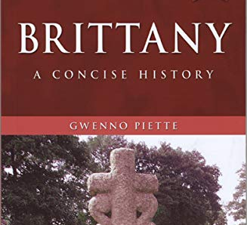
Gwenno Piette

Slide 3
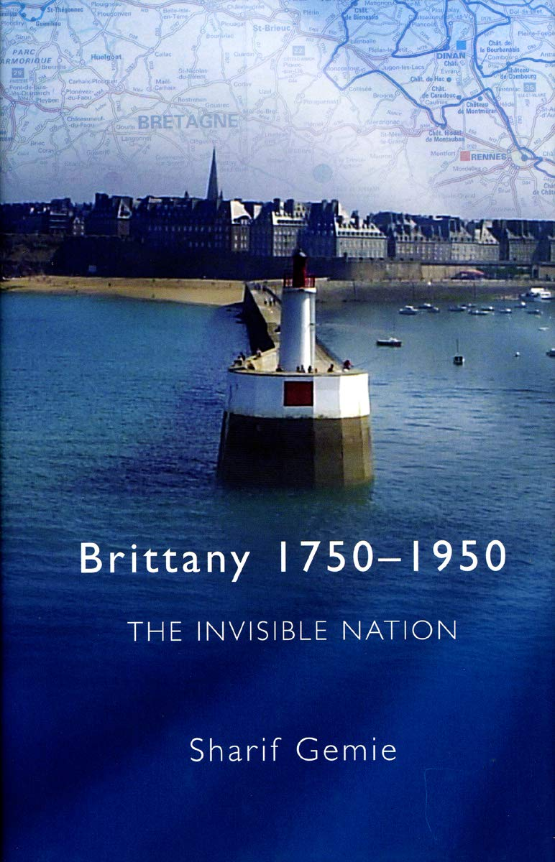
Sharif Gemie

Slide 4
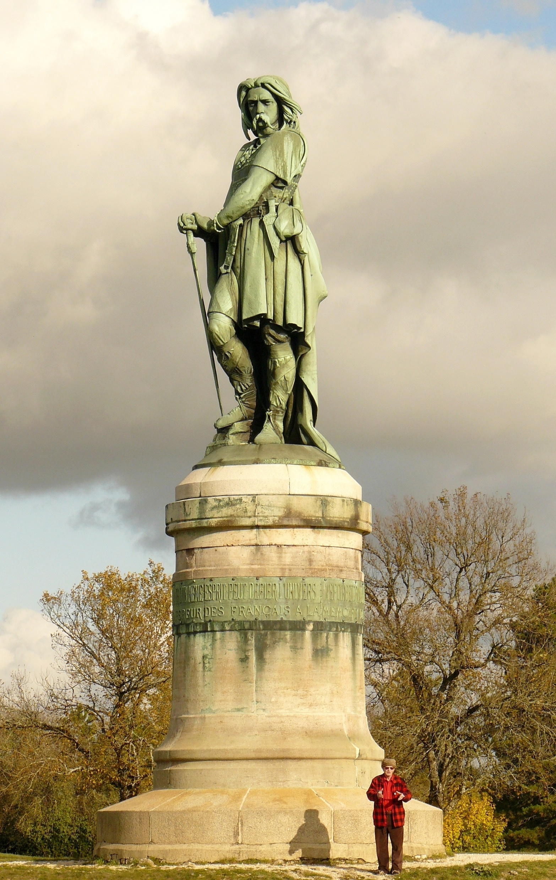
Vercingétorix

Slide 5
Regionalism
‘petite patrie’
Peasants into Frenchmen?

Slide 6
Recent work in history
Caroline Ford, Creating the Nation (1993) has shown how the nation was ‘made’ in provincial France
Stéphane Gerson, The Pride of Place: Local Memories and Political Culture in Nineteenth-Century France (2003):
  ‘French identity was articulated neither in the center nor the provinces, but at the juncture of Paris and the localities’
  The state: ‘simultaneously curbed and galvanized local difference’

Slide 7
3 phases of Breton nationalism
First Emsav: the birth of the Breton movement before 1914
Second Emsav: 1914–1945
Third Emsav: postwar movements

Slide 8
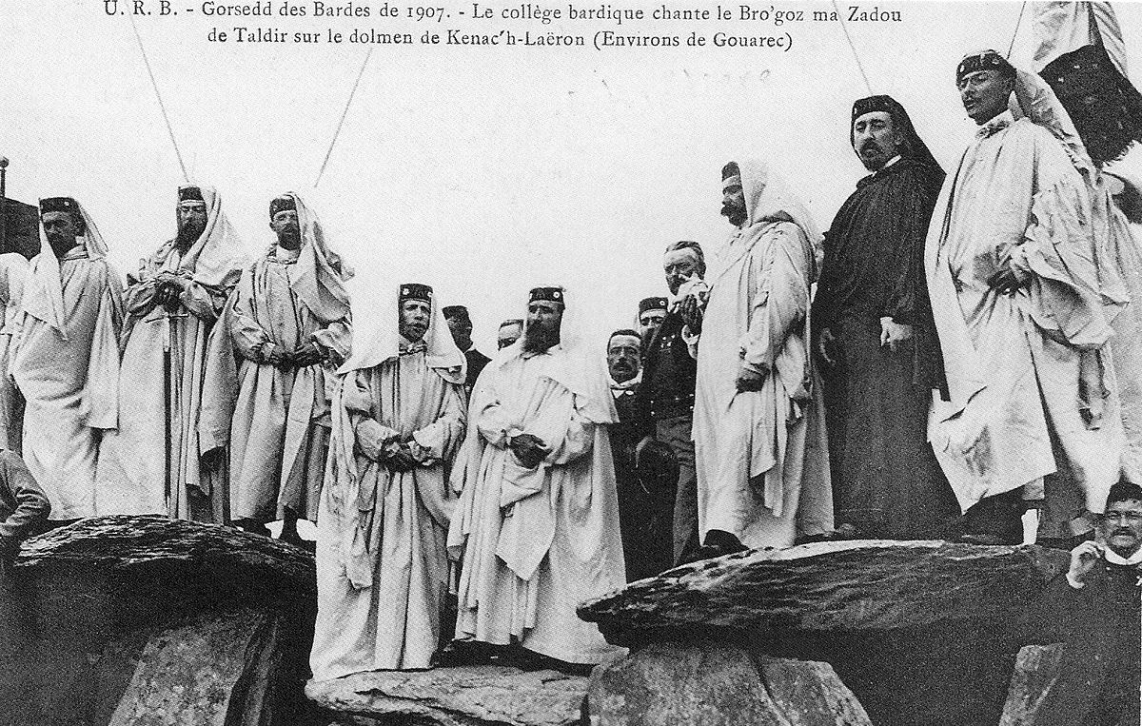
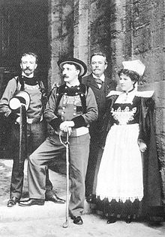
Pan-Celticism

Slide 9
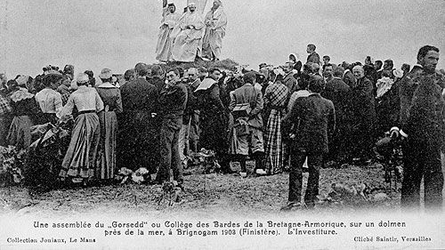
Brittany’s Goursez

Slide 10
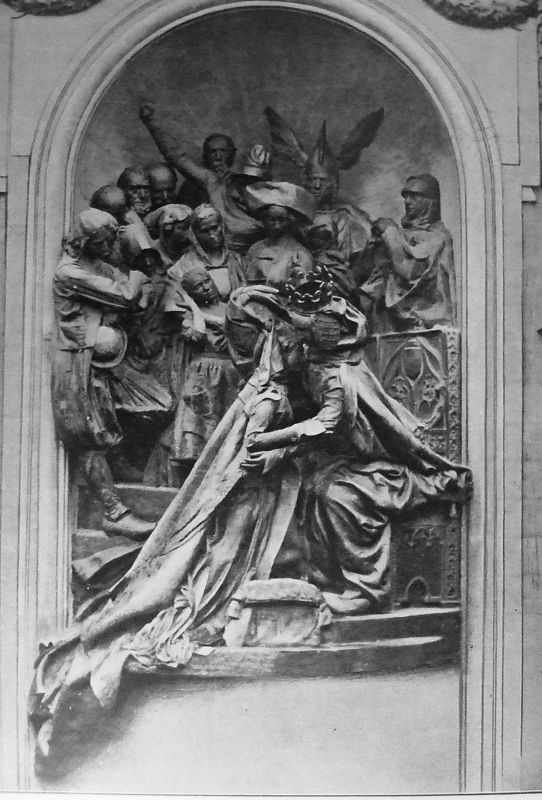
Le monument de la honte
Monument of shame
1911

Slide 11
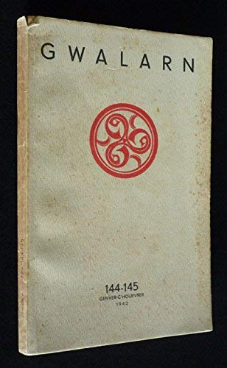
Gwalarn
Roparz Hemon,
Jakez Riou,
Youenn Drezen,
Abeozen (pseudonym of Fañch Elies)

Slide 12
Gwalarn and Bretonness
But it is written in Breton! Ah, these Frenchified Bretons who admire Breton-language literature like they admire village squares and Bigouden lacework – how gutted they would be if they knew just how little our literaure cares about ‘being Breton’, how, on the contrary, our literature strives for the universal and rejects all efforts at the level of the territory. - Roparz Hémon

Slide 13

Ar Seiz breur

Slide 14
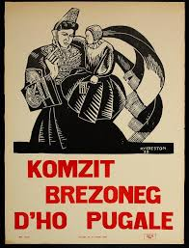
Committed art

Slide 15

Traditional imagery

Slide 16
Collaboration
The number of Breton nationalists who agreed with Mordrel and Debauvais [PNB leaders] in seeing the forthcoming war with Germany as a golden opportunity for Brittany was literally a handful, and their actions and beliefs were completely out of step with the rest of the population who regarded Germany as the enemy.
- Gwenno Piette, in A Concise History of Brittany

