Slide 1
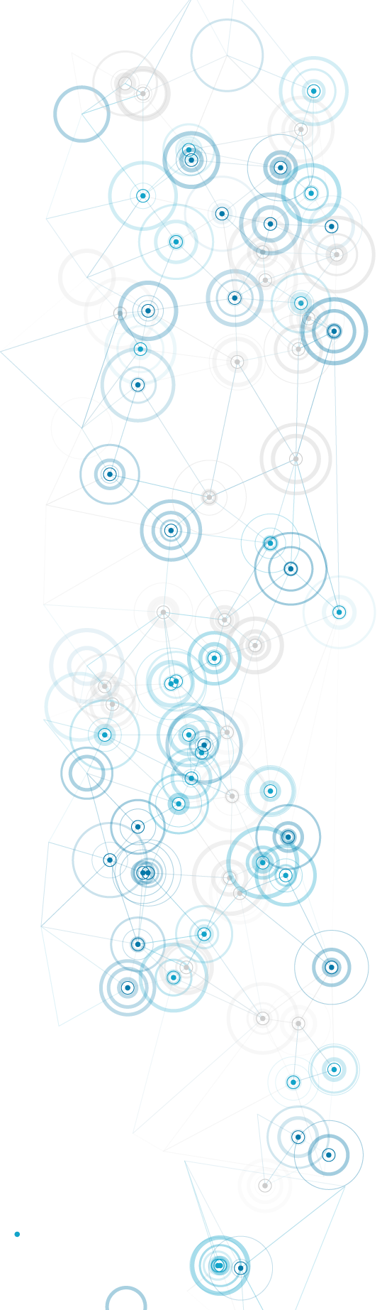

BMHP6026
Digital transformation in the Health and Care Professions
IQ004
Dr L. Simona Ferraraccio
s.ferraraccio@uwtsd.ac.uk
University of Wales Trinity Saint David
Week 2 – 06.10.2026

Slide 2

BMHP6026 Scheme of work
WEEK 1
WEEK 2
WEEK 3
WEEK 4
WEEK 5
WEEK 6
WEEK 7
WEEK 8
WEEK 9
WEEK 10
Impact on service users and community
Digital innovations in Healthcare
Information governance
Preparation for VIVA VOCE
What is DT
Introduction to the module
Impact on workforce and service delivery
Reading
Week
Digital Strategy

Slide 3
Table of contents:
What is Digital Transformation
Key milestones in digital transformation & INDUSTRY 4.0
  What is it?
  Industrial revolutions
  INDUSTRY 4.0 and sustainability
  Architecture of INDUSTRY 4.0: design principles and Technology trends
2. Digital transformation in the Healthcare: e-Health & Health 4.0
  Background and Context: evolution of the Healthcare
  Definition of e-Health and the “10 e’s”
  Key technologies
3. Group activity: Digital innovations in the healthcare

Slide 4
Without searching on the web, try to define “Digital Transformation” in general terms.
Individual
Activity
2. Search on Google a definition of “Digital transformation” and report it on Whiteboard with the corresponding citation.

Slide 5

Digital transformation - Definitions
“Digital transformation refers to the economic and societal effects of digitization and digitalization. Digitization is the conversion of analog data and processes into a machine-readable format. Digitalization is the use of digital technologies and data as well as their interconnection which results in new or changes to existing activities.”
(OECD ,2018)
[Digital transformation is] “the application of technology to build new business models, processes, software and systems that result in more profitable revenue, greater competitive advantage, and higher efficiency.”
(Schwertner, 2017)
“Digital transformation is characterized by a fusion of advanced technologies and the integration of physical and digital systems, the predominance of innovative business models and new processes, and the creation of smart products and services.”
(European Commission, 2019)
Digital transformation is the use of technology to radically improve the performance or reach of an organisation. In a digitally transformed business, digital technologies enable improved processes, engaged talent, and new business models.”
(Deloitte, 2018)
[Digital transformation is a] “process through which companies converge multiple new digital technologies, enhanced with ubiquitous connectivity, with the intention of reaching superior performance and sustained competitive advantage, by transforming multiple business dimensions, including the business model, the customer experience (comprising digitally enabled products and services) and operations (comprising processes and decision-making), and simultaneously impacting people (including skills talent and culture) and networks (including the entire value system).”
(Ismail, Khater and Zaki, 2017)
“Digital transformation requires the organisation to deal better with change overall, essentially making change a core competency as the enterprise becomes customer-driven end-to-end. Such agility will facilitate ongoing digitalization initiatives but should not be confused with them.”
(Bloomberg, 2018)

Slide 6

What is Digital transformation? – Conceptual definition
Businesses
Governance
Lifestyle
Industries
Who is affected by the DT?
Individuals
Target entity
Politics
Education
Networks
Conceptual definition:
Healthcare
To create
Digital transformation is a process that aims to create, modify, and improve all entities by enabling significant changes through combination of information, computing, communication, and connectivity technologies.
Vial (2019)
Why is the DT affecting the target?
To improve
Scope
To modify
New technologies
Information
Means
How can the DT affect the target?
Communication
Connectivity
What is the outcome of the DT?
Significant changes
Outcome

Slide 7
Why it matters?
Competitivity
Digital transformation is responsible for optimizing the internal processes of a company, making them more efficient.
Market change and emerging trends
People
Digital transformation empowers employees of a company and the consumers at the same time.
Innovation
Digital transformation is responsible for optimising the internal processes of a company, making them more efficient embracing new technologies.
Digitisation of tasks and processes
Cultural transformation: employees willing to change their resistance and be ready for the transformation
Moving towards CUSTOMER-CENTRIC model with the integration of digital platforms for the real-time communication and support.
People-driven approach: user-friendly interfaces and processes
Development of new business models like platform-based business to increase the value of the business
Organisational change: protection against digital disruption
Possibility to offer unique products and services based on costumers' preferences and behaviours: using the data-driven approach
Market expansion with the use of digital platforms: e-commerce
Improved process and higher operational standards
Digital ECO-SYSTEMS based on the collaboration between customers, partners and stakeholders for the mutual growth and innovation
Innovation of labs and R&D centres for the development of new solutions
AGILE methodologies: continuous improvement of products and processes based on feedback
Faster services, improved efficiency and reduced costs
Greater customer interaction and collaboration
Ensure that key decisions, actions, and processes are strongly influenced by data-driven insights, rather than by human intuition

Slide 8

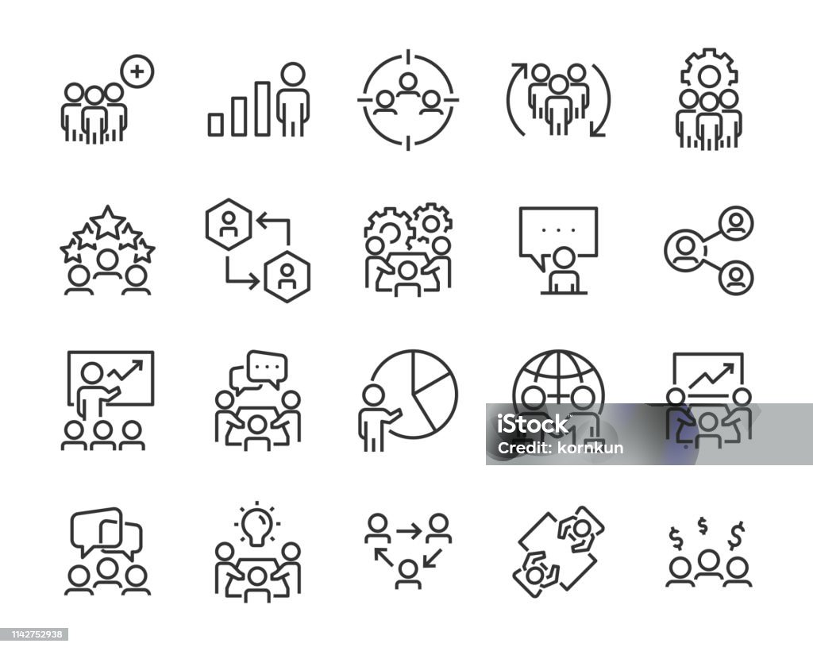
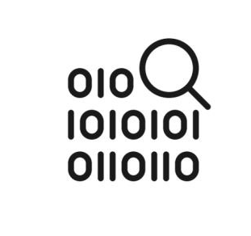
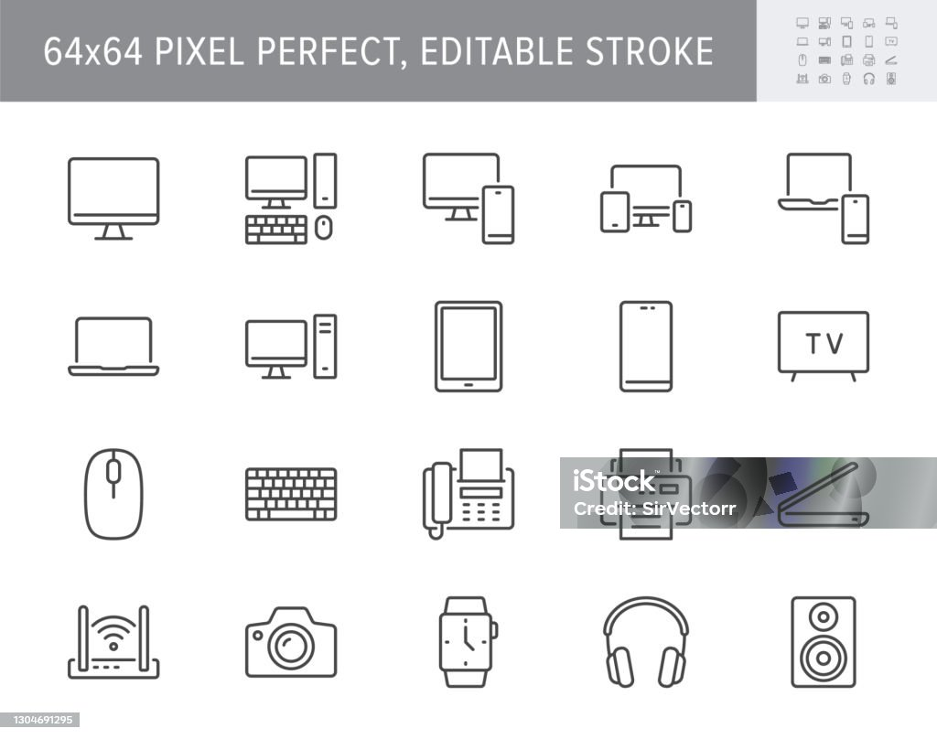

What are the core elements of digital transformation?
Costumer-centricity
Technology integration
Agile processes
Culture and organisational change
Data-driven insights

Slide 9

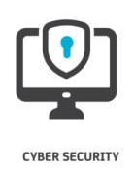
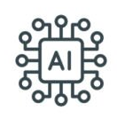
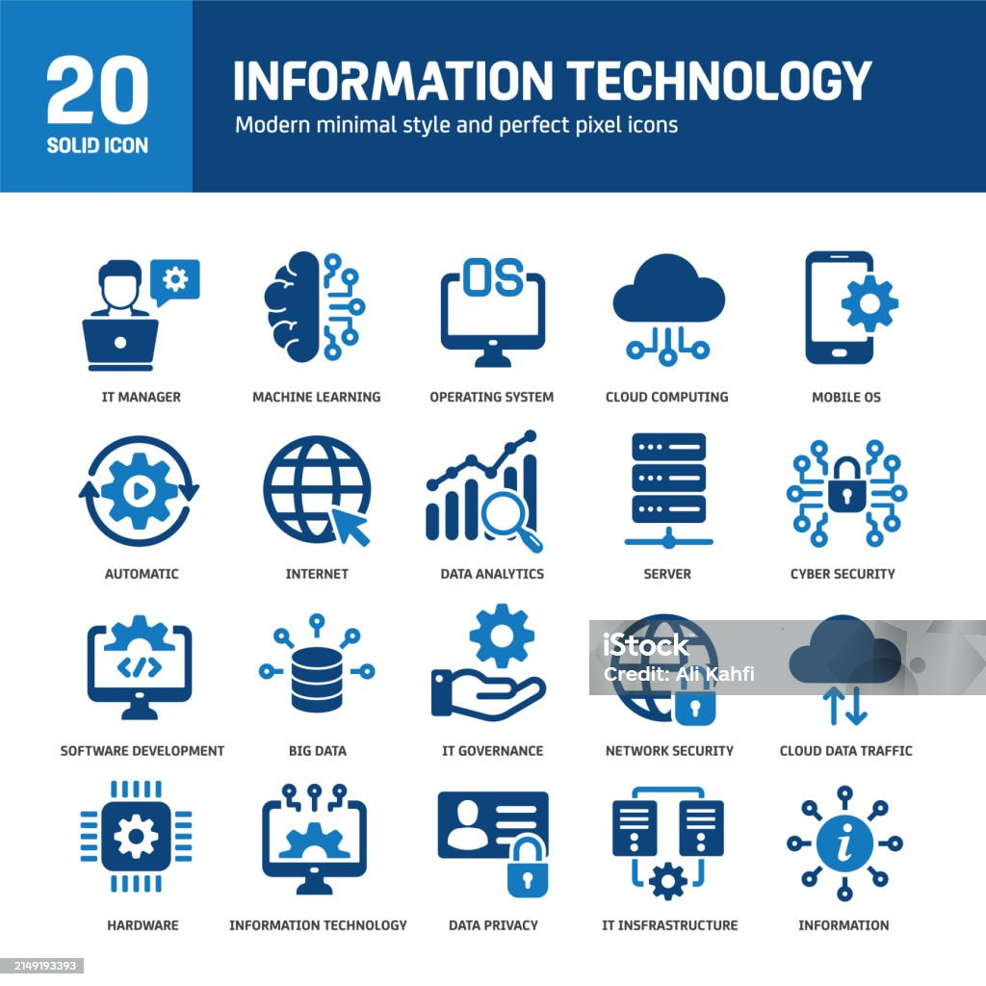
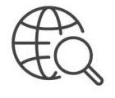
Key milestones in the Digital transformation
Advent of the Internet
Introduction of Cloud Computing
Big Data and Analytics
Adoption of Social Media
Development of Internet of Things (IoT)
Expansion of Digital Payment Systems
2020s
2010-2020
Shift to Remote Work and Collaboration tools
Advancements in Cybersecurity
2010s
Emerging of Artificial Intelligence
2000s
1990s

Slide 10
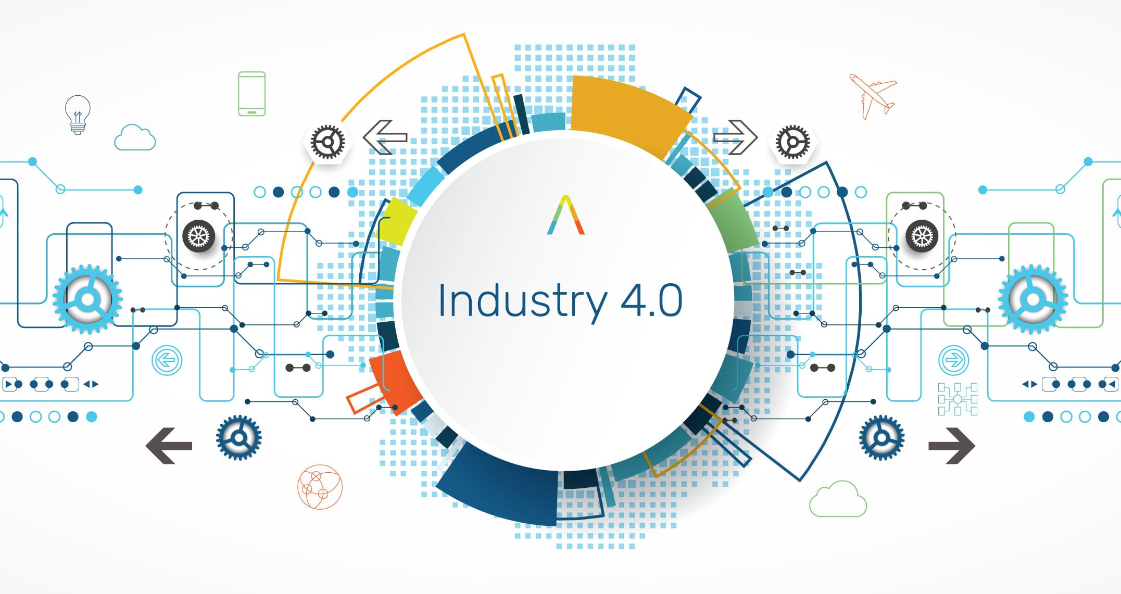

Slide 11




INDUSTRY 4.0 : History of the INDUSTRIAL REVOLUTIONS
Late 18th Century
Industry 1.0
Late 19th Century
Industry 2.0
1970-2000
Industry 3.0
2010 onward
Industry 4.0
1ST Industrial revolution
WATER AND STEAM
2nd Industrial revolution
ELECTRICITY
3rd Industrial revolution
AUTOMATION
4th Industrial revolution
CYBER-PHYSICAL SYSTEMS
Water and steam power replace human and and animal power with machines.
Electricity, internal combustion engines, airplanes, telephones, cars, radio, mass production
Electronics, the Internet and IT used to further the automation of the mass production
Smart robotics, lighter materials, manufacturing processes built around 3D printing
Driven by the discovery of steam and water
Mechanical production (replace animal and human power)
Improving manufacturing
Application of electrical technology
Manufacturing plants, processing
Mass production
Computation and data analysis technologies
Electronics, internet and IT
Automation and mass production
Together digital, physical and biological systems
Transformation of connection and communication
New technologies for manufacturing

Slide 12
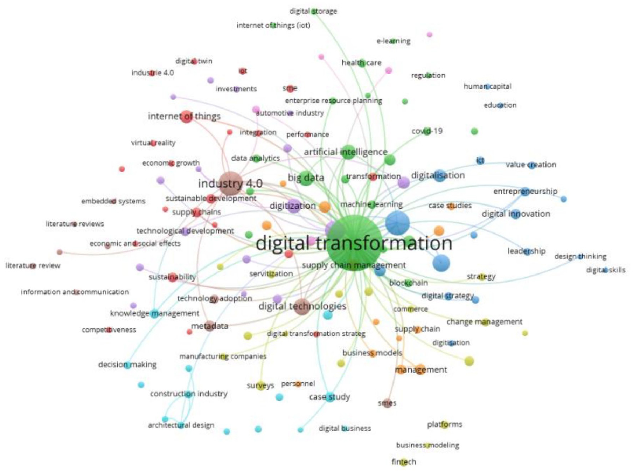
What is INDUSTRY 4.0?
INDUSTRY 4.0
Concept related to the 4th Industrial revolution associated with the advancements of CYBER-PHYSICAL SYSTEMS, automated systems and data exchange technology with industries.

Slide 13
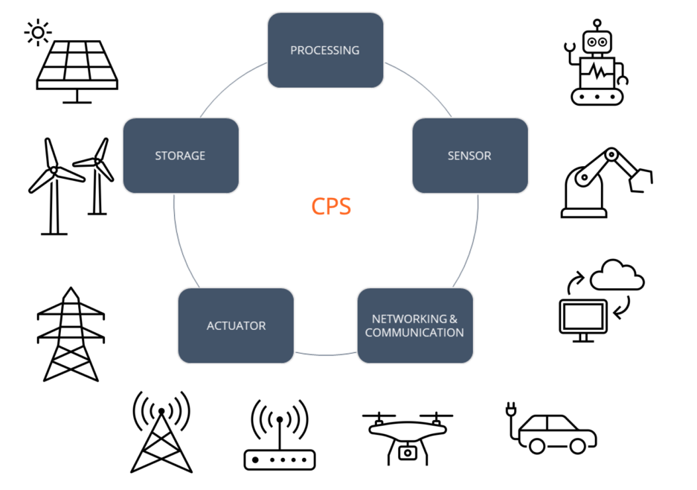
INDUSTRY 4.0: Cyber-physical systems (CPS)
MONITOR
Wearable Health devices
CONTROL
SMART traffic management system
OPTIMISE
SMART grid
SMART buildings
SMART manufacturing systems
SMART water management

Slide 14
INDUSTRY 4.0: Sustainability
Environmental Sustainability
Economic Sustainability
Social Sustainability
Maintaining the health and stability of our natural ecosystem over the long term. Find the balance between human activities and the natural world:
Resource Management
Ecosystem preservation
Pollution reduction
Sustainable practices
Climate change mitigation
Ability of an ecosystem to ensure the long-term growth while preserving environmental and social resources:
Long-term viability
Efficient resources use
Economic equity
Innovation and adaptation
Resilience
Ability of recognising and managing the positive and negative environmental, economic, and technological impact on people:
Equity and inclusiveness
Community well-being
Social stability
Economic and social opportunities
Participation and empowerment
INDUSTRY 4.0:
Reduce waste
Optimise the use of resources
Low energy consumption
Enhancement of energy efficiency
Minimise ecological footprint of industries
INDUSTRY 4.0:
Creating countless job opportunity in automation engineering, machine learning, control system, software engineering

Slide 15
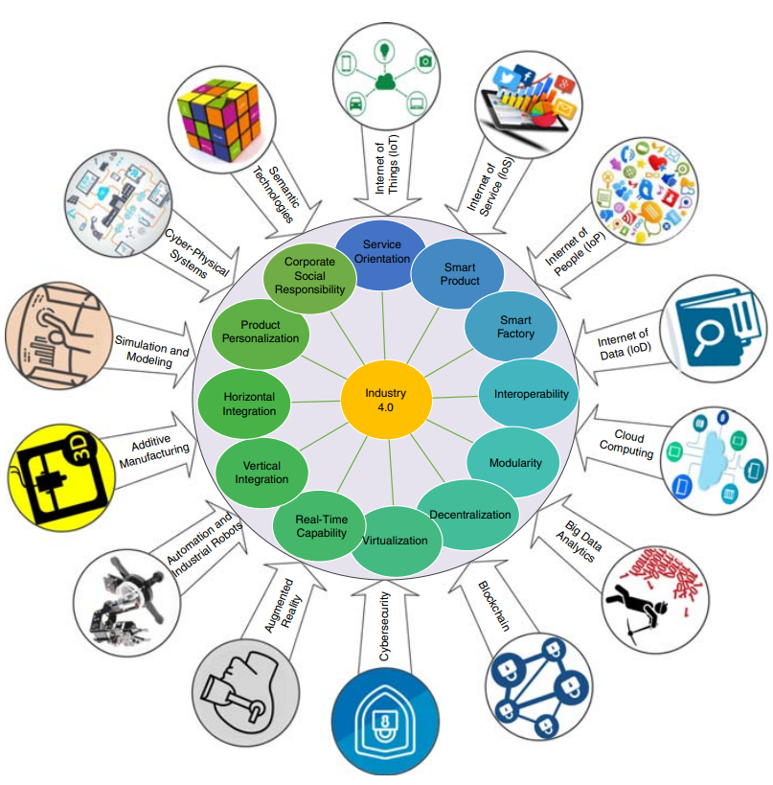
INDUSTRY 4.0: Architecture
Design principles: “How to do” knowledge for the development of processes and procedures.
Integrated and dynamic systems
Fusion of physical and virtual worlds
Interaction, communication, learning
Technological trends: advanced digital technology innovations enabling the customer-centric approach.
Increase automation
Predictive maintenance
Self-optimisation
Efficiency and responsiveness to customers

Slide 16
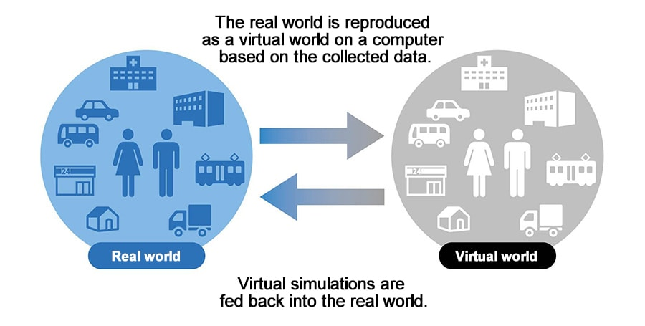
INDUSTRY 4.0: DIGITAL TWINS
Short development periods
Individualisation of the DEMAND
Social Economic Perspective
Flexibility
DIGITAL TWIN
Decentralisation
Efficiency of resources
Automation
Technological Perspective
Digitisation

Slide 17
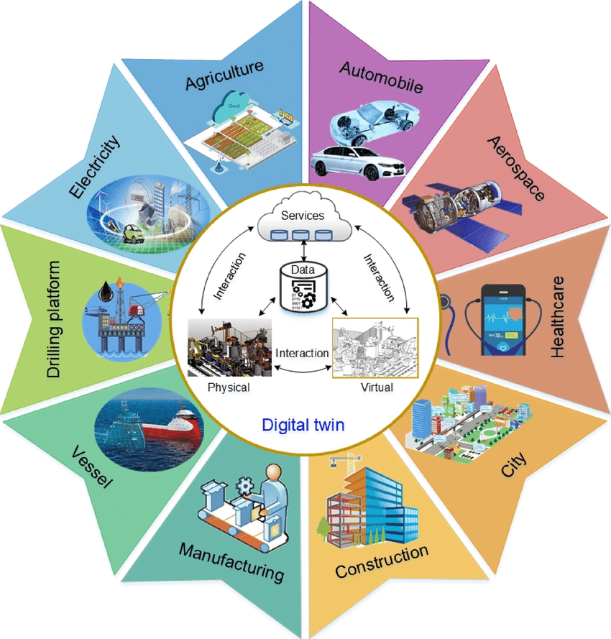
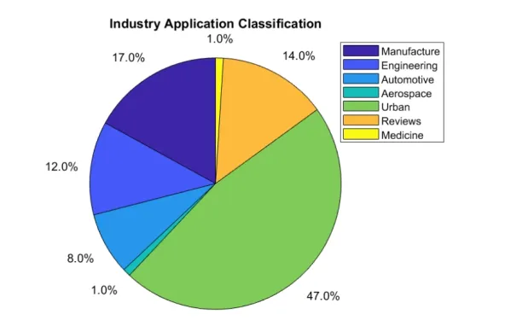
INDUSTRY 4.0: DIGITAL TWINS
Botin-Sanabria, (2022)
Qi, (2019)

Slide 18
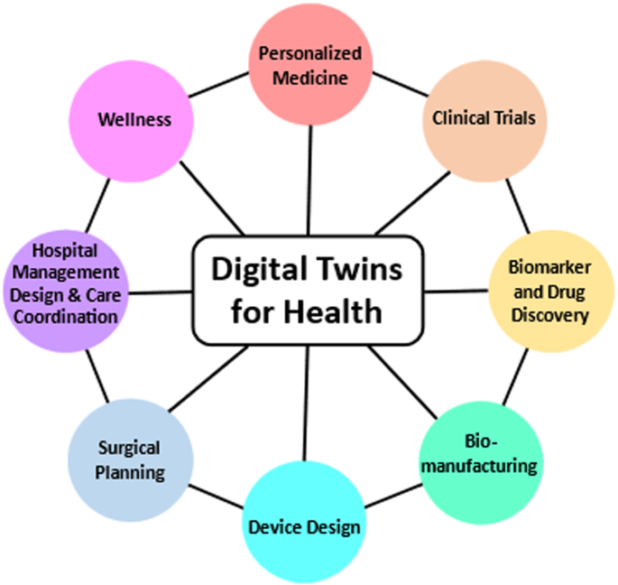
DIGITAL TWINS for the Healthcare Industry
Digital twins technology gathers vital data from EHRs, telemedicine, or patient portals, which helps to track conditions. The physicians use the data to track the reactions of patients to each treatment.
Digital twins are used to test possible treatments and pharmacy products. It speeds up the process and eliminates the possible need for animal or human trials, making drug development easier and safer.
Detecting bed shortages, creating operating rooms, optimising medical staff schedules. These data are useful to increase efficiency of hospitals and staff performance, decreasing costs, implementing strategies to solve issues related to hospitals.
With a digital twin of the human body, physicians can discover disorders before the onset of diseases. They can also experiment with which treatment works best and improve patient outcomes. A human being model may also aid with planning surgeries.
By using twins technology, researchers can visualise the entire lifecycle of a disease, including factors that affect it. This can transform healthcare approaches and treatment, mainly for complex cases.
Developers can test operating conditions, check design variations, and foresee malfunctions of medical devices. This approach reduces the risk of product failures and is cost-effective.
(Katsoulakis, et al., 2024)

Slide 19
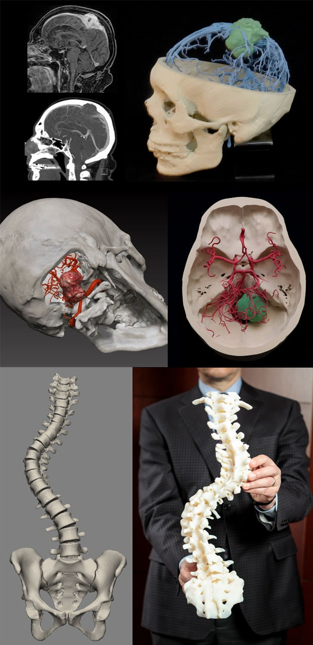
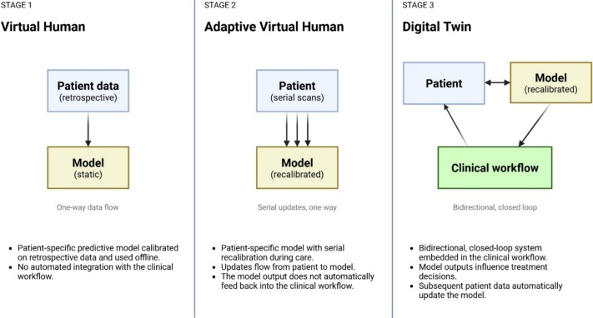
3D models enhance neurosurgical care
Mayo clinic examples
Stages along the path of clinical digital twins in radiation oncology
(Mayo Clinic, 2025)
(Mastroleo, et al., 2026)

Slide 20

15 mins

Slide 21
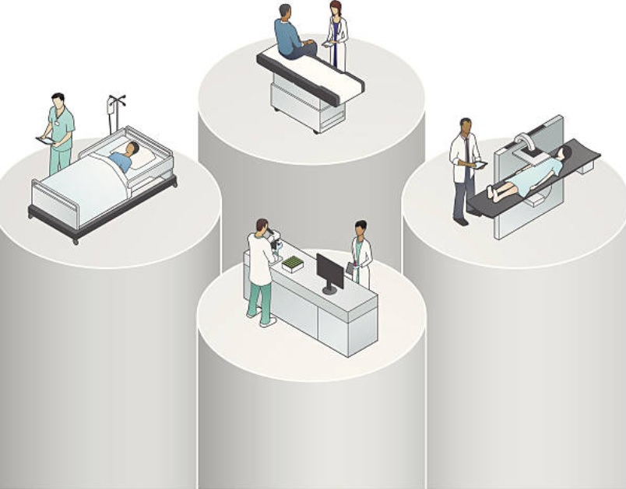
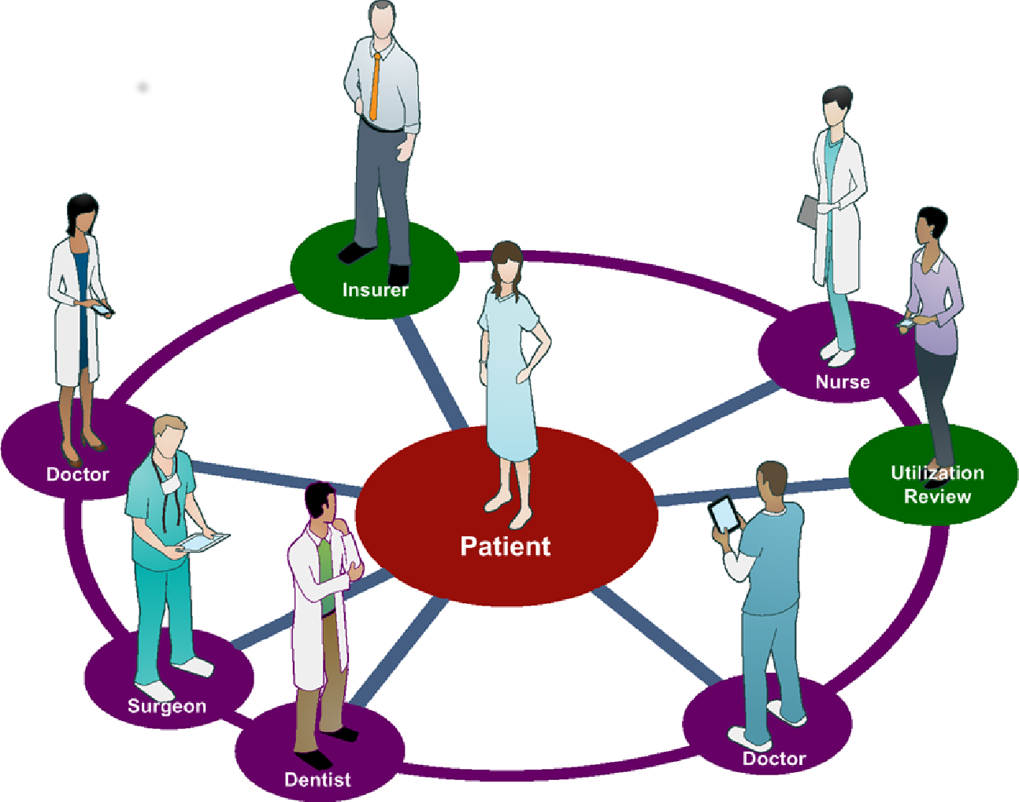
Digital Transformation in Healthcare
Comprehensive integration of digital technologies, data analytics and innovative processes with the main goal of improving and enhancing the delivery of healthcare services.
HEALTH 4.0
Hospital-centred systems
Patient - centred systems

Slide 22
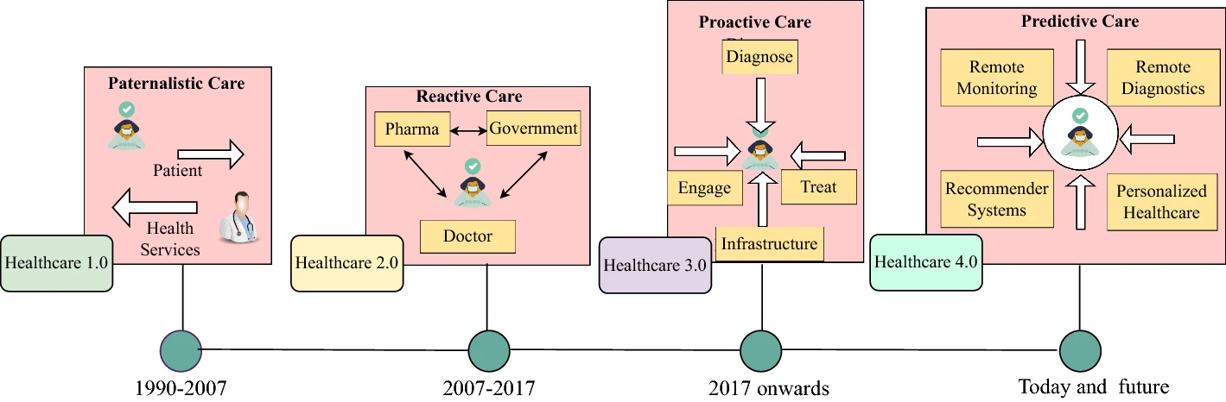
Evolution of the healthcare
 | Healthcare 1.0 | Healthcare 2.0 | Healthcare 3.0 | Healthcare 4.0
Key objectives | Enhance performance and reduce paperwork | Boost productivity and data exchange | Deliver patient-centred services | Offer real-time analytics and reporting services
Target | Effortless automation | Collaboration with other organisations | Physical interaction with patients | AI-based interactions with real-time monitoring and diagnostics
Information sharing | Intra-organisation | Laboratory information management system | Cloud computing and electronic data interchange | EMR, IoT, CPS, AI
Challenges | Standalone devices with limited computational resources | Only sharing critical information without interacting with patients | Different protocols with limited accessibility | INDUSTRY 4.0 untested technologies

Slide 23
HEALTH 4.0 vs e-Health
HEALTH 4.0
E-Health
Integration of advanced technologies like IoT, Big-Data, AI to create a more connected and intelligent healthcare system.
Use of information and communication technologies for health services and information.
SCOPE: revolutionise healthcare by integrating advanced technologies to create a SMART and interconnected system.
SCOPE: digitisation of existing healthcare processes.
OBJECTIVE: enhance the overall quality, flexibility and personalisation of healthcare services.
OBJECTIVE: improve access and efficiency in healthcare.
TECHNOLOGY: Incorporation of IoT, AI, Big-Data and blockchain.
TECHNOLOGY: Information and Communication technologies (ICTS).

Slide 24
e-Health and the “10 e’s”
e-Health
Efficiency
Enhancing quality
Evidence-based
Encouragement
Empowerment
Education
Enabling
Extending
Ethics
Equity
Firstly introduced in 1999: Electronic communication and information technology in the health sector.
Use of DIGITAL DATA in healthcare for different purposes:
  CLINICAL → Medical Informatics
  EDUCATIONAL→ Public Health
  ADMINISTRATIVE → Business
COST-EFFECTIVE and SECURE use of INFORMATION and COMMUNICATION TECHNOLOGIES in support of HEALTH and HEALTH-related fields including healthcare services, health surveillance, health literature, health education, knowledge and resource.
WHO, 2005

Slide 25


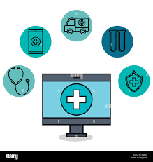
Benefits of Digital transformation in Healthcare
For Patients:
Increased patient engagement
Enhanced convenience and accessibility
Personalised care
Greater transparency and communication
For Healthcare Providers:
Increased efficiency and productivity
Improved decision-making
Enhanced collaboration and care coordination
Reduced administrative burden
For Healthcare Systems:
Reduced healthcare costs
Improved population health management

Slide 26
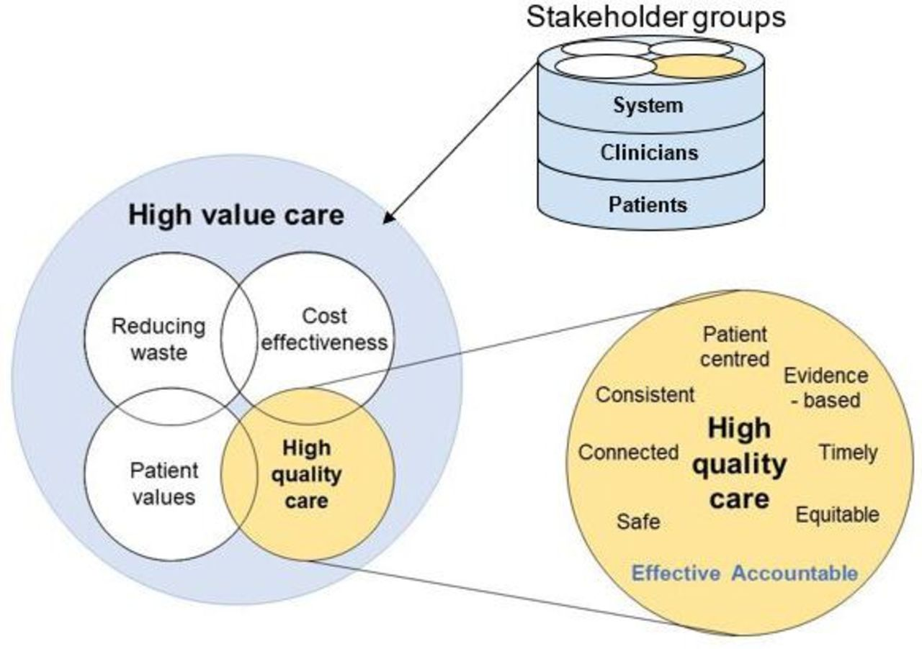
What Is High-Value Care?
Delivery of the best possible outcomes for patients at the lowest cost.
SAFE: care does not harm the patient. Safe care should be well supported by policies and procedures and a clear reporting procedure.
CONNECTED: care allows patients to move easily between and across sectors of healthcare. Prioritise efficient interprofessional communication and empower patients to maintain continuity over their own care.
PATIENT-CENTRED: care is built around patient’s needs and values ensuring the patient is empowered to take an active role in their care. Adapt communication and assessment according to patient’s needs and partnering with patients to develop treatment plans.
EVIDENCE-BASED: care is guided by up-to-date evidence for the decision making regarding the patient’s care.
EQUITABLE: care is of equal quality for all cultural background, age, gender, religion, sexual orientation, disability status, religion, socio-economic status.
EFFECTIVE: effective care should be evidence based and based on skilled communication and understanding patient’s needs.
Gleadhill, 2023

Slide 27
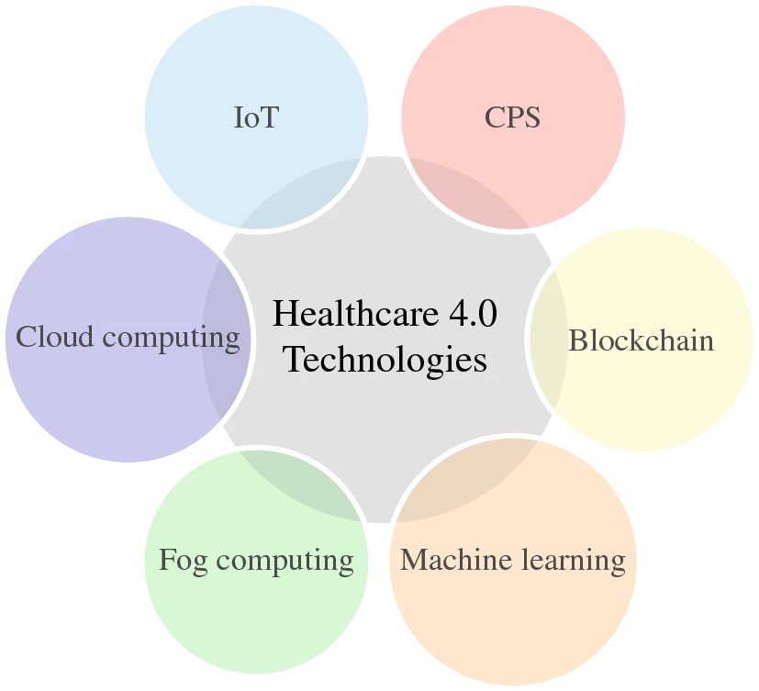
Key innovations in healthcare
Key applications in healthcare
Electronic Health Record (EHRs)
Patient Management
Electronic Medical Record (EMRs)
Predictive healthcare
Telemedicine and Tele-health
Remote Monitoring
Patient Portals and APPs
e-Prescribing
Personalised medicine
Data Analytics and security
Wearable devices and Mobile Health
Interoperability
Health Information System and Health Information Exchange
Clinical decisions and support systems

Slide 28
15 mins

Slide 29

Objective: Research the digital innovation assigned to your group and fill the quiz
Group 1: Electronic Health Records (EHRs)
Group 2: Telemedicine
Group 3: Wearable devices
Group 4: Personalised medicine
Group 5: Patient apps (NHS App)
Benefits and challenges of Digital Health Innovations
Teamwork
Research questions:
Purpose of the innovation
Impact on patients
Benefits
Challenges
Time: 30 mins

Slide 30
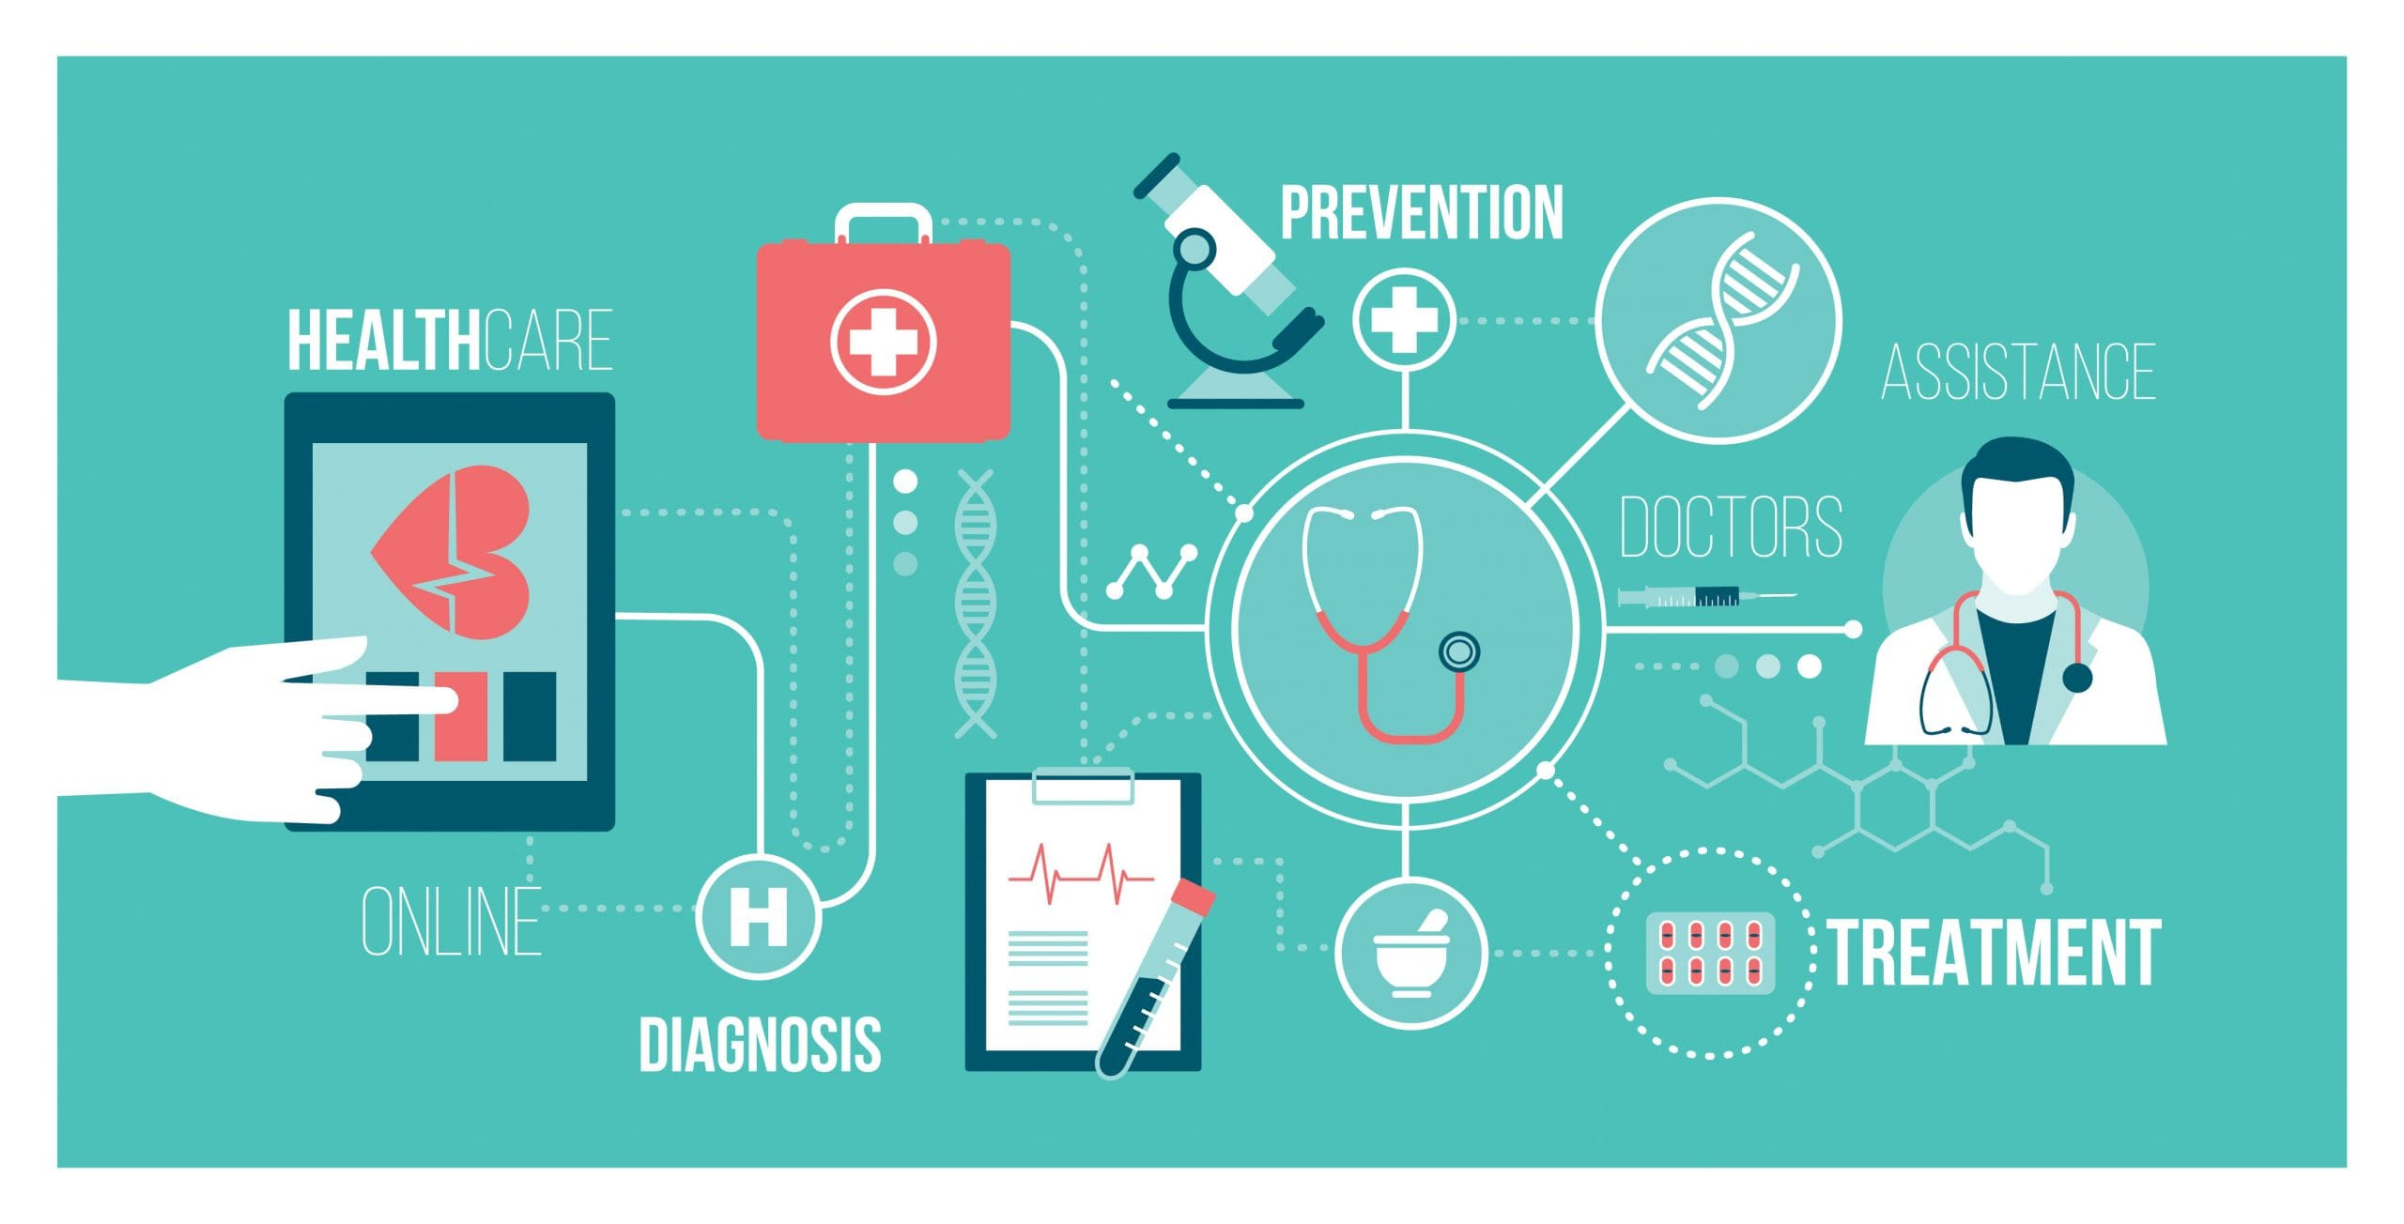
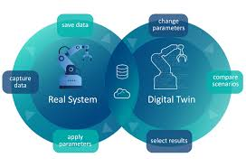
Mind Map : Digital transformation
Digital Health
Digital twins
Evolution of the Industry
Cyber-physical systems
Sustainability
Architecture
Evolution of the healthcare industry
Health 4.0 and e-Health
Technological innovations
Digital transformation
Definition
Core elements
Key milestones
Digital transformation in Health and social care

Slide 31
References
Bloomberg, J. (2018). Digitization, digitalization, and digital transformation: confuse them at your peril. Retrieved from Digitization, Digitalization, And Digital Transformation: Confuse Them At Your Peril (forbes.com)
Deloitte (2018). Digital enablement turning your transformation into a successful journey. Retrieved from IE_C_HC_campaign.pdf (deloitte.com)
European Commission. (2019). Digital transformation. Retrieved from Digital transformation (europa.eu)
Ismail, M. H., Khater, M., & Zaki, M. (2017). Digital business transformation and strategy: What do we know so far? Retrieved from 2017NovPaper_Mariam.pdf (cam.ac.uk)
OECD (2018). Going digital in a multilateral world. Retrieved from: Digital | OECD
Gregory Vial, Understanding digital transformation: A review and a research agenda. The Journal of Strategic Information Systems, 2019. DOI: https://doi.org/10.1016/j.jsis.2019.01.003.
Schwertner, K. (2017). Digital transformation of business. Trakia Journal of Sciences, 15(1), 388-393. DOI:10.15547/tjs.2017.s.01.065
Evangelia Katsoulakis, Qi Wang , Huanmei Wu, Leili Shahriyari, Richard Fletcher, Jinwei Liu, Luke Achenie, Hongfang Liu, Pamela Jackson, Ying Xiao, Tanveer Syeda-Mahmood, Richard Tuli & Jun Deng (2024). Digital twins for health: a scoping review. Digital medicine, 2024. DOI: https://doi.org/10.1038/s41746-024-01073-0.
Botín-Sanabria, D.M.; Mihaita, A.-S.; Peimbert-García, R.E.; Ramírez-Moreno, M.A.; Ramírez-Mendoza, R.A.; Lozoya-Santos, J.d.J. Digital Twin Technology Challenges and Applications: A Comprehensive Review. Remote Sens. 2022. DOI: https://doi.org/10.3390/rs14061335
Rula Al-Rimawi, Doa'a Dwairej, Arwa Masadeh, Enaam Al-Ananbeh, Muayyad Ahmad. E-health Concept Development and Maturity in Literature. Journal of Health. Medicine and Nursing, 2016 . ISSN 2422-8419.
Qi, Qinglin & Tao, Fei & Hu, Tianliang & Anwer, Nabil & Liu, Ang & Wei, Yongli & Wang, Lihui & Nee, Andrew. Enabling technologies and tools for digital twin. Journal of Manufacturing Systems. (2021). DOI: 58. 3-21. 10.1016/j.jmsy.2019.10.001.
Mayo Clinic, (2025), 'Digital twins': 3D models enhance neurosurgical care - Mayo Clinic. Available at: 'Digital twins': 3D models enhance neurosurgical care - Mayo Clinic
Mastroleo F, Borras-Osorio M, Patel SP, Routman DM, Moseley DJ, Shiraishi S, Foong AYK, Waddle MR. Translational barriers to digital twins in radiation oncology. Phys Imaging Radiat Oncol. 2026 Jun 18;40:101024. doi: 10.1016/j.phro.2026.101024

