Slide 1
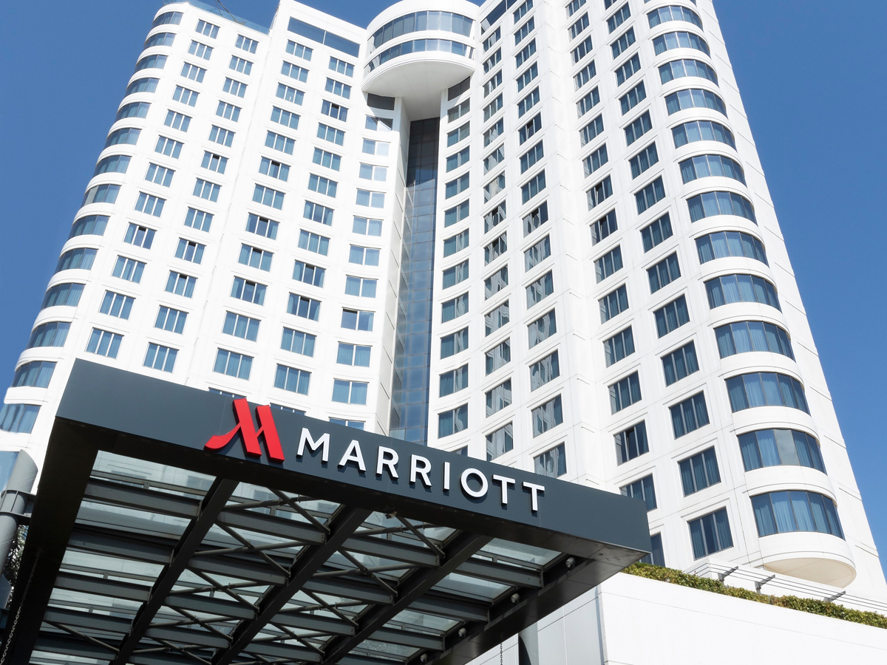
LARA MEDINA BARCENILLA
Employee Lifecycle
MARRIOTT
HOTELS
Personnel Resourcing and Development (BMIH4010)

Slide 2
  Introduction to Marriott
  The Employee Lifecycle Concept
  Attraction
  Recruitment Processes
  Onboarding
  Development
  Retention
  Separation
  Employee Reviews and Workplace Experience
  Conclusion
  REFERENCES
CONTENTS

Slide 3

Introduction to
One of the world’s largest hotel companies
Operates 8,500+ properties in over 130 countries
Follows a people-first philosophy
Employee management influences guest satisfaction
Marriott’s approach shows that employee management is important for service quality in hospitality (Marriott, 2026; Armstrong and Taylor, 2023).

Slide 4
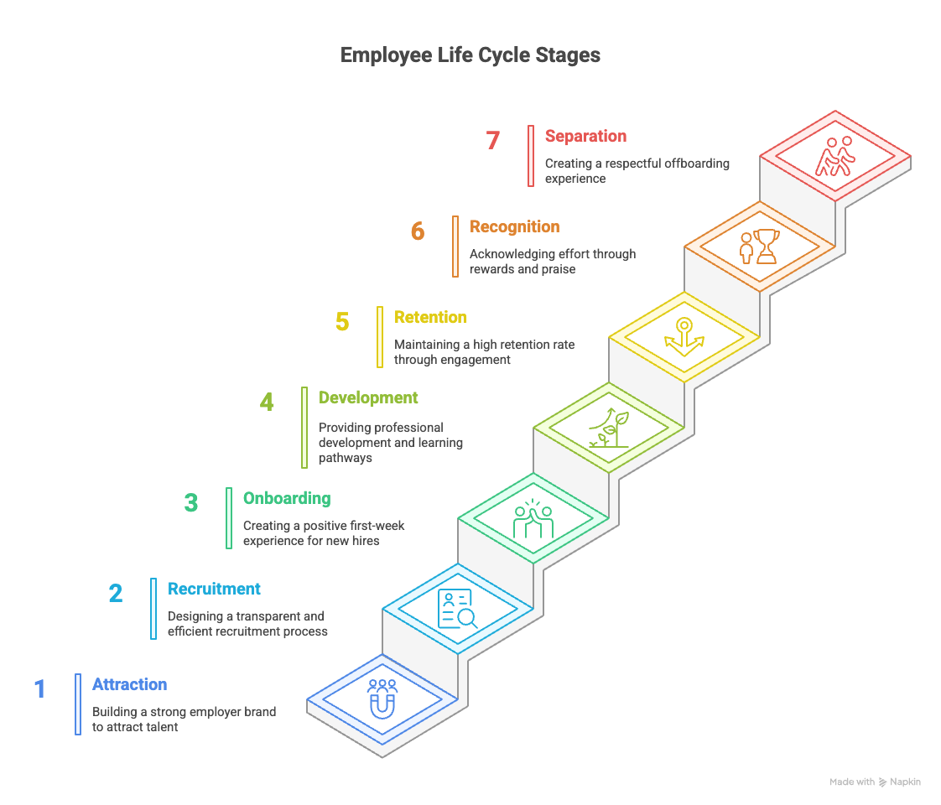
  The Employee Lifecycle
Different stages an employee goes through during their relationship with an organisation.
Effective lifecycle management improves employee engagement, organisational performance and service quality (Armstrong and Taylor, 2023; Wilton, 2022).

Slide 5
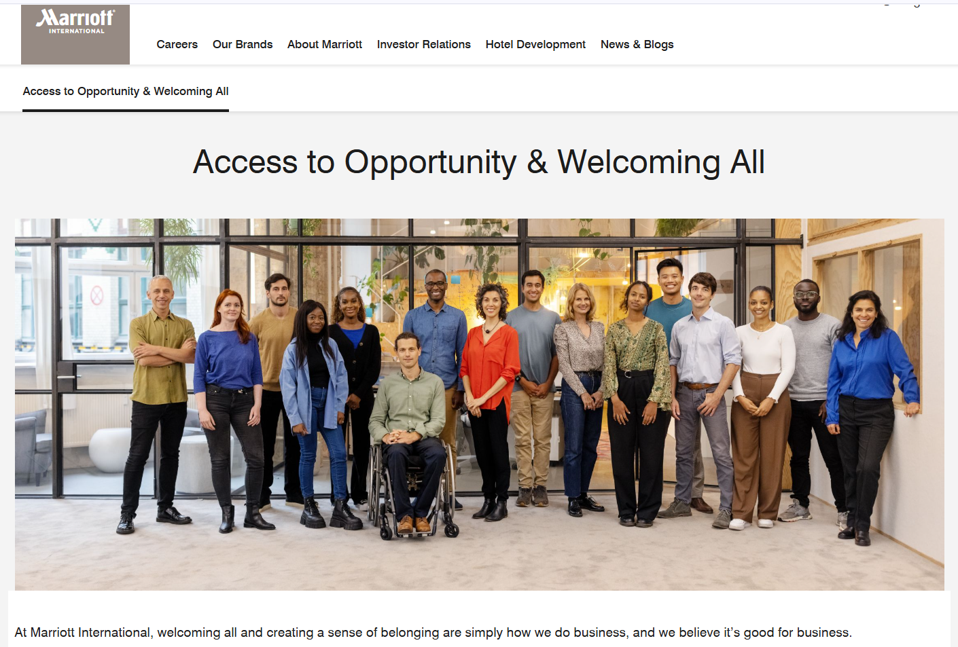

  Attraction
https://www.marriott.com/welcoming-all.mi
Marriott attracts employees through its employer brand and corporate culture:
  Employee wellbeing
  Diversity and inclusion
  Career development opportunities
  Internal promotion
Attraction strategies include:
  Online careers platforms
  Social media recruitment campaigns
  Hospitality career events
Strong employer branding is essential for attracting talent in hospitality industries (Baum, 2015).

Slide 6
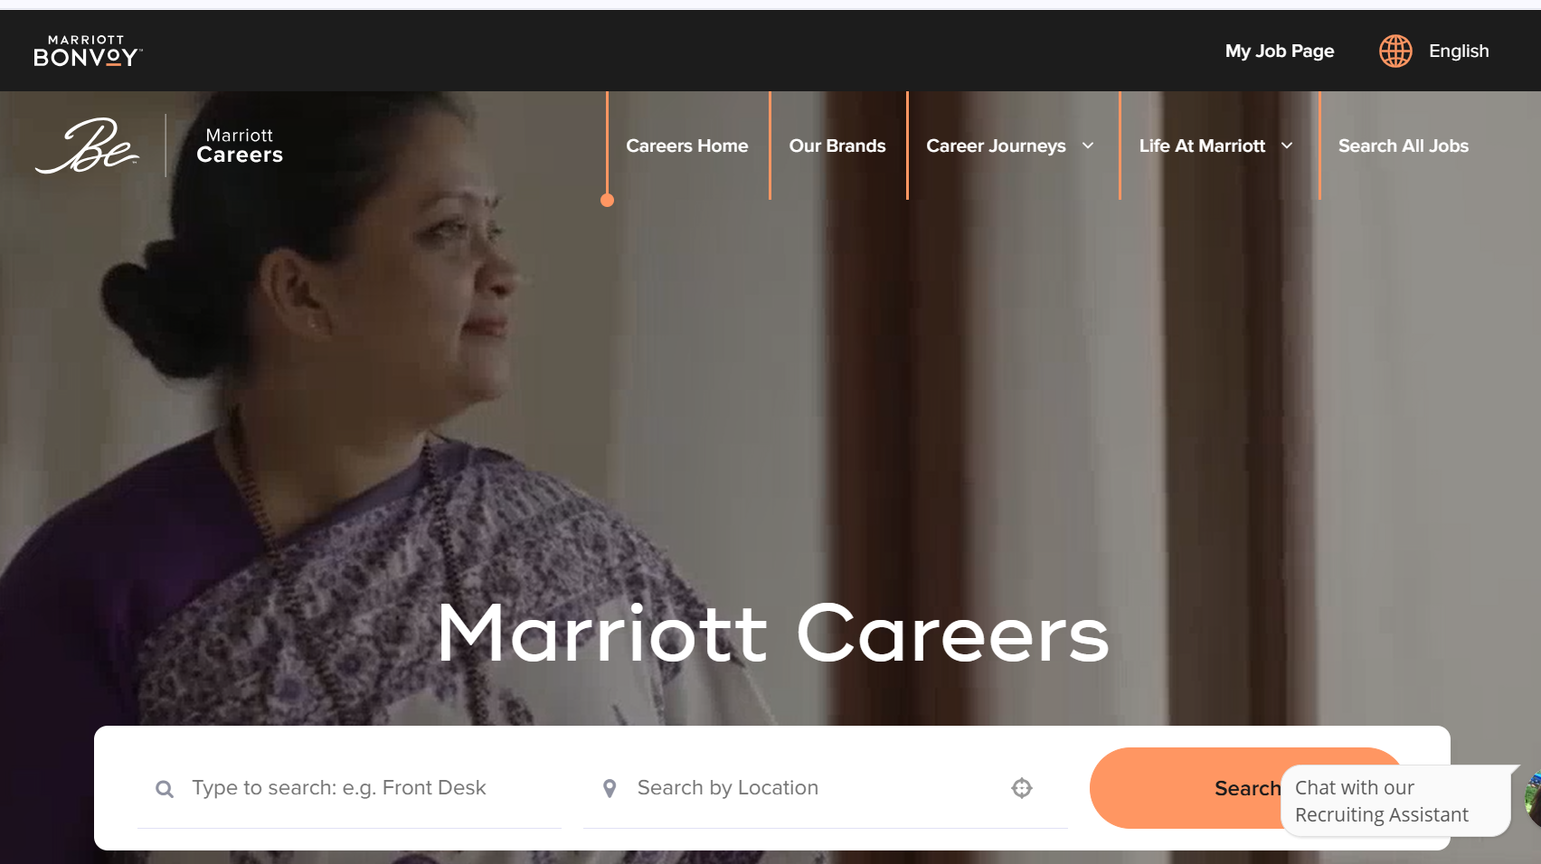
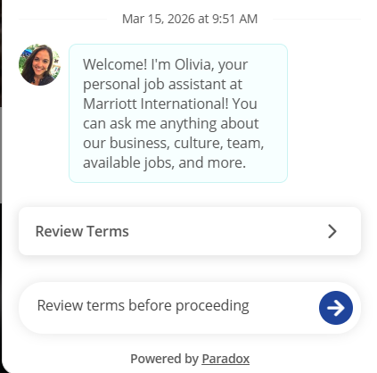
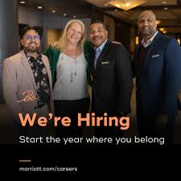
  Recruitment Process
Recruitment focuses on candidates with strong customer service skills and teamwork abilities, which are essential in hospitality (Wilton, 2022).
Marriott uses a digital careers platform
Jobs can be searched by role, location and brand
Online applications make recruitment faster
“Olivia” helps guide candidates through the process
Digital tools support large-scale global recruitment
https://careers.marriott.com/

Slide 7
  Onboarding (First Day Experience)
The onboarding stage helps new employees integrate into the organisation and understand its culture.
The first day is designed to help employees feel welcomed, supported and empowered.
At Marriott, the first day experience includes:
  Introduction to Marriott’s collaborative workplace culture
  Meeting colleagues and supervisors across departments
  Learning company values and service standards
  Encouragement to solve guest problems independently
A supportive onboarding experience helps employees feel engaged from the first day (San Segundo, 2023; Armstrong and Taylor, 2023).

Slide 8

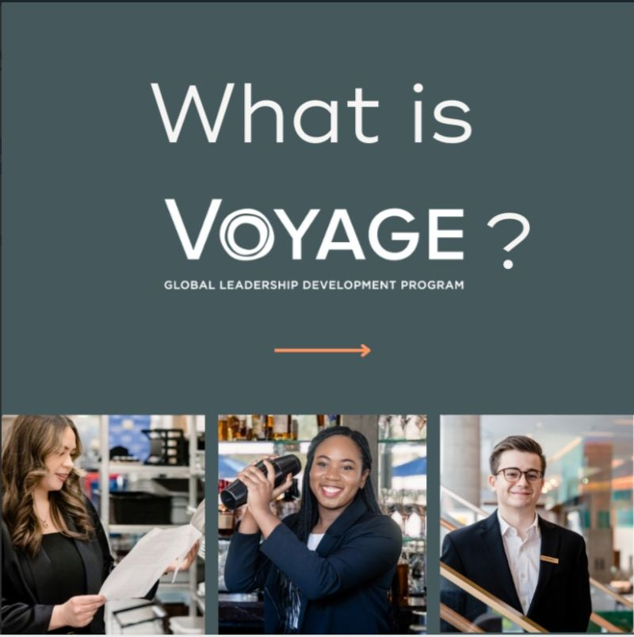
  Development
Marriott supports employee development through training and career programmes:
Hotel Internship Program provides hands-on training
Voyage develops future leaders in over 50 countries
Apprenticeships combine paid training and qualifications
Development supports career growth and internal progression
Training and development can improve employee retention and organisational commitment in the hotel industry, especially when employees see clear opportunities for career growth (Marriott Careers, 2026c; Dorta-Afonso et al., 2021; Mirić and Slavković, 2023).
https://careers.marriott.com/career-journeys/early-careers/

Slide 9
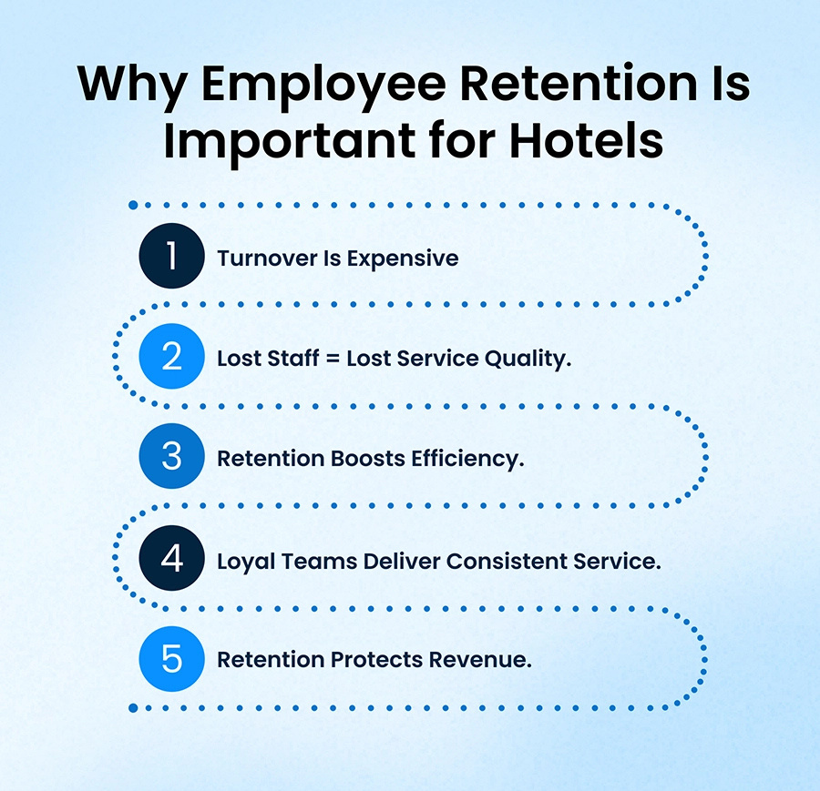
  Retention
Encouraging employees to stay with the company.
Competitive compensation and employee benefits
Paid leave and wellbeing support
Long-service recognition programmes
Career growth and tuition support
Retention improves stability and service quality
Retention is strengthened when employees experience recognition, development opportunities and supportive HR practices (Dorta-Afonso et al., 2021; Mirić and Slavković, 2023).

Slide 10

  Separation
Final stage of the employee lifecycle.
Happens when an employee leaves the organization.
Includes handover and return of company property.
Exit interviews can provide useful feedback.
A respectful exit protects the employer brand.

Slide 11
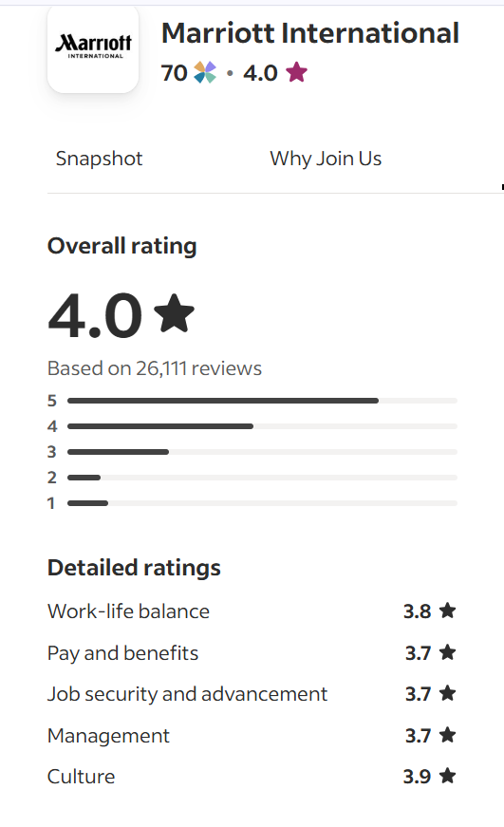
  Employee Experience and Feedback
Employee reviews give insight into real workplace experience
Indeed UK shows an overall rating of around 4.0/5
Positive comments mention friendly teams and employee benefits
Some reviews also mention long hours and heavy workloads
Feedback helps show both strengths and challenges at Marriott
Marriott has strong HR practices, but retention can still be affected by workload and pressure.
(Indeed, 2026; Dorta-Afonso et al., 2021)
(Indeed, n.d.)

Slide 12

  CONCLUSION
The employee lifecycle plays an important role in managing employees in the hospitality industry.
Marriott supports this process through:
  Strong employer branding
  Structured recruitment and onboarding
  Continuous training and development
  Employee benefits and career opportunities

Slide 13
LARA MEDINA BARCENILLA
Thank You!
ANY QUESTIONS?

Slide 14
REFERENCES
Armstrong, M. and Taylor, S. (2023) Armstrong’s handbook of human resource management practice. 16th edn. London: Kogan Page.
Baum, T. (2015) Human resource management for tourism, hospitality and leisure: An international perspective. 2nd edn. Harlow: Pearson.
Dorta-Afonso, D., González-de-la-Rosa, M., García-Rodríguez, F.J. and Romero-Domínguez, L. (2021) ‘Effects of high-performance work systems (HPWS) on hospitality employees’ outcomes through their organizational commitment, motivation, and job satisfaction’, Sustainability, 13(6), 3226. Available at: https://doi.org/10.3390/su13063226
Indeed (no date) Marriott International employee reviews in United Kingdom. Available at: https://uk.indeed.com/cmp/Marriott-International/reviews?fcountry=GB&floc=United+Kingdom (Accessed: 15 March 2026).
Marriott (2026) Access to Opportunity & Welcoming All. Available at: https://www.marriott.com/welcoming-all.mi (Accessed: 15 March 2026).
Marriott Careers (no date) Marriott employee benefits: an overview per country. Available at: https://life.marriott.com/blog/marriott-benefits/ (Accessed: 15 March 2026).
Marriott Careers (no date) Marriott International Careers. Available at: https://careers.marriott.com/ (Accessed: 15 March 2026).
Marriott Careers (no date) Search jobs | Marriott International Careers. Available at: https://careers.marriott.com/jobs (Accessed: 15 March 2026).
Marriott Careers (2026c) Early Careers at Marriott International. Available at: https://careers.marriott.com/career-journeys/early-careers/ (Accessed: 15 March 2026).
Mirić, M. and Slavković, M. (2023) ‘Does training and development affect employee retention in the hotel industry? The mediator role of organizational commitment’, Hotel and Tourism Management, 11(1), pp. 51–65. Available at: https://www.htmanagementvb.com/index.php/HITM/article/view/249 (Accessed: 15 March 2026).
Wilton, N. (2022) An introduction to human resource management. 5th edn. London: Sage.

