Slide 1


The Societal Marketing Concept
Monica Tamara Antonache

Slide 2




Introduction
The societal marketing concept extends the previous marketing philosophy by introducing the notion of social and environmental responsibility to business strategy.
In addition to profitability, businesses must also hold themselves accountable to people, communities, and the planet.
Corporate Social Responsibility, sustainable innovation, and full transparency of both operations and branding is encouraged.
Societal marketing concept applies customer satisfaction along with social good and elevates marketing from short-term to long-term social change.

Slide 3
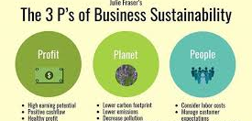


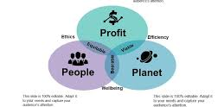
Key Features
The societal marketing concept is the fifth and most sophisticated adaptation of a marketing philosophy that incorporates learnings from subsequent models to reach a more comprehensive approach to business practice.
The societal marketing concept is centered on the customer but greatly enhances with the objectives of social equity and environmental sustainability.
Businesses are encouraged to strive toward the triple bottom line of people, planet, and profit to achieve balanced advantages.
The societal marketing concept aligns with current global considerations such as ethical trade practices, inclusivity, and responsible innovation.

Slide 4

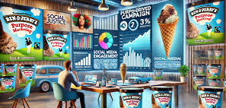


Modern Applications
Businesses apply the societal concept through embedding Corporate Social Responsibility (CSR) and sustainability in their mission and overall strategy.
There are leading examples of brands with profitability mixed with ethics; think Patagonia, The Body Shop and Ben & Jerry’s.
Contemporary consumers are loyal to brands who give authenticity and transparency, as well as a sense of purpose.
Beyond authenticity, the conceptual changes give structure to what corporations can do so that taking social action or environmental care becomes standard elements in contemporary marketing.

Slide 5




The Best Model for 2025
Company's success will rest in the highest ability to combine innovation with social and environmental responsibility.
The societal marketing concept is designed to prepare firms for global challenges such as climate change, inequality, sustainability demands, etc.
Aligning ethics and business models, firms will attract loyal customers, investors and employees who share these values
The concept makes sure marketing is applied as more than just to sell; it is used to sustain, inspire us to offer a better future.

Slide 6
References
Abratt, R., & Sacks, D. (1988). The marketing challenge: Towards being profitable and socially responsible. Journal of Business Ethics, 7(7), 497-507.
Crane, A., & Desmond, J. (2002). Societal marketing and morality. European journal of marketing, 36(5-6), 548-569.
Chandy, R. K., Johar, G. V., Moorman, C., & Roberts, J. H. (2021). Better marketing for a better world. Journal of Marketing, 85(3), 1-9.
Firat, A. F. (2022). Marketing and market. Japan Marketing History Review, 1(1), 48-53.
Kotler, P. (1998). A generic concept of marketing. Marketing Management, 7(3), 48.
Kotler, P. (1994). Reconceptualising marketing: an interview with Philip Kotler. European Management Journal, 12(4), 353-361.
Kotler, P. (2011). Philip Kotler's contributions to marketing theory and practice. In Review of marketing research: Special issue-marketing legends (pp. 87-120). Emerald Group Publishing Limited.
Lee, N. R., & Kotler, P. (2019). Social marketing: Behavior change for social good. Sage Publications.
Murphy, P. E., Laczniak, G. R., & Harris, F. (2017). Ethics in marketing. International cases and perspectives.
Voronov, A. A., Gorlachev, P. V., Mirzoeva, E. V., Rudenko, V. A., & Popova, T. S. (2021). Role of social and ethical marketing in improving sustainable business development. In Сooperation and Sustainable Development (pp. 1249-1255). Cham: Springer International Publishing.
https://thembains.com/societal-marketing-concept/
https://eightception.com/societal-marketing-guide/

