Slide 1

The role of influencers in modern marketing
Presented by Omrakha Hassan

Slide 2

Agenda
Introduction
2. why the topic matter in modern business
3. how influencer shape consumer behaviour
4. challenges facing influencers marketing
5. real world example

Slide 3

Introduction
This presentation will explore the role of influencers in modern marketing
The topic matter because traditional advertising is no longer enough to capture consumer attention (Forbes council,2025)

Slide 4

How influencers shape consumer behaviour
Influencers cultivate strong online communities (IZEA, 2024)
Influencers use creative storytelling to promote products (influencity, 2025)
Another important element is trust and authenticity (Research gate, 2023).

Slide 5
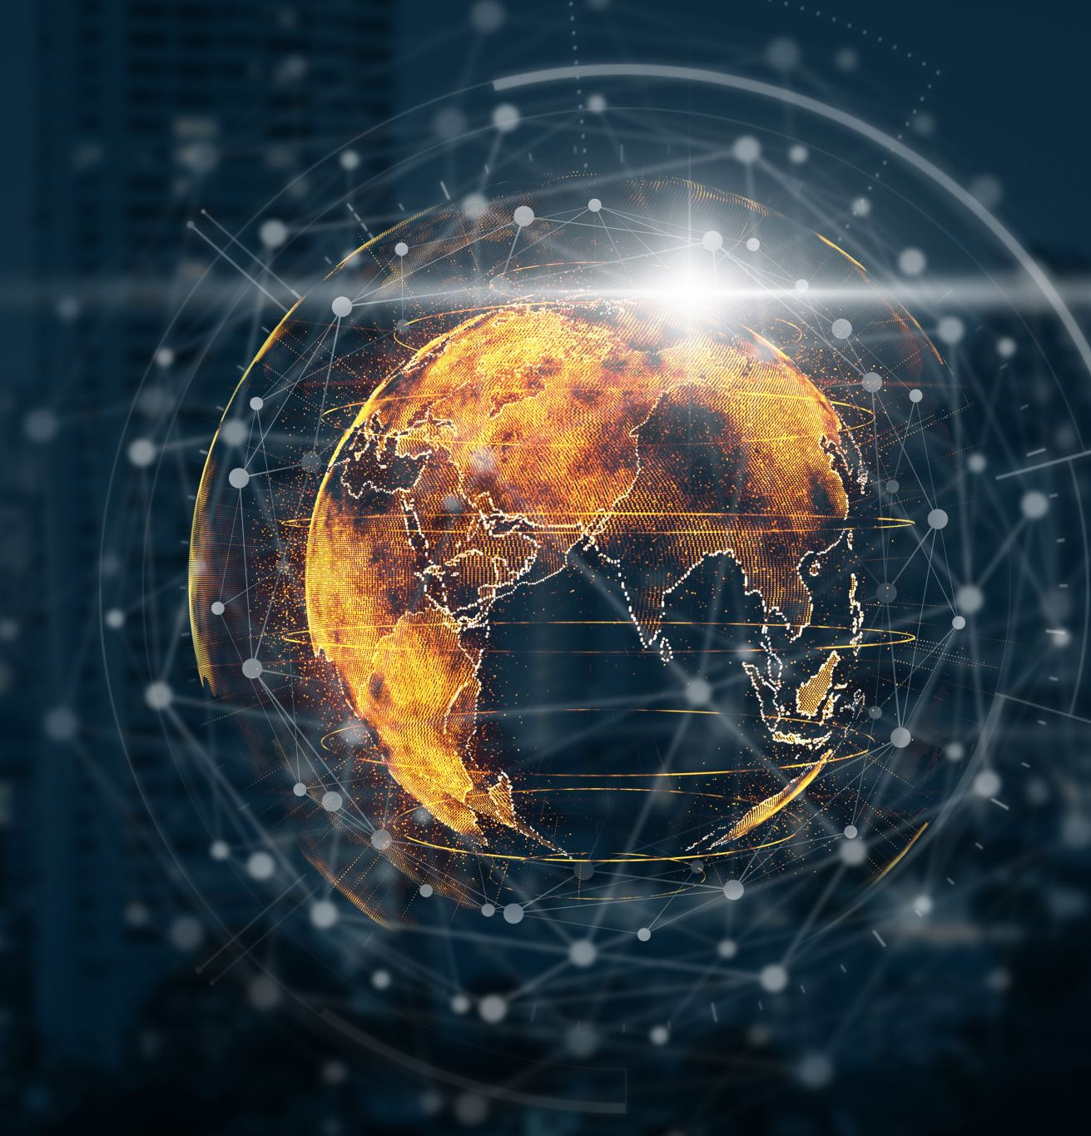
A powerful world example is
Mr beast (Jimmy Donaldson)

Slide 6

Challenges facing influencers marketing
Ethical concerns like lack of transparency (Journalism, 2023).

Slide 7
summary
Influencers marketing is an effective and powerful strategy when executed responsibly

Slide 8
Referencing list
Forbes Council (2025) The role of influencers in innovative brand strategies. Available at:https://councils.forbes.com/blog/the-role-of-influencers-in-innovative-brand-strategies?hs_amp=true (Accessed 21 November 2025).
Research Gate (2023) The role of influencer marketing in building authentic brand relationships online. Available at:(PDF) The Role of Influencer Marketing in Building Authentic Brand Relationships Online (Accessed 21 November).
Influencity (2025) Storytelling in marketing: how influencers can build a brand narrative that sells. Available at: Storytelling in Marketing: How Influencers Can Build a Brand Narrative That Sells (Accessed 21 November 2025).
IZEA (2024) Impact and influence: the effects of influencer culture on society. Available at:Impact and Influence: The Effects of Influencer Culture on Society - IZEA Worldwide, Inc (Accessed 21 November 2025).
Journalism (2023) Challenges and ethical considerations in influencer marketing. Available at: Challenges and Ethical Considerations in Influencer Marketing • Journalism University (Accessed 22 November 2025).

