Slide 1


Glad To be Best
Valentines Menu
Student: Khaleda Hayder
ID: 22124476
Module: BMIH4002 Food and Beverage Operation
Lecturer: Rohan Dubrey

Slide 2

Valentines Menu
7-14 February 2023
Open 16:00 pm – 00:00 am
Starter (Choose One):
Seared Scallops with Pea Puree and Pancetta (Scallops, Peas, Pancetta)
Stuffed Mushrooms with Spinach and Feta (Mushrooms, Spinach, Feta Cheese) (V)
Sun-Dried Tomato Arancini with Pesto (Risotto, Sun-Dried Tomatoes, Pesto) (V, VE)
Main Course (Choose One):
Beef Wellington with Roasted Vegetables (Beef, Puff Pastry, Mushrooms, Spinach)
Grilled Salmon with Lemon Butter Sauce (Salmon, Lemon, Butter, White Wine)
Ravioli with butternut squash with a sage brown butter sauce (Butternut Squash, Pasta, Sage, Vegan Butter) (V, VE)

Slide 3
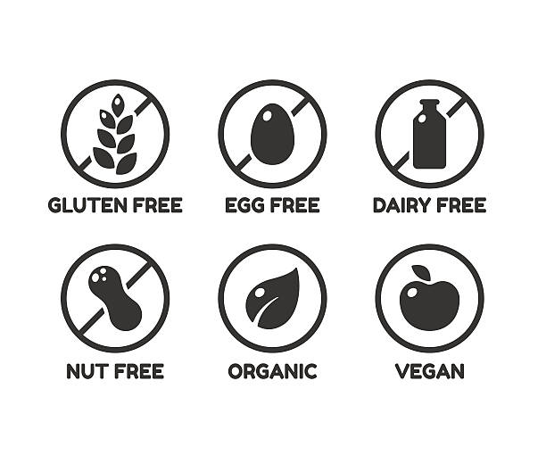
Dessert (Choose One):
5. Chocolate Lava Cake with Vanilla Ice Cream (Dark Chocolate, Flour, Sugar, Vanilla Ice Cream)
6. Lemon Meringue Tart with Fresh Berries (Lemon, Sugar, Meringue, Berries)
7. Tiramisu with Espresso Syrup (Mascarpone, Espresso, Ladyfingers (biscuit), Cocoa Powder) (V, VE)
Drinks (Choose One):
8. Specialty Hot Drinks (A menu of specialty hot drinks, such as a Spiced Hot Chocolate (200ml) or a Vanilla Chai Latte (200ml) , would be a cosy and romantic way to end the evening.)
9. Cordials and Digestifs (A selection of cordials and digestifs, such as Amaretto or Grand Marnier, can be offered as an after-dinner treat.)
Pricing:
Price per Couple: £107
Price per Person: £55
Complimentary:
A glass of Prosecco per person
We Are Now Taking Pre-Orders
V – Vegetarian
VE- Vegan
If you have any food allergies or particular dietary requirements, kindly let us know.
The Trinity Hotel, 20 Park Lane, Mayfair, London W1K 1PN

Slide 4
References:
Guzder K. (2020) Menu Engineering: How to Use it to Increase Profitability, [Blog] 23 March, Available at: https://www.highspeedtraining.co.uk/hub/menu-engineering/ (Accessed: 10 February 2023)
Michael L. Kasavana, Donald I. Smith (1990) Menu Engineering: A Practical Guide to Menu Analysis. Hospitality Pub.
Jones E. & Goode M. (2017) ‘The influence of menu design, menu item descriptions and menu variety on customer satisfaction.’ Tourism and Hospitality Research. 19(1). DOI:10.1177/1467358417708228
Marie A. (2022) Menu Hacks: The Psychology Behind Menu Design [Blog] 25 March. Available at: https://www.sweetstreet.com/menu-hacks-the-psychology-behind-menu-design/ (Accessed: 15 February 2023)
Easyorder (N/A) Engineering your menu the smart way [Blog] 17 May, Available at: https://www.easyorderapp.com/en/blog/engineering-your-menu-the-smart-way (Accessed: 15 February 2023)
Lee, H. J., & Lee, S. (2019). The influence of menu engineering on customer value and satisfaction. Journal of Foodservice Business Research, 22(5), 485-499.
Sebastien Rankin 2022-09-29 et al. (2023) Menu engineering: How to make a profitable restaurant menu, Lightspeed. Available at: https://www.lightspeedhq.com/blog/menu-engineering/ (Accessed: February 15, 2023).
Sundar, S. (2022) What is menu engineering? how to create a profitable restaurant menu?, Gofrugal. Available at: https://www.gofrugal.com/blog/menu-engineering/ (Accessed: February 15, 2023).

