Slide 1

Strategic and Agile Business ManagementBMMB7027
Enablers
Daniela Hellyer
June 2026

Slide 2
This week we will focus on…
Topics:
  Welcome
  Introduction to strategy and strategic management
  Strategic analysis
  Competitive strategy
  Strategic capabilities
  Organisational structure
  Incentives
  Enablers

Slide 3
Key enablers for strategy implementation
Key Enablers:
  Organisational Culture
  Implementation of Strategy: Planning
  Planning for Strategic Response

Slide 4

Organisational culture
Effective organisational design also concerns building strong relationships in the organisation:
  Between management and employees
  Between the employees
Organisational /Corporate Culture:
  Collectively shared values, norms and practices that occur within organisation
  ‘Values’ = what is important to employees
  ‘Norms’ = what constitutes appropriate employee attitudes and behaviour

Slide 5

Organisational culture
Organisational Culture:
  Reflected in ‘artefacts’, e.g. office design or workplace symbols or slogans
  Cultures permeate the corporation through socialisation:
    employees are immersed through day-to-day activities, relationships and interactions with co-workers
  A strong organisational culture is present when values and norms are widely shared, resulting in stronger relationships
  All organisations possess some form of culture, whether it is directed by management or not.

Slide 6

Organisational culture
Organisational Culture:
  Reflected in ‘artefacts’, e.g. office design or workplace symbols or slogans…
  How would you describe the ‘artefacts’ of your organisation? How does it feel?

Slide 7

Imprinting of culture – by founder
Founder Imprinting:
  Often, the organisation’s founder defines an organisational culture through their decisions, directives, and personality
  Their created organisational culture often lasts long after they leave
Imprinting of Culture
  Culture is imprinted:
    Explicitly: through founder’s intentional, strategic attempts to build positive workplace culture
    Implicitly: through the decisions, communications, and working style in which they carry out the company's management and leadership

Slide 8

Founder imprinting example: apple
Example of Founder Imprinting:
  Steve Job’s unique drive, creativity and perseverance led many to idolise him, even after his passing
  His legacy: a very strong lasting corporate culture
  Strong organisational culture can be a strategic asset that differentiates and may contribute to a sustained competitive advantage
  Can you think of any other founders who had a profound effect on their organisation’s culture – how?

Slide 9
Organisational change is correlated with interest in oganisational culture
Interest in organisational culture is often greatest during times of organisational change, e.g. due to:
  Change of leadership
  Change of strategic agenda
  Performance management related issues (e.g. culture becomes a hinderance)
  Structural changes, incl. diversification, mergers and acquisitions

Slide 10

Organisational culture can be influenced by various factors
Such factors include:
  Organisation’s founder
  Business development stage (maturity / size etc.)
  Organisational structure
  Internal control mechanisms (e.g. incentives and rewards)
  External market environment / industry

Slide 11

How do you analyse or measure ‘culture’?
Culture can be a rather ‘elusive’ thing that is difficult to analyse or measure…
Is there a way to analyse or measure it – what do you think?

Slide 12

The cultural web
Culture can be a rather ‘elusive’ thing that is difficult to analyse or measure…
‘The Cultural Web’ is a model for analysing and changing an organisation’s culture
  It was developed by Gerry Johnson and Kevan Scholes (1992)
  It captures six elements that influence the ‘Paradigm’ of Culture
  Each element can be analysed to gain a thorough understanding of the culture as a whole

Slide 13
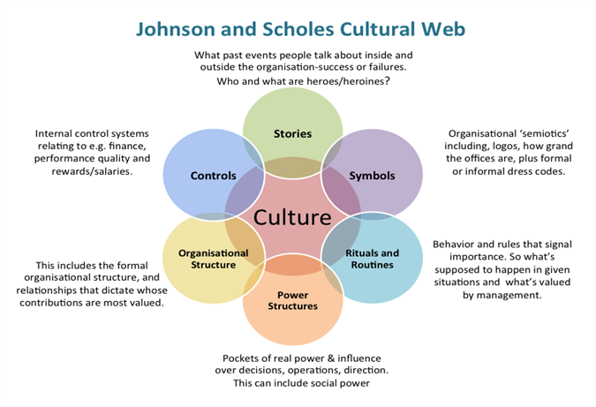
The cultural web

Slide 14

Creating a Culture of Learning - LinkedIn Case Study:
Kellogg Company
https://youtu.be/_oPeeFYlvf0?si=wISAfwXYEoRDZbip

Slide 15

How Netflix builds a culture of excellence
Elizabeth Stone (CTO)
https://youtu.be/2XgU6T4DalY?si=JfcmwJuHp6ViC7kt

Slide 16

Implementation of strategy: planning

Slide 17
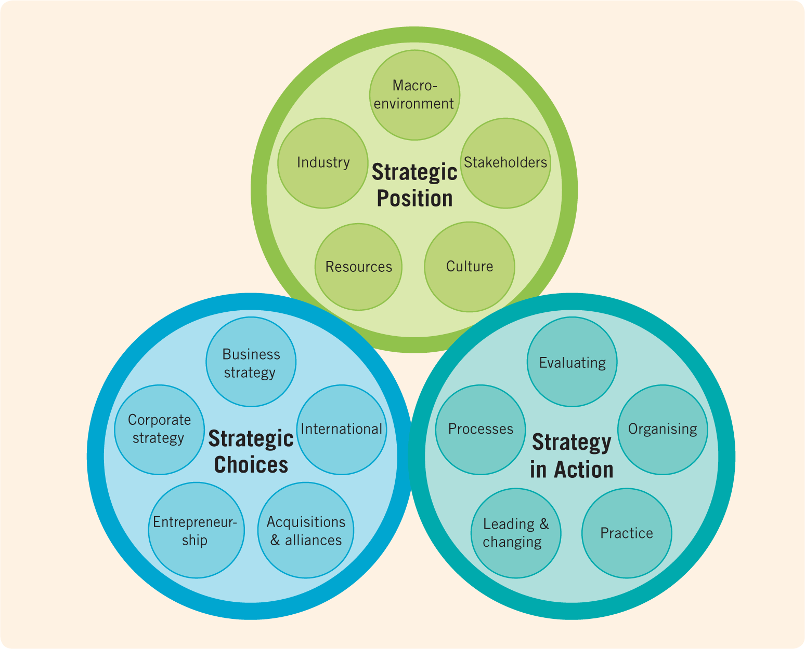
The exploring
Strategy framework
&
Planning
Planning
Johnson, Whittington, Scholes, Angwin, Regner (2017)

Slide 18
What % of strategies fail?
Approximately 70% of strategies fail due to poor execution

Slide 19

reasons why strategy execution fails
No or insufficient communication
Lack of commitment
Insufficient or inadequate resources
Isolated and fragmented actions
Ambiguous or conflicting goals
No or unclear strategy
No clear priorities
Ambiguous responsibilities
Lack of performance information
Wrong or ineffective culture
Resistance to change
Over-complexity
Insufficient management capabilities
Delay, plans are not met
Budget is exceeded
Lack of middle management support
Strategy is not adapted to changes
Poor leadership

Slide 20

Strategy implementation/execution
Implementation may not be the most exciting thing to talk about.
However, it is a fundamental managerial practice that’s critical for any business strategy to take hold.
Organisations can gain competitive advantage through implementation, if done effectively.
The process must involve all team members, who should know their responsibilities and be committed.

Slide 21

Strategic plan implementation
  Provides the roadmap needed to pursue a specific strategic direction, achieve performance goals, deliver customer value, and to be successful
  Encompasses various activities, resources, staffing and personnel considerations
Strategic Plan – addresses the what and why of activities
Implementation – addresses the who, where, when, and how
Both are critical to success and need awareness and managing

Slide 22
Requirements for successful implementation
Requirements surrounding successful implementation can be grouped into
STRUCTURAL = Organisational Requirements and
BEHAVIOURAL = Employee Requirements
Organisational Requirements (Structural) | Employee Requirements (Behavioural)
Importance of a market-oriented structure (with no functional silos and isolation) Corporate culture enables flexibility and co-operation Appropriate policies, procedures, control systems | Adequate employee motivation ‘Internal marketing’: developing programs to win support for new strategies Employee programmes (action plans) translating strategies to frontline employees

Slide 23

Guidelines for successful strategy implementation
  Requires a comprehensive and systematic approach.
  Change routine, do not be afraid to think differently and do things differently.
  Identify your own management tactics / leadership styles to achieve the goals.
  Without direct involvement of each and everyone in the company, successful strategy implementation is impossible.
  Motivate your team and use their full potential.
  Provide adequate resources – human, financial, technical etc.
  Follow-up on the assigned task and seek responsibility.
  Identify relationships between projects and keep an eye on their contribution to the achievement of your goals.
  Build a good foundational company culture.

Slide 24

The Difference Between Strategic Planning and Strategic Thinking
Watch this video and take notes:
  What are the key messages that you take away from this?
  We will discuss this together after the video.
https://youtu.be/V2Hndmk18z0?si=7ppk3mnCZFNaHqgN

Slide 25

planning for strategic response
In addition to choosing what strategic direction to take and aligning internal capabilities, you also have to decide whether to respond to moves made by rivals.
This is often one of the most challenging decisions… with many variables and factors to consider.
The smallest strategic mistake in rival engagement could spell disaster for your operations and marketing.

Slide 26
Factors determining likelihood of a competitive move
Three key factors determine the likelihood that an organisation will respond to a competitor’s move:
Level of Awareness
Level of Motivation
Level of Capability
The organisation must continuously monitor competitors and anticipate their potential moves:
What competitor actions are possible?
What is most likely – now and in the future?
The organisation’s motivation to respond is likely to be high when a competitor has made a competitive move. But…:
How high is their motivation?
Are they likely to respond?
In what situations are they likely to respond?
The organisation must have plans and resources to respond to the move of their competitor:
How capable is the organisation to respond?
How will they achieve their ‘attack’?
What resources do they have to assist them?

Slide 27

If an organisation is going to respond to a competitor’s move, speed is important.
Competitors can capitalise on any delays and then use them in turn to counter-attack.

Slide 28

Rather than responding to a competitor’s move, how about making the first move?
First Mover Advantage:
  What do you think this is?
  What advantages could there be for an organisation to make the first move?
  Which companies can you think of that ‘made the first move’ in a market?

Slide 29



First mover advantage
‘First Mover’:
  Organisation that is the first to establish itself in a given market or industry
  Hopes to gain sustainable competitive advantage by establishing themselves before anyone else
  Building on strategic resources (e.g. protected technology and innovations) makes it difficult for rivals to imitate, examples:
First Mover Advantage:
  Occurs when initial move into a market allows an organisation to establish a dominant position that other organisations will struggle to overcome.
First Mover Risks:
  Customers might not embrace the new offering (organisation had no previous market or industry knowledge and did not fully understand customer needs)
  High costs of developing the product and educating customers on product or service
Choose wisely: how likely is it that this move will provide my organisation with a sustainable competitive advantage?

Slide 30
This is the end of our session ☺

