Slide 1

Evidence Based Policing
Week 8
Crime Analysis
Dr. Luke Roach
L.Roach@UWTSD.ac.uk

Slide 2

Crime Analysis
Within each problem category (immediate, short-term, long-term), crime analysis results are created to be used for different purposes by different audiences

Slide 3
Two Key Focuses of Crime Analysis
Situational Awareness
Crime Reduction

Slide 4
Situational Awareness
The development of a perception of the environment in which an officer, no matter the rank, works
Crime analysts produce “information” for police personnel about crime
  Details about individual incidents or aggregate counts of incidents by different time periods
  Report facts but do not present conclusions about what the facts mean

Slide 5
Crime Reduction
The crime analysis results are created with the intention of guiding police in implementing specific strategies for crime reduction
Conclusions are presented about the relationships that exist among the facts – results are “action-oriented”

Slide 6

Contrasting the Purposes of Crime Analysis Results
Distinguished by the process by which they are developed
The systematic use of both types of results critical for agencies to effectively fight crime

Slide 7
The Crime Analyst (National Crime Agency)
https://www.youtube.com/watch?v=nzAfaVwIQLE&feature=youtu.be

Slide 8
Crime Analysis Audiences
Audiences within a police agency require different types of analysis for situational awareness and crime reduction
Consider job responsibilities
  Operational personnel
  Management personnel
  Command personnel

Slide 9
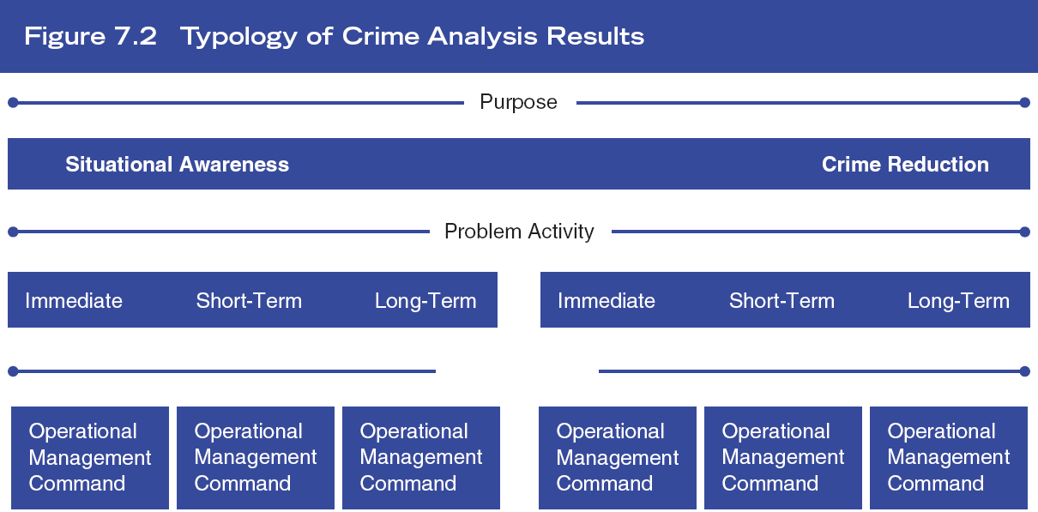
Crime Analysis Typology
Break down potential crime analysis results by:
  Category of problem
  Purpose of crime analysis
  Time of internal police audience

Slide 10
Situational Awareness Examples
Immediate – isolated incidents that are resolved relatively quickly
Short-term– repeat incidents and patterns
Long-term – a set of related activity that occurs over time that stems from systematic opportunities
  Operational
  Management
  Command

Slide 11
Crime Reduction Examples
Immediate – Public Order Situation
Short-Term – Drugs Death Spike
Long-Term – Continued Burglary Problem
  Operational
  Management
  Command

Slide 12
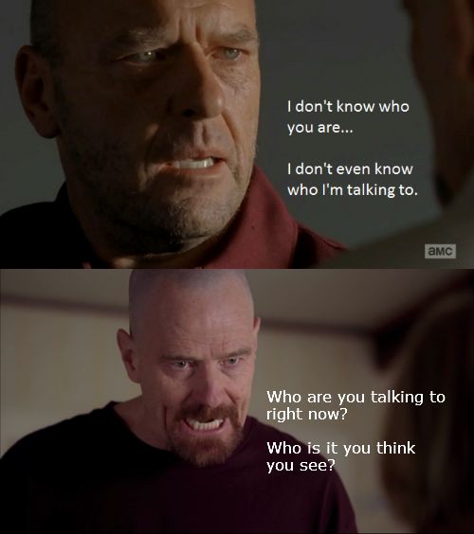
Discussion Exercise
Contrast the types of analysis for crime reduction that the different audiences within a police agency require:
  What are the key differences?
  How do their requirements overlap?

Slide 13
Repeat Incidents
A cluster of two or more incidents that are similar in nature and have happened at the same place or by the same person
To address repeat incidents:
  Identify addresses of multiple calls for service
  Engage in qualitative data analysis (e.g., observation, interviews) to understand cause of calls
  Can you give an example of a common repeat incident?

Slide 14
Domestic Abuse
https://www.youtube.com/watch?v=B2h_PO9subA&feature=youtu.be

Slide 15
Repeat Incident Data
Complements pattern analysis
Calls for service relating to disorder, quality of life, and interpersonal disputes are examined
Each agency would conduct analysis based on its own codes, the nature of activity in its jurisdiction, and in line with crime reduction efforts

Slide 16
Domestic Abuse Statistics UK (ONS 2018)
The latest figures from the Crime Survey for England and Wales show little change in the prevalence of domestic abuse in recent years. In the year ending March 2018, an estimated 2.0 million adults aged 16 to 59 years experienced domestic abuse in the last year (1.3 million women, 695,000 men).
The police recorded 599,549 domestic abuse-related crimes in the year ending March 2018. This was an increase of 23% from the previous year. This in part reflects police forces improving their identification and recording of domestic abuse incidents as crimes and an increased willingness by victims to come forward.

Slide 17
Domestic Abuse Statistics UK (ONS 2018)
The percentage of convictions secured for domestic abuse-related prosecutions is at its highest level since the year ending March 2010. In the year ending March 2018, 76% of prosecutions resulted in a conviction.
Why is the Evidence Based Approach so critical here?

Slide 18
Domestic Homicide
“Domestic” homicides from the Homicide Index include any homicide where the relationship between an adult victim, including;
spouse
common-law spouse
cohabiting partner
boyfriend or girlfriend
ex-spouse, ex-cohabiting partner or ex-boyfriend or girlfriend
adulterous relationship
son or daughter (including step and adopted relationships)
parent (including step and adopted relationships)
brother or sister
other relatives

Slide 19
Domestic Homicide
There were a total of 400 domestic homicides recorded by the police in England and Wales between April 2014 and March 2017; this represents 25% of all homicides where the victim was aged 16 years and over during this time period
Four in five female victims of domestic homicide were killed by a partner or ex-partner (239, 82%); of which the majority of the suspects were male (238)
Therefore the vast majority of people who are murdered are killed by someone they know

Slide 20
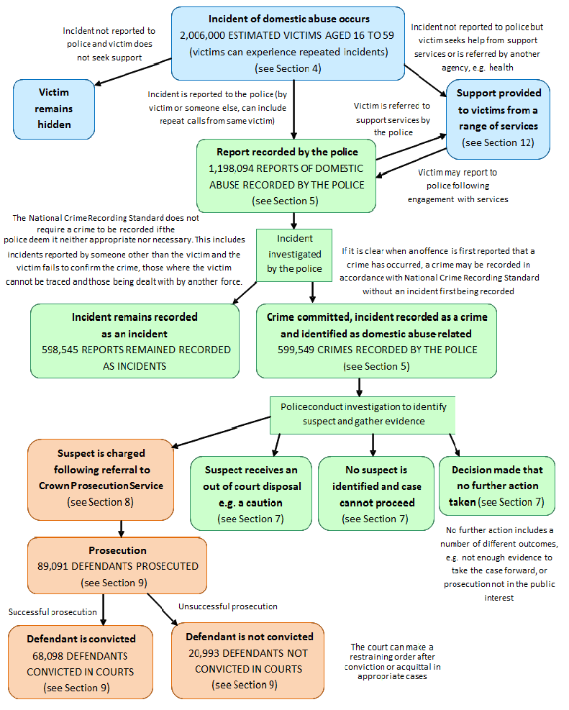

Slide 21
Dataset Tool (Office National Statistics 2018)
https://www.ons.gov.uk/peoplepopulationandcommunity/crimeandjustice/bulletins/domesticabuseinenglandandwales/yearendingmarch2018

Slide 22
Watch the Film – The Child Victims
https://www.youtube.com/watch?v=RNYPGwmOxnY

Slide 23
Repeat Incident Location Report
Time period reported should be short term
Goal to identify and resolve the issues as soon as possible
  A “rolling report” over 2-4 weeks
  Analysis will determine crime reduction strategies
Most agencies have 5-10 new repeat incident addresses each week

Slide 24
Collection and Collation of Tactical Crime Analysis Data
First step to tactical crime analysis is collecting necessary data
To identify patterns, need information on how, when, and where crimes have occurred
Information pulled from both quantitative and qualitative information within police reports

Slide 25
Crime Report Data
Tactical crime analysis seeks to identify patterns of crimes that are not easily linked together
Focuses on crimes in which the offender and the victim do not know one another

Slide 26
Modus Operandi (MO)
”Method of Operation”
The key elements of the crime incident itself
May also include qualitative information about incidents
The habits and procedures adopted by offenders

Slide 27
Persons Involved in the Crime
Data about a person
Type of contact
Name and address
Physical description
Photograph of the person attached to the case record
Additional qualitative information can be included

Slide 28
Vehicle Involved in the Crime
Vehicles may be used as transportation, weapons, methods of entry, etc.
Info collected includes:
Official info (VIN, license plate, etc.)
Physical description
Nature of vehicle at time of incident

Slide 29
Field Information
Used when an official police report is not necessary, but additional information is worth collecting
In many agencies, officers fill out FI Cards (field information or field interview cards) when responding to calls

Slide 30
Field Information Used in Tactical Crime Analysis
Suspicious persons
Suspicious vehicles
Persons warned for trespassing
Individuals with unique scars, marks, or tattoos

Slide 31
Discussion Exercise
You have been asked to develop a repeat incident location report that helps to identify domestic violence situations before they get too serious. These situations include disputes between parents, between parents and children, and between children.
Decide the following in the development of the report:
types of calls for service to be included,
timeframe of the report (e.g., 2 weeks versus 6 weeks),
number of calls to make a repeat incident location,
format of the report,
timing of the report (e.g., how often it is provided to officers).

Slide 32
Discussion Exercise
For each of the following crimes, list (in order of importance) 10 to 15 characteristics from MO, suspect, or vehicle information that are important for pattern analysis of that crime. There may be additional characteristics that are important, but list only the top 10 by importance.
  Robbery
  Theft from vehicle
  Residential burglary
  Stranger rape

Slide 33

Maintaining Professional Standards and Reflective Practice

Slide 34
The Way Forward
Focusing upon reflective practice as the means by which professional standards can be achieved within policing.
We will examine how as the police service evolves to focus on evidence based policing, as well as introducing the Police Educational Qualifications Framework (PEQF)
the importance of reflective practice will need to be further embedded within mainstream policing to ensure its impact and success along with the well-deserved recognition of the professionalism of the service.

Slide 35
The Way Forward
The introduction of the Policing Education Qualifications Framework (PEQF) in England and Wales marks an important milestone in the history of British policing.
For the first time there will be mechanisms in place that link explicitly higher levels of knowledge and understanding to the performance of a police officer and the professional standards expected within policing.
The PEQF thus goes hand in hand with the drive towards evidenced based policing; both assume that knowledge plays an important role in establishing what is good policing and what makes a good police officer.

Slide 36
Reflection, Recognition & Improvement
Moreover, this requires police organisations to encourage, enable and ensure such reflection is embedded within the idea of what it means to be a police officer.
The seminal text in this area of study is Schön’s (1983) The Reflective Practitioner: How professionals think in action. This publication built upon Schön’s earlier work with Argyis from the 1970s, which focused on the development of knowledge within organisational practices (Argyis & Schön, 1974, 1978).
This work was important in breaking down the division between theory and practice, building upon the earlier philosophical perspectives of Dewey (1904; 1916) and Piaget (1977) that had challenged traditional ways of understanding how people learn.

Slide 37
Knowledge & Learning
Jean Piaget (1977) in particular believed that from a very young age we develop what he called ‘schemas’ or way of thinking (ideas) we test them, if they work we carry them forward and in general if they do not we dismiss them.
In an adult professional context we gain knowledge and understanding from doing things, although we cannot easily articulate what this knowledge and understanding is.
This is what makes it tacit knowledge: “we know without knowing how we know.”
Schön (1983) develops his thinking further by situating knowing and reflecting in action within a concept of professional practice.

Slide 38
Knowing & Learning
Schön’s (1983) idea of reflective practice has been widely established within different professional areas, in particular within education and the health professions. Indeed, its influence has been perceived as widespread and uncritically accepted (Halpin, 2015).
However, whilst in some areas of professional life the idea of the reflective practitioner is embraced perhaps too readily, within policing the opposite is true.
Reflexivity is largely absent in the policing literature (Christopher 2015a).
It is therefore difficult to discuss in detail how reflective practice currently informs professional practice.

Slide 39
Knowledge to Practice
The problem with this is discussed by Waddington (2013) when he notes that professional standards deal with unethical behaviour but do little to promote ethical behaviour, noting that such standards set only minimum expectations.
Negating unethical behaviour does not in itself produce ethical behaviour, nor does it promote reflective practice.
The focus on professional standards, encourages not ethically informed decision making, but rather compliance with minimal standards, risk aversion and a cautionary approach that falls short of the noble calling emphasised by Waddington (2013)
This needs to be at the core of policing degrees and the PEQF more generally.

Slide 40
Reflection
Why is reflection important in any walk of life?
Reflexivity understood in this way draws upon a quality identified by Aristotle as phronesis (Grint, 2007).
Does anyone know what phronesis means?
Phronesis is a Greek team which means ‘practical wisdom’ that has been derived from learning and evidence of practical things.
In other words the ability to learn a subject and then combine the learning with practical experience to get the best result.

Slide 41
Week 8 Lecture Complete!
Any Questions?
Thanks for listening!
See you in the Workshop!

