Slide 1

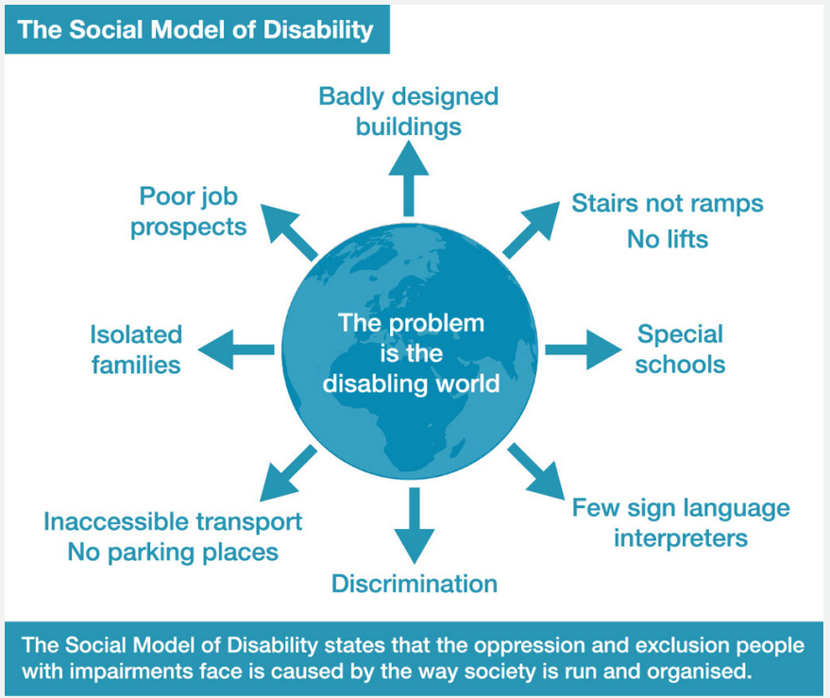
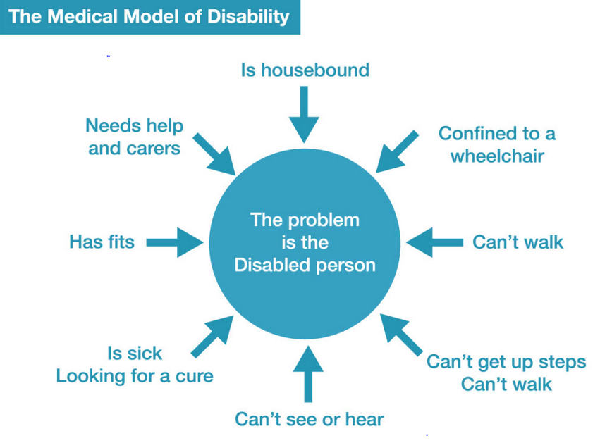
What is the social model of disability?
The social model shows the difference between an impairment and a disability
“If education is about anything, it is about influencing and indeed changing the individual child. One may do this by modifying the social environments in which the child is placed, but one cannot eliminate the individual dimension altogether”.
Lord Low (2007)
The social model of disability offers solutions to the needs of the disabled person
(Cigman, 2010)
What can we do in the educational setting to support the social model of disability?
Remove discrimination
Offer encouragement
Avoid busy display /information boards
Provide appropriate resources
Adapt teaching and learning methods.
Ensure ramps are available for access to buildings/classes
(Inclusion London 2020)
(The Social Model of Disability | Inclusion London, 2020)

Slide 2
References/Bibliograpghy
Cigman, R., 2010. Social Model Of Disability - An Overview | Sciencedirect Topics. [online] Sciencedirect.com. Available at: <https://www.sciencedirect.com/topics/medicine-and-dentistry/social-model-of-disability> [Accessed 18 August 2020].
Disability Wales. 2020. Social Model - Disability Wales. [online] Available at: <http://www.disabilitywales.org/social-model/> [Accessed 17 August 2020].
Flood, t., 2019. Making Inclusion Normal. [online] Wcmt.org.uk. Available at: <https://www.wcmt.org.uk/sites/default/files/report-documents/Flood%20T%20Report%202018%20Final.pdf> [Accessed 21 August 2020].
Inclusion London. 2020. The Social Model Of Disability | Inclusion London. [online] Available at: <https://www.inclusionlondon.org.uk/disability-in-london/social-model/the-social-model-of-disability-and-the-cultural-model-of-deafness/> [Accessed 17 August 2020].
Inclusionlondon.org.uk. 2020. [online] Available at: <https://www.inclusionlondon.org.uk/wp-content/uploads/2015/05/social-model-graphic_expanded-01.jpg> [Accessed 18 August 2020].
Inclusionlondon.org.uk. 2020. [online] Available at: <https://www.inclusionlondon.org.uk/wp-content/uploads/2015/05/social-model-graphic_expanded-01.jpg> [Accessed 18 August 2020].

