Slide 1


BMHP_6029_ BIRM
PSYCOPATHOLOGICAL CLASSIFICATIONS & PROVISIONS
Component 1- Academic Poster Presentation
Lecturer- Tomy Adattu Chacko
Student- Nagish Aquil
(2316023)

Slide 2
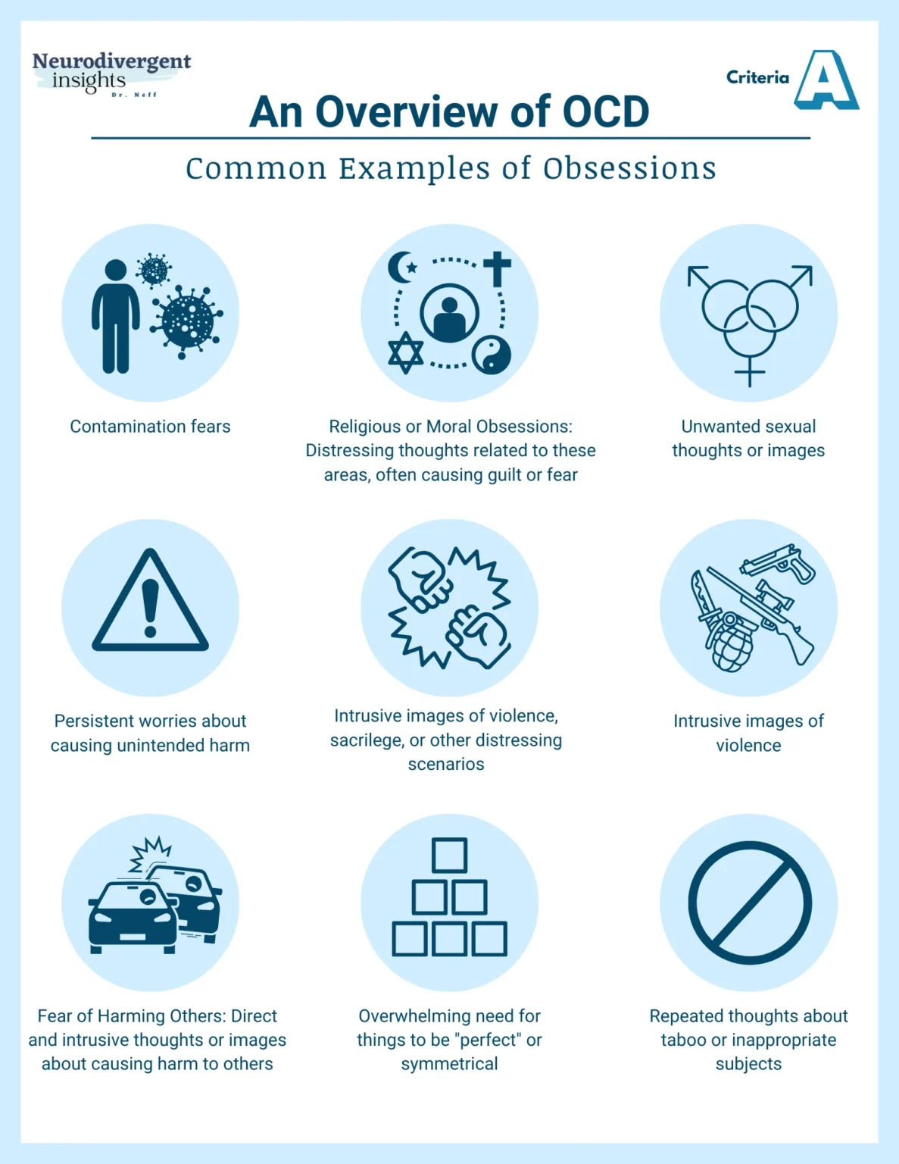
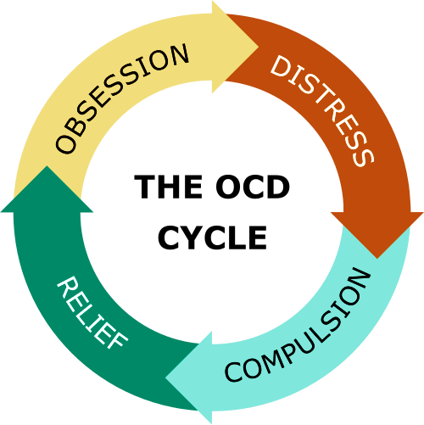
OBSSESIVE – COMPLUSIVE DISORDER (OCD)
Social Cultural and Political Contexts
Treatment of OCD
Introduction
Historical Overview
The main treatments for OCD include medication like the SSRIs and Cognitive Behavioral Therapy (CBT) with Exposure and Response Prevention (ERP).
It is known in many cases that combination of CBT and SSRIs has been most effective.
Available through the NHS, treatment is individualized according to severity (NHS, 2025).
Social Context: According to OCD Action (2024) One of the biggest obstacles for treating OCD is still stigma which causes delays in diagnosis.
Cultural Context: Highly religious communities are more likely to have religious or moral obsessions, which can affect diagnosis (Oxford Handbook of OCD, 2023).
Culturally sensitive therapy is necessary; not all backgrounds will benefit from standard cognitive behavioral therapy (IODCF, 2023).
Political Context: According to NHS England’s 2019 mental health policy, OCD is one of six prevalent mental health conditions.
The ICD-11 places OCD under the heading of “ Obsessive-Compulsive or related disorders” (6B20) which suggests cultural factors that can affect the way symptoms are diagnosed or expressed.
The Equality Act 2010 requires non- discrimination in healthcare and in mental health services although there are still enforcement gaps (Equality Act, 2010).
ICD-11 CODE: 6B20
OCD CLASSIFICATION: OCD is a chronic mental health disorder that includes recurrent, intrusive thoughts called obsessions and repetitive actions or thoughts called compulsions. It is classified under the ICD-11 Chapter 6 Mental, Behavioural and Neurodevelopmental disorders. (World Health Organization, 2023).
1-2% of the UK population is affected by OCD (OCD Action, 2024).
OCD was misunderstood in the past and often mistaken with moral or religious deficiencies (Szymanski and Bourne, 2017).
In early psychiatric studies OCD was considered a personality disorder neurosis (Szymanski and Bourne, 2017).
OCD is categized by the ICD-11 under Obsessive Compulsive Disorder or related disorders (6B20) considering its psychological and neurobiological components (Seemuller,2023).
CONTEMPORARY UNDERSTANDING
The focus of modern knowledge is evidence-based care particularly the gold standard Cognitive Behavioral Therapy with Exposure and Response Prevention (CBT-ERP) (OCD Action,2024).
Important effects of OCD on people
Recommendations
Increase funding for OCD- specific services: To reduce wait times and improve access to CBT-ERP.
Implement cultural competency training: for clinicians to address disparities in diagnosis and treatment (Oxford Academic, 2017).
Expand public education campaigns: To combat stigma and promote early intervention.
Mandate routine screening for OCD: In primary care settings to facilitate timely referrals.
Emotional distress and anxiety: Individuals often experience intense fear, guilt or shame due to intrusive thoughts (NHS, 2025).
Professional and academic impairment: concentration, time management and decision-making affecting performance in school or work (MentalHealth.com,2025).
Sleep disruption: insomnia or poor sleep quality (Access CBT, 2023)

Slide 3
REFRENCE LIST
Access CBT, (2023) How does OCD affect others? Available at:How OCD Affects Others? | Obsessive Compulsive Disorder | Access CBT, (Accessed 27 October 2025).
Abramowitz, J.S., McKay, D. and Storch, E.A., eds., (2023) The Oxford Handbook of Obsessive Compulsive and Related Disorders, Oxford : Oxford University Press. Available at: The Oxford Handbook of Obsessive-Compulsive and Related Disorders | Oxford Academic, (Accessed: 27 October 2025).
International OCD Foundation (IOCDF), (2023) Culturally Responsive Treatment for OCD. Boston: IOCDF. Available at: Why culturally competent care matters when treating scrupulosity OCD | International OCD Foundation, (Accessed: 27 October 2025).
Mental Health, (2025) Ways OCD affects the individual and their life. Available at: 3.2 Describe the ways OCD affects the individual and their life – Care Learning, (Accessed: 27 October 2025).
NHS England (2019) The NHS Long Term Plan: Mental Health. London: NHS England. Available at: NHS England » NHS Mental Health Implementation Plan 2019/20 – 2023/24, (Accessed: 27 October 2025).
NHS England (2025) Treatment – Obsessive Compulsive Disorder (OCD). London: NHS. Available at: Treatment - Obsessive compulsive disorder (OCD) – NHS, (Accessed: 27 October 2025).
OCD Action (2024) The unseen crisis: A Manifesto for OCD Awareness and Action. London : OCD Action. Available at: OCD Action, (Accessed 27 October 2025).
Seemuller, F., (2023) Obsessive Compulsive and Related Disorders in ICD-11: Classification and Clinical Implications. World Psychiatry, pp 45-47
Szymanski. and Bourne, L., (2017) Obsessive Compulsive Disorder: Etiology, Diagnosis and Treatment. In : J. Wenzel, ed. The Practitioner’s Guide to Evidence based psychotherapy. 2nd ed. New York: Springer, pp 145-172.
Seemuller, F., (2023) Obsessive Compulsive and Related Disorders in ICD-11: Classification and Clinical Implications. World Psychiatry, pp 45-47.
UK Government (2010) Equality Act 2010. London: The Stationery Office. Available at: Equality Act 2010, (Accessed: 27 October 2025).

Slide 4
Williams, M.T. and Ching, T.H.W., (2017) OCD in Ethnoracial Minorities: Symptoms, Barriers to Care, and Cultural Considerations for Treatment. In: C. Pittenger, ed. Obsessive Compulsive Disorder: Phenomenology, Pathophysiology and Treatment. Oxford: Oxford University Press, pp.703-714. Available at: OCD in Ethnoracial Minorities: Symptoms, Barriers to Care, and Cultural Considerations for Treatment | Obsessive-compulsive Disorder: Phenomenology, Pathophysiology, and Treatment | Oxford Academic, (Accessed: 27 October 2025).
World Health Organization (2023) International Classification of Diseases 11th Revision (ICD-11): 6B20 Obsessive Compulsive Disorder. Available at: ICD-11 for Mortality and Morbidity Statistics, (Accessed: 27 October 2025).

