Slide 1
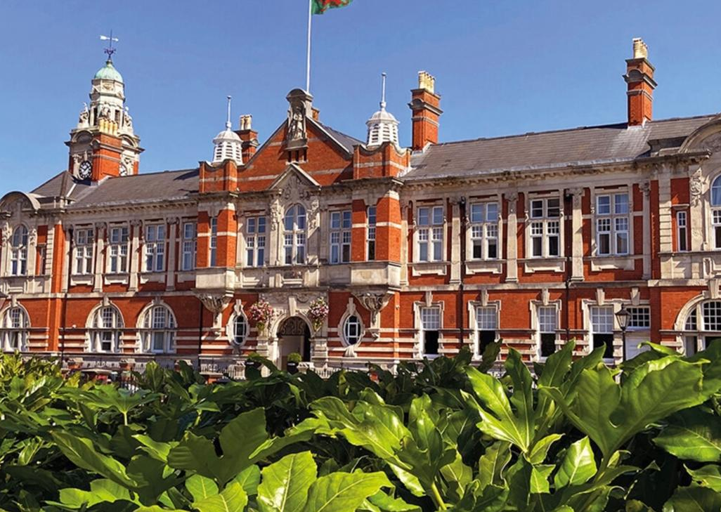
Hosting a Two-Day International Business Conference at the Morgan Hotel
Swansea
Adriana Ghiocel-Ioaniciu
Student number :21217376
Date : 02/12/2025

Slide 2

I confirm that I have not used any AI tools in the research and creation of this assignment. I confirm that I have not presented any AI generated materials as my own work. I confirm I have copies of my drafts, notes, and other resources I used, which I may be asked to provide in evidence.

Slide 3
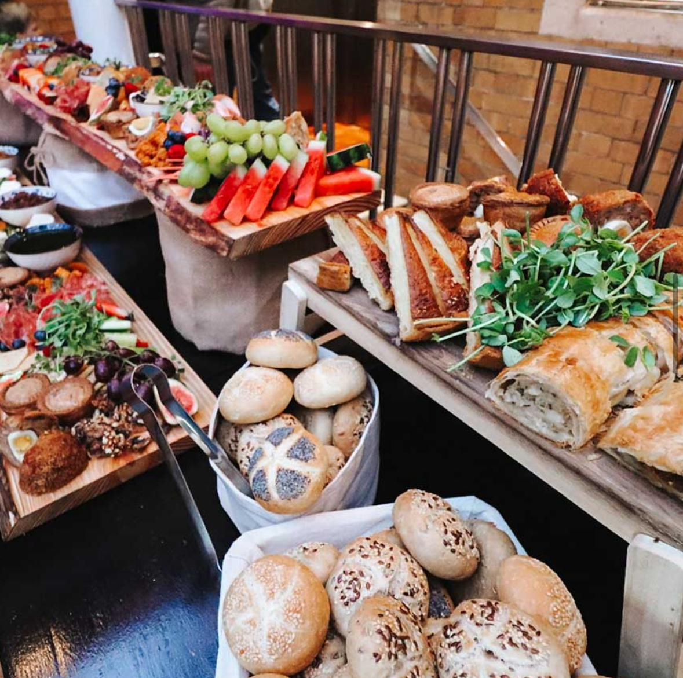
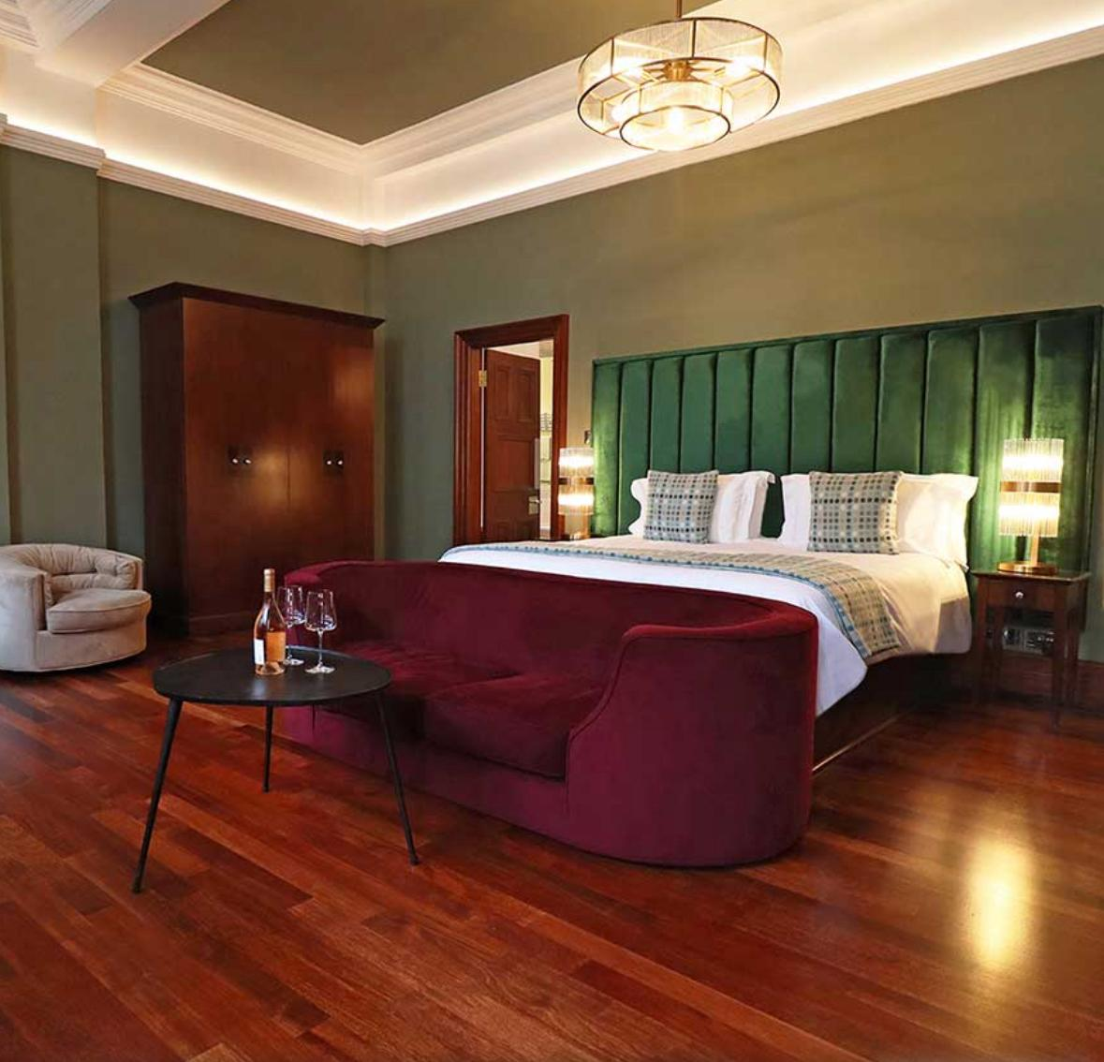
Event overview
-event theme: European Leadership and Innovation Summit 2025
- two-day event: -day 1: 10 am to 5 pm
-day 2:10 am to 2 pm
-25 international + UK business delegates
-accommodation -2 nights
-catering - lunch and refreshments/ delegates responsible for breakfast

Slide 4
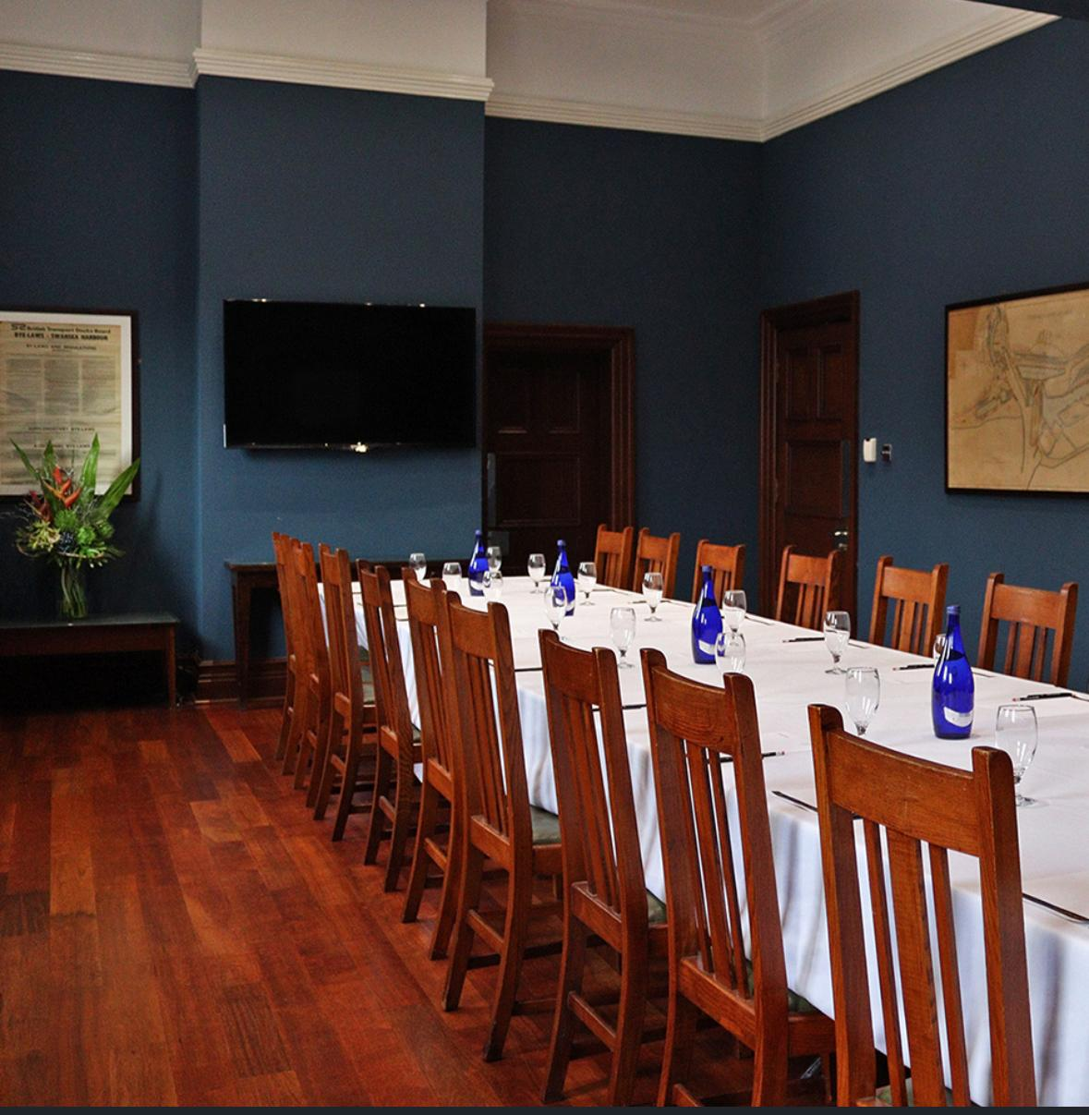
Morgans Hotel
-boutique 4-star hotel
-54 rooms:- 20 rooms in the main building
-22 rooms in the Townhouse
-12 rooms in a Georgian building
-strong reputation and repeat business
-event spaces: -Sir Galahad suite -40 people
-Banqueting Hall -100 people
-The Plimsoll Line -20 people
(Morgans Hotel,2022)
-business facilities: exclusive benefits (Morgans Hotel ,2024)

Slide 5

Market and demand analysis
-Swansea's growing business tourism sector
-central location
-offer a unique experience in Swansea
-2024 tourism generated £658M in economic impact (Council Swansea, 2025)
-international tourists spend 10 billions £ in the UK, supporting local economies and jobs (Edginton, Tracey 2023)

Slide 6

COMPETITOR ANALYSIS
MAIN COMPETITORS
1. The Grand Hotel Swansea
2. Village Hotel Swansea
3. Delta Hotels by Marriott Swansea
(Conferences-Uk,2025)
MORGAN vs COMPETITORS
-boutique and personalised service
-unique historic building
-central location

Slide 7
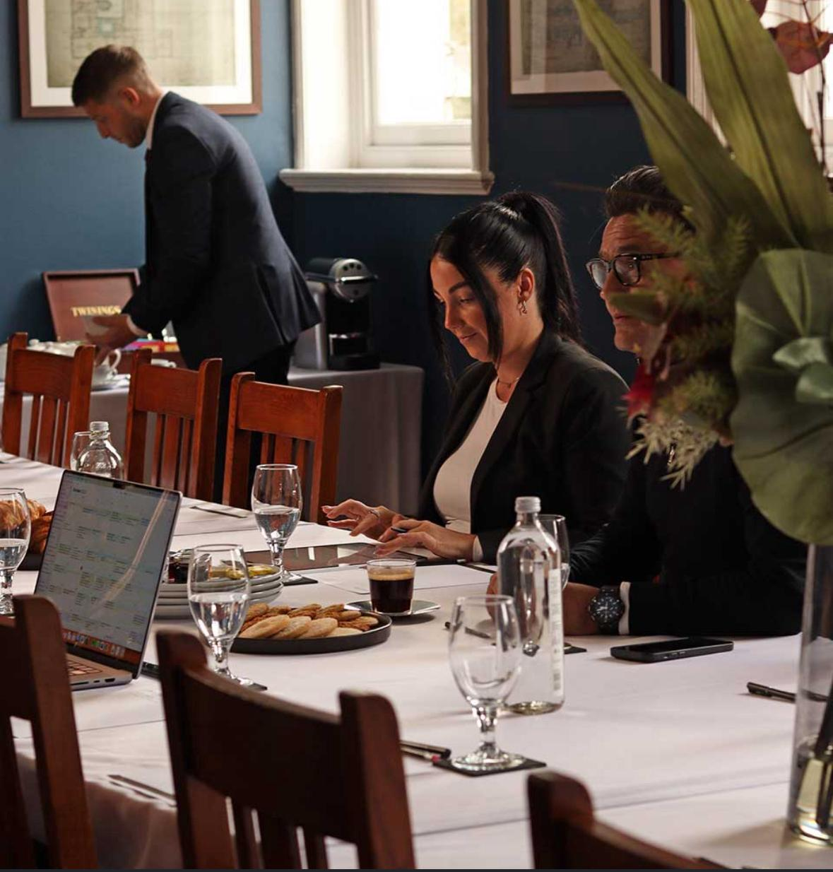
VENUE SUITABILITY
-best fit for 25 delegates
-includes screen and sound system
-AV/projector rent if needed
-bar on site for the breakout session

Slide 8

Financial feasibility
REVENUE SOURCE | Details/Calculations | Estimated Income £)
Accommodation | 25 x 2 x £115 | £5,750
Conference Room Hire | £600 x 2 | £1,200
Catering – Lunch & Refreshments | £20 x 25 x 2 | £1,000
F&B – Breakfast, Dinner | £10 x 25 x2 | £500
AV & Equipment Service Fee | 150 x2 | £300
Total Estimated Revenue |  | £8,750
ESTIMATED COSTS
Staffing | £200 x 3 x 2 | £1,200
Room Costs |  | 0
Catering Costs |  | £600
AV / Equipment Hire |  | 0
Marketing & Printing |  | £100
Utilities & Maintenance |  | £250
Décor & Setup |  | £150
Contingency (10%) 0,10x £2,300 |  | £230
Total Expenditure
PROFIT/(LOSS) |  | £6,220 / £2,530

Slide 9

Operational and risk consideration
OPERATIONAL NEEDS :
-early check-in for long-distance travellers
-late check-out
-room set up
-catering schedule
RISK MANAGEMENT
-health and safety compliance
-reputation risk/financial risk
-limited meeting rooms for a parallel session
-technical problems
SUSTAINABILITY
-use the water station
-waste reduction
-local suppliers for catering (Lara, A,2025 )
-use digital materials

Slide 10

Long-term strategic success
Strategic steps:
-offer a discount for repeat bookings
-create a customised annual summit packing
-collect delegate satisfaction data
-explore hybrid meeting capabilities

Slide 11

Conclusion and recommendation
Conclusion :
Event is operationally feasible
Event is financially profitable
- The Morgan hotel has the best match facilities
Strong potential for repeat annual business
RECOMANDATION
-allocate budget for AV/staff
-develop annual summit package
-increase room capacity

Slide 12


Slide 13

Council, S. (2025). Tourism research and statistics. [online] Swansea. Available at: https://www.swansea.gov.uk/tourismresearch [Accessed 10 Nov. 2025].
Edginton, T. (2023). VisitBritain publishes inbound tourism forecast for 2024. [online] VisitBritain.org. Available at: https://www.visitbritain.org/visitbritain-publishes-inbound-tourism-forecast-2024 [Accessed 9 Nov. 2025].
Morgans Hotel. (2022). History | Morgans Hotel. [online] Available at: https://www.morganshotel.co.uk/history/ [Accessed 9 Nov. 2025].
Morgans Hotel. (2024). The Business Club | Exclusive Corporate Discounts & Offers. [online] Available at: https://www.morganshotel.co.uk/business-club/ [Accessed 9 Nov. 2025].
Visitswanseabay.com. (2023). Morgans Hotel. [online] Available at: https://www.visitswanseabay.com/listing/morgans-hotel/48845101/ [Accessed 9 Nov. 2025].
Morgans Hotel. (2022). Private Parties And Celebrations | Morgans Hotel. [online] Available at: https://www.morganshotel.co.uk/private-functions/ [Accessed 25 Nov. 2025].
Morgans Hotel. (2024). The Business Club | Exclusive Corporate Discounts & Offers. [online] Available at: https://www.morganshotel.co.uk/business-club/ [Accessed 25 Nov. 2025].
Conferences-uk. (2025). Conference Venues & Meeting Rooms Swansea | Conferences UK. [online] Available at: https://www.conferences-uk.org.uk/swansea-conference-venues [Accessed 26 Nov. 2025].

