Slide 1
International Business Communications
Week one: Assessing international environments

Slide 2

Chapter 1: Assessing the Environment
Political, Economic, Legal, Technological
Deresky_chapter1
Ninth Edition
Global Edition

Slide 3

Learning outcomes
Understand the global business environment and how it affects the strategic and operational decisions which managers must make
To develop an appreciation for the ways in which political and economic factors and changes influence the opportunities that companies face
To develop an appreciation of the legal environment for international business
To review the technological environment around the world and how it affects the international manager’s decisions and operations

Slide 4

Opening Profile: Assessing Risks in Russia
Top two risks:
  Sanctions-based retaliatory measures
  Decline in business activity
Other issues: threat of backlash in Russia against Western products;
Globalization has compounded the types and level of business risks.
Changes in legal/political/economic..etc (due to the current global tensions faced between Russia and other countries, including the EU)

Slide 5

Opening Profile: Challenges Managers Face
Politics
Cultural differences
Global competition
Terrorism
Technology
Sustainability
Social obligations

Slide 6
What is International Management?
The process of developing strategies, designing and operating systems, and working with people around the world to ensure sustained competitive advantage.

Slide 7
What is Globalization?
Global competition characterized by networks of international linkages that bind countries, institutions, and people in an interdependent global
economy.
Notes:
Globalization has also been described as the emergence of a level playing field due to decreasing differences in regional output growth rates, increased economic activity, and other non-economic factors.
Examples of international linkages:
Only 65% of the Ford Mustang’s content comes from the US or Canada
90% of the Toyota Sienna is made with US components, and it is assembled in Indiana
Example of the level playing field:
China’s recent growth (9.9% in 2005)

Slide 8
Global Trends
Five key global trends:
  Changing balance of growth towards emerging markets
  Need for increased productivity and consumption in developed countries
  Increasing global interconnectivity
  Increasing gap between supply and demand of natural resources
  Challenge for governments to develop policies for economic growth and financial stability

Slide 9
Covid19 and its impact.
Summary of the impact on the UK during 2019 – 2020 based on the ONS Office for National statistics)
Link: https://www.ons.gov.uk/businessindustryandtrade/internationaltrade/articles/internationaltradeinuknationsandregionstheimpactofcoronaviruscovid19/2020#:~:text=1.-,Main%20points,services%20from%202019%20to%202020.

Slide 10
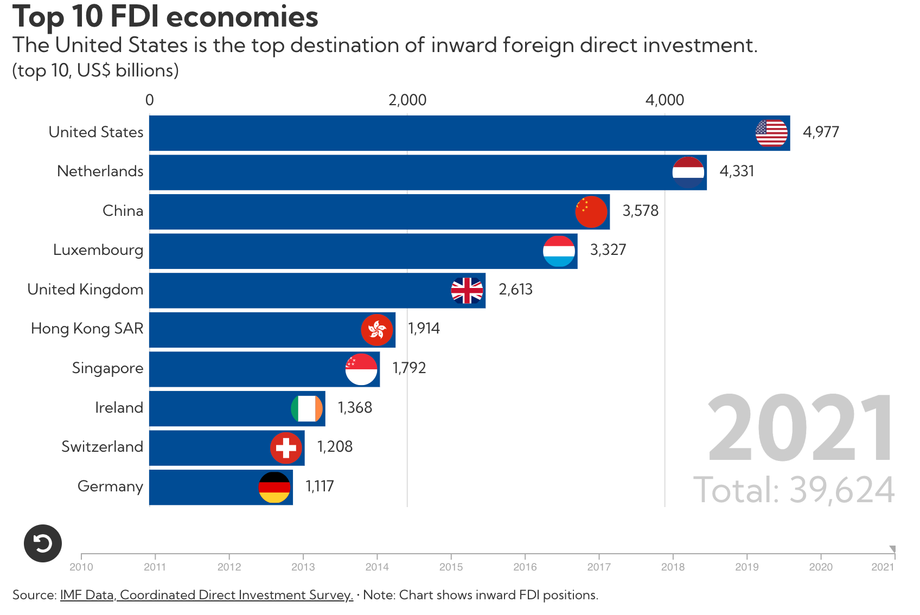

Slide 11
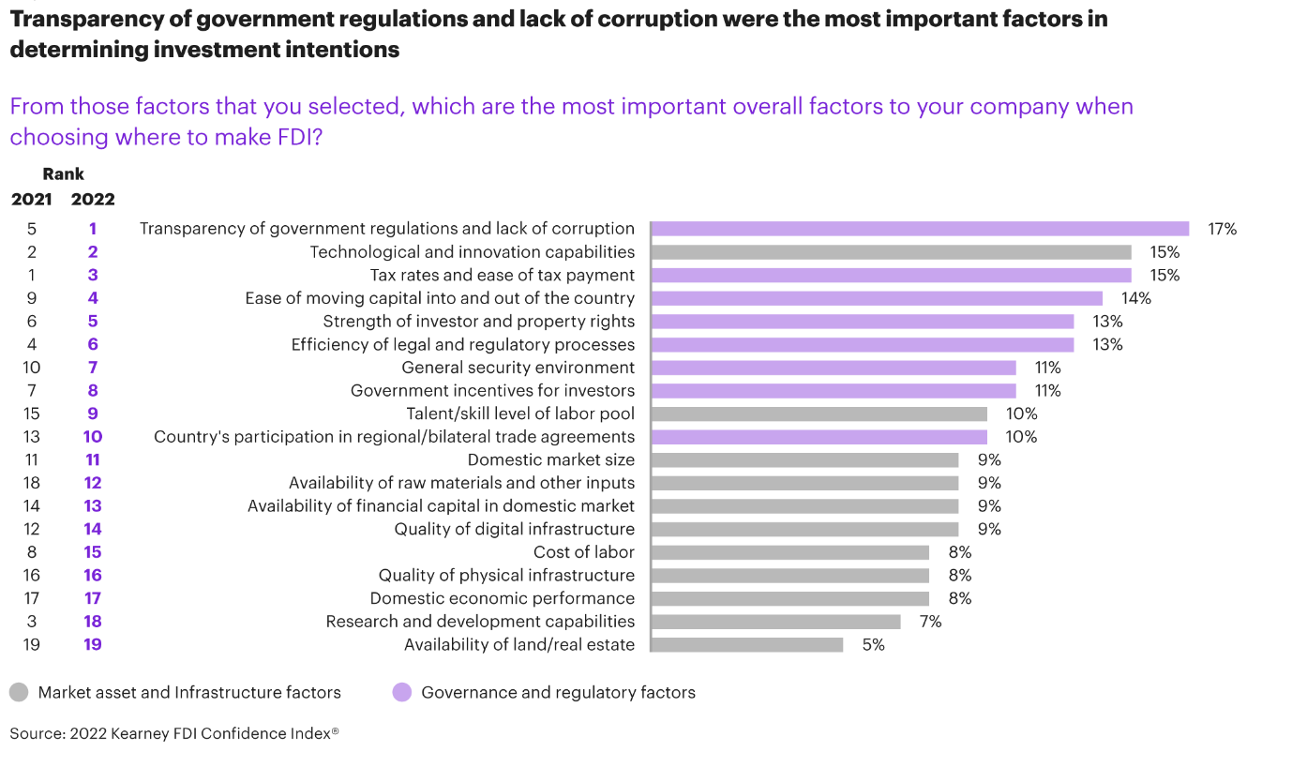

Slide 12
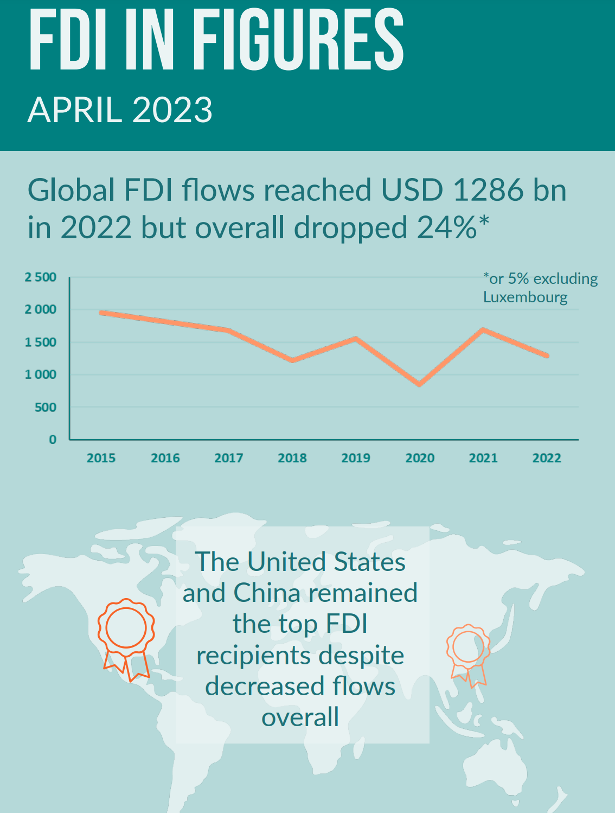
Notes:
Full report can be found here:: https://www.oecd.org/investment/statistics.htm#:~:text=28%2F04%2F2023%20-%20Global,billion)%2C%20despite%20lower%20flows.

Slide 13
Challenges to Globalism
Backlash against capitalism and rekindling of nationalism
Increased protectionism of high-demand resources
Need to develop top managers with international understanding and experience
Increasing pressure and publicity for companies to consider the social responsibility of their actions
Notes:
The backlash against globalization comes from those who feel that it benefits advanced industrial nations at the expense of many other countries and the people within them who are not sharing in those benefits.

Slide 14
Effects of Globalization on Corporations
Global companies are becoming less tied to specific locations
Companies that desire to remain competitive will have to develop a cadre of experienced international managers
Small companies are also affected by and in turn affect globalism
Notes:
Greater international investment by global companies means greater transfer of financial, technological, and managerial resources around the world. In turn, the latter leads to the growth of developing economies, which opens up potential markets and locations for operations for global companies. As they are no longer tied to specific locations and can locate their activities in the most suitable areas, the companies have opportunities for flexibility and efficiency.
SMEs (which are companies with fewer than 500 employees) also benefit. In particular, technological developments (e.g., the Internet) make international trade and activities easier for smaller companies.

Slide 15

The Globalization of Human Capital
While firms still offshore manufacturing jobs, some are reshoring jobs to lower shipping costs
Firms are outsourcing white-collar jobs to India
For global firms, winning the war for talent is a pressing issue

Slide 16
Globalization of Information Technology
The speed and accuracy of information transmission are changing the nature of international manager’s jobs
Cultural barriers are being lowered gradually
Technology gets dispersed around the world by MNEs
Explosive growth of information technology is both a cause and effect of globalism

Slide 17

Management In Action:
Global Cybertheft of Corporate Secrets
Cybertheft: hard to detect and combat
In 2014, the U.S. Department of Justice charged Chinese military personnel of stealing trade secrets
Digital reprisal: China targeted firms which contested its policies at the World Trade Organization
Protection of intellectual property is the primary risk in China
China’s goal is to achieve technological superiority by importing and adapting technologies

Slide 18
Regional Trading Blocs
Much of today’s world trade is grouped around three dominant currencies:
  Euro, yen, and the dollar
These trade blocs are continually expanding their borders to include neighboring countries
Much of today’s world trade takes place within these three regional free-trade blocs:
  Western Europe, Asia, and the Americas
Notes:
The three regional free-trade blocs are known as “The Triad,” and they are grouped around three main currencies: the Euro, the Yen, and the Dollar.

Slide 19

The European Union
“EU”
A unified market over 500 million people in 28 nations (However, consider Brexit and its implications)
Stability of the euro and the debt crisis in question
Challenges for global managers:
“Fortress Europe”
Multiple cultures in one market
Notes:
The EU internal market is characterized by free movement of goods and people among EU countries and the elimination of internal tariffs and customs, financial and commercial barriers.
The EU gives preference to insiders, creating challenges for firms outside of the EU who wish to do business there.
Despite the unification associated with the EU, Europeans still identify with their national cultures, and businesses operating across the EU must take national culture into consideration.

Slide 20
Asia
China
India
ASEAN
South Asia Association of Regional Cooperation (SAARC)
Japan
Asian Tigers:
    Hong Kong
    Singapore
    South Korea
    Taiwan
Notes:
Japan and the Four Tigers (Singapore, Hong Kong, Taiwan, and South Korea) have abundant natural resources and labor. They have provided most of the capital and expertise for Asia’s developing countries. Japan is the world’s second largest economy.
China, which recently joined the World Trade Organization, is Japan’s biggest trading partner and has the fastest growth rate in the world. It is negotiating with ASEAN (the Association of Southeast Asian Nations, which is also negotiating to create the ASEAN Free Trade Area [AFTA]). China offers a large population of low-wage workers and a large consumer market, which has helped it attract manufacturing companies from around the world. China is known as the world’s factory.
India is the fastest growing free-market democracy, and it is known as the world’s services supplier. It is the world’s leader in outsourced back-office and high-tech services.
The South Asia Association of Regional Cooperation (SAARC) is a free trade agreement between seven South Asian nations that will lower tariffs to 25% within three to five years and eliminate them within seven years. Member countries comprise 1.5 billion people, with an estimated one-third of them living in poverty.

Slide 21

The Americas
North American Free Trade Agreement (NAFTA)
Brazil
MERCOSUR
Central America Free Trade Agreement (CAFTA)
Notes:
NAFTA is a free trading bloc between the US, Mexico, and Canada comprised of 470 million consumers. The goal of NAFTA is to increase exports and trade among members. Although NAFTA was controversial, many positive changes have occurred in Mexico since its ratification. Mexico’s trade with the US and Canada has tripled, and it has signed trade agreements with 43 nations. Today, Mexico is experiencing competition from China for offshore jobs.
DR-CAFTA, which is modeled after NAFTA, liberalizes trade between the US and five Central American countries. It is a stepping stone to the FTAA, which would encompass 34 economies.

Slide 22
Other Regions in the World
The Russian Federation
Middle East
The African Union—AU
South Africa
Less developed countries—LDCs
    Low Gross National Product (GNP)
    Low Gross Domestic Product (GDP)
    Large, relatively unskilled workforce
    High international debt
Notes:
The Russian Federation is characterized by economic growth, a large supply of natural resources, and a large, well-educated population—but it also is affected by corruption and government interference. For example, business “oligarchs” are a small group of businesspeople with political influence who capitalize on the privatization of Russia’s economy and who limit competitive opportunities for small businesses. Despite the increasing strength of Russia’s economy, foreign investors remain somewhat wary of corruption and interference.
Many countries in Central and South America, the Middle East, and Africa are considered LDCs. Though such countries often hope to attract foreign investment, their economic situation and often high levels of government intervention discourages the foreign investment they need to stimulate their economies. Despite these political risks, LDCs can offer considerable opportunities for international businesses.

Slide 23
Comparative Management in Focus:
China Loses Its Allure
Until 2010, China grew at 10 percent for 30 years, declining to 7.3 percent in 2014
Growth of 7 percent for 2015 was called “a new normal” by Premier Li Keqiang
However, due to covid19 and other political factors:
China Q4 GDP growth slows; 2022 growth one of worst on record
2022 GDP grows 3.0%, far below official target
Dec factory output, retail sales weak but beat expectations
Population shrinks for the first time since 1961

Slide 24
Comparative Management in Focus:
China Loses Its Allure
However:
China’s legal and regulatory system is arbitrary
China leans toward protecting its local firms
Political goals and agendas often take precedence over commercially based decisions
Discrepancies of business practices make it difficult for SMEs to get started

Slide 25
Management Focus:
Tips for doing business in China
Connections are important
Negotiations will be different from the U.S. and difficult
Communication must be clear, honest, and fully prepared for
Culture matters

Slide 26
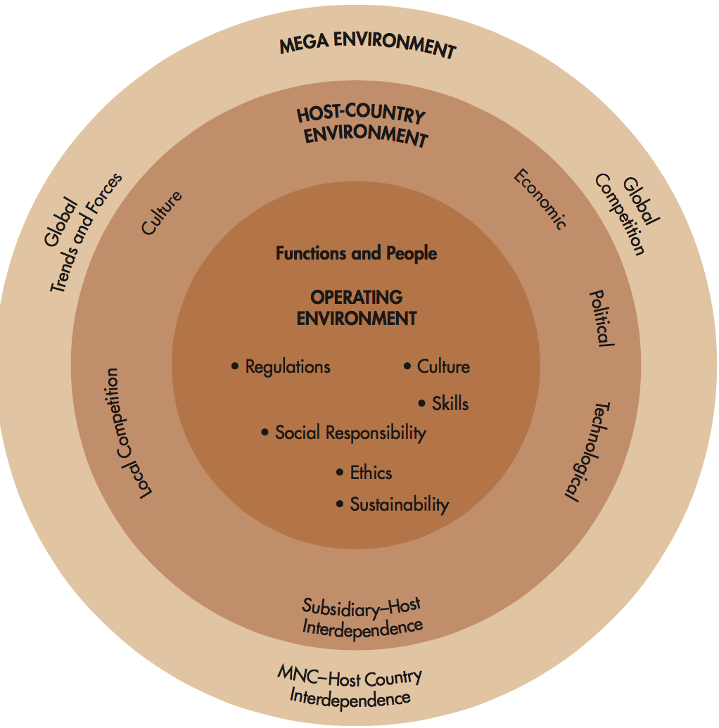
The Global Manager’s Role

Slide 27
The Political and Economic Environment
Sustainability—economic, political, social, and environmental—has become a significant worldwide issue
Ethnicity—a driving force behind political instability around the world
Religion—religious disputes lie at the heart of regional instabilities, for example, former Yugoslavia, Northern Island, the Middle East…

Slide 28
Political Risk
Examples:
Any governmental action or politically motivated event that could adversely affect the long-term profitability or value of a firm
Argentina announced plans to nationalize Repsol YPF, the Spanish oil co., taking 51%
In Russia, the Kremlin exploited the financial crisis to take control of energy companies

Slide 29

The Political Risk Cont.
Typical Political Risks
Political Risk Assessment
Expropriation and confiscation
Nationalization
Terrorism
Discriminatory treatment
Barriers to repatriation of funds
Interference in managerial decision making
Dishonesty by government officials
Helps companies manage exposure to risk and minimize financial loss
Two forms:
  Consultation with experts
  Development of internal staff capabilities – increasingly common
Notes:
Expropriation occurs when a local government seizes and provides inadequate compensation for the foreign-owned assets of a firm. When no compensation is provided, it is confiscation.
Nationalization is the forced sale of equity to host-country nations, often at or below value.
These risk events can be macro or micro. Macropolitical risk events affect all foreign firms doing business in a country or region. An example is Iraq’s invasion of Kuwait in 1990, which halted all international business with and within both of these countries. Micropolitical risk affects one industry or company or only a few companies. These types of political risk events have become more common than macropolitical risk events. An example of micropolitical risk is “creeping expropriation”—a government’s gradual and subtle action against foreign firms.
The goal of risk assessment is to monitor political issues before they become problems, evaluate their potential impact on the company, and make suggestions for dealing with them.
The experts consulted may include consultants, advisers, and committees. Internal staff capabilities can be developed by assigning staff to foreign subsidiaries, using affiliates to monitor local political activities, and/or hiring staff with expertise in critical regions.

Slide 30

Managing Political Risk
Avoidance and Adaptation
Dependency and Hedging
Equity sharing
Participating management
Localization of the operation
Development assistance
Input control
Technology control
Expatriate position control
Distribution control
Political risk insurance (OPIC and FCIA)
Local debt financing
Notes:
American Can uses the Primary Risk Investment Screening Matrix (PRISM), which synthesizes information from managers and consultants on 200 variables into an index of economic desirability and of political and economic stability. Those countries with the most favorable PRISM ratings are considered for investment.
Ranking entails quantifying variables into ranking systems for countries. Staff or outside consultants consider factors such as the political and economic environment, domestic economic conditions, and external economic relations. One drawback of such systems is that they rely primarily on information from past events.
Early warning systems use lead indicators to predict possible political dangers, such as signs of violence or riots, developing pressure on the MNC to hire more local workers, or pending import-export restrictions.
Avoidance refers to avoiding investment or withdrawing investment from a risky location.
Adaptation is accommodating the risk. Use adaptation when the risk in a given country is relatively low or when a high-risk environment is worth the potential returns. There are four primary forms of adaptation. Equity sharing is sharing equity with a local partner, such as through a joint venture. Participative management means actively involving nationals. Localization is transforming the subsidiary into a national firm. Development assistance refers to involvement in host country infrastructure development.
Dependency is keeping the subsidiary and host nation dependent on the parent firm. There are four approaches to dependency. Input control involves keeping control of raw materials, technology, and know how. Market control is keeping control of the means of distribution. Position control is keeping control of key management positions. Staged contribution involves successively increasing contributions to the host nation.
Hedging is minimizing losses, such as through the use of political risk insurance and/or local debt financing. Local debt financing is borrowing money from the host nation.

Slide 31

Managing Terrorism Risk
Develop a benevolent image (IBM and Exxon)
Maintain a low profile and minimize publicity
Using teams to monitor terrorist activities
Hiring counterterrorism consultants
Notes:
IBM and Exxon try to develop benevolent images and maintain low profiles in high-risk countries.
Some companies have teams for monitoring terrorist activities, such as kidnappings, hijackings, and blackmail.
Many MNCs hire counterterrorism consultants to train employees in coping with the threat of terrorism.

Slide 32
Economic Risk
Closely related to political risk
Determined by a country’s ability or intention to meet its financial obligations
Historically, most industrialized nations have posed little risk of economic instability
However the level of economic risk in Europe is of concern in the eurozone due to debt problems in Greece previously. EU and UK relationship as one of the main challenges facing the EU. However, it is not the only one.

Slide 33
Categories of Economic Risk
Loss of profitability due to abrupt changes in monetary and fiscal policies
Loss of profitability due to changes in foreign investment policies
Risk of currency exchange rate volatility
results in currency translation exposure
Notes:
Examples of loss of profitability due to changes in foreign investment policies include inability to repatriate earnings, interest rate volatility, and currency translation exposure.
Currency translation exposure occurs when the value of one country’s currency changes relative to that of another. When the balance sheet of the entire corporation is consolidated, currency translation exposure may cause a negative cash flow from the foreign subsidiary.
In 2015, for example, the U.S. dollar was so strong against other denominations that developing countries, in particular, were negatively affected because it cost them more to import from the United States, and their exports would bring less revenue. When exchange-rate changes are radical, repercussions are felt around the world.

Slide 34
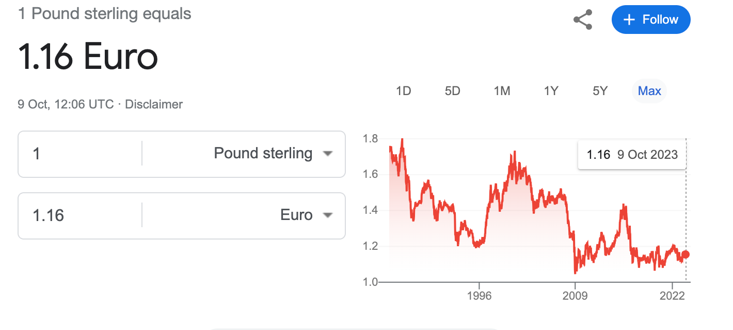
currency exchange rate volatility

Slide 35
The Legal Environment
Consists of the local laws and legal systems of those countries in which an international company operates, and of international law, which governs relationships between sovereign countries
Notes:
An example of a relevant international laws is the United Nations Convention on Contracts for the International Sale of Goods (CISG). The CISG spells out the rights and obligations of buyers and sellers when goods are sold between countries adopting the convention.

Slide 36


The Legal Environment
Types of Legal Systems
Approaches to Contract Law
Common law
Civil law
Islamic law
Common law: details must be written in the contract to be enforced
Civil law: assumes promises will be enforced without specifying the details
In Asia the contract may be in the relationship, not on the paper
Notes:
Common law uses past court decisions as precedents. It is used in the US and 26 other countries of English origin or influence.
Civil law represents a comprehensive set of laws organized into code. It is used in about 70 countries, including Japan and many in Europe.
Islamic law is based on religious beliefs and combines common, civil, and indigenous laws to varying degrees.
Islamic law is used in Islamic countries, such as Saudi Arabia.
A contract is an agreement to establish the rules to govern a business transaction.
Contract law plays a major role in international business transactions because of the complexities arising from different legal systems and because the host government in developing and communist countries often is a third party in the contract.

Slide 37

Other Regulatory Issues
Protectionist policies, such as tariffs or quotas and other import and trade restrictions
The attractiveness of the tax system
The level of government involvement in the economic and regulatory environment
Notes:
Protectionist policies give preference to a country’s own products and industries. Japan is often criticized for its policies that limit imports of foreign goods.
Foreign tax credits, holidays, exemptions, depreciation allowances, and taxation of corporate profits affect the relative level of profitability for a MNC in a given location.
Canada provides a good example of government involvement in the economic and regulatory environment. The Canadian government has wholly and partly owned enterprises in many industries (e.g., transportation, petrochemicals, fishing, steel, textiles, building materials). The government’s role, therefore, is one of both control and competition. There is a high number of unionized workers in Canada (30%). In Quebec official bilingualism requires managers to be fluent in French and English.

Slide 38
The Technological Environment
The appropriability of technology
The International Convention for the Protection of Industrial Property (the Paris Union)
Inappropriate use of technology by JVs, franchisees, licensees, and employees
Appropriateness of technology for the local environment
Notes:
Appropriability of technology refers to the ability of the innovating firm to profit from its own technology by protecting it from competitors. Common methods of protection include patents, trademarks, trade names, copyrights, and trade secrets.
In developing countries, firms generally face few restrictions on the creation and dissemination of technology. In developing countries, however, restrictions on licensing agreements, royalties, and patent protection often exist. For example, Egypt will only patent production processes, and it will do so only for 15 years. LDCs often use their investment laws to acquire needed technology, increase exports, and train local people.
The Paris Union protects patents, but only in 80 signatory countries.
MNCs also may be exposed to risk from the inappropriate use of technology by joint venture partners, licensees, and employees.
The introduction of technology may have cultural consequences, especially in LDCs. The choice of technology may be capital-intensive, labor-intensive, or intermediate, but it should suit the level of development in the area and the needs and expectations of the people who will use it. Sometimes, the local government regulates the choice of technology to suit their own needs.

Slide 39
Under the Lens: The Global Role of Information Technology
Making Geographic barriers less relevant
Both cause and effect of globalization
Lowering cultural barriers
Encouraging convergence of consumers’ tastes and preferences
However, China still monitors and limits electronic information flows
Notes:
The growth of information technology is a cause and effect of globalism.
Though technology makes more information freely available to managers, consumers, and other decision-makers, some information is subject to export controls by the EU.

Slide 40
Global E-Business
E-Business—the integration of systems, processes, organizations, value chains, and entire markets using Internet-based and related technologies and concepts
E-Commerce—marketing and sales process via the internet
B2B—Business to Business (Example: Alibaba in China, large proportion is SMEs)
B2C—Business to Customer (Example: Amazon.com)
Notes:
E-business refers to the integration of systems, processes, organizations, value chains, and entire markets using internet-based and related technologies and concepts.
E-commerce refers to the marketing and sales process via the internet.

Slide 41
References
Chapter 1:
Deresky, H. (2017). International management. Harlow, Essex: Pearson.

