Slide 1
Week 3: Power and control

Slide 2
InfoSkills Moodle page
Go through what’s new on Moodle page
Assignment support

Slide 3
Learning objectives
.
Define and critically discuss concepts of power and control.
Apply Foucault’s theory and others of power to contemporary social structures.
Explore the impact of power and control on the lives of people in society

Slide 4
Assignment 2:
Critically consider the role played by power and control in the (re)production of inequality for a group of your choosing

Slide 5
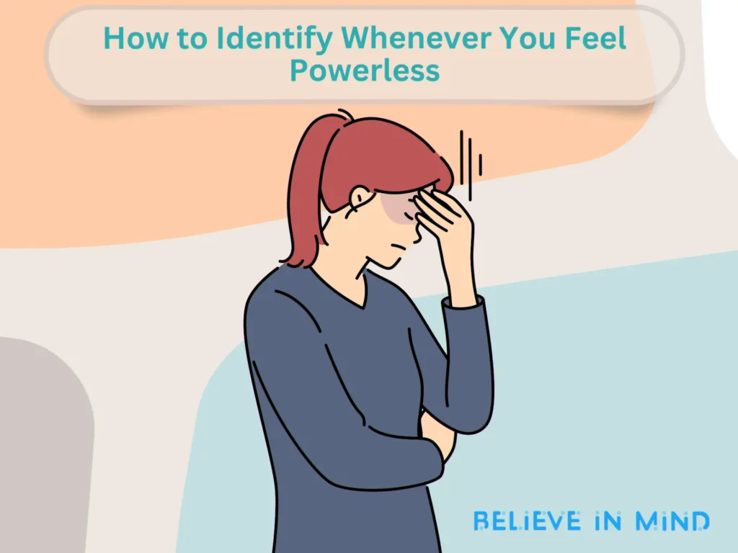
Think of a time when you felt powerless or controlled in a social setting. What structures or norms contributed to that feeling?
Notes:
Prompt:
"Think of a time when you felt powerless or controlled in a social setting. What structures or norms contributed to that feeling?"
Students write a short reflection.
Pair-share or small group discussion.
Link to Foucault’s idea of power being embedded in everyday practices.

Slide 6
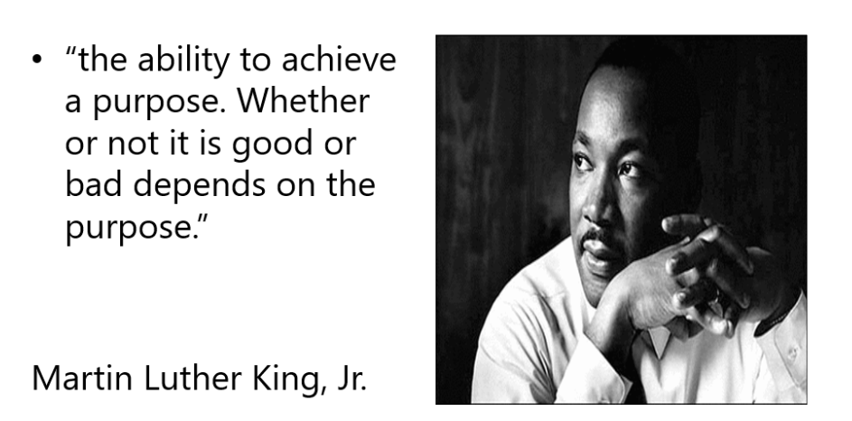
Pŵer/ Power

Slide 7
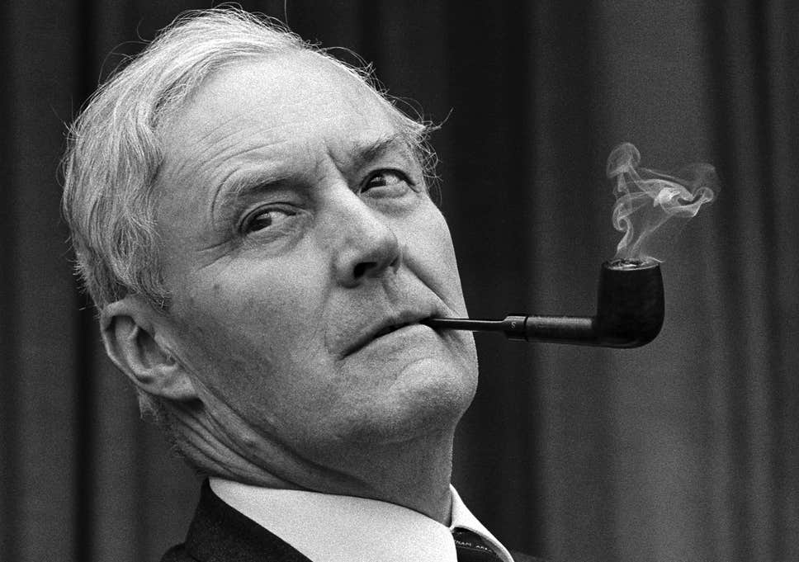
Power
Who has it?
Where did they get it from?
In whose interest do they exercise it?
How can we get it from ‘them’
Notes:
Tony Benn

Slide 8
Rhai Meddyliau ar Bŵer
Some Thoughts On Power
Cymerwch eiliad i ystyried y datganiadau ar y tair sleid nesaf.
Beth maent yn dweud?
Ydych chi’n cytuno neu’n anghytuno, a pham?
Take a moment to consider the statements on the next three slides
What are they saying?
Do you agree or disagree and why?

Slide 9
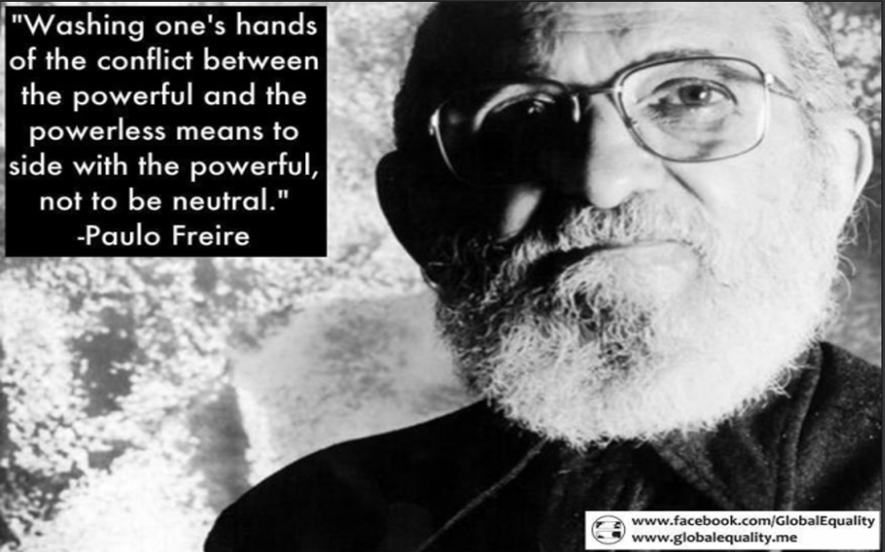

Slide 10
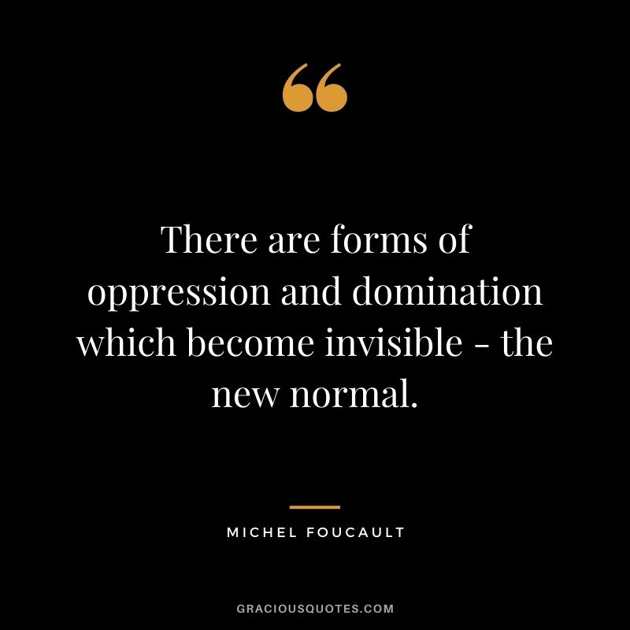

Slide 11
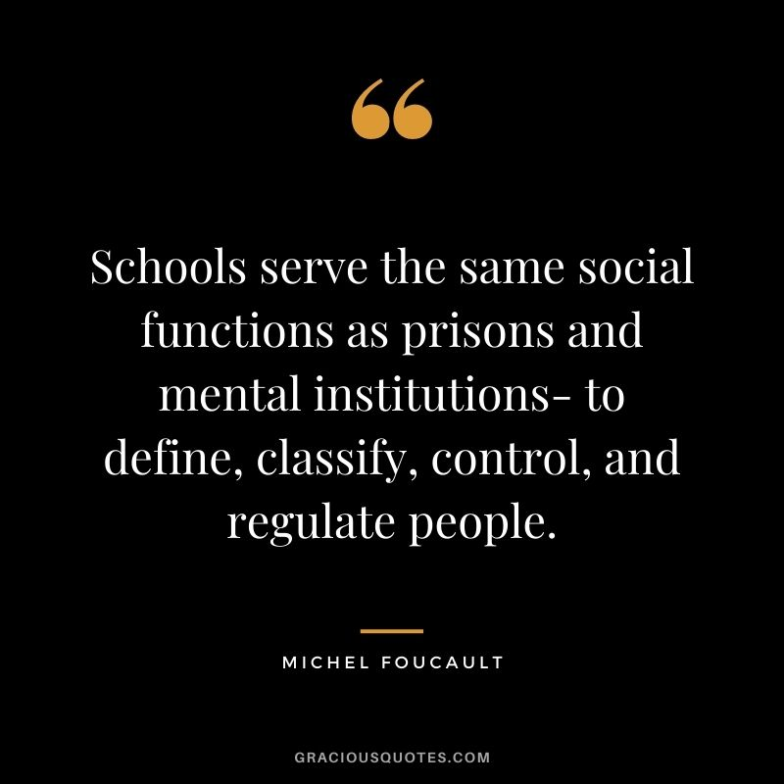
(Foucault, 1977))

Slide 12
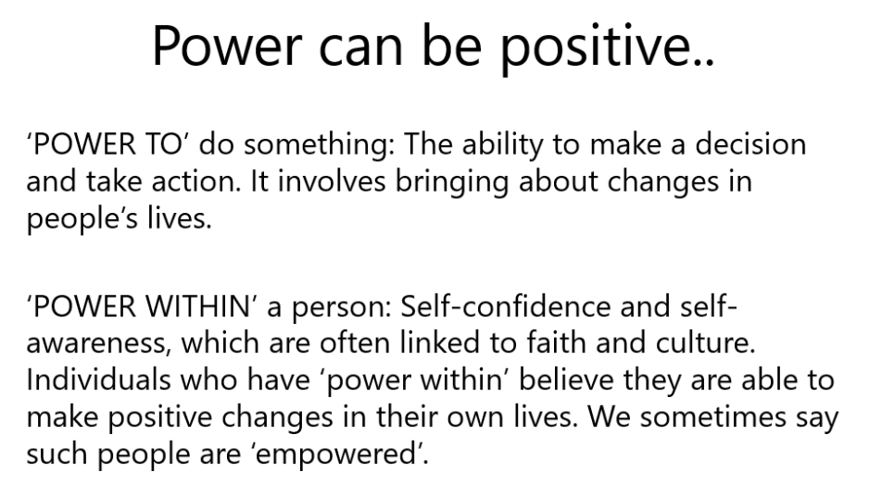

Slide 13
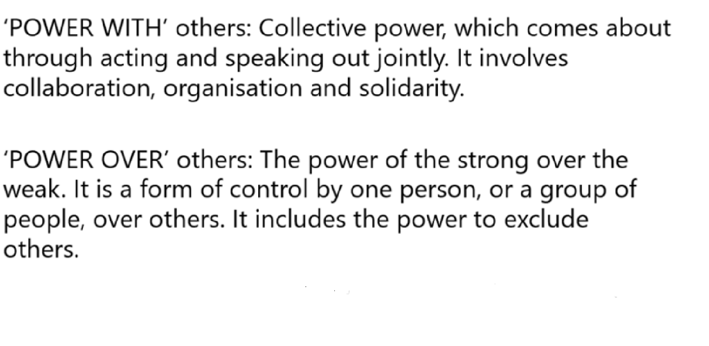
VeneKlassen and Miller, 2002, cited in Miller et al., 2006 p.7-9)

Slide 14
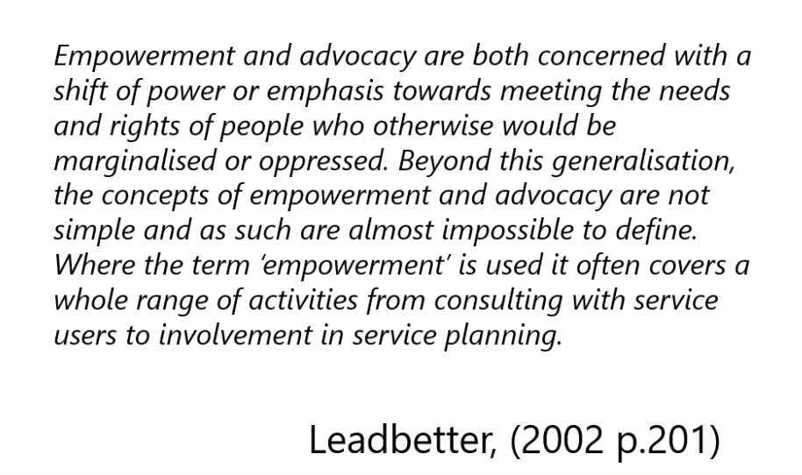

Slide 15
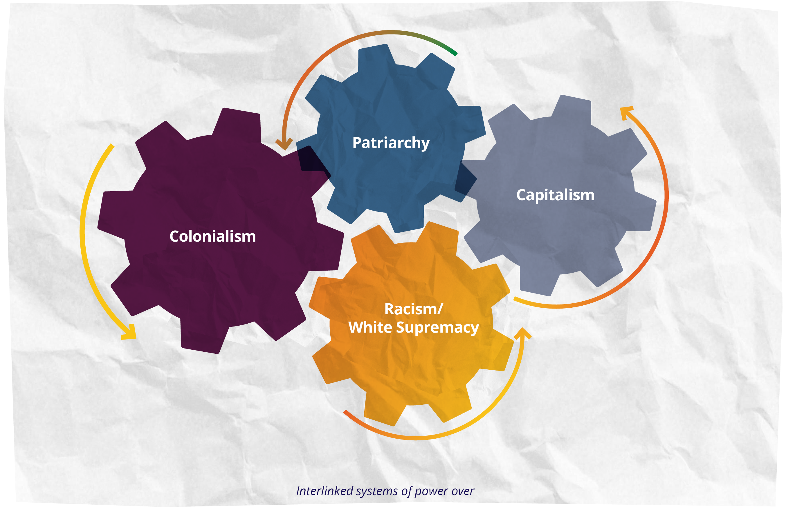
Notes:
JASS (2025) See link on Moodle

Slide 16
Social control
‘social control’ served as a central concept both for relating sociology to social philosophy and for analysing total societies
In its classical sense:
• The capacity of a social group to regulate itself
• While the traditional usage of social control has persisted, the term has been redefined to mean either socialisation or social repression

Slide 17

How does social control happen in society?
Notes:
Forms of Social Control
Informal Control: Social norms, peer pressure.
Legal Control: Laws and regulations.
Medical Control: Using medical frameworks to define and manage deviance.
Surveillance and Technology
Example: Use of facial recognition in public spaces and schools.
Discussion Angle: Foucault’s panopticon and digital surveillance.
2. Education Systems
Example: Behaviour management policies, uniform codes, and streaming by ability.
Discussion Angle: How schools regulate behaviour and aspirations.
3. Social Media Algorithms
Example: Content moderation and echo chambers.
Discussion Angle: Control of discourse and shaping public opinion.
4. Policing and Criminal Justice
Example: Stop and search practices disproportionately affecting minority groups.
Discussion Angle: Repression vs regulation—who is being controlled and why?
5. Welfare and Benefits Systems
Example: Conditionality in Universal Credit (e.g., mandatory job-seeking activities).
Discussion Angle: Control through economic dependency and bureaucratic oversight.

Slide 18
Types of control
Direct: Can you think of a time when someone changed their behaviour because they feared punishment?
Direct (sanctions),
Internal (socialisation),
Indirect (relationships)
(Nye, 1958)
Internal: What values have you internalised that influence your decisions, even when no one is watching?
Indirect: How do your relationships influence the choices you make?
Key theorists: Nye, Hirschi, Katovich, Beniger, Gibbs
Concepts: Cooperative vs coercive control, norms, sanctions, and societal regulation
Notes:
1. Ivan Nye (1958) – Control Theory
Nye was one of the early sociologists to formalise control theory in criminology and sociology.
Key Ideas:
Three types of social control:
Direct control: External punishments or sanctions (e.g. legal penalties, parental discipline).
Indirect control: Emotional attachments to others (e.g. not wanting to disappoint parents).
Internal control: Internalised norms and values that guide behaviour.
Impact:
Nye’s framework helped explain why individuals conform to societal norms even when external enforcement is absent. His work laid the foundation for later theories like Hirschi’s social bond theory.
1. Direct Control (Sanctions)
Definition: External pressures or punishments used to prevent deviant behaviour.
Examples:
Legal system: A person caught shoplifting is fined or imprisoned.
School discipline: A student is suspended for bullying.
Workplace rules: An employee is fired for repeated lateness.
Community norms: A neighbour is publicly shamed for vandalism.
Internal Control (Socialisation)
Definition: Individuals internalise norms, values, and beliefs that guide their behaviour.
Examples:
Religious upbringing: A person avoids lying because they believe it is morally wrong.
Cultural norms: Someone dresses modestly because they were raised to value humility.
Education: A child learns to respect authority through school routines and expectations.
Personal ethics: An individual refuses to cheat on a test because they feel it’s dishonest.
3. Indirect Control (Relationships)
Definition: Emotional bonds with others discourage deviance due to fear of disappointing them.
Examples:
Family ties: A teenager avoids drugs because they don’t want to let their parents down.
Friendship loyalty: A person refuses to gossip to protect a friend’s reputation.
Mentorship: A student works hard to impress a respected teacher.
Romantic relationships: Someone avoids risky behaviour to maintain trust with a partner.
Travis Hirschi – Social Bond Theory (1969)
Hirschi’s theory is a cornerstone of modern criminology and sociology. He argued that deviance occurs when an individual’s bond to society is weak or broken.
Key Components of the Social Bond:
Attachment
Emotional and social ties to others, especially parents, teachers, and peers.
Strong attachment discourages deviance.
Commitment
Investment in conventional activities like education, career, or family.
The more someone has to lose, the less likely they are to risk deviant behaviour.
Involvement
Participation in socially approved activities (e.g. sports, clubs, work).
Keeps individuals too busy to engage in deviance.
Belief
Acceptance of societal norms and laws.
If people believe rules are legitimate, they are more likely to follow them.

Slide 19

Sanctions could be:
Natural sanctions
• Social sanctions
• Legal sanctions
• Supernatural sanctions
(Hirschi and Gottfredson, 2005: 215-217)
Notes:
Types of Sanctions in Social Control
1. Natural Sanctions
Definition:
Consequences that arise directly from the physical environment or nature, without human intervention.
Examples:
Touching a hot stove results in a burn.
Walking barefoot in snow leads to frostbite.
Eating spoiled food causes illness.
Purpose in Social Control:
Natural sanctions teach individuals about boundaries and risks through direct experience. They are immediate and often painful, reinforcing caution and self-regulation.
2. Social Sanctions
Definition:
Reactions from other people or groups that encourage conformity or punish deviance.
Examples:
A friend stops talking to you after a betrayal.
Being excluded from a peer group for breaking norms.
Receiving praise for helping others.
Purpose in Social Control:
Social sanctions rely on relationships and emotional bonds. They are powerful because people care about acceptance, reputation, and belonging.
3. Legal Sanctions
Definition:
Formal penalties imposed by the state or legal institutions for violating laws.
Examples:
Fines for speeding.
Imprisonment for theft.
Community service for minor offences.
Purpose in Social Control:
Legal sanctions are codified and enforced by official agents (police, courts). They represent society’s formal response to deviance and aim to deter future violations.
4. Supernatural Sanctions
Definition:
Beliefs in divine or spiritual consequences for behaviour, often tied to religious or cultural systems.
Examples:
Fear of going to hell for committing a sin.
Belief in karma or divine punishment.
Rituals to appease spirits after wrongdoing.
Purpose in Social Control:
Supernatural sanctions shape behaviour through moral and spiritual beliefs. They are especially influential in societies or communities with strong religious traditions.

Slide 20
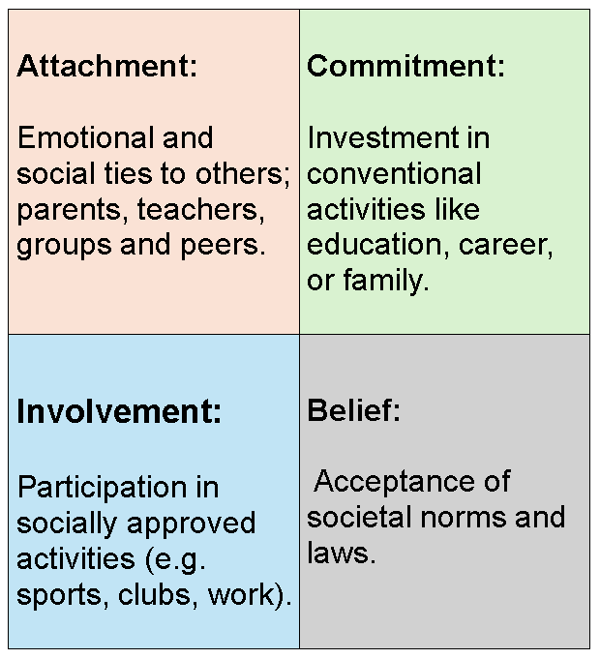
Hirschi (1969)
Deviance occurs when an individual’s bond to society is weak or broken.
Notes:
Emphasis on bonds rather than structural issues
Informal norms:
What Are Informal Norms?
Examples:
Saying “please” and “thank you”
Not talking loudly in a library
Dressing appropriately for different occasions
Respecting personal space
Function:
Informal norms help maintain social order by shaping behaviour in subtle ways. They are enforced through social sanctions like disapproval, gossip, or exclusion.

Slide 21
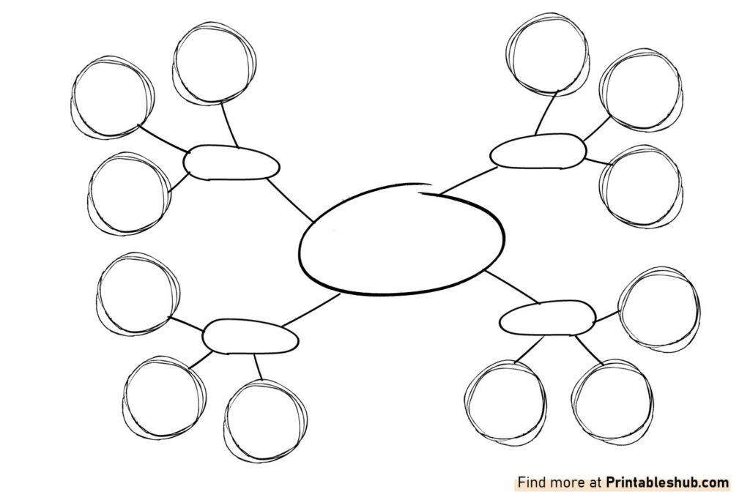
Power – Foucaldian approach Power is Diffuse, Not Centralized
How does power operate in a specific institution (e.g., a university, hospital, or social media platform)
Who holds formal power?
What informal norms shape behaviour?
How do rules, routines, and expectations enforce control?
Notes:
Social control theory, particularly as developed by Travis Hirschi, posits that individuals refrain from deviant behaviour due to their bonds to society; through attachment, commitment, involvement, and belief. When these bonds weaken, deviance (including protest
Power is Diffuse, Not Centralized
Michel Foucault argued that power is not held by a single authority but is dispersed throughout society.
It operates through institutions, norms, and everyday practices.
Disciplinary Power
Emerges in modern societies through institutions like schools, prisons, hospitals.
Focuses on surveillance, normalization, and examination.
Individuals internalize norms and regulate themselves—self-surveillance becomes a form of control.
Panopticism
Inspired by Jeremy Bentham’s Panopticon prison design.
A metaphor for modern surveillance: people behave because they might be watched.
Leads to internalized discipline—people conform even without direct oversight.
Biopower
Power over populations through regulation of bodies, health, reproduction, etc.
Seen in public health, census data, and policy-making.
Governs not just individuals but entire populations.
Knowledge and Power
Foucault emphasized the link between knowledge and power.
Institutions produce knowledge (e.g., psychiatry, criminology) that defines what is “normal” or “deviant”.
This knowledge is used to control and categorize people.
Foucauldian approaches
The term ‘Foucauldian’ refers to theoretical frameworks influenced by the writings of the French philosopher, Michel Foucault (see Box 5.2).Box 5.2: Michel Foucault (1926–1984)Foucault was both an enormously influential intellectual and an activist. He was a philosopher who also studied psychology. His writings were based on practical as well as intellectual work. For instance, he worked at one stage as a researcher in a hospital. His works include studies of the treatment of mental illness, prisons and sexuality. He is generally described as a post-structuralist or postmodernist (although he himself rarely used the latter term). His activism embraced gay rights and the prison system and he was arrested when he participated in the student rebellions of May 1969 in Paris. One dictionary entry states that ‘his intellectual presence is felt throughout the social sciences’ (Cohen, 2006, p 214).Foucauldian approaches mark a shift away from the kind of functionalist thinking that marked earlier theories of social control. In line with postmodernist theorisation of the state, discussed in Chapter 4, the focus of analysis is not the state as such. Instead, broader notions of governmentality (the mentality, techniques and practices involved in the exercise of political power at all levels) and governance (the processes through which political power is exercised through a range of government and non-government bodies) are used to convey the wide range of mechanisms and institutions through which the behaviour of populations is moulded or governed. There is a particular emphasis on the ways in which individuals are encouraged to govern their own behaviour. Governmentality has been described as the ‘how’ of governing (McKee, 2009, p 466). Its meaning is illustrated from a criminological perspective by Pat O’Malley:‘the state’ becomes merely one site – or rather a complex of sites – in which government is located. Governmentality work has examined how government of crime is practised, not simply by police and
Foucault viewed power not as something held by individuals or institutions, but as diffuse, relational, and embedded in everyday practices. Power is productive, not just repressive—it shapes knowledge, norms, an
An important step in understanding Foucault's broader projects is to understand his view of power. Foucault's analyses of power are simultaneously articulated at two levels, the empirical and the theoretical. The first level is constituted by a detailed examination of historically specific modes of power and how these modes emerged out of earlier forms. Hence, he identifies modern forms of power, such as the closely related modes he termed “disciplinary power” and “biopower”, and earlier, premodern forms such as “sovereign power”. Indeed, much of his work on power is devoted to the task of articulating the emergence of later modes of power from earlier ones, and his analyses of disciplinary power in particular have been especially useful for subsequent scholars.
Three very simple examples can illustrate these forms of power. First, imagine a pyramid, with a king at the top, his ministers in the middle and the king's subjects (the people) at the bottom. If the king issues an edict, then his ministers will execute the order, imposing it upon the king's subjects. Traditionally, power has been understood as “being at the top of the pyramid”; and that was all that it was understood to be. But Foucault expands (indeed, totally reconceives) what constitutes power, and shows how this traditional view can be situated within a fuller understanding. He observed that in actual fact, power arises in all kinds of relationships, and can be built up from the bottom of a pyramid (or any structure).
Key Concepts:
Disciplinary Power: Regulates behaviour through surveillance and normalization.
Biopower: Governs populations through health, reproduction, and statistics.
Governmentality: The art of governing beyond the state, through institutions and norms.
Power/Knowledge: Power and knowledge are intertwined; knowledge is both a product and a tool of power.
d identities.

Slide 22
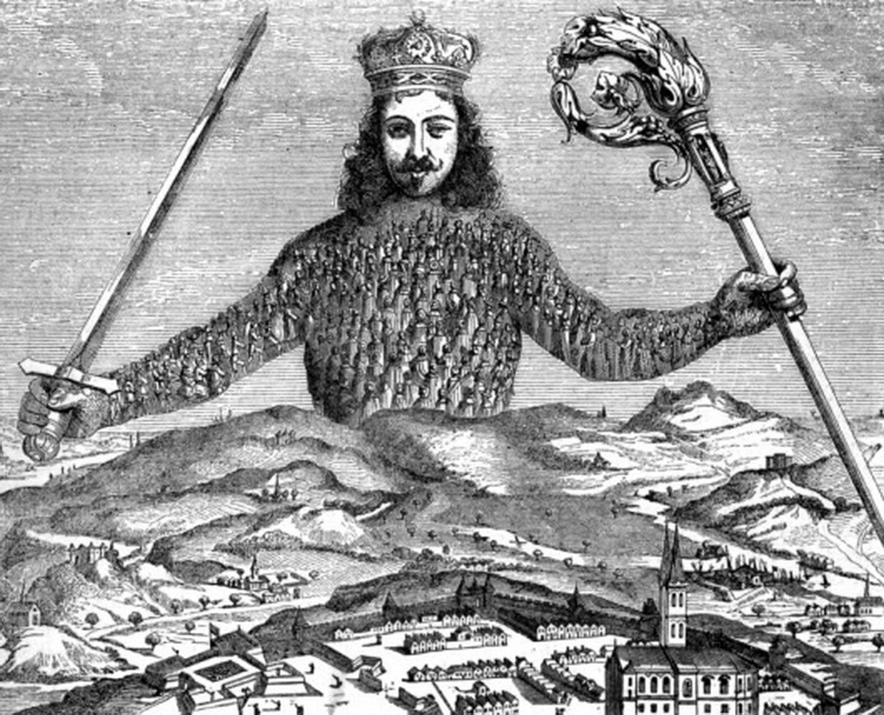
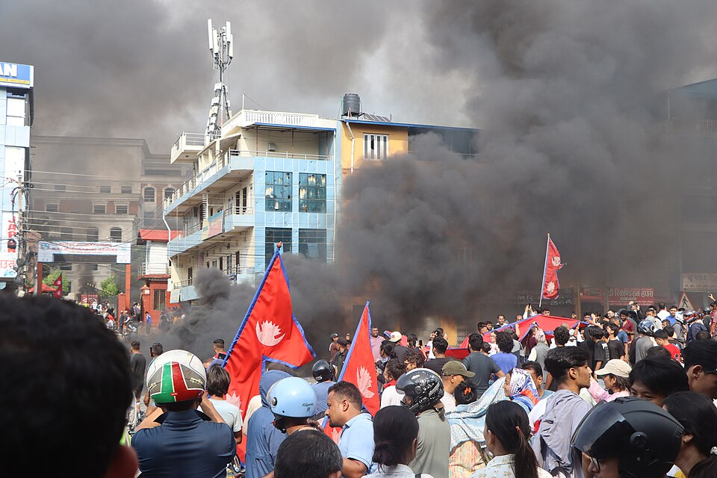
Notes:
Three very simple examples can illustrate these forms of power. First, imagine a pyramid, with a king at the top, his ministers in the middle and the king's subjects (the people) at the bottom. If the king issues an edict, then his ministers will execute the order, imposing it upon the king's subjects. Traditionally, power has been understood as “being at the top of the pyramid”; and that was all that it was understood to be. But Foucault expands (indeed, totally reconceives) what constitutes power, and shows how this traditional view can be situated within a fuller understandin
g. He observed that in actual fact, power arises in all kinds of relationships, and can be built up from the bottom of a pyramid (or any structure).
Nepal’s youth uprising explained: Decades of corruption reach a tipping point · Global Voices
Nepal’s youth uprising explained: Decades of corruption reach a tipping point
Gen Z protesters inherited their grandparents’ hard-won democracy, then watched it decay together with their parents
Written bySupriya Thapa
Posted 14 October 2025
Gen Z protesters in front of Bharatpur Mahanagarpalika office, Nepal. September 2025. Photo by Himal Subedi, via Wikimedia Commons (CC BY-SA 4.0).
Weeks after police shot into a crowd of student demonstrators in September, killing at least 19 people, the smoke still hung over Kathmandu, Nepal’s capital. The streets, once filled with schoolchildren, were now occupied by armed soldiers.
What started as a protest against a social media ban wasn’t solely about TikTok or Facebook. It was the emergence of long-held frustrations and a reckoning with a century of instability and corruption.
The Gen Z protesters in Nepal inherited a democracy their grandparents fought for, and watched with their parents as it unraveled. To understand the anger of 2025, you must review a history characterized by kings, revolutions, and continual demands for accountability.
For much of modern history, Nepal was governed by kings. The Rana dynasty seized power in 1848, establishing an oligarchy that isolated Nepal for over a century. Education was limited to elites, and the general Nepali population had little say in government.
Autocracy and the Panchayat system
After World War II, inspired by India’s independence, Nepali exiles began to form opposition parties. A revolt in 1951, backed by King Tribhuvan, ended Rana rule and opened Nepal’s borders.
Within a year, King Mahendra dissolved parliament, banned parties, and imposed the autocratic Panchayat system. For the next 30 years, Nepal was governed by a complicated hierarchy of councils that reported directly to the crown. Political dissidents or challengers to the crown were either jailed or exiled. News media were heavily censored, but some dissent still survived underground.
The 1990 People’s Movement
Protest during the 1990 People’s Movement, Kathmandu, Nepal. Photo by Min Ratna Bajracharya, via Wikimedia Commons (CC BY-SA 4.0).
As the 1980s drew to a close, the economy was stagnant, government corruption was rampant, and a new generation of students was demanding change. Following weeks of mass action in 1990 by the People’s Movement, or Jana Andolan I, King Birendra agreed to return to a multiparty democracy.
A new constitution established a constitutional monarchy and civil liberties.
Political instability and the Maoist insurgency
However, euphoria quickly turned to disappointment. Governments changed with great consistency; in the decade from 1991 to 2001, a prime minister was appointed and dismissed more than a dozen times. Political parties split into factions that sought to hold power rather than craft policy.
As inequality deepened and rural communities lost faith in politicians who failed to deliver roads, electricity, or jobs, space opened for a radical alternative. In 1996, the Communist Party of Nepal (Maoist) launched an armed rebellion demanding the end of the monarchy, as well as land reform and social justice. The conflict engulfed much of the countryside, leaving over 17,000 dead by the early 2000s.
The 2001 royal massacre and Gyanendra’s rule
The country then faced a national trauma when, in 2001, there was a royal massacre. Crown Prince Dipendra reportedly shot and killed King Birendra, Queen Aishwarya and nine other royals before turning the gun on himself; he was said to be intoxicated at the time.
King Gyanendra assumed the throne and, in 2005, dissolved parliament, declaring a state of emergency, which united opposition political parties, civil society, and the Maoists.
In 2006, during mass protests referred to as Jana Andolan II, Gyanendra was forced to step down. By 2008, the monarchy was finally abolished. Nepal became a federal democratic republic, and the former Maoist leaders became parliamentarians.
The new republic and constitution
Map of Nepal showing its seven provinces. Image by SimulationWig, via Wikimedia Commons (CC BY-SA 4.0).
The new republic gave rise to great hope. The first constituent assembly was set up to draft a constitution that would guarantee representation for women, Dalits, Indigenous groups, and Madhesi groups.
However, the process took seven years, marked by disputes among the elites. It was after the assembly was dissolved twice that it finally adopted a new constitution in 2015.
The new document established a federal regime dividing Nepal into seven provinces and also provided for rights and inclusion. However, the document was created amid controversy, and many marginalized groups said they were excluded.
Political corruption and growing inequality
Over the next few years, the country cycled through coalitions of the same people, including K.P. Sharma Oli, Sher Bahadur Deuba, and Pushpa Kamal Dahal, known as “Prachanda,” in roles as prime ministers and each, without exception, said they would deliver reforms, but either had their assets challenged or misappropriated with patronage or corruption.
As migration increased, nearly 14 percent of the population was now working outside the country, and remittances had become the country’s economic lifeline. But the gap between rich and poor was expanding. Schools and hospitals in rural areas were deteriorating, while the elite flaunted their wealth.
Social media became both a salve and a reflection, a place where frustration brewed, as hashtags like #NepoKids and #YouthsAgainstCorruption highlighted elite privileges.
By 2024, the Nepali economy was suffocated by inflation, youth unemployment and political stagnation. The government’s response was not to improve through reforms, but to impose new regulations that restricted online platforms and digital publishers.
The student-led protests of 2025
In early September, student groups began organizing through encrypted apps and offline groups. Within days, thousands of students marched in Kathmandu, Pokhara and Lalitpur.
They held signs, like “Stop corruption, not social media.” Many were teenagers raised on stories of the democracy movement, but having only experienced dysfunction.
When crowds grew outside parliament, police fired tear gas and then live rounds. Hospitals were flooded with students in school uniforms. At least 19 people were dead, according to local media and human rights organizations. The government imposed a curfew period, shut down mobile networks, and deployed army forces.
That night, as public anger erupted, the Home Minister resigned. The cabinet reversed the ban, but protests spread beyond Kathmandu as anger ignited over inequality and corruption.
In the upheaval that ensued, mobs attacked government buildings and politicians’ homes. Former Prime Minister Deuba and his wife, Arzu Rana Deuba, were rescued by the army after protesters stormed their residence.
Interim leadership and calls for accountability
Sushila Karki at the US-Nepal Summit for Democracy, 2021. Photo by U.S. Embassy Kathmandu, via Wikimedia Commons (Public domain).
With the capital under military lockdown, President Ram Chandra Poudel appointed former Chief Justice Sushila Karki as interim prime minister, making her Nepal’s first woman to hold this position.
Karki, 73, is a retired Supreme Court justice known for her anti-corruption rulings. Her appointment had the endorsement of the youth representatives who helped lead the protests.
Karki’s caretaking government has congratulated itself on the pledge to investigate the killings, restore order and hold new elections in March 2026; whether or not that counts for building trust is another question entirely.
Continuity and hope: Lessons from history
Nepal’s history has been one of surges followed by stagnation: revolution, hopes, paralysis. Every time, from 1951 to 1990 to 2006, the revolution brought down an old order but then failed to generate sustainable change.
For Gen Z, the challenge is whether the moment can achieve its breakthrough. The movement has already made history: by holding accountable, by getting a woman to the highest position in the country, and by making it clear that civic action is still possible in a compromised system.
The streets of Kathmandu are silent, but tension remains. Students are still keeping vigils every night in memory of the deaths. The university walls are covered with graffiti saying, “If not now, when?”
Human Rights Watch and Amnesty International have called for independent inquiries into the actions of the police and military. The military maintains it acted to protect public order, noting many involved were minors.
In her first statements as interim prime minister, Karki urged calm during this time of unrest. “Change must come through institutions, not fire,” she stated. But she also expressed agreement that young Nepalis were “right to demand dignity and opportunity.”
It remains to be seen whether the protests will mark the beginning of a journey towards reform or simply be the latest chapter in Nepal’s long narrative of hope and disappointment.
But there is one constant; every one of our movements since the fall of the Ranas has been driven by students who believed their country could be better. By that measure, the protests in 2025 were in no way a break from history; instead, they were a continuation of it.

Slide 23
Informal control: Cooley, Nye, Hirschi, Goffman, Mead
Subtle, everyday regulation of behaviour that happens through:
Socialisation: Learning norms and values from family, peers, and community
Peer pressure: Adjusting behaviour to fit in or avoid disapproval.
Cultural expectations: Following traditions or customs.
Social sanctions: Experiencing shame, gossip, or exclusion when norms are violated.
Notes:
Shark Attack! https://youtu.be/FW4N8YxW
1. Charles Horton Cooley
Introduced the idea of primary groups (family, close friends) as key agents of informal control.
Emphasised how identity and behaviour are shaped through expressive relationships.
2. Nye (1958)
Identified internal control (internalised norms) and indirect control (emotional bonds) as forms of informal control.
3. Travis Hirschi
In Social Bond Theory, informal control is embedded in attachment, involvement, and belief.
4. Erving Goffman
Explored interaction rituals and the unspoken rules of everyday encounters.
5. George Herbert Mead
Focused on how the self develops through social interaction, reinforcing informal norms.
1. Charles Horton Cooley – Primary Groups
Reference:
Cooley, C. H. (1909). Social Organization: A Study of the Larger Mind. New York: Charles Scribner's Sons.
Key Idea: Introduced the concept of primary groups (e.g., family, close friends) as central to shaping identity and enforcing informal norms.
Access:
The Primary Group as Cooley Defines It Author(s): S. C. Lee Source: The Sociological Quarterly , Winter, 1964, Vol. 5, No. 1 (Winter, 1964), pp. 23-34 Published by: Taylor & Francis, Ltd. (find it in uni library online)
The Primary Group as Cooley Defines It
2. F. Ivan Nye (1958) – Social Control Theory
Reference:
Nye, F. I. (1958). Family Relationships and Delinquent Behavior. New York: John Wiley & Sons.
Key Idea: Identified internal control (conscience) and indirect control (emotional bonds) as mechanisms of informal social control.
Nye,_F._Ivan_-_Family_Controls_and_Delinquency.pdf
Wells (2010) Encyclopedia of Criminological Theory Nye, F. Ivan: Family Controls and Delinquency
3. Travis Hirschi – Social Bond Theory
Reference:
Hirschi, T. (1969). Causes of Delinquency. Berkeley: University of California Press.
Key Idea: Informal control is embedded in attachment, involvement, commitment, and belief—strong social bonds reduce deviance.
Access: see The Functions of the Social Bond Author(s): James J. Chriss Source: The Sociological Quarterly, Fall, 2007, Vol. 48, No. 4 (Fall, 2007), pp. 689-712 .Published by: Taylor & Francis, Ltd
4. Erving Goffman – Interaction Rituals
Reference:
Goffman, E. (1967). Interaction Ritual: Essays in Face-to-Face Behavior. New York: Pantheon Books.
Key Idea: Explored face-work, deference, and demeanor as unspoken rules that regulate everyday social encounters.
Access: Taylor & Francis eBook [taylorfrancis.com]
5. George Herbert Mead – Development of the Self
Reference:
Mead, G. H. (1934). Mind, Self, and Society. Edited by Charles W. Morris. Chicago: University of Chicago Press.
Key Idea: The self develops through social interaction, especially via role-taking and the concept of the generalized other.
Access:free download here: mead1934.pdf
s4Q?si=5Agu7Y-DJgtm5qq1 shark attack video

Slide 24
Medical Social Control
Medicalisation: Reframing personal/social issues as medical problems.
  Example: Drapetomania (1851) – a supposed illness causing enslaved people to flee.
Conrad & Schneider (1980): Medicine enforces social norms by treating deviance as illness.

Slide 25

Authority of Medicine
Doctors hold high status and are seen as competent experts.
Medical discourse normalises behaviours and defines health, illness, and pathology.
Non-medical professionals also adopt medical language (e.g., HR managers, school counsellors).

Slide 26
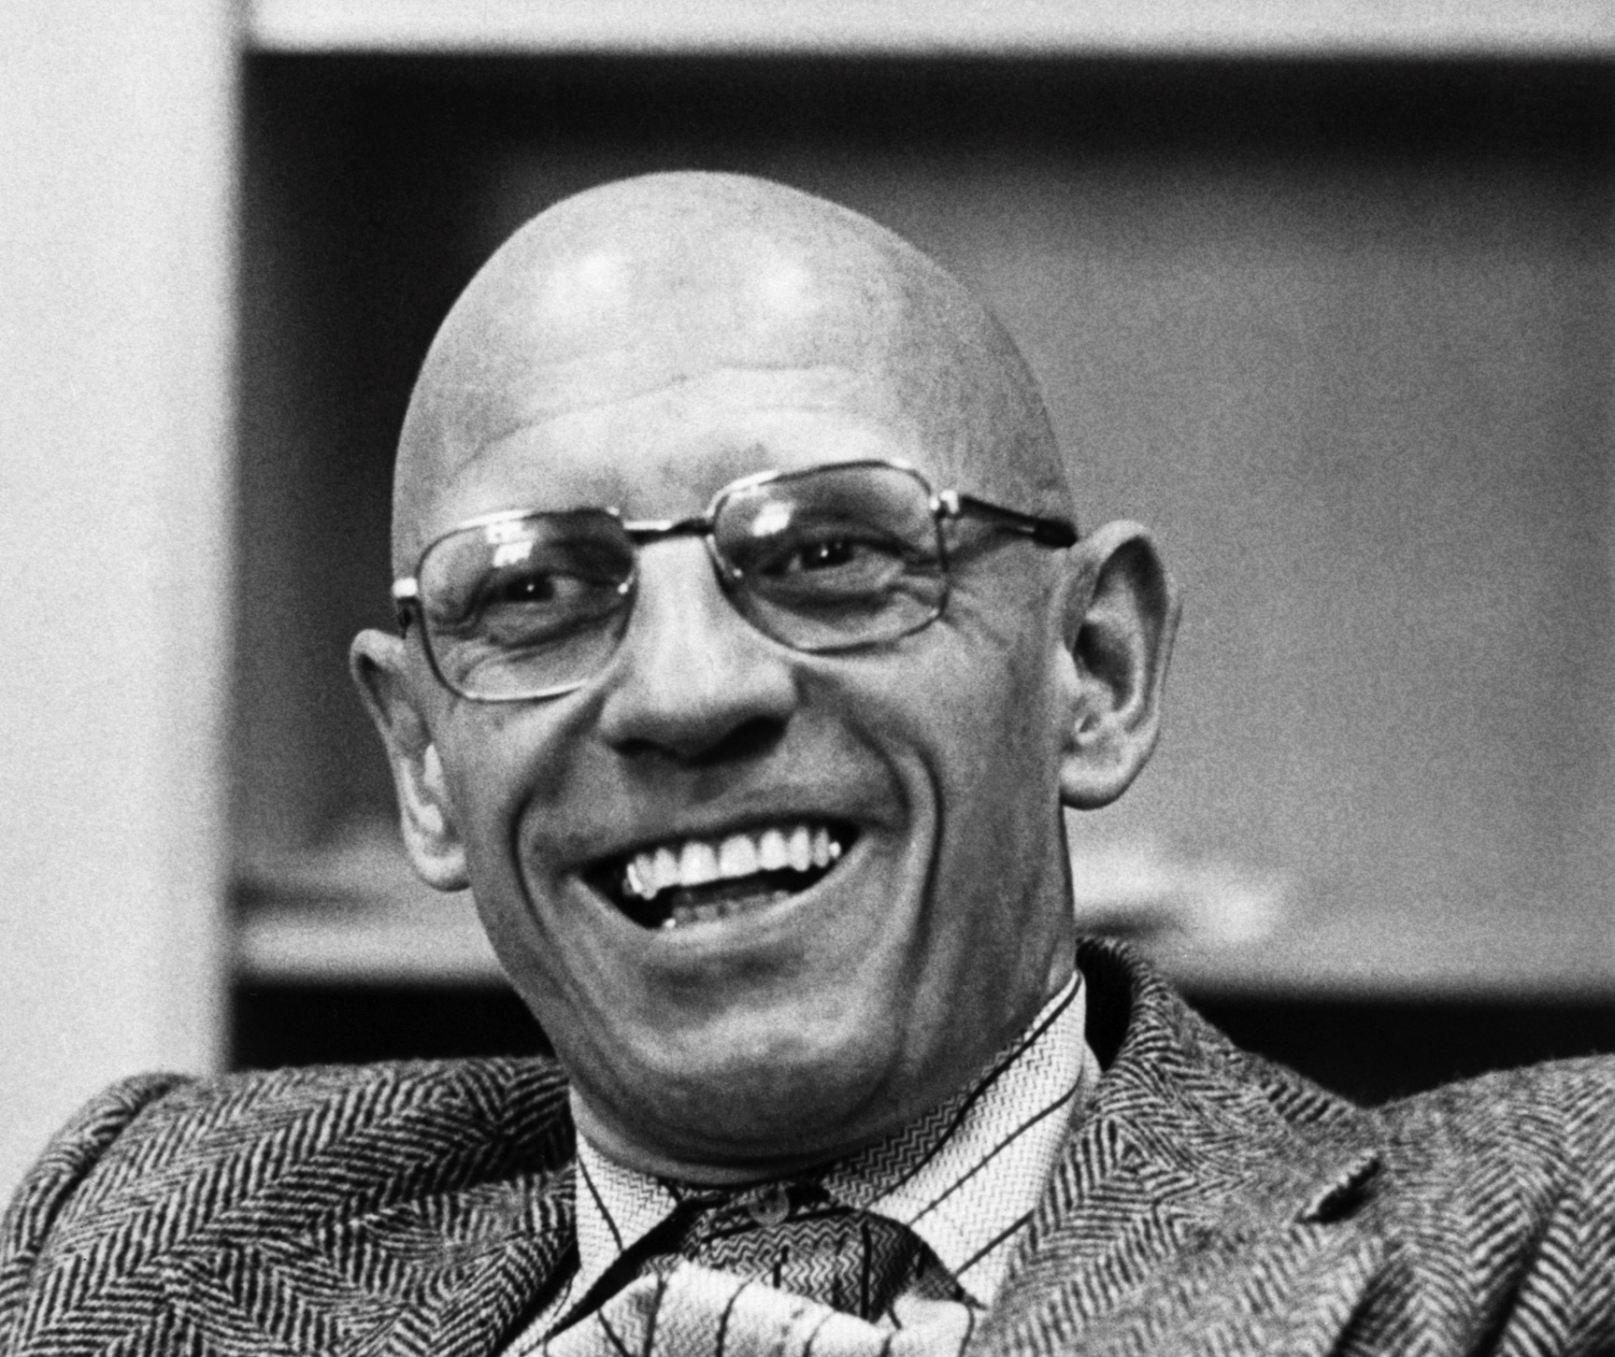
Changing Views of Deviance (Foucault’s Timeline)
Pre-1600s: Deviance = ignorance/sin.
1600s–1800s: Deviance = bad genes or choices.
Post-1800s: Deviance = illness needing treatment.
Notes:
Madness and Civilization: A History of Insanity in the Age of Reason
Original French title: Folie et Déraison: Histoire de la folie à l'âge classique
First published: 1961 (French), 1964/65 (English translation)
Author: Michel Foucault
Publisher: Librairie Plon (French), Pantheon Books (English)
A link to the translation:
Michel Foucault - Madness And Civilization
Key texts:
Madness and Civilization (1961): Historical treatment of mental illness. The Birth of the Clinic (1963): Rise of medical gaze and clinical power. Discipline and Punish (1975): Surveillance and control through institutions. The History of Sexuality Vol. 1 (1976): Medicalisation of sexuality and emergence of biopower.

Slide 27
Medicalisation, De-medicalisation, Re-medicalisation
Medicalisation: More life issues treated medically.
De-medicalisation: Conditions (e.g., homosexuality) removed from medical classification.
Re-medicalisation: Biological/genetic framing reintroduces medical discourse (e.g., “gay gene”).
(Conrad, 2007)

Slide 28
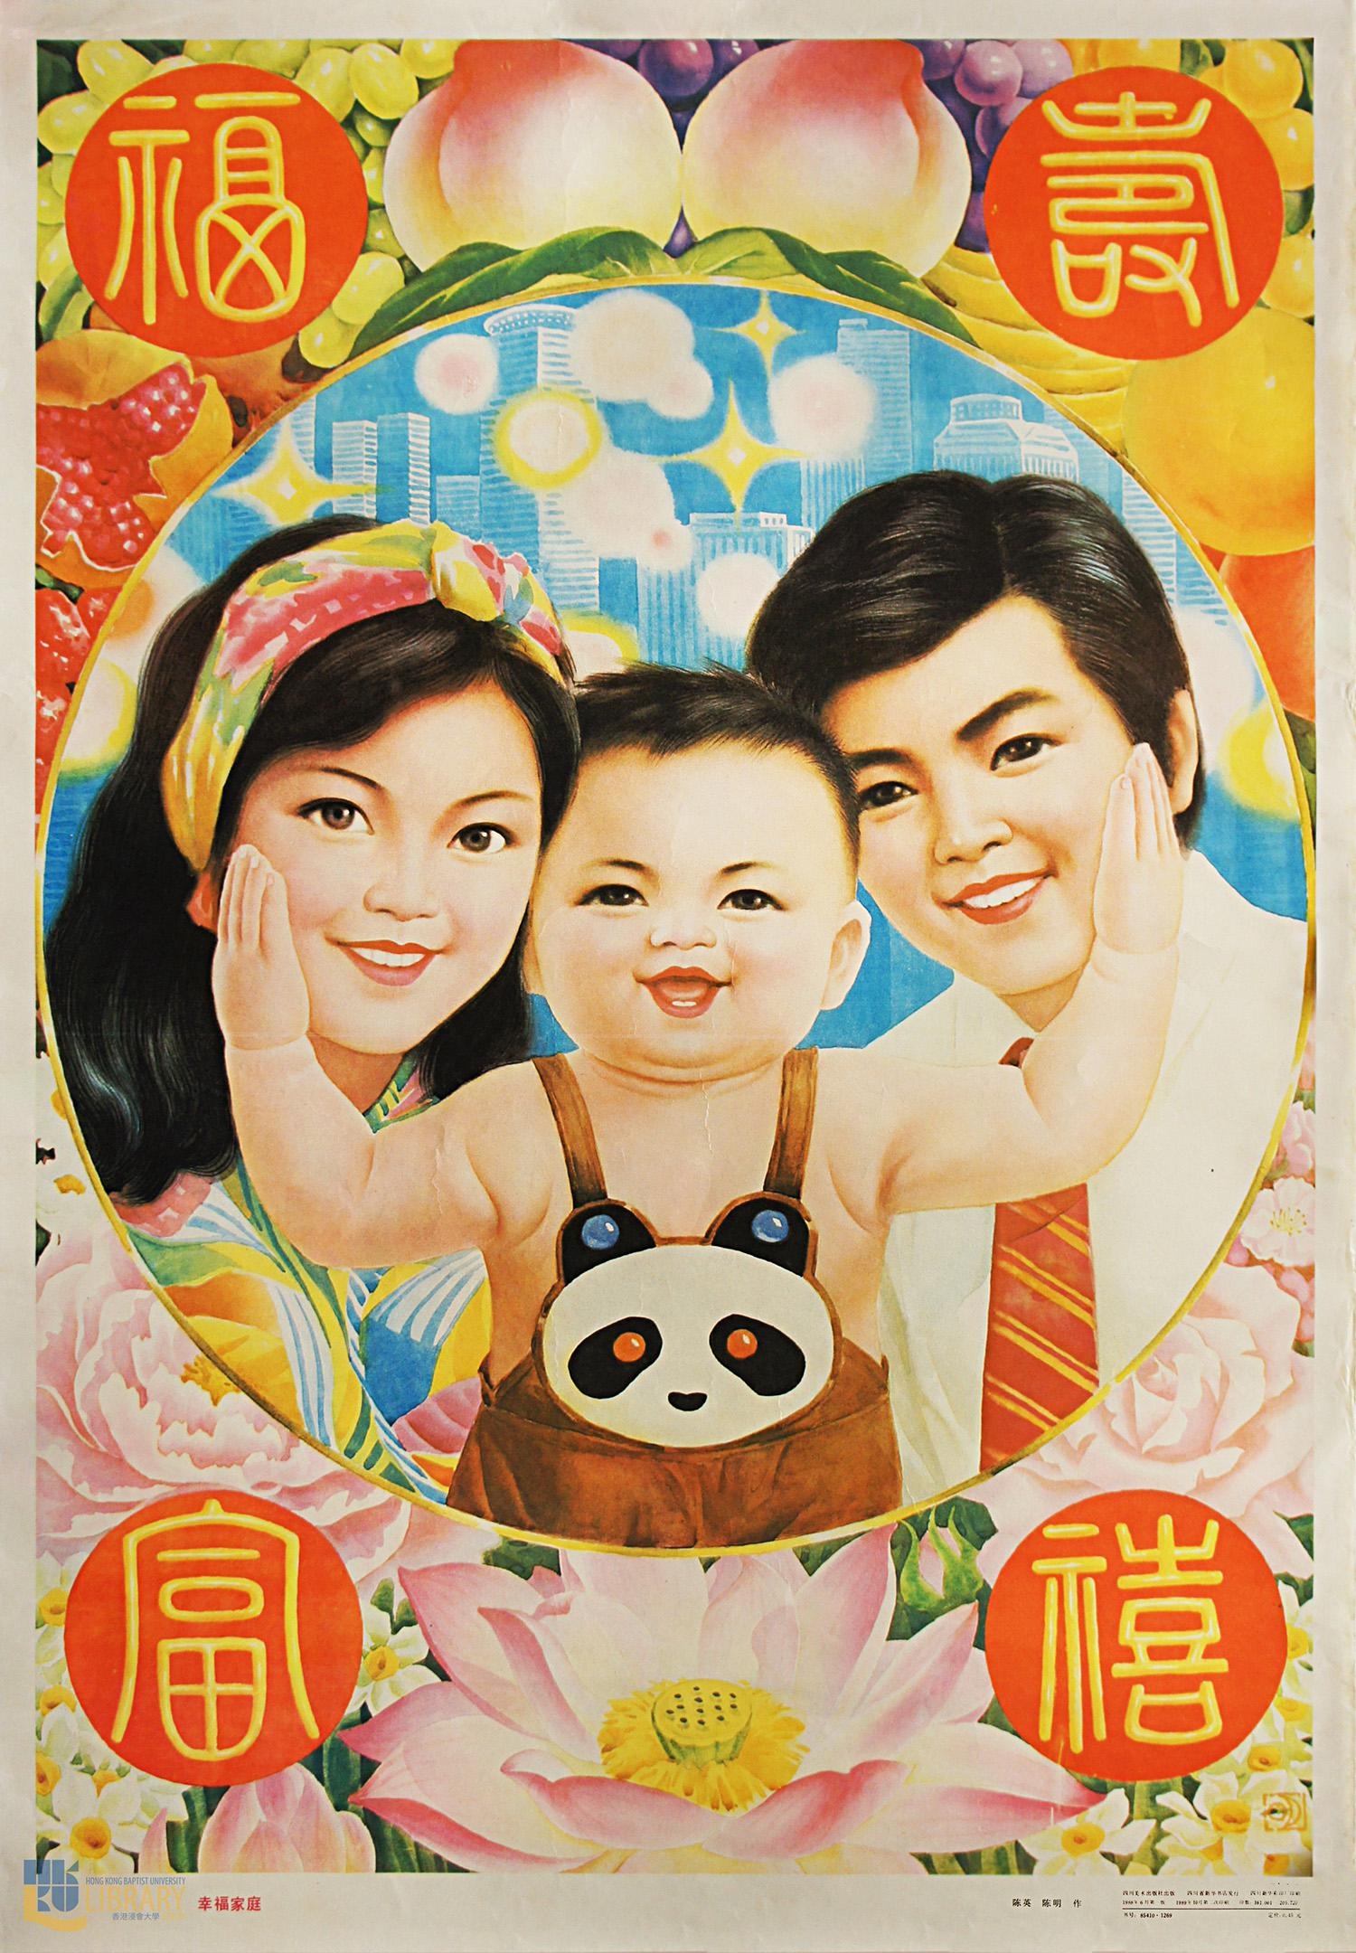
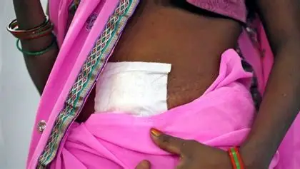
Biopower - Foucault (1976)
the way modern states exert control over people not through force, but by managing life itself health, reproduction, hygiene, longevity, and population statistics.
Focuses on populations, not individuals.
Uses medical, scientific, and statistical knowledge to regulate life.
  Vaccination programs
  Birth control policies
  Public health campaigns
  Surveillance of disease and risk factors
Biopower shifts power from visible institutions (like the police or military) to subtle, everyday mechanisms—like health checkups, school vaccinations, or fitness apps—that shape how people live.
Notes:
Mass Sterilisation in India (1975–77 Emergency Period)
What happened: Over 8 million men were forcibly sterilised under Indira Gandhi’s regime, often without consent, as part of a population control campaign.
Biopower lens: The state used medical procedures to regulate reproduction, treating citizens as biological units to be managed.
Forced Hysterectomies of Sugarcane Workers in Maharashtra Hundreds of female sugarcane workers in Beed underwent hysterectomies before the 2024 harvest season, raising concerns about medical necessity and informed consent
What happened: Thousands of women were pressured into hysterectomies to increase labour productivity.
Biopower lens: Medical authority used to reshape bodies for economic efficiency.
China’s One-Child Policy (1979–2015)
What happened: Families were restricted to one child, with forced abortions and sterilisation used to enforce the policy.
Biopower lens: State regulation of reproduction to control population growth.
Eugenics and Sterilisation of Marginalised Groups
What happened: In the 20th century, thousands of people with disabilities, mental illness, or from minority groups were sterilised in the US.
Biopower lens: Medicalised control of “undesirable” traits in the population.
COVID-19 Pandemic Policies
What happened: Lockdowns, vaccine mandates, and digital health surveillance were implemented globally.
Biopower lens: Governments used health data and medical authority to regulate movement and behaviour.
Foucault warned that biopower is not inherently evil—but it becomes dangerous when:
It normalises control through health and science.
It targets vulnerable populations.
It erodes autonomy under the guise of care or progress.

Slide 29
Exercise: Medical, Social, or Both?
ADHD in adults
Social anxiety
Obesity
Gender dysphoria
Burnout
Tech addiction
Grief
Loneliness
Menopause
Children’s behaviour in schools
Is this issue best understood as a
medical condition, a social issue, or both?
Who benefits from its medicalisation?
What are the risks of medicalising this issue?
How does medicalisation affect personal
responsibility, stigma, and access to support?

Slide 30
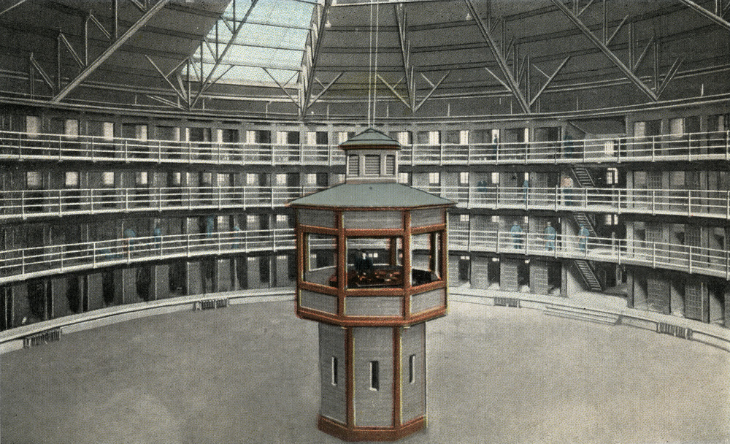
Social legal control: The Panopticon
Foucault – Surveillance and Governmentality
Notes:
The Panopticon in Today's Society
The Panopticon Effect: Surveillance in Modern Society
Foucault: Surveillance & Governmentality
The Panopticon is a hypothetical prison design conceived by Jeremy Bentham in 1785. The design features a central watchtower surrounded by a ring of cells, allowing a single guard to monitor all prisoners simultaneously. The Panopticon's innovative design was not only meant to optimize surveillance but also to induce a state of conscious and permanent visibility in prisoners, thereby ensuring the automatic functioning of power.
"The Panopticon is a machine for dissociating the see/being seen dyad: in the peripheral ring, one is totally seen, without ever seeing; in the central tower, one sees everything without ever being seen." - Michel Foucault, Discipline and Punish (1977)
Bentham's design was influenced by his utilitarian philosophy, which emphasized the importance of rational management and control. The Panopticon was meant to be a tool for social control, where the mere possibility of being watched would discipline individuals into conforming to societal norms.
Panopticon in Media
Representation in Literature and Film
The Panopticon has been a recurring theme in literature and film, often serving as a metaphor for the surveillance state. Examples include:
George Orwell's 1984, which depicts a dystopian society where citizens are constantly surveilled by the state
Michel Foucault's Discipline and Punish, which analyzes the Panopticon as a symbol of modern power dynamics
Films like The Truman Show and Minority Report, which explore the themes of surveillance and control
Impact on Individual Behavior and Self-Censorship
The Panopticon effect has a profound impact on individual behavior, with many people self-censoring their actions and opinions due to the fear of being judged or surveilled. This can lead to a stifling of free speech and creativity, as individuals become increasingly cautious in their online and offline behavior.
Effects on Social Norms and Cultural Values
The Panopticon effect also shapes social norms and cultural values, as individuals conform to societal expectations in order to avoid being seen as deviant. This can result in a homogenization of culture, where individuals suppress their unique identities and perspectives in order to fit in.
The Relationship Between Surveillance and Power Dynamics
The Panopticon effect is deeply tied to power dynamics, with those in positions of power often using surveillance as a means of maintaining control. This can lead to a reinforcement of existing social hierarchies, where those who are already marginalized are further oppressed.
The following diagram illustrates the relationship between surveillance and power dynamics:

Slide 31
Legal Social Control
July 2025, the prison population in England and Wales stood at 87,966, with an operating capacity of 89,373 – higher than in 2014.
Crime Survey for England and Wales (CSEW), overall crime has decreased over the past decade
Crime rates fell, but prison population remain high; why?
How does legal control disproportionately affect marginalised groups?
Notes:
What does Foucault’s concept of the Panopticon reveal about modern legal control?
Surveillance is now constant and decentralised—“the many watch the many”.
Legal control extends beyond punishment to data tracking, CCTV, and digital footprints.
Governmentality: Power is exercised through professionals (teachers, doctors, auditors) who regulate behaviour.
Crime Survey for England and Wales (CSEW), overall crime has decreased over the past decade, but: Fraud increased by 31% in the year ending March 2025.
Sexual assault and domestic abuse rates remained stable but high. [ons.gov.uk]
Despite falling crime rates, the prison population has not decreased proportionally.
Net widening refers to the expansion of the criminal justice system’s control over individuals, often as an unintended consequence of reforms or alternative sanctions. Originally coined in the 1960s, the term describes how efforts to divert offenders from incarceration can paradoxically increase the number of people under formal supervision.
“Net widening occurs when programs designed to divert individuals from prison end up subjecting more people to criminal justice control than before.”
— LegalClarity [legalclarity.org]
Mechanisms of Net Widening
Creation of New Offenses
Minor behaviours previously handled informally are now criminalised.
Example: Anti-social behaviour orders (ASBOs) and Community Protection Notices (CPNs) in the UK.
Alternative Sanctions Misapplied
Electronic monitoring or intensive probation used for low-risk individuals who wouldn’t have been incarcerated.
Instead of reducing prison numbers, these sanctions expand the net.
Diversion Programs
Youth diversion schemes may pull in individuals who would have otherwise avoided formal processing.
Example: Juvenile justice reforms in San Francisco led to more youth being formally processed.
Why It’s Problematic
Over-criminalisation: More people are subjected to surveillance and control.
Resource Drain: Diverts attention from high-risk individuals to those who may not need intervention.
Civil Liberties: Increased supervision can erode privacy and autonomy.
Failure to Reduce Recidivism: Often does not lower reoffending rates.

Slide 32
Assignment 2
Critically consider the role played by power and control in the (re)production of inequality for a group of your choosing

Slide 33

In your chosen group…
Decision-making power (visible actions)
Non-decision-making power (controlling the agenda)
Ideological or latent power (shaping desires, beliefs, and perceptions)
The three dimensions of power (Lukes, 1975) influenced by Bachrach and Baratz (1962)
whose voices are heard?
whose are anticipated?
whose are ignored?
Notes:
Decision-making power (visible actions) Non-decision-making power (controlling the agenda) Ideological or latent power (shaping desires, beliefs, and perceptions)
Non-decision-making power (controlling the agenda)
Agenda-Setting and Non-Decision-Making
These ideas were introduced by Peter Bachrach and Morton Baratz in: Bachrach, P., & Baratz, M. S. (1962). Two Faces of Power. American Political Science Review, 56(4), 947–952.
They argued that power is not only about making decisions but also about preventing certain issues from being discussed—a subtle but powerful form of control.
Who gets to speak in UK society—and who doesn’t?”
How does agenda-setting shape inclusion?”
Issues affecting marginalised groups may be excluded from policy debates. Silence can be a form of power - what’s not discussed is just as important as what is. Inclusion requires intentional amplification of unheard voices.

Slide 34
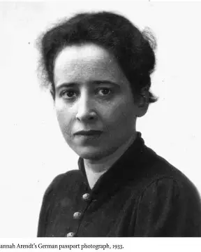
Arendt
Power corresponds to the human ability not just to act but to act in concert.”
— Hannah Arendt, The Human Condition
Notes:
Arendt believed that power arises when people act together, not from force or violence. It is created through communication, cooperation, and shared purpose. Power is not something individuals possess, but something that exists between people when they engage in political life.
Major Works
The Origins of Totalitarianism (1951)
Analyzes Nazism and Stalinism as forms of totalitarian rule.
The Human Condition (1958)
Explores the nature of political action, labour, and public life.
Eichmann in Jerusalem: A Report on the Banality of Evil (1963)
Based on her coverage of Adolf Eichmann’s trial; introduced the controversial idea that evil can be committed by ordinary people who fail to think critically.
On Revolution (1963)
Compares the American and French revolutions.
On Violence (1970)
Distinguishes between power and violence.
Power arises from collective action and public engagement, not domination.
It is fragile, existing only as long as people act together.
She distinguished power from violence, arguing that violence is what happens when power breaks down.
“Power corresponds to the human ability not just to act but to act in concert.”
— The Human Condition

Slide 35
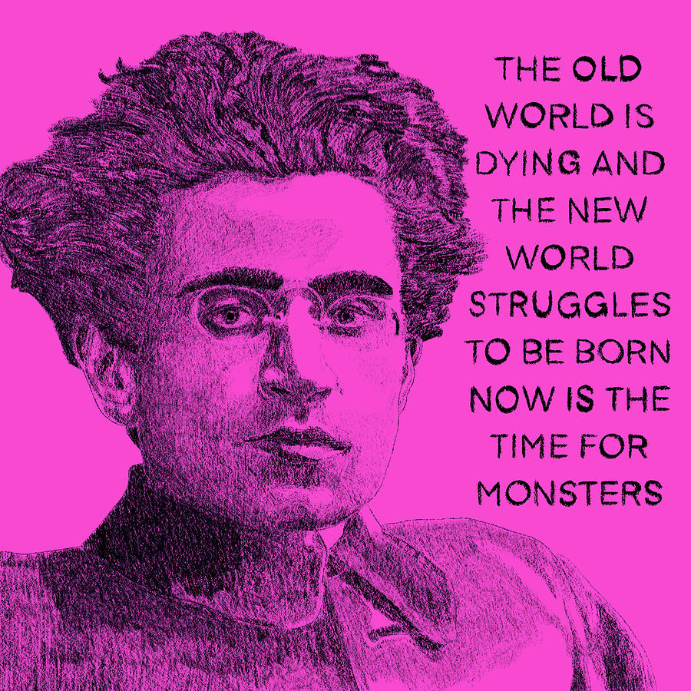
Gramsci - Hegemony explained
the cultural, moral, and intellectual leadership exercised by the dominant group over other groups in society. It is a form of rule or dominance that is achieved not merely through coercion or physical force but primarily through the creation and dissemination of a particular worldview or ideology that becomes accepted as "common sense" or "natural" by both the dominant and subordinate groups (Sardar, 2024 p.1)
Notes:
Antonio Gramsci's concept of hegemony has become a central principle for understanding the mechanisms by which dominant groups maintain power and control in society
Hegemony is a concept developed by the Italian Marxist philosopher Antonio Gramsci (1891- 1937) to explain how dominant groups in society maintain their power and influence over subordinate groups. Gramsci's theory of hegemony is a crucial contribution to the understanding of power dynamics in society and has been widely influential in various fields, including political theory, cultural studies, and social analysis.
Capitalism, Gramsci suggested, maintained control not just through violence and political and economic coercion, but also ideologically, through a hegemonic culture in which the values of the bourgeoisie became the 'common sense' values of all. Thus a consensus culture developed in which people in the working-class identified their own good with the good of the bourgeoisie, and helped to maintain the status quo rather than revolting
According to Gramsci, hegemony refers to the cultural, moral, and intellectual leadership exercised by the dominant group over other groups in society. It is a form of rule or dominance that is achieved not merely through coercion or physical force but primarily through the creation and dissemination of a particular worldview or ideology that becomes accepted as "common sense" or "natural" by both the dominant and subordinate groups. Gramsci argued that the ruling class in a capitalist society maintains its power not only through economic control and the threat of force but also through the establishment of a hegemonic culture that shapes the beliefs, values, and norms of the entire society. This hegemonic culture is propagated through various institutions, such as education, media, religion, and cultural institutions, which serve to reinforce the dominant ideology and marginalise alternative world views. Gramsci's concept of hegemony emphasises the importance of consent and persuasion in the exercise of power. The dominant group must constantly work to maintain its hegemonic position by winning the active or passive consent of the subordinate groups. This involves not only the dissemination of a particular ideology but also the incorporation of certain elements of the subordinate groups' interests and values into the hegemonic worldview, creating a sense of unity and shared interests between the dominant and subordinate groups
Features of Gramsci’s Hegemony Here are some important features of Antonio Gramsci's hegemonic principle:
Ideological dominance - Hegemony refers to the ideological dominance of one social institution over others, whereby the world view and perception systems of the dominant group are ordinary everyday and valid at some point of society. The method of ‘hegemonizing’ spreads and strengthens the values, norms and perception structures of the ruling elegance via cultural, social and political institutions.
2. Manufacturing consent -Gramsci emphasised that for a dominant group to exercising actual power, it should go past bodily coercion and political authority and actively produce the consent of subordinate businesses. Cultural hegemony creates this consensus by means of imparting the dominant ideology as well-known and making alternative world-views marginal or unthinkable.
3. Role of Civil Society - Civil society establishments along with schools, church buildings, media and so forth., according to Gramsci, play a key position in spreading and strengthening hegemonic ideologies and ideals most of the loads. These institutions socialise people to conform to the assumptions, values and "not unusual sense" of the dominant social organization.
4. Traditional versus natural intellectuals -Gramsci outstanding among "conventional" intellectuals who beef up the hegemony of the ruling class via their function in institutions, and viable "organic" intellectuals who can construct a hegemonic counter-modern awareness primarily based at the stories of the operating magnificence.
5. War of position -His idea covered a "warfare of position" wherein a dominant institution constantly uses strategies to defend and reproduce its hegemony via civil society, while hegemonic resistance organizations may additionally have interaction in ideological and cultural resistance to task the status quo.
6. Cultural Struggle - For Gramsci, ideological and cultural conflict in civil society become critical to attain hegemony or create counter-hegemonies. Economy and politics were essential, but now not the best determinants of power relations in society.
7. The opportunity of counter-hegemony- Although hegemony appears long lasting, Gramsci argued that it's miles neither permanent nor monolithic. Through anti-hegemonic academic and cultural work, subordinate agencies should overturn dominant ideologies and update them with new frameworks for the innovative reorganisation of society.Basically, Gramsci's hegemony broke from monetary determinism to research the capacity of a social group to unite. A worldview as everyday not unusual sense across social institutions is principal to achieving and maintaining electricity..

Slide 36
hegemony is about consent and cultural leadership, not force.
The supremacy of a social group manifests itself in two ways: as domination and as intellectual and moral leadership.
Gramsci (1926), Selections from the Prison Notebooks
Identify examples of cultural hegemonic ideas in:
Media (e.g., news, advertising)
Education (e.g., curriculum content)
Everyday life (e.g., gender roles, work ethic)
Whose values are being normalised? Whose voices are missing?
Intellectual hegemony:
Notes:
What Examples in Today’s Society Show Cultural Hegemony?
but also through consent, which is shaped by ideas, values, and beliefs. Intellectuals play a key role in this process by producing and disseminating ideologies that support the status quo
The Prison Notebooks (Italian: Quaderni del carcere [kwaˈdɛrni del ˈkartʃere])^{[1]} are a series of essays written by the Italian Marxist Antonio Gramsci. Gramsci was imprisoned by the Italian Fascist regime in 1926. The notebooks were written between 1929 and 1935, when Gramsci was released from prison to a medical center on grounds of ill-health.^{[2]} His friend, Piero Sraffa, had supplied the writing implements and notebooks. Gramsci died in April 1937.
Antonio Gramsci, depicted in 1922Gramsci wrote more than 30 notebooks and 3,000 pages of history and analysis during his imprisonment. The original Prison Notebooks are kept at the Fondazione Gramsci in Rome. These notebooks were initially smuggled out of prison, catalogued by Gramsci's sister-in-law Tatiana Schucht, and sent to Moscow for safekeeping. They were returned to Italy after World War II and have since been preserved by the Gramsci Foundation
Intellectuals and education
Gramsci gave much thought to the question of the role of intellectuals in society. Famously, he stated that all people are intellectuals, in that all have intellectual and rational faculties, but not all people have the social function of intellectuals. He claimed that modern intellectuals were not simply talkers, but directors and organisers who helped build society and produce hegemony by means of ideological apparatuses such as education and the media. Furthermore, he distinguished between a traditional intelligentsia which sees itself (wrongly) as a class apart from society, and the thinking groups which every class produces from its own ranks organically. Such organic intellectuals do not simply describe social life in accordance with scientific rules, but rather articulate, through the language of culture, the feelings and experiences which the masses could not express for themselves. The need to create a working-class culture relates to Gramsci's call for a kind of education that could develop working-class intellectuals, who would not simply introduce Marxist ideology from outside the proletariat, but rather renovate and make critical the status quo of the already existing intellectual activity of the masses. His ideas about an education system for this purpose correspond with the notion of critical pedagogy and popular education as theorized and practised in later decades by Paulo Freire in Brazil, and have much in common with the thought of Frantz Fanon. For this reason, partisans of adult and popular education consider Gramsci an important voice to this day.

Slide 37
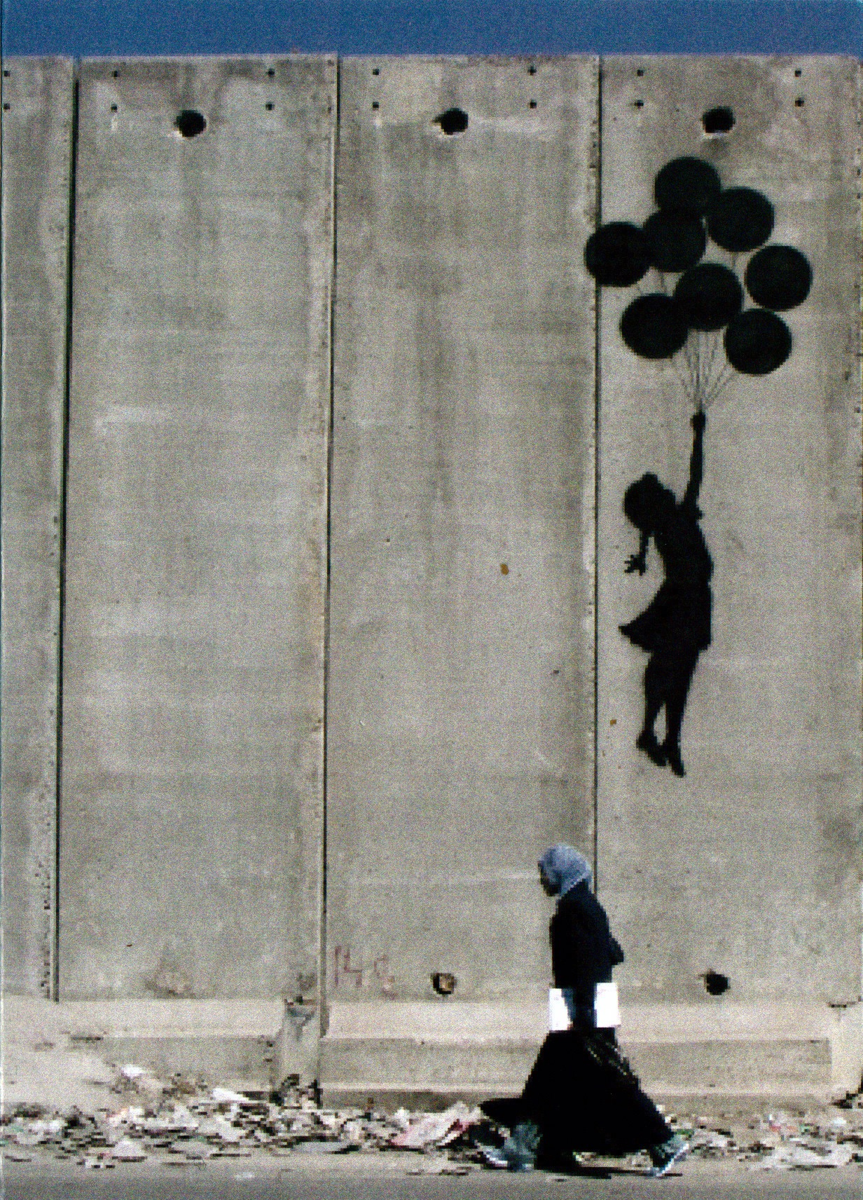
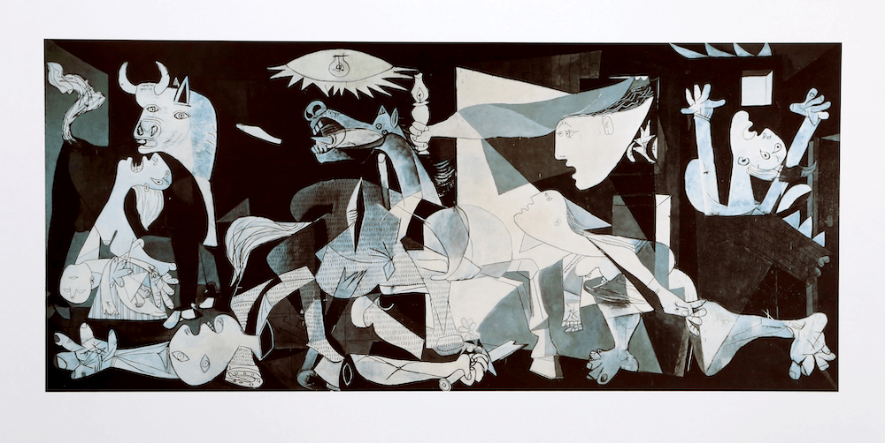
Alveson (2021) power for social change:
Notes:
1. Pablo Picasso – Guernica (1937)
Theme: Anti-war, human suffering
Power Lens:
Power over: Fascist violence
Power to: Artistic resistance
Centred power: State violence
Diffused power: Global protest movements
Use in Class: Ask students how visual chaos conveys oppression and how art can be a form of resistance. [artsproutsart.com]
2. Banksy – Girl with Balloon & West Bank Graffiti
Theme: Innocence, displacement, human rights
Power Lens:
Power over: Military control, surveillance
Power to: Street art as protest
Empowerment vs Disempowerment: Role reversal in the West Bank piece (child searches soldier)
Use in Class: Discuss how anonymity and public space challenge traditional power structures. [gigwise.com]

Slide 38
Power is a contested term (Avelino, 2021)
Ranging from power as actor-specific resources used in the pursuit of self-interests (Weber in: Fuchs 2001)
to
power as the capacity of a social system to mobilize resources to realize collective goals (Parsons, [1967] 2002)
‘Any attempt to capture the ‘essence’ of the word will exclude aspects that might be essential in a given context’ (Avelino, 2021 p.426)
explicit power theories tend to privilege stability over change

Slide 39
🔹 Power Over / To / With
Who is controlling or limiting others? (Power over)
Who is acting to create change? (Power to)
Who is working together? (Power with)
Think of a protest or campaign:
Who’s leading it?
Who’s being affected? Are people working together or being silenced?
Notes:
2. Power ‘over’ versus power ‘to’ Even if one holds that power is exercised rather than possessed (Foucault [1977]2002), the question remains what is exercised; is it a capacity ‘to’ act and achieve something, or is it a social relationship in which A exercises power ‘over’ B? In this regard Morriss points out that power is derived from the Latin word potere – ‘to be able’ – and claims that in philosophical and linguistic terms, power ‘is always a concept referring to an ability, capacity or dispositional property’ ([1987]2002, p. 283).
According to Morriss, ‘everything that needs to be said about power can be said by using the idea of the capacity to effect outcomes’ (Morris [1987]2002, p. 299). This definition of power as a capacity to act, does not exclude conflictual or violent dimensions: ‘if we are interested in the “conflictual aspect” of power, we can very easily look at someone’s power to kick others around, or their power to win conflicts’ (ibid).
Nevertheless, theories that focus on power as a capacity (as in e.g. Parsons and Arendt) are criticized for ignoring the relational or oppressive aspects of power ‘over’ others (Lukes [1974]2002), or for ‘fail[ing] to account for individuals or groups in the community who, though they do not exercise power, nonetheless have power, in the sense that many people try assiduously to anticipate their reactions’ (Dahl [1968]2002:20 in reference to Bachrach and Baratz 1962).
The previous citation points to another question, i.e. to what extent power exists before its exercise; does an actor already have power if he or she has the potential to exercise it, or can an actor only be considered powerful once he or she actually exercises power? According to Barnes, power is both ‘a potential or capacity which may or may not be used’, as well as something that ‘is possessed’ ([1988]2002, p. 125), the relevant point being that power always ‘resides in the social context and outside its possessor’ (ibid:127). Or as Clegg puts it; people ‘possess power only in so far as they are relationally constituted as doing so’ (Clegg [1989]2002, p. 257)
. The same could be said about the exercise of power; that it resides in the social context and outside of its exerciser, and that people only exercise power in so far as they are relationally constituted in doing so. Thus it seems that power ‘over’ and power ‘to’ are not mutually exclusive; both can be ‘possessed’ and ‘exercised’, and both are ‘relationally’ constituted in some way or another. Some authors have proposed to nuance and elaborate the distinctions between ‘power over’ and ‘power to’, by e.g. elaborating power with as a third type, distinguishing between power over (coercion and manipulation), power to (resistance and empowerment) and power with (cooperation and learning) (cf. Partzsch 2015).
The argument made is that ‘there are situations in which power is neither attributed solely to A nor to B, but to both’, however that ‘power with is not exercised independently from power over dimensions’, and that we need to analyse how these different types of power are intertwined so as to remain attentive to conflicts of interests and values that often remain invisible or hidden (Partzsch and Fuchs 2012).
Power ‘to’ versus power ‘over’: implications for research on social change and innovation While ‘power over’, ‘power to’ and ‘power with’ refer to different perspectives on power, they can also be understood as different manifestations of power. An important starting point for understanding change is acknowledging how these different manifestations of power can play a role in processes of change. For instance, A and B can contribute to or resist change (power to), and/or A can coerce or hamper B to change (power over), and/ or A and B can cooperate for or against change (power with). Moreover, all three manifestations of power can be objects of change, in the sense that change and innovation initiatives can explicitly strive to challenge certain forms of oppression and domination (power over), and/or strive to empower people through capacity building (power to) or collaboration (power with). Relevant empirical questions to be asked about social change and innovation are:
● Power over: Who is exercising power over whom? How are which structures of domination/oppression/dependence changed or (re)produced? ○ How does change (re)construct (new) structures of domination, oppression and dependency? Which existing dependencies, dominations and oppressions are reinforced? ○ How and to what extent do change initiatives aim to overcome/resolve/improve existing structures of domination? How and to what extent are existing power dependencies challenged and ‘independencies’ created?
● Power to: How is power exercised for/through/against change? ○ How do actors exercise power to enable or resist change? ○ (To what extent and how) does the change contribute to capacity-building in terms of power to?
● Power with: How do actors collaborate in the exercise of power for/against change? ○ What are the power coalitions that enable/resist change? ○ (How and to what extent) are existing power coalitions (re)produced/challenged by/for/through change

Slide 40
🔹 Centred vs Diffused Power
Is power held by a few (government, corporations, organisations)?
Or is it spread out (community groups, social media users)?
Who makes the big decisions? Is it one group or lots of smaller ones?”
Notes:
3. Centred versus diffused Another classical debate on power is the one between ‘pluralists’ and ‘elitists’. One side emphasized that elites possess power over society, while the other side stressed that political power concerns a struggle between plural interest groups. While Dahl ([1968]2002] criticized the ‘ruling elite model’ by pointing out that political power comes from broad decisionmaking processes, Bachrach and Baratz (1962) referred to the ‘second face of power’ to emphasize how elites are capable of predetermining agenda-setting before and outside the open process of decision-making, for instance by keeping certain issues off the agenda (also referred to as ‘non-decision making’). In addition, Lukes ([1974]2002) introduced a ‘third face of power’, referring to processes of preference-shaping. Therein certain groups shape the interests and preferences of other groups, as such not even having to keep issues ‘off the agenda’, as these issues are prevented from emerging in people’s minds in the first place. JOURNAL OF POLITICAL POWER 429 This debate relates to Foucault’s notions that the hierarchical, centralized notion of power as a King would have it or any other judicial-political entity is an outdated legacy from the past, and to Mann’s distinction between authoritative power and diffused power. While authoritative power ‘comprises definite commands and conscious obedience’, diffused power ‘spreads in more, spontaneous, unconscious, decentred ways throughout a population, resulting in similar social practices that embody power relations but are not explicitly commanded’ (Mann in: Stewart 2001:25). An essential trait of diffused power is ‘normalization’, i.e. the belief that certain practices are ‘moral’ or in the ‘common interest’, which relates back to Lukes’ preference-shaping, and to various discursive interpretations of power as found in Foucauldian analyses. 3.1. Centred versus diffused power: implications for research on social change and innovation Both academic and public discourses on social change and innovation involve various empirical cases as well as conceptual notions of diffusion or decentralisation of power. Such decentralisation is often implicitly or explicitly assumed to be ‘good’ and to lead to more ‘equal’ or ‘just’ power relations. Examples are renewable energy innovations and the associated (possibilities) for decentralisation of energy production, which may enable community-led energy cooperatives. Theories of power can be useful to question how, to what extent and under which conditions, such change and innovation contribute to a decentralisation of power relations. However, power theories also provide insights on how processes of power decentralisation can also involve the (re)construction of old or new power inequalities and oppressions (e.g. if and when community-led energy cooperatives primarily involve affluent actors with a high social capital, possibly – and often unintendedly – excluding others). Moreover, power theories help remind us that social change and innovation processes do not necessarily strive for the decentralisation of power. On the contrary, they can also manifest in a ‘recentralisation’ or ’re-enforcement’ of centralised power (e.g. when renewable energy is coopted by existing energy multinationals). As such, it is particularly pertinent to study the following empirical questions about power in social change and innovation processes: ● (How) are the three faces of power manifested in processes of change? ● How and to what extent is power diffused, (de)centralised and/or recentralised by/ for/through change? ● Are there ‘ruling elites’ or ‘centres of power’ that hamper and/or enable change, and if so, who/where are they? Which other groups are involved, and who is excluded? ● How and by whom is the agenda of change decided? Which issues are kept off the agenda? ● How are preferences and interests underlying processes of change shaped? What are related processes of normalization

Slide 41
🔹 Constraining vs Enabling Structures
What rules, laws, or systems help or block change?
Is there a law that helps people speak up? Or one that stops them?
Notes:
4. Consensual versus conflictual Debates on power often revolve around the question whether power is consensual or conflictual (Haugaard 2002). This relates to the question whether power is distributive or 430 F. AVELINO collective. In the distributive model, power is ‘zero-sum’, i.e. gained by one actor at the cost of another actor. In the collective model, actors can enhance their joint power, as is the case in Parsons’ earlier mentioned definition of power as the capacity of a societal system to achieve collective goals (Parsons [1967]2002, p. 93), or in Arendt’s interpretation of power as ‘the human ability not just to act but to act in concert’ 1979]2002, p. 137). These models are ‘consensual’ in the sense that both Parsons and Arendt position consensus as a necessary condition of power. Parsons compared power to money, claiming that its meaning can only survive as long as society supports it, and that power diminishes when it is used illegitimately (similarly to processes of inflation). According to Arendt, violence can destroy power, but ‘is utterly incapable of creating it’, and ‘power and violence are opposites; where the one rules absolutely, the other is absent’ 1979]2002, p. 143). This starkly contradicts with Mann’s characterization of violence as ‘the most concentrated, if bluntest, instrument of human power’ ([1986]2002, p. 177). Distinguishing violence from power does not necessarily take away the conflictual, physical, or oppressive dimensions of power. Quite on the contrary, the ability of oppressing without blunt violence is regarded by some as the essential characteristic of power. As Foucault puts it: ‘subjection is not only obtained by the instruments of violence or ideology; it can also be direct, physical, pitting force against force, bearing on material elements, and yet without involving violence; it may be calculated, organized, technically thought out; it may be subtle, make use neither of weapons nor of terror and yet remain a physical order’ (Foucault [1977]2002, p. 191). According to Foucault, ‘power is a form of pacification which works by codifying and taming war through the imposition of particular knowledge as truth’ (ibid: 185). This resonates with Lukes’ preference-shaping, which challenges the Weberian premise of power as influence in spite of resistance. The capacity to make resistance dissolve – by shaping preferences – is understood as a decisive moment in the exercise of power. The distinction between ‘consensual’ and ‘conflictual’ power is therefore a tricky one, as power is characterized by some as the ability of blurring this distinction, either by turning a conflictual situation into a consensual one, or by preventing conflict from emerging in the first place. Here it is also important not to equate ‘conflictual’ with ‘power over’ or ‘consensual’ with ‘power to’. As Haugaard (2012, p. 37) points out: “The idea that in principle not all exercises of power over constitute domination shifts the line between the consensual and conflictual traditions. It has generally been assumed that consensual traditions concerned power to, while the conflictual, power over. Thus, power over equates with domination. What always was slightly anomalous in this interpretation was that the main consensual theorists (Parsons 1963, Arendt 1970, Barnes 1988, Searl 2007) clearly see themselves as writing about power over, as well as power to”

Slide 42
Different types of power – understanding ‘politics’
1. Visible Power: Observable Decision making
2. Hidden Power: Setting the Political Agenda
3. Invisible Power: Shaping Meaning
(VeneKlasen and Miller, 2007 but linked to Lukes (1974) Three dimensions of power. )
Notes:
Visible Power: Observable Decision making - This level includes the visible and definable aspects of political power – the formal rules, structures, authorities, institutions, and procedures of decision making. Examples include elections, political parties, laws, legislatures, budgets, corporate policy, by-laws, etc. There are two main ways that visible power discriminates against certain interests and people: • biased laws and policies that may seem “neutral” but clearly serve one group of people at the expense of others, such as health policies that do not adequate
2. Hidden Power: Setting the Political Agenda This level of power over is less obvious and, hence, more difficult to engage. Certain powerful people and institutions maintain their influence by controlling who gets to the decision making table and what gets on the agenda. These dynamics exclude and devalue the concerns and representation of other less powerful groups, such as women and the poor. Excluded groups often point out that they and their issues, such as toxics, land rights, and domestic violence, are both invisible to the society at large and absent from the political agenda. Difficulties in gaining media coverage can further inhibit visibility and legitimacy since media outlets often do not see these groups’ issues as “mainstream” or newsworthy.
In some contexts, powerful political and economic interests attempt to discredit disadvantaged groups, making it impossible for citizens without resources or affiliation to get their voices heard, even if they represent a substantial population. In some cases, leaders are vilified or even killed. By preventing important voices and issues from getting a fair public hearing, policymaking can be skewed to benefit a few at the expense of the majority. Advocacy groups challenge this level of power over by creating broad-based constituencies for policy and institutional reform that reduce systemic discrimination. In building strong and accountable organizations they tap their power with others to get to the table. They produce and disseminate analysis and alternative perspectives about their issues and politics. They also attempt to develop ties with powerful allies to increase their political voice and presence. These strategies have been pursued effectively by environmental, AIDS, women’s and rights groups, among others
3. Invisible Power: Shaping Meaning Probably the most insidious of the three dimensions of power, this third level operates in ways that render competing interests and problems invisible. Significant problems and issues are not only kept from the decision making table, but also from the minds and consciousness of the different players involved, even those directly affected by the problem. By influencing how individuals think about their place in the world, this level of power shapes people’s beliefs, sense of self, and acceptance of their own superiority or inferiority. In many societies, for example, men and women have been taught to accept their respective roles and relationships as natural. Socialized consent prevents people from questioning or envisioning any possibilities for changing these relationships or addressing injustices. Processes of socialization, culture, and ideol

Slide 43
Visible power! How the Equality Act (2010) Can Unintentionally Discriminate
Digital-First Public Services
Equality Act compliance excludes older adults or low-income groups when services move online without alternatives.
Healthcare Policies
“Neutral” maternity care guidelines overlook higher risks for Black and Asian women, contributing to disparities despite formal equality compliance.
Workplace Adjustments
Employers may meet minimum legal requirements but fail to provide meaningful accommodations for neurodiverse employees.
Notes:
The Equality Act 2010 is a UK law designed to protect individuals from discrimination and promote equality across nine protected characteristics:
Age
Disability
Gender reassignment
Marriage and civil partnership
Pregnancy and maternity
Race
Religion or belief
Sex
Sexual orientation

Slide 44

UNCRC
Focuses on universal rights for children, but implementation often assumes equal access to resources.
Rights to education and health may not account for marginalised groups (e.g., refugee children or those in poverty), leading to unequal outcomes despite formal compliance
Notes:
he right to education under the UNCRC is covered by:
Article 28 – Right to Education
States Parties recognize the right of the child to education and agree to make primary education compulsory and free for all.
They also commit to:
Encourage secondary education accessibility (including vocational training).
Make higher education accessible based on capacity.
Ensure school discipline respects the child’s dignity.
Promote international cooperation to eliminate ignorance and illiteracy.
Additionally, Article 29 focuses on the aims of education, emphasizing development of the child’s personality, talents, and respect for human rights.
Picture from: Supporting refugee and asylum-seeking children in their education – Enquire Scotlands support Services for refugee children.

Slide 45
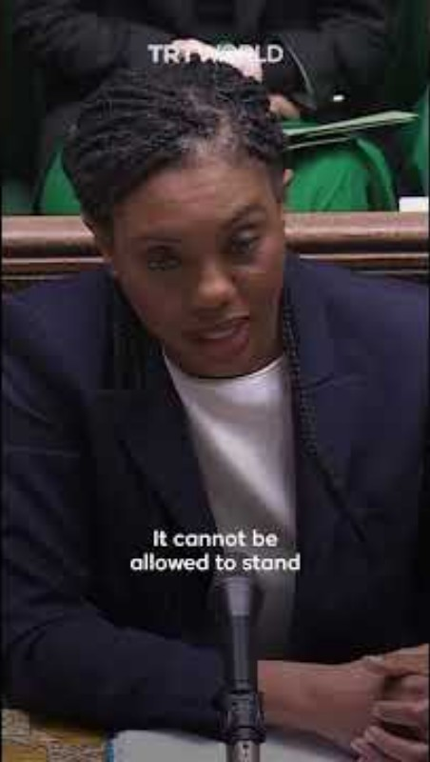
Human Rights Act 1998 (HRA)
Guarantees rights like privacy and family life, but enforcement depends on legal challenges, which require resources and knowledge.
This disadvantages low-income individuals, making rights protection uneven.
Notes:
The Human Rights Act 1998 sets out the fundamental rights and freedoms that everyone in the UK is entitled to. It incorporates the rights set out in the European Convention on Human Rights (ECHR) into domestic British law. The Human Rights Act came into force in the UK in October 2000.
The human rights that are covered by the Act
The Act sets out your human rights in a series of ‘Articles’. Each Article deals with a different right. These are all taken from the ECHR and are commonly known as ‘the Convention Rights’:
Article 2: Right to life
Article 3: Freedom from torture and inhuman or degrading treatment
Article 4: Freedom from slavery and forced labour
Article 5: Right to liberty and security
Article 6: Right to a fair trial
Article 7: No punishment without law
Article 8: Respect for your private and family life, home and correspondence
Article 9: Freedom of thought, belief and religion
Article 10: Freedom of expression
Article 11: Freedom of assembly and association
Article 12: Right to marry and start a family
Article 14: Protection from discrimination in respect of these rights and freedoms
Protocol 1, Article 1: Right to peaceful enjoyment of your property
Protocol 1, Article 2: Right to education
Protocol 1, Article 3: Right to participate in free elections
Protocol 13, Article 1: Abolition of the death penalty
Articles 1 and 13
Articles 1 and 13 of the ECHR do not feature in the Act. This is because, by creating the Human Rights Act, the UK has fulfilled these rights.
For example, Article 1 says that states must secure the rights of the Convention in their own jurisdiction. The Human Rights Act is the main way of doing this for the UK.
Article 13 makes sure that if people’s rights are violated they are able to access effective remedy. This means they can take their case to court to seek a judgment. The Human Rights Act is designed to make sure this happens.
What the Human Rights Act does
The Act has three main effects:
1. You can seek justice in a British court
It incorporates the rights set out in the European Convention on Human Rights (ECHR) into domestic British law. This means that if your human rights have been breached, you can take your case to a British court rather than having to seek justice from the European Court of Human Rights in Strasbourg, France.
2. Public bodies must respect your rights
It requires all public bodies (like courts, police, local authorities, hospitals and publicly funded schools) and other bodies carrying out public functions to respect and protect your human rights.
3. New laws are compatible with Convention rights
In practice it means that Parliament will nearly always make sure that new laws are compatible with the rights set out in the European Convention on Human Rights (although ultimately Parliament is sovereign and can pass laws which are incompatible). The courts will also, where possible, interpret laws in a way which is compatible with Convention rights.
Find out more about human rights and how they play a part in our everyday lives: what are human rights?
Download a full copy of the Human Rights Act.
See ERHC website for more details:
The Human Rights Act | EHRC
Key Case: Palestinian Family under Ukraine Visa Scheme
A UK judge recently ruled in favour of a Palestinian family applying under the Ukraine visa scheme, allowing them to reunite in the UK based on Article 8 of the HRA.
This decision emphasized that separating the family would breach their right to family life.
The case sparked political debate, with government figures suggesting closing what they called a “loophole,” which shows how Article 8 is a qualified right and can be limited for reasons like immigration control.
Why it matters for low-income individuals: These cases often require extensive evidence and legal representation, which is difficult for refugees or low-income families to access. Without resources, many cannot challenge decisions, making rights protection uneven.

Slide 46
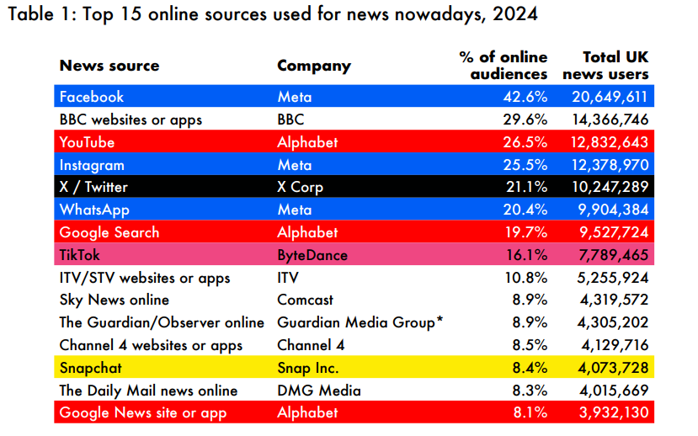
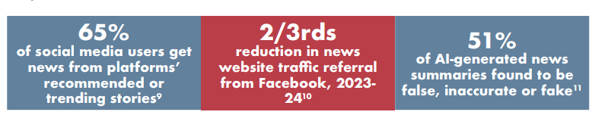
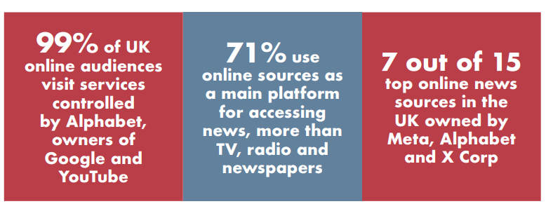
Hidden power
Media Ownership in the UK (2025):
90% of UK newspapers are owned by three corporations, limiting diversity of perspectives and reinforcing agendas.
Notes:
Media Report:
2025-Who-Owns-The-UK-Media-report.pdf

Slide 47
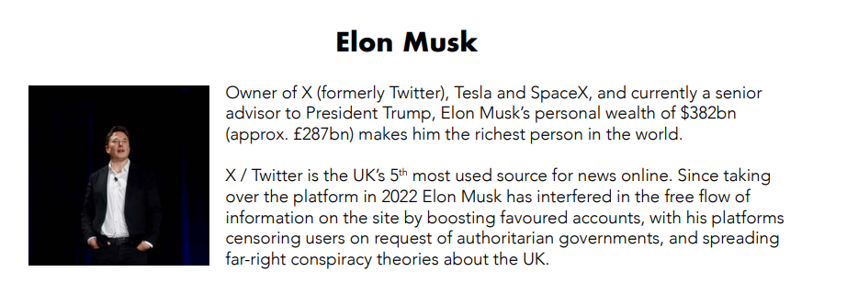
Notes:
2025-Who-Owns-The-UK-Media-report.pdf

Slide 48
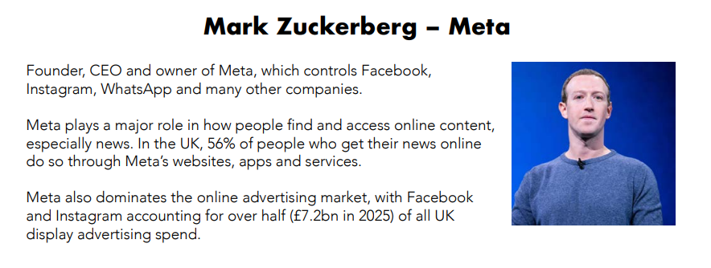
Notes:
2025-Who-Owns-The-UK-Media-report.pdf

Slide 49
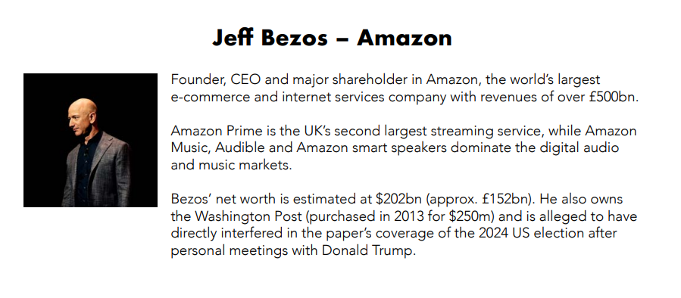
Notes:
2025-Who-Owns-The-UK-Media-report.pdf

Slide 50
Which issues in your community rarely make headlines? Why might that be?
Let’s look at the news today together on our phones…

Slide 51

Invisible Power: links to other theories we discussed!
Definition of Invisible Power
  Invisible power shapes beliefs and perceptions through culture and ideology, making norms seem natural and unquestioned.
Mechanisms of Influence
  Socialization and cultural norms embed invisible power, excluding key issues from public awareness.
Gender Bias Example
  The 2023 UNDP report reveals strong global gender biases influencing perceptions of leadership and roles.
See: Feminist Theorist Judith Butler
Gender norms are socially constructed and maintained through repeated performance. Key Work: Gender Trouble (1990).Contribution: Invisible power operates through cultural scripts that define what is “normal” for men and women.

Slide 52
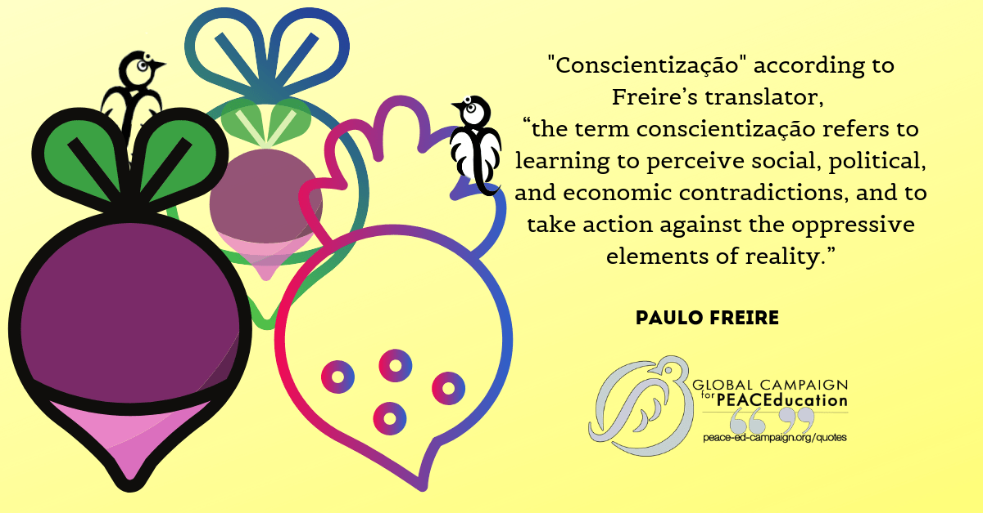
Why It Matters
Hardest form of power to challenge because it’s internalized.
Requires critical consciousness (Conscientização)
(Paulo Freire) and cultural change to dismantle
Critical consciousness (or conscientização) is the ability to perceive social, political, and economic oppression and take action against the oppressive elements of society.

Slide 53

Homework:
See Moodle for a copy of this sheet. This may help you to look at the issues your group may face and what could help

Slide 54
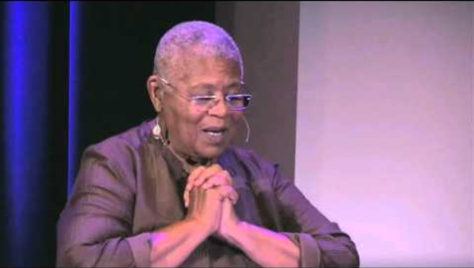
Non Violence as Power

Slide 55
Consensual Power
Based on shared goals, mutual recognition, and legitimacy.
Often seen in democratic processes, teamwork, or collective action.
Example: A community group working together to improve local housing.
Conflictual Power
Involves struggles, opposition, or resistance.
Can be emancipatory (challenging injustice) or oppressive (suppressing dissent).
Example: Protest movements against police brutality.
Notes:
“Power is not always visible. Consensus may hide conflict, and conflict may lead to consensus.”

Slide 56
🔹 Empowerment vs Disempowerment
Who is gaining confidence or resources to act?
Who is being left out or made more vulnerable?
Does the change help everyone equally?
Or - does it leave some people behind?
Notes:
Using ‘empowerment’ in social change and innovation research requires awareness of that ‘historical discursive legacy’ of the empowerment concept. The (dis)empowerment paradox implies that ‘empowerment’ processes in change and innovation often come with (unintended) ‘disempowerment’ consequences, and that it is necessary to remain critical and attentive to both sides of that same coin. An additional insight from empowerment literature is that (dis)empowerment concerns should not only be with ‘social change agents’ but also with other actors affected by the social change (e.g. government officials or conservative groups)
Using ‘empowerment’ in social change and innovation research requires awareness of that ‘historical discursive legacy’ of the empowerment concept. The (dis)empowerment paradox implies that ‘empowerment’ processes in change and innovation often come with (unintended) ‘disempowerment’ consequences, and that it is necessary to remain critical and attentive to both sides of that same coin. An additional insight from empowerment literature is that (dis)empowerment concerns should not only be with ‘social change agents’ but also with other actors affected by the social change (e.g. government officials or conservative groups)
Examples to illustrate:
Community activism:
A local council supports youth-led activism to empower young people in shaping public spaces.
But older residents may feel disempowered if their needs or voices are ignored in the process.
Gender equality in the workplace:
A company introduces policies to empower women in leadership.
Some male employees might feel left out or resistant, especially if they perceive the change as unfair or threatening to their status.
Digital inclusion projects:
A tech initiative empowers rural communities with internet access and digital tools.
Local government officials may feel disempowered if they weren’t consulted or if the project bypasses their authority.

Slide 57
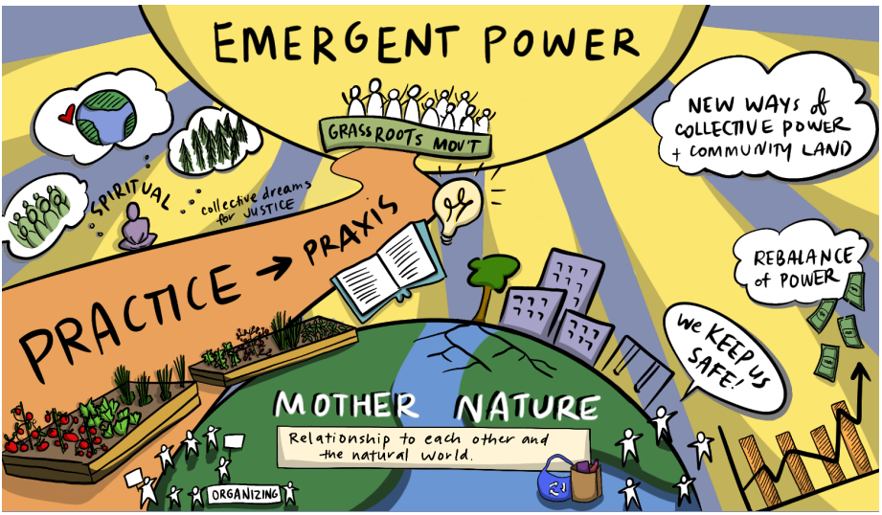
Notes:
The NorthStar network would say:
Image is from Northstar Network
From mutual aid and basic support for food, housing, PPE, and vaccines to mobilizing to call out abuse or to defend land, water, labuor rights and protections, care, justice, and access, an expanded sense of community is being born out of loss, indignation, and longing. A rebalanced relationship to the earth offers a new global grounding for the future we need to build
Praxis means:
aulo Freire’s concept of praxis is central to his philosophy of education and social transformation. He defines praxis as:
“Reflection and action upon the world in order to transform it.”
In Freire’s view, praxis is not just practice or activity—it is critical, conscious, and purposeful action that emerges from deep reflection. It’s the process by which oppressed people become aware of their conditions and take collective action to change them. This is deeply tied to power, as praxis enables individuals to challenge dominant structures and reclaim agency.

Slide 58
Avelino, F. (2021) Theories of power and social change. Power contestations and their implications for research on social change and innovation, Journal of Political Power, 14:3, 425-448, DOI: 10.1080/2158379X.2021.1875307
Bachrach, P., and Baratz, M. S. (1962). Two Faces of Power. American Political Science Review, 56(4), 947–952.
Conrad, P. (2007). The Medicalization of Society: On the Transformation of Human Conditions into Treatable Disorders. Johns Hopkins University Press.
Conrad, P., and Schneider, J. W. (1980). Deviance and Medicalization: From Badness to Sickness. St. Louis: Mosby.
Expanded edition: Conrad, P., and Schneider, J. W. (1992). Deviance and Medicalization: From Badness to Sickness. Philadelphia: Temple University Press.

Slide 59
Hirschi, T. (1969) Causes of delinquency.
Hirschi, T. (2010) Social Control Theory. In: Encyclopedia of Criminological Theory. Francis T. Cullen and Pamela Wilcox Editors, Thousand Oaks, CA: SAGE Publications, Inc. pp. 452-458 Available at: https://doi.org/10.4135/9781412959193.n124 [Accessed 14 Oct 2025].
Hirschi T & Gottredson MR (2005) ‘Punishment of Children from the Perspective of Control Theory’ in Donnelly M & Straus MA, Corporal Punishment of Children in Theoretical Perspectives, New Haven, CT: Yale University Press.

Slide 60
Leadbetter, M. (2002) ‘Empowerment and advocacy’. in Adams, R, Dominelli, L and Payne (eds) Social work: Themes, issues and critical debates. Basingstoke: Palgrave Macmillan. Available at: Full details and actions for Social work: themes, issues and critical debates [Last Accessed 08/10/2025]
Lister, R, Partick, R. and Brown, K. (eds) (2024) Understanding theories and concepts in social policy. Second edition. Bristol: Policy Press.
Miller, V. et al. (2006). Making change happen: Power. Available at: mch3_2011_final_0.pdf [Last Accessed 08/10/2025]
VeneKlasen, L. and Miller, V. (2007) A new weave of power, people & politics: The action guide for advocacy and citizen participation. Bourton-on-Dunsmore: Practical Action Publishing.

