Slide 1

Teaching Counting and Early Number Sense

Slide 2
Objectives
To understand the principles of counting and early number development
To consider how teacher knowledge of these principles can impact on children’s learning
To consider opportunities for developing counting strategies within the early years Foundation Phase setting
To understand national expectations in relation to counting

Slide 3
Success Criteria
By the end of the session you should:
understand the processes involved in learning to count and recognising number
feel more confident in identifying teaching/learning opportunities for counting and number recognition

Slide 4
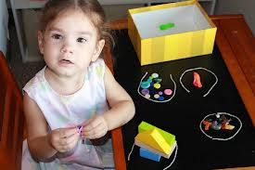
Pre-counting Skills
communication skills
understanding of more or less
being able to sort and match objects

Slide 5
What numbers may represent…
Cardinal aspect (the size of a set)
Ordinal aspect (the position of an object in a set)
Labels (e.g. bus numbers, group names etc)

Slide 6

National Expectations
Look at the new (2015) Foundation Phase Framework Mathematical Development area of learning; this is statutory from this September.
Where is counting explicit? Where is counting implicit?
Now look at the Mathematical Development ‘Foundation Phase Outcomes’. Note the progression in counting skills.
http://gov.wales/topics/educationandskills/earlyyearshome/foundation-phase/?lang=en

Slide 7
Using Puppets…
http://www.youtube.com/watch?v=Gk7mkIAMc7s
Read: Counting with Miss Count (Moodle)
How is using a puppet an effective way of helping children?

Slide 8
How many in each set?

Slide 9
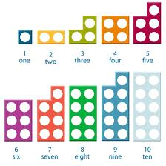

Numicon as a representation of number
Make a list of advantages and possible disadvantages of using Numicon as a representation for number

Slide 10
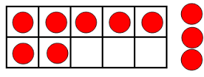
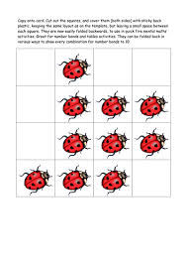
Resources to help develop number sense…
The ten frame (see http://nrich.maths.org/10742)
The ‘flick flack’ or ‘flip flap’
https://apps.mathlearningcenter.org/number-frames/
http://www.teacherled.com/iresources/hundredsquareadvanced/

Slide 11
Further reading/activities…
Tucker, K. (2010) Mathematics Through Play in the Early Years. London, Sage
http://www.youtube.com/watch?v=6bqCewhXSGI#
(If you would like to consolidate your understanding of counting principles)
http://www.communication4all.co.uk/Numeracy/Number%20Formation%20Rhyme%20Cards.pdf
(For number formation rhymes)
http://www.tes.co.uk/teaching-resource/Interactive-Number-Formation-Rhymes-6193194/
(For a number formation powerpoint)
Ncetm resources:
Work through early years cpd ‘counting’ microsite and:
  Early Years magazine archive. Take some time to browse the magazine as there are useful ideas in every issue.
  Investigating how children’s play can enrich the early mathematical experience (Teacher Enquiry Funded Project)
  Maximising opportunities for mathematics learning across the primary curriculum
  As the Bell Goes: Audio reflections
  Rain, Rain Come and Play!

Slide 12
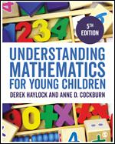
Complete reading Chapter 2 of Haylock and Cockburn (2017), or re-read if you feel you need to consolidate.

