Slide 1
OPERATING HOTEL FACILITIES
Component three: Presentation Slides
Vasile Pitirici
Student ID:2213442
Student ID:
Date:

Slide 2
Table of Contents
Introduction……………………………………………………………………………………… Slide 3
Implication of Maslow’s Hierarchy of Needs principles for employee engagement……. Slide 4
Determining training needs…………………………………………………………….. Slide 5
Selection of objectives………………………………………………………………………. Slide 6
Developing activities for training………………………………………………………. Slide 7 and 8
Material resourcing…………………………………………………………………………….. Slide 9
Program evaluation…………………………………………………………………………….. Slide 10
Assessment of health and safety measurements…………………………………. Slide 11
Conclusion………………………………………………………………………………………….. Slide 12
References…………………………………………………………………………………………… Slide 13

Slide 3
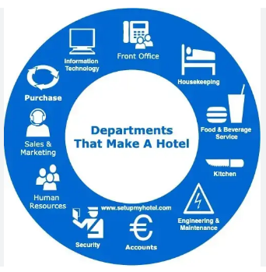
Introduction
The training facility is aimed at improving the operational capability of housekeeping team members.
It may contribute to improving guest satisfaction and performance improvement within the organisation.
Notes:
Improving the operational efficiency of workers involved in housekeeping tasks is important for maintaining the brand reputation of the hotel (Choi and Choi, 2021, p.23). Incorporating industry-based practices and developing respective activities regarding them can help integrate their professional efficiencies. The discussed training activities are aimed at accomplishing those aspects within the housekeeping team operating for this hotel. Moreover, it is expected that better guest satisfaction can be achieved through the implementation of this training facility.

Slide 4
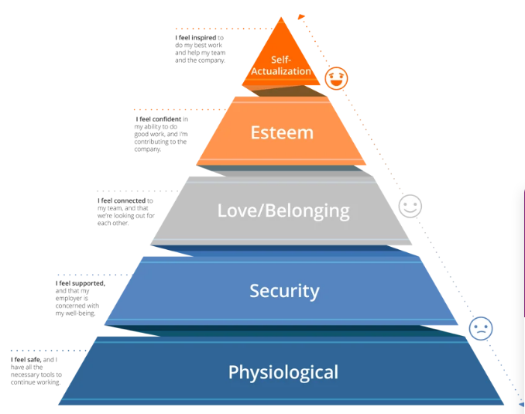
Implication of Maslow’s Hierarchy of Needs principles for employee engagement
Meeting the fundamental needs of employees helps increase their engagement with operations (vantagecircle, 2023)
The critical implication of this model allows organisations to track growth and development among employees
Notes:
Considering housekeeping activities in a hotel can be exhausting, preparing an employee engagement training process by addressing their fundamental needs often becomes helpful. According to this model of employee engagement failing to meet any of the proposed stages can affect the overall well-being of employees and hereafter their performance. Thus, the training process considers activities to meet each needs of housekeeping employees to keep them engaged with operations.

Slide 5
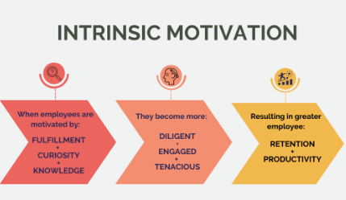
Determining training needs
A better understanding of job roles
Increasing intrinsic motivational factors among employees
Enhancing self-awareness regarding personal and professional competencies
Obligation to organisational commitments
Notes:
Several reasons are involved with the need for training facilities after evaluating the checklist in the previous task. The inability to meet checklist requirements has been one of the important ones. Belias and Trihas (2022, p.102) mentioned that employee training can become a core competency during crisis management. Therefore, offering the training facility to housekeeping employees would help create a capable employee base with a better commitment to organisational standards and operational practices.

Slide 6
Selection of objectives
To address the needs of employees to develop intrinsic motivations
To enhance communication and collaboration capabilities in 2 months
To evaluate employee commitment to operational practices in 1 month
Collaboration
Productivity
Communication
Notes:
Facilitation of employee objectives helps comprehend progress among employees in terms of the proposed training sessions (indeed, 2023). For the housekeeping training, the aforementioned training objectives have been prioritised to ensure proper personal and professional growth among team members of housekeeping services. On the contrary, Bakker and Leiter (2010, p.92) also mentioned that training is necessary for assisting employees to achieve their work goals. It justifies the importance of the proposed objectives.

Slide 7
Developing activities for training
Activities | Expected outcome | Timelimit
Team operations with a group of 4 members | Better collaboration and communication among members | 2 months
Distribution of work responsibilities | Identifying the most capable employees and recognising them for their effort | 2 months
Notes:
According to the opinion of Bridger (2018, p.136), it is necessary for teamwork that members feel to be a part of the group. The main target of the first activity is to develop a sense of belonging among members followed by addressing esteem needs by recognising their efforts throughout the operations.

Slide 8
Developing activities for training
Activities | Expected outcome | Timelimit
Service training such as checking and addressing required amendments in hotel rooms for each employee | Better performance and job satisfaction with the intention for operational autonomy | 2 to 3 months
Appointing one of the members in team leading based on their performance | Improving leadership qualities and supporting operational environment | 1 month
Notes:
Kyalo (2023, p.15) explained that training is essential for providing a skilled human resource to improve knowledge and skills of a workforce. The proposed activities are expected to be advantageous in enhancing leadership and management skills among employees that would address their psychological and self-actualisation needs. It is essential for enhancing the overall employee engagement in housekeeping services.

Slide 9
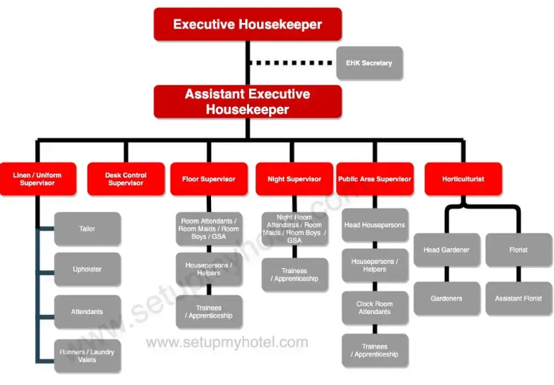
Material resourcing
Funding from hotels and other investors
Assigning and expert guidance for new employees who have joined the housekeeping department
Notes:
Different resources could be required for the completion of this training session for housekeeping employees involved with the hotel organisation. One of the main required resources is investment as it can be offered to employees with the best performance as a gesture of performance recognition. Nonetheless, advancing in workers’ development often results in profit from investment (Barreto and Mayya, 2023, p.29). Therefore, using it as a resource and offering guidance from an expert could be helpful in the proper execution of the activity.

Slide 10
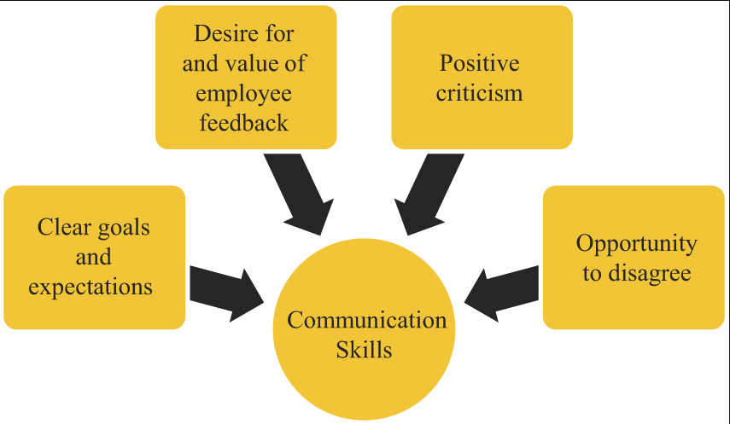
Program evaluation
Betterment of leadership skills among employees
Improvement in communication and collaborative outcomes
Better job satisfaction among employees
Notes:
The aforementioned aspects are contemplated to be evaluated to determine whether the training program has been effective or not. Mejabi and Adah (2021, p.1) commented that a lack of training among hotel staff can be counterproductive leading to low productivity. Therefore, evaluating each employee’s progress is essential which would be measured through those improvements.

Slide 11

Assessment of health and safety measurements
Adherence to employee safety code of conduct
Maintaining hotel’s ethics for safety standards
Obligation to government regulations in hotels
Notes:
During the housekeeping process overall safety management of the hotel is also considered. The Wales government employs the “Regulatory Reform (Fire Safety) Order 2005” which will be considered as well along with the “Equality Act 2010” and “local Environmental Health Department” (businesswales, 2023). Obligation to these measurements can help preserve an overall integrated housekeeping service within the hotel industry.

Slide 12
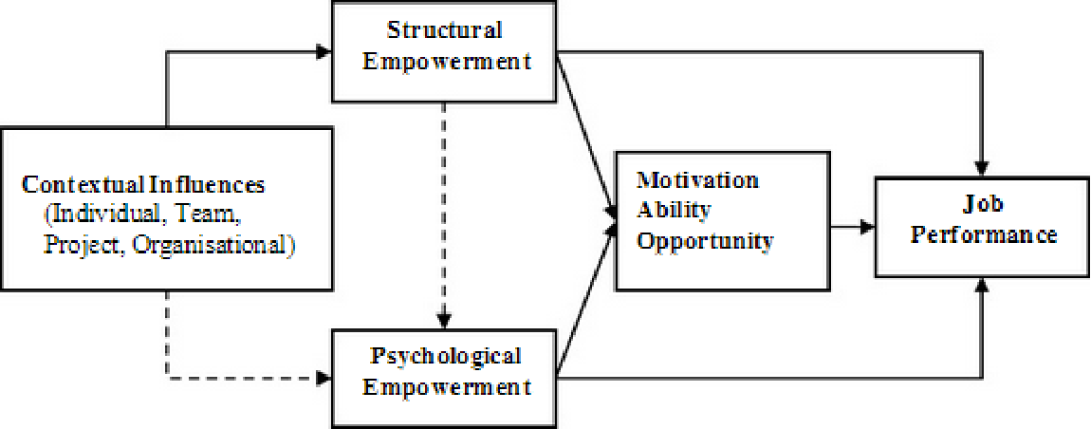
Conclusion
Strategic training facilities for housekeeping employees are beneficial for enhancing their performance competencies
It allows hotel organisations to deliver satisfactory guest service regarding accommodation services
Notes:
The training facilities are suitable for preparing a competent employee base for executing housekeeping services. The activities mentioned for the training facilities are capable of improving employee capabilities while offering an opportunity for them to be more engaged with organisational commitment and ensure job security. It makes the possibility of reducing the potential for high employee turnover relevantly low. Hence, it can be concluded that the preparation of employee training for better engagement needs to be concentrated on addressing the needs of employees while aligning them with organisational goals and objectives.

Slide 13
References
Bakker, A.B. and Leiter, M.P. eds., (2010). Work engagement: A handbook of essential theory and research. Psychology press.
Barreto, N. and Mayya, S., (2023). A Systematic Review on Training and Development in the Hotel Industry. International Journal of Management, Technology and Social Sciences (IJMTS), 8(2), pp.22-52. Available at: https://search.crossref.org/?q=10.47992%2FIJMTS.2581.6012.0268&from_ui=yes.
Belias, D. and Trihas, N., (2022), April. Human Resource Training of Front Office Employees and Change Management in Hospitality Sector during Crisis. In FEMIB (pp. 101-106). Available at: 10.5220/0011060000003206.
Bridger, E. (2018) Employee engagement: a practical introduction. 2nd ed. HR Fundamentals. London: CIPD and Kogan Page.
Businesswales, (2023). “Serviced Hotel Accommodation”. Available at: https://businesswales.gov.wales/sites/business-wales/files/tourism/Serviced%20Hotel%20Guidance.pdf. (Accessed: 5 November 2023)
Choi, M. and Choi, Y., (2021). Employee perceptions of hotel CSR activities during the COVID-19 pandemic. International Journal of Contemporary Hospitality Management, 33(10), pp.3355-3378. Avialable at: https://eprints.leedsbeckett.ac.uk/id/eprint/7885/1/EmployeePerceptionsOfHotelCSRActivitiesDuringTheCOVID19PandemicAM-CHOI.pdf.
Indeed, (2023). “7 Steps for Developing Training Programs for Employees”. Available at: https://ca.indeed.com/career-advice/career-development/developing-training. (Accessed: 5 November 2023)
Kyalo, J., (2023). Effect of Short Course Training on Service Delivery in the Hospitality Industry in Housekeeping and Laundry Department of Kenya Utalii College. Journal of Hospitality and Tourism, 3(1), pp.14-30. Available at: https://www.ajpojournals.org/journals/index.php/JHT/article/download/1386/1489.
Mejabi, E.I. and Adah, G., (2021). Strategic Capacity Building through Human Resources Development in the Hospitality Industry of Lokoja, Kogi State, Nigeria. Journal of International Relations Security and Economic Studies, 1(3), pp.1-8. Available at: https://doi.org/10.36758/jirses/v1n3.2021/1.
Vantagecircle, (2023). “Maslow's Hierarchy of Needs in Employee Engagement (Pre and Post Covid 19)”. Available at: https://blog.vantagecircle.com/maslows-hierarchy-of-needs-in-employee-engagement/. (Accessed: 5 November 2023)

