Slide 1



BUSINESS SKILLS FOR THE INTERNATIONAL
HOTEL INDUSTRY
PRESENTER
SANDY GLADYS LOZANO GRIMALDO
2514605
CONTENTS
Key Attributes Required by Employees
My Learnings from the Module
My Personality and Skills
References & Conclusion
Notes:
Overview of Upper Crust and SSP Group

Slide 2

Key Attributes Required By Employees
01
02
03
04
Customer Service
Teamwork & Adaptability
Organization & Time Management
Communication
08
07
06
05
Industry Knowledge
Emotional Intelligence
Attention to Detail
Problem-Solving & Initiative
Source – (ACCOR, 2024; Dapo, 2023)

Slide 3

My Learnings From the Module
Verbal
No Verbal
Writing
Digital
Communication in Hospitality
Think
Prioritize
Adjust
Experience
Reflection
Action
Effective Planning and Tips for Successful Planning
The ERA Cycle
Check-in / Check-out
Room Reservations
What is Professional Writing
Hotel- Specific Time Management Tips
Clarity
Conciseness
Coherence
Correctness
Why Digital Skills Matter
In University
In Workplace
Objectives

Slide 4
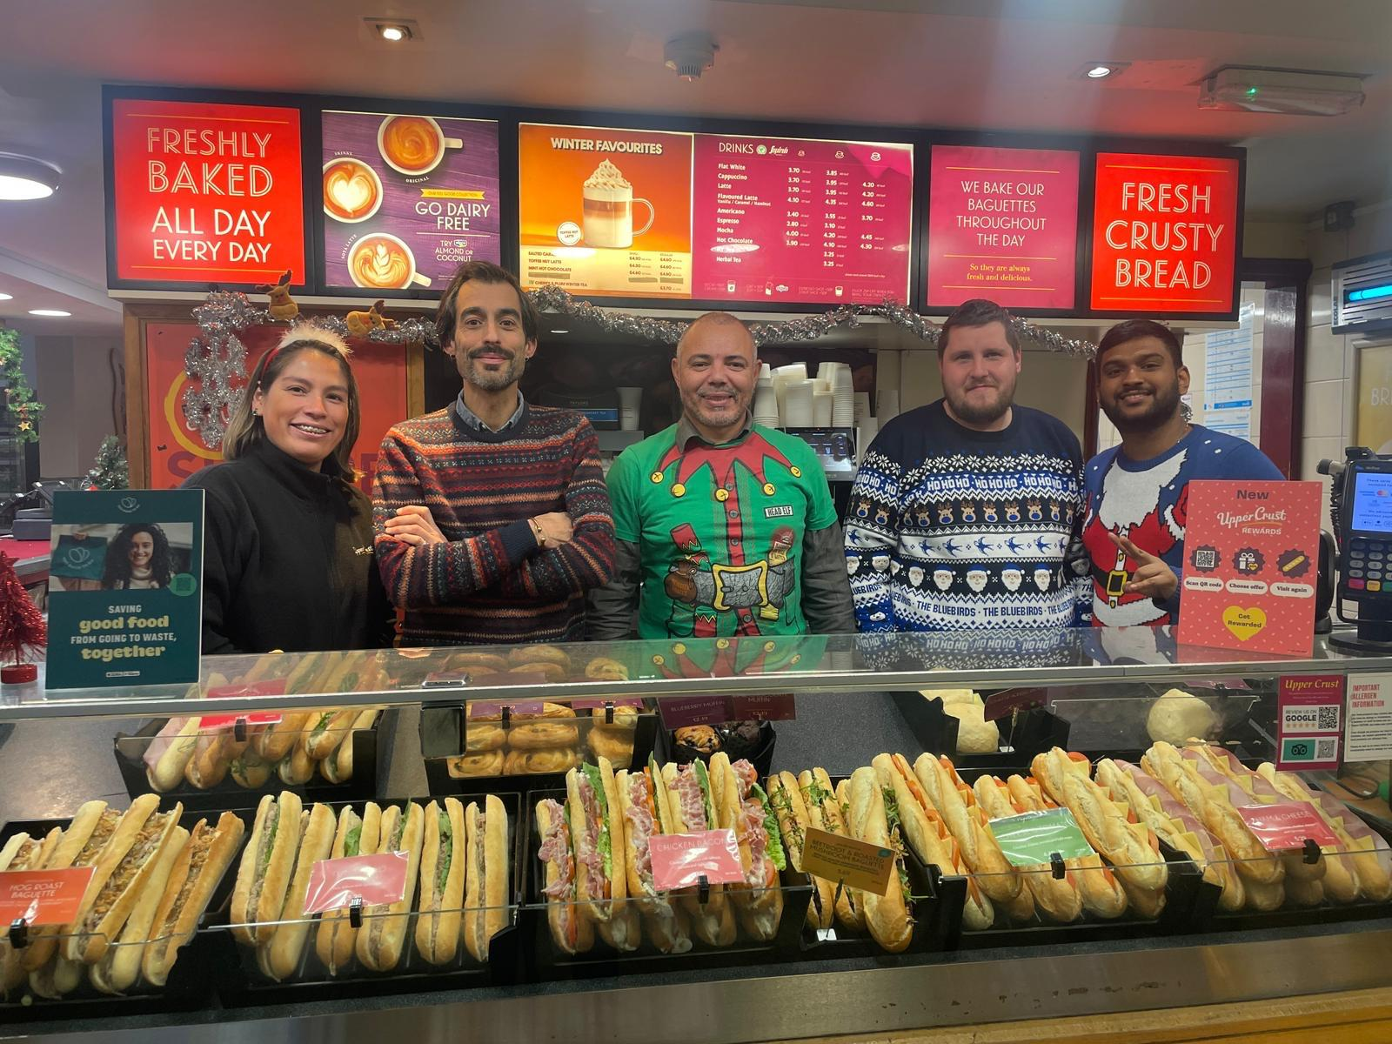
My Personality and Skills
Leadership
Empathy
Initiative taking and productive
Teamwork
Effective communi-
cation
Customer Service Operation
Notes:
Upper Crust creates value by delivering fast, consistent, and high-quality service, which enhances the travel experience for customers. Stakeholders include employees, customers, SSP Group, and travel partners such as GWR and airport authorities. Each stakeholder benefits from the brand’s performance: employees gain career development opportunities, customers enjoy convenience and quality, SSP strengthens its brand equity, and travel partners experience increased footfall and customer satisfaction. This comprehensive value creation model supports long-term sustainability and stakeholder alignment.

Slide 5
References & Conclusion
ACCOR. “Top 10 Must-Have Skills to Thrive in a Hospitality Career | Accor News and Blogs.” Accor, 2024, careers.accor.com/global/en/blogs/2024-11/top-10-must-have-skills-to-thrive-in-a-hospitality-career.
Dapo, Michelin . “Top 10 Essential Skills That Hospitality Employees Need.” Www.torrens.edu.au, 3 Feb. 2023, www.torrens.edu.au/stories/blog/hospitality/top-10-essential-skills-that-hospitality-employees-need.

Slide 6

ANY QUESTIONS ?

