Slide 1

ECDE7018: Introduction to Research Methods in Education
Session 2: Research Questions

Slide 2

Research Planning Task

Slide 3
DISCUSSION:
INVESTIGATING HANDEDNESS
Research suggests that around 10% of the population are left-handed.
Design a study to compare two types of student.
You are aiming to see whether left handedness is more common in students who study some subjects, such as art students or geographers.
How might you go about doing this?
What are the elements that you will need to consider?

Slide 4
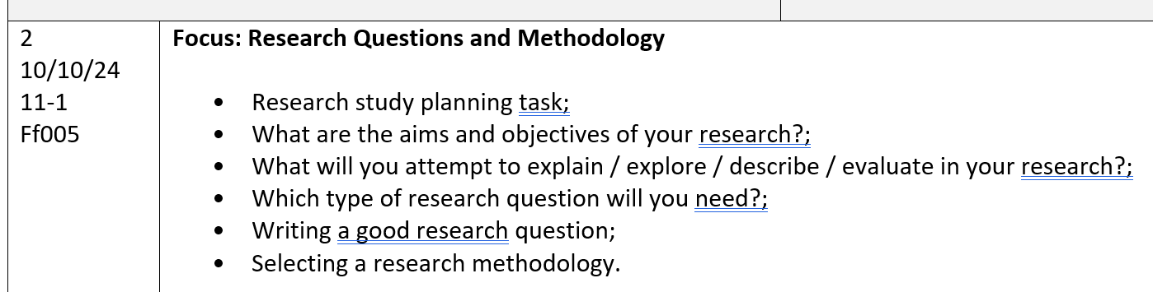
Today’s session

Slide 5
Can you answer the following questions?:
What is the aim of your research project?
Why is it important for you to explore?
What will be the benefits – to you, students/ others, a school/ university/ other?
Who does your research involve? participants (number, who are they?)
What is your research question?
What type of research study will it be?

Slide 6
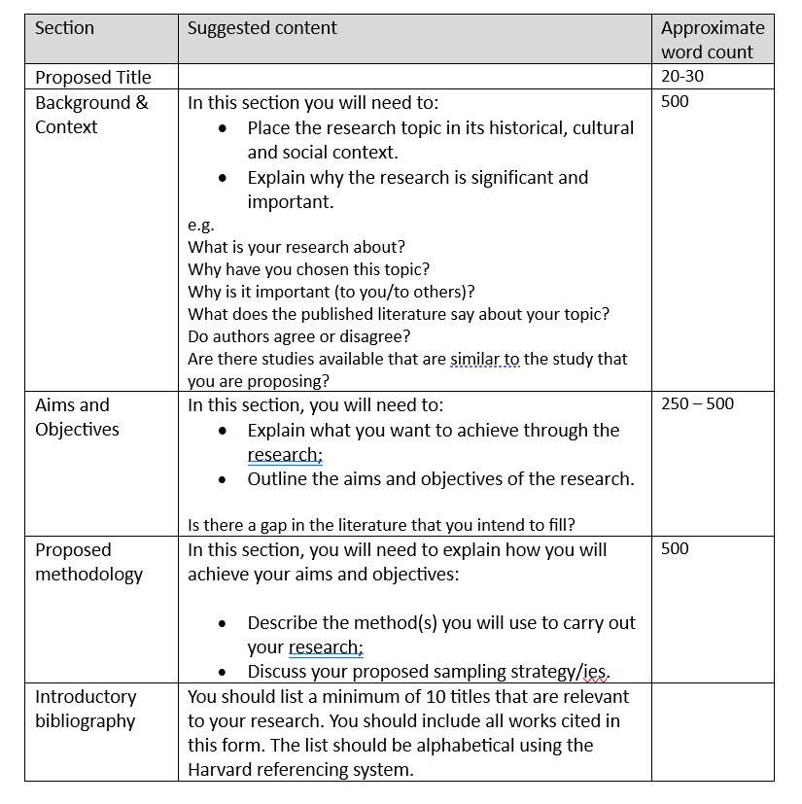
Assessment Component 1

Slide 7
Aims and Objectives
Aims: the overall driving force of the research – what is it that you want to find out?
Objectives: the means by which you intend to achieve the aim - how will you find this out?

Slide 8
Can you answer the following questions?:
What is the aim of your research project?
Why is it important for you to explore?
What will be the benefits – to you, students/ others, a school/ university/ other?
Who does your research involve? participants (number, who are they?)
What is your research question?
What type of research study will it be?

Slide 9
Assessment Component 1

Slide 10

What will you attempt to explain / explore / describe / evaluate in your research?
Notes:
Need to frame research topic or problem statement as a question.
A good research question is also one that is well-focused. A well-focused question helps you tune out irrelevant information and not try to answer everything about the world all at once. You could be the most eloquent writer in your class, or even in the world, but if the research question about which you are writing is unclear, your work will ultimately lack direction.

Slide 11
Types of Research Question
Descriptive
seek to describe the nature of what already exists.
Explanatory
seek to expound on a phenomenon or examine reasons for and associations between what exists.
Exploratory
investigate little-known areas of a particular topic.
Contextual
seek to describe the nature of what already exists.
Evaluatory
assess the effectiveness of existing methods or paradigms.

Slide 12
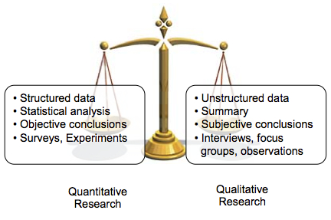
Qualitative and Quantitative Data
Quantitative data refers to numerical information generated through the research process that can be understood, represented and analysed statistically.
Qualitative data is non-numerical (e.g. text, image, audio) and offers the researcher a descriptive account of the phenomenon being studied.

Slide 13
Types of Research Question:
Quantitative
Quantitative research questions:
seek to understand particular social, familial, or educational experiences or processes that occur in a particular context and/or location (Marshall & Rossman, 2011);
typically include the population to be studied, dependent and independent variables and the research design to be used;
usually written and finalised at the start of the project (Berger, 2015);
not answerable with “yes” or “no” responses;
don’t use words such as: is, are, do / does;
can be further categorized into three types: descriptive, comparative and relationship.

Slide 14
Quantitative Research Questions
Descriptive research questions aim to measure the responses of a study’s population to one or more variables or describe variables that the research will measure. These questions typically begin with “what.”
Comparative research questions aim to discover the differences between two or more groups for an outcome variable. These questions can be causal as well. For instance, the researcher may compare a group where a certain variable is involved and another group where that variable is not present.
Relationship research questions seek to explore and define trends and interactions between two or more variables. These questions often include both dependent and independent variables and use words such as “association” or “trends.”

Slide 15
Types of research question –
Qualitative
Qualitative research questions:
may concern broad areas of research or more specific areas of study.
usually adaptable, non-directional, and flexible (Creswell, 2013);
generally aim to discover, explain or explore;
can be further categorized into several types (Marshall and Rossman, 2011; Ritchie et al., 2014).

Slide 16

A good research question generally has the following features:
It is written in the form of a question
It is clearly written
It cannot be answered with “yes” or “no”
It has more than one plausible answer
It considers relationships among multiple variables
It is specific and clear about the concepts it addresses
It includes a target population
Notes:
In addition to being written in the form of a question and being well-focused, a good research question is one that cannot be answered with a simple yes or no. For example, if your interest is in gender norms, you could ask, “Does gender affect a person’s performance of household tasks?” but you will have nothing left to say once you discover your yes or no answer. Instead, why not ask, about the relationship between gender and household tasks. Alternatively, maybe we are interested in how or to what extent gender affects a person’s contributions to housework in a marriage? By tweaking your question in this small way, you suddenly have a much more fascinating question and more to say as you attempt to answer it.
A good research question should also have more than one plausible answer. In the example above, the student who studied the relationship between gender and household tasks had a specific interest in the impact of gender, but she also knew that preferences might be impacted by other factors. For example, she knew from her own experience that her more traditional and socially conservative friends were more likely to see household tasks as part of the female domain, and were less likely to expect their male partners to contribute to those tasks. Thinking through the possible relationships between gender, culture, and household tasks led that student to realize that there were many plausible answers to her questions about how gender affects a person’s contribution to household tasks. Because gender doesn’t exist in a vacuum, she wisely felt that she needed to consider other characteristics that work together with gender to shape people’s behaviors, likes, and dislikes. By doing this, the student considered the third feature of a good research question–she thought about relationships between several concepts. While she began with an interest in a single concept—household tasks—by asking herself what other concepts (such as gender or political orientation) might be related to her original interest, she was able to form a question that considered the relationships among those concepts.

Slide 17
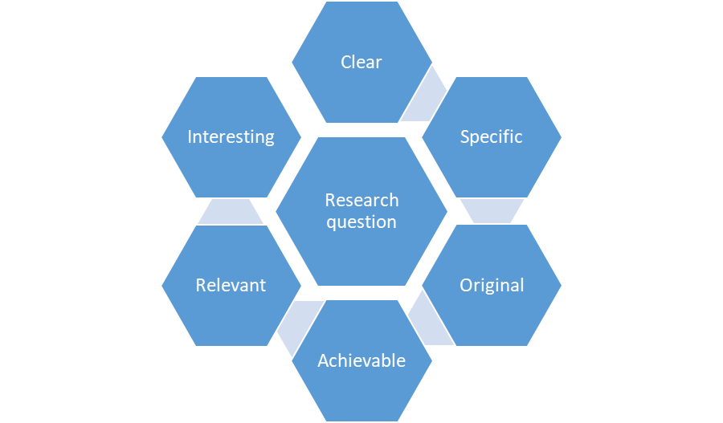
Research Questions should be:
Clear – it should be easy to understand
Specific – convey exactly what you want to know
Original – remember that you’re researching something new that has not been done before
Achievable – is it possible for you to answer this question?
Relevant – to the literature you’ve read, your own setting, the purpose of your enquiry
Interesting – Why do people need to know about this?
(Adapted from Lewin, 1948)

Slide 18


Class discussion:
What is the best way to teach counting to young children?

Slide 19
TASK : Discuss the strengths and limitations of the following RQs.
1. Why do some learners find aspects of school difficult and what could the school do about it?
2. How often does the average parent listen to their child read and what is the impact on progress?
3. How many school days are lost through pupils’ unauthorised absence?
4. What are the advantages and disadvantages of mobile phone use in schools?

Slide 20

Focused and researchable
Feasible and specific
Relevant and original
Focused on a single topic or problem
Does not ask for a subjective value judgement
Answerable within practical constraints
Uses specific, well- defined concepts
Addresses a problem relevant to your practice/setting
Contribute to a topical or academic debate
Notes:
First draft

Slide 21

Ask yourself:
Does the question deal with a topic or issue that interests me enough to spark my own thoughts and opinions?
Is the question easily and fully researchable?
What type of information do I need to answer the research question?
Is the scope of this information reasonable? (e.g., can I really research 30 writing programs that have been developed over 10 years?)
Given the type and scope of the information that I need, is my question too broad, too narrow, or ok?
What sources will be able to provide the information I need to answer my research question (journals, books, internet, government documents, people)?
Can I access these sources?
Given my answers to the above questions, do I have a good-quality research question that I actually will be able to answer by doing research?

Slide 22
Can you answer the following questions?:
What is the aim of your research project?
Why is it important for you to explore?
What will be the benefits – to you, students/ others, a school/ university/ other?
Who does your research involve? participants (number, who are they?)
What is your research question?
What type of research study will it be?

Slide 23

Any questions?

Slide 24

Research Design

Slide 25
Can you answer the following questions?:
What is the aim of your research project?
Why is it important for you to explore?
What will be the benefits – to you, students/ others, a school/ university/ other?
Who does your research involve? participants (number, who are they?)
What is your research question?
What type of research study will it be?

Slide 26
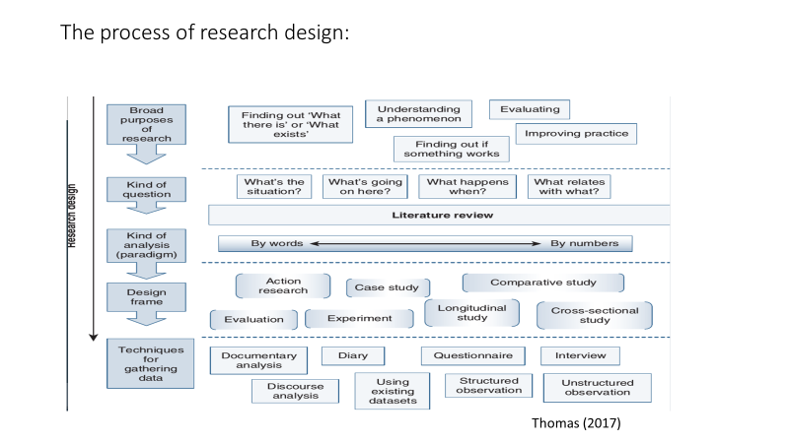
Notes:
Talk through aspects of research design.

Slide 27
Method
The ‘doing’ of the research
Strategy employed in the collection of data for analysis to uncover new information or gain a better understanding of a topic
The tool(s) used to carry out the research
Methodology
Theoretical positioning of the research
Body of knowledge that explains how the research is done
Justification of using a particular research method

Slide 28
QUANTITATIVE
QUALITATIVE
MIXED METHODS

Slide 29
Quantitative Research (numbers)
A means for testing objective theories by examining the relationship among variables.
These variables can be measured, typically on instruments.
Numbered data can be analysed using statistical procedures.
(Creswell, 2008)

Slide 30
Qualitative Research (words)
A means for exploring and understanding the meaning of individuals or groups ascribed to a social or human problem.
The process of research involves emerging questions and procedures.
Data is typically collected in the participant’s setting.
Data analysis inductively builds from particulars to general themes, and the researcher making interpretations of the meaning of the data.
(Creswell, 2008)

Slide 31
Mixed Methods Approach
An approach to inquiry that combines both qualitative and quantitative methods.
It involves the use of both approaches in tandem so that the overall strength of a study is greater than either qualitative or quantitative research.
(Creswell, 2008)

Slide 32
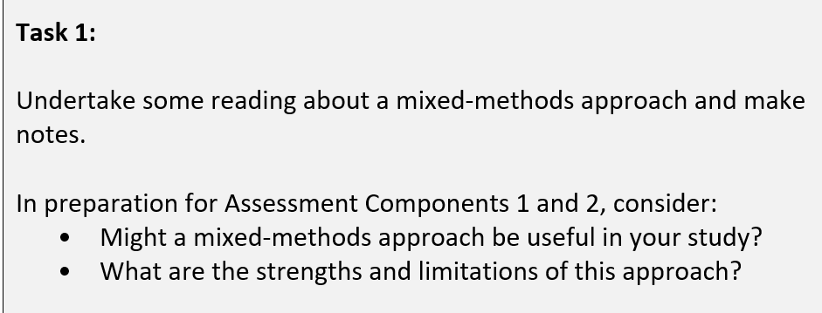
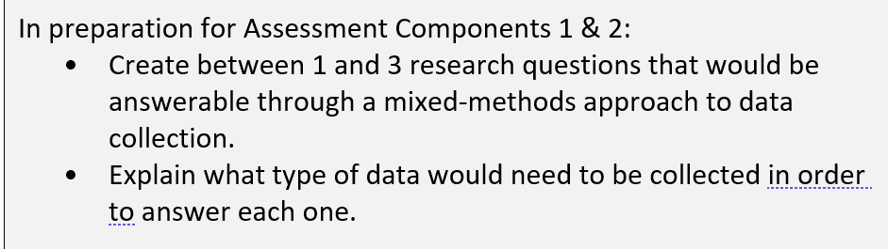
Follow-up tasks
For this assignment, you could choose a research focus that allows you to carry out a mixed-methods approach.
This is VERY IMPORTANT!

Slide 33

See you next week!

