Slide 1

Stress in the UK

Slide 2

What is Stress?
Stress is termed as an unpleasant emotion state capable of affecting human function.
It is accompanied by emotional, physical and biochemical changes in the body.
Your body responds to change by changing its biochemical reactions in the brain corresponding to the phenomenon of stress (Edwards et al.).

Slide 3

Understand how stress affects employee health and productivity and understand ways to bring it down.
Our Objective?
Let’s dive in

Slide 4

Stress in Workers
Stress has severely started to impact organizations and its effects can be seen on employee productivity and mental health.
Psychological strain, caused by stress, can cause employees to act out and harm the organization.
Workers may be stressed due to several factors, such as harassment, long working hours, insufficient rewards, instability in the workplace and so on (Hamaideh, 2011).

Slide 5
Workplace Environment
Workers will be stressed out if they feel the organization is biased or against them.
The policies of the company should favor the employee.
there needs to growth for advancement and progress of the employees.
Workers should be encouraged to have a healthy work-life balance.
Management should play its part in ensuring the workers are satisfied and happy.

Slide 6
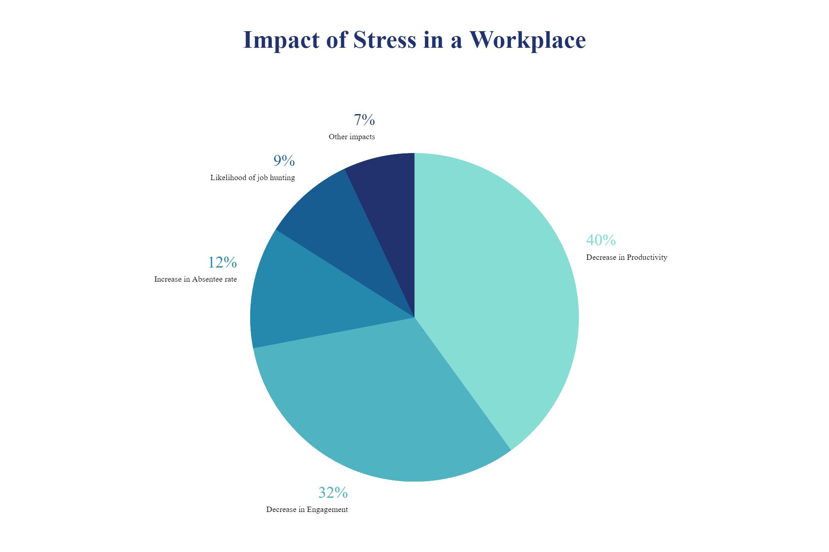
(Dagget, Molla and Belachew, 2016)

Slide 7

Workers suffering from stress are more at risk to suffer from anxiety, a heart attack, substance abuse, burnout and so on.
Psychological impacts of Stress

Slide 8
Stress impacts an Organization
Studies have shown that workers which have manageable stress levels are shown to more productive and more positive.
With manageable stress levels, workers were able to take less sick days (Grawitch, Ballard and Erb, 2015).
There was a boost in morale due to healthy stress levels.
Employees are also able to abstain from absenteeism at work.

Slide 9
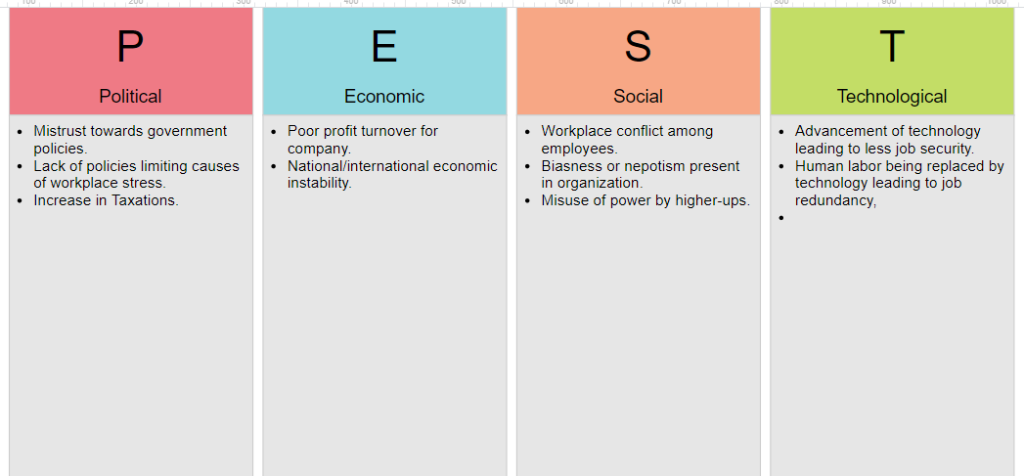
Pestle Analysis

Slide 10

Causes of Stress in the Workplace
STRESS IN WORKERS
MANAGEMENT ROLE
Misuse of power
Financial
Problems
Lack of Leadership
Poor Healthcare
Lack of Supportive Attitude
Work Overload
STRESS
IN
WORKPLACE
Repeated Mistakes
Harassment
Low Salary Compensation
POOR SUPPORT

Slide 11

Conclusion
Stress needs to be managed properly among employees and kept within a healthy range in order for it not to prove detrimental to the health of the employees or the reputation and working of the organization.

Slide 12
References:
Dagget, T., Molla, A. and Belachew, T. (2016). Job related stress among nurses working in Jimma Zone public hospitals, South West Ethiopia: a cross sectional study. BMC Nursing, 15(1).
Edwards, J.A., Webster, S., Van Laar, D. and Easton, S. (2008). Psychometric analysis of the UK Health and Safety Executive’s Management Standards work-related stress Indicator Tool. Work & Stress, 22(2), pp.96–107.
Grawitch, M.J., Ballard, D.W. and Erb, K.R. (2015). To Be or Not to Be (Stressed): The Critical Role of a Psychologically Healthy Workplace in Effective Stress Management. Stress and Health, 31(4), pp.264–273.
Hamaideh, S.H. (2011). Occupational Stress, Social Support, and Quality of Life among Jordanian Mental Health Nurses. Issues in Mental Health Nursing, 33(1), pp.15–23.

