Slide 1

CARL Framework of Reflection
By Harrison Meadows

Slide 2
Acknowledgement
I confirm that I have not used any AI tools in the research and creation of this assignment. I confirm that I have not presented any AI generated materials as my own work. I confirm I have copies of my drafts, notes, and other resources I used, which I may be asked to provide in evidence.

Slide 3
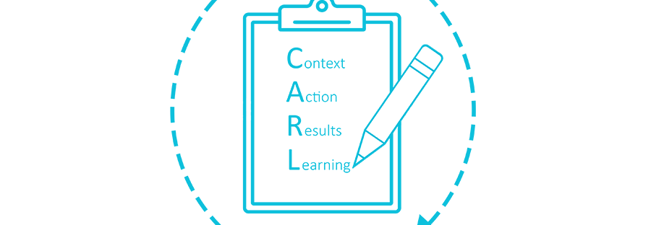
What is CARL Framework of Reflection?
The CARL reflective model is based upon experiences that occur within your professional life. CARL is different from other reflection models as CARL is the most acceptable used in a workplace setting (Robinson, 2022)
CARL has four parts to its model those being:
Context
Action
Results
Learning

Slide 4
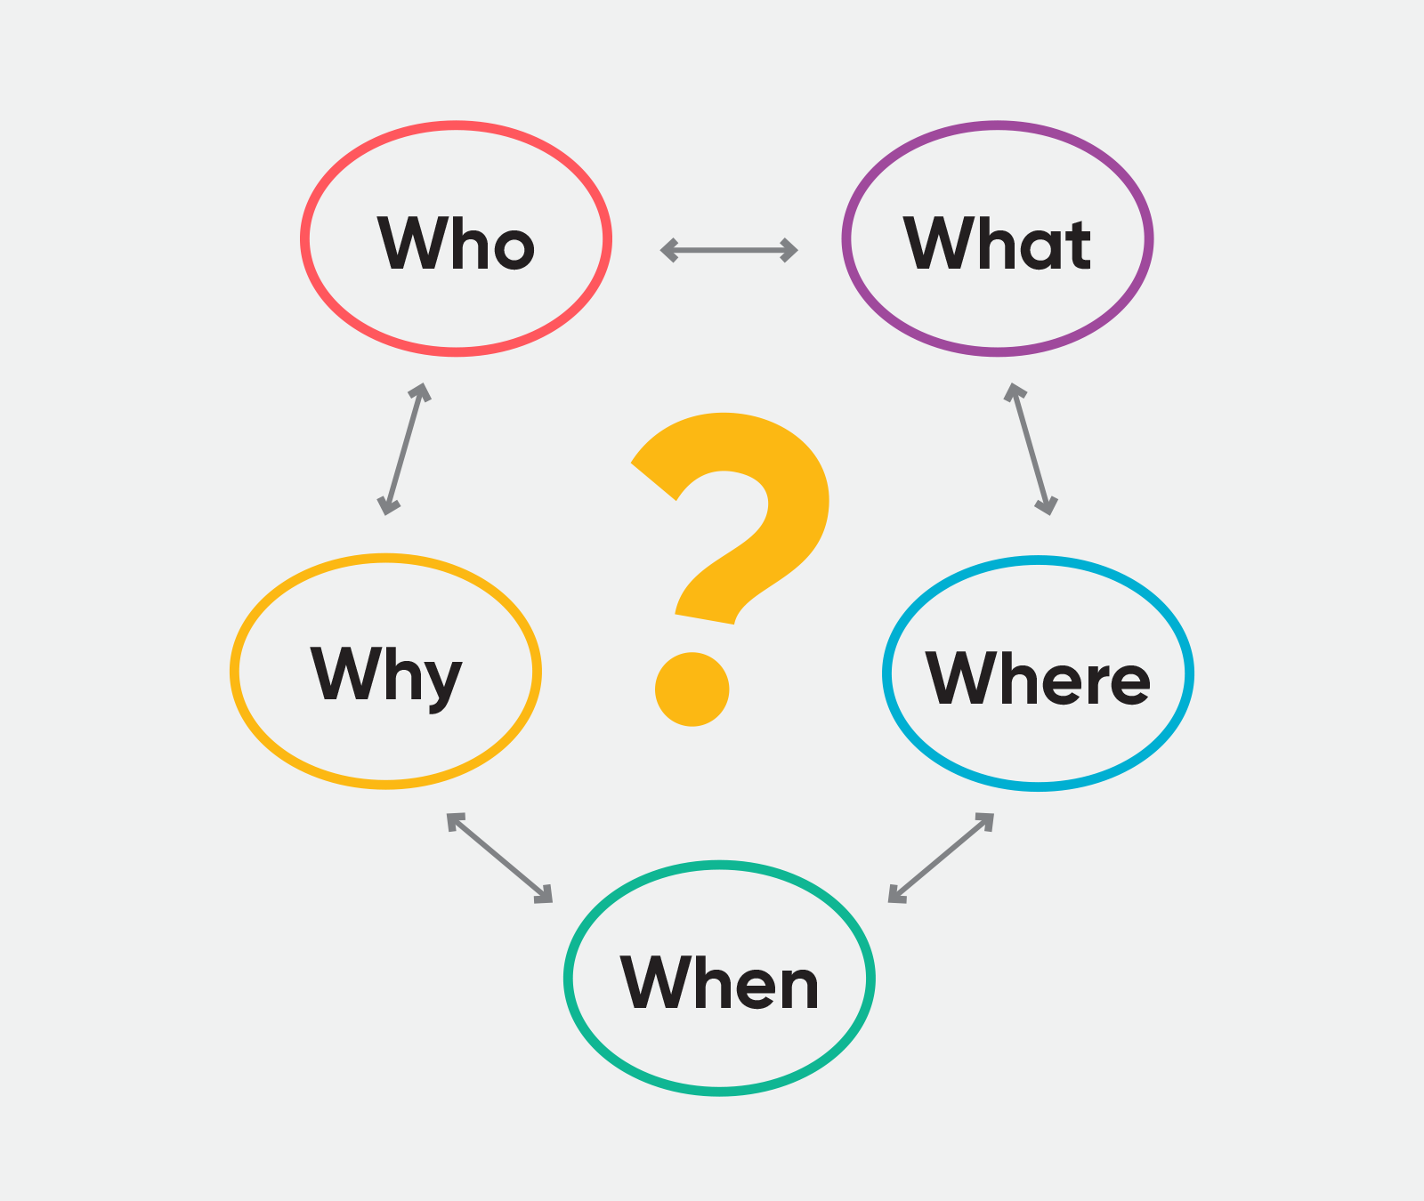
Stage 1: Context
The Context of CARL is using the “Five Ws” it is helpful for the context as it allows you to think on the situation.
You are allowed to customise how much effort you put into for example using it for personal use such as looking back on your work or on a presentation where you only need the context to be understood. (University of Edinburgh, 2024)

Slide 5
Stage 2: Action
The Action part of CARL Framework uses the same “Five Ws” as the Context however its purpose is to question your actions you have taken instead of being broad like Context, Action is to make you think upon your own actions you have taken and what other options you had but didn’t partake. (Bromley, 2023.)

Slide 6

Stage 3: Results
In the Results section of the CARL model, you will explain the result of your actions you have taken and then you will assess yourself with the positives and negatives you have taken along with how much of a success your work has been. (Dabell, 2021.)

Slide 7
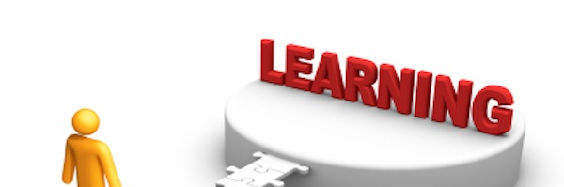
Stage 4: Learning
In the final part of CARL’s model, we have Learning. Learning from what we have done and asking the questions of what would you keep the same or change for future projects that you will be apart. (Dabell, 2021)

Slide 8
The Pros of CARL framework of reflection
The pros of using CARL framework is it has flexibility within your professional. The CARL reflection used in your work making it more effective and more rememberable for yourself.
Being customisable to fit the person that is using it without losing any feature so every person who uses this reflection technique will not have an easier or harsher time than the other.

Slide 9
The Cons of CARL framework of reflection
The CARL framework is by far one of the more simplified perfect for presentations, but it may be oversimplified not for use that goes on for more extensive facts about what a person can do to improve themselves.
It is clear you must follow the steps provided rather than working at your own pace which may cause issues to not following them.

Slide 10
Reference List
Bromley (2023), Reflection Models. Link Here
Jessica Robinson (2022), Ace Your Interviews With The CARL Framework of Reflection. Link Here
John Dabell (2021), The CARL Framework of Reflection. Link Here
John Dabell (2021), The CARL Framework of Reflection. Link Here
Research Method (2022). Link Here
Rick (2011), ARE YOU TEACHABLE? Link Here
University of Edinburgh (2024), The CARL framework of reflection. Link Here
University of Edinburgh (2024), The CARL framework of reflection. Link Here
Zoe Del mar (2022), Using a 5 W’s Graphic Organizer Chart. Link Here

