Slide 1
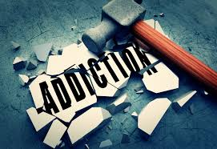
Applied Psychology
Lecture 7: Reward and Addiction
Stacey Coleman

Slide 2
Lecture outline
Discuss definitions of ‘addiction’, ‘abuse’, and ‘dependency’
Introduce psychological and neural bases of reward and addiction
Explore diagnostic criteria and prevalence rates of substance disorders
Start to discuss characteristics of certain substances and the impact on addiction and dependency

Slide 3







What do all these people have in common??

Slide 4
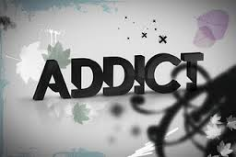
What does the word ADDICT mean to you??

Slide 5
What is ADDICTION?
How do we define the phenomenon of ‘addiction’?
What are the characteristics of addictions?
Can anyone become addicted to something?

Slide 6

How do we define ‘addiction’?
Substance abuse?
Do addictions only involve chemical substances?
ABUSE?
DEPENDENCE?
Notes:
The concept of addiction has been heavily criticised, leading some to reject it in favour of terms such as ‘abuse’ and ‘dependence’. However, there are a number of researchers that argue that the concept of addiction should be broadened in order to cover certain recent forms of ‘addictive’ behaviours that don’t involve chemical substances at all.

Slide 7
How do we define ‘addiction’?
APA:
  A condition in which the body must have a drug to avoid physical and psychological withdrawal symptoms. Addictions first stage is dependence, during which the search for drugs dominates an individuals life. An addict eventually develops tolerance, which forces the person to consume larger and larger doses of the drug to get the same effect.
Notes:
The concept of addiction has been heavily criticised, leading some to reject it in favour of terms such as ‘abuse’ and ‘dependence’. However, there are a number of researchers that argue that the concept of addiction should be broadened in order to cover certain recent forms of ‘addictive’ behaviours that don’t involve chemical substances at all.

Slide 8
Contemporary addiction
The term “Addiction” is now used more broadly to refer to a condition in which an individual feels a constant desire to use a specific type of substance, or engage in a certain activity, despite potential harmful consequences.

Slide 9
Contemporary addiction
Oxford dictionary:
  The fact or condition of being addicted to a particular substance or activity
Medical dictionary:
  Addiction is a persistent compulsive dependence on a behaviour or substance

Slide 10
Why addiction?
Addiction:
  To use compulsively or uncontrollably
Abuse:
  To use wrongly or improperly
Habit:
  A constant, often unconscious, inclination to perform some act, acquired through its frequent repetition
Addiction liability? Addiction potential?
The tendency to develop/produce an addiction?
Who has this potential?
Can anyone develop an addiction?

Slide 11
Addiction…
Drug use to the point where the body’s ‘normal’ state is the drugged state So the body requires the drug to feel normal
* Addiction is a term that is rarely used nowadays because it implies that drug dependency is primarily a physical one, whereas in reality it is a complex mix of physical and psychological dependency

Slide 12
Substance Abuse and Dependency…
Substance abuse:
  “a maladaptive pattern of substance use manifested by recurrent and significant adverse consequences related to repeated use of the substance”
Substance dependency:
  “a cluster of cognitive, behavioural and physiological symptoms indicating that the individual continues use of the substance despite significant substance-related problems”

Slide 13
Dependence
Addictions cause Physical and Psychological dependency:
  Physical dependency is defined by withdrawal symptoms that become present when substance use/participation in activity is discontinued
  Psychological dependency is defined by the mental desire to experience the effects produced by the drug or activity
Addictions that are dependency-specific may drive compulsive use, and therefore require different treatment strategies
Notes:
Addictions can cause both physical and psychological dependency. Physical dependency on a substance or an activity is defined by the withdrawal symptoms that an individual experiences when use of the substance or participation in the activity is discontinued. Physical withdrawal symptoms vary from addiction to addiction.
Psychological dependency would be defined by the mental desires an individual has to experience the effects that are produced by the drug or activity. For heroin users, for example, they would feel a chemical high – gamblers would experience elevated levels of arousal.
Addictions that are dependency-specific may drive compulsive use, and require different treatment strategies.

Slide 14
DSM-5
Substance use disorders
Combined the categories of substance abuse and substance dependence into one all-encompassing disorder
Mild
Moderate
Adopts a spectrum approach: degrees of severity
Severe
Notes:
The DSM-5 has combined the categories of substance abuse and substance dependence into one all-encompassing disorder – substance use disorder. The change in this is the result of research that indicates that abuse and dependence are not distinct disorders but part of a continuum (as with many things in the new DSM). The new diagnosis of substance use disorder adopts the spectrum approach, with degree of severity being qualified as ‘mild’, ‘moderate’ and ‘severe’.
Gambling disorder is the only non-substance-related disorder that is included in the Substance-Related and Addictive Disorders. The rationale for moving a behavioural disorder to this section of DSM-V includes scientific evidence that indicates gambling activates areas of the brain similar to the brain’s reward systems that are activated by substances. Other repetitive behaviours that could lead people to have difficulties if they are not controlled (such as shopping, gaming and sex) do not have sufficient peer-reviewed research to be labelled as mental disorders at this time.

Slide 15
Substance disorders – diagnostic criteria

Slide 16
Substance Abuse and Dependency
Regardless of the substance, the diagnosis of substance use disorder is based upon a pathological set of behaviours related to the use of that substance:
  Impaired control (1, 2, 3, 4)
  Social impairment (5, 6, 7)
  Risky use (8, 9)
  Pharmacological indicators (tolerance and withdrawal) (10, 11)

Slide 17
DSM-5
Substance-related and addictive disorders
Gambling disorder is the only non-substance-related disorder that is included in this category.
Rationale for including a behavioural addiction in this section is that there is an abundance of scientific research that indicates engaging in gambling activity activates the same pleasure pathways in the brain as are activated by substances.

Slide 18


Slide 19
Messages from this video:
Addiction doesn’t respect your background
      Age, gender, SES, rich or poor
Addiction serves a purpose to the individual
All drugs of abuse share common features
      One of the most important is that they increase activity in the reward pathway or pleasure centre in the brain

Slide 20
Messages from this video:
A hallmark of addiction is that it take precedent over all other needs, and time invested in great
      Using the drug in itself
      Experiencing the effects
      Recovering from the effects
Addiction is ultimately characterised by compulsion
      Feelings of craving or desire that build up when we just try to say ‘no’

Slide 21
Characteristics of addictions
Griffiths (2005)

Slide 22
Characteristics of addictions
Why can’t people just say no?
Is addiction a disease?
Are addicts simply people that lack moral strength and/or willpower
Is addictive behaviour a choice?
Surely to stop an addiction all one needs to do is decide NOT to use anymore

Slide 23
Core components:
Salience
The activity/substance has a high level of importance in everyday life
Mood modification
A change in subjective experiences. People may feel a ‘high’ or a ‘buzz’
Conflicts
These can be intrapersonal or interpersonal

Slide 24
Core components:
Relapse
After a period of control the addiction/addictive behaviour can manifest again
Impaired self control
The inability to suppress urges
It becomes harder to say ‘no’ as time goes on and as the addiction develops

Slide 25
Core components:
Tolerance
Decreased sensitivity to the activity over time
Withdrawal symptoms
Unpleasant physical/psychological symptoms when the activity is reduced
Put together, these represent the biological components of addiction.
Contribute to physical dependence and physical addiction
Notes:
Tolerance – a decrease in tolerance or sensitivity to the drug or activity over a period of time. This can lead to an increase in the amount of drug the individual has to take, or an increase in the amount of the activity the individual takes part in.
Over a period of time the levels of alcohol, for example, that people are drinking might reach levels that many would find astonishing. People using opiates such as heroin after a period of time can take doses and function normally at levels that might kill novice/first time users.
Withdrawal – people begin to feel sad or nauseous when they are prevented from taking part in the activity, or stopped from taking the substance. Many gamblers, for example, report feeling agitated when they miss a session of betting, and drug addict can experience significant and painful physical withdrawal symptoms.

Slide 26
Substance disorders – prevalence rates

Slide 27
The prevalence of substance use disorders
Rates vary significantly across countries depending on legal, moral and religious attitudes to drugs
Lifetime prevalence rate for substance dependency in the US is 5.1% (Warner et al., 1005)
In the US, 51% of 15 to 54 year olds reported having used illegal drugs
Highly comorbid with other psychological disorders

Slide 28
Comorbidity
The occurrence of two disorders or illnesses in the same person, either at the same time (co-occurring comorbid conditions) or with a time difference between the initial occurrence of one and the initial occurrence of the other (sequentially comorbid conditions).

Slide 29
Comorbidity of Substance Use Disorders
Psychiatric Disorder | % of individuals also diagnosed with a substance use disorder (SUD)
Bipolar disorder | 60.7%
Major depression | 18%
Obsessive-compulsive disorder (OCD) | 32.8%
Panic disorder | 35.8%
Schizophrenia | 47%
Bulimia nervosa | 28%
Personality disorders | 42%

Slide 30
What are the effects on the reward pathway/pleasure centre?

Slide 31
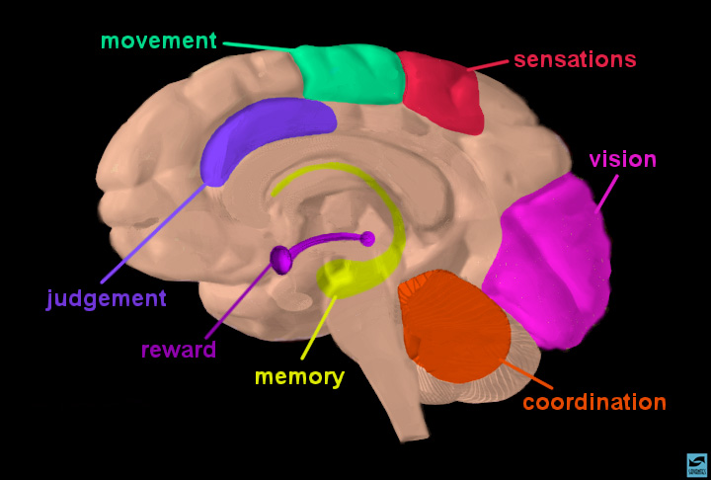
What is the reward pathway?
The reward pathway is located in the limbic system in the brain
The limbic region specialises in emotion
The pathway of neurons that pass through the limbic region to the frontal cortex is called the reward pathway
If/when information passes through the reward pathway, we feel happy and euphoric

Slide 32
What is the reward pathway?
The reward pathway connects with the part of the brain, therefore, where we process information, make decisions, and where we make new memories.
These decisions and memories are then given an emotional meaning

Slide 33
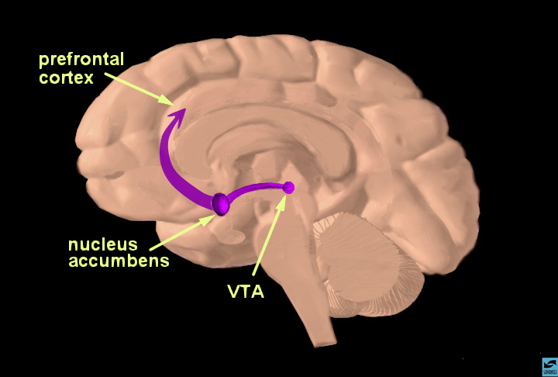
What is the reward pathway?
The reward pathway consists of the nucleus accumbens, ventral tegmental area (VTA) and the prefrontal cortex.
The neurons of the VTA contain dopamine which is released into the nucleus accumbens and prefrontal cortex in response to natural reward stimuli or artificial reward stimuli

Slide 34
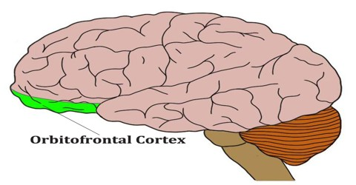
Orbitofrontal cortex
Part of the prefrontal cortex
Involved in some critical human functions, including social awareness, control of mood, drive, responsibility, etc
Clinical studies show that there is an increase in activity in the orbitofrontal cortex when drug addicts are exposed to drug associated stimuli
Nucleus accumbens projects to the OC
The OC also receives direct projections from dopamine cells in the VTA

Slide 35
What is the reward pathway?
Natural rewarding stimuli:
  Food, sex, water, nurture, love
Artificial rewarding stimuli:
  E.g., drugs
Both types of rewarding stimuli result in ‘pleasure’ information (dopamine) travelling from the VTA to the nucleus accumbens and then up to the prefrontal cortex.

Slide 36
Reward pathway
Stimulation of the reward pathway produces highly pleasurable sensations, providing positive reinforcement which promotes further drug use
Dopamine is the neurotransmitter in charge of pleasure
Dopamine is a monoamine
  Responsible for changes in mood
Dopamine is ultimately the fuel for intentional behaviours, and the fuel for desire

Slide 37

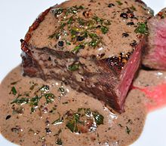
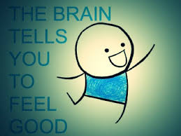
Reward pathway
Dopamine production is turned on when we’re cued by a stimulus paired with a reward
+
=
Stimulus
(food)
Reward
(eat food)
Dopamine production turned on

Slide 38
Dopamine and the reward centre
Three main dopamine pathways:
    Nisgrostriatial pathway:
      Important in movement and behaviours
      When this doesn’t work properly, we see stereotyped behaviours and movements disorders such as Parkinson’s
    Mesolimbic pathway:
      Associated with emotions and control of behaviour
      The ultimate reward pathway
      From midbrain to nucleus accumbens
    Mesocortical pathway:
      Associated with higher level thoughts of planning and deciding
      From midbrain to prefrontal cortex (amongst other parts)

Slide 39
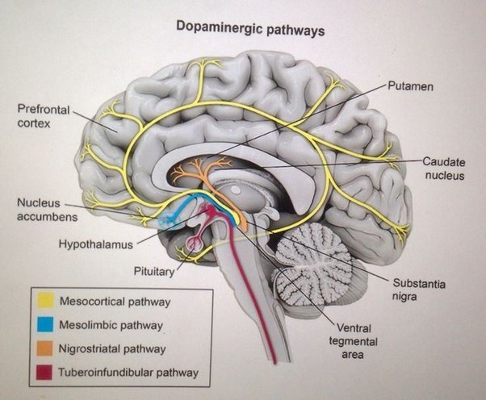

Slide 40
Dopamine and addiction
The most addictive drugs are plant based, and the chemicals these plants produce so closely mimic dopamine that the brain think it is receiving the equivalent of massive amounts of dopamine, thus increasing pleasure and ‘reward’
Addictive drugs are also biochemically quite different.
  They can activate different neurotransmitter systems
  They can produce different psychoactive effects
  But all either stimulate dopamine release (e.g., heroin, nicotine) or enhance dopamine action (e.g., cocaine) in nucleus accumbens

Slide 41
Substance/chemical addictions

Slide 42
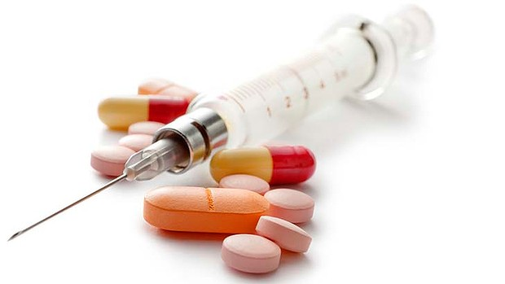
Problems associated with regular substance use
A drug can be defined as any substance, other than food, that affects either our bodies or our minds in some way – a substance that has a physiological effect when ingested or otherwise introduced into the body

Slide 43
Problems associated with regular substance use
In Westernised cultures, ‘drugs’ are almost a normal part of daily life
  Caffeine in tea/coffee
  Nicotine in cigarettes
  Paracetamol to reduce pain
  Dieting pills
  Alcohol and sleeping pills

Slide 44
Problems associated with regular substance use
Many drugs have short-term benefits but long-term negative physical and psychological effects
  E.g., alcohol
People can become either psychologically or physically addicted to a drug
  Develop to other drugs when it no longer has the original benefits
Regular drug use can blight social, educational and occupational functioning
  E.g., cocaine, hallucinogens, solvents

Slide 45

Problems associated with regular substance use
Significant burden to NHS services (e.g., car accident, overdosing, cancer, binge drinking, etc)
So, why do we still continue to ingest drugs?

Slide 46
Drugs of abuse
Fall roughly across three categories:
  Stimulants
  Sedatives
  Hallucinogens

Slide 47
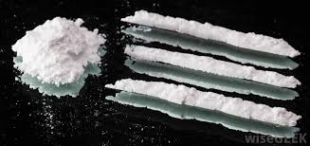
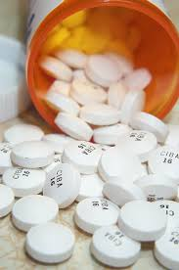
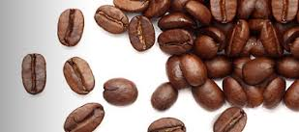
Characteristics of specific substance abuse disorders
STIMULANTS
Substances that increase central nervous system activity and increase blood pressure and heart rate
E.g.,
  Amphetamines
  Cocaine
  Caffeine

Slide 48
Stimulant Use Disorders
Cocaine
Lifetime prevalence rate in developed countries = 1-3%
Use by young adults in the UK aged 15-34 is around 4%
Amphetamines
Worldwide, amphetamine-type stimulants (ex. Ecstasy) have an estimated prev. of 0.3-1.2%
Second most widely used type of drug
Lifetime prevalence rate of A use disorders is 1.5%
Caffeine
85% of the worlds population take caffeine in some form
  Tea, coffee, chocolate, etc
Caffeine is a CNS stimulant that increases alertness and combats fatigue
Can lead to caffeine intoxication and withdrawal
Caffeine disorder new to DSM-5

Slide 49
Stimulant Use Disorders
Cocaine
Lifetime prevalence rate in developed countries = 1-3%
Use by young adults in the UK aged 15-34 is around 4%
Amphetamines
Worldwide, amphetamine-type stimulants (ex. Ecstasy) have an estimated prev. of 0.3-1.2%
Second most widely used type of drug
Lifetime prevalence rate of A use disorders is 1.5%
Caffeine
85% of the worlds population take caffeine in some form
  Tea, coffee, chocolate, etc
Caffeine is a CNS stimulant that increases alertness and combats fatigue
Can lead to caffeine intoxication and withdrawal
Caffeine disorder new to DSM-5

Slide 50
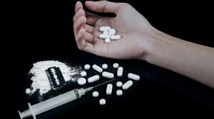
Cocaine

Slide 51
Cocaine
A natural stimulant derived from the coca plant
Can be injected, snorted or in some forms smoked (crack cocaine)
Makes users feel excited and energised
Main effects caused by cocaine blocking the reuptake of dopamine in the brain
  This facilitates neural activity and results in feelings of pleasure and confidence

Slide 52
Cocaine intoxication
Cocaine causes tolerance and severe withdrawal symptoms
High doses can cause cocaine intoxication where the individual becomes anxious, angry and may have psychotic episodes
Physical effects of intoxication include:
    Increased blood pressure and heart rate
    Perspiration
    Chills
    Nausea
Chronic used can cause long-term irritability, paranoid thinking, and disturbances of eating and sleeping

Slide 53
Cocaine use disorder
Effects last for only 30 minutes, so there is a need for frequent use to maintain the ‘rush’
Dependency occurs when user finds it difficult to resist whenever it is available
  This leads to neglect of important responsibilities (work, family, relationships)
Tolerance occurs with repeated use making larger doses necessary
Erratic behaviour, social isolation, and sexual dysfunction are regular characteristics of long-term dependency

Slide 54
The costs of cocaine dependency
Adversely effects cognitive functioning and health
Can cause development deficits in the offspring of pregnant cocaine users
Can cause cardiac problems because of its effects on blood pressure and heart rate

Slide 55
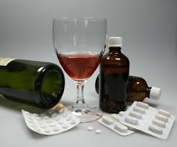
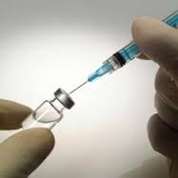
Characteristics of specific substance abuse disorders
2. SEDATIVES
Central nervous system depressants which slow the activity of the body, reduce its responsiveness, and reduce pain, tension and anxiety
E.g.,
  Alcohol
  Heroin
  Barbiturates
Notes:
Barbiturates – class of drugs derived from barbituric acid. This itself has no therapeutic activity, however its derivatives enhance the action of GABA, a neurotransmitter than inhibits the activity of nerve cells in the brain. Historically used in the treatment of anxiety, epilepsy and as anaesthetics. But, they have a tendency to cause psychological and physical dependency and there is a fine line between a normal dose and a toxic dose.

Slide 56
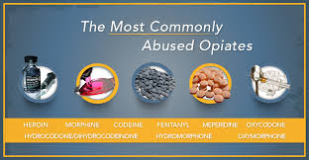
Opiates
Heroin
Codeine
Oxymorphone
Oxycodone
Morphine
Hydrocodone
Fentanyl
Notes:
Fentanyl – pain medication
Codeine – uses in pain medication
oxycodone – used to treat moderate to severe pain

Slide 57
Prevalence of opiate use
Opiates consist of opium – taken from the sap of the opium poppy – and its derivatives
Increases the production of endorphins
13-21 million people worldwide take opiates (WHO, 2010)
In 2009-2010, there was an estimated 306,000 adult opiate or crack cocaine users in England (National Treatment Agency for Substance Misuse, 2011)
Heroin is currently the most widely used of the opiates

Slide 58
Opiate use disorder
Tolerance builds up rapidly and users begin to experience severe withdrawal effects very soon
Withdrawal symptoms include:
  Anxiety
  Restlessness
  Muscle aches
  Increased sensitivity to pain
  Renewed cravings for the drug

Slide 59
Opiate use disorder
Opiate dependency is indicated by compulsive, prolonged administration
However, some users can control use and have been labelled controlled drug users or unobtrusive heroin users (Shewan & Delgarno, 2005)

Slide 60
The costs of opiate dependency
Opiate dependency is associated with:
  The risk of accidental overdose
  Using street heroin that contains lethal additives
  The risk of contracting HIV or hepatitis from needle sharing
In a long term study of US heroin addicts, 28% had died before the age of 40 years (Hser et al., 1993)

Slide 61
Heroin use
The most widely used form of the opiate drug
Profound feelings of warmth, relaxation and euphoria
  4-6 hours before individual experiences ‘come down’ symptoms
Once dependent on heroin, withdrawal usually begins about 8 hours after an injection
  Muscle pain, sweats and uncontrollable yawning
  After 36 hours, symptoms worsen and can include uncontrollable muscle twitching, cramps and a rise in heart rate
Notes:
Heroin is an opiate. Opiates are a group of drugs derived from the opium poppy. Heroin is the most widely used form of this drug – others include opium and morphine.
Taking heroin results in profound feelings of warmth, relaxation and euphoria. Worries, fears and concerns are forgotten, self-confidence increased. These effects last for between 4-6 hours before the individual ‘comes down’ from the drugs.
Once dependent on the drug, withdrawal usually begins about 8 hours after an injection, and results in muscle pain, sweats, sneezes and uncontrollable yawning. Within 36 hours, the symptoms become increasingly severe and can include uncontrollable muscle twitching, cramps, chills, sweats and a rise in heart rate. The person is unable to sleep and vomits violently. Theses symptoms last for around 72 hours, and then gradually reduce over a period of between 5 and 10 days.

Slide 62
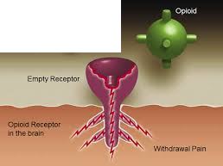
Heroin use
Opioid receptors are found within the central nervous system and peripheral tissues
Most of the
most common
opioids are
agonists
  Bind to receptors
  of cells and
  trigger response
  by that cell
Notes:
Opioid receptors are found within the central nervous system and peripheral tissues. Most of the most common opioids are agonists. Agonist drugs are drugs that bind to the receptors of a cell and triggers a response by that cell.
Opioids act by attaching to specific proteins called opioid receptors. These receptors are found in the brain, spinal cord, and other organs in the body. When these drugs attach to their receptors, they reduce the perception of pain.
The opioid attaching to the receptor will reduce or eliminate the pain produce by withdrawal symptoms in this situation.

Slide 63
Heroin addiction
Three receptors:
  Mu
  Delta
  Kappa
All three produce analgesia when an opiate binds to them, however activation of the KAPPA receptors does not produce as much physical dependence as activation of the MU receptors
Notes:
Opioid binding sites are classified into three receptors referred to as mu, delta and kappa. An opioid attaching to any of the three will produce analgesia (reduction of pain), however activation of the kappa receptors does not produce as much physical dependence as activation of the mu receptors. The effects of heroin are also dependent upon the mode of administration – for example, whether it is smoked or injected.

Slide 64
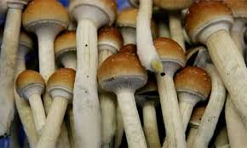
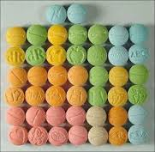
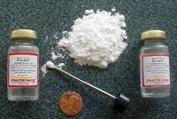
Characteristics of specific substance abuse disorders
3. HALLUCINOGENS
Psychoactive drugs which affects the user’s perceptions. They may either sharpen the individuals sensory abilities or create sensory illusions of hallucinations
E.g.,
  LSD
  Ketamine
  Magic mushrooms

Slide 65
Lysergic Acid Diethylamide (LSD)
Arguably the first of the widely used psychedelic drugs
Taken as tablets or capsules, starts to take effect after 30-90 minutes
Produces sharpened perceptions, but can cause hallucinations, including distorted perceptions of space and time
Can also exaggerate negative emotions causing ‘bad trips’
Has its effects by influencing neurons in the brain that normally control visual information and emotion

Slide 66
LSD abuse and dependency
Most hallucinogens have an extended duration of action causing individuals with hallucinogen dependency to spend many days recovering from a single dose
Some hallucinogens such as MDMA are associated with ‘hangover’ symptoms
Hangover symptoms include insomnia, fatigue, drowsiness, headaches, and sore jaw muscles from teeth clenching
Dependency associated with psychiatric disorders

Slide 67
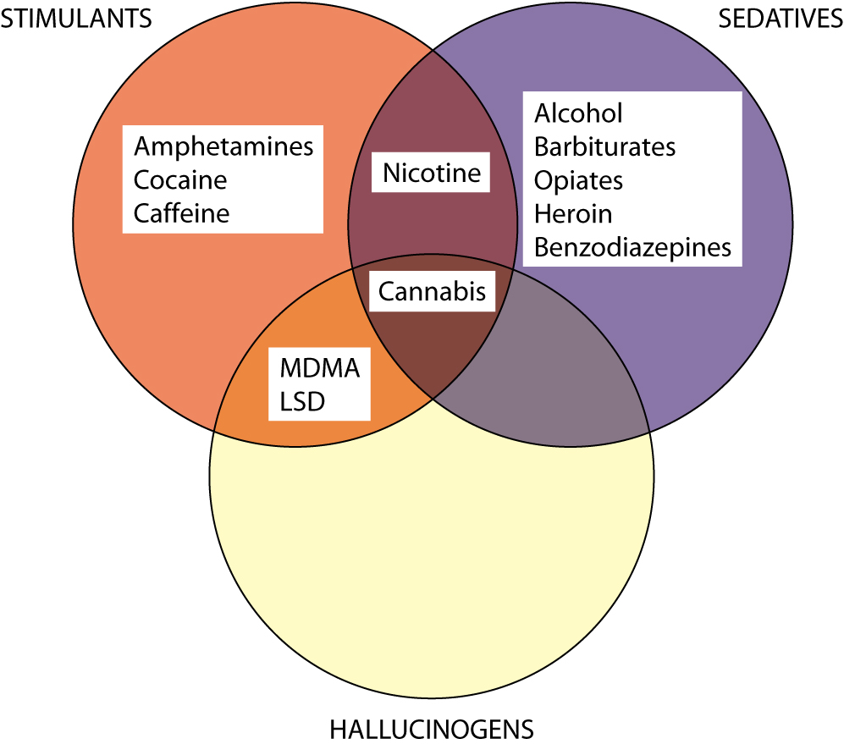
Substance overlap between categories

Slide 68
Can anyone develop an addiction?

Slide 69
Aetiology of substance abuse and dependency
Aetiology of substance dependency has to be viewed in developmental terms
Most individuals who become substance dependent go through three developmental stages:
Experimentation
Regular use
Abuse and dependency

Slide 70
Experimentation

Slide 71
Experimentation
Based on:
  Availability
  Familial factors
  Peer group influences
  Media influences
Availability of drug/substance will influence time of first use
Inverse relationship between first use and cost (Stead and Lancaster, 2005)

Slide 72
Experimentation
Based on:
  Availability
  Familial factors
  Peer group influences
  Media influences
Early substance use determined by 2 factors:
Whether substance is regularly used by other family members
Where the family environment is problematic
Neglectful parenting increased early use of alcohol, cigarettes and cannabis

Slide 73
Experimentation
Based on:
  Availability
  Familial factors
  Peer group influences
  Media influences
Adolescents will start using drugs to self-categorise themselves as a member of a particular group
Once an individual becomes a regular user, this will also influence the social groups they will mix with

Slide 74
Experimentation
Based on:
  Availability
  Familial factors
  Peer group influences
  Media influences
Substance abuse in young adolescents is significantly affected by advertising and exposure to the product in media contexts
Banning advertising of a product (e.g., cigarettes) has been shown to significantly decrease adolescent use

Slide 75
Regular Use

Slide 76
Regular use
Mood-alteration effects
Impact on reward pathways One main reason for using drugs is that they have important mood-altering effects Most drugs of abuse either relieve negative mood or create euphoria and feelings of well-being However, these mood-altering effects are more complicated than they may appear to the user (e.g., alcohol myopia)

Slide 77
Regular use
Self-medication
When individuals are suffering more severe adjustment and coping problems, substance use can act as a means of self-medication Supported by the fact that substance abuse and dependency are highly comorbid with other psychiatric disorders Anxiety disorders and depression tend to pre-date SUD’s Substance abusers frequently cite self-medication as a reason for using drugs

Slide 78
Regular use
Long-term expectations
and beliefs
Many substance users develop expectations that the substance will have positive effects Many substance users also develop erroneous beliefs that the substance they use is harmless

Slide 79
Regular use
Cultural context
Cultural differences in frequency of drug use may mediate the transition from first use to regular use (e.g., alcohol consumption in wine-drinking societies) There are also cultural differences in beliefs about the effects of drugs

Slide 80
Abuse and dependence

Slide 81

Abuse and dependence
Genetic Predisposition
A number of genetic factors may make individuals prone to substance abuse and dependency
Twin studies suggest inherited factors in cannabis abuse, nicotine dependency, and drug abuse generally

Slide 82
Abuse and dependence
Genetic Predisposition
Genetic factors may interact with environmental factors to cause dependency (e.g., alcohol dependency)
Inheritance of specific genes may influence substance dependency by influencing the physiological experience of the drug (e.g., Wall et al., 2001)

Slide 83
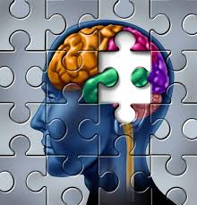
Abuse and dependence
Long-term substance-induced cognitive deficits
Regular use of some drugs may cause long-term cognitive and behavioural deficits (Iversen, 2005)
Long-term deficits may adversely affect judgement resulting in continued long-term substance abuse
Some neuropsychological evidence that drugs such as cocaine can cause long-term damage to the brains of regular users (Little et al., 2003)

Slide 84
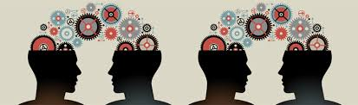
Abuse and dependence
Concurrent psychiatric diagnoses
Treatment outcomes for substance abuse and dependency are significantly worse in those with concurrent psychiatric disorders
Those with psychiatric disorders:
  May face more stressors than those without (so causing more substance abuse)
  Are less likely to consider drugs problematic or may lack the motivation to abstain (Ramo et al., 2005)

Slide 85
Abuse and dependence
Poverty
Socioeconomic factors are important in determining whether someone will use drugs
Conditions such as unemployment, no other forms of recreation, little hope of education fulfilment, and environments that revere drug dealing as a high-status profession are all likely to influence continued substance use

