Slide 1
Introduction to Module
Learning for Children and Young People
BMHP5011

Slide 2
Contents
Brief Overview
Level of Study
Aims of Module
Lesson Content
Assessments
Deadline Dates
Referencing
Reading List
Q&A

Slide 3
Brief Overview
Duration
27th January to 15th May 2020
20 Credits

Slide 4
Level of Study : 5
Achievement at Level 5 reflects the ability to identify and use relevant understanding, methods and skills to address broadly-defined, complex problems.
It includes taking responsibility for planning and developing courses of action as well as exercising autonomy and judgement within broad parameters.
It also reflects understanding of different perspectives, approaches or schools of thought and the reasoning behind them.

Slide 5
Aims of Module
To examine developments in learning and education, including historical, current and international perspectives.

Slide 6
Learning Outcomes
Upon the successful completion of this module, the student should be able to demonstrate the ability to:
Prepare and evaluate a planned learning opportunity for children and/or young people, justifying the rationale for the specified activity or experience.
Examine and evaluate current developments within regional learning frameworks taking into consideration relevant theories and international perspectives.

Slide 7
Lesson Content
This module is designed to develop students’ awareness and understanding of:
The meaning of “Curriculum” from a historical, regional and international perspective.
A range of contemporary theories and approaches to learning and the curriculum.
Influences on learning and the principles of the early years and National Curriculum.

Slide 8
Lesson Content
Factors influencing the facilitation of positive learning experiences in a range of environments.
Factors which support and hinder learning.
The principles of the planning of learning experiences for a range of settings. Methods of assessment of learning.

Slide 9
Assessments
Assessment Component 1 – 50%
Activity Plan 2500 Words
Outcome 1
Students will be required to prepare and evaluate a planned learning opportunity for children and/or young people, justifying the rationale for the specified activity or experience.

Slide 10
Assessments
Assessment Component 2 – 50%
Critical Essay 2500 Words
Outcome 2 Students will be required to produce an essay which examines and evaluates current developments within regional learning frameworks, taking into consideration relevant theories and international perspectives.

Slide 11
Deadline Dates
Assignment 1 Submission
Friday 1st May 2020.
Draft Tutorial Week
23rd March to 27th 2020
Assignment 2 Submission
Friday 15th May 2020
Draft Tutorial Week
27th April to 1st May 2020

Slide 12
Student Task
Find out about how learning activities and experiences are planned at your setting.
How are long, medium and short term plans decided and recorded?
How are individual activity/experiences planned and recorded?
How are plans for children with additional needs recorded?
Bring your notes about the above and examples of plans from your setting to the next session for discussion.

Slide 13
Student Task
Find out what curriculum or learning philosophy is followed at your setting in order to plan the learning for children and young people e.g. Foundation Phase, National Curriculum (which Key Stage), Montessori, Steiner Waldorf etc.

Slide 14
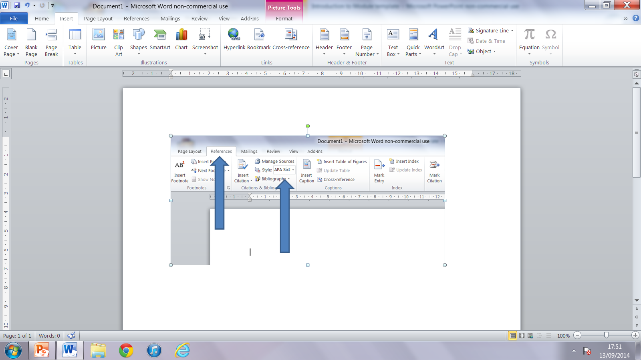
Referencing
Makes up at least 20% of your grade
Best to input
manually
You can utilise
word referencing
Your referencing system is HARVARD 2008

Slide 15
Reading Lists
Essential
Johnston, J. & Halocha, J. (2010) Early Childhood and Primary Education: Readings and Reflections. Maidenhead: Open University.
Pound, L. (2011) Influencing Early Childhood Education. Maidenhead: Open University.

Slide 16
Reading Lists
Background
Gray, C & Macblain, S (2012) Learning Theories in Childhood. London: Sage
Rodger, R. (2012) Planning an Appropriate Curriculum in the Early Years: A guide for early years practitioners and leaders, students and parents.Third Edition. Abingdon: Routledge

Slide 17
Journals and Websites
Journals:
5-7 years
Children and young People Now
Early Years Educator
Education 3-13
Teaching Today
Useful Websites:
www.education.gov.uk
www.nfer.ac.uk/
www.forestschoolwales.org.uk
www.standards.dfes.gov.uk/eyfs
http://wales.gov.uk

Slide 18
Reading Lists
Always check your handbook for reading lists
Additional reading and links will also be found on your Moodle page (more about this below)
You can use campus libraries in this building (Swansea Business School), Townhill, Mount Pleasant, Carmarthen, or even Lampeter
Libraries will order in books from other campuses or may buy them in for you
DON’T BE AFRAID TO REQUEST WHAT YOU NEED

Slide 19
Q&A
Any Questions?

