Slide 1

INTERNATIONAL BUSINESS COMMUNICATIONS
INDIVIDUAL PRESENTATION ASSIGNMENT:
CROSS-CULTURAL NEGOTIATIONS
STUDENT NAME: CODRIN IOAN CHIRCIU
STUDENT ID: 2027548

Slide 2
CONTENT
DEIFINIG CULTURE
ELEMENTS OF CULTURE
THEORETICAL FRAMEWORK: HOFSTEDE’S DIMENSIONS
THEORETICAL FRAMEWORK: HALL’S CONTEXT THEORY
KEY CHINESE CULTURAL ELEMENTS TO OVERCOME
IMPACT ON BUSINESS OPERATIONS
NEGOTIATION STRATEGIES FOR SUCCESS
IMPORTANCE OF CULTURAL AWARENESS
CONCLUSION
REFERENCES LIST

Slide 3

DEFINING CULTURE
- “Shared values, beliefs, norms, and behaviours that distinguish one group from another.”
- Influences communication, decision‑making, and business expectations.
- Shapes how organisations interpret relationships and agreements.
Notes:
Culture can be defined as “the collective programming of the mind which distinguishes the members of one group or category of people from another” (Hofstede, 2011). In business, this means that cultural assumptions influence how partners interpret trust, hierarchy, time, and negotiation behaviour. For example, UK firms tend to prioritise direct communication and efficiency, whereas Chinese firms emphasise relational harmony and long‑term orientation.

Slide 4

ELEMENTS OF CULTURE
Key Cultural Elements:
  Communication style
  Power distance
  Attitudes toward time
  Relationship orientation
  Approach to conflict
  Decision‑making style
Notes:
Hall’s (1976) high‑context vs. low‑context theory is especially relevant. China is a high‑context culture where meaning is conveyed indirectly through tone, silence, and relationships. The UK is low‑context, relying on explicit verbal communication. This difference affects how agreements are expressed, how disagreement is signalled, and how trust is built.

Slide 5
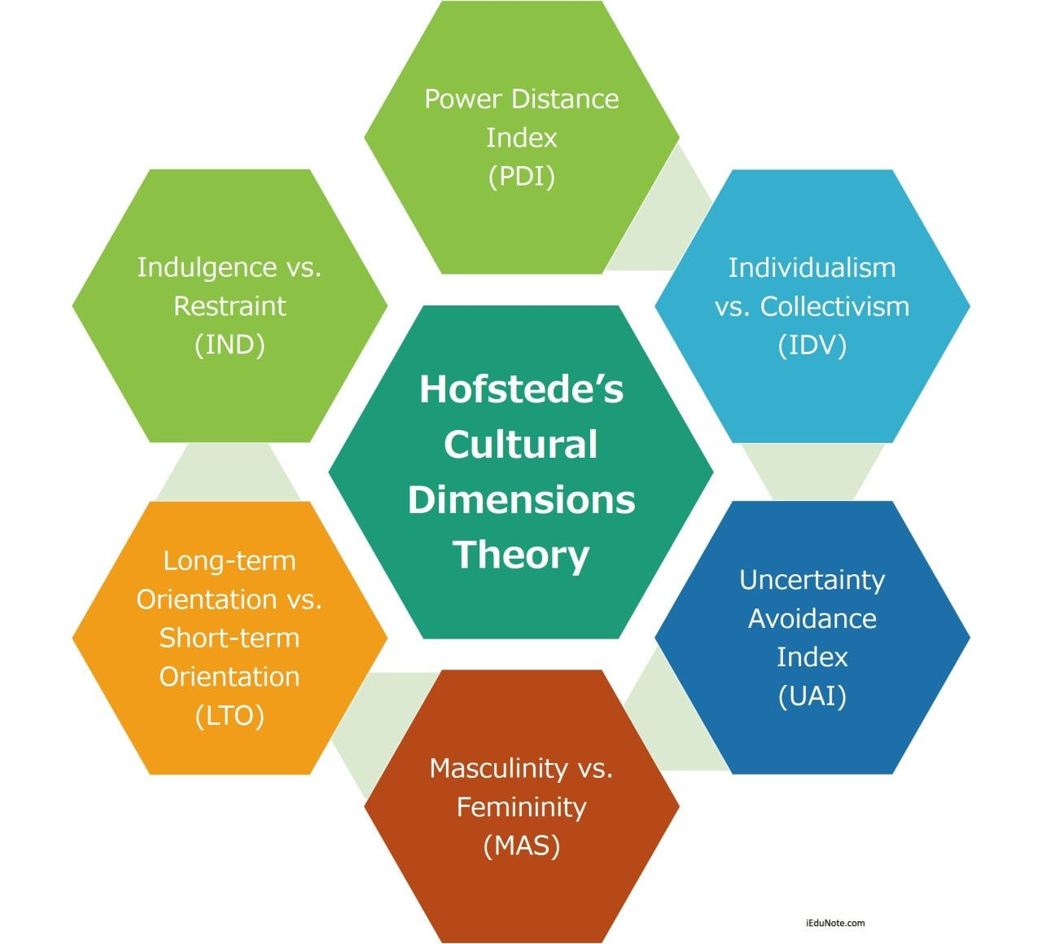
THEORETICAL FRAMEWORK: HOFSTEDE’S DIMENSIONS
Relevant Dimensions:
Power Distance: China high, UK moderate
Individualism vs. Collectivism: China collectivist, UK individualist
Long‑Term Orientation: China very high, UK moderate
Uncertainty Avoidance: China moderate, UK moderate
Notes:
In China’s high Power Distance culture, hierarchy is respected and decisions often require approval from senior leaders. This means negotiations may progress slowly. China’s collectivism means decisions are made with group harmony in mind, not individual preference. Their strong Long‑Term Orientation means they prioritise sustainable partnerships, which aligns well with strategic collaboration.

Slide 6
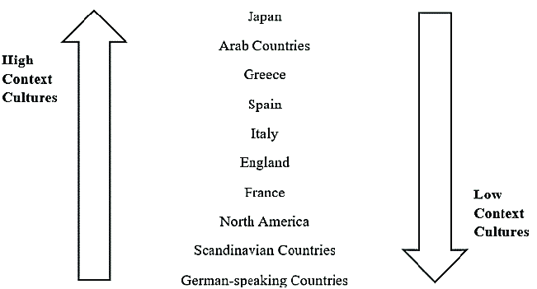
THEORETICAL FRAMEWORK: HALL’S CONTEXT THEORY
High‑Context (China):
Indirect
Relational
Implicit meaning
Non‑verbal cues important
Low‑Context (UK):
Direct
Task‑focused
Explicit meaning
Written communication valued
Notes:
In high‑context cultures like China, silence can be a strategic communication tool. A Chinese negotiator may avoid saying ‘no’ directly to preserve harmony. UK negotiators must learn to interpret subtle cues and avoid assuming that verbal agreement equals commitment.

Slide 7
KEY CHINESE CULTURAL ELEMENTS TO OVERCOME
Cultural Factors:
  Guanxi (relationship networks)
  Face-saving (mianzi)
  Indirect communication
  Consensus-based decision-making
  Preference for long-term relationships
Notes:
Guanxi is more than networking; it is a system of reciprocal obligations that builds trust. Without guanxi, Chinese firms may hesitate to commit.
Face-saving (mianzi) means avoiding embarrassment or confrontation. This affects how feedback is given and received.
Consensus-based decision-making means decisions involve multiple stakeholders, requiring patience.

Slide 8
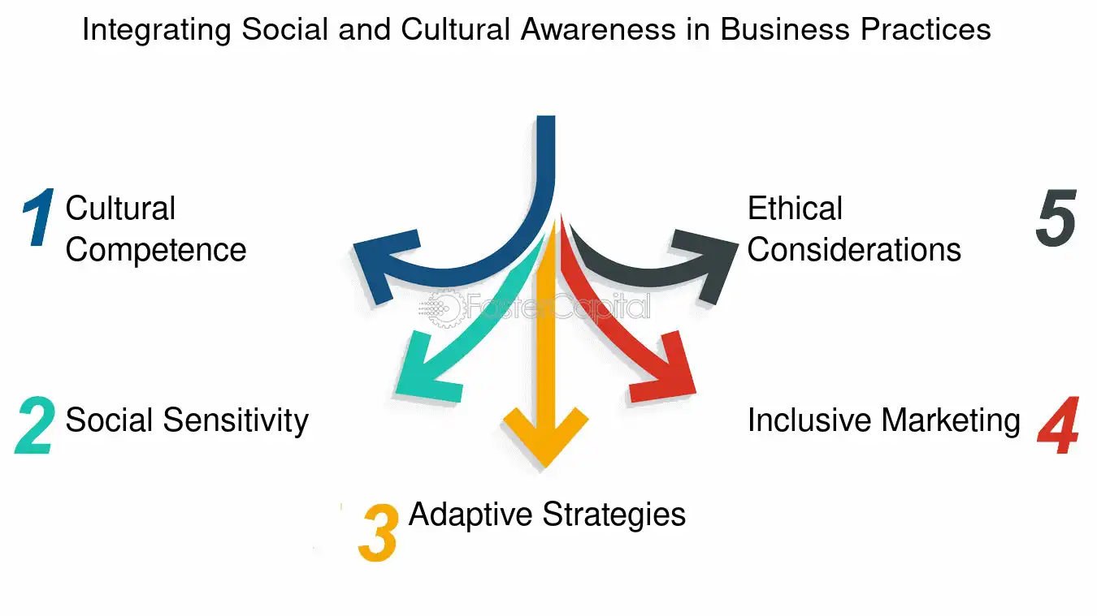
IMPACT ON BUSINESS OPERATIONS
IMPACTS:
Longer negotiation timelines
Need for relationship-building before contracts
Avoidance of confrontation
Senior leadership involvement required
Importance of informal meetings
Notes:
These cultural elements influence how we schedule meetings, structure proposals, and interpret responses. For example, a lack of immediate feedback does not indicate disinterest—it may reflect internal consultation. Understanding these dynamics prevents misinterpretation and builds trust.

Slide 9
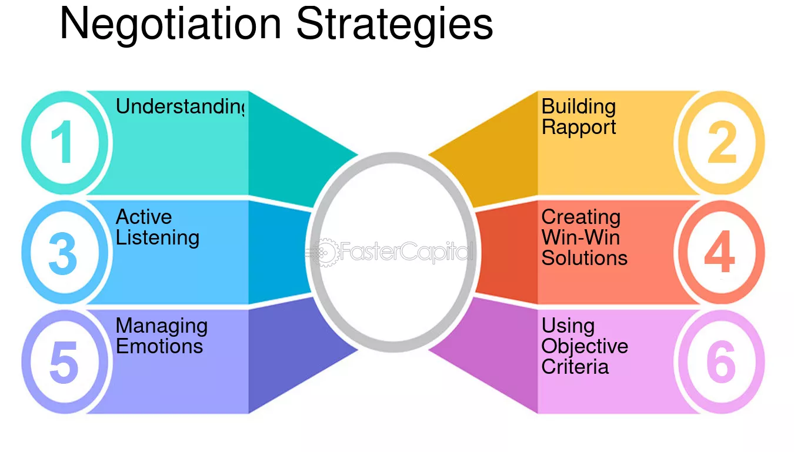
Negotiation Strategies for Success
Strategies:
Build guanxi through informal interactions
Use respectful, indirect communication
Demonstrate patience and flexibility
Show long-term commitment
Adapt negotiation style to Chinese expectations
Avoid public disagreement
Notes:
Research by Fang (2006) shows that Chinese negotiators prioritise trust and personal rapport before discussing contractual details. Therefore, we must invest time in relationship-building. Adapting our communication style—being less direct, more diplomatic—helps maintain harmony and strengthens the partnership.

Slide 10

Examples:
Begin meetings with informal conversation
Avoid direct criticism; use softening language
Provide written summaries to clarify meaning
Allow time for internal consultation
Show respect for hierarchy by addressing senior leaders first
Notes:
These behaviours demonstrate cultural intelligence. For example, instead of saying ‘This proposal won’t work,’ we might say, ‘Perhaps we could explore an alternative approach.’ This preserves face and maintains harmony.

Slide 11
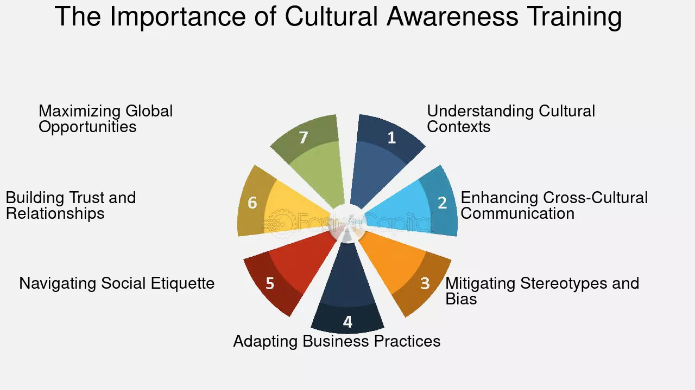
IMPORTANCE OF CULTURAL AWARENESS
Why It Matters:
Reduces misunderstandings
Builds trust
Improves negotiation outcomes
Strengthens long-term partnerships
Enhances organisational reputation
Notes:
Brett (2014) argues that culturally intelligent negotiators create more value for both sides. Cultural awareness enables us to interpret behaviours accurately, avoid conflict, and build sustainable partnerships. In a globalised economy, cultural competence is a strategic asset.

Slide 12
CONCLUSION
Cultural differences are manageable with preparation
Relationship-building is essential
Adaptability leads to successful cross-cultural deals
A culturally informed approach strengthens our competitive advantage
Notes:
By understanding Chinese cultural expectations and adapting our negotiation approach, we can secure a mutually beneficial partnership that supports our long-term strategic goals.

Slide 13
Reference List
Brett, J. (2014) Negotiating Globally. Jossey-Bass.
Chen, X. & Chen, C. (2004) ‘On the intricacies of Chinese guanxi’, Asia Pacific Journal of Management, 21(3), pp. 305–324.
Fang, T. (2006) ‘Negotiation: The Chinese style’, Journal of Business & Industrial Marketing, 21(1), pp. 50–60.
Hall, E. (1976) Beyond Culture. Anchor Books.
Hofstede, G. (2011) ‘Dimensionalizing cultures’, Online Readings in Psychology and Culture, 2(1).
Hofstede Insights (2023) Country Comparison: China and UK.

