Slide 1
Effective Management
International Gastronomy Management
[BMGM4000]
Week 2 – FOH & BOH Structures & The Principles of Management

Slide 2
Recap
Introductions
Module Overview & content to be covered
Module Handbook & Assessments
Introduction of key terms: management styles, kitchen brigade etc.

Slide 3
Today’s objectives
Structure: BOH/FOH (roles & responsibilities).
Kitchen Brigade.
What is management & leadership?
Function of management.
5 levels of leadership.
Styles of management/leadership.

Slide 4


Structure: BOH/FOH (roles & responsibilities)

Slide 5

Restaurant Terminology
BOH – Back of House
Encompasses all the behind-the-scenes areas that customers will not see. This acts as the central command centre because it is where the food is prepared, cooked, and plated before making its way to the customer’s table.
FOH – Front of House
Refers to all actions and areas that a customer will be exposed to during their stay at a restaurant, such as the lobby and dining area.
Notes:
Spend 5 mins brainstorming different FOH & BOH roles, discuss whether they have held any of these roles, and their thoughts/opinions on them.

Slide 6

Restaurant Structure - Hierarchal
General Manager
Restaurant Manager
Assistant Restaurant Manager
Operations Manager
Floor Manager/Supervisor
Headwaiter/waitress
Assistant Headwaiter/waitress
Waiter/Waitress/Server/Food Runner

Slide 7
Restaurant Structure - Hierarchal
Head Sommelier
Sommelier
Bar Manager/Beverage Manager
Bartender
Guest Relation Manager
Front Desk Manager/Head Host
Host/Receptionist
Cleaner/Back of House

Slide 8
Roles & Responsibilities - FOH
Role | Responsibilities
General Manager/Restaurant Manager | Menu Design, Quality Control, Profit Maximisation, VIP Services, RevPash (revenue per available seat hour)
Operation Manager/Floor Manager/Supervisor | Monitor Restaurant Activities, Track Inventory, Make Purchases, Training New & Existing Employees, VIP Services
Head Waiter/Waitress/Supervisor/Assistant Head Waiter/Waitress | Day-to-day Operations, Supervising Junior Team Members
Head Sommelier/Bar or Beverage Manager | Wine Menu Design, Beverage Management, Quality Control, Wine & Spirit Stocking, Beverage Purchasing
Guest Relations Manager | PR, Marketing, Event Management, VIP Management
Front Desk Manager/ Head Host | Greeting, Welcoming, Seating, Booking
Server/Food Runner | Day-to-day Operations, Cleaning

Slide 9
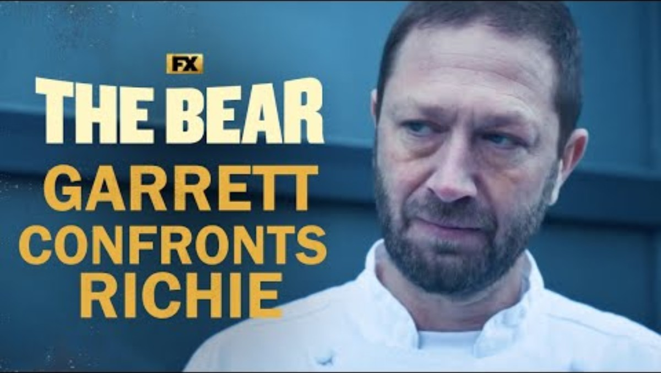

Slide 10
Kitchen Brigade

Slide 11
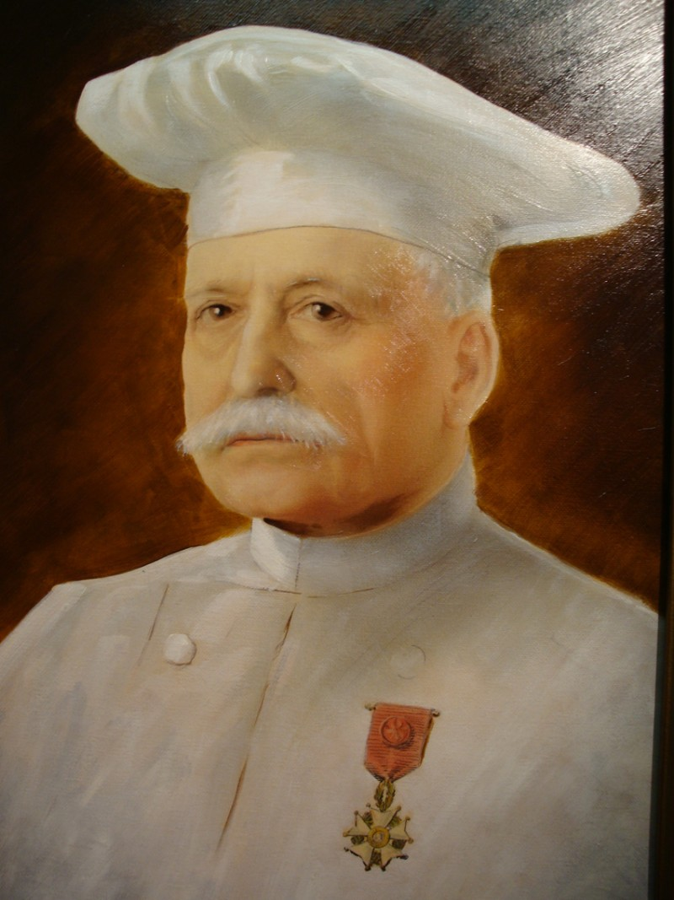
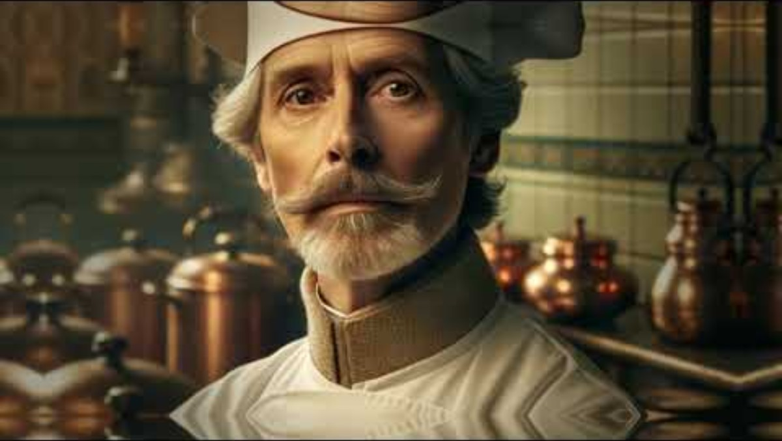
Auguste Escoffier (1846 – 1935)

Slide 12
Auguste Escoffier (1846 – 1935)
Five French mother sauces: Béchamel, Velouté, Espagnole, Hollandaise & Tomato
Mise en place: ‘everything in its place’: gather ingredients & tools and prep through chopping, measuring etc before you start cooking. Familiarise yourself with recipe & have an organised workspace to dispose of scraps etc.
Brigade system: coordinated labour division e.g. grill chef or fish chef etc. A revolutionary approach still widely used today around the world.
Notes:
Bechamel = white sauce (roux of butter & flour heated in cream or milk) used to thicken, equal parts of flour & butter.
Veloute = roux of butter & flour mixed with a white stock (chicken, veal, fish or veg).
Espagnole = dark brown roux mixed with a veal or beef stock & tomato puree or paste. Combined with mirepoix (finely diced onions, carrots & celery).
Hollandaise = egg yolk (emulsifier & creamy base), butter, lemon juice or white wine vinegar reduction.
Tomato = thickened with a blond roux (butter & flour), flavoured with pork or white stock & mirepoix (diced carrots, onions & thyme).

Slide 13
Auguste Escoffier (1846 – 1935)
Popularised the style of service where dishes are brought to the table as separate courses – still common practice today (before this dishes were often brought altogether with diners expected to serve themselves).
1903 – published Le Guide Culinaire – a resource to train future chefs.
Retired after a career spanning 50 years.

Slide 14
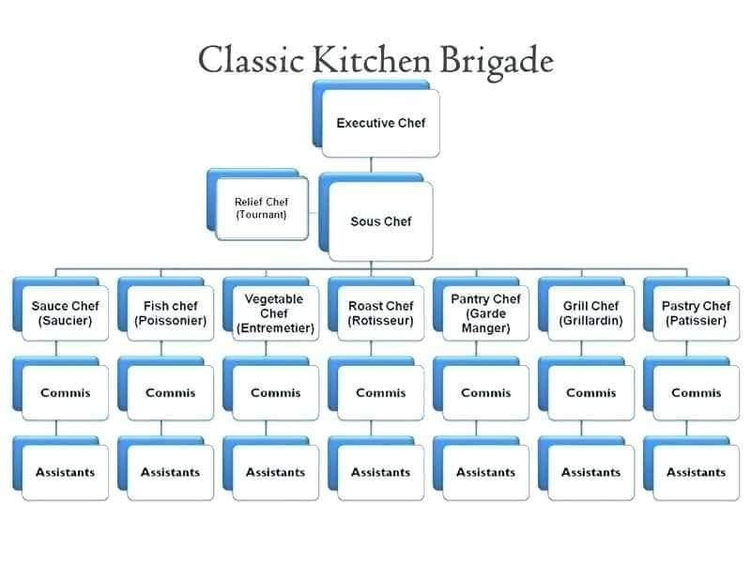
Chef Exécutif (Executive Chef)
Chef de Cuisine (Head Chef)
Sous Chef de Cuisine (Deputy Chef)
Chef de Partie (Line Cook)
Commis Chef (Junior Chef)
Garçon de cuisine (Kitchen Porter)
Escuelerie (Dishwasher)

Slide 15
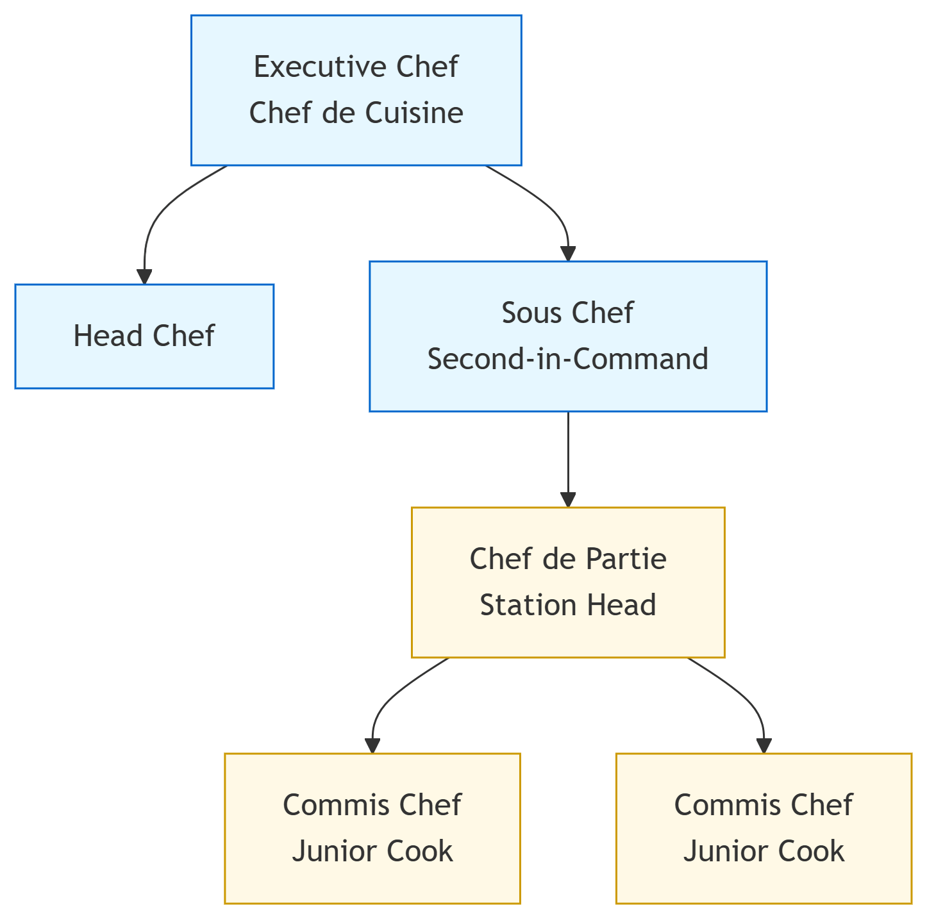
The modern brigade system is:
More streamlined
More flexible
Includes fewer specialised roles
Merges more niche roles
Relies heavily on cross-training and staff adaptation

Slide 16
Activity

Slide 17
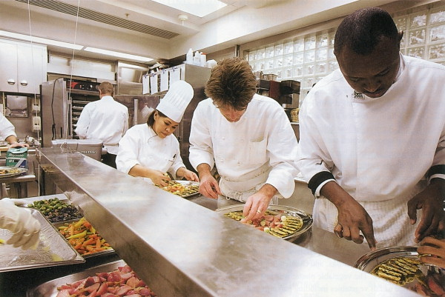
Group Discussion
Is the kitchen brigade system suitable for every restaurant, or should it be limited to fine dining and larger kitchens?
Notes:
Ideal for fine dining – large kitchen teams and specialised chefs in clearly defined sub sections. It promotes communication and avoids overlap of tasks or something getting missed. Maintains order and efficiency.
Less ideal for small establishments or quick service eateries – may not have a large team, may find chefs covering multiple sections. These eateries promote flexibility over specialisation. Cross training is usually more useful in these establishments.
Consider a hybrid – smaller brigade (less parts/roles overall), allow for team members to cover more than one station, employ the discipline of Escoffier’s brigade system whilst allowing for flexibility/adaptations.

Slide 18
Pros & Cons of hierarchy/brigade
Advantages | Disadvantages
Efficiency | High Stress Environment
Specialisation | Abuse (Emotional, Physical, Verbal)
Development Pathway | Stifles Innovation & Adaptability

Slide 19
What is management & leadership?

Slide 20
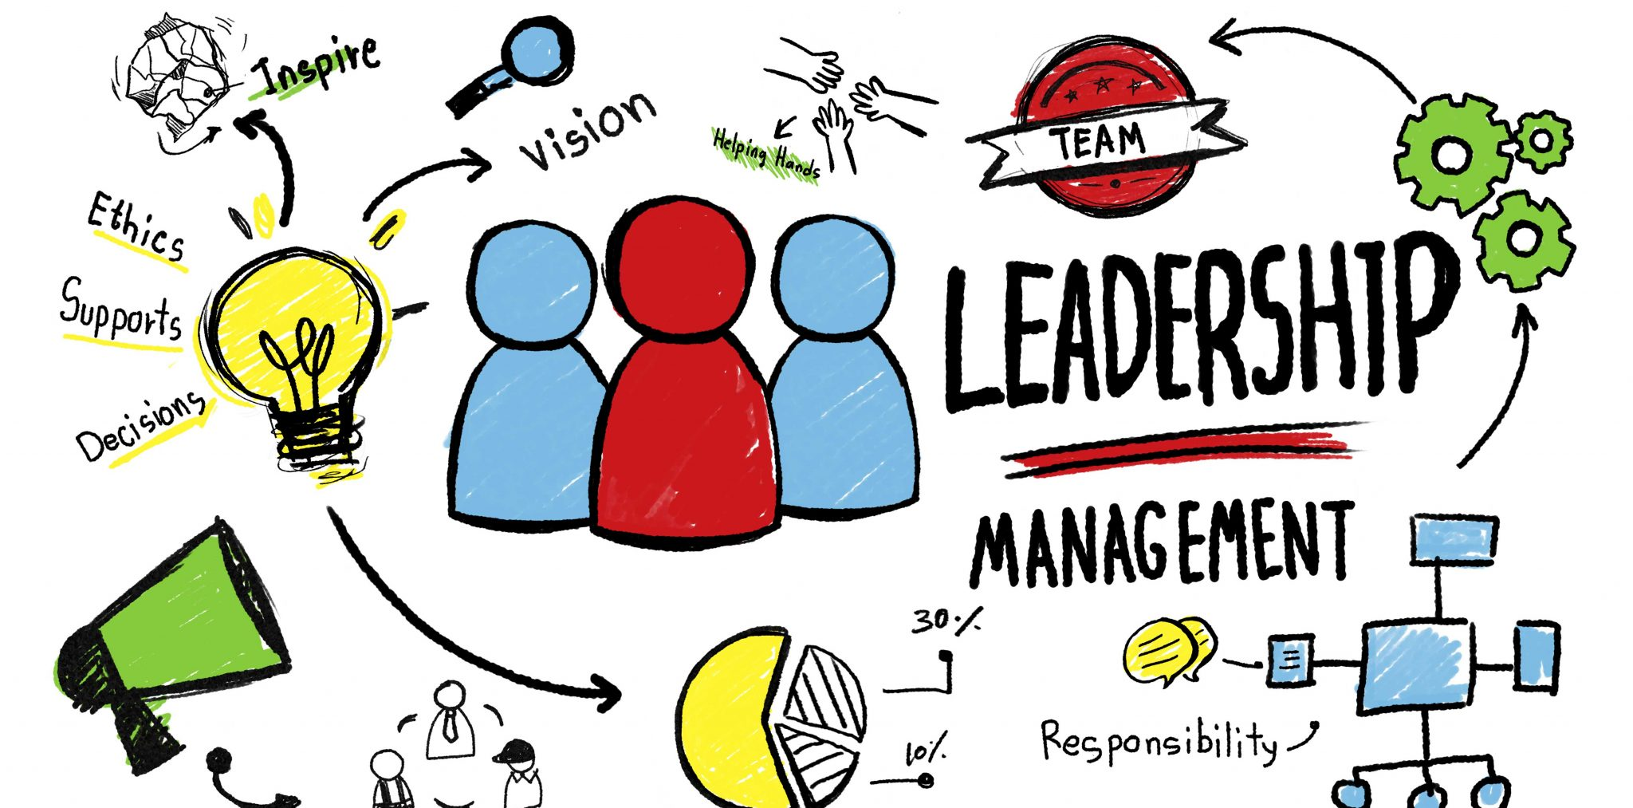

Slide 21

What is management?
Kotter (2017) defined management as a job that takes care of planning, organising, budgeting, coordinating, and monitoring activities for a group or organisation.
Notes:
Appears authoritative – do as I say. Manager makes decisions, workforce follows instructions.

Slide 22
What is leadership?
McKinsey & Company (2024) defined leadership as: a set of mindsets and behaviours that aligns people in a collective direction, enables them to work together and accomplish shared goals, and helps them adjust to changing environments.
Notes:
Leadership is more collaborative, perhaps more democratic, everyone has a voice.

Slide 23

Management vs Leadership
Management is about seeking order and stability; leadership is about seeking adaptive and constructive change.

Slide 24
Function of management

Slide 25
What is the function of management?
The core activities managers perform to coordinate people and resources.
Why?
To achieve organisational goals.

Slide 26

Join the Vevox session
Go to vevox.app
Enter the session ID: 177-403-615
Or scan the QR code

Slide 27
What are the core activities that managers perform?
0/0
Join at: vevox.app
ID: 177-403-615
Question slide

Slide 28
What are the core activities that managers perform?
0
Join at: vevox.app
ID: 177-403-615
Showing Results
RESULTS SLIDE

Slide 29

Planning
Organising
Staffing
Directing/Leading
Controlling
Notes:
Will look in more depth in following slides.

Slide 30
Planning =
Setting objectives
Advance decision making on what needs to be done/which person(s) for task
Forecasting – what is probable
Strategy development – in line with organisational goals
Clear action steps – route to success/completion

Slide 31
Organising =
Arranging resources: people, materials, finances, technology
Establish roles & responsibilities of each person
Communicate plans & requirements
Establish authority/hierarchy

Slide 32
Staffing =
Recruitment
Training
Development – right people for right job(s)
Ensure organisation has skilled & motivated employees

Slide 33
Directing/Leading =
Guiding, motivating & supervising employees to achieve objectives
Requires leadership, communication & conflict management

Slide 34
Controlling =
Monitor performance throughout
Compare performance to previously set standards
Take corrective action where required
Ensure goals are met

Slide 35
Join the Vevox session
Go to vevox.app
Enter the session ID: 177-403-615
Or scan the QR code

Slide 36
Why is planning considered the first step in the management process?
##/##
Join at: vevox.app
ID: XXX-XXX-XXX
Question slide
It helps managers delegate tasks immediately
##.##%
It sets the direction and goals for the organisation
##.##%
It focuses on supervising employees
##.##%
It ensures financial control
##.##%

Slide 37
Why is planning considered the first step in the management process?
##/##
Join at: vevox.app
ID: XXX-XXX-XXX
Results slide
It helps managers delegate tasks immediately
##.##%
It sets the direction and goals for the organisation
##.##%
It focuses on supervising employees
##.##%
It ensures financial control
##.##%
RESULTS SLIDE

Slide 38
In a restaurant, which of the following best demonstrates the organising function?
##/##
Join at: vevox.app
ID: XXX-XXX-XXX
Question slide
A manager creating the annual budget
##.##%
A chef developing a new menu
##.##%
A front of house manager assigning staff members to specific shifts
##.##%
A supervisor giving a motivational speech
##.##%

Slide 39
In a restaurant, which of the following best demonstrates the organising function?
##/##
Join at: vevox.app
ID: XXX-XXX-XXX
Results slide
A manager creating the annual budget
##.##%
A chef developing a new menu
##.##%
A front of house manager assigning staff members to specific shifts
##.##%
A supervisor giving a motivational speech
##.##%
RESULTS SLIDE

Slide 40
Which of the following is NOT part of staffing?
##/##
Join at: vevox.app
ID: XXX-XXX-XXX
Question slide
Recruitment and selection
##.##%
Training and development
##.##%
Pricing and menu design
##.##%
Performance appraisal
##.##%

Slide 41
Which of the following is NOT part of staffing?
##/##
Join at: vevox.app
ID: XXX-XXX-XXX
Results slide
Recruitment and selection
##.##%
Training and development
##.##%
Pricing and menu design
##.##%
Performance appraisal
##.##%
RESULTS SLIDE

Slide 42
How does effective directing improve customer satisfaction?
##/##
Join at: vevox.app
ID: XXX-XXX-XXX
Question slide
By giving employees less supervision
##.##%
By ensuring motivated employees provide excellent service
##.##%
By reducing staff interactions with guests
##.##%
By increasing operational costs
##.##%

Slide 43
How does effective directing improve customer satisfaction?
##/##
Join at: vevox.app
ID: XXX-XXX-XXX
Results slide
By giving employees less supervision
##.##%
By ensuring motivated employees provide excellent service
##.##%
By reducing staff interactions with guests
##.##%
By increasing operational costs
##.##%
RESULTS SLIDE

Slide 44
Which of the following is the first step in the controlling process?
##/##
Join at: vevox.app
ID: XXX-XXX-XXX
Question slide
Establishing performance standards
##.##%
Evaluating employee feedback
##.##%
Taking corrective action
##.##%
Measuring performance
##.##%

Slide 45
Which of the following is the first step in the controlling process?
##/##
Join at: vevox.app
ID: XXX-XXX-XXX
Results slide
Establishing performance standards
##.##%
Evaluating employee feedback
##.##%
Taking corrective action
##.##%
Measuring performance
##.##%
RESULTS SLIDE

Slide 46
Management Tools

Slide 47

What are management tools?
Methods, techniques & systems used to plan, monitor, analyse & improve organisational performance.
Notes:
Help managers to make better decisions, solve problems, increase efficiency and achieve business objectives.

Slide 48
Restaurant Specific
Reservation Management
Point of Sale (POS)
Inventory Management
HR Management
Analytics
Notes:
Reservation management – bookings
Point of sale (POS) – orders/billing
Inventory management – stock levels
HR management – employee data/rotas/training/payroll
Analytics – consumer preferences, trends, staff performance
Examples – Toast POS, OpenTable (reservations), Oracle Micros (all in one)

Slide 49

Why are management tools so important?
Managing a restaurant requires fast and constant adaptation.
Many moving parts to monitor – customers, staff, inventory, costs, quality.
Eases pressure, ensures consistency and reduces some task associated admin.
Digital platforms enable trackable trends to determine successful and less successful areas.
Centralised platforms that multiple staff members can access if required – particularly useful for establishments with a management team rather than one person.

Slide 50
Management by objectives

Slide 51

Process of Managing Business Objectives
Set Organisation Objectives
Create Objectives for Employees
Monitor
Evaluate Performance
Reward Performance
MBO
Notes:
Set organisation objectives/monitor & evaluate performance (mid semester)
Reward performance (in depth at level 5 during Professional Service)

Slide 52
Action-centred leadership model

Slide 53
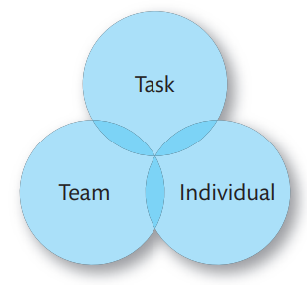
Action-centred Leadership model
Achieving the task
Managing the team or group
Managing individuals
The circles overlap because they require attention simultaneously
John Adair’s action-centred Leadership model
(Adair, 1989)

Slide 54
Action-centred Leadership model
Practical theory designed for consistent use
Can be used in any industry at any level
Adair believes leadership can be taught
To be an effective leader you simply need to learn how to lead – not all leaders are born that way
John Adair’s action-centred Leadership model
(Adair, 1989)

Slide 55
Action-centred Leadership model
Advantages – easy to use, adaptable, encourages focus and motivation.
Disadvantages – some find it too simplistic, some believe it is autocratic as it focuses on control by the leader, can be viewed as outdated.
Start by defining the task and then consider whether team or individual requires more focus, branch out from there. Monitor all elements throughout and adjust level of focus as and when required.
John Adair’s action-centred Leadership model
(Adair, 1989)

Slide 56
5 levels of leadership

Slide 57
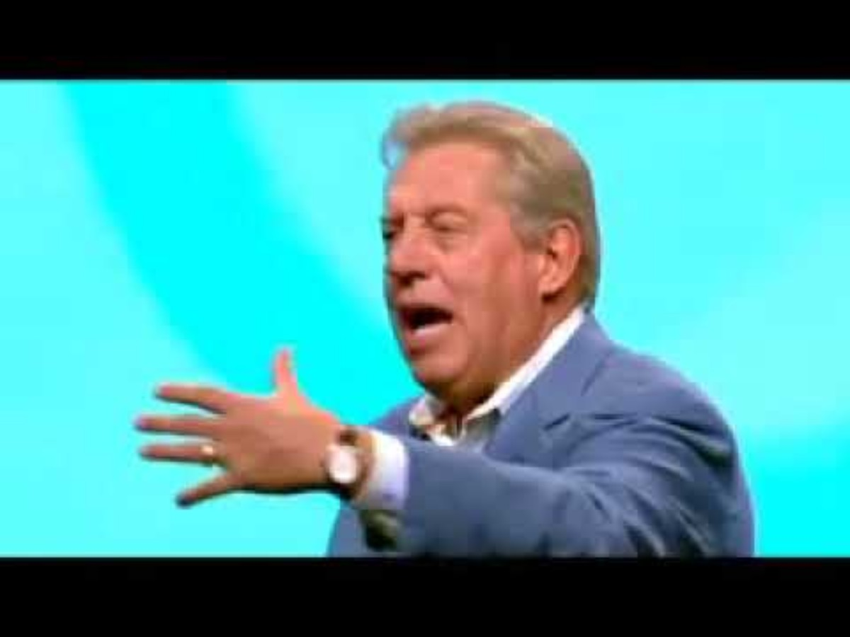
5 levels of leadership
Notes:
Show if there is time, otherwise ask them to watch in their own time.

Slide 58
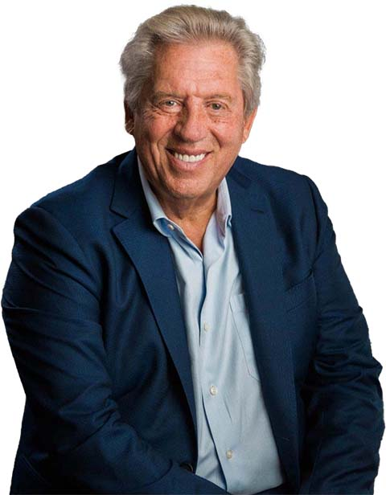
John C. Maxwell
“People do what people see”
“We attract who we are, not what we want”
You grow a company by growing people”
You can’t teach someone what you can’t do yourself”
Leadership is always ongoing”
Leadership is influence”

Slide 59
People Follow You Because…
5 Levels of Leadership
Pinnacle (Respect)
Permission ( Relationship)
Position (Rights)
Production (Result)
People Development (Reproduction)
of whom you are and the quality you have
of what you have done for them
of what you have done for the organisation
they want to
they have to
(Maxwell, 2013)

Slide 60

Ever worked with a bad leader?
Think of that person
How would you describe him or her?
How did they make you feel?
Any common themes?
Notes:
The “dark side of leadership is an ongoing pattern of behavior exhibited by a leader that results in overall negative organizational outcomes based on the interactions between the leader, follower, and the environment.” Colin Slattery, 2009

Slide 61
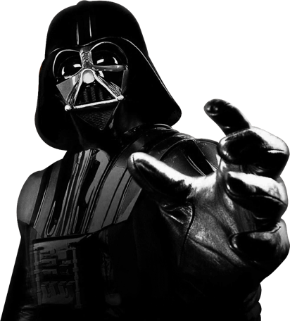
What is the Dark Side?
Incompetent – lack will or skill (or both) to sustain effective action.
Rigid – unable or unwilling to adapt to new ideas, information or changing times.
Intemperate – lacks self-control.
Callous – uncaring/unkind. Needs of subordinates are ignored or discounted.
Corrupt – lie/cheat/steal.
Insular – disregard health of ‘the other’: those outside of organisation.
Evil – use pain as an instrument of power (physical, psychological or both).
Barbara Kellerman – “Bad Leadership” 2014.

Slide 62
Styles of management/leadership

Slide 63
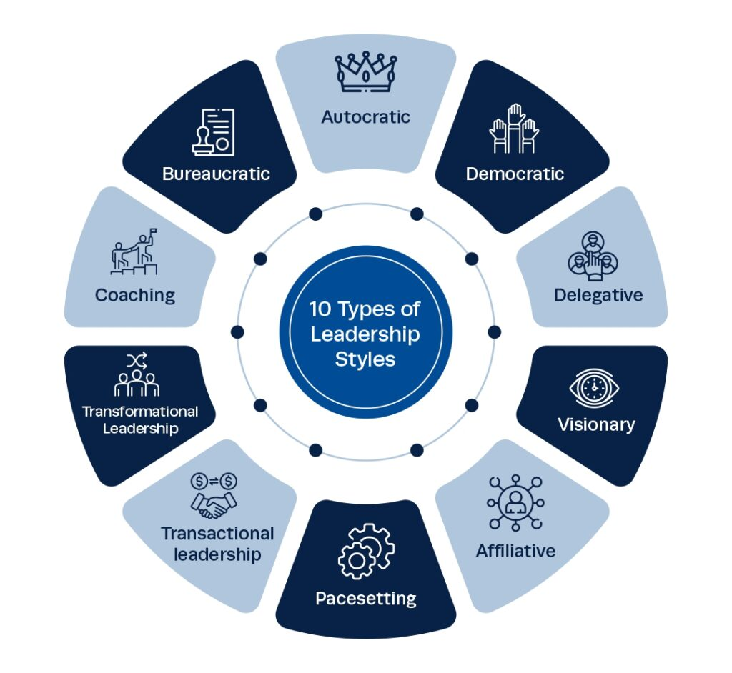
Notes:
Will explore in more depth in upcoming slides.

Slide 64
Autocratic – Makes decisions with little or no input. Maintains strict control. Efficient in emergencies but can reduce creativity & team morale.
Democratic – Encourages group participation in decision making. Collaboration is valued, but leader makes final decision. Promotes engagement & commitment but slows down decision making.
Delegative – Hands off approach. Little supervision or direction from leader. Great for well-skilled teams but can lead to confusion or lack of accountability.
Visionary – Focus on inspiring and guiding others to long-term goals. Motivate through purpose, values & clear sense of direction. Powerful for driving change & innovation but can cause lack of focus on short-term goals.
Affiliative – Focus on building strong emotional bonds & team harmony. Leader prioritises empathy, trust & wellbeing. Boosts morale, reduces conflict but can cause poor performance to be overlooked.

Slide 65
Pacesetting – High-performance standards. Leader expects team to follow their example. Leader is highly driven and hands on. Drives fast results but can cause burnout & stress.
Transactional – Clear structure & specific goals. Rewards for success, consequences for failing. Effective for short term tasks & routine work but may limit creativity & long-term motivation.
Transformational – Inspires & motivates followers to exceed expectations through shared vision, innovation & individual development. Effective for driving change & growth but requires strong emotional intelligence & commitment.
Coaching – Focus on developing individuals for long-term success by guiding, mentoring & providing feedback. Builds skills & confidence but can be time consuming. Less effective if team isn’t open to growth.
Bureaucratic – Strict adherence to rules, policies & procedures. Prioritises structure & order. Leader is predictable but stifles innovation.

Slide 66
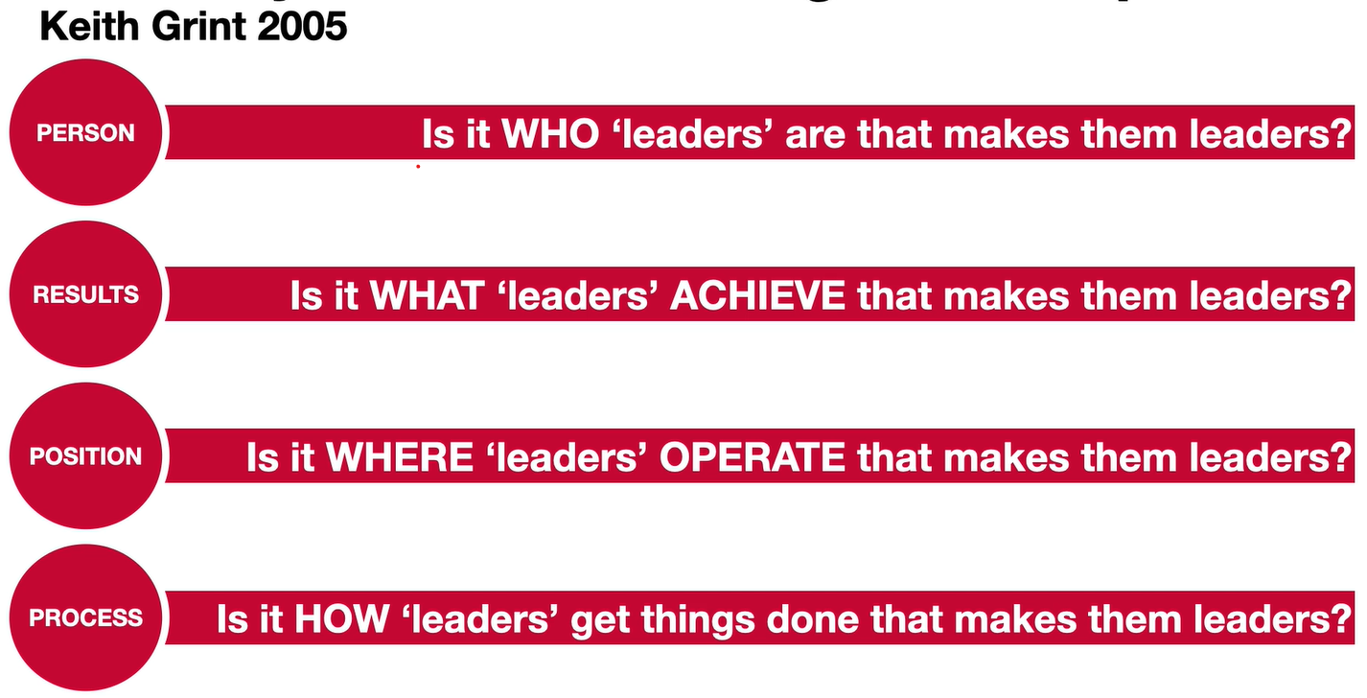
There are multiple ways of perceiving leadership:
Traits - What type of person? Leaders are born not made.
Situational – “Contingency Theory” Context dictates style, match the right style to the right situation.
Power/Influence – Root of power e.g. rewards/incentives, coercive approaches, expert knowledge to influence.
Behaviour - What they do/method? Task or people oriented. Good leaders act in certain ways regardless of their personal traits.
Are leaders born or made?
(Grint & Nixon, 2015)

Slide 67
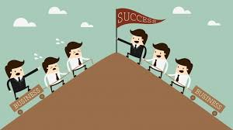
12 characteristics of a good leader
An effective leader needs to manage and supervise but also positively influence others to perform to the best of their abilities.
Self-awareness
Respect
Compassion
Vision/strategic thinking
Communication
Learning agility
Collaboration
Influence
Integrity
Courage
Gratitude
Resilience

Slide 68
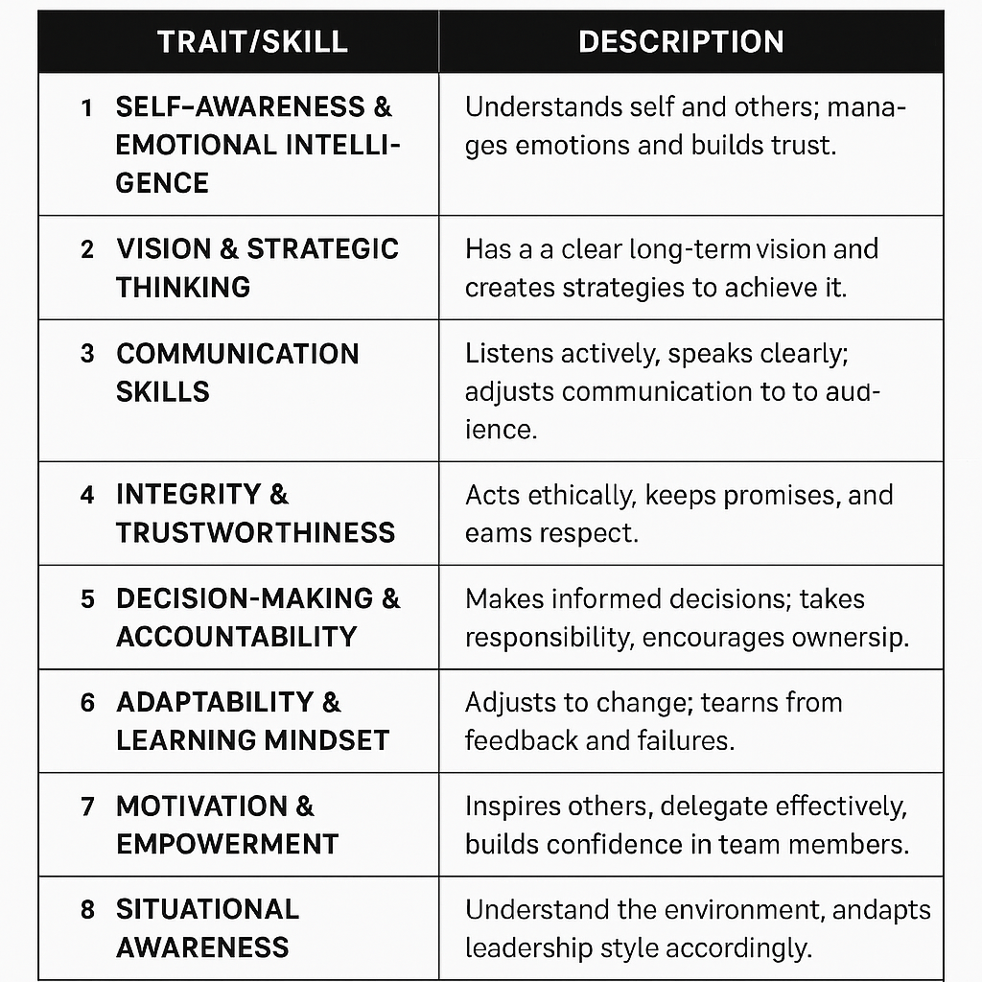
What does this mean in practice?

Slide 69

Simon Sinek
American Author
Expert on Business Leadership
“Start with WHY”
“The greatest contribution of a leader is to make others leaders”
“Good leaders share the credit when things go well and take responsibility when things go badly”
Famous TedTalk where he introduced The Golden Circle – concept that successful leaders start with WHY they do what they do, instead of focusing on what they do or how they do it

Slide 70
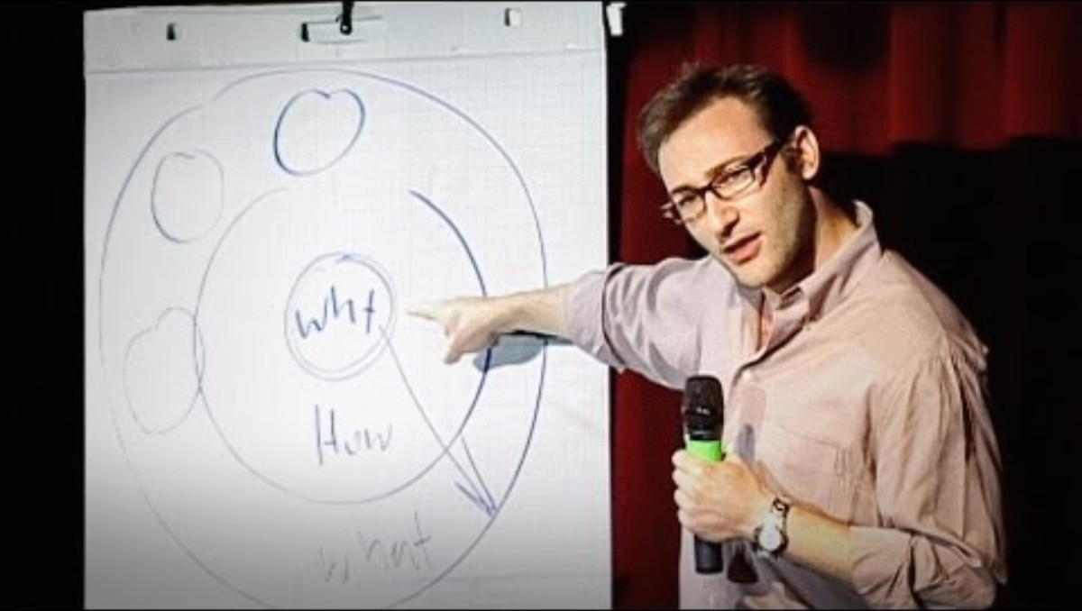
Notes:
Show if there is time, otherwise ask them to watch in their own time (20 mins long).

Slide 71
Today’s objectives – did we achieve them?
Structure: BOH/FOH (roles & responsibilities).
Kitchen Brigade.
What is management & leadership?
Function of management.
5 levels of leadership.
Styles of management/leadership.

Slide 72
Any Questions?

Slide 73

Identifying your role within a team & your preferred leadership style
Managing diverse teams effectively
Belbin Team Roles
MBTI Personality Test

Slide 74
Reference List
Adair, J.E. (1989) Action-centred leadership. Aldershot, England: Gower.
FX Networks. (2023) Garrett Confronts Richie While Polishing Forks – Scene | The Bear | FX [online], available at: Garrett Confronts Richie While Polishing Forks - Scene | The Bear | FX
Grint, K. and Nixon, D. (2015) The sociology of Work. Cambridge: Polity Press.
Kellerman, B. (2014) Bad leadership what it is, how it happens, why it matters. Boston: Harvard Business Review Press.
Kotter, J.P. (2017) ‘What leaders really do’, Leadership Perspectives, pp. 7–15. doi:10.4324/9781315250601-2.
McKinsey & Company. (2024) ‘What is leadership: A definition and way forward’ [online], available at: What is leadership: A definition and way forward | McKinsey
Sinek, S. (2025) Would You Still Lead If No One Ever Knew Your Name? [online], available at: The Power of Leading Without Recognition - Simon Sinek
TED. (2010) How Great Leaders Inspire Action | Simon Sinek | TED [online], available at: How Great Leaders Inspire Action | Simon Sinek | TED
Weber, M., Roth, G. and Wittich, C. (2013) Economy and society: An outline of interpretive sociology. Berkeley: University of California Press.

