Slide 1




Problem solving
2028051
Mikeisha Alidadas Carty

Slide 2
Introduction
what is problem solving?
Problem solving is the act of defining a problem ; determining
The cause of the problem ; identifying ,prioritizing , and selecting alternatives of a solution ; and implementing a solution. The problem-solving process . Problem solving resources .

Slide 3
What is the Nature of work related-related stress
The nature of work-related stress would be , excessive workload , work patterns and working environment Expressed the mutual agreement on the definition of stress as psychological and cognitive support.
The key features of work – related stress would be a sequences of events that would result in a huge demands for normal functioning following significant set of evaluative processes which typically effects the individual wellbeing due to the of confidence caused by generational stress related problems at work deprive from lack resources the importance of an individual failing to cope with their work loads , to help individuals have a better coping mechanism suggests the its crucial to increase personal resources of high importance for the ability to enhance self –efficacy , having larger ( MacKay et . All,2004)
HSE definition of work-related stress .
The adverse reaction people have to excessive pressure of other types to demands placed on them at work .
. Psychological states with cognitive and emotional components
. Importance of individual’s appraisal and perception , it's important for an individual to learn how to cope with others
. Organizational system should incorporate the ability to enhance personal resources

Slide 4
The impact of work related stress
Not getting enough hours to work
Less productivity
Loosing job
Not getting to cooperate with workers
Feeling moody and not finishing the work

Slide 5
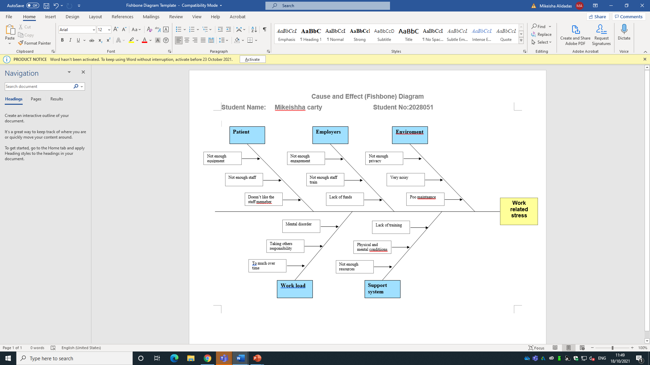
Fishbone analysis

Slide 6
PESTEL ANALYSIS
political | economic | social | technological | environmental | legal
Corruption | Economic growth | Cultural barriers | Technology incentives | weather
Labour law | Exchange rates | Life style attitudes | automation | climate
stability | income | Age distribution | Technological awareness | Environmental policies
Trade restrictions | Unemployment rates |  | Technological change
policy | disposable |  | Level of innovation

Slide 7
An evaluation of alternative solutions to work related
Change job
Asking for support from the management
Changing flexible working hours
Medical support

Slide 8
PMI for Changing flexible working hours
PLUS | Minus | Interesting
Reduce the stress 8 | Less money -9 | More time to work from home 8
Come to work on time 8 | Not getting spend enough time at work -7 | Quality time with family 9
More time with the family 8 | Lack of time to spend with workmates. -6 | More time to enjoy 10
24+27+(-22)=29

Slide 9
CONCLUSION
Effects of work-related stress are negative
Causes related to stress are ; patients, employee, environment , related
The different factors such as political, legal affecting work related stress
After evaluating possible solution, flexible working hours identified as the best solution for me.

