Slide 1

Challenges for Transgender people in prison in England and Wales
Why is this topic important?
Challenges
Evidence
Policy response
Tim Nicholas
2310510

Slide 2
Definitions, Prisons and conflict
What does transgender mean?
(Equality Act, 2010)
Sex segregation
Coercion and sexual exploitation Risks
Scarcity of Privacy
(HMPPS, 2024 & Equality Act 2010 &Human Rights Act 1998)

Slide 3

Data Limitation
True numbers?
Under-reporting
Reporting living/presenting differently from biological sex
(HMPPS, 2025; HM Inspectorate of Prisons, 2017)

Slide 4
Scale and trend
339 transgender prisoners (March 2025)
Increase from 295 (March 2024)
81% recorded biological sex male and 19% female
Small number but high operational consequences
(HMPPS,2025)

Slide 5

Risk governance and proportionality
Risk management
Human Rights
Equality
(Van Hout et al., 2020; White Hughto et al., 2016; European Court of Human Rights, 2021;
R F D J V Secretary of state, 2021)

Slide 6

Victimisation and exploitation risk
(Beck, 2014; Bromdal et al, 2018; Hughto et al, 2022)

Slide 7
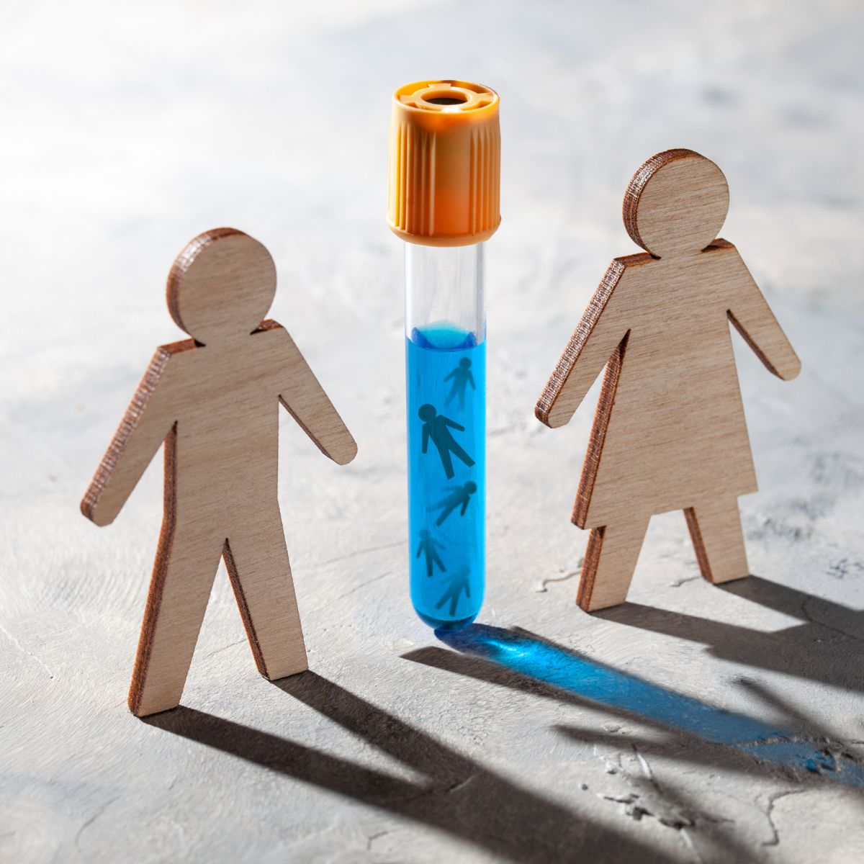
Placement conflict women’s safety and privacy
Sex segregation and safeguarding for women
Specialist accommodation/avoid long term segregation
Trans women’s experiences in male prisons
Healthcare inconsistencies
(Van Hout et al., 2020; Donohue et al., 2021; Engelberg et al., 2023; Haney, 2018; HMPPS, 2024)

Slide 8



Mental health, distress and self-harm
Vulnerabilities
Anxiety
Structural stigma/ stress and health disparities
(Van Hout et al., 2020; Donohue et al., 2021; WHO, 2022 ; White and Hughto et al, 2016)
This Photo by Unknown Author is licensed under CC BY-ND

Slide 9
Healthcare continuity and access
Treatment
Counselling
Staff competence
(HMPPS, 2024; NHS England, 2024; Fuller et al., 2024; Murphy et al., 2023; McCauley et al, 2018)

Slide 10


Daily living friction
Non-discriminatory treatment
Dignity and security
Showers/clothing
Consistency reduces incidents
(UNODC, 2015) (HM Inspectorate of Prisons, 2017)

Slide 11


England and Wales current framework
Mandatory actions
Case boards
Equalities report
External guidance
(HMPPS, 2025; UK Parliament, 2017; HM Inspectorate of Prisons, 2024)

Slide 12

Birth sex default and Interventions
Default: sex-based location for privacy/safeguarding
Specialist accommodation
Staff retraining
Structured risk assessment
Monitoring and audit processes
Exception pathway: high-threshold risk-based board decision
Alternative options: specialist units/regimes (avoid long-term segregation))
(HMPPS, 2024; HMPPS, 2025; NHS England, 2024; Prisons and Probation Ombudsman, 2017; Sevelius and Jenness, 2017)
This Photo by Unknown Author is licensed under CC BY-NC

Slide 13
Critical evaluation
Outcomes-based on evaluation/ balance stigma and safeguarding
Reduce harm to trans prisoners and protect women’s safety/privacy
Demonstrate proportionality and defensibility
Evidence gaps need better UK evaluation

Slide 14

conclusion
Core Challenges
Best approach
Focus
This Photo by Unknown Author is licensed under CC BY-NC

Slide 15
References
Beck, A.J. (2014). Sexual victimisation in prisons and jails reported by inmates, 2011–12. Bureau of Justice Statistics. Available at: https://bjs.ojp.gov/content/pub/pdf/svpjri1112.pdf (Accessed: 3 March 2026).
Bromdal, A., Mullens, A.B., Phillips, T.M. and Gow, J. (2018) ‘Experiences of transgender prisoners and their knowledge, attitudes, and practices regarding sexual behaviours and HIV/STIs: A systematic review’, International Journal of Transgenderism, 19(1), pp. 4–20. https://doi.org/10.1080/15532739.2018.1538838
Donohue, G., McCann, E. and Brown, M. (2021) ‘Views and experiences of LGBTQ+ people in prison: A systematic review’, International Journal of Environmental Research and Public Health, 18(17), 9335. https://doi.org/10.3390/ijerph18179335
Engelberg, R., Beauchamp, G.A., Miller, A. and Saldana, C. (2023) ‘Challenges unique to transgender persons in correctional settings’, Cureus, 15(6), e42420. https://doi.org/10.7759/cureus.42420
Equality Act 2010. Available at: https://www.legislation.gov.uk/ukpga/2010/15/contents (Accessed: February 2026).
European Court of Human Rights (2021) European Convention on Human Rights. Available at: https://www.echr.coe.int/documents/convention_eng.pdf (Accessed: February 2026).

Slide 16
Fuller, C., Tong, L. and Paynter, M. (2024) ‘Gender-affirming healthcare for incarcerated transgender and gender diverse people: A systematic review’, International Journal of Transgender Health, 25(1). Available at: https://pmc.ncbi.nlm.nih.gov/articles/PMC12857669/ (Accessed: February 2026).
Haney, C. (2018) ‘The psychological effects of solitary confinement: A systematic critique’, Crime and Justice, 47(1), pp. 365–416. https://doi.org/10.1086/696041
HM Inspectorate of Prisons (2017) The treatment and conditions of transgender prisoners. Available at: https://www.justiceinspectorates.gov.uk/hmiprisons/ (Accessed: February 2026).
HM Inspectorate of Prisons (2024) Annual Report 2023–24. Available at: https://www.justiceinspectorates.gov.uk/hmiprisons/annual-reports/ (Accessed: February 2026).
HM Prison and Probation Service (2024) The care and management of individuals who are transgender. Available at: https://www.gov.uk/government/publications/the-care-and-management-of-individuals-who-are-transgender (Accessed: February 2026).
HM Prison and Probation Service (2025) Offender equalities annual report 2024–2025. Available at: https://www.gov.uk/government/statistics/hmpps-offender-equalities-annual-report-2024-to-2025 (Accessed: February 2026).

Slide 17
Hughto, J.M.W. et al. (2022) ‘Victimization within and beyond the prison walls’, American Journal of Public Health, 112(S1). Available at: https://pmc.ncbi.nlm.nih.gov/articles/PMC10281010/ (Accessed: February 2026).
Human Rights Act 1998. Available at: https://www.legislation.gov.uk/ukpga/1998/42/contents (Accessed: February 2026).
Link, B.G. and Phelan, J.C. (2001) ‘Conceptualizing stigma’, Annual Review of Sociology, 27, pp. 363–385. https://doi.org/10.1146/annurev.soc.27.1.363
McCauley, E.J., Eckstrand, K.L. and Desta, B. (2018) ‘Exploring healthcare experiences for incarcerated transgender individuals’, Transgender Health, 3(1), pp. 123–131. https://doi.org/10.1089/trgh.2017.0046
Murphy, M. et al. (2023) ‘Implementing gender-affirming care in correctional settings’, Journal of Correctional Health Care, 29(2). Available at: https://pmc.ncbi.nlm.nih.gov/articles/PMC10081719/ (Accessed: February 2026).
NHS England (2024) Children and young people’s gender services: implementing the cass review recommendations. Available at: https://www.england.nhs.uk/long-read/children-and-young-peoples-gender-services-implementing-the-cass-review-recommendations/ (Accessed: February 2026)

Slide 18
Prisons and Probation Ombudsman (2017) Learning lessons bulletin: Transgender prisoners. Available at: https://ppo.gov.uk/ (Accessed: February 2026).
R (FDJ) v Secretary of State for Justice [2021] EWHC 1746 (Admin). Available at: https://www.bailii.org/ew/cases/EWHC/Admin/2021/1746.html (Accessed: February 2026).
Sevelius, J. and Jenness, V. (2017) ‘Challenges and opportunities for gender-affirming healthcare for transgender women in prison’, International Journal of Prisoner Health, 13(1), pp. 32–40. https://doi.org/10.1108/IJPH-08-2016-0046
UK Government Equalities Office (2018) Transgender equality. Available at: https://www.gov.uk/government/publications/transgender-equality (Accessed: March 2026).
UK Parliament (2017) Transgender prisoners (CBP-7420). Available at: https://researchbriefings.files.parliament.uk/documents/CBP-7420/CBP-7420.pdf (Accessed: February 2026).
United Nations Office on Drugs and Crime (2015) United Nations Standard Minimum Rules for the Treatment of Prisoners (the Nelson Mandela Rules). Available at: https://www.unodc.org/ (Accessed: February 2026).

Slide 19
Van Hout, M.C., Crowley, D. and O’Dwyer, M. (2020) ‘Contemporary transgender health experience and health situation in prisons: A scoping review’, International Journal of Transgender Health, 21(3), pp. 258–306. https://doi.org/10.1080/26895269.2020.1772937
White Hughto, J.M., Reisner, S.L. and Pachankis, J.E. (2016) ‘Transgender stigma and health: A critical review of stigma determinants, mechanisms, and interventions’, Social Science & Medicine, 147, pp. 222–231. https://doi.org/10.1016/j.socscimed.2015.11.010
World Health Organisation (2022) Gender and health. Available at: https://www.who.int/health-topics/gender (Accessed: February 2026).
I confirm that I have not used any AI tools in the research and creation of this assignment. I confirm that I have not presented any AI-generated materials as my own work. I confirm I have copies of my drafts, notes, and other resources I used, which I may be asked to provide in evidence.

Slide 20


