Slide 1


Graduate Project – Assessment 2
Evaluation
Notes:
Introduction – Name
Remember PERSONAL, PROFESSIONAL AND ACADEMIC !!!!!

Slide 2

Synopsis and Rational
To Create a short promo film, between 3 and 5 minutes, to advertise Mamgu Welshcakes and celebrate the vast range of places where people may enjoy these sweet treats and celebrate Pembrokeshire diversity.
Why ??
Personal Development
Skills Development
The practice of work with Industry
Notes:
Talk through Synopsis and WHY?
The Why is the Rational in bullet points.

Slide 3
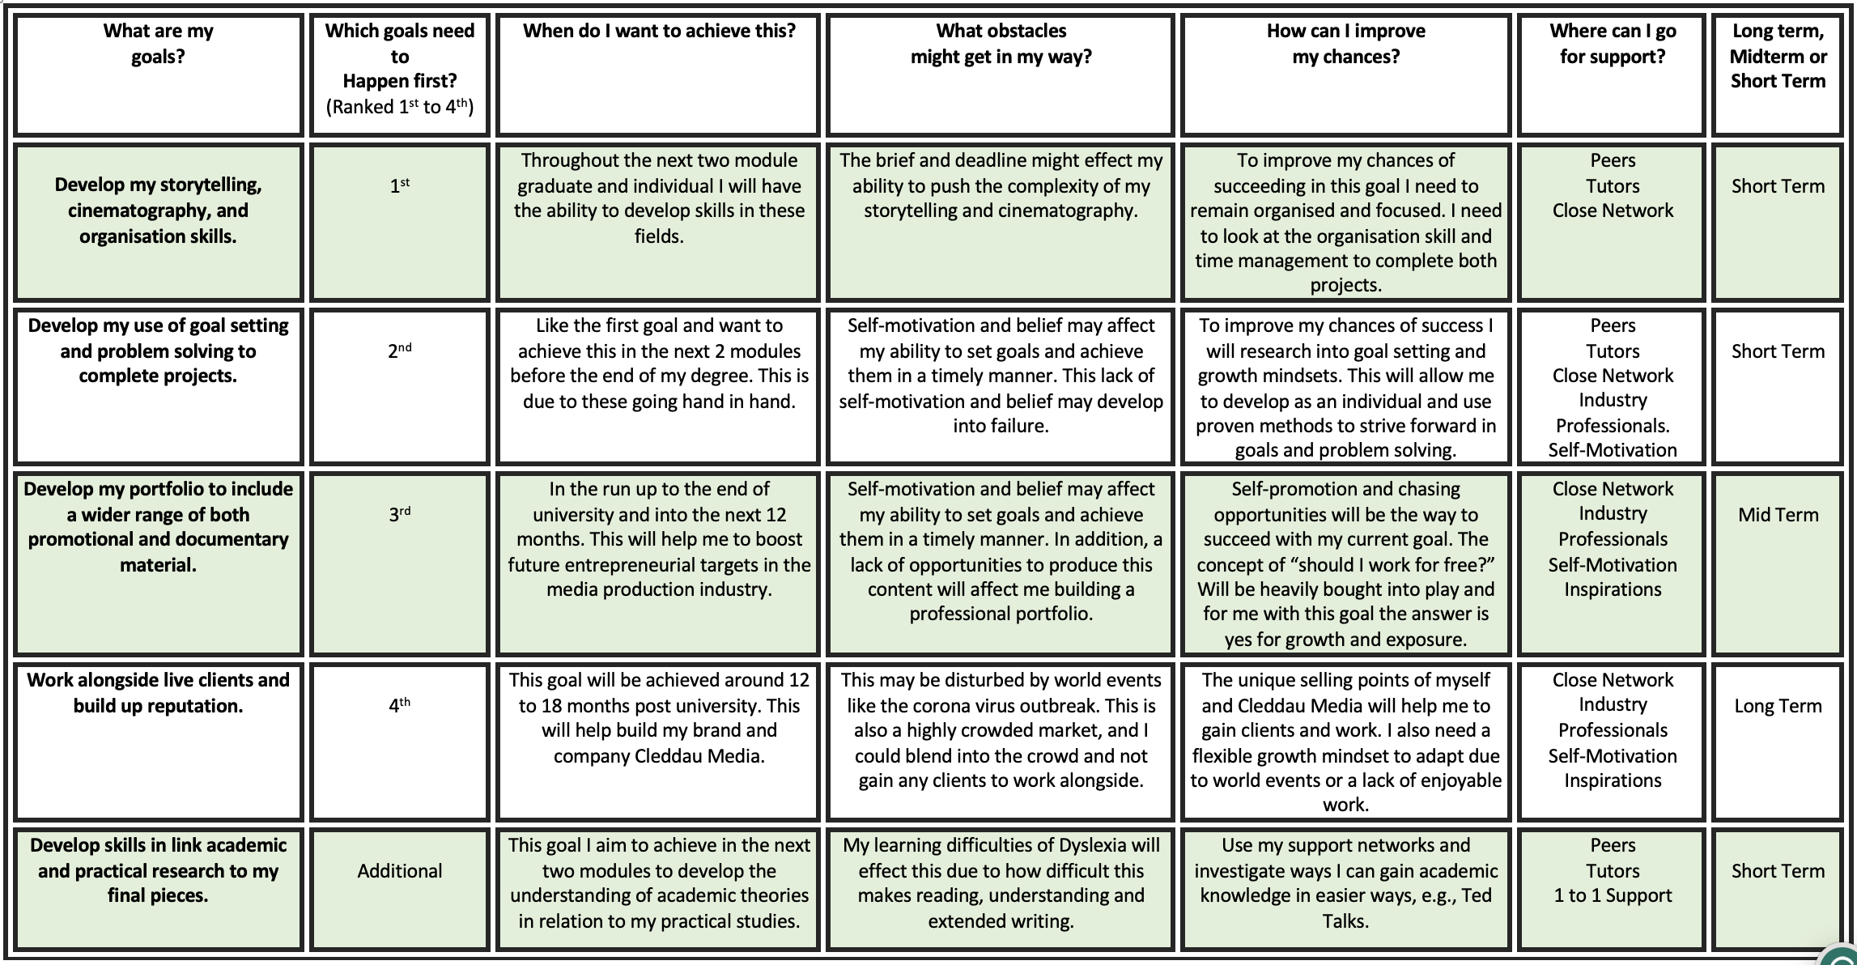
Notes:
Talk through the PDP how this links to the project
Develop my storytelling, cinematography, and organisation skills.
Develop my use of goal setting and problem solving to complete projects.
Develop my portfolio to include a wider range of both promotional and documentary material.
Work alongside live clients and build up reputation.
Develop skills in link academic and practical research to my final pieces.

Slide 4

Academic – Lecture on Understand Narrative, Story and Plot. (Dr Matt Jones and Nick Lacey)
"Story: a story is a narrative of events as they occur in chronological (or 'story') order." Dr Matt Jones, 7th February 2023
"Plot: The plot is the order in which the events of the story are presented. These may occur in chronological order or be rearranged." Dr Matt Jones, 7th February 2023
Casual Logic - Case and Effect: "Each event logically follows on from the previous one; each event causes the next one. A narrative needs at least 2 connected events." Nick Lacey, Narrative and Genre, p.14
Notes:
The Story and Plot Lectures
Massive starting point in project and personal development

Slide 5
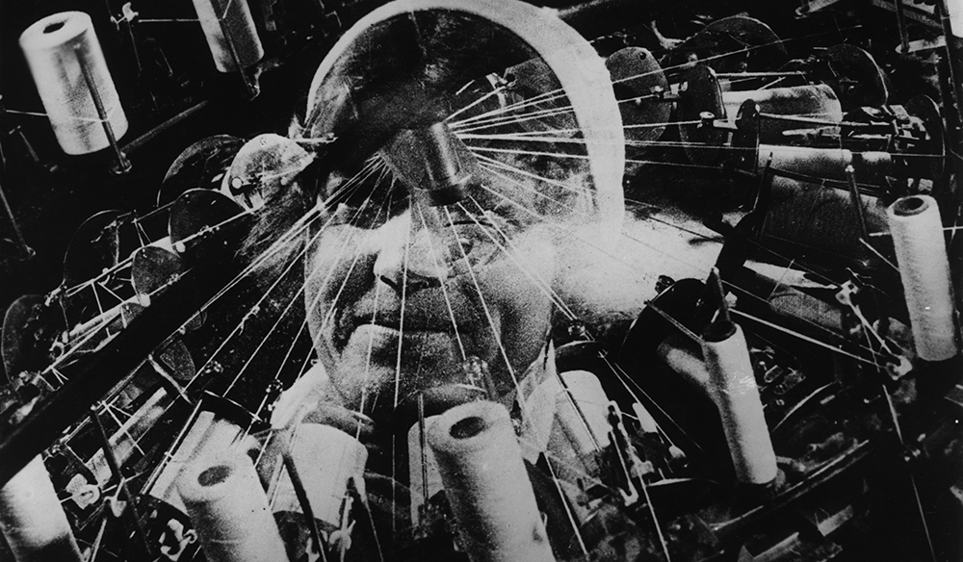
Academic – Documentary Modes and Movements (ALDREDGE, J., 2022) & (Nichols, 2017)
Expository
Poetic
Observational
Participatory
Reflective
Performance
Notes:
Modes and Movements in DOCUMENTARY
Use of the two source allowed me to get a balanced understanding of these modes.
They link to project in away that it’s a narrative with the aim of informing

Slide 6

Theoretic - Narrative Model: Tristan Todorov
Equilibrium – start and show everything is ok
Disruption of Equilibrium – something happens to turn everything bad
Recognition of Disruption of Equilibrium – recognising that something has gone bad
Attempt to repair Equilibrium – attempt to make everything better again
Return to Equilibrium – return to everything being ok
Notes:
Todorov Theory of Narrative
Structuring the wider Narrative
As well as the smaller scene narratives
Although nothing goes bad it is the idea of hunger from exploring creates the disruption in the smaller narratives and the running out of welsh cakes is that wider distruption

Slide 7

Theoretic – Models of Buyers Behaviours
1 Influences specific to the individual might include:
- attitudes and beliefs
- past experience and the motivation to purchase
2 External influences might include:
- how a product/service is promoted and advertised
- whether the product/service is easily available
- whether the product/service is recommended by a friend/colleague/relative.
Notes:
Idea of how can I tie these into the film.
This came for acadmic research from a book on Advertising
Big Take away is familiarity and personal connection to affect peoples attitudes beliefs and promoting the product

Slide 8
Pre-Production
Shots Listing
Finding Cast
Music
Managing the project and all logistics – GANTT Chart
Notes:
Speak through your pre production
You know each step
Talk about the importance and what you gained

Slide 9
Meeting the Client
In-person meeting
Idea generation and an understanding of Mamgu
Location recce and meeting the staff
Discussion of options
Notes:
Talk about the first meeting
First time meeting a client to discuss a project
How it went, what would you change?

Slide 10
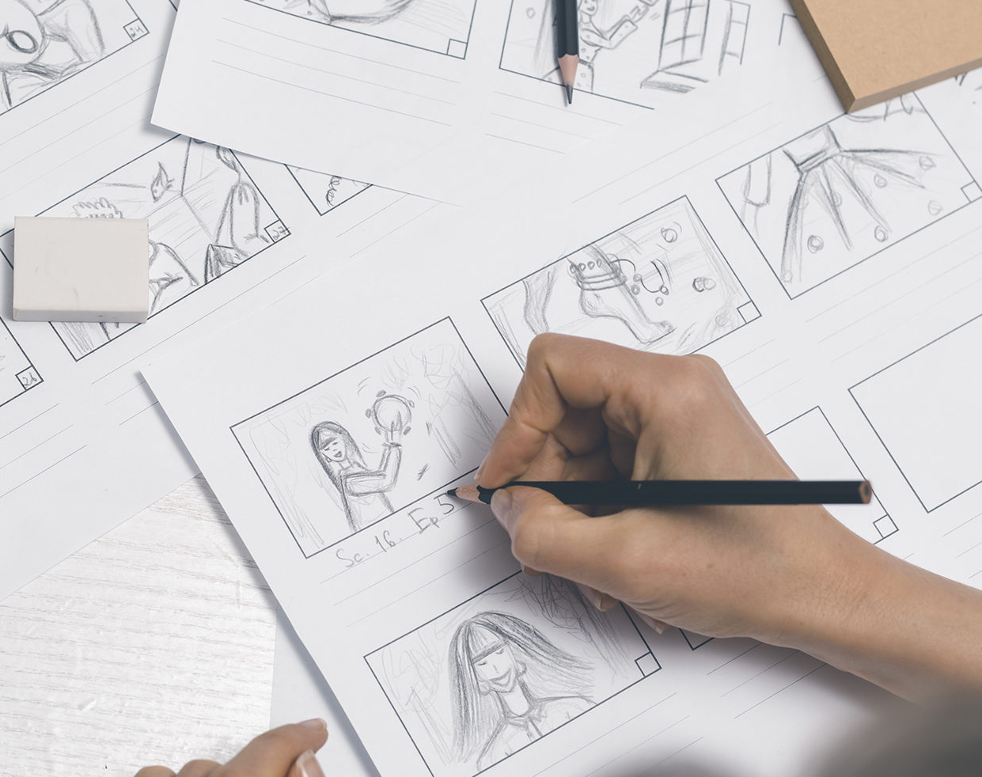
Pre-Production Developments
Due to some uncontrollable issues including weather and illness, I have had to cancel or not pursue shoots including climbing, paddle boarding and fishing trip. With this in mind, I have changed locations and plans.
The scene changes & Location Changes
Learning Points – Dealing with change, adaptability and stress control
Notes:
Remember illness, working for free no tie ins, and weather wettest March in over 40 years

Slide 11
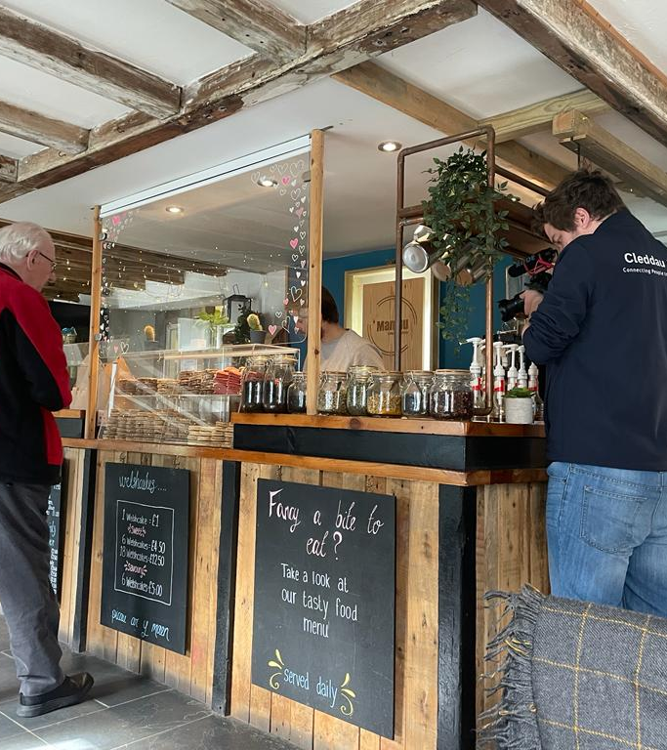
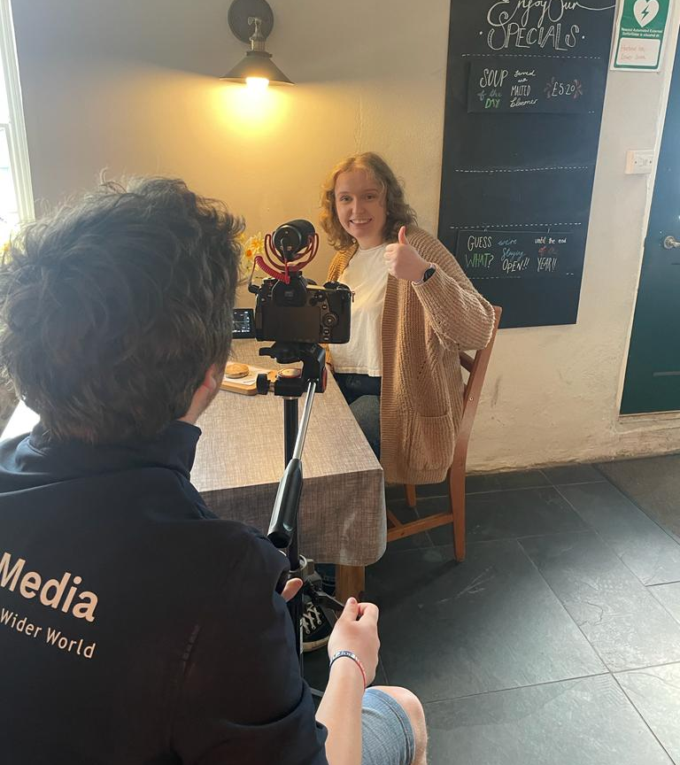
Production Days
Notes:
4 days well few hours on 4 days in 4 locations
Strong opportunitirs
Don’t work with filmmakers as actors – cast/crew

Slide 12
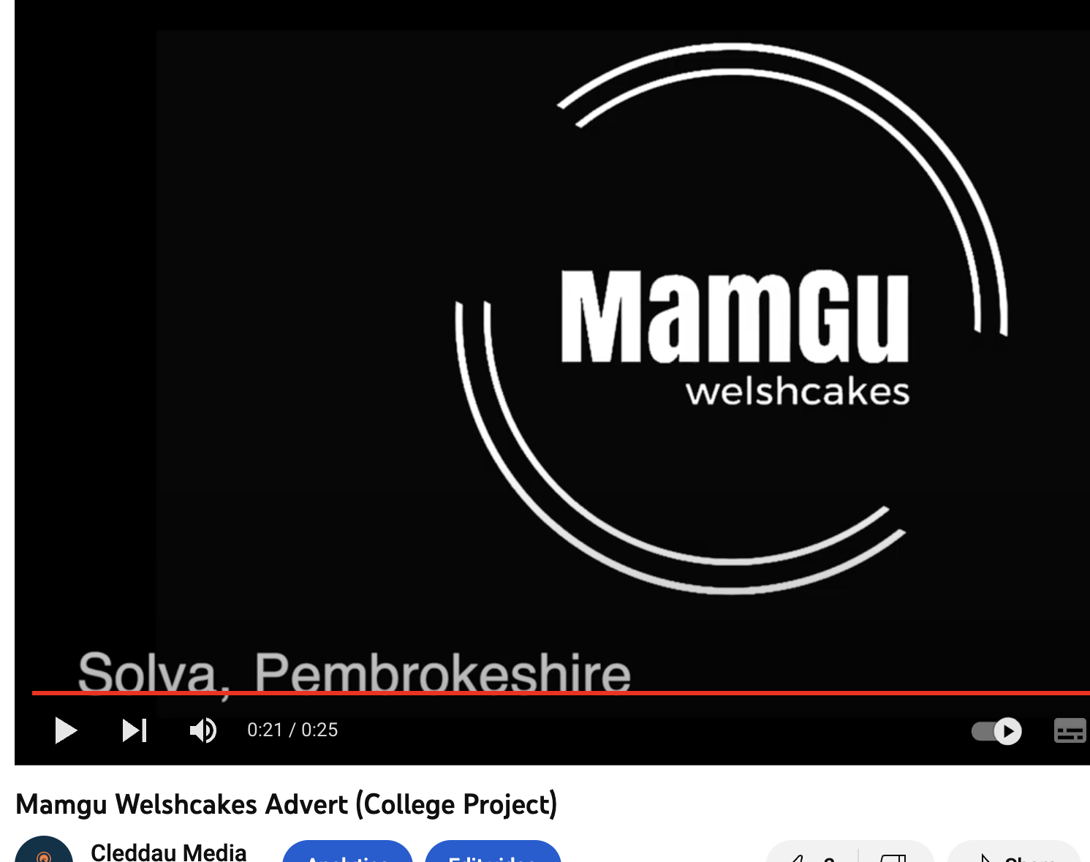
Comparison to Previous Work
A slow-paced more personal connection to an audience
Clearer storyline
Wider Shot Range
Different style of Film
Notes:
Compare talk trough the idea of showing improvement in 4 years
Whats is better etc

Slide 13
Self Reflection
Very Happy with the outcome, one of my strongest outcomes to date
Variety of Shots
Strong Story & Emotion
Learnt a lot from the project on how to manage big-scale logistics
Hard to achieve big on no budget
Notes:
You know this is your thoughts and reflections

Slide 14
Notes:
This supports your reflections

Slide 15

Peer Feedback
I love that Iest. Genuinely. I think that’s a favourite product of yours. It’s so authentic and subtly but surely shows exactly what Mamgu’s is about. It goes to show that you don’t need super fast-paced, wow-factor shots and ideas to create something memorable. I know you wanted the climbing and other stuff in it too, but what you’ve done with what you got is absolutely lovely. You should be so proud of yourself for that, I’m certainly proud of you. – Friends (Non Filmmaker)
The shot of the St David’s Cathedral sign held a tiny bit too long. Tighten this and the shot following. Close-up of the bag held too long. My overall opinion for the first 45 seconds is to just tighten the cuts slightly. Really like the fade from Nerys to the castle. Tracking shot to be cut in later. Shots by the water have great pacing to them. End titles held too long.
Really lovely story about friends and family sharing time together with Welsh cakes, good pacing, and a nice variety of shots. I like the use of the fade between locations. The advert feels very wholesome and the café welcoming. – Friend (Filmmaker)
Notes:
Peer Feedback backs up development and supports what my thoughts were in relfection

Slide 16

Thank You & Any Questions?

