Slide 1
Personalised Learning
Week 4: Monday 22nd October

Slide 2
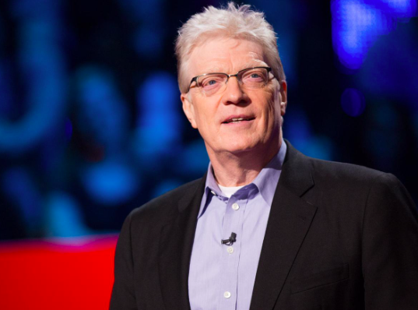
Background of personalised learning
Government initiative (New Labour Plan) (2004)
  Drive up standards increasing quality of learning and teaching through a pupil-centred approach to education provision.
  Every Child Matters (2004) The Children’s Plan (2007)
  Pupils from different backgrounds targeted as most in need (DCSF, 2008)
  “With personalised learning agenda there is a moral purpose to create a more equal and fair education system” (DCSF, 2008: 6)
Education reform links
  School improvement agenda – Responsibility for greater provision
  Teachers and schools to critically think about the relationship between pedagogy, curriculum and assessment (Hipkins et al., 2010)
Ken Robinson (2010)
Changing Paradigms (Ted Talk)

Slide 3
Structural constraints of schools prevent fully promoting personalised learning (or inclusive practice)
Wales – additional learning needs transformation programme

Slide 4
Differentiation
STEP
Space
Task
All
Most
Some
Equipment
People
Differentiation is central to personalised learning (DCSF, 2008) and inclusive teaching (Vickerman, 2004).
“A recognition and commitment to modify and adapt…teaching and learning strategies in order to enable access and entitlement to the physical education curriculum” (Vickerman, 2004: 162)

Slide 5
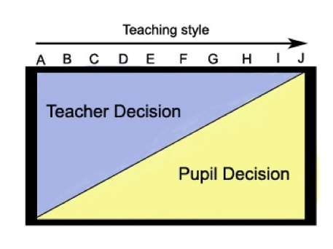
Teaching styles
Mosston and Ashworth, 2008
Using a variety of TS can improve inclusive practice. What are the inclusive strengths and weaknesses of areas of the spectrum?
Underwood and Banyard (2008) Because of increased pupil performance in examinations teachers tend to over-rely on command teaching styles
Pressures to meet targets impacts on teaching styles used

Slide 6
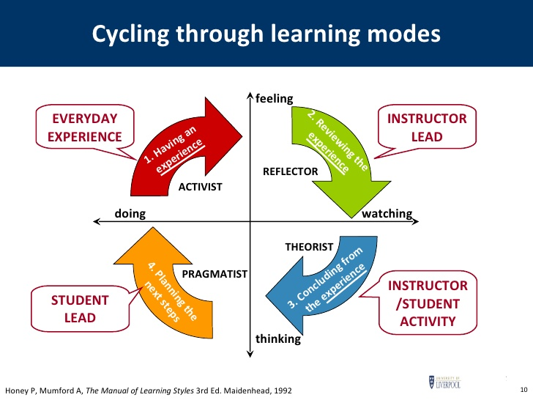
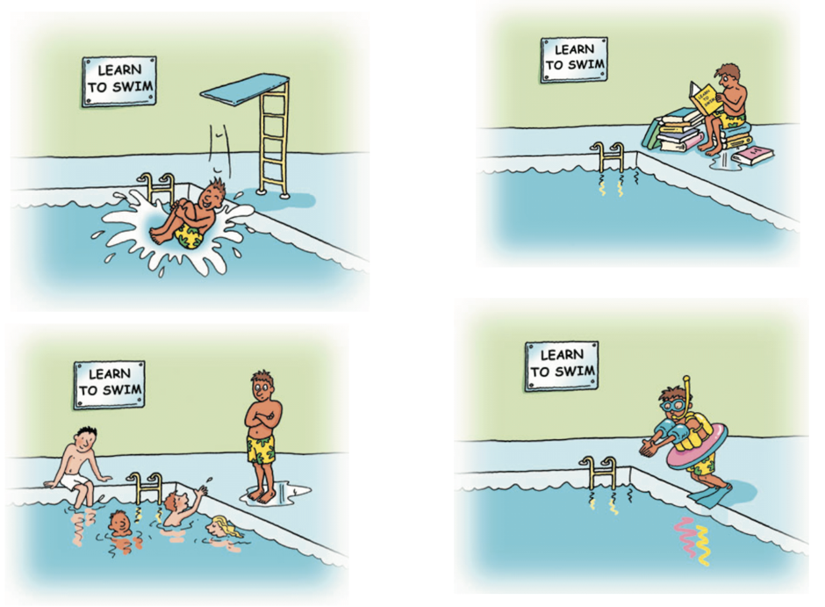
Learning Styles
Honey and Mumford (1992)
Klob (1984)

Slide 7
Assessment
Deeper changes in assessment practice needed (Pollard and James 2004).
Aims of PE?
Do the common assessment categories reflect the aims?
Ideas for assessment to reflect aims?
More inclusive/personalised assessment strategies
SE

Slide 8
Activity: What do you see as the advantages and disadvantages of inclusive PE?
Three Perspectives:
  The Teacher
  The Child with ALN
  The ‘mainstream’ child
Advantages
Disadvantages

