Slide 1

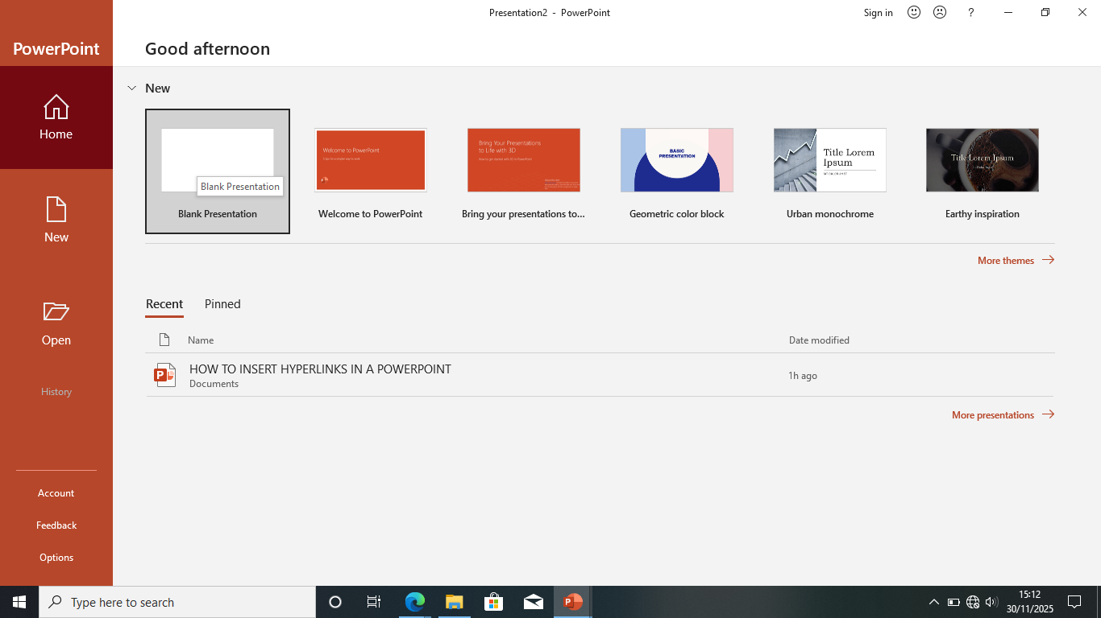
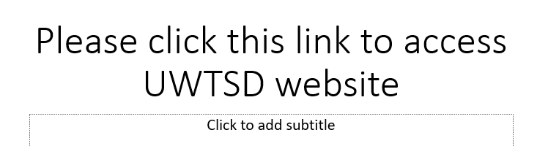

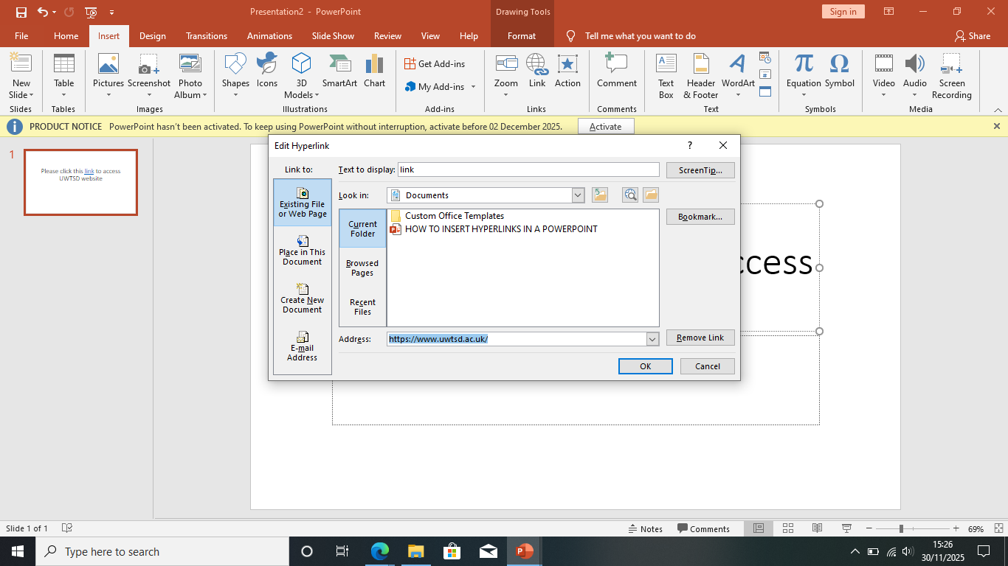
HOW TO INSERT HYPERLINKS IN A POWERPOINT
WHAT IS A HYPERLINK? A hyperlink is a clickable element in a digital document that links/takes you to another digital location such as
Another webpage
Email address
Files
How to insert a Hyperlink: To insert a clickable hyperlink you must first highlight the text or image you wish to hyperlink, then you right click on highlighted tab and select link. A dialog box will appear where you can paste the web address of said hyperlink, this will determine the destination of your hyperlink such a file on your computer or a specific section of a document.
Hyperlinks are very useful because they allow you to access different digital locations quickly and efficiently.
Step 1: Load powerpoint with a blank slide
Step 2: Type a sentence to create a hyperlink
Step 3 go to Uwtsd website
Step 4: Highlight word called “link” and click insert and then click link and paste URL

