Slide 1
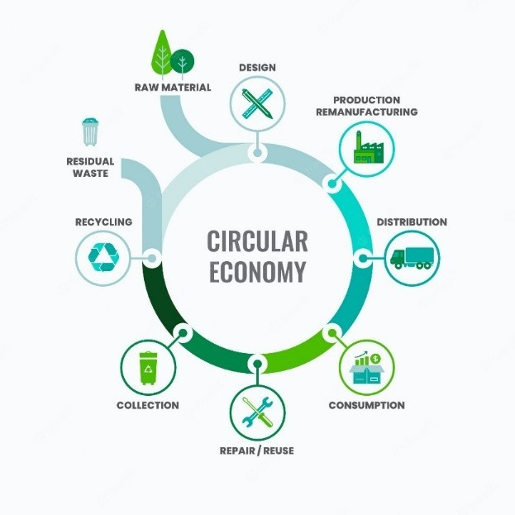
10/02/2026
ACNA5002: Lecture 3:
Recycling economy
Dr Alisdair Cunningham
Senior Lecturer
2025 / 2026
10/02/2026
Slide 1 / 27

Slide 2
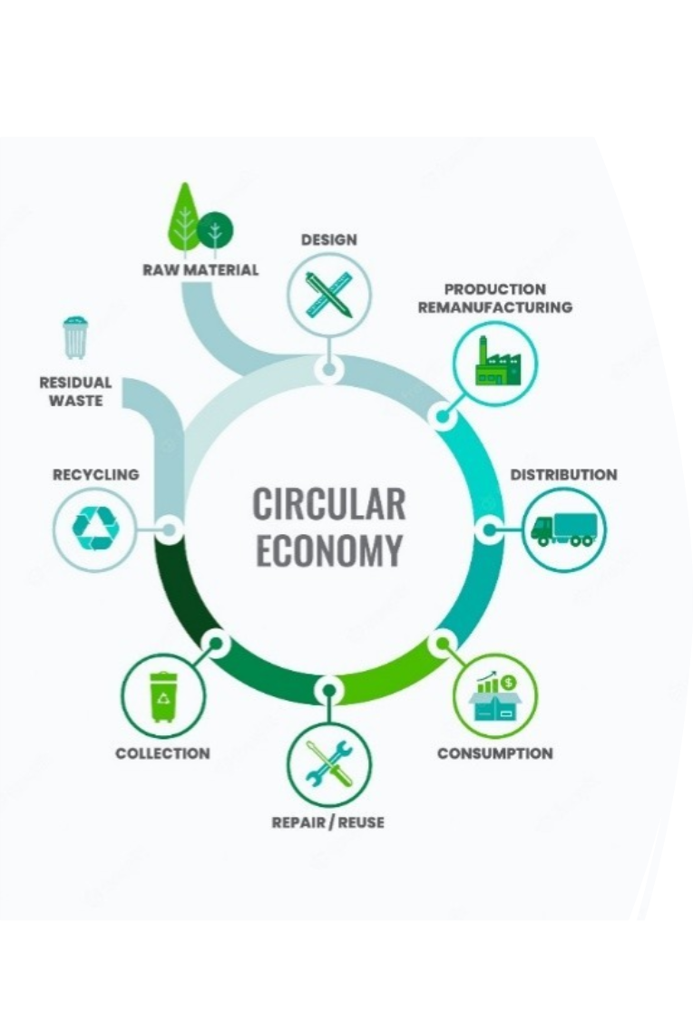
Module ACNA6003: 2025 / 2026 Lecture Contents
10/02/2026
This lecture will contain the following:
Slide(s) | Topic
3 | Recap
4 | Recycling Economy
5 | Natural Recycling concepts
6 – 7 | Early examples of Recycling
8 – 10 | Changing Drivers for Recycling
11 | Modern Recycling rates: Plastics
12 | Modern Recycling rates: Textiles
13 | Recycling rates: UK
14 | Issues with Recycling
15 | The R strategies
16 – 17 | Recycling: Pros and Cons
18 – 19 | Recovery: better solution?
20 | Informal Recycling
21 | Waste-pickers
22 | Affluence and Recycling
23 | Summary
24 | Next Session
A. Cunningham Lecture 3: Recycling Economy
Slide 2 / 27

Slide 3
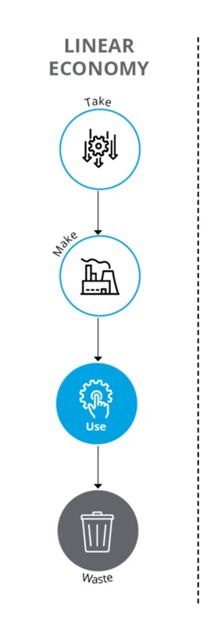
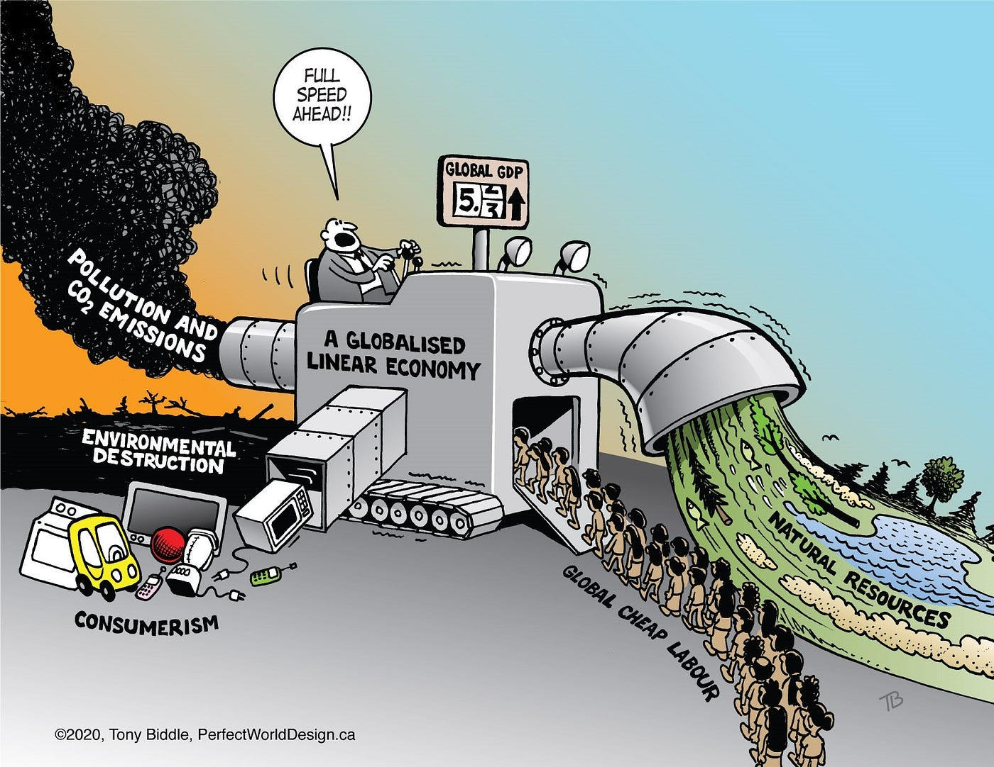
Module ACNA5002: 2025 / 2026 Recap
10/02/2026
In the previous lectures we covered the following:
Linear Economy flow
Links between LE and economic
‘progress’ (GDP)
Externalities of consumerism
Environmental pollution during
all stages of linear process
Case study examples of environmental pollution (air, water, and soil) from production / manufacturing industry and resultant waste.
A. Cunningham Lecture 3: Recycling Economy
Slide 3 / 27

Slide 4

Module ACNA5002: 2025 / 2026 Recycling Economy
10/02/2026
Recycling: The process of converting waste material into new / reusable products – with the same or lower grade quality
Question 1: What defines ‘waste’?
Question 2: Recycling has been a fundamental concept of sustainable practices, still present in circular principles – but when did it originate?
A. Cunningham Lecture 3: Recycling Economy
Slide 4 / 27

Slide 5
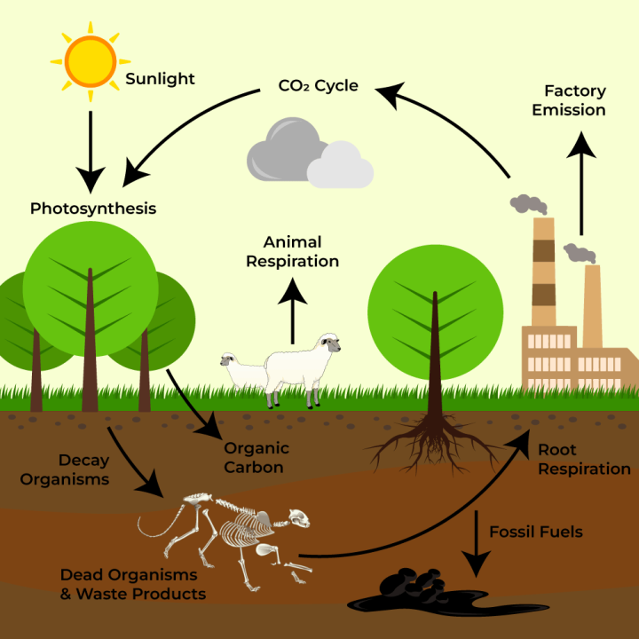
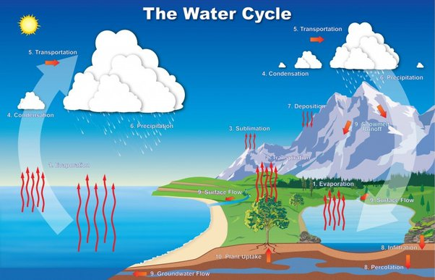
Module ACNA5002: 2025 / 2026 Natural Recycling concepts
10/02/2026
Origin of recycling: Nature has recycling inherent within its processes, in that all matter is never lost (first law of thermodynamics – conservation of energy)
The nutrient cycles of minerals (e.g. carbon, nitrogen, phosphorous, oxygen) are perpetual, though some occur at very slow rates (geological timescales).
Waste (faecal matter, decomposing bodies) is a part of natural ecosystems, but it does not accumulate like anthropogenic waste.
Termed “Cradle to Cradle”
(McDonough, W., and
M. Braungart. 2002)
Imagine a world where matter was created, but not lost – where natural waste accumulated
A. Cunningham Lecture 3: Recycling Economy
Slide 5 / 27
Notes:
McDonough, W., and M. Braungart. 2002. Remaking the way we make things: Cradle to cradle. New York: North Point Press.

Slide 6
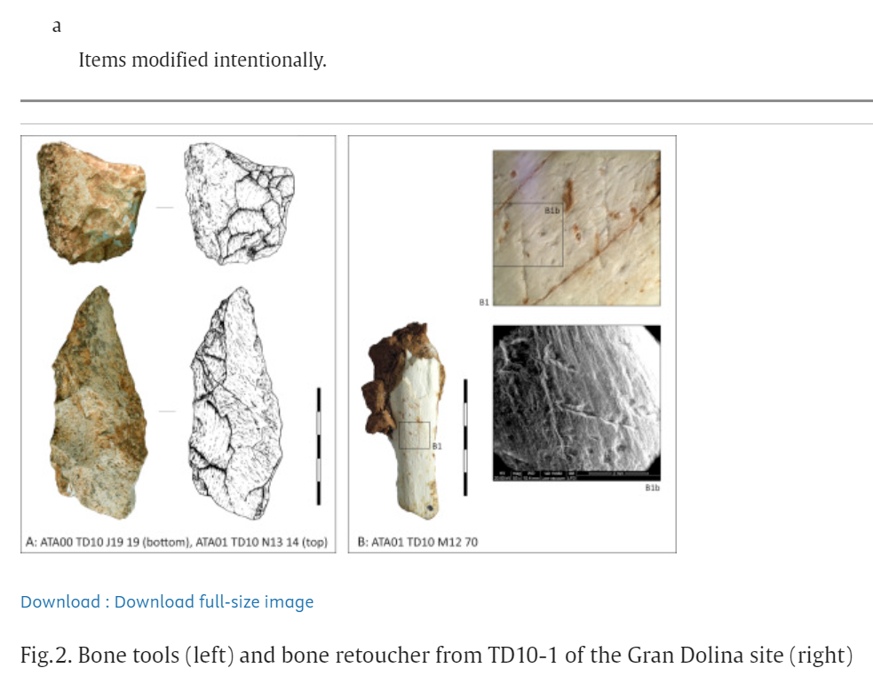
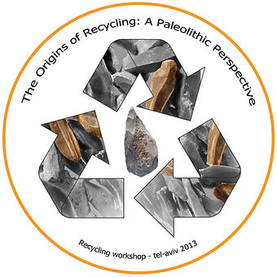
Module ACNA5002: 2025 / 2026 Early examples of Recycling
10/02/2026
Depending on the definition of recycling, early examples have gone back thousands of years.
A Workshop entitled “The Origins of Recycling: A Palaeolithic Perspective” determined that early man recycled discarded bones (for nutritional purposes) into various tools:
Source: Rosell et al., 2015
A. Cunningham Lecture 3: Recycling Economy
Slide 6 / 27
Notes:
Rosell, J., Blasco, R., Peris, J.F., Carbonell, E., Barkai, R. and Gopher, A., 2015. Recycling bones in the middle pleistocene: some reflections from Gran Dolina TD10-1 (Spain), bolomor cave (Spain) and Qesem cave (Israel). Quaternary International, 361, pp.297-312.

Slide 7
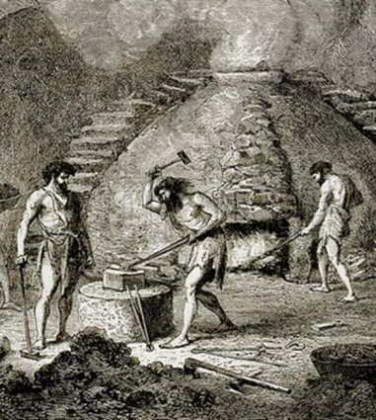
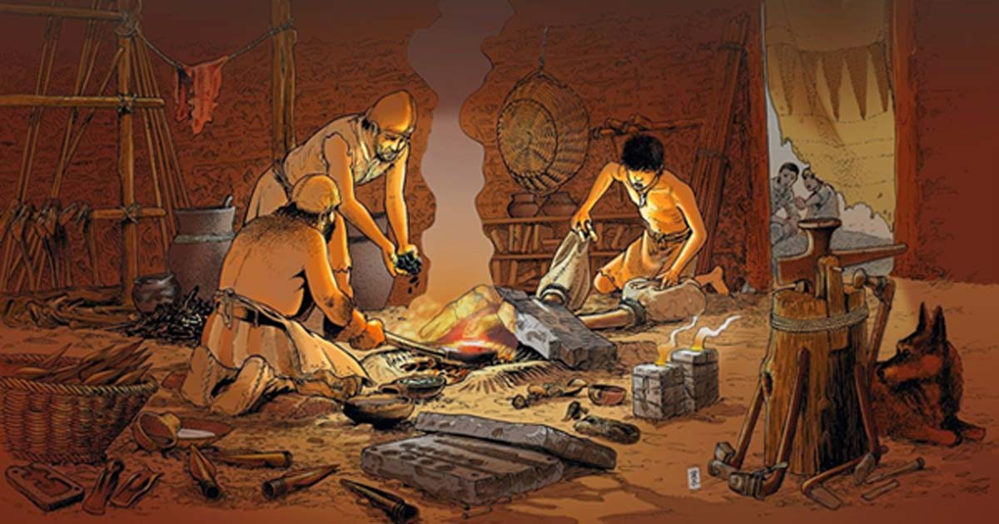
Module ACNA5002: 2025 / 2026 Early examples of Recycling
10/02/2026
Amick (2015) conducted a review of historic (ancient) practices and highlighted a number of materials that have been recycled throughout early human history:
Ceramics – crushed ceramics (temper) in creation of new ceramics & mud bricks
  Note: practice was reductive, material reduced with usage.
Glass – melting down old glass items to make new containers
Metals – copper, bronze, and iron
Paper - replaced parchment and now one of
  largest proportions pf material consumption and waste
Drivers:
  Not environmental – driven by efficiency (reduced time and effort)
  Increase in recycling activity driven by item scarcity
  Different from today – recycle to reduce guilt and remove waste and reduce pollution
A. Cunningham Lecture 3: Recycling Economy
Slide 7 / 27
Notes:
Amick, D.S., 2015. The recycling of material culture today and during the Paleolithic. Quaternary International, 361, pp.4-20.
Circular Economy: How the Ancients Pioneered the Idea of Recycling Waste | Ancient Origins (ancient-origins.net) - https://www.ancient-origins.net/news-history-archaeology/circular-economy-0011311

Slide 8
Module ACNA5002: 2025 / 2026 Changing Drivers for Recycling
10/02/2026
Amick (2015) compares behavioural differences between ancient recycling practices and today’s contemporary recycling
Ancient / Historic Drivers:
Not environmental – driven by efficiency (reduced time and effort)
Increase in recycling activity driven by item scarcity or poverty
  Typically rates of scavenging increase during periods of economic depression
Contemporary Drivers:
Different from today – recycle to reduce guilt of environmental burden
Aim to reduce waste going to landfill and associated contamination
Public demand opposed to commercial / industrial goals
A. Cunningham Lecture 3: Recycling Economy
Slide 8 / 27
Notes:
Amick, D.S., 2015. The recycling of material culture today and during the Paleolithic. Quaternary International, 361, pp.4-20.
Circular Economy: How the Ancients Pioneered the Idea of Recycling Waste | Ancient Origins (ancient-origins.net) - https://www.ancient-origins.net/news-history-archaeology/circular-economy-0011311

Slide 9

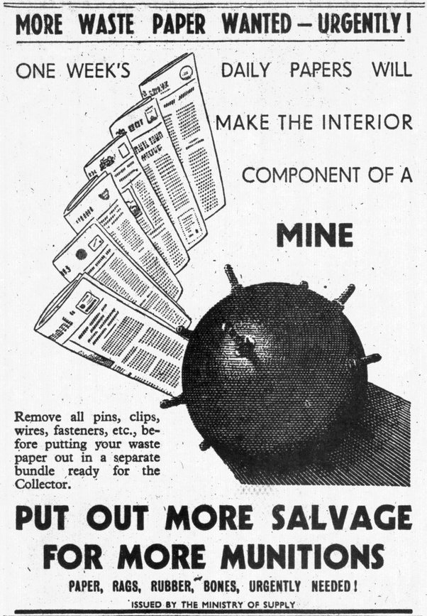
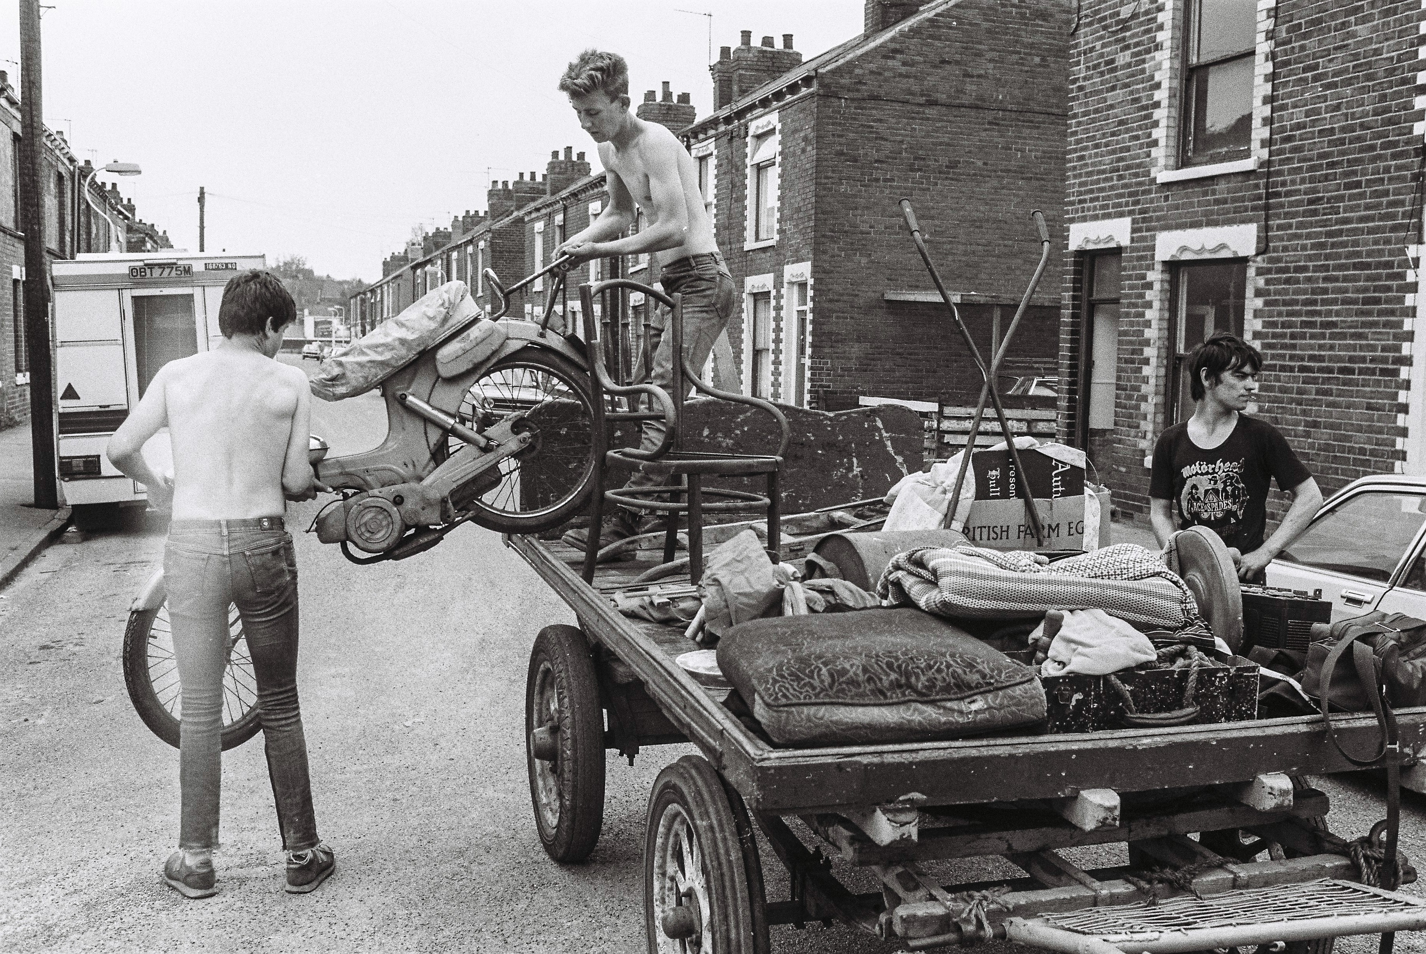
Module ACNA5002: 2025 / 2026 Changing Drivers for Recycling
10/02/2026
There is a strong correlation between the drive for recycling and times of economic stress and / or material scarcity
During wartimes (especially World War 2), recognition of the material value of salvaged goods (household paper, metals, and fabrics) led to increased demand for recycling (Denton, C. and Weber, H., 2022)
‘Waste’ materials helped to feed the increased demand at a rate not achievable from extraction alone (scarcity)
Formalised traditional scavenger processes e.g. rag-and-bone man
A. Cunningham Lecture 3: Recycling Economy
Slide 9 / 27
Notes:
Denton, C. and Weber, H., 2022. Rethinking waste within business history: A transnational perspective on waste recycling in World War II. Business History, 64(5), pp.855-881.
Cooper, T., 2008. Challenging the ‘refuse revolution’: war, waste and the rediscovery of recycling, 1900–50. Historical research, 81(214), pp.710-731.

Slide 10
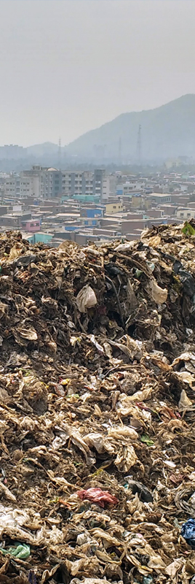
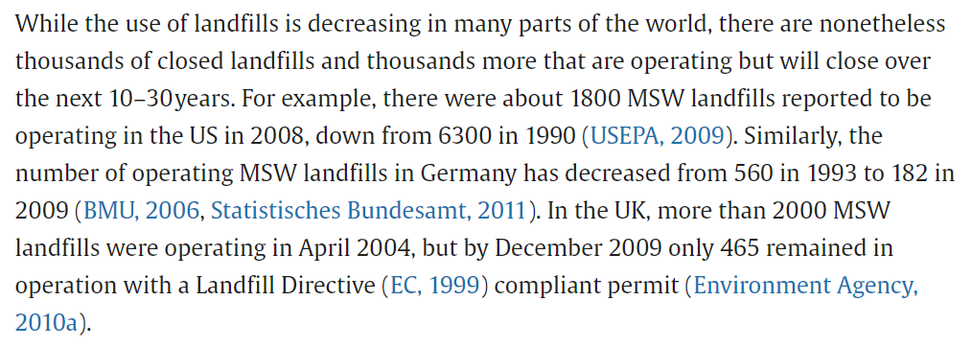
Module ACNA5002: 2025 / 2026 Changing Drivers for Recycling
10/02/2026
Blight (2011) and Tammemagi (2000) states that while many counties have been dependent on Municipal Solid Waste (MSW) landfill systems, there is a growing pressure to reduce the presence of these landfills.
Tammemagi (2000):
- growing social pressure of Not-In-My-Back-Yard behaviour (NIMBYism)
- increased environmental justice
- increased pressure on countries to find alternative waste solutions
- Also, trend towards fewer sites, but therefore larger sites.
Source: Laner, et al., 2012.
So, what impact has this had on recycling…?
A. Cunningham Lecture 3: Recycling Economy
Slide 10 / 27
Notes:
Vallero, D.A. and Blight, G., 2019, January. The municipal landfill. In Waste (pp. 235-258). Academic Press. Landfills – Yesterday, Today and Tomorrow – ScienceDirect https://www.sciencedirect.com/science/article/abs/pii/B9780123814753100300
Laner, D., Crest, M., Scharff, H., Morris, J.W. and Barlaz, M.A., 2012. A review of approaches for the long-term management of municipal solid waste landfills. Waste management, 32(3), pp.498-512.
Tammemagi, H., The All-Powerful NIMBY. 2000. In The Waste Crisis. Oxford University Press. The All-Powerful NIMBY | The Waste Crisis: Landfills, Incinerators, and the Search for a Sustainable Future | Oxford Academic (oup.com)

Slide 11
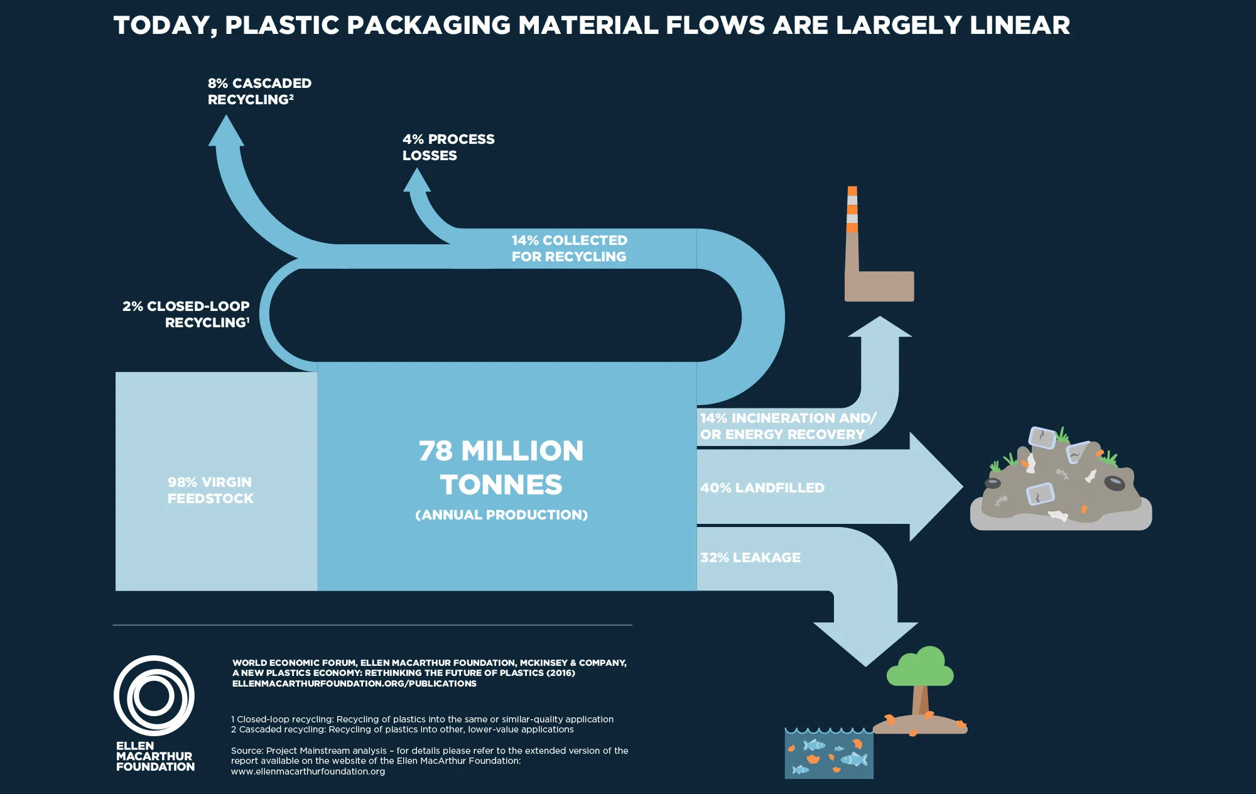
Module ACNA5002: 2025 / 2026 Modern Recycling rates: Plastics
10/02/2026
A. Cunningham Lecture 3: Recycling Economy
Slide 11 / 27

Slide 12
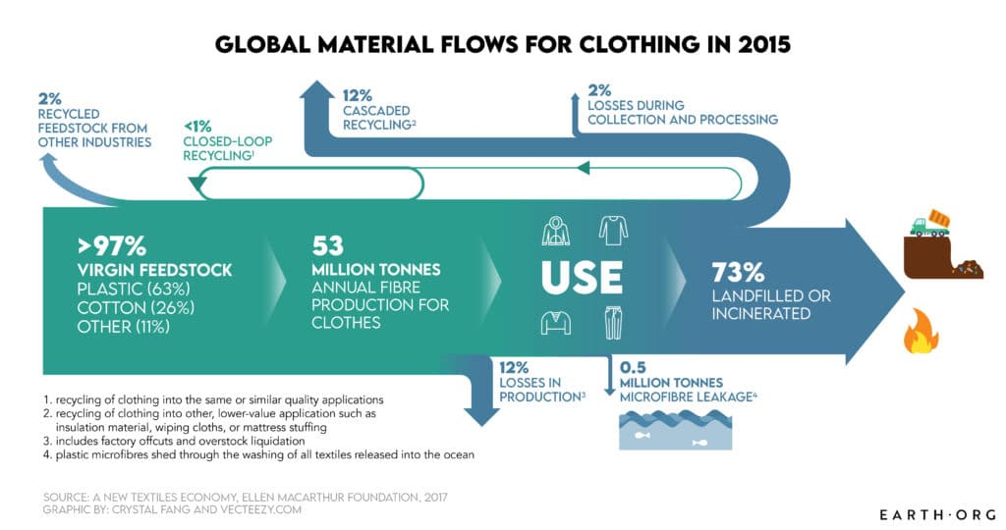
Module ACNA5002: 2025 / 2026 Modern Recycling rates: Textiles
10/02/2026
Source: https://earth.org/data_visualization/fast-fashion-the-environment-and-climate-change-a-data-viz-story/
A. Cunningham Lecture 3: Recycling Economy
Slide 12 / 27
Notes:
In Scope: Fast Fashion, the Environment and Climate Change | Earth.Org https://earth.org/data_visualization/fast-fashion-the-environment-and-climate-change-a-data-viz-story/

Slide 13

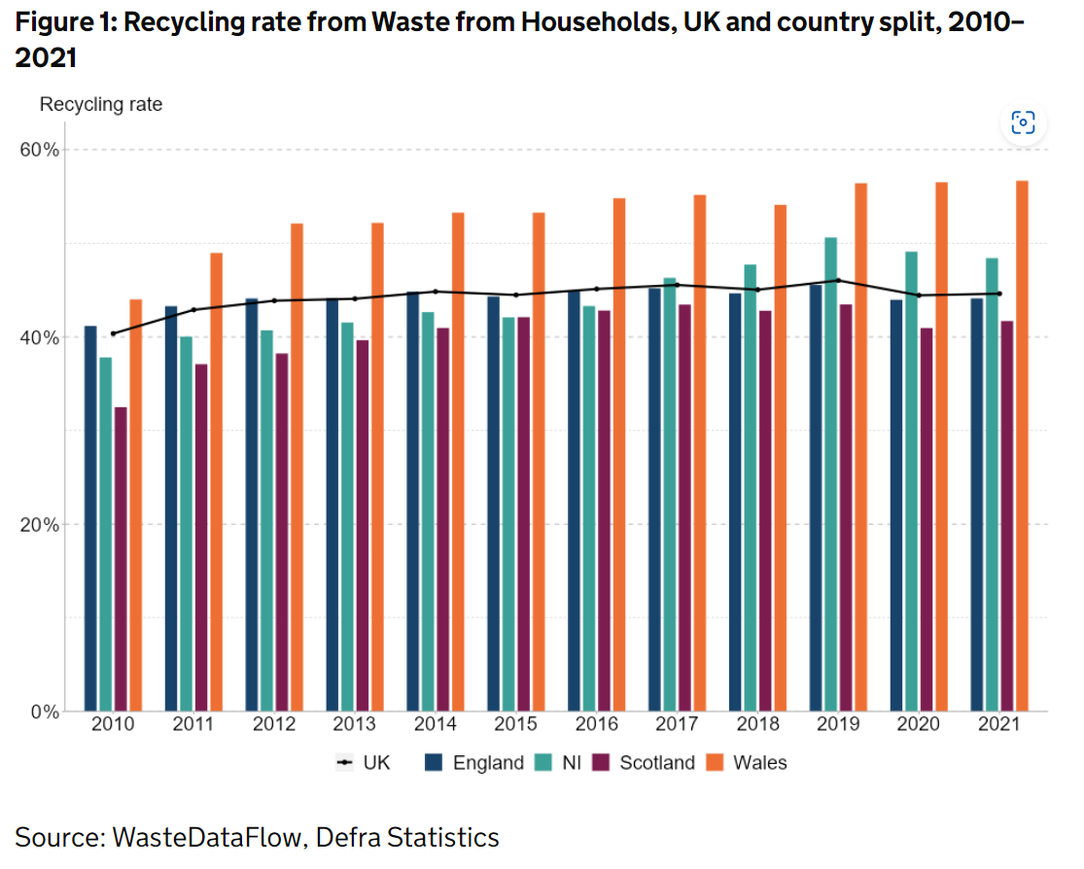
Module ACNA5002: 2025 / 2026 Recycling rates: UK
10/02/2026
Wales 3rd best at recycling in the world!
For the past decade the rate of recycling of household MSW in the UK has remained roughly the same while the total amount of waste has increased.
Source: https://www.gov.uk/government/statistics/uk-waste-data/uk-statistics-on-waste
A. Cunningham Lecture 3: Recycling Economy
Slide 13 / 27

Slide 14
Module ACNA5002: 2025 / 2026 Issues with Recycling
10/02/2026
Some authors state that recycling has negative consequences and is not a perfect solution
In fact, some authors suggest that recycling can lead to increased consumption rates (Maier, J., Geyer, R. and Steigerwald, D.G., 2023; Sun, M. and Trudel, R., 2017.)
This impact on the system is termed the “Circular Economy Rebound“ effect.
The studied behavioural activity shows positive emotions associated with recycling, which reduce guilt of consumption, leading to greater consumption.
A. Cunningham Lecture 3: Recycling Economy
Slide 14 / 27
Notes:
Maier, J., Geyer, R. and Steigerwald, D.G., 2023. Curbside recycling increases household consumption. Resources, Conservation and Recycling, 199, p.107271.
Sun, M. and Trudel, R., 2017. The effect of recycling versus trashing on consumption: Theory and experimental evidence. Journal of Marketing Research, 54(2), pp.293-305.

Slide 15
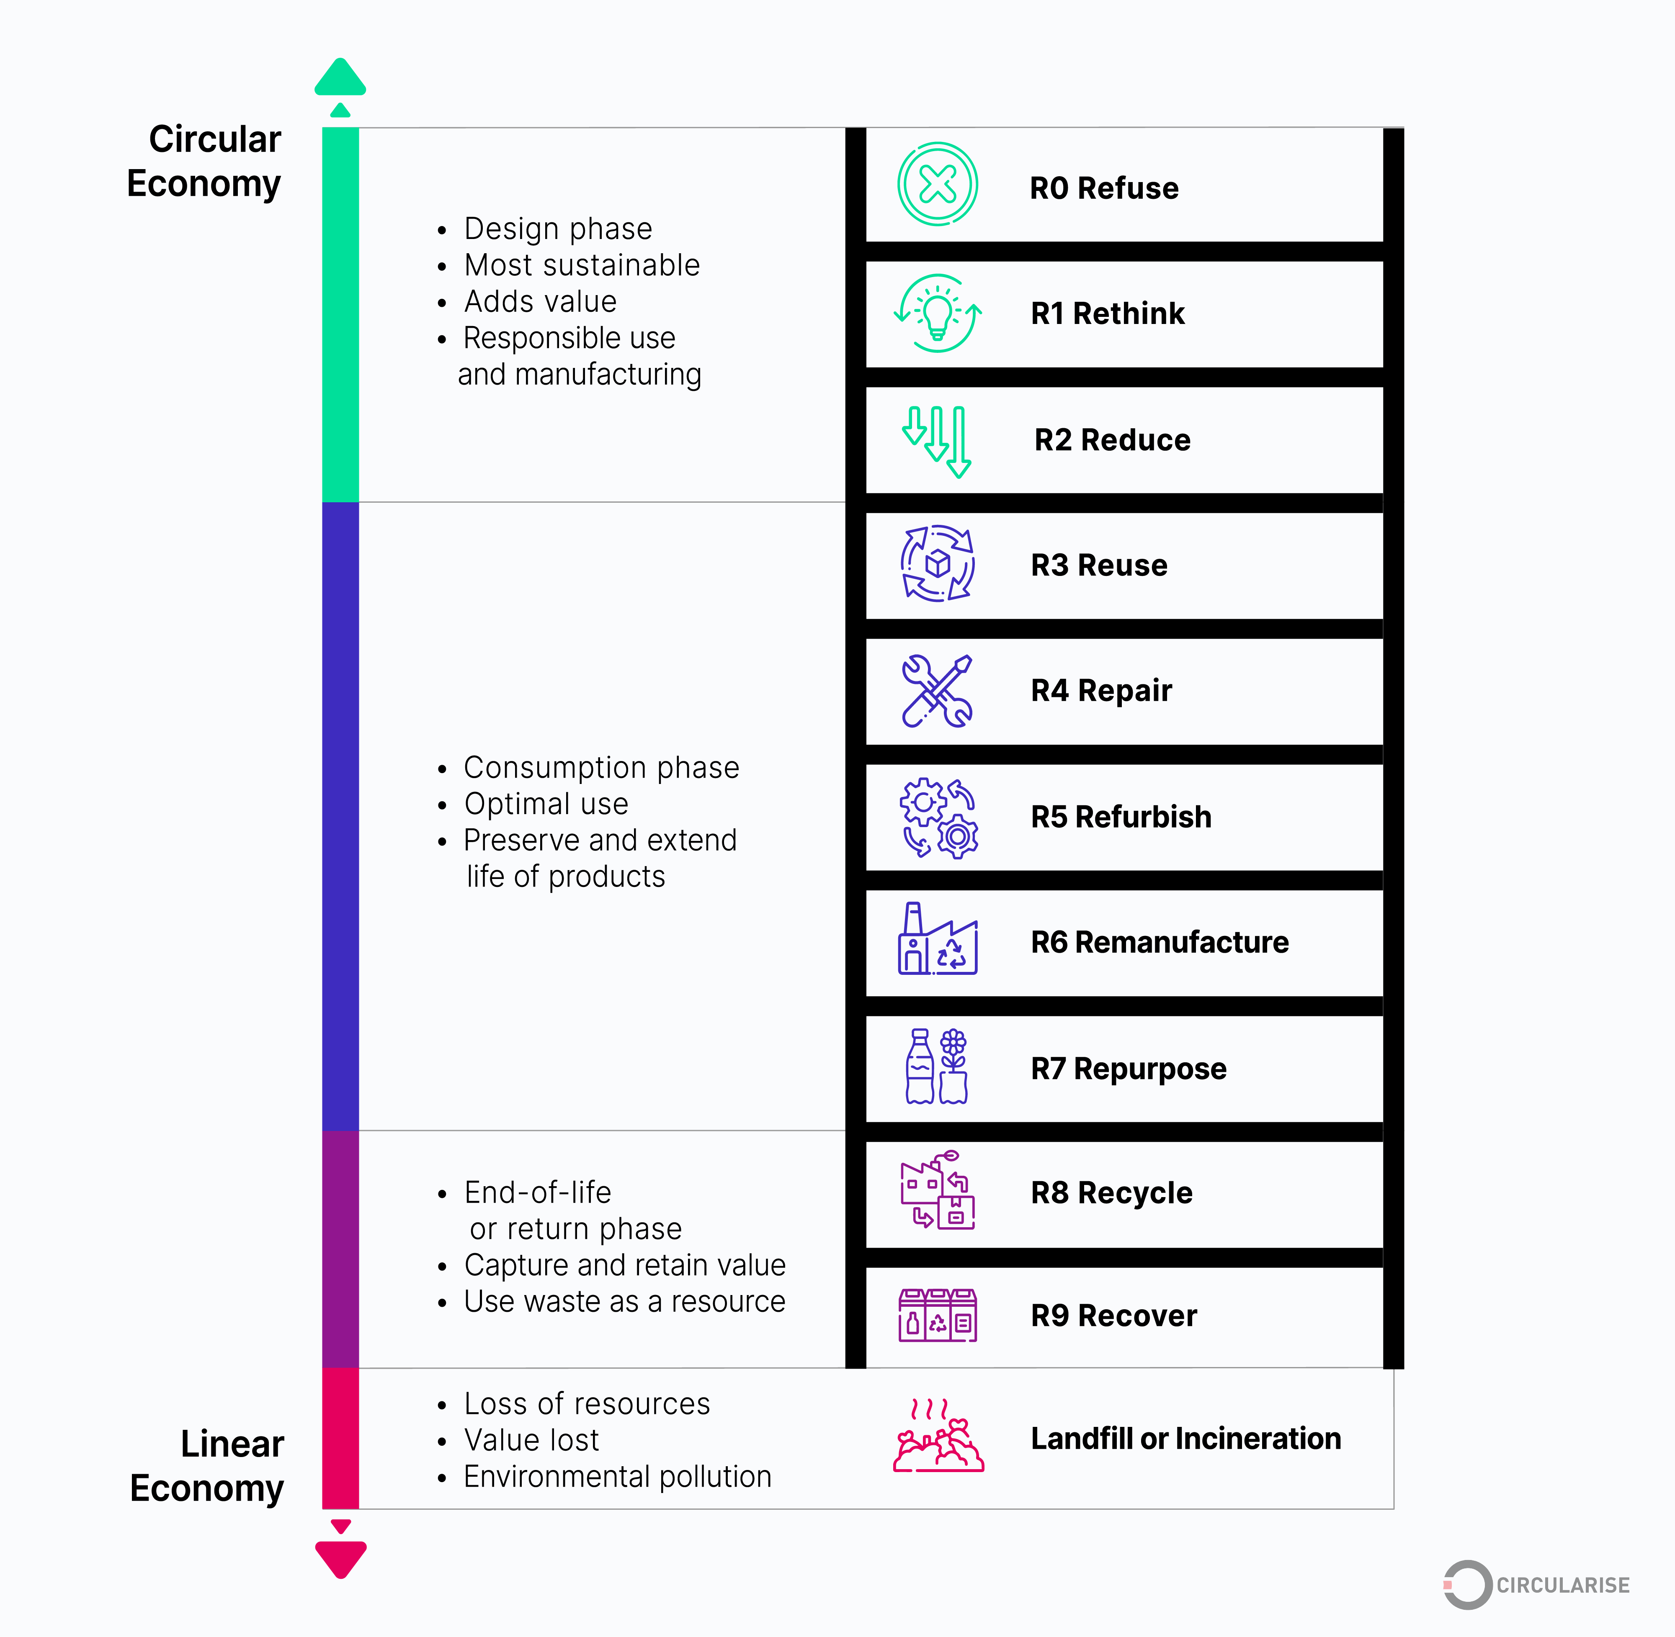
Module ACNA5002: 2025 / 2026 The R strategies
10/02/2026
Recycling is only one process or action that can reduce the issues of a linear economy (and associated impacts)
While the 3 R’s (Reduce, Reuse, Recycle) have been commonly cited as environmental initiatives (originated in the 1970’s alongside environmental movements), the “R-strategies” are a hierarchical system, highlighting the relative strength in moving away from linear economic practices.
Question: Recycling is a low performer in terms of efficacy compared to other strategies – why do you think this is?
A. Cunningham Lecture 3: Recycling Economy
Slide 15 / 27
Notes:
Source: R-Strategies for a Circular Economy (circularise.com) https://www.circularise.com/blogs/r-strategies-for-a-circular-economy
Originated from: Morseletto, P., 2020. Targets for a circular economy. Resources, Conservation and Recycling, 153, p.104553.

Slide 16
Module ACNA5002: 2025 / 2026 Recycling: Pros and Cons
10/02/2026
Take
(100)
Take
(60)
Recycling benefits the global natural environment through:
Reduction of virgin material extraction
Reduction of deposited toxic waste and associated contamination of land, air, and water
More energy and resource efficient to recycle than make products from raw materials (reduction in extraction)
60
100
Make
(100)
Make
(100)
Recycle
100
40
60
Use
(100)
Use
(100)
100
60
Waste
(100)
Waste
(60)
Linear Process
Recycling effect
A. Cunningham Lecture 3: Recycling Economy
Slide 16 / 27

Slide 17
Module ACNA5002: 2025 / 2026 Recycling: Pros and Cons
10/02/2026
Take
(60)
Recycling can have detrimental impacts:
Increased consumption through the rebound effect
Bias over closed loop systems (reduce and reuse) – which should be prioritised (Barnett et al., 2023)
Take
(90)
60
90
Make
(100)
Make
(130)
Recycle
Recycle
40
60
40
90
Use
(100)
Use
(130)
Priority should be reduction in the early part of the system – reduction in extraction and use (product demand)
Early strategies (R0 to R7)
60
90
Waste
(60)
Waste
(90)
Recycling effect
Rebound effect
A. Cunningham Lecture 3: Recycling Economy
Slide 17 / 27
Notes:
Barnett, M.J., Hancock, P.I., Klotz, L.E. and Attari, S.Z., 2023. Recycling bias and reduction neglect. Nature Sustainability, 6(11), pp.1418-1425.

Slide 18
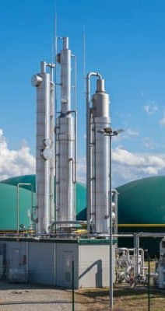
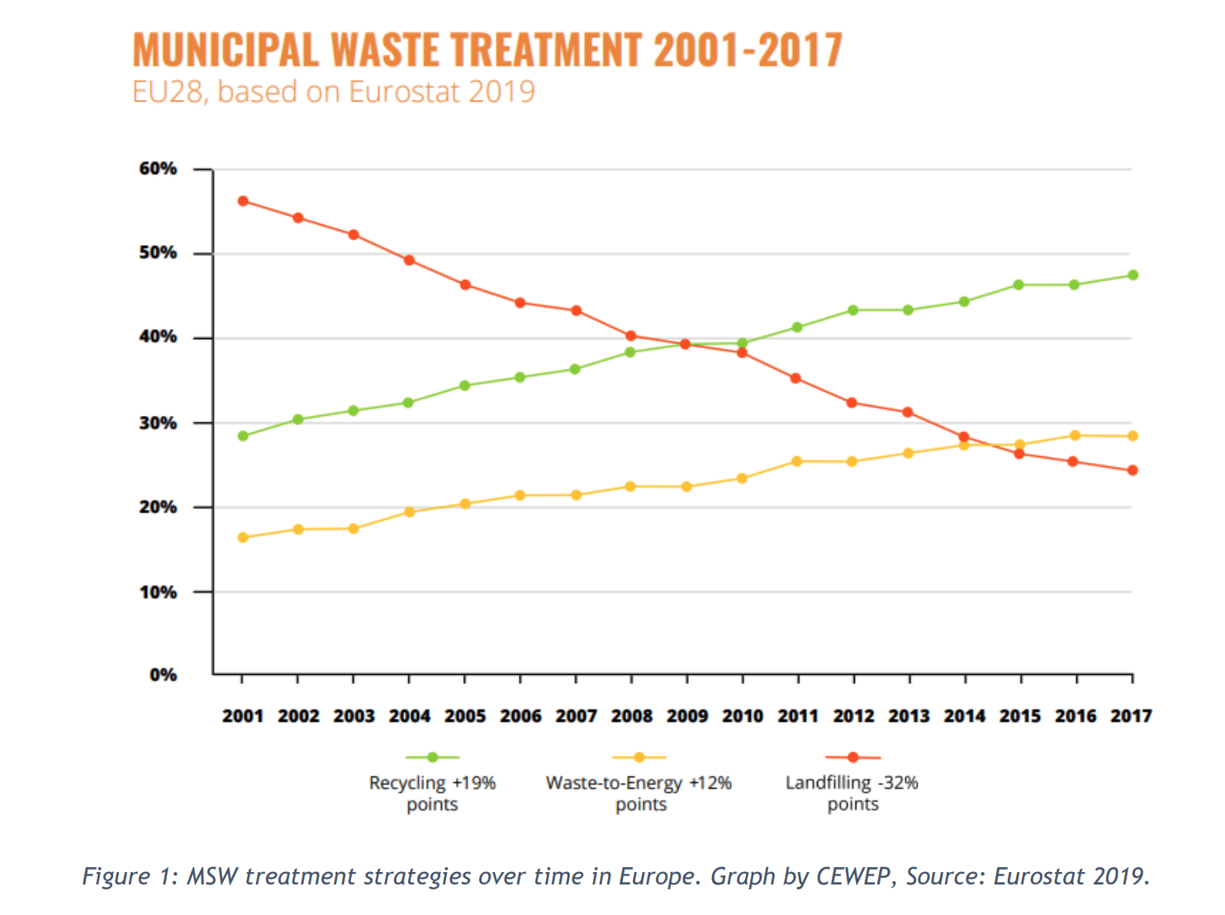
Module ACNA5002: 2025 / 2026 Recovery: better solution?
10/02/2026
In order to manage increased municipal solid waste, meet targets, and negate environmental pollution, many states / countries have increased recovery options.
Recovery is the term for ‘energy-from-waste’ – incineration of waste or waste by-products (gases and liquids) to generate energy.
These processes:
reduce the demand for raw fossil fuel extraction
divert waste material from landfill (and associated contamination)
achieve waste reduction targets without effort and resources required for reprocessing (separating, cleaning etc.) recycled materials
A. Cunningham Lecture 3: Recycling Economy
Slide 18 / 27
Notes:
T36_Waste_Circuar_Economy_final_report.pdf (ieabioenergy.com) https://www.ieabioenergy.com/wp-content/uploads/2022/05/T36_Waste_Circuar_Economy_final_report.pdf

Slide 19
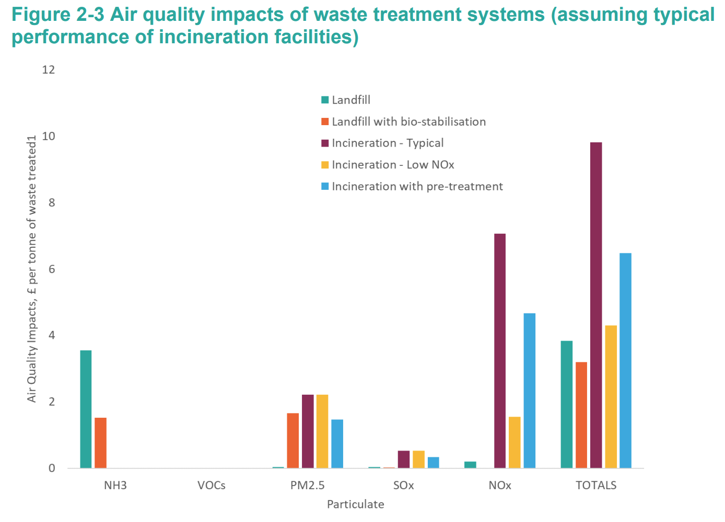
Module ACNA5002: 2025 / 2026 Recovery: better solution?
10/02/2026
However, Energy from Waste options:
release chemicals into the atmosphere, contributing to air pollution.
reduce the re-usable value / elements of the original source material – no reduction in production demand.
Also, evidence shows inequality in spatial distribution of incinerators: How waste burning affects UK’s poorest neighbourhoods (youtube.com)
Source: Client Earth report “Greenhouse Gas and Air Quality Impacts of Incineration and Landfill” (2020)
A. Cunningham Lecture 3: Recycling Economy
Slide 19 / 27
Notes:
Title Page layout (clientearth.org) https://www.clientearth.org/media/1h2nalrh/greenhouse-gas-and-air-quality-impacts-of-incineration-and-landfill.pdf

Slide 20
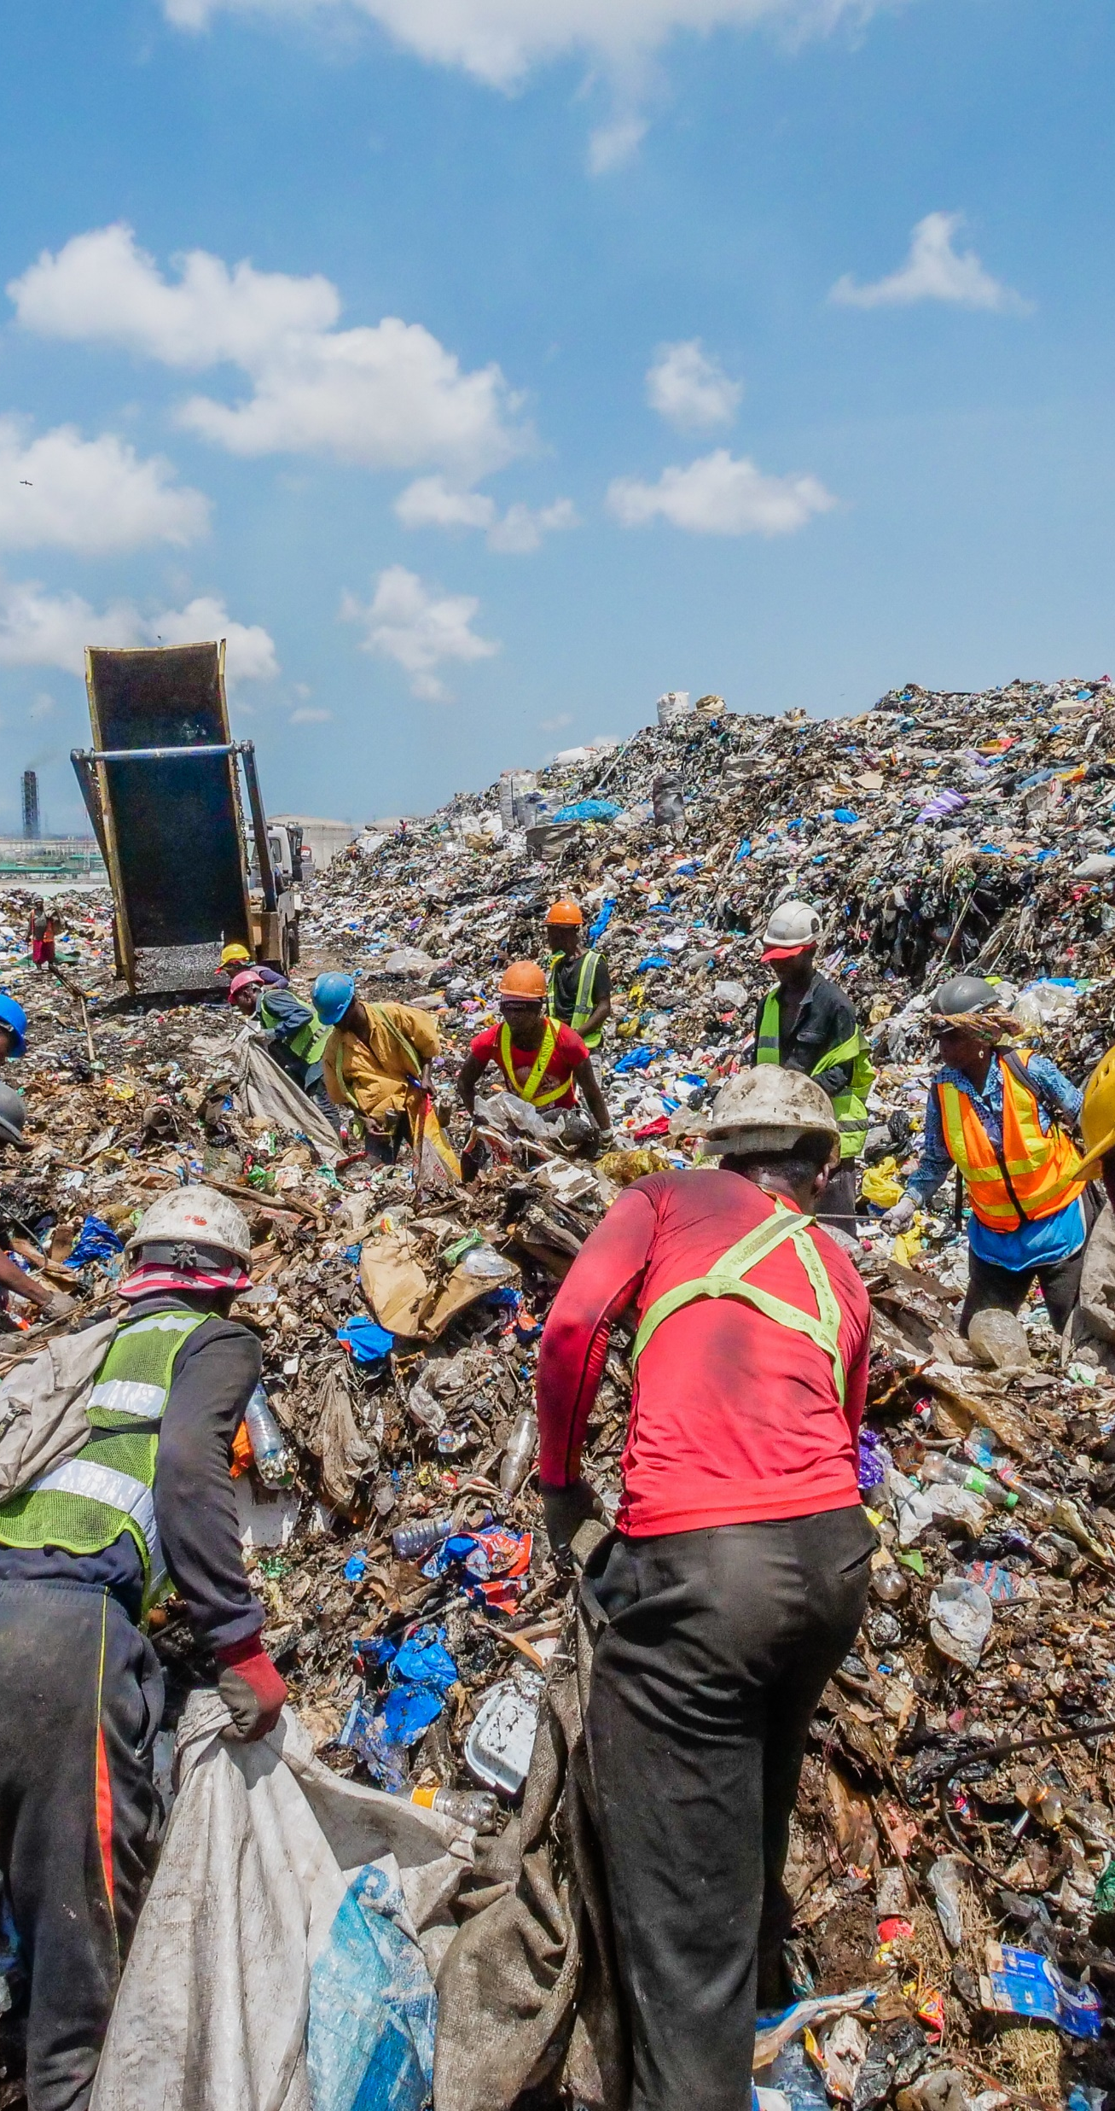
Module ACNA5002: 2025 / 2026 Informal Recycling
10/02/2026
While affluent countries can afford to collect, sort, and salvage waste materials (often away from domestic centres), less developed countries or low socio-economic regions do not have this infrastructure.
History reveals informal waste-picking (also called ‘scavenging’) has existed for centuries.
When scarcity of materials increases, so does the value of discarded ‘waste’ materials.
Waste-pickers often operate informally (not part of national policy practices)
Fundamentally play a significant role:
- Remove material from waste flows – reducing downstream pollution
- Low economic burden (often casual or black-market)
A. Cunningham Lecture 3: Recycling Economy
Slide 20 / 27
Notes:
How Waste Pickers Help The Environment - Dr Earth https://drearth.com/resources/article/how-waste-pickers-help-the-environment/
Morais, J., Corder, G., Golev, A., Lawson, L. and Ali, S., 2022. Global review of human waste-picking and its contribution to poverty alleviation and a circular economy. Environmental Research Letters, 17(6), p.063002.

Slide 21
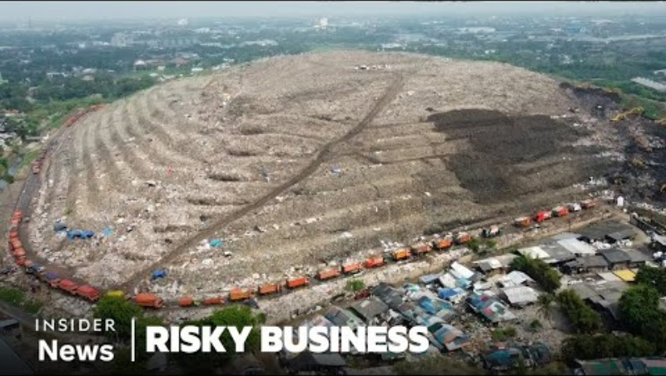
Module ACNA5002: 2025 / 2026 Waste-pickers
10/02/2026
TBC
A. Cunningham Lecture 3: Recycling Economy
Slide 21 / 27

Slide 22
Module ACNA5002: 2025 / 2026 Affluence and Recycling
10/02/2026
The review of historical trends in recycling practices and drivers indicates that there is a trend between socio-economic factors and recycling behaviour
During periods of deprivation / low economic success, resulting in poverty or scarcity in access to / availability of materials, recycling increases.
During period of affluence, consumption increases, and so does waste.
The potential / actual value of the material and its perceived value vary
We will cover Value in a subsequent lecture
A. Cunningham Lecture 3: Recycling Economy
Slide 22 / 27

Slide 23
Module ACNA5002: 2025 / 2026 Summary
10/02/2026
In this lecture we covered the following:
Definition of recycling
Historic (ancient) examples for recycling, and the drivers behind it
The changing drivers of recycling behaviour over time
The effectiveness of recycling, its benefits and drawbacks
The R-strategies and the limited effectiveness of recycling in comparison to other circular strategies
The role of informal recycling (waste-pickers)
A. Cunningham Lecture 3: Recycling Economy
Slide 23 / 27

Slide 24
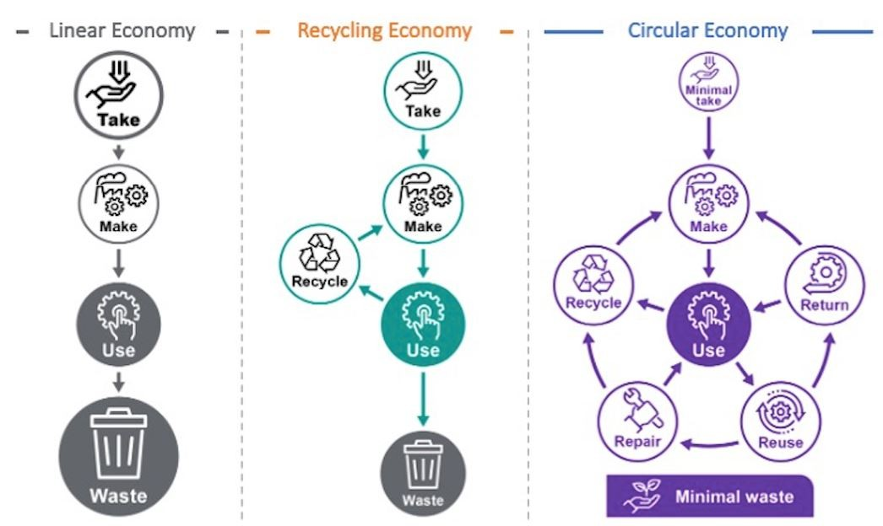
Module ACNA5002: 2025 / 2026 Next Session
10/02/2026
The next lecture will cover:
Introduction to Circular Economy
Suggested activities:
Explore recycling rates in Europe: Statistics | Eurostat (europa.eu)
Suggested reading:
Please see the Notes section of the PowerPoint slides where all literature cited in the slides is referenced, alongside the References slide at the end.
This is the case for all lectures.
A. Cunningham Lecture 3: Recycling Economy
Slide 24 / 27

Slide 25

Module ACNA5002: 2025 / 2026 References
10/02/2026
Amick, D.S., 2015. The recycling of material culture today and during the Paleolithic. Quaternary International, 361, pp.4-20.
Barnett, M.J., Hancock, P.I., Klotz, L.E. and Attari, S.Z., 2023. Recycling bias and reduction neglect. Nature Sustainability, 6(11), pp.1418-1425.
Laner, D., Crest, M., Scharff, H., Morris, J.W. and Barlaz, M.A., 2012. A review of approaches for the long-term management of municipal solid waste landfills. Waste management, 32(3), pp.498-512.
McDonough, W., and M. Braungart. 2002. Remaking the way we make things: Cradle to cradle. New York: North Point Press.
Morais, J., Corder, G., Golev, A., Lawson, L. and Ali, S., 2022. Global review of human waste-picking and its contribution to poverty alleviation and a circular economy. Environmental Research Letters, 17(6), p.063002.
Rosell, J., Blasco, R., Peris, J.F., Carbonell, E., Barkai, R. and Gopher, A., 2015. Recycling bones in the middle pleistocene: some reflections from Gran Dolina TD10-1 (Spain), bolomor cave (Spain) and Qesem cave (Israel). Quaternary International, 361, pp.297-312.
Tammemagi, H., The All-Powerful NIMBY. 2000. In The Waste Crisis. Oxford University Press.
Vallero, D.A. and Blight, G., 2019, January. The municipal landfill. In Waste (pp. 235-258). Academic Press. Landfills – Yesterday, Today and Tomorrow – ScienceDirect https://www.sciencedirect.com/science/article/abs/pii/B9780123814753100300
A. Cunningham Lecture 3: Recycling Economy
Slide 25 / 27

Slide 26
Module ACNA5002: 2025 / 2026 Questions
10/02/2026
Any questions?
Please contact via:
Email: a.cunningham@uwtsd.ac.uk
Teams: “ACNA5002 Environmental Legislation & Circular Economy 2025/26_GRP”
A. Cunningham Lecture 3: Recycling Economy
Slide 26 / 27

Slide 27
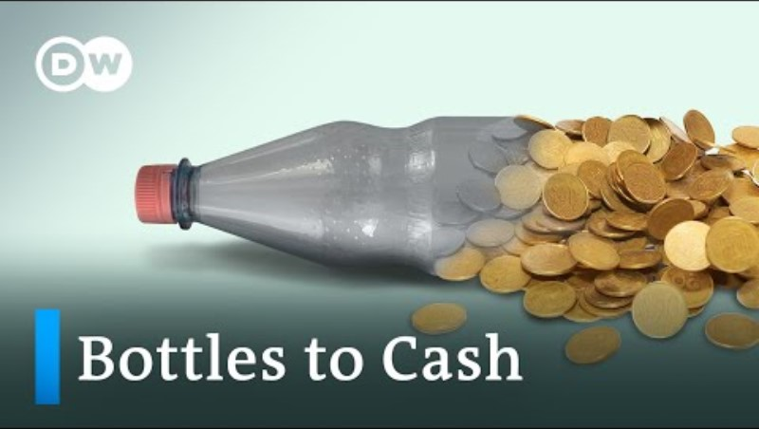
Module ACNA5002: 2025 / 2026 Germany’s 99% recycling rate
10/02/2026
A. Cunningham Lecture 3: Recycling Economy
Slide 27 / 27

Slide 28
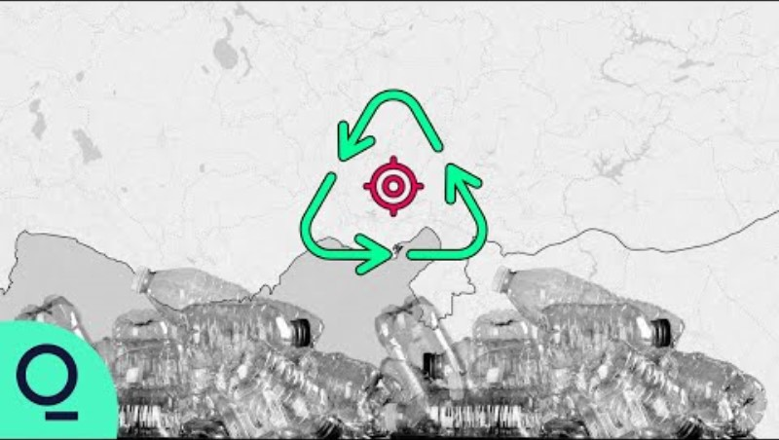
Module ACNA5002: 2025 / 2026 Tracking plastic recycling
10/02/2026
A. Cunningham Lecture 3: Recycling Economy
Slide 28 / 27

