Slide 1
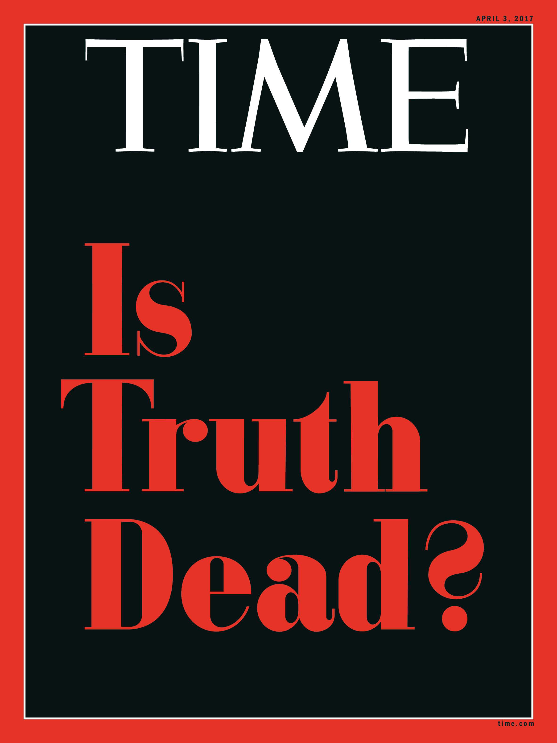
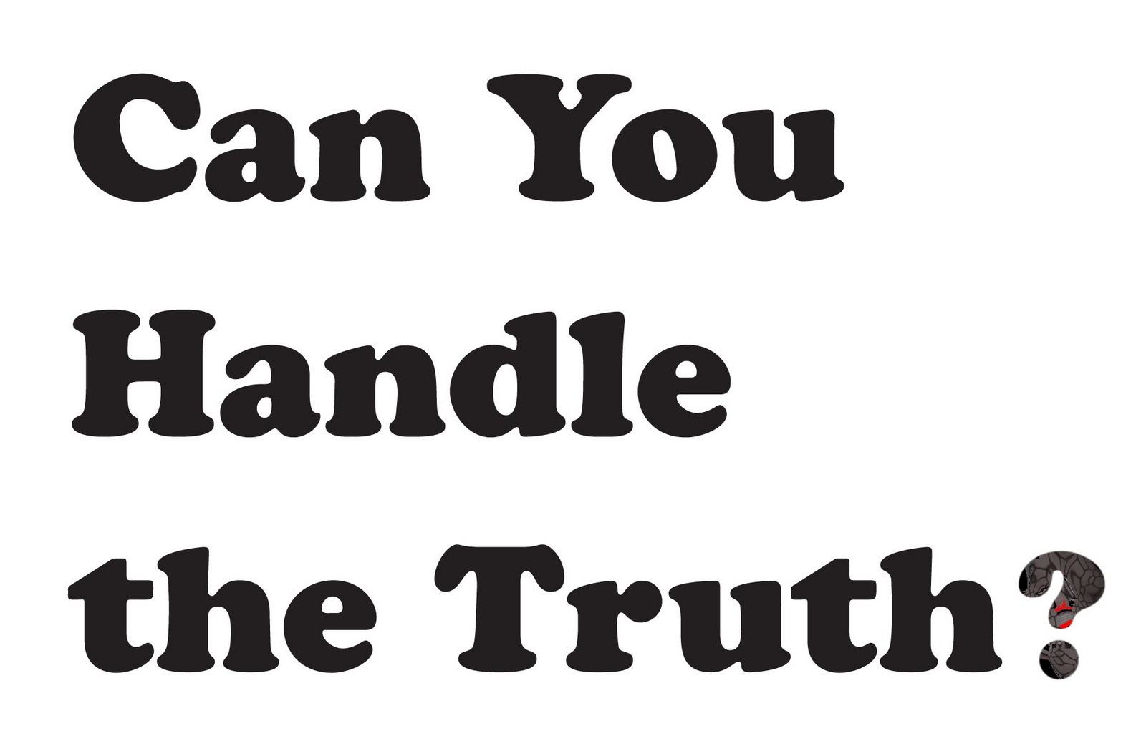
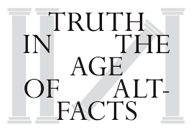
Post-Truth
ECSS6002: Current Political and Ethical Landscape
By Matthew Philpott

Slide 2
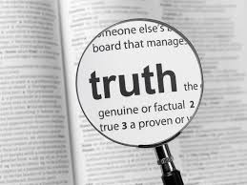
Some important questions to consider..
What do we mean by ‘truth’?
How is truth different from knowledge, experience, reality, belief..
Rationalism vs. Empiricism
And perhaps most importantly..
Does truth exist?
Can we know it, or experience it?
How do truth & facts have a role in politics?

Slide 3
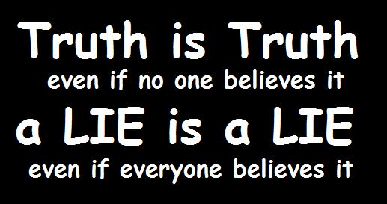
Is truth objective?

Slide 4
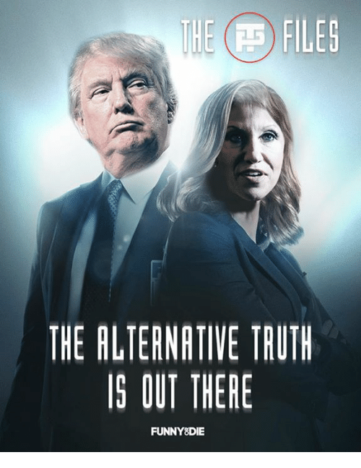
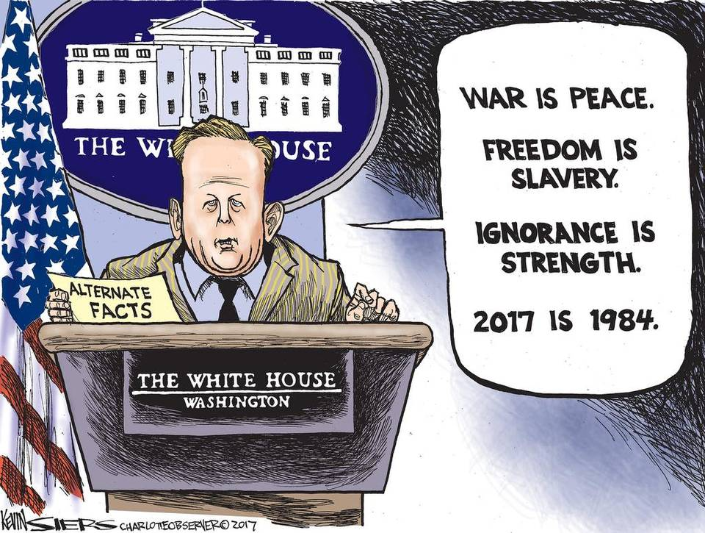
https://www.youtube.com/watch?v=VSrEEDQgFc8 1:38 – 2:17
Kellyanne Conway’s use of the phrase “alternative facts” to describe demonstrable falsehood was widely mocked, and extensively described as ‘Orwellian’. Within 4 days of the interview, sales of Orwell’s 1984 had sharply risen and became a number one bestseller on Amazon.

Slide 5
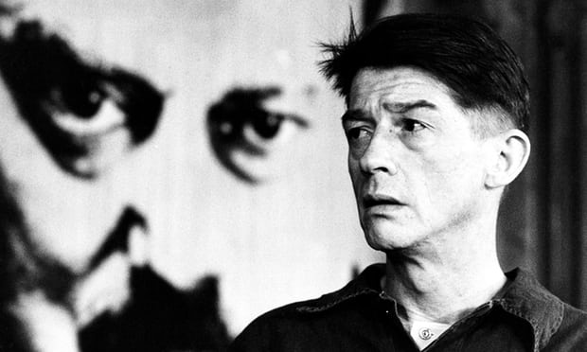
Orwell & 1984
O’Brien, warns that ‘reality is not external. Reality exists in the human mind, and nowhere else ….Whatever the Party holds to be truth, is truth. It is impossible to see reality except by looking through the eyes of the Party.’
‘We control matter because we control the mind. Reality is inside the skull … There is nothing that we could not do. Invisibility, levitation – anything. I could float off this floor like a soap bubble if I wish to … You must get rid of those nineteenth-century ideas about the laws of Nature. We make the laws of Nature.”
2+2=5

Slide 6
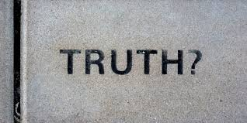
What is TRUTH then?
Truth as a statement of fact:
Facts concern reality
By examining reality, we form ideas about the world
Ideas are the basis for our beliefs
Beliefs become knowledge when a proposition is valid with a true premise
Let’s examine what O’Brien means when he says ’19th century ideas..’

Slide 7
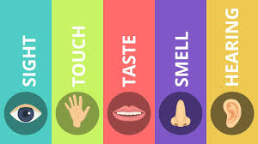
Reality & ‘True Premises’
We form beliefs about the world in various ways..
Our experience of the world is through the five senses
We can use reason and intuition to make judgements..
This can be either deductive or inductive
Deductive = Humans are mortal, Matthew is a human, therefore Matthew is mortal.
Inductive = I have dropped the ball 10 times, it has fallen to the ground 10 times, therefore in future when I drop the ball it will fall to the ground.

Slide 8
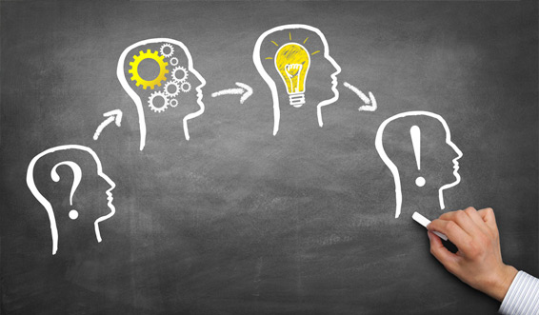
So, in order to discover truth we use :
Our senses
Deductive reasoning
Inductive reasoning
Are these reliable?

Slide 9
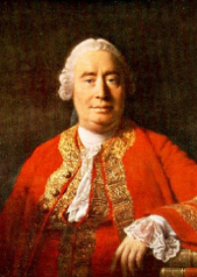
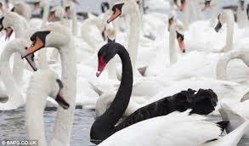
Problems with induction / deduction
Deductive reasoning is a tautology; it tells us nothing new, it just restates what we understand by a linguistic term i.e “unmarried men are bachelors”
Inductive reasoning is proven wrong the first time something unexpected happens i.e All swans are white, and then we discover black swans in Australia..
This is called the Problem of Induction, as suggested by philosopher David Hume

Slide 10
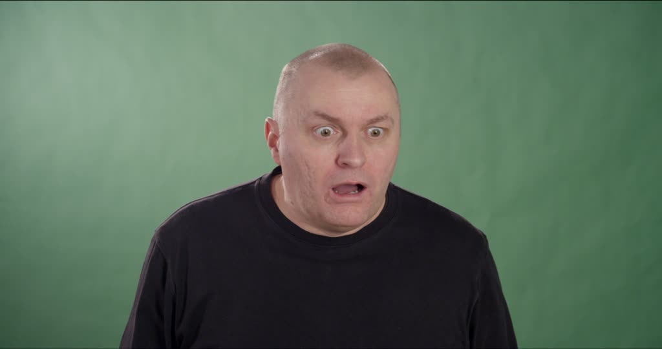
What about our senses?
Our senses can be easily misled, whether by hallucinations or dreams, or more physical causes such as colour-blindness, drug or alcohol intoxication.
But our senses are the major means by which we interpret the world!
If our senses are giving us the wrong impression of the world, how would we know?
We could ALWAYS BE WRONG, AND NOT KNOW UNTIL WE’RE CORRECTED, WHICH MIGHT NEVER HAPPEN
What’s happened to truth now?

Slide 11
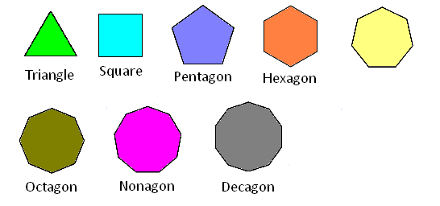
So induction and deduction are flawed, and my senses are unreliable..
Then how can I reach Truth? Knowledge? Reality?
Perhaps science offers truth! Or the truths of mathematics, geometry..
A triangle always has 3 sides, all the angles always add up to 180 degrees..
2+2=4, this cannot be otherwise (unless you’ve got “alternative maths”..)

Slide 12
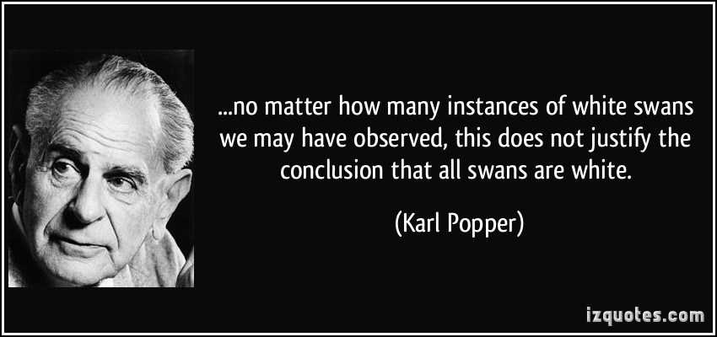
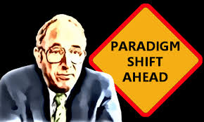
Is Science objective?
Major scientific changes in world view have included (in chronological order);
Plato, Aristotle, Ptolemy, St Thomas Aquinas, Nicolaus Copernicus, Tycho Brahe, Johannes Kepler, Galileo, Isaac Newton, Pierre Laplace, Charles Darwin, Pierre Teilhard de Chardin, Albert Einstein, Steady-state theory, Quantum theory, Big Bang theory..
So is science really an objective study of the universe? Or is it just a prevailing trend at the time? And does it give us any truth?
What about Thomas Kuhn and ‘Kuhn Loss’? Karl Popper and Falsification?

Slide 13
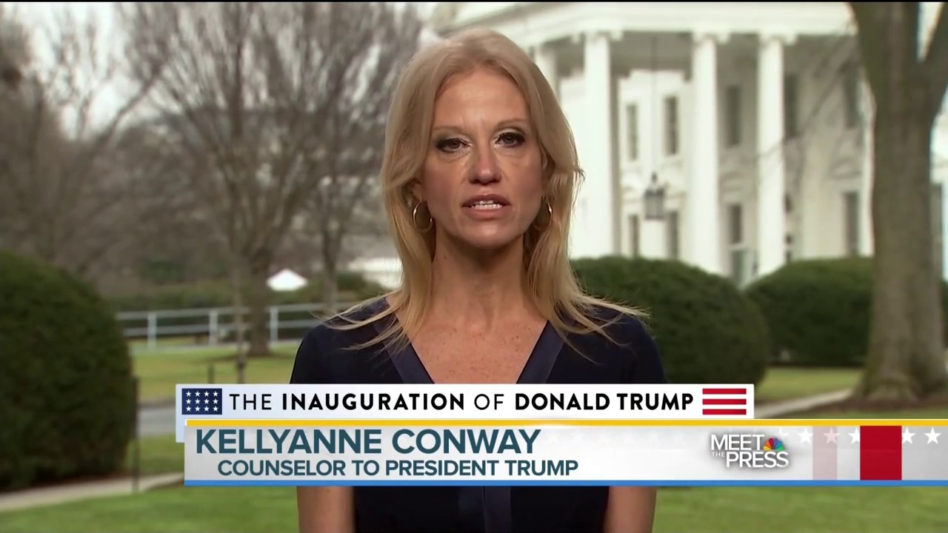
All this effort to undermine truth!
So perhaps we are then POST-TRUTH, maybe truth is subjective, maybe we are sceptical, ironic, cynical and rejecting the old ideas of universal truth: We are post-modern!
Post-modern = rejecting traditional concepts of moral absolutism, objective reality, universal truth
Perhaps Trump and Conway are very post-modern? Very Post-truth?

Slide 14
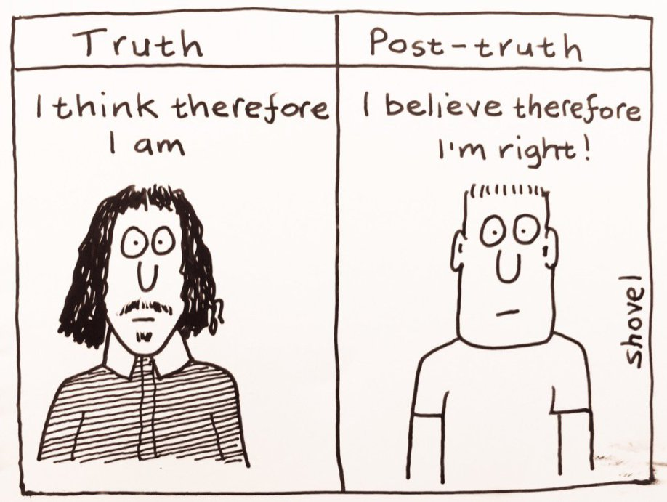
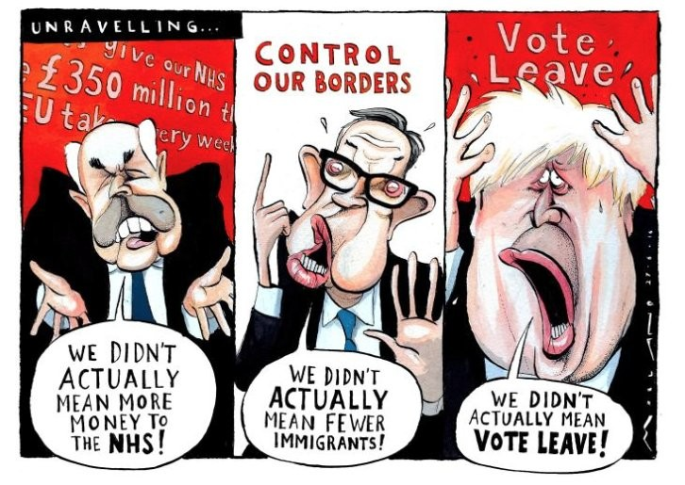
Post-truth Politics

Slide 15
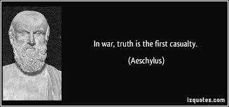
What are some of the causes of Post-truth society?
War (conflict more broadly)
Freedom of information
Ease of information and communication
Conspiracy theory
An evolving zeitgeist
Subjectivism, or relativism (your opinion is as good as mine!)

Slide 16
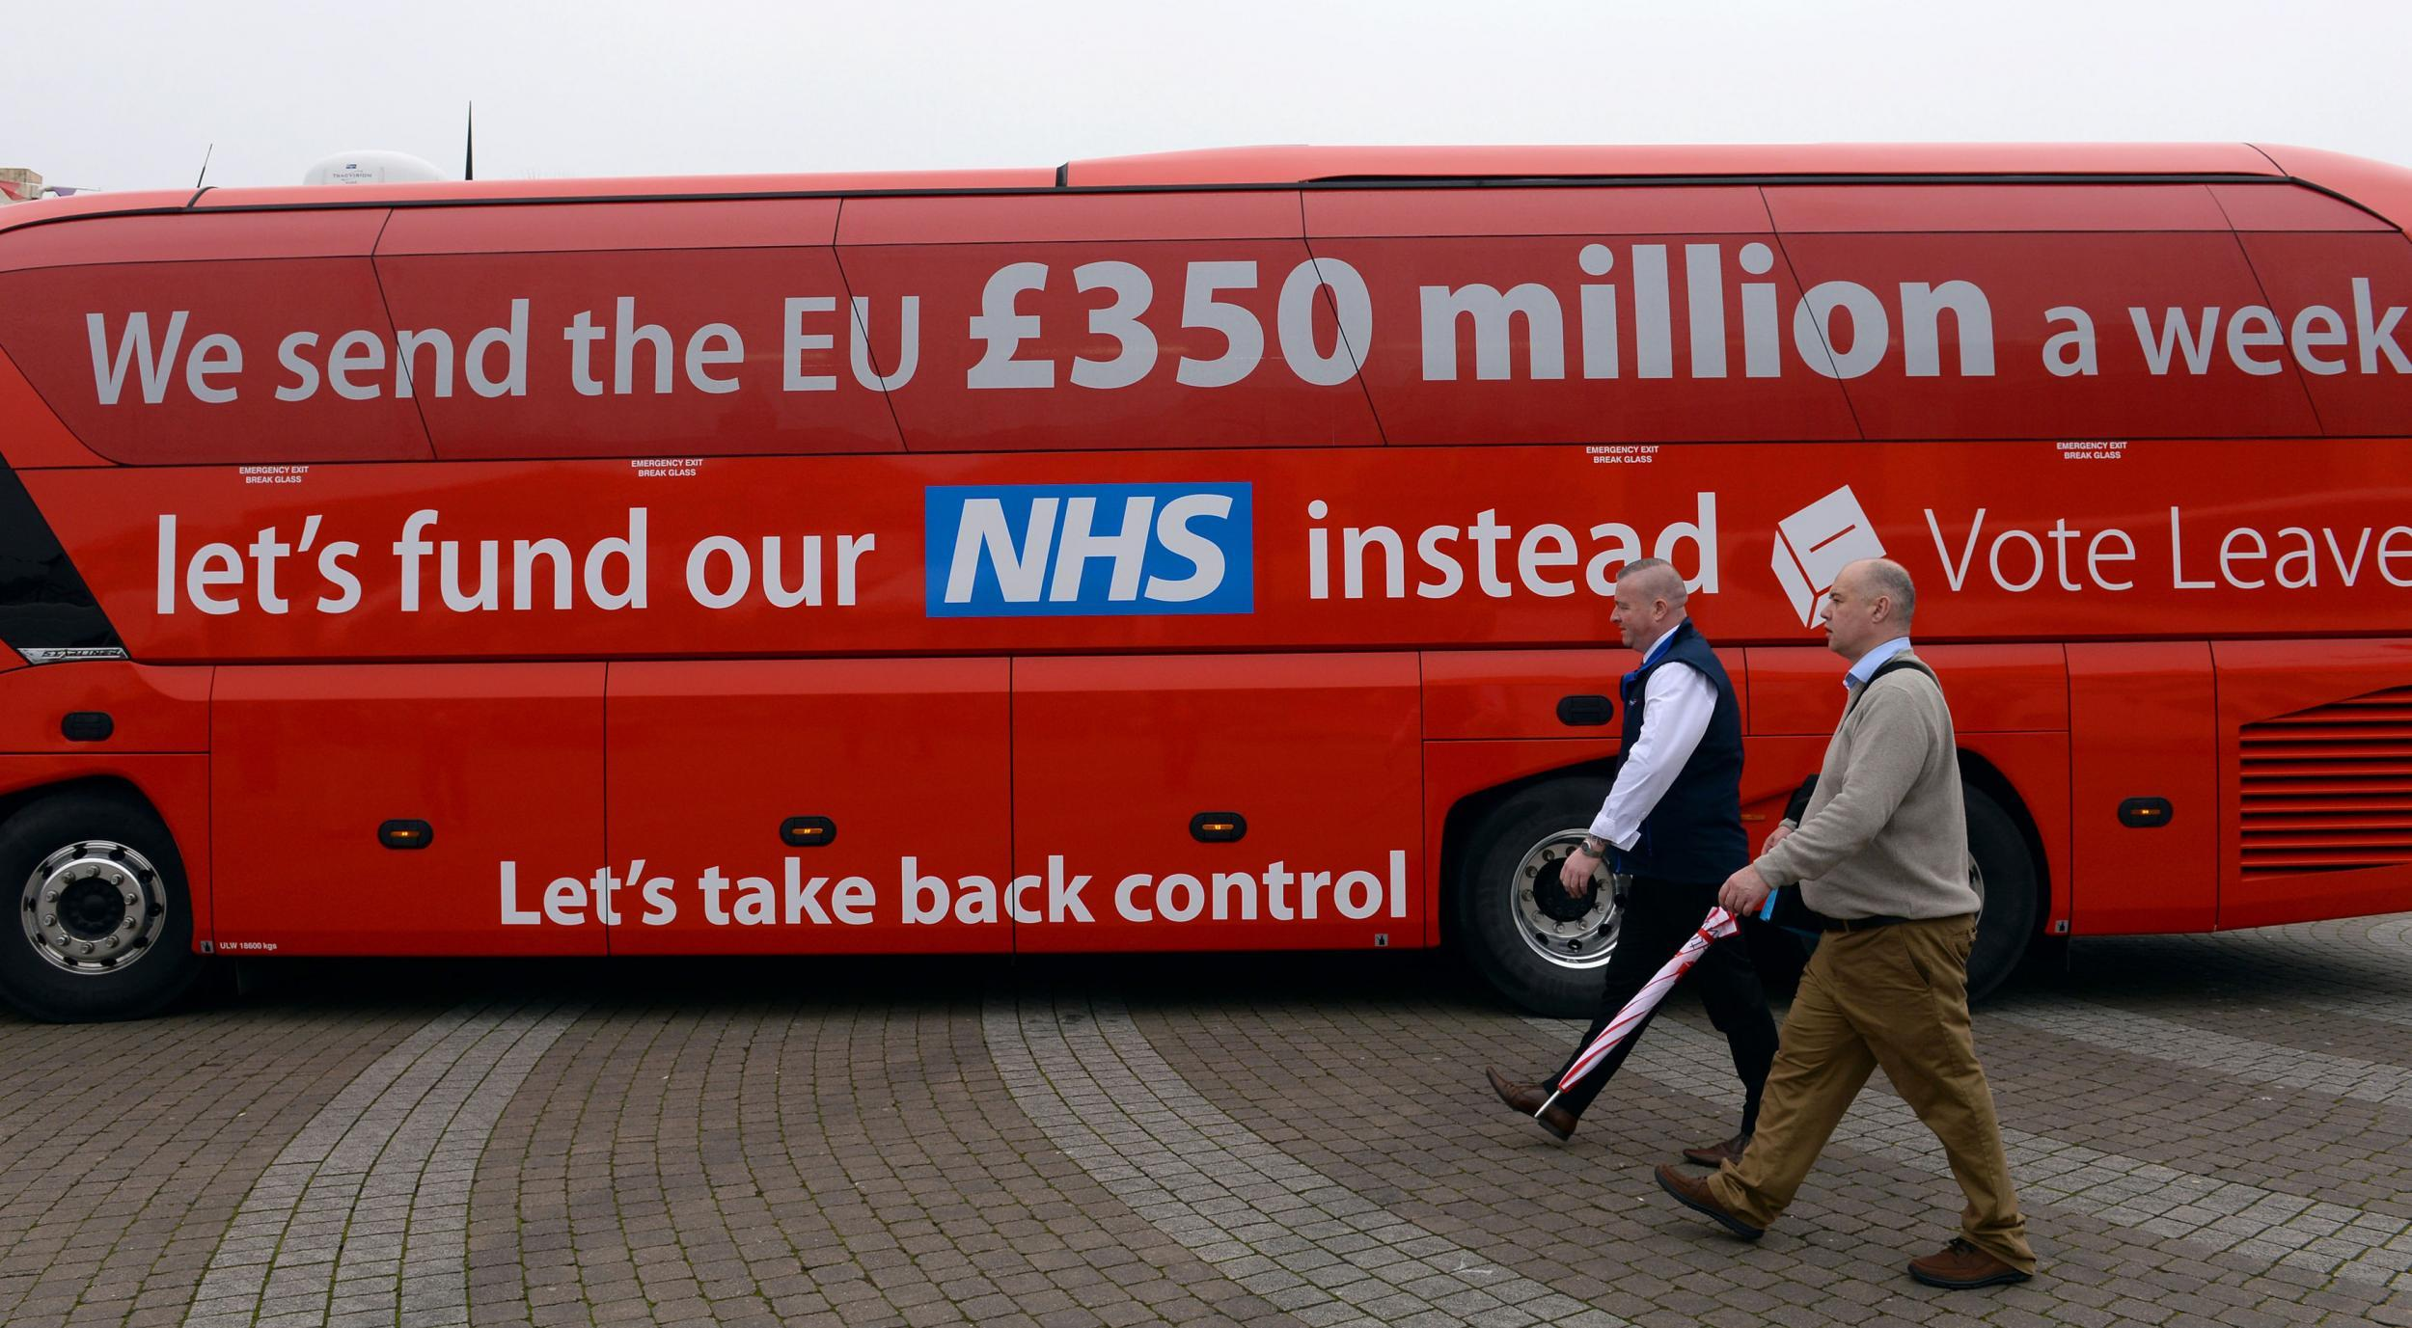
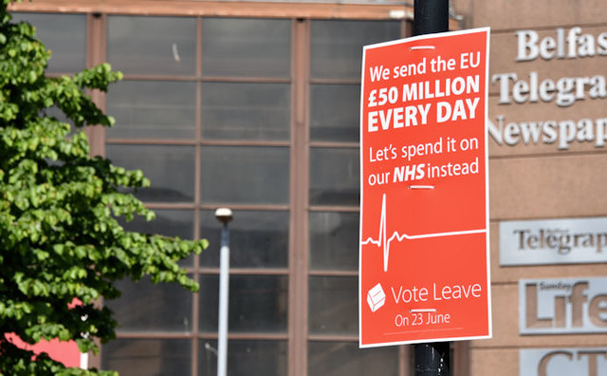
What does it mean to be Post-Truth?
Post-Truth has now been added to the Oxford Dictionary; due in part to the coverage it received with regards to the Brexit campaigns and President Trump
A defining trait of post-truth politics is that campaigners continue to repeat their talking points, even if these are found to be untrue by the media or independent experts (“we have had enough of experts”)
“Yeah, well, you can prove anything with facts though can’t you?” – from Stewart Lee

Slide 17
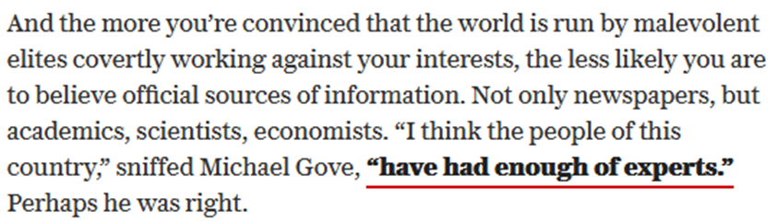
In this sense, facts don’t matter. What matters more is the feeling, the emotion that a mantra is able to connect with. Inconvenient facts are smears and warnings are scaremongering. Questions or uncertainty are “talking down” an issue, whereas those who engage in post-truth politics see themselves as optimistic and hopeful.
https://www.youtube.com/watch?v=FYPy-4nxJ5M :9.40 – 12:54

Slide 18

Is this right? Perhaps 86% of facts are made up..
What is the difference between “post-truth politics” and philosophical questions about the nature of truth and knowledge?
Does it have a different agenda?

Slide 19
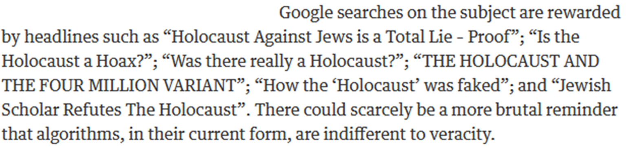
What relationship does Post-truth have with history?
From The Guardian Friday 12th May 2017

Slide 20
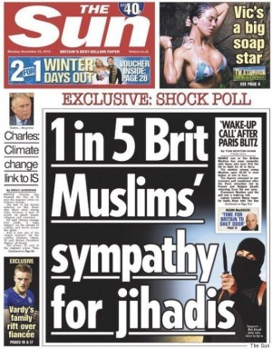
3,000 complaints filed against this headline, which The Sun was later investigated for by Independent Press Standards, and admitted the statistic was ‘deeply misleading’.

Slide 21
How has Post-truth politics influenced modern society?
Data becomes increasingly more accessible through technology
An obsession for data & stats filters into the political scene
Newspapers and speeches are filled with snippets of information
This information may be false, misconstrued, out of context, not contain the whole picture and so on..
What matters is not necessarily the data’s accuracy, but the overall emotive message that the speech / newspaper is trying to convey
This shapes how the public engages with political views, candidates and their attitudes towards certain issues.

Slide 22

Does it matter that this is not ‘true’?
Is it more concerned with a feeling, that leaving the EU would address?

Slide 23
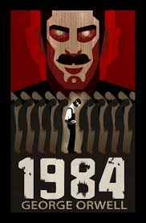
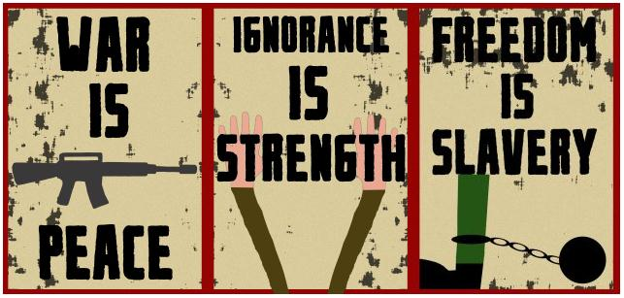
How did we get here?! What’s left?
Maybe for every-day life it is impossible to act as if things are not true or false
Perhaps we need to hold on to SOME idea of truth, even if what that means is tenuous, or requires a great deal of thought
Particularly with regard to the political world, where decisions have real social and economic consequences in the lives of others
If we abandon truth entirely, are we more vulnerable?

