Slide 1

ASSINMENT 2
MODULE: INTRODUCTION TO RESEARCH SKILLS IN CARE (BMHP4013)
STUDENT NAME: ALPHA SILLAH
STUDENT NUMBER: 1705038
TOPIC: JOURNAL CRITIQUE

Slide 2

INTRODUCTION
Methodology is the design that can be used by scientists to foster peoples' subtleties and understanding, consequently depending on optional subtleties. Qualitative examination is utilized to extend scientists' information on the story and the goal is to gain some comprehension of discernment (Green, 2000)
- The article looks at more seasoned individuals' view of personal satisfaction according to the viewpoint of access and utilization of wellbeing and social care services. It is fundamental on how nurses oversee care, and the patients' independence in their daily life. (Rand and Malley, 2014)
- The title of the article "THEY'RE ALWAYS IN A HURRY"- OLER PEOPLES@ PERCEPTION OF ACCESS AND RECOGNITION IN HEA;LTH AND SOCIAL CARE SERVICES.
- The author is called Elisa Tiilikainen.
- The Journal is called "Wiley Health and Social Care Services in The Community". Dated 23 June 2018.

Slide 3
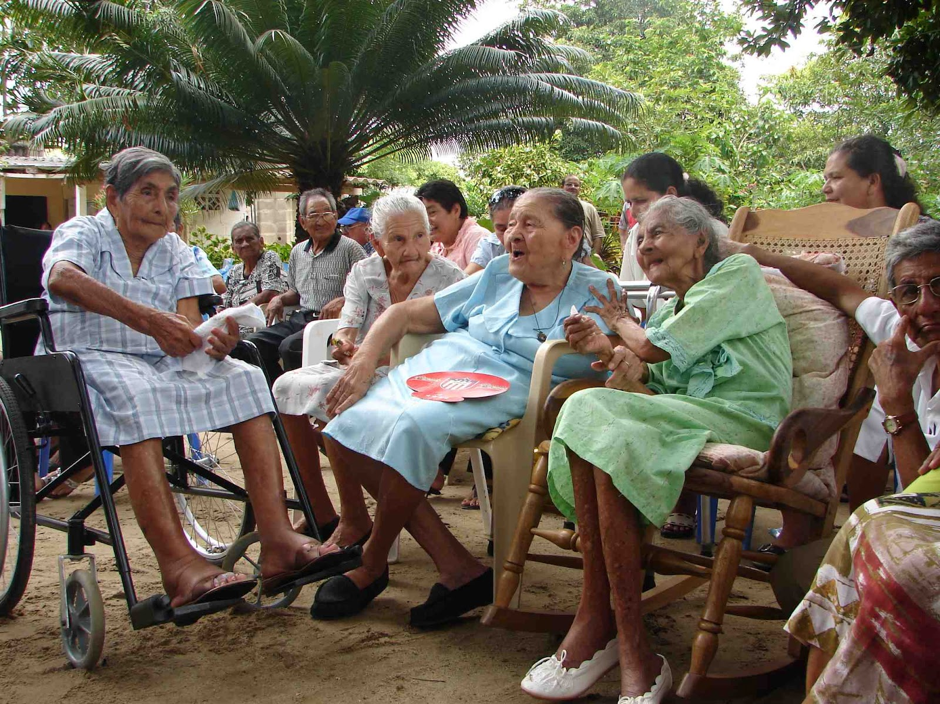
STRUCTURE
-
- As the populace ages, the quantity of individuals utilizing wellbeing and social care administrations increases.
- Admittance to administrations and nature of care are known to have serious areas of strength with more established people groups' personal satisfaction.
- Past subjective examinations in the point have amassed in long term care and informal carers.
- home consideration is not tied in with giving more seasoned individuals the monetary assets and primary changed in mentalities and in the care of professionals (Varane and Pieger, 2014).
- The design was not aligned correctly ,I find it a bit confounding to peruse from one subject through the passages.
- It does not have all the section io would have expected because there were lot of inaccuracies between the interviewer and the participants.
_
-
.

Slide 4

CONTENT
- It is accurate because the author was trying to elaborate the importance of quality care in the health and social care services. All of the themes were described as both positive and negative factors in the participants' lives (Bond and Corner, 2004., Farquhar, 1995).
- The article is backed up by citations from different authors and researchers.
-The topic was based on group discussions,, at the point when service users feel they have the rights to ask for independence way of living their lives. Satisfaction and unsatisfactory towards the administrations were not included in the interview

Slide 5

RESEARCH AND FINDINGS:
- The story is linked logically to the overall examination as it took almost a month to put together data and many of the participants described the difficulty to gain access to information within the wellbeing and social care settings.
- The writer was trying to raise awareness about concerns the older people shared with regards to the importance of independence.
- Attitudes of professionals were discussed several times during the group discussions (Bloor et al., (2001)
-Patients talked about being mistreated by health professionals. They spoke about the positive experience they had with the interview
D.

Slide 6
VALIDITY
https://youtu.be/x51BzIV3vJY
- The study has proven to have a few constraints. The information was gathered to accumulate aggregate perspectives on personal satisfaction of more established individuals. Not in view of encounters of access and utilization of wellbeing and social; care benefits (Braun and Clarke, 2006). Their messages seemed, by all accounts, to be clear and rational. Inspecting the more established individuals' impression of personal satisfaction have ended up being credible
- The article features the significance of creating wellbeing and social care administrations in which old and people's needs are perceived and upheld (Pirhonen, 2017)
- the article was used, and accepted on the 15 January 2019 (Tiilikainen et al., 2019)
- The research was funded by the Strategic Research of the Academy of Finland (# 303615; # 303654)

Slide 7
RECOMMENDATIONS FOR IMPROVEMENT
- I will recommend the writer to do an extensive investigation and looked into the facts raised by the patients of being mistreated by their providers, and to inform the social services about these findings so that such incidents will not occur in the future (student learning support services, 2022).
- article must be well organized,, and be exquisite with the goal that it could try and be pleasurable to read (thomson, 2013)

Slide 8
REFERENCE
Bloor, M., Frankland, J., Thomas, M., & Robson, K. (2001) Focus groups in social research, London: Sage
Bond, J., & Corner, L. (2004) Quality of life and older people. Buckingham: Open university Press.
Braun, V., & Clarke, V. (2006) Using thematic analysis in psychology. Qualitative Research in psychology, (3), pp.77-101. Available at: https://doi.org10.1191/1478088706qp063oa
Farquhar, M. (1995) Elderly people's definitions of quality of life. Social Science and medicine, (41), pp.1439-1446. Available at : https://doi.org/10.1016/0277-9536(95)00117-p
Malley. J. N., Towers, A. M., Netten, A. P., Brazier, J. E., Forder, J.E., & Flynn, T. (2012) An assessment of the construct validity of the ASCOT measure of social care-related quality of life with older people. Health and Quality of Life Outcomes, (10), P.21. Available at : https://doi.org/10.1186/1477-7525-10-21
Pirhonen, J. (2017) Good Human Life in assisted Living for Older People. What the residents are able to do and be. Acta universitatisTamperensis 2272. Tampere: Tampere University Press. Available at : https://Tam-pub.utafi/bitstream/handle/10024/101042978-9552-03-0416-4.
Rand, S., & Malley, J. (2014) Carers' quality of life and experiences of adult social care support in England. Health and Social Care in the community. (22), pp. 375-385. Available at : https://doi.org/10.1111/hsc.12089.
Thomson, p. (2012) Celebrating social sciences, The British Library. Available at : https://Patthomson.net
Thorpe, J. M., Thorpe, C. T., Kennelty, A., & Pandhi, N. (2011) Patterns of perceived barriers to medical care in older adults: A latent class analysis. BMC Health Services Research, (11), p.181. Available at : https://doi.org/10.1186/1472-6963-11-181
Vaarama, M. (2009) Care-related quality of life in old age. European journal of ageing, (6), pp. 113-125. Available at : https://doi.org/10.1007/s10433-009-0115-y

