Slide 1
Ratio analysis
BA international hotel management
Student: vasvie redzheb student number: 1909618

Slide 2
Ratio families
Profitability
Efficiency
Liquidity
Capital structure
Investment
Financial ratios illustrates the overall progress of a certain firm, and also give an insight to its entrepreneurs to evaluate their company’s performance. Ratio measures the relation between two or more components of financial statements.

Slide 3
Ratios
Profitability
Efficiency
ROCE
Asset turnover
Gross profit turnover
Net operating profit turnover
Inventory turnover
Non-current asset turnover

Slide 4
Ratios
Liquidity
Capital structure
Investment
Current ratio
Acid test
Creditor days
Debtor days
Gearing
Interest cover
Earnings per share (EPS)
Price earning ratio (P/E)
Dividends per share (DPS)
Dividends payout

Slide 5
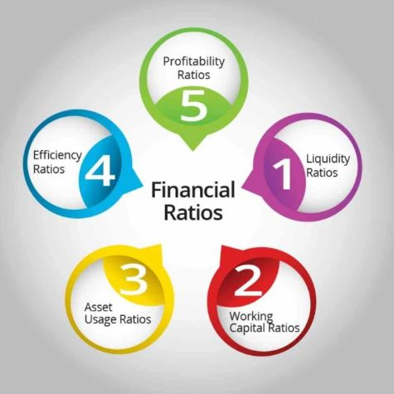
All ratio families are equally important
By evaluating a company's utilize of credit, stock, and resources, efficiency ratios can offer assistance to small firms’ proprietors and directors conduct
business even better. These ratios can illustrate how fast the company is collecting cash for its credit deals or how numerous times stock turns over in a given time period

Slide 6

Why is necessary?
Financial analysis can forecast a company's future performance—for superior or more regrettable. Effective companies usually g0ian a high ratio than not pick up tall proportions in all departments and sectors within the company, but any sudden treats in one zone may bring a critical stock sell-off.

Slide 7

Conclusion
The ratio analysis is very important for a company which would like to prosper. This analyze is in equal importance as a SWOT and PESTLE analysis- all of them point the strength and weaknesses from which strategies and initiatives can be formed

