Slide 1

Celebrating Language & Cultural Belonging to Wales
Urdd Gobaith Cymru
James Williams
(Twinkl, N.D)

Slide 2
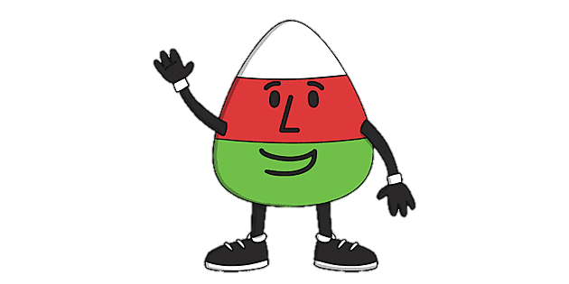
Introduction
History of the Urdd
The aims for the Urdd
Eisteddfod
Residentials
Sports
Conclusion
(Twinkl, N.D)

Slide 3
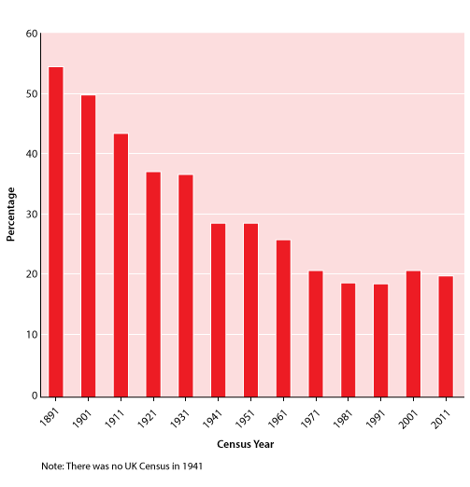
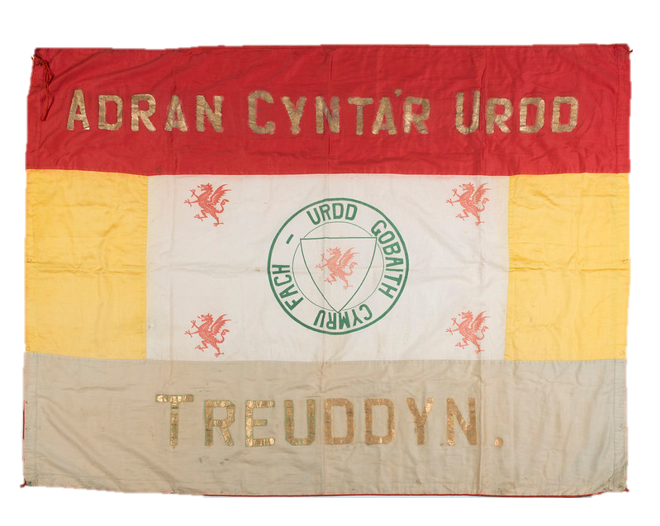
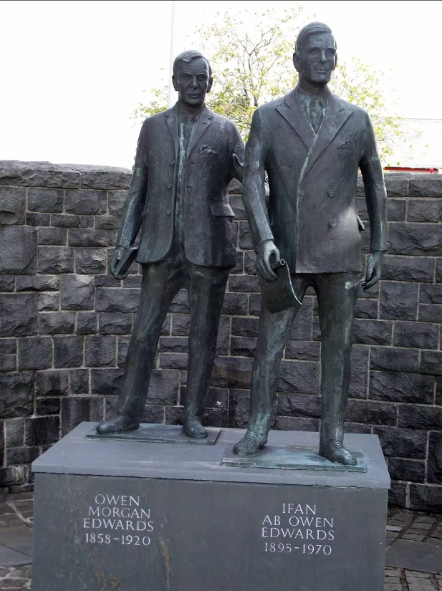
History of the Urdd
(Wrexham Council, 2018)
(Welton, 2014)
(The Open University N.D)
Established in 1922
Decline in Welsh
First Urdd Branch
(Moore, 2022)

Slide 4

The Urdd’s Aims:
Protect the Welsh language
Engagement
Development of young people
Safe place
(Poligrafistka, 2015)
(Welsh Government, 2021)

Slide 5


Eisteddfod
Competitive touring festival
Singing
Dancing
Performing
Local
Regional
National
(Avci. Serkan, 2023)
(Urdd Gobaith Cymru, 2024)

Slide 6

Residentials
Llangrannog, Glan-llyn, Cardiff, Pentre Ifan
Range of activities
Brings different schools together
Allows students to communicate in Welsh and learn about Welsh culture
Sudowoodo, 2018)
(Urdd.Cymru, 2024)

Slide 7

Sport
Increase inclusive opportunities
Clubs through the medium of Welsh
Competitions against other schools
Sports buddies – Trained pupils to play games on the playground
Grebeshkova, 2023)
(Sport Wales, 2024)

Slide 8

Covid
Financial struggles
Residential closures
Multiple Eisteddfod cancelations
Long term affects
(Dimitris66, 2020)
(BBC News, 2022)

Slide 9
To Conclude:
The Urdd has made a huge impact on Welsh learning across Wales
Will the Urdd survive the financial strain since the Covid-19 pandemic?
How is the Urdd going to help the Welsh Government achieve their goal of 1M Welsh speakers by 2050?
(Urdd Gobaith Cymru, 2023)

Slide 10
Reference List
Avci. Serkan, (2023) Children singing and dancing cartoon vector stock illustration, ‘iStock’ [Image] Available at: https://www.istockphoto.com/vector/children-singing-and-dancing-cartoon-vector-gm1479729995-507618132?phrase=singing+dancing+performing+clip+art&searchscope=image%2Cfilm (Date Accessed: 07/01/2024)
BBC News, (2022) National Eisteddfod: Tregaron hosts first festival since Covid, ‘BBC News’ [Website] Available at: https://www.bbc.co.uk/news/uk-wales-62340725 (Date Accessed: 07/01/2024
Dimitris66, (2020) Medical Mask stock illustration, ‘iStock’ [Image] Available at: https://www.istockphoto.com/vector/medical-mask-gm1223005128-359086236?phrase=covid-19+clip+art&searchscope=image%2Cfilm (Date Accessed: 07/01/2024)
Grebeshkova. Ekaterina, (2023) 3d realistic soccer ball iwith flag of Wales on studio background stock illustration, ‘iStock’ [Image] Available at: https://www.istockphoto.com/vector/3d-realistic-soccer-ball-iwith-flag-of-wales-on-studio-background-gm1774133053-546126775?phrase=welsh+sports+clip+art&searchscope=image%2Cfilm (Date Accessed: 07/01/2024)
ITV, (2020) Urdd jobs at risk as organization faces £14m income loss due to coronavirus, ‘ITV NEWS’ [Website] Available at: https://www.itv.com/news/wales/2020-07-15/80-urdd-jobs-at-risk-as-organisation-faces-14million-income-drop-due-to-coronavirus (Date Accessed: 07/01/2024)
Moore. D, (2022) The history of Urdd Gobaith Cymru and how it began, ‘South Wales Argus’ [Website] Available at: https://www.southwalesargus.co.uk/news/19838611.history-urdd-gobaith-cymru-began/ (Date Accessed: 07/01/2024)
Poligrafistka, (2015) Flag of Wales stock illustration, ‘iStock’ [Image] Available at: https://www.istockphoto.com/vector/flag-of-wales-gm537288195-58156500
Sport Wales, (2024) Enabling Sport In Wales to Thrive, ‘Sport Wales’ [Website] Available at: https://www.sport.wales/ (Date Accessed: 07/01/2024)
SportsWales (2024), The Urdd, ‘Sport.Wales’ [Website] Available at: https://www.sport.wales/partners/national-partners/the-urdd/ (Date Accessed: 07/01/2024)
Sudowoodo, (2018) Kids sleeping in bunk bed stock illustration, ‘iStock’ [Image] Available at: https://www.istockphoto.com/vector/kids-sleeping-in-bunk-bed-gm900703406-248499116?phrase=bunk+beds+clip+art&searchscope=image%2Cfilm (Date Accessed: 07/01/2024)
The Open University, (N.D.) Contemporary Wales, ‘Open University’ [Image] Available at: https://www.open.edu/openlearn/society-politics-law/sociology/contemporary-wales/content-section-6.1.2 (Date Accessed: 07/01/2024)
Twinkl, (N.D) What is the Urdd? ‘Twinkl’ [Image] Available:https://www.twinkl.co.uk/blog/what-is-the-urdd (Date Accessed: 07/01/2024)
Urdd Cymru, (2024) Diwrnodau Hwyl! Fun Days!, ‘Urdd.Cymru’ [Website] Available at: https://www.urdd.cymru/en/residential-centres/llangrannog/your-visit/open-public/activity-fun-days/ (Date Accessed: 07/01/2024)
Urdd Gobaith Cymru, (2023) Urdd for All, ‘Urdd Gobaith Cymru’ [Website] Available at: https://www.urdd.cymru/files/7116/8494/1285/Cynllun_Strategol_2023_Saesneg_compressed.pdf (Date Accessed: 07/01/2024)
Welsh Government, (2021) Urdd Gobaith Cymru, ‘Welsh Government’ [Website] Available at: https://www.gov.wales/st-david-awards/urdd-gobaith-cymru#:~:text=The%20Urdd%20is%20Wales'%20largest,its%20100th%20birthday%20this%20year. (Date Accessed: 07/01/2024)
Welton. Blake, (2014) Urdd Eisteddfod 2014: Founder’s son full of praise for modern-day festival, ‘North Wales Live’ [Image] Available at: https://www.dailypost.co.uk/incoming/gallery/7141194 (Date Accessed: 07/01/2024)
Wrexham Council, (2018) Cyngor Wrescam’s Photostream ‘Flickr’ [Image] Available at: https://www.flickr.com/photos/wrexhamcouncil/41514554991 (Date Accessed: 07/01/2024)

