Slide 1
Building your Personal Brand for Sustainable Employment
ADPA5003 Changemakers:

Slide 2




Learning Outcomes
Upon the successful completion of this module, the student should be able to:
Evaluate personal employability skills and their congruence with the skills required for professional practice in a real or simulated environment.
Build a personal brand and promote a professional identity for a specific opportunity.

Slide 3

Tasks
Tuesday 27th February 2024
Component 1: (50%) E:Portfolio
You will create an E-Portfolio (approx. 2000words) that will demonstrate your engagement in industry focused research along with your preparation of professional engagement materials such as CVs, biogs and email responses to castings.
Component 2: (50%) Practical Performance and Audition Technique
The preparation and performance of two contrasting audition speeches that will be delivered under simulated audition conditions.
A ‘sight reading’ audition process, where you will be given a piece of text and a limited time to prepare your response.
A simulated interview with a casting director for an acting role
z

Slide 4
Marking Rubric
Component 1 – all criteria 20%
Your E-Portfolio will be submitted to Turnitin by the agreed deadline - Monday 15th April 2:00pm (after Easter Break)

Slide 5
Marking Rubric
Component 2
Criteria 1 – Engagement with Literature 10%
Criteria 2– Knowledge and Understanding – 10%
Criteria 3 – Cognitive and Intellectual – 20%
Criteria 4 – Practical Skills – 30%
Criteria 4 – Transferrable Skills and Professional Practice – 30%
This Practical Assessment will take place on campus in an appropriate rehearsal room. Wed 20th March

Slide 6

What is a Brand?
z

Slide 7
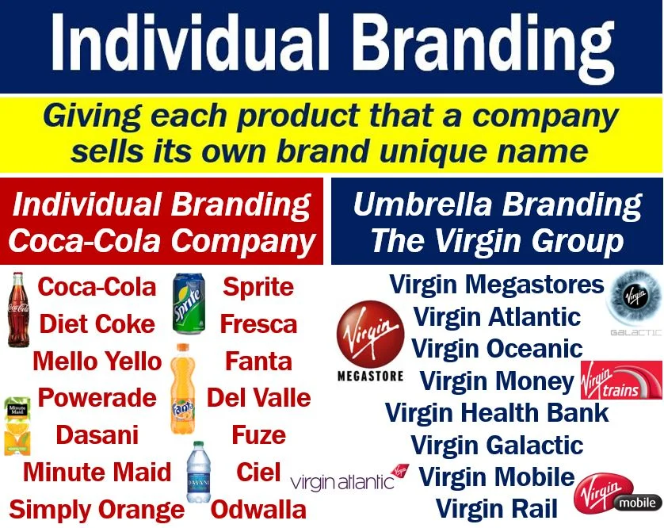

Slide 8
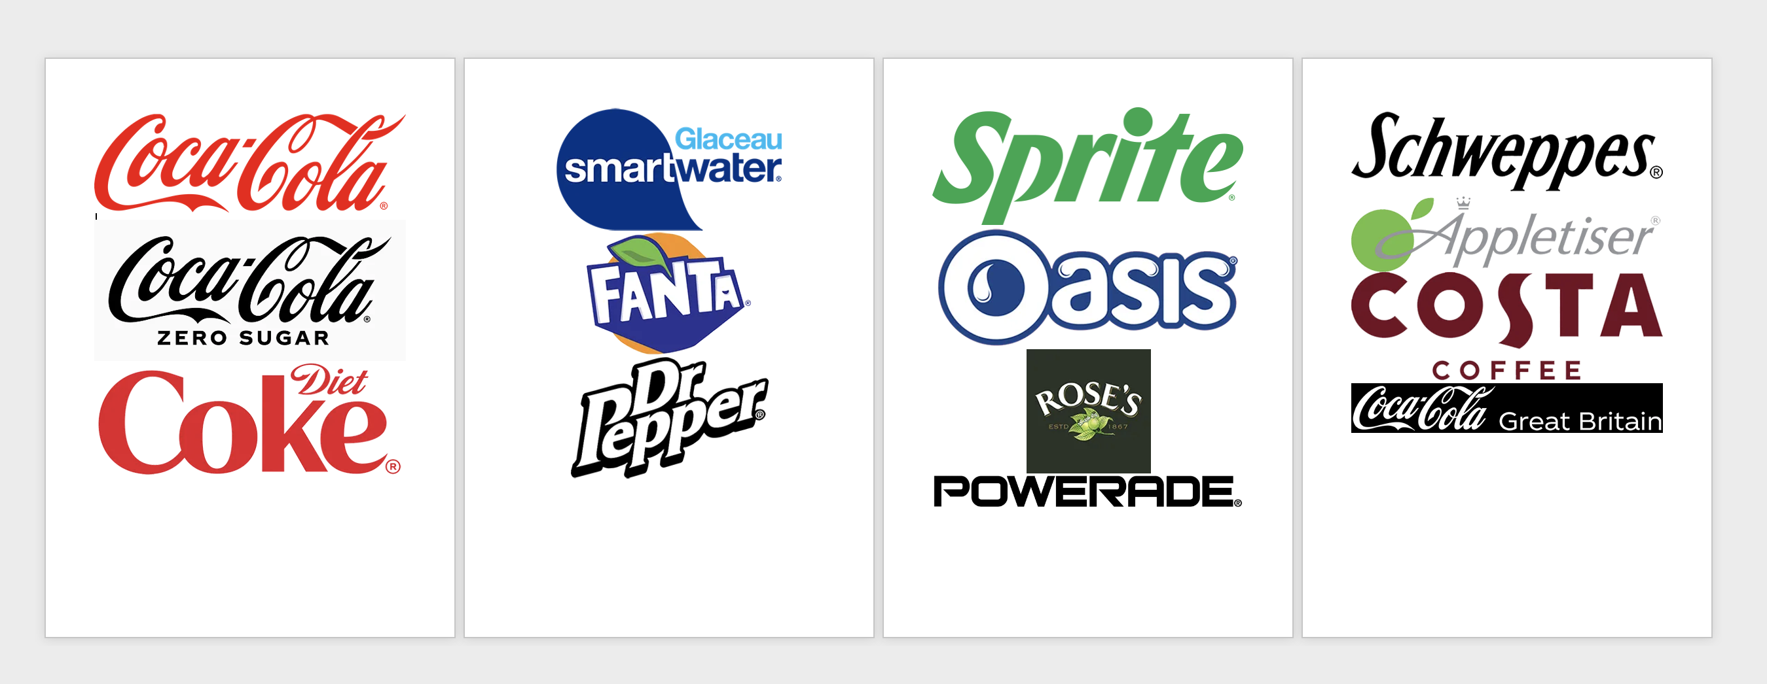
All these brands are owned by Coca-Cola

Slide 9
Partner Task
Take one of the Subsidiaries of Coca-Cola, find out the key facts listed and create a Mood Board
Present back to the group.
Brand/Mission Statement
Advertisement Campaigns / Slogans / Images
Celebrity Endorsements
Invent a ‘Typical Customer’

Slide 10
How we buy / consume
What do our purchases say about us?
Do we judge others but what they buy / how they present themselves?
What are our values?
How do our values influence our choices?

Slide 11

Have you considered what YOUR values are?
z

Slide 12
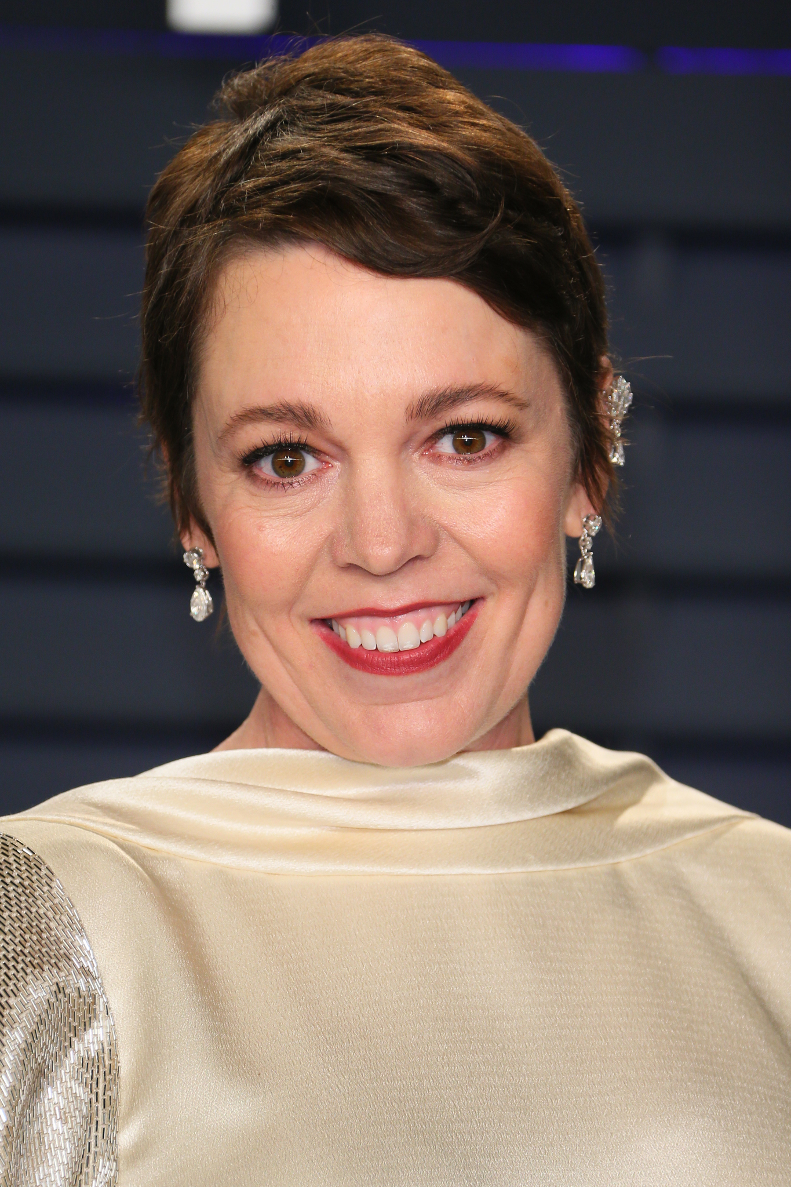
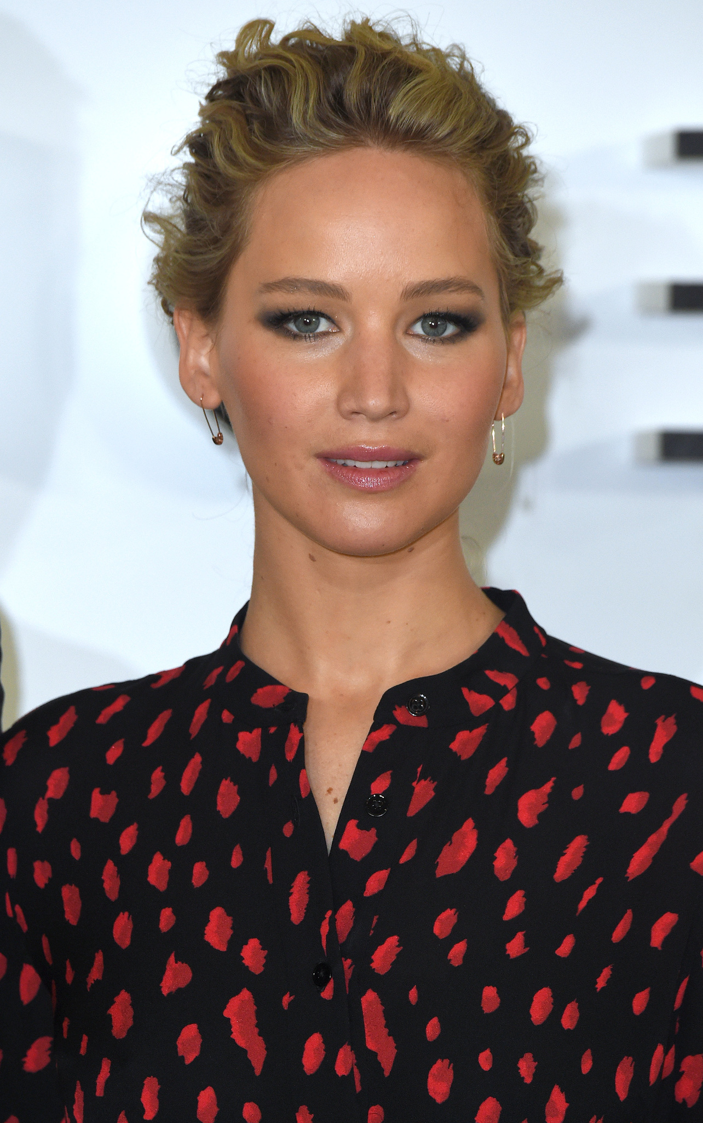
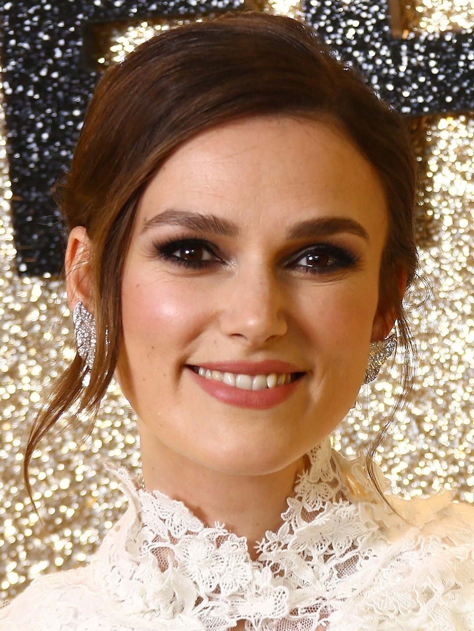
What do we know about these brands?
Olivia Coleman
Jennifer Lawrence
Keira Knightly

Slide 13

Why is creating a personal brand so hard?
Humans have a blind spot.
We are unable to ever truly understand how others see us. That is what makes personal branding, designing your own website, or writing your bio so difficult.

Slide 14

Is it different for actors?
Being realistic about your castability is key.
Know your personal brand. Know who and what you are selling. Don't provide too many options, keep it simple and play to your strengths. Make sure your brand is clear across all channels: social, casting profiles, headshots and showreels so people choosing you will feel secure in their choice. Trust is the key.
(Charlotte Thornton, Spotlight 2024)

Slide 15
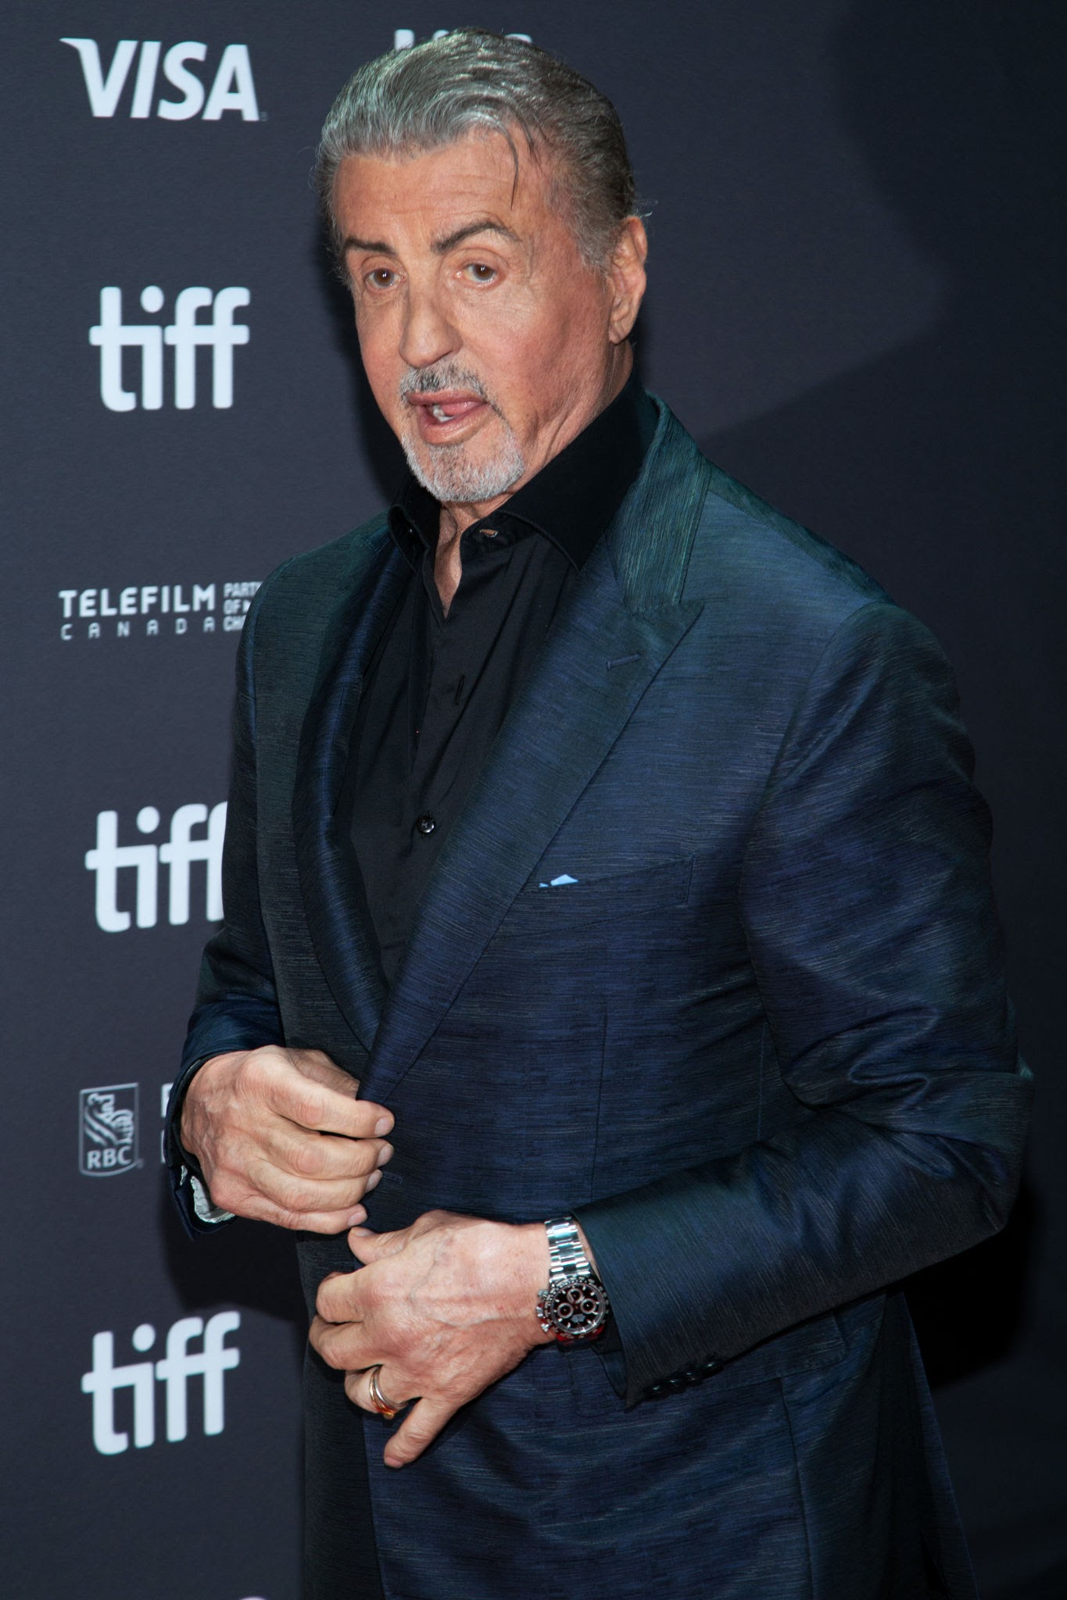
What is a brand actor?
The word brand is used similarly to “typecast.”
For an actor to brand themselves, they are marketing themselves according to their physical appearance and personality, both of which dictate what types of characters they are likely to be offered to play.
(Backstage 2024)

Slide 16
Individual Task
Find your values – Complete the worksheet
Add your values to your E:Portfolio
Do they influence your choices for CV / Website etc

