Slide 1

CHAPTER 4
Distribution and
Omni-Channel Network Design
Supply Chain Management: A Logistics Perspective (10e)
Coyle, Langley, Novack, and Gibson
© 2016 Cengage Learning. All Rights Reserved.
May not be scanned, copied or duplicated, or posted to a publicly accessible website, in whole or in part.

Slide 2
Discussion Outline
Drivers of supply chain network redesign
Process of comprehensive supply chain network design
Major locational determinants
Modeling approaches for supply chain network design
Omni-channel network design

Slide 3
Drivers of Supply Chain Network Redesign
Competitive capabilities
7
Changes in global trade patterns
1
Cost pressures
6
Supply Chain Network Redesign
Changes in customer service requirements – The emergence of omni-channel supply chains
2
Corporate organizational change
5
3
4
Shifts in customer and/or supply market locations
Changes in corporate ownership/merger and acquisition activity

Slide 4
Supply Chain Network Design Process
1. Define Process Steps
2. Perform Supply Chain Audit
Continuous Improvement
3. Examine Network Alternatives
Network Transformation Team Involved in All Steps
4. Facility Location Analysis
5. Network Decision-Making
Location Selection Team
6. Develop Implementation Plan
Source: Figure 4-1

Slide 5

Supply Chain Network Design Process
Step 1: Define the Supply Chain Network Design Process
Form a supply chain network transformation team.
Establish the parameters and objectives of the network design or redesign process.
Evaluate the potential involvement of third-party suppliers of logistics services.
Image courtesy of DynamicCIO

Slide 6
Supply Chain Network Design Process
Step 2: Perform a Supply Chain Audit
1. Fundamental Business Information
2. Logistics/Supply Chain System
3. Key Logistics/Supply Chain Activities
4. Measurement and Evaluation
5. Strategic Logistics/Supply Chain Issues
6. Logistics/Supply Chain Strategic Plan
Source: Figure 4-2

Slide 7

Supply Chain Network Design Process
Step 3: Examine the Supply Chain Network Alternatives
Apply suitable quantitative models to the current logistics system and to the alternatives under consideration.
Identify preliminary supply chain network design solutions consistent with the key objectives identified during the audit phase.
Conduct “what-if” analysis to test the sensitivity of recommended network designs to changes in key variables.
Image courtesy of line-of-sight

Slide 8

Supply Chain Network Design Process
Step 4: Conduct a Facility Location Analysis
Form a location selection team.
Qualitatively and quantitatively analyze the attributes of specific regions and locales.
Identify recommended specific sites for logistics facilities.

Slide 9
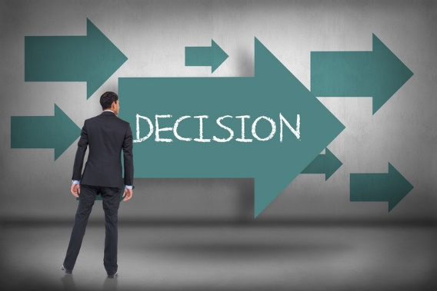
Supply Chain Network Design Process
Step 5: Make Decisions Regarding Network and Facility Location
Evaluate the recommended network and specific sites for logistics facilities (Steps 3 and 4) for consistency with the design criteria identified in Step 1.
Image courtesy of decisionnel.info

Slide 10

Supply Chain Network Design Process
Step 6: Develop an Implementation Plan
Develop a “blueprint for change” as a road map for moving from the current supply chain network to the desired new one.
Commit the resources necessary to assure a smooth, timely implementation, and the continuous improvement of the network decisions.

Slide 11
Major Locational Determinants

Slide 12


Broad Geographic and Site-Specific Locational Determinants
Global/National/ Regional Determinants
Site-Specific
Determinants
Labor climate
Transportation services and infrastructure
Proximity to markets and customers
Quality of life
Taxes and industrial development incentives
Supplier networks
Land costs and utilities
IT infrastructure
Company preference
Transportation access
Truck
Air
Rail
Water
Inside/outside metropolitan area
Availability of workforce and needed skill sets
Land costs and taxes
Utilities

Slide 13
Current Trends Governing Site Selection
Site Selection
Strategic positioning of inventories
(fast-moving, profitable items vs. slower-moving, less-profitable items)
Greater use of “Customer-direct” delivery from manufacturing
Growing use of and need for strategically located cross-docking facilities
Greater emphasis on access to major airports and/or ocean ports for import and export shipments
Greater use of providers of third-party-logistics services

Slide 14
Modeling Approaches for Supply Chain Network Design

Slide 15
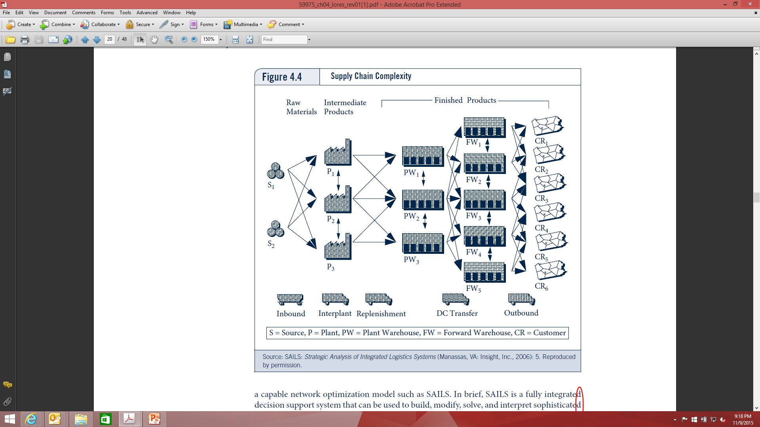
A Network Design Model
The Challenge of Supply Chain Complexity

Slide 16
A Network Design Model
Objective and Need for Decision Support Tools
Today’s Objective
Classic Objective
Procurement
Expanded Scope & Complexity of Network Design Model
Various Stages of Manufacturing
Finished Goods DCs
DCs
Transport Flows
Answering network design questions today is virtually impossible without the help of very powerful decision support tools.

Slide 17
Types of Modeling Approaches
Designed to find the “best,” or optimum solution, while recognizing relevant constraints.
Optimization Models
Designed to develop a computer representation of supply chain network & observe changes as cost structures, constraints, and other factors are varied.
Modeling Approaches
Simulation Models
Designed to reduce a problem to a manageable size and search automatically through various alternatives in an attempt to find a better solution.
Heuristic Models
(e.g. grid technique)

Slide 18
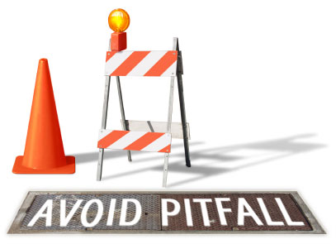
Potential Supply Chain Modeling Pitfalls to Avoid
Short-term horizon
Too little or too much detail
Thinking in two dimensions
Using published costs
Inaccurate or incomplete costs
Fluctuating model inputs
Use of erroneous analytical techniques
Lack of appropriate robustness analysis

Slide 19
Omni-Channel Network Design

Slide 20
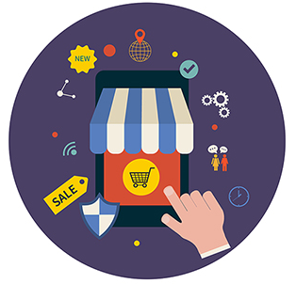
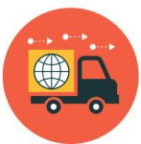
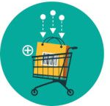
Omni-Channel Retailing Defined
“A direct to consumer (D2C) business model where all sales channels ranging from online, mobile, telephonic, mail order, self-service, and physical retail establishments are aligned and fulfillment processes integrated to provide consumers with a seamless shopping experience in alignment with the company’s brand proposition.”
Three Important Elements
Omni-channel strategy must align with the firm’s “go to market” strategy.
The fulfillment processes must be integrated regardless of order entry point.
“Ease of shopping” for the consumer is a priority regardless of where or how the order is placed.

Slide 21
Omni-Channel Network Design
Marketing Channel vs. Logistics Channel
Typical Retail Logistics and Marketing Channels
Logistics Channel
Marketing Channel
Supplier
E-Procurement
Transport
National account sales
Manufacturer
Transport
Wholesale/Distributor
DCs/Fulfillment center
Internet site
Transport
Retail store
Retail customer
Consumer
Source: Figure 4.7

Slide 22

Omni-Channel Network Design
Cost Consideration
Fixed Cost and Variable Cost Consideration:
A Rule of Thumb in Channel Design
  “Assuming that the origin and destination remain the same, the more intermediaries used to deliver the product the higher the fixed cost and the lower the variable cost, and vice versa.”

Slide 23
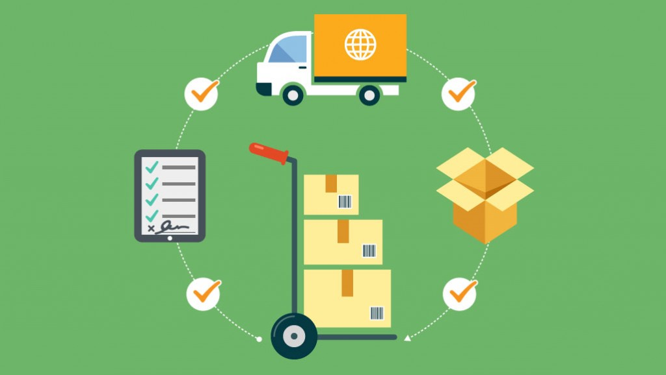
Omni-Channel Network Design
Customer Order Fulfillment Models
Integrated Fulfillment
Dedicated Fulfillment
Store Fulfillment
Pool Distribution
Flow-Through Fulfillment
Direct Store Delivery (DSD)

Slide 24
Omni-Channel Network Design
Customer Fulfillment Models (continued)
1
2
3
4
5
6
Integrated Fulfillment
Dedicated Fulfillment
Pool Distribution
Direct Store Delivery (DSD)
Store Fulfillment
Flow-Through Fulfillment
Retail DC
Fulfill-ment Center
DC
DC
Supplier DC
Retail Store
Retail DC
TL, LTL, Parcel
TL, LTL
Store
TL, LTL
Parcel
Parcel
TL, LTL
Third Party
LTL
Delivery or Pick up
Delivery or Pick up
Store
Con-sumer
Con-sumer
Store
Store
Store
Consumer
Consumer
Source: Figure 4-9

Slide 25

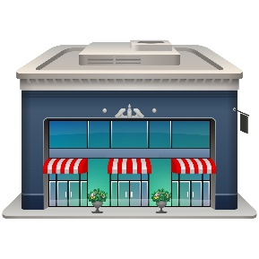
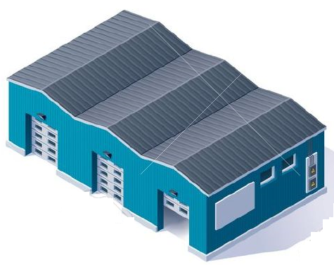
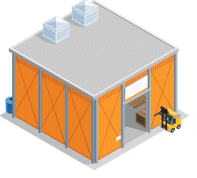
Omni-Channel Customer Fulfillment Models
Integrated Fulfillment
Supplier Distribution Center
Retailer Distribution Center
Retail Store
Delivery
Consumer
Ship truckload, LTL
Pick-up
Ship truckload, LTL
Ship Case
Picking
Picking
Pallet, Case, Each
Consumer
Integrated fulfillment means the retailer operates one distribution network to service both “bricks-and-mortar” (retail stores) and “clicks-and-mortar” (Internet sites) channels.
Advantages: Low start-up costs for retailers, Workforce efficiency
Disadvantages: Order profile changes, Unavailability of products in eaches, “Fast pick” or broken case operation requirements for unit pick (each pick)
Source: Figure 4-10

Slide 26


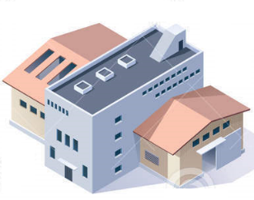
Omni-Channel Customer Fulfillment Models
Dedicated Fulfillment
Supplier Distribution Center
Retail Store DC
Retail Store
Ship truckload, LTL
Delivery
Ship truckload, LTL
Pick-up
Consumer
Picking
Pallet, Case, Each
Picking
Retail Internet DC
Ship truckload, LTL
Ship case
Consumer
Picking
Each
Dedicated fulfillment means the retailer operates two separate distribution networks to service “bricks-and-mortar” (retail stores) and “clicks-and-mortar” (Internet sites).
Advantages: Elimination of most of the disadvantages of integrated fulfillment
Disadvantages: Duplicate facilities and duplicate inventories
Source: Figure 4-11

Slide 27
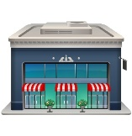


Omni-Channel Customer Fulfillment Models
Pool Distribution
Stores
Supplier Distribution Center
Retail Distribution Center
Third Party DC
Delivery
Ship LTL
Pick-up
Ship TL, LTL
Ship TL
Ship LTL
Delivery
Multiple LTL
Pick-up
Ship LTL
Consumer
Delivery
Ship LTL
Pick-up
Picking
Picking
Pallet, Case, Each
Mixing
Delivery
Pick-up
In pool distribution, small retailers use third party logistics companies, or pool distributors, for store delivery, allowing them to achieve efficiency of a truckload shipment for the line haul and the effectiveness of allowing stores to receive LTL orders on a regular schedule
Source: Figure 4-12

Slide 28
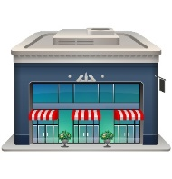
Omni-Channel Customer Fulfillment Models
Direct Store Delivery
Supplier Distribution Center
Supplier Required DC
Stores
Delivery
LTL
Pick-up
Ship TL
Delivery
LTL
Multiple LTL
Pick-up
Consumer
LTL
Delivery
Picking
Mixing
Pick-up
Direct store delivery involves a manufacturer delivering its product directly to a retailer’s stores, bypassing the retailer’s distribution network.
Advantages: Reduction of inventory in the distribution network
Disadvantages: Possible reduction of inventory visibility of the products to the retailers, Requirements of close collaboration and agreement between the manufacturer and retailer
Source: Figure 4-13

Slide 29
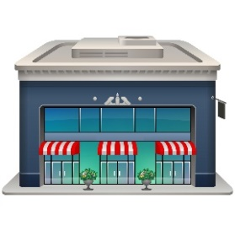
Omni-Channel Customer Fulfillment Models
Store Fulfillment
Supplier Distribution Center
Retail DC
Retail Store
Delivery
Ship TL
Ship TL, LTL
Pick-up
Consumer
Picking
Picking
Pallet, Case, Each
Picking
Each
In store fulfillment model, the order is placed through the Internet site. The order is sent to the nearest retail store where it is picked and put aside for the customer to pick up or the store can arrange for delivery.
Advantages: Short lead time to the customer, Low start-up costs for the retailer, Returns handled through the retail store, Product available in consumer units
Disadvantages: Reduced control and consistency over order fill, Conflicts between store and Internet order inventories, Requirements of real-time visibility to in-store inventories, Requirements of stores’ space to store and stage products for pickups
Source: Figure 4-14

Slide 30
Omni-Channel Customer Fulfillment Models
Flow-through Fulfillment
Supplier Distribution Center
Retail DC
Retail Store
Delivery
Ship TL, LTL
Ship TL, LTL
Pick-up
Consumer
Picking
Picking
Pallet, Case, Each
Picking
Each
In flow-through fulfillment, the product is picked and packed at the retailer’s distribution center and then sent to the store for customer pickup or delivery.
Advantages: Eliminates the inventory conflicts between store sales and Internet sales, No cost of the “last mile” transportation, Store-level inventory status not required, Returns handled through the retail store,
Disadvantages: Storage space at the store for pickup items, Longer fulfillment lead time
Source: Figure 4-15

Slide 31
Summary
The strategic importance of supply chain network design decision is growing with the increasing globalization of manufacturing, marketing, sourcing, and procurement.
A formal, structured process for network design or redesign is preferable to an informal, unstructured one.
Numerous factors may affect the design of a logistics network and the location of specific facilities within the context of the network.
Principal modeling approaches to gain insight into the topic of supply chain network design include optimization, simulation, and heuristic models.
In an omni-channel environment, many network models exist that can be used to service retail stores and Internet consumers, each of which has its advantages and disadvantages. Trade-offs must be taken into consideration when deciding which network model to use.

