Slide 1

Handlebars.js
By Josh D, Keiran H, Adam B
Notes:
Referances:
. Handlebars. https://www.npmjs.com/package/handlebars

Slide 2
Welcome to our Seminar
Welcome to Handlebars.js by Adam B, Josh D, Keiran H
Here we will be discussing:
  About Handlebars.js
  Purpose of Handlebars.js
  Limitations of Handlebars.js
  Other technologies similar to Handlebars.js
  Suitability of Handlebars.js
We will be concluding with a demonstration of Handlebars.js which was designed and developed by Adam Borstal
Notes:
BP1) “Welcome to Handlebars.js by Adam, Josh” and Myself.
BP2) For this seminar “we will be discussing” these five factors in relation to handlebars.js
BP2.1) “About”
BP2.2) “Purpose”
BP2.3) “Limitations”
BP2.4) “Other technologies”
BP2.5) and “suitability of handlebars.js” for projects
BP3) “We will be concluding with a demonstration of Handlebars.js which was designed and developed by Adam Borstal“

Slide 3
About
Handlebars.js; a templating engine
  Adds to JavaScript to reduce the workload and time required on the developer.
  Referred to as a logic less language
  Can be classed as a compiler
Developed by Chris Wanstrath
  An extension to Mustache
  Written in JavaScript
  Named due to the high use of { } brackets
  Released in Feb 14 2013
At the time of writing Handlebars.js was on v4.0.12 which was released September 4th, 2018
Notes:
Start) What is Handlebars.js?
BP1) “Handlebars.js; a templating engine”; a templating engine is used to describe methods or frameworks that provide a way for developers to interpole strings effectively to increase the efficiency.
BP1.1) Handlebars “Adds to JavaScript to reduce the workload and time required on the developer.“ it saves them countless hours of unnecessary work by reducing complexity and instead providing semantic templates.
BP1.2) This reference to being “logic-less” is due to Handlebars.js providing a template without logic their is not scatter of logic; you become obliged to put the logic elsewhere leaving the template less likely to be cluttered; it separates the controllers and logic in the code to improve formatting and blind eye observation of the code.
BP1.3) Handlebars.js takes HTML and handlebars expression and compiles them to a JavaScript function; it compiled into a variable first before it renders data onto the page.
BP2) Handlerbars.js was “developed by Chris Wanstrath”.
BP2.1) He created it as “an extension to Mustache”.
BP2.2) Was “written in JavaScript”
BP2.3) Is named handlebars due to the “high use of curly brackets”.
BP2.4) The first proper version, version 1 was “released on February the 14th in 20,13”.
BP3) “At the time of writing Handlebars.js was on v4.0.12 which was released September 4th, 2018”.

Slide 4
Purpose
Handlebars is a template system that can be used with:
  ActionScript, C++, Clojure, Common Lisp, Dart, Erlang, Fantom, Haskell, Java, JavaScript, Lua, .NET, Objective-C, OCaml, Perl, PHP, Pharo, Python, Racket, Ruby, Rust, Scala, Xquery ETC.
The most common use of handlebars.js are:
  Web applications
  Mobile applications.
Handlebars.js can be used to display data on a web page.
  E.G. if you wanted to query a database and display the extracted data on a web page, you could pass it through with a handlebars page using curly brackets to format and display the data.
Handlebars makes longer code easier to read by splitting it up from other code.
Notes:
Start) What can Handlebars.js do?
BP1) “Handlebars is a template system that can be used with” many different languages with some of them listed here.
BP2) Although there is a great deal that Handlebars can be used with here are the two “most common” uses.
BP2.1) “Web” apps
BP2.2) And “mobile” apps.
BP3) The reason for it being commonly used for apps is due to its ability to display data on a page.
BP3.1) An example would be that you'd want to query a database and display extracted data; by passing the data though handlebars.js through the curly brackets you will be provided said data, formatted.
BP4) As projects grow and develop they normally become cluttered and difficult and manage. However if you’d use Handlebars.js at the start you could have the code split and formatted more effective and make the code simpler to understand visually as long as you understand Handlebars. You can introduce Handlebars latter on in development but this could create more work then it will increase the effeiciency.

Slide 5
Limitations
Not much editor support
  Handlebars. doesn't seem to have many text editors that support things like auto-complete, syntax highlighting or error checking.
Handlebars are still an HTML code
  Handlebars use the standard HTML syntax with its own {{tags}} for templating. This doesn't add much to readability or design speed.
Notes:
Start) What limits the use of handlebars.js?
BP1) Handlebars.js requires learning; understanding it is not overly complicated but there is “not much editor support”.
BP1.1) Where a lot of languages will have auto-completes, syntax highlighting or error checkers within to support the developer these features where not present during examination. This limitation can be overcome through learning but is still a large limitation to new developers.
BP2) Handlebars.js is in fact HTML code.
BP2.1) It limited by standard HTML syntax with the addition of curly brackets for templating.

Slide 6
Suitability
Client-side templating engine
Used to develop JavaScript applications
Used for semantic templates
Specialized in client-side templating
Compatible with Mustache templates
Logic-free templates – No logic in templates on HTML page
Good for users who do not want to learn a new syntax
Decouples logic-based JavaScript files from HTML pages

Slide 7
Other technologies (Templating engines)
Here are some other popular templating engines and JavaScript libraries
Underscore.js
Mustache.js
EJS
Dust.js

Slide 8

Underscore.js
Basic JavaScript library
Many functions for manipulating data such as
  Map
  Filter
  Invoke

Slide 9

Mustache.js
Handlebars.js was based on the Mustache template language and improved on
Fully logic-less which results in less cluttered templates
It is used for both web applications and mobile applications
Does not contain helpers unlike handlebars
Slower than handlebars.js
Does provide Server-side support
Notes:
9) Slant. Handlebars vs Mustache. https://www.slant.co/versus/181/183/~handlebars-js_vs_mustache-js

Slide 10
EJS
Stands for Embedded JavaScript Templates
Simple templating language
Generates HTML markup
Use's plain JavaScript

Slide 11
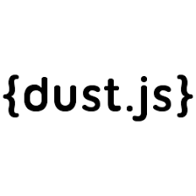
Dust.js
Not completely logic-less like mustache which results in slower performance although it uses asynchronous rendering if templates are taking time to load
Can output as other formats and isn't limited to HTML
Doesn't need to preload templates and can render templates on the fly

Slide 12
Other technologies JavaScript Frameworks
Meteor.js – Uses Handlebars.js
Derby.js – template syntax is based on Handlebars
Ember.js

Slide 13
How well does it mesh with other technologies?
Contains HTML and text
Contains handlebar expressions
Compatible with Mustache

Slide 14
Suitability framework
Handlebars.js is suitable for JavaScript front end frameworks such as
  Ember.js
  Backbone.js
Handlebars.js is suitable for single-page web applications with multiple views
Handlebars.js is suitable if you want to manage your HTML content and don’t want your JavaScript code to contain HTML mark-up
Notes:
14)Danny Markov. Learn Handlebars in 10 Minutes or Less . https://l.messenger.com/l.php?u=https%3A%2F%2Ftutorialzine.com%2F2015%2F01%2Flearn-handlebars-in-10-minutes&h=AT2xvlSvmyH8wPmvoKOWCg-Qa1w6lZqfLWMzX8-wQ2-nxMAQ1RhxkYLIwZF97D1rbNA1Uue5NZTTerfazUbW0oKCNTX69ANmywL-sY2M7IULpTohlbZcngIppEdgtUqKCWtwNQ

Slide 15
Examples of Handlebars.js
The next few slides will show you examples of the handlebars.js; these examples are as followed:
  Compiled Template
  Expressions
  Script Tags
  Data
  Compile function
Notes:
Start) “Examples of Handlebars.js”
BP1) As stated for “The next few slides will show you examples of the handlebars.js; these examples are as followed:”
BP1.1) “Compiled Template”
BP1.2) “Expressions”
BP1.3) “Script tags”
BP1.4) “Data”
BP1.5) “Array”
BP1.6) and “compile functions”.

Slide 16
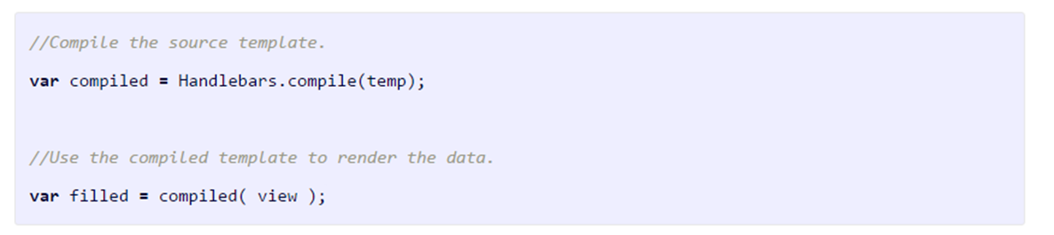
Example of compiled template

Slide 17
Handlebars.js Expressions
The variables used inside the templates are surrounded by double curly braces {{}} and are known as expressions
This expression means "look up the {{name}} property in the current context"
My name is {{name}}
Expressions can also have dot seperated paths:
{{name.First}}

Slide 18


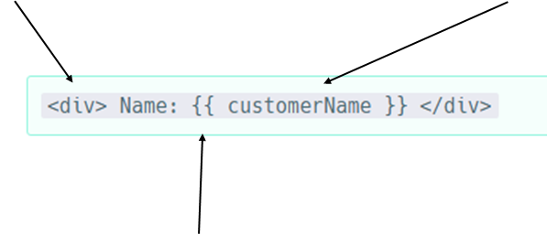

Example

Slide 19
Handlebars.js Block expressions
In Handlebars blocks are expressions that have a block opening ({{# }}) and closing ({{/}}).
{{#if published}}
{{content}}
{{/if}}

Slide 20
Script tags
•Templates are embedded in script tags
•HTML content in the script tag is then passed to the Handlebars compiler
•Each template needs to be enclosed in a script tag

Slide 21

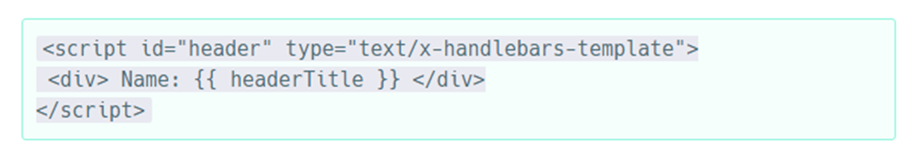
Example

Slide 22
Handlebars.js Data
•Data is passed as an object just like an ordinary JavaScript object
•Objects can consist of strings, numbers, arrays and others

Slide 23
Example (array)

Slide 24
Handlebars.js Compile function
Handlebars compiles a template so it can be executed immediately.
When handlebars is installed globally, you need to create templates in different flies using file names with .handlebars. For example home.handlebars and main.handlebars.
These are then stored in a new folder called templates.
This method increases the performance of the application and the page loading time also decreases as we are using the runtime build of Handlebars that is lighter than the whole library.

Slide 25
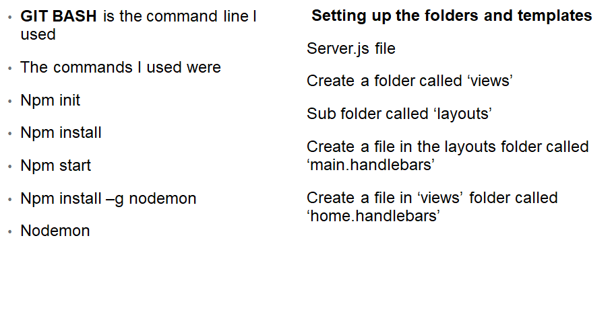
Demonstration

