Slide 1
DSAW 4068 DSAW7068
Leadership and Change

Slide 2

Welcome/Croeso
Evaluate the influence of organisational culture in the context of change initiatives

Slide 3
Topics
Organisational Culture:
Evaluate the influence of organisational culture in the context of change initiatives
Theoretical approaches to organisational and national culture
Analysis of organisational values and culture
Evaluation of personal leadership behaviours that reinforce organisational values and cultures
Evaluation of culture in relation to change initiatives

Slide 4
Organisational Culture

Slide 5
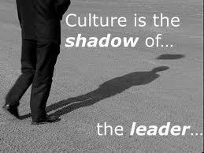

What is organisational culture?

Slide 6
Organisational culture
“Values, beliefs, behaviours, customs, and
attitudes that help the members of the
organisation understand what it stands for, how
it does things, and what it considers important.
Source: CMI 2010

Slide 7
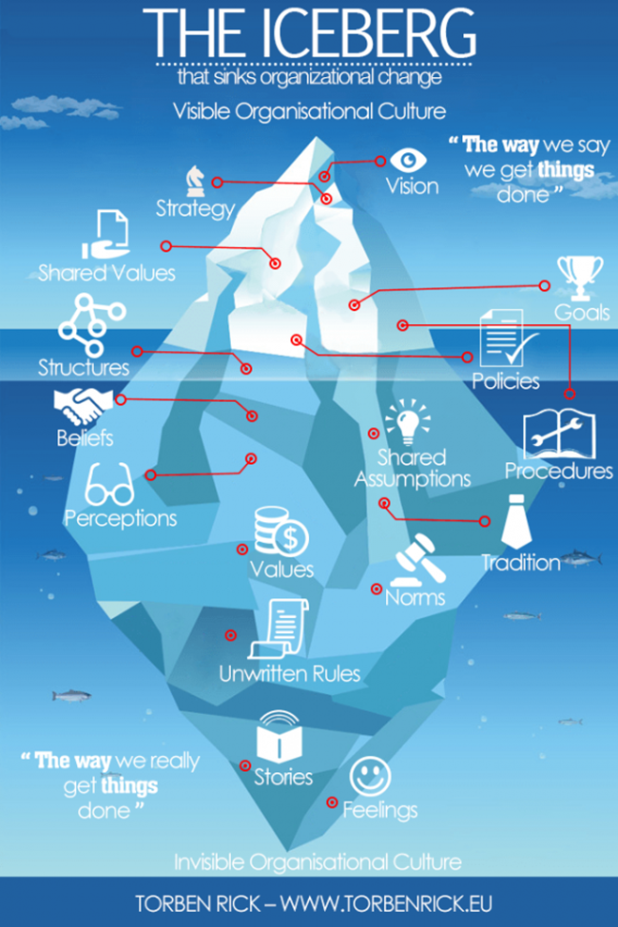
Organisational
culture
  “A pattern of basic assumptions that are
  considered valid and that are taught to new
  members as the way to perceive, think and feel in the organisation.”
  Source: Nelson and Quick; Organisational Behaviour (2007)

Slide 8
Organisational culture
“Culture is the commonly held and
relatively stable beliefs, attitudes
and values that exist within an
organisation”.
“….the way things are done around here”.
(Deal and Kennedy, 1992)

Slide 9
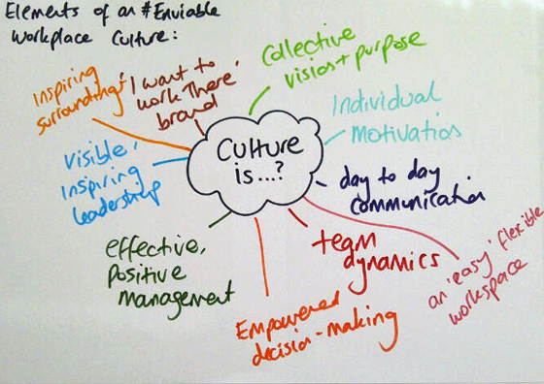
Organisational culture
Culture determines what is:
acceptable or unacceptable
important or unimportant
right or wrong
workable or unworkable
It encompasses...
values attitudes behaviour language

Slide 10
Do leaders affect culture?
Douglas McGregor’s Theory X and Theory Y stated that the beliefs held by managers have a strong influence on the people working in an organisation.
As a result, McGregor stated that employees can only respond as their manager’s “style” allows – this can have a major influence on attitudes to work (positive and negative)

Slide 11
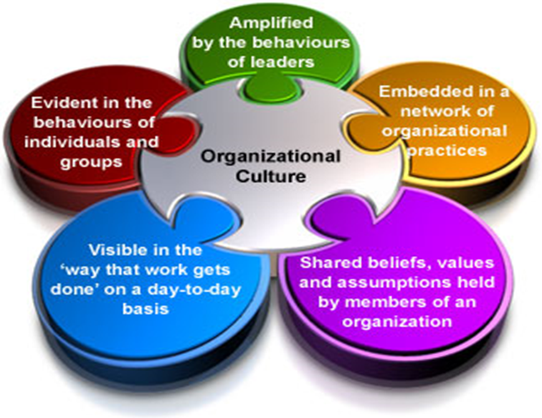
Leadership and organisational culture

Slide 12
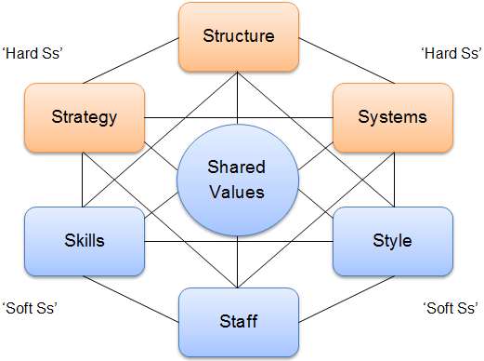
McKinsey 7 S Model

Slide 13
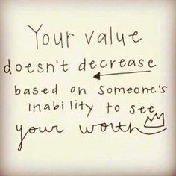
Do leaders affect culture?
Culture at Apple
Culture at Google
Culture at Facebook
Culture at Coastal Housing

Slide 14
Managing organisational culture
  Understand the current culture to decide whether to maintain or change it
  Articulate the culture through slogans, ceremonies, and shared experiences
  Reward and promote people whose behaviours are consistent with desired cultural values

Slide 15


Slide 16
Mission Statement: Why?
Defines the fundamental purpose of the organisation and why it exists
It should be concise, to the point, realistic and clear

Slide 17
Vision Statement: Why?
Answers the questions:
What do we aspire to be?
How do we want others to see us?

Slide 18
Value Statement: Why?
Reflect the core ideals or principles by which an organisation functions or conducts business
Tells the wider community what is truly important to the organisation

Slide 19



Activity
Match the organisation’s logo to the mission, vision or values statements issued.

Slide 20

Fieldbay values
What are Fieldbay’s core values of care?
Privacy | Dignity | Rights
Independence | Choice | Fulfilment
Security | Respect | Equality

Slide 21

Activity
Complete
the questionnaire issued

Slide 22

Influences on the development of culture
Primary function of the organisation
Management and staffing
Goals and objectives
The environment
History
Size
Location

Slide 23
CIPD Research (May 2014)
“The overall message from our research is that culture is not static; it can be affected by internal and external events, small and large. And, if not attended to and reinforced, it can take on a life of its own and your values and purpose can become diluted and even lost over time.”

Slide 24
Determinants of Organisational Culture
  Organisation’s founder (personal values and beliefs)
  Symbols, stories, heroes, slogans, and ceremonies that embody and personify the spirit of the organisation
  Corporate success that strengthens the culture.
  Shared experiences that bond organisational members together

Slide 25
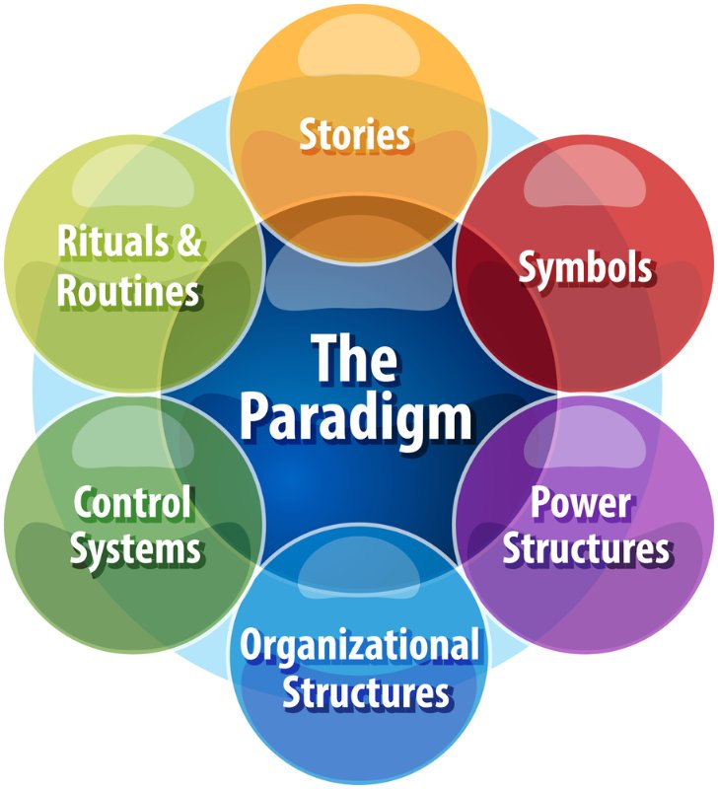
Activity
Notes:
Elements of the Cultural Web
The Cultural Web identifies six interrelated elements that help to make up what Johnson and Scholes call the "paradigm" – the pattern or model – of the work environment. By analyzing the factors in each, you can begin to see the bigger picture of your culture: what is working, what isn't working, and what needs to be changed. The six elements are:
Stories – The past events and people talked about inside and outside the company. Who and what the company chooses to immortalize says a great deal about what it values, and perceives as great behavior.
Rituals and Routines – The daily behavior and actions of people that signal acceptable behavior. This determines what is expected to happen in given situations, and what is valued by management.
Symbols – The visual representations of the company including logos, how plush the offices are, and the formal or informal dress codes.
Organizational Structure – This includes both the structure defined by the organization chart, and the unwritten lines of power and influence that indicate whose contributions are most valued.
Control Systems – The ways that the organization is controlled. These include financial systems, quality systems, and rewards (including the way they are measured and distributed within the organization.)
Power Structures – The pockets of real power in the company. This may involve one or two key senior executives, a whole group of executives, or even a department. The key is that these people have the greatest amount of influence on decisions, operations, and strategic direction.

Slide 26




Research activity

Slide 27
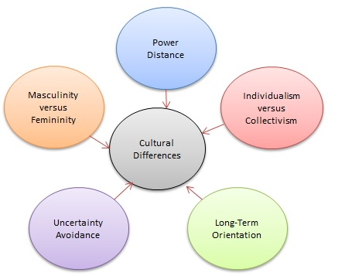
Geert Hofstede and national culture
Geert Hofstede Cultural Dimensions

Slide 28
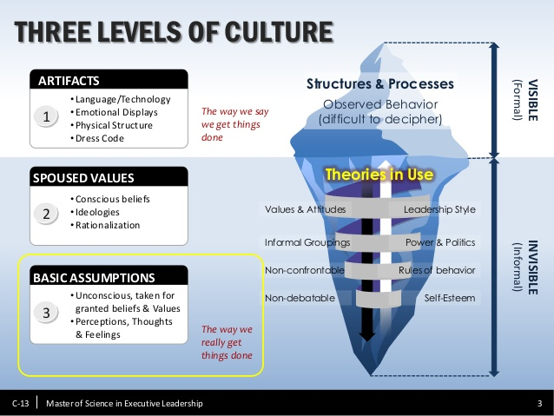
Schein’s Three Levels of Culture

Slide 29
Schein’s Three Levels of Culture
Basic assumptions
Values and beliefs
Artefacts and behaviours

Slide 30
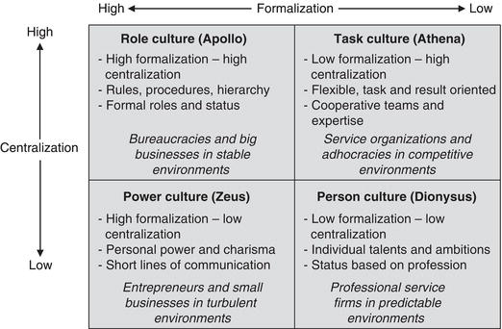
Handy’s model of organisational culture

Slide 31
Harrison’s types of culture
Roger Harrison identified four types of culture:
1. Power Culture
2. Role Culture
3. Achievement Culture
4. Support Culture

Slide 32
Harrison: Power culture
Power and authority centred with an individual at the heart of the organisation who is often a charismatic or autocratic chief executive or owner.
Decision making is seen as part of the leaders role – contributions not encouraged from staff.

Slide 33
Harrison: Role culture
Organisations with a dominant role culture can be bureaucratic and hierarchical in nature.
Often quite rigid role boundaries.
Staff often unprepared to step out of their job role.
Where there is a reluctance to upset the status quo.

Slide 34
Harrison: Achievement culture
Focuses on performance, tasks and success.
Little focus on hierarchy and status.
Contributions welcomed from staff in relation to projects, problems or goals.
Some failure is tolerated –
“you can’t win them all” mentality.

Slide 35
Harrison: Support culture
Nurturing of personal relationships, mutual trust and support.
Often typical of organisations formed by professionals such as doctors, barristers, charity groups and architects.
Can lack competitiveness and awareness of what is going on outside of own organisation.

Slide 36
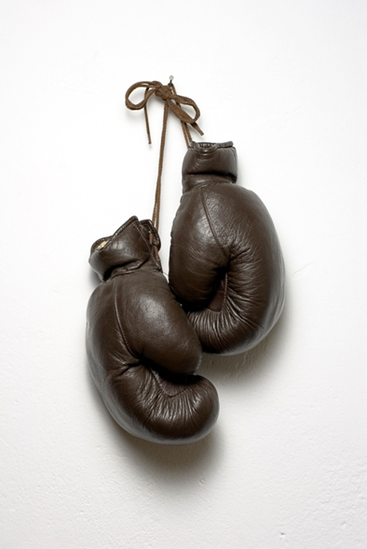
Problems arise when....
The organisation’s culture clashes with the beliefs and values systems of its managers and employees

Slide 37
Developing organisational culture
Activity: In small teams read through the case studies and feed back your
thoughts

Slide 38
Culture and organisational performance
‘Without exception, the dominance and coherence of culture proved to be an essential quality of the excellent companies.’
Peters and Waterman
‘There is nothing accidental about cultural strengths… There is a relationship between an organisation’s culture and its performance.’
Heller (Cited in Mullins, 2010)

Slide 39
Leadership Responsibilities
“It is the board’s role to determine the purpose of the company and ensure that the company’s values, strategy and business model are aligned to it.”
“Leaders, in particular the chief executive, must embody the desired culture, embedding this at all levels and in every aspect of the business. Boards have a responsibility to act where leaders do not deliver.”
Financial Reporting Council (2016)

