Slide 1
ECEY5008
Diogelu: arfer, deddfwriarth a’r tîm aml-ddisgyblaeth Safeguarding: practice, legislation and the multi-disciplinary team
Dilyn Trefniadau
Following Procedures
Darlith 4
Lecture 4

Slide 2
Sgiliau Cyflogadwyedd/Trosglwyddadwy
Employability/Transferable Skills
Proffesiynoldeb
Ymwybyddiaeth
Cyfrifoldeb
Atebolrwydd
Deallusrwydd
Professionalism
Awareness
Responsibility
Accountability
Knowledge

Slide 3
Rhaglen Ymarferydd Blynyddoedd Cynnar
Early Years Practitioner programme
Meini prawf y NOS a gyflawnwyd yn y ddarlith hon:
Craidd –
K35, K37, K38, K39, K43
SCD CCLD 0408 – K74
SCD HSC 0044 – K54, K58, K59
The NOS criteria met in this lecture:
Core –
K35, K37, K38, K39, K43
SCD CCLD 0408 – K74
SCD HSC 0044 – K54, K58, K59

Slide 4
Cynnwys
Contents
Canllawiau Amddiffyn Plant Cymru Gyfan 2008
Gweithdrefnau Diogelu Cymru 2019
Fframwaith deddfwriaethol
Gweithdrefnau
Cyfrifoldebau
All Wales Child Protection Procedures 2008
Wales Safeguarding Procedures 2019
Legislative Procedures
Procedures
Responsibilities

Slide 5
Pwrpas Canllawiau?
Purpose of Procedures?
Canllawiau Amddiffyn Plant Cymru Gyfan
Cyhoeddwyd yn 2002 yn gyntaf
Diweddarwyd o ganlyniad i Adroddiad Ymchwiliad Victoria Climbié
Diweddariadau blynyddol
BLDP
I ddarparu un fframwaith
All Wales Child Protection Procedures
First published in 2002
Reviewed following Victoria Climbié
Inquiry Report
Annual updates
LSCB
To provide one framework
Notes:
Procedures are the step by step instructions that set out how policies will be achieved.​
Following Devolution in 2000, which also coincided with the Waterhouse Report, which we will look at in further detail in a later lecture, but the report had been commissioned 4 years previous in 1996 to look into alleged historical report of abuse of young people in care in a Welsh care home in North Wales. The longest and biggest inquiry, stemming back to the 70's. When the report, also known as 'Lost in Care' was published by Sir Ronald Waterhouse in 2000, it had 72 recommendations, the first being the introduction of a Children's commissioner. Children's commissioner instigated the AWCPP.

Slide 6

Comisiynydd Plant Cymru
Children’s commissioner for Wales
Deddf Comisiynydd Plant Cymru 2001/ Children’s commissioner for Wales Act 2001
Peter Clark 2001-2007
Keith Towler 2008-2015
Sally Holland 2015-2022
Rocio Cifuentes 2022-
Notes:
In 2000, Sir Ronald Waterhouse published the report of his inquiry into abuse in children's homes in north Wales, which we will look at in another lecture but in it he recommended the creation of a Children's Commissioner post to prevent such scandals in the future. The UK Parliament subsequently passed the necessary legislation for the position to be established (the Children's Commissioner for Wales Act 2001). It was under this legislation that the first Children’s commissioner for Wales was appointed. 3 Years before the UK recommendations from the Children Act 2004. By the time those recommendations had been made Wales, Scotland and Northern Ireland had already appointed a children’s commissioner.​
The children’s commissioner, because of the very nature of the role, the post tenure lasts for no more than 7 years.​
First Children's commission was Peter Clarke, then Keith Towler, then Sally Holland (a huge advocate for children's rights) and more recently, this year, Rocio Cifuentes. ​
Peter Clarke, the first children's commissioner studied practices in Europe and worked closely with Sweden's children's ombudsman Lena Nyberg. Clarke was particularly interested in the smacking ban imposed in Sweden in 1979 a radical worlds first.​
His background as a social worker led him to wanting to introduce child protection procedures acorss all authorities in Wales, after finding significant inconsistencies with quality and services in Wales, insisting that more robust and clear policies and procedures were put in place. Therefore the very first set were written in 2002. However no sooner had they been published, Lord Lamings Report was published, leading to the new Children Act 2004, with new statutory and legal requirements, including the establishment of Local Safeguarding Children's boards. ​
This led to Clarke having to review the procedures again, and eventually the new procedures were launched in 2008, a year after his death. Obviosuly we now have a new set of procedures, but none of this would have possible without the drive and determination of Clarke.

Slide 7
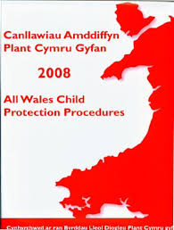
Canllawiau amddiffyn plant Cymru Gyfan 2008
All Wales Child Protection Procedures
2008
Cyfrifoldeb pawb/ Everyone’s responsibility
Glir, Cynhwysfawr/ Clear, concise and comprehensive
Notes:
Huge, heavy and intimidating file of policies and procedures

Slide 8
I bwy?
Who for?
Unrhyw unigolyn sydd…
Unrhyw asiantaeth sydd…
…yn gweithio gyda phlant, teuluoedd neu oedolion a allai achosi niwed
Canllawiau amddiffyn plant Cymru Gyfan 2008
Any individual who…
Any agency who…
…works with children, families or with adults who may be a risk to children
All Wales Child Protection Procedures, 2008:49
Notes:
The All Wales Child [Prot3ection Procedures have now been replaced by the Wales Safeguarding Procedures 2019. These are for EVERYONE!! Professionals, Practitioners, members of the public.​
All those involved with the voluntary sector football clubs, rugby, swimming, cubs, brownies, scouts, rainbows music, ballet, anywhere that children are left to be involved with recreational events.

Slide 9

2019
Notes:
The All Wales Child Protection Procedures reviewed and amended in 2019. The Wales Safeguarding Procedures replaced the AWCPP. ​
How to reference this;​
Orally – Wales Safeguarding Procedures 2019 or Wales Safeguarding Procedures 2019 (Social Care Wales) ​
Reference List – Social Care Wales (no date) Wales Safeguarding Procedures 2019. Available at: https://safeguarding.wales/ (Accessed: 7th June 2022).

Slide 10
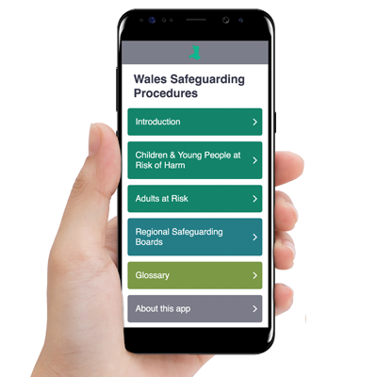
Notes:
Ask them to Download

Slide 11
Lord Laming
‘Doing the basic things well keeps children safe.’
Lord Laming, The Victoria Climbié Inquiry, 2003:190
Notes:
Lord Laming Report 2003 highlighted the drive to ensure better, safer, more robust and effective procedures under the New Children Act 2004

Slide 12
Fframwaith Deddfwriaethol
Legislative Framework
Deddf Plant 1989
CCUHP
Deddf Hawliau Dynol 1998
Derddf Safonau Gofal 2000
RDDC 2018
Deddf Comisiynydd Plant Cymru 2001
Adroddiad Bichard 2004
Deddf Plant 2004
Children Act 1989
UNCRC
The Human Rights Act 1998
Care Standards Act 2000
GDPR 2018
Children’s Commissioner for Wales Act 2001
The Bichard Report 2004
Children Act 2004
Notes:
Consider using this as a tick list for your group

Slide 13
Fframwaith Deddfwriaethol
Legislative Framework
Deddf Gofal Plant 2006
Mesur Plant a Phobl ifanc (Cymru) 2011
Deddf Gwasanaethau Cymdeithasol a Llesiant (Cymru) 2014
Deddf Addysg 2002
Deddf Amddiffyn Plant 1999
Deddf Llesiant Cenedlaethau'r Dyfodol (Cymru)
Childcare Act 2006
Children and Young Persons (Wales) Measure 2011
Social Services and Well-being Act (Wales) 2014)
Education Act 2002
Protection of Children Act 1999
Well-being of Future Generations (Wales) Act 2015
Notes:
Consider using this as a tick list for your group

Slide 14
Teil 2
Tile 2
Plant a phobl ifanc sy’n wynebu risg o gamriniaeth
Children and young people at risk of harm
Notes:
Within this section:​
6 sections​
Section 1: Safeguarding principles and effective practice​
Section 2: The duty to repost a child at risk of abuse, neglect and/or harm​
Section 3​
divides into:​
Section 3 – Part 1: Responding to a report of a child at risk of harm, abuse and/or neglect​
Section 3 – Part 2: Decision making and initial child protection conferences​
Section 4: Planning and intervention for children on the child protection register​
Section 5: Safeguarding allegations/concerns about practitioners and those in positions of trust​
Section 6: All Wales Practice Guidance

Slide 15
Teil 4
Tile 4
Byrddau Diogelu Rhanbarthol
Regional Safeguarding Boards
Notes:
The 22 Local Safeguarding Children's Boards that were established under the Children Act 2004, now reduced to just 6 Regional Safeguarding Boards​
Caridff and Vale​
Cwm Taf Morgannwg​
Gwent​
Mid and West Wales​
North Wales​
Western Bay (West Glamorgan/ Swansea​
All info on the App
Contact numbers​
The person on the other end of the phone will always be the DUTY SO call

Slide 16
Esiampl Bwrdd Diogelu Lleol
Example of Local Safeguarding Board
Mid and West Wales Safeguarding Board
https://www.cysur.wales/
Link to a Referral form:
https://www.cysur.wales/contacts-and-useful-links/reporting-concerns-child/
If you have any doubts about sharing or reporting your concerns, Speak Out. Don’t think what if I’m Wrong – think what if I’m Right! (Cysur website, 2020).

Slide 17
Teil 5
Tile 5
Geirfa
Glossary
Notes:
Really useful little resource. We use a great deal of jargon still, this offers a library of definitions and terms explained

Slide 18
Adnabod Niwed Sylweddol
Identifying Significant Harm
Cyflwynwyd yn gyntaf - Deddf Plant 1989
Trothwy sydd yn cyfiawnhau ymyrryd
Yn cael ei ddiffinio fel ‘trin plentyn yn wael’ neu ‘niweidio’n ddifrifol’
Canllawiau Amddiffyn Plant Cymru Gyfan, 2008: 58
First introduced in the Children Act 1989
The threshold which justifies intervention
Defined as ‘ill-treatment’ or ‘impairment’
All Wales Child Protection Procedures, 2008:59
Notes:
Consider this process as a set of traffic lights​
Green – no concerns for a child​
Amber – You are beginning to ask questions about some aspects of what you see, for example the child in your scenario. These concerns build and require careful attention and discussions with senior professionals such as the DSO – Designated Safeguarding Officer.​
Red – When something occurs which crosses that threshold, takes you over the line in terms of suspicion of harm and concern for the child – this is identifying SIGNIFICANT HARM.​
So in your scenario, significant harm has been identified by the key worker and leader/manager of the setting which justifies contact with the Regional Safeguarding Board, namely the duty social worker, or your local social services department.

Slide 19
Niwed Sylweddol
Significant Harm
Gweithdrefnau Diogelu Cymru:
Teil 2: Plant a phobl ifanc sydd mewn perygl o niwed
Adran 3 Rhan 1:
Niwed Sylweddol
Wales Safeguarding Procedures:
Tile 2: Children and young people at risk of harm
Section 3 Part 1:
Significant Harm

Slide 20
Adran 47
Section 47
Beth yw hwn?
Pwy sydd yn dechrau’r broses?
O fewn 24 awr
What is this?
Who begins the process?
Within 24 hours
Notes:
Following advice form the Duty Social Worker to submit a referral, a team of social workers will carefully consider whether they believe this is a case of significant harm. If so, this triggers the process referred to as Section 47, first introduced as part of the Children Act 1989.​
The decision to instigate the section 47 enquiries must be made within 24 hours of the receipt of the referral.​
A section 47 means the referral will be investigated.

Slide 21
Adran 47
Section 47
Gweithdrefnau Diogelu Cymru:
Adran 2: Plant a phobl ifanc sydd mewn perygl o niwed
Adran 3 Rhan 2:
Trosolwg
Ymholiadau Adran 47
Wales Safeguarding Procedures:
Section2: Children and young people at risk of harm
Section 3 Part 2:
Overview
S47 Enquiries

Slide 22
Cynhadledd Diogelu Plentyn Cychwynnol (CDPC)
Initial Child Protection Conference (ICPC)
Mae Cynhadledd Diogelu Plentyn Cychwynnol yn cael ei drefnu os yw’r plentyn yn wynebu risg o niwed sylweddol (ar ôl ymholiadau adran 47).
Yn y gynhadledd achos, mae pobl proffesiynol priodol yn rhannu gwybodaeth, adnabod risgiau a gosod amlinelliad o beth sydd rhaid gwneud er mwyn amddiffyn y plentyn.
Yng Nghymru, rhaid bod hwn yn digwydd o fewn 15 diwrnod gwaith.
An Initial Child Protection Conference is held if the child is at risk of significant harm (after section 47 enquiries).
At the case conference relevant professionals share information, identify risks and outline what needs to be done to protect the child.
In Wales, this must happen within 15 working days.
Notes:
If, after section 47 enquiries have taken place, the child is deemed as being at risk of significant harm, an INITIAL CHILD PROTECTION CONFERENCE is held.​
In Wales this must happen within 15 days.​
Relevant professionals share information and make decisions.

Slide 23
Canlyniad CDPC
Outcome of an ICCP
Os yw’r sawl proffesiynol yn y gynhadledd cychwynnol yn penderfynu bod y plentyn yn wynebu risg o niwed sylweddol, bydd y plentyn yn cael ei ychwanegu i Gofrestr Diogelu Plentyn a/neu bydd paratoadau ar gyfer Cynllun Diogelu’r Plentyn.
Bydd cynadleddau achos yn parhau i gwrdd yn gyson nes yr amser nad oes risg sylweddol i’r plentyn, neu ei fod yn cael ei osod mewn i ofal.
If professionals at the initial case conference decide a child is at risk of significant harm they will add the child to the Child Protection Register and/or a Child Protection Plan is drawn up.
Case conferences will continue at regular intervals until the child is no longer considered at risk of significant harm or until they are taken into care.

Slide 24

Pobl proffesiynol yn gweithio gyda’u gilydd
Professionals working together
Byrddau Diogelu Rhanbarthol
Gwasanaethau Cymdeithasol
Heddlu
Awdurdod Iechyd
Awdurdod Addysg
Gwasanaeth Prawf
CAFCAS – Cymru
NSPCC – Cymru
MASH – Hyb diogelu amlasiantaeth
Regional Safeguarding Boards
Social Services
Police
Health Authority
Education Authority
Probation
CAFCAS - Cymru
NSPCC – Cymru
MASH – Multi Agency Safeguarding Hub

Slide 25
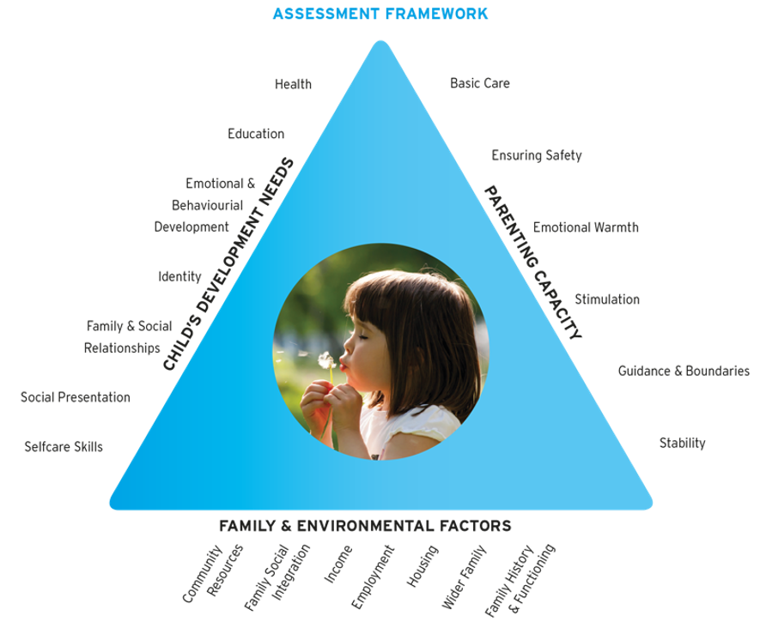
Fframwaith Asesiad/ Assessment Framework
Notes:
Assessment framework is used by professionals to assess and understand individuals needs and to plan and work collaboratively to support children and vulnerable adults. A good assessment will consider all 3 of these.

Slide 26
Byrddau Diogelu Rhanbarthol (Cymru)
Regional Safeguarding Boards (Wales)
Yn flaenorol 22 o Fyrddau Lleol Diogelu Plant a sefydlwyd o dan Ddeddf Plant 2004
Wedi gostwng i ddim ond 6 Bwrdd Diogelu Rhanbarthol
Previously 22 Local Safeguarding Children's Boards that were established under the Children Act 2004
Now reduced to just 6 Regional Safeguarding Boards
Notes:
The 22 Local Safeguarding Children's Boards that were established under the Children Act 2004, now reduced to just 6 Regional Safeguarding Boards
Caridff and Vale
Cwm Taf Morgannwg
Gwent
Mid and West Wales
North Wales
Western Bay (West Glamorgan/ Swansea
All info on the App
Contact numbers
The person on the other end of the phone will always be the DUTY SO call

Slide 27

Partneriaeth (Lloegr)
Partnerships (England)
Partneriaeth diogelu
Awdurdod Lleol
Heddlu
Iechyd
Safeguarding partnerships
Local Authority
Police
Health

Slide 28
Cyfrifoldebau’r Partneriaeth Diogelu
Responsibilities of the Safeguarding Partnership
Cynnwys asiantaethau perthnasol yn yr ardal
Nodi a gorchwilio adolygiad o achosion diogelu difrifol
Cyhoeddi trefniadau diogelu lleol
Trefnu craffu cyhoeddus o’r drefniadau diogelu
Cyhoeddi adroddiadau adolygu blynyddol ar ei gweithgareddau diogelu
Involve relevant agencies in the area
Identify and supervise the review of serious safeguarding cases
Publish local safeguarding arrangements
Arrange public scrutiny of safeguarding arrangements
Publish annual review reports on their safeguarding activity
Notes:
These are the same responsibilities that the regional safeguarding boards would have in Wales

Slide 29
Asiantaethau eraill/ Other agencies
Addysg (wladwriaeth a preifat)
Gwasanaeth prawf a carchardai
Gwasanaeth tân
Grwpiau cymunedol, ffydd, chwaraeon, elusen
Education (state and private)
Probation and prison services
Fire Service
Community faith, support, sport, charity groups

Slide 30
Rolau a chyfrifoldebau tîm amlasiantaethol
Roles and responsibilities of a multi-agency team
Dulliau cydweithredol
Agored a gonest
Cyfathrebu cywir ac effeithiol
Rhannu a chofnodi gwybodaeth yn effeithiol
Dilynol
Iaith benodol
Her
Blaenoriaethu
Collaborative approaches
Open and honest
Accurate and Effective communication
Effective sharing and recording of information
Follow up
Specific language
Challenge
Prioritise
Notes:
Roles and responsibilities of a multi-agency team in child protection and in a range of safeguarding meetings
A collaborative and joint approach is vital to ensure safeguarding responsibilities are met and everyone involved is working to the same agenda
The need to be open and honest ensures that approaches can be made specific for the needs of the child and family
The effectiveness and approaches to protecting and promoting a child’s welfare is dependent on accurate and effective communication and also on the recording and sharing of information.
The need to follow up is essential, by doing this it ensures that processes are met and objectives can achieved.
There is a need to consider the language that is used in communication to allow everyone to have a thorough understanding, so avoiding abbreviations and acronyms that may not be universally recognised, avoid jargon, use plain English.
Remember you have the ability to challenge decisions and choices, this ensures a robust approach to protecting children, if something doesn’t feel right, raise this and take further if necessary.
The ability to prioritise is important, again because it is the best to ensure that children’s safety needs are put first and the policies and procedures in place are robust.

Slide 31
Polisi Diogelu
Safeguarding Policy
Nas-cynhelir: AGC/Estyn
Cynhelir: Estyn
Dogfennaeth Diogelu statudol/cyfreithiol (er engraifft Safin 20 SGC)
Dogfen pawb
Dogfen gweithio
Dogfen sydd yn cael ei adolygu yn gyson
Adnabod rôl Swyddog(ion) Diogelu Penodedig y lleoliad
Non-maintained: CIW/Estyn
Maintained: Estyn
Statutory/Legal Safeguarding documents (For example: Standard 20 NMS)
Everyone’s document
Working document
A document which is regularly reviewed
Recognising the role of the Designated Safeguarding Officer(s) at the setting
Notes:
In Wales Estyn and CIW will require schools and settings to have Safeguarding policies in place. This must be a working document which is familiar to each stakeholder. This is a statutory requirement. The DSO for the setting must be named on the policy and must be on display.

Slide 32

Rolau a chyfrifoldebau tîm amlasiantaethol ym maes amddiffyn plant ac mewn ystod o gyfarfodydd diogelu
Roles and responsibilities of a multi-agency team in child protection and in a
range of safeguarding meetings
Notes:
It is only when the jigsaw pieces come together that we get the real picture, meaning we must have all of the available information to understand what is happening.

Slide 33
Rolau a chyfrifoldebau'r Swyddog Diogelu Dynodedig (DSO)
Roles and responsibilities of the Designated Safeguarding Officer (DSO)
Datblygu ac adolygu polisïau a gweithdrefnau amddiffyn
Gweithredu polisïau a gweithdrefnau, gan sicrhau yr ymatebir i bob pryder yn briodol
Sicrhau bod yr holl randdeiliaid yn deall y polisi a'r gweithdrefnau
Develop and review protection policies and procedures
Implement policies and procedures, ensuring all concerns are responded to appropriately
Ensure all stakeholders understand the policy and procedures
Notes:
Settings are required to appoint an appropriate senior member of staff who has overall responsibility for overseeing all processes, policies and procedures with regards to safeguarding and child protection concerns within the setting, This person is referred to as the Designated Safeguarding Officer (Designated Safeguarding Lead DSL in England). However it is vital to remember that Safeguarding is EVERYONES responsibility. It is worth noting here that there is a drive to make it an offence if it is identified that where a child has suffered serious child abuse, resulting in death or serious injury, any individuals who may have known or suspected and failed to act upon those concerns or information can be prosecuted. This puts an even bigger responsibility on practitioners to report.
All stakeholders should be made aware of who the Designated Safeguarding Officer for the setting is and how they can be contacted.
Some of the key responsibilities of the DSO are
Take a lead role in developing and reviewing all of the settings safeguarding and child protection policies and procedures.
Take a lead role in implementing the settings safeguarding and child protection policies and procedures: ensuring all safeguarding and child protection issues concerning children and young people who take part in the settings activities are responded to appropriately and effectively.
Make sure that everyone working or volunteering with or for children and young people at the setting, including the board of trustees/management committee members, understands the safeguarding and child protection policy and procedures and knows what to do if they have concerns about a child’s welfare.
Make sure children and young people who are involved in activities at the setting and their parents know who they can talk to if they have a welfare concern and understand what action the organisation will take in response
Receive and record information from anyone who has concerns about a child who takes part in the settings activities, this should be done in accordanc with settings policies and procedures and statutory requirements.

Slide 34
Rolau a chyfrifoldebau'r Swyddog Diogelu Dynodedig (DSO)
Roles and responsibilities of the Designated Safeguarding Officer (DSO)
Sicrhau bod gan blant a theuluoedd bwynt cyswllt penodol, a'u bod yn ymwybodol ohono
Derbyn a chofnodi gwybodaeth
Ensure children and families have, and are aware of a specific point of contact
Receive and record information
Notes:
Settings are required to appoint an appropriate senior member of staff who has overall responsibility for overseeing all processes, policies and procedures with regards to safeguarding and child protection concerns within the setting, This person is referred to as the Designated Safeguarding Officer (Designated Safeguarding Lead DSL in England). However it is vital to remember that Safeguarding is EVERYONES responsibility. It is worth noting here that there is a drive to make it an offence if it is identified that where a child has suffered serious child abuse, resulting in death or serious injury, any individuals who may have known or suspected and failed to act upon those concerns or information can be prosecuted. This puts an even bigger responsibility on practitioners to report.
All stakeholders should be made aware of who the Designated Safeguarding Officer for the setting is and how they can be contacted.
Some of the key responsibilities of the DSO are
Take a lead role in developing and reviewing all of the settings safeguarding and child protection policies and procedures.
Take a lead role in implementing the settings safeguarding and child protection policies and procedures: ensuring all safeguarding and child protection issues concerning children and young people who take part in the settings activities are responded to appropriately and effectively.
Make sure that everyone working or volunteering with or for children and young people at the setting, including the board of trustees/management committee members, understands the safeguarding and child protection policy and procedures and knows what to do if they have concerns about a child’s welfare.
Make sure children and young people who are involved in activities at the setting and their parents know who they can talk to if they have a welfare concern and understand what action the organisation will take in response
Receive and record information from anyone who has concerns about a child who takes part in the settings activities, this should be done in accordanc with settings policies and procedures and statutory requirements.

Slide 35
Rolau a chyfrifoldebau'r Swyddog Diogelu Dynodedig (DSO)
Roles and responsibilities of the Designated Safeguarding Officer (DSO)
Ymateb i'r pryderon
Cysylltu ag asiantaethau eraill
Storio a chadw cofnodion
Gweithio'n agos gydag adroddiad rheolaidd i'r pwyllgor rheoli / bwrdd ymddiriedolwyr
Respond to concerns
Liaise with other agencies
Store and retain records
Work closely with and regularly report to management committee/ board of trustees
Notes:
Take the lead on responding to information that may constitute a child protection concern, including a concern that an adult involved with the setting may present a risk to children or young people. This includes:
assessing and clarifying the information
making referrals to statutory organisations as appropriate
consulting with and informing the relevant members of the organisation’s management and
following the organisation’s safeguarding policy and procedures.
Liaise with other agencies on safeguarding concerns, this can involve passing on information to and receiving information from statutory child protection agencies such as:
the regional safeguarding boards
b. the police and
c. Social services
This includes making formal referrals to agencies when necessary.
Store and retain all safeguarding records according to legal requirements and the organisation’s safeguarding and child protection policy and procedures.
Work closely with the management committee/board of trustees and senior safeguarding lead, to ensure they are kept up to date with safeguarding issues and are fully informed of any concerns about organisational safeguarding and child protection practice. Report regularly to the management committee/board of trustees on issues relating to safeguarding and child protection
ensure that child protection is seen as an ongoing priority issue and that safeguarding and child protection requirements are being followed at all levels of the organisation.
Be familiar with and work within inter-agency child protection procedures developed by the local child protection agencies.
Be familiar with issues relating to child protection and abuse, and keep up to date with new developments in this area.
Some other responsibilities are that the DSO Attend regular training in issues relevant to child protection and share knowledge from that training with everyone who works or volunteers with or for children and young people
Attend team meetings, supervision sessions and management meetings as arranged
Work flexibly as may be required and carry out any other reasonable duties.
Ensure that all staff have the correct and up to date DBS checks in place

Slide 36
Rolau a chyfrifoldebau'r Swyddog Diogelu Dynodedig (DSO)
Roles and responsibilities of the Designated Safeguarding Officer (DSO)
Sicrhau bod diogelu yn flaenoriaeth i'r lleoliad
Gweithio o fewn polisïau amlasiantaethol
Byddwch yn gyfredol ac yn gyfoes
Ensure safeguarding is a priority for the setting
Work within multiagency policies
Be current and up to date
Notes:
Take the lead on responding to information that may constitute a child protection concern, including a concern that an adult involved with the setting may present a risk to children or young people. This includes:
assessing and clarifying the information
making referrals to statutory organisations as appropriate
consulting with and informing the relevant members of the organisation’s management and
following the organisation’s safeguarding policy and procedures.
Liaise with other agencies on safeguarding concerns, this can involve passing on information to and receiving information from statutory child protection agencies such as:
the regional safeguarding boards
b. the police and
c. Social services
This includes making formal referrals to agencies when necessary.
Store and retain all safeguarding records according to legal requirements and the organisation’s safeguarding and child protection policy and procedures.
Work closely with the management committee/board of trustees and senior safeguarding lead, to ensure they are kept up to date with safeguarding issues and are fully informed of any concerns about organisational safeguarding and child protection practice. Report regularly to the management committee/board of trustees on issues relating to safeguarding and child protection
ensure that child protection is seen as an ongoing priority issue and that safeguarding and child protection requirements are being followed at all levels of the organisation.
Be familiar with and work within inter-agency child protection procedures developed by the local child protection agencies.
Be familiar with issues relating to child protection and abuse, and keep up to date with new developments in this area.
Some other responsibilities are that the DSO Attend regular training in issues relevant to child protection and share knowledge from that training with everyone who works or volunteers with or for children and young people
Attend team meetings, supervision sessions and management meetings as arranged
Work flexibly as may be required and carry out any other reasonable duties.
Ensure that all staff have the correct and up to date DBS checks in place

Slide 37
Caniatâd rhieni
Parental Consent
Blaenoriaeth i ddiogelu plentyn
Ymarfer da i hysbysu, serch hynny…
Gwasanaethau Cymdeithasol i benderfynu…
Ble mae amheuaeth o gamdrinaneth…mae ymholiadau yn gallu parhau neu yn aml yn parhau heb hysbysu’r rhieni,gofalwyr.
Priority is to safeguard child
Good Practice to inform, however…
Social Services decide…
Where abuse is suspected…enquiries can be/are often carried out without the knowledge of parents/caregivers
Notes:
Whenever possible, it is considered good practice to inform parents when a referral is being made. However seek advice on this issue from the duty social worker as to whether it is appropriate and/or safe to do so.​
Ensure that if you are ever in a position where you are speaking with parents/carers about a referral or a safeguarding issue, protect yourself by having a witness.

Slide 38
Adnabod ac Atgyfeirio
Recognition a Referral
Rhaid bod awdurdodau lleol yn sicrhau bod trefniadau effeithiol ar gael er mwyn galluogi unigolion neu asiantaethau i adnabod a gweithredu
Local authorities must ensure that they have effective systems in place which allow individuals and agencies to recognize and respond
Notes:
This is why recognising signs and symptoms and changes in behaviour is important.​
That is why training and awareness is important​
Staff training – Safeguarding training now forms part of the mandatory training requirements for ESTYN and CIW.​
This ensures a consistent, effective approach to recognising signs and symptoms and knowing the procedures.

Slide 39
Cadw Cofnodion
Record Keeping
Yn gywir
Yn gryno
Yn glir
Llofnod a dyddiad
Iaith syml a ffeithiol
Yn gyfrinachol
Cadw, storio, dinistrio
Correct
Concise
Clear
Signature and date
Clear, simple language – which is factual
Keeping, storing and destroying
Notes:
Remember to consider GDPR 2018 and other statutory policies and requirements under Estyn and CIW which will require complete confidentiality of all information.​
Carefully written/concisely written/ correctly written notes.​
Storage of documents is paramount. ​
My concern – software that many schools use now, it is secure, easy to use, builds reports, GDPR compliant, supports multiagency working with external agencies.

Slide 40
Operation Encompass
https://www.operationencompass.org/why-was-operation-encompass-created
'Operation Encompass is a police and education early information safeguarding partnership enabling schools to offer immediate support to children experiencing domestic abuse'
Operation Encompass (no date)
Notes:
Operation compass is an initiative that ensures that schools have timely information about all police-attended incidents of domestic abuse, no matter where in the world the child lives.​
This enables staff in every school to understand how to support children who are experiencing domestic abuse, no matter where in the world the child lives.

Slide 41
Asesiad Cychwynnol Diogelu Plant
Initial Child Protection Conference
Background:
Anne and Terry's story (Part 1) - child protection conference – YouTube
Initial Child Protection Conference:
https://www.youtube.com/watch?v=3Q11zm-L-hQ

Slide 42
Nawr ymchwiliwch…
Now research …
Gweithdrefnau Diogelu Cymru:
Adran 2: Plant a phobl ifanc sydd mewn perygl o niwed
Adran 3 Rhan 2:
Penderfynu a chynadleddau amddiffyn plant ychwynnol (Pwynt 4 ymlaen)
Wales Safeguarding Procedures:
Section2: Children and young people at risk of harm
Section 3 Part 2:
Decision making and initial child protection conferences (Point 4 onwards).
Notes:
Demonstrating an excellent understanding of knowledge will support you in achieving high marks.

Slide 43
Diogelu plentyn ar frys
Immediate protection of a child
Materion difrifol
Materion cymhleth
Hawliau gan yr awdurdodau ar gyfer tynnu’r plant oddi wrth y sefyllfa yn syth
Y broses meddygol
Y broses gofal
Serious matters
Complex matters
Powers by authorities to remove children immediately from the situation
The medical process
The care process

Slide 44
Symud o fodel cydymffurfiaeth i ddull integredig
Moving from a compliance model to an integrated approach
•Model cydymffurfiaeth – cyflawni’r ddyletswydd diogelu statudol
•Dull integredig – adfyfyriol a phwrpasol, wedi ymgorffori yn eich arfer eich hun
Compliance model – delivery of statutory safeguarding duty
Integrated approach – reflective and bespoke embedded into your own practice

Slide 45
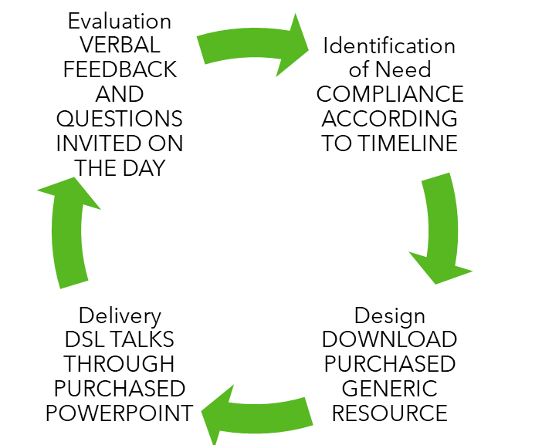
Model Cydymffurfiad
Compliance model
Notes:
The compliance led model being where settings are doing the minimum in order to meet statutory requirements, so this would be your legal and regulatory safeguarding course, so as you can see by the diagram on the slide, a need is identified, and that could a member of staff whose safeguarding certificate has expired, a generic or standard safeguarding resource or package is sourced, this is then delivered, with an opportunity to evaluate usually on the day of the training.

Slide 46

Dull integredig
Integrated Approach
Notes:
The integrated approach is much more tailored and specific to the needs of the setting, the area, the practitioners and the families of the setting. So a need may be identified, and rather than a generic, standard resource being sourced, or more bespoke and tailored resource is sourced, this is delivered by an appropriate facilitator and aimed specifically at needs, and there is opportunity for on going reflection, follow up and revisiting to embed the knowledge.

Slide 47
Cyfrifoldeb Pawb
Everyone's Responsibility
'Ni all unrhyw asiantaeth lwyddo i amddiffyn plant yn effeithiol trwy weithio ar ei phen ei hun'
Canllawiau Amddiffyn Plant Cymru Gyfan, 2008: 46
'The effective protection of Children cannot be achieved by a single agency acting on its own'
All Wales Child Protection Procedures, 2008: 46

Slide 48
I gloi…
To summarise…
Hyfforddiant/Cyrsiau
Gwybodaeth a dealltwriaeth = hyder
Nabod y plant yn eich gofal
Nabod teuluoedd y plan (deal cefndiroedd)
Adnabod arwyddion a newidiadau mewn ymddygiad
Cydweithio
Cyfathrebu
Cysondeb
Cyfrinachedd
Cyfrifoldeb personol
Gweithredu…bob amser…
Training/Courses
Knowledge and understanding = confidence
Knowing the children in your care
Knowing the families of children (understanding backgrounds)
Recognising signs, indicators and changes to behaviour
Cooperation
Communication
Consistency
Confidentiality
Personal responsibility
Action…every time …

Slide 49
Ymchwil pellach…
Further research…

Slide 50
Cyfeirnod/ References
Operation Encompass (no date) https://www.operationencompass.org/about-us (Accessed: 10th June 2022).
The Office of the Children's Commissioner for Wales (2008) https://www.basw.co.uk/system/files/resources/basw_125225-1_0.pdf (Accessed: 10th June 2022)
Wales Safeguarding Procedures Project Board (2019) Wales Safeguarding Procedures [Accessed 05/12/19]

