Slide 1
Teamwork

Slide 2
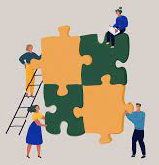
What is a Teamwork?
Teams can be categorised as a group of people with complementary skills who strive to achieve a common purpose and hold responsibility for their contribution.

Slide 3
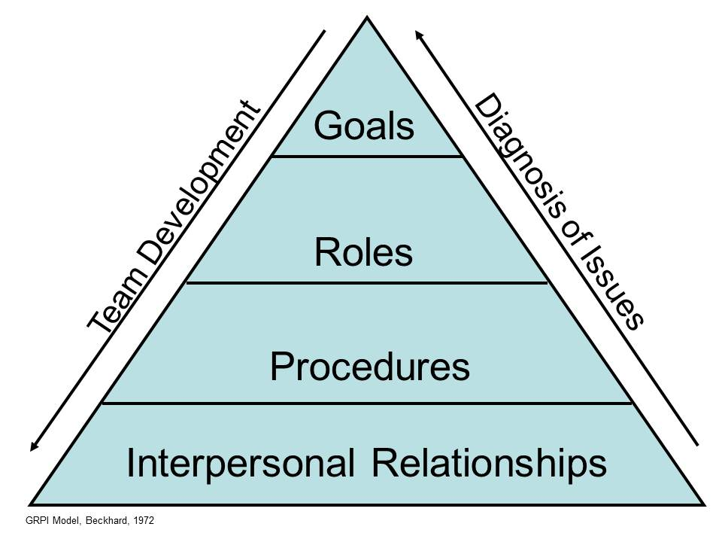
Rubin, Plovnick, and Fry's GRPI Model of Team Effectiveness (1997)
Goals: Well-defined objectives plus communicated priorities and expectations.
Roles: Well-defined responsibilities and acceptance of a leader
Processes: Clear decision-making processes.
Interpersonal relationships: Good communication, trust, and flexibility.

Slide 4
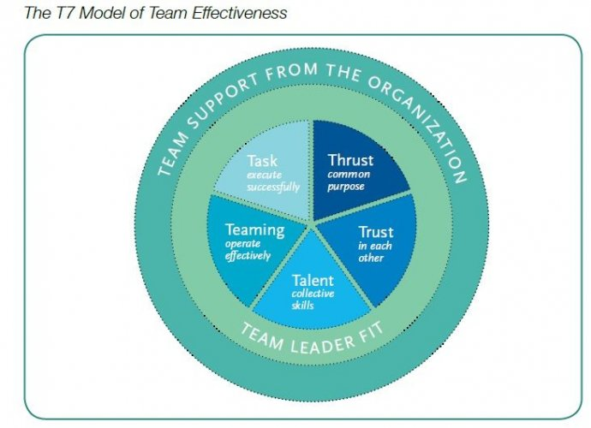
The T7 Model of Team Effectiveness.
This model of teamwork emphasizes the factors that can impact effectiveness.
Trust: knowledge of team support
Task: Execution
Talent: Skills to contribute
Teaming: function as a team.
Thrust: A common goal
Notes:
Michael Lombardo and Robert Eichinger developed T7 model of Teamwork was developed to define factors that affect team effectiveness.

Slide 5
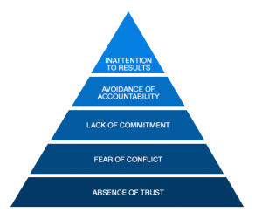
The Lencioni Model
The five dysfunctions of a team written by Patrik Lencioni,
Notes:
”The five dysfucntions of a team” wrote by Patrik Lencioni presents teamwork effectivenss based upon dysfunctions, politics, and conflicts.
An absence of trust: If team members are afraid to be vulnerable or afraid to ask for help, then they won't turn to their teammates for assistance.
A fear of conflict: If everyone tried to preserve peace at all costs, there wouldn't be any dynamic conflicts that result in productive ideas.
A lack of commitment: If people aren't committed to their work or team, then they won't follow through on their decisions or deadlines.
Avoidance of accountability: This is another drawback of the fear of conflict where no one wants to hold others accountable for their work.
Inattention to results: If personal goals become more important than the success of the group, no one will monitor and optimize team performance.

Slide 6
Advantages of working within a Team
It builds trust
Understanding Development
Fosters Creativity
Develops Motivation
Develop Conflict and Resolution skills
Promotes Diversity
Reduction in work stress

Slide 7
Disadvantages of Teamwork
??

Slide 8

Activity
In pairs or groups, provide a definition of the following terms:
Interdisciplinary
Multidisciplinary

Slide 9
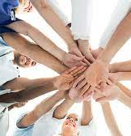
Multidisciplinary Teams
Multidisciplinary team(s) area group of health care practitioners who are members of various disciplines, each providing specific provisions to achieve a positive outcome for the patient.

Slide 10

Interdisciplinary Teams
Interdisciplinary approach involves team members from different disciplines working collaboratively, with a common purpose, to set goals, make decisions and share resources and responsibilities.

Slide 11
Teams
Can you give me examples of good teams.
What do you think constitutes a good team.
A successful team is a group of many hands and one mind.
Team work
Coming together is the beginning
Keeping together is progress
Working together is success.

Slide 12

Thank you remember teamwork is essential
Jan Howells-Johnson

