Slide 1

Changemakers: Creativity & Value Creation.
2. Ideation.
This Photo by Unknown author is licensed under CC BY-SA-NC.

Slide 2
Project design & implementation:
In this module (L5 CM-CVC), we will focus on your Project idea, research methods and project planning & design, and you are asked to in:
1. Assignment 1:
> Brainstorm and select an idea;
> Document research methods (e.g. Qualitative & Quantitative methods such as Secondary Lit. rev. research and Primary Questionnaire/interview research).
2. Assignment 2:
> Document Project Planning (project scope, proposed solution and required resources)
> Project Management (project timeline/Gantt chart) & some Project Analysis & Design work.
> Enterprise & Innovation and Deployment considerations.
There will be an opportunity at L6 to practically implement the project idea, either in the Emerging Trends or the Major independent project module.

Slide 3
Last week’s Activity:
Online lesson: Unit 1: Section 1.
Assignment 1 Task 1 Q.1 = Mind Map.

Slide 4

Bg. Assignment 1 - Task 1 Q1:
Task 1: Moodle Unit 1 topic 1 & Mind Map.
Use the topics covered in the following online sections to help you answer the questions below.
  Unit 1 Section 1: How Innovation Shapes The World. The role that creativity and innovation plays in the development of society and self.
Q1. Create a mind map that includes some of the topics from topic 1 of Unit 1 on Moodle and some project ideas from areas of personal interest related to your programme of study.

Slide 5
This week’s focus & Activity:
Assignment 1 Task 1 Q.2:
Q2. Brainstorm, consider and select a project idea that you would like to take forward, and add this to the mind map created for Q1.

Slide 6

Activity: ideation notes
The following slides provide some tips to help you create an idea for your project:
  If not already done so: create a new OneNote Notebook / word document for the module.
  Note down ideas that come to you while considering what you would like to do for your project, during and after this tutorial.

Slide 7
New and emerging technologies
Your project idea can use new and emerging technologies or apply an existing/traditional technology in a new contemporary way.
Your project can be based on a new technology that you would like to learn, such as: AR/VR, Web or Mobile App. Development, Game des./dev., Cloud tools, App. Deployment & Container Management (Docker / Kubernetes), AI, Quantum Computing, or Create/Contribute to an Online Open Source Project, a, IoT/electronics solution using a Rasp.Pi/Arduino, CyberSec tools for penetration testing and system hardening or use of Digital Marketing tools. These are only a few examples.
Ultimately your project idea should be in an area of interest to you.

Slide 8
IMAGINATION
Creativity & Innovation is like a blank canvas: You can create anything you can imagine.
Think differently - Think outside the box.
Use your imagination 👍💡☼.
Value and note down ideas that come to your mind.
Trust Yourself.
Value areas that are of interest and important to you.

Slide 9
PERSONAL INTEREST & SOCIETAL TRENDS
Consider your likes and what inspires and motivates you?.
What is important to you?
What are you interested in?
What do you value ad appreciate in life?
Consider what is happening in society that you are interested in?
You could create a Web App, App, Game or device, on an area of interest or on a trend or current change occurring in society at this time.
You could create something to solve a problem that frustrates you, or a problem you care about, or raise awareness of a topic that you are passionate about.
Notes:
- E.g. When FROZEN exploded across the world innovative people made millions creating FROZEN (or Star Wars) themed indie games, 3D printed snow-flake coasters etc…

Slide 10
PROMBLEMS & FRUSTARTIONS
  Problems, frustrations and challenges in life can be a great source of motivation and inspiration.
  They can lead to beneficial innovations.
  Many people will have the same problem / frustration and challenge.
    Can you think of a problem that needs solving?
    Can you think of a better way of doing something?
    Can you create something to help yourself or another person?
    Can you create something to help a colleague, family member or friend?
    Consider how technology could be used to help/solve a problem.

Slide 11
TECH TRENDS
LEARN and USE NEW TECH
Use new technologies in an area of your personal interest / programme of study e.g.
New Web or Mobile Application Development technologies
New Cloud Apps / Tools / Services
Augmented Reality (AR)/ Virtual Reality (VR)
Artificial Intelligence (AI)
IoT Internet of Things, Smart & Connected devices
Game design, Game development, Visual effects / Animation
Enhancing Usability & Accessibility
Data Analysis & Visualization
Electronics / embedded systems
3D printing, Immersive Projection, Motion detection, Voice detection, Drone tech
Quantum Computing
Tip: Note down what new tech you would like to try and experiment with?
What are you interested in and what new skills would you like to develop?.

Slide 12
SYNERGISE NEW TECH
  Consider how you can bring together 2 or more Tech areas e.g.
  Electronics (e.g. Arduino) and an area of interest (e.g. create a Robot, a Retro Games Machine, Web Server & a Web Application, Wearable Computing).
  A Web & Mobile App to help an Organisation/Business/Charity or to make life easier, help people. Could be a learning App.
  VR or AR Games perhaps with a Health & Well-being focus.
  Gaming & Social Media combo such as Social Media games.
  Drones & Gaming or Drone & Health solution.
  Voice enable solution e.g. Alexa App using the Alexa Skills Kit (ASK), Alexa Health App., Alexa and IoT eletonic device, Alexa Game.
  IoT Smart Connected device e.g. perhaps a device to assist people with a Health or Medical issue.
  A Security / Cybersecurity Solution linking the Web and Mobile App perhaps even to an electronic device.
  Tip: Note down what technology you could combine to create something new / an innovative solution.

Slide 13
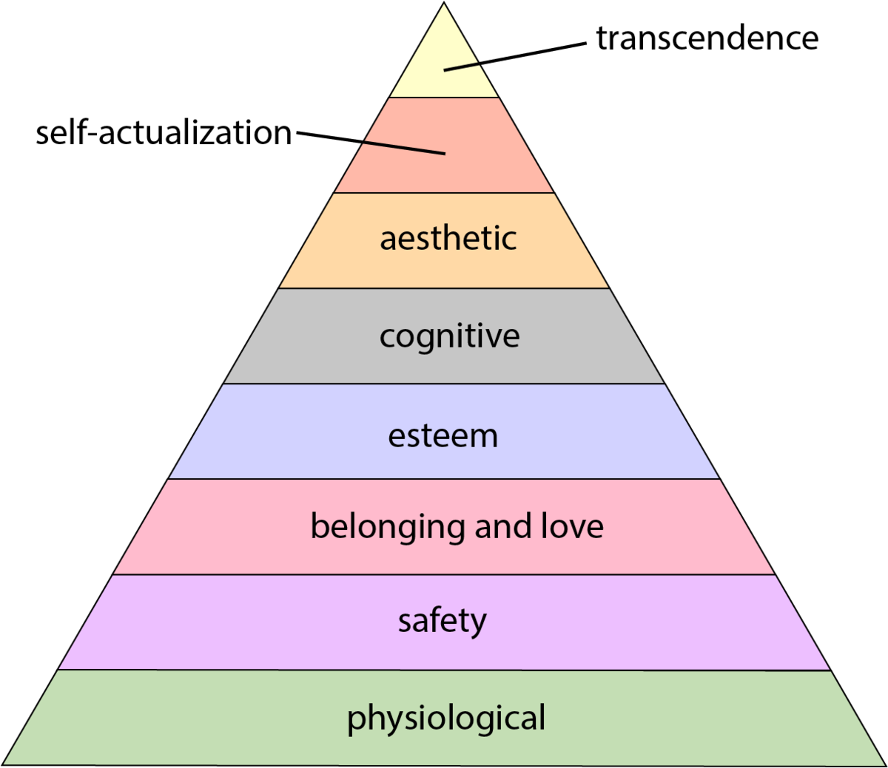
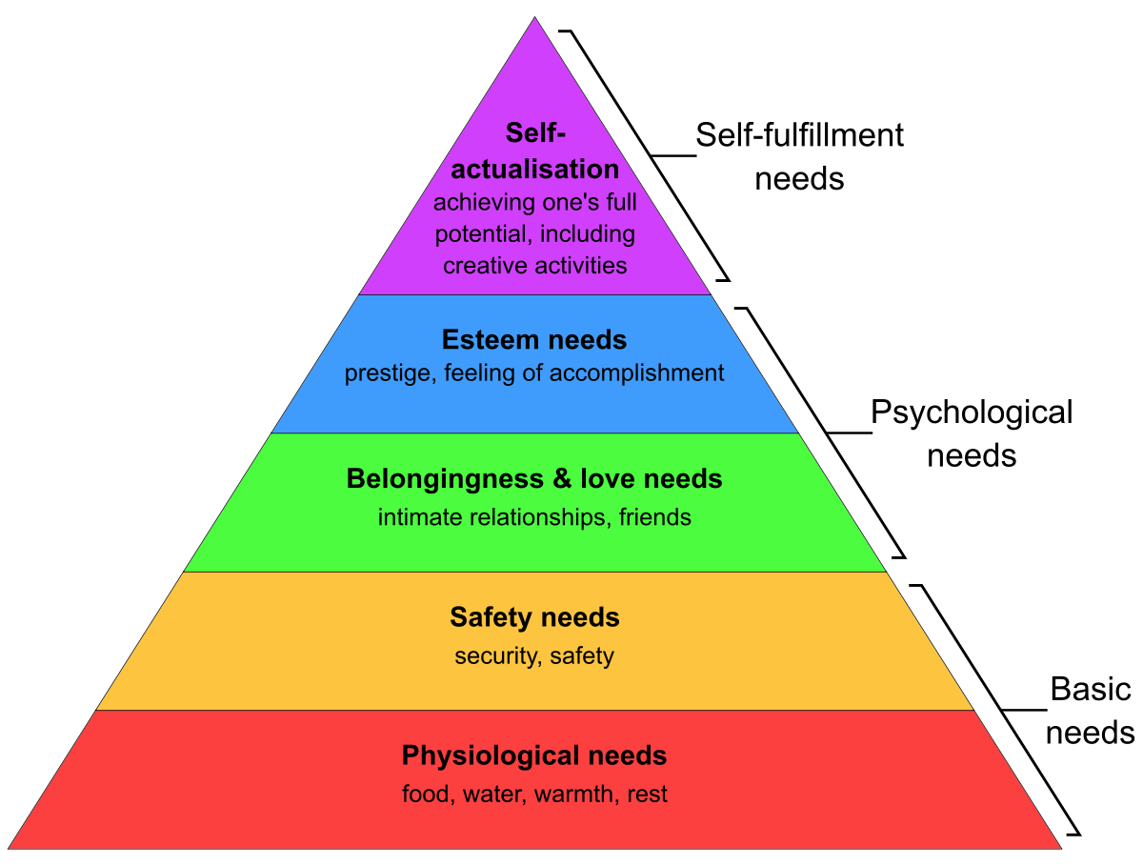
HUMAN NEEDS
Consider satisfying a universal human need, perhaps in a new, enhanced or unique way.
You could consider Maslow’s hierarchy of needs and produce an idea that could help people satisfy a need, in a new, enhanced or unique way.
Physical, Safety, Social, Esteem, Self-Actualization.
  E.g. Applying technology to enhance Health & Well-being.
  E.g. The Internet/Web allows for communication and social connection such as ‘Facebook’ a simple Social Networking tool satisfies peoples social needs. Or ‘Indeed’ for job searching. Or the Joy of playing a new game, a vitamin/tablet reminder App., Biometric monitoring device/app.
Notes:
It could bring people together in some way e.g. to help them collaborate or support each other or create connections to achieve an aim – perhaps a social or skill-sharing element.
Or allow people to use and apply their skills (self-actualise) in a way that would help others.

Slide 14
POSITIVE SOCIAL IMPACT
Consider using technology to enhance peoples lives. It could have a positive effect for a specific group of people, a community, yourself a friend or family member.
    Heal a pain / make life easier for someone.
    Make a task or process easier.
    It could be related to the environment.
    Facilitating social groups.
    It could include the creation of an information system, Web App, Mobile App, Game, Health / Medical device or other application or service etc.
Notes:
It could bring people together in some way e.g. to help them collaborate or support each other or create connections to achieve an aim – perhaps a social or skill-sharing element.
Or allow people to use and apply their skills (self-actualise) in a way that would help others.

Slide 15
EDUCTION
Your idea could educate or inform people in an area you are passionate about or interested in.
It could help people learn and develop new skills e.g. Education App or Game.

Slide 16
HOBBIES
Your idea could relate to something you love 💚 and enjoy 😀.
Create a project idea around a hobby, a topic you are passionate about.

Slide 17
SIMPLICITY
Make things easier, simpler, more social &/or enjoyable.
More user friendly.
E.g. Google, GitHub, Flappy Birds.

Slide 18
GAMIFY
Make something currently mundane into something engaging and/or exciting to use.
IT COULD BE ANYTHING, Gamify a work process or a learning task e.g. in education (rewards for attendance).

Slide 19

Project purpose and PSI
There need’s to be a purpose for your project e.g., the idea could help to solve a problem, provide value to society, a group of people or an Organisation in some way.
Ultimately the project will help you to learn new skills and will have a positive impact.
Consider how what you are interested in or a technology you want to learn could help others.
When you have an idea. Then consider how your idea could have a PSI Positive Social Impact. Don’t worry too much about it initially.
First, choose an idea that you are interested in, that excites you.

Slide 20
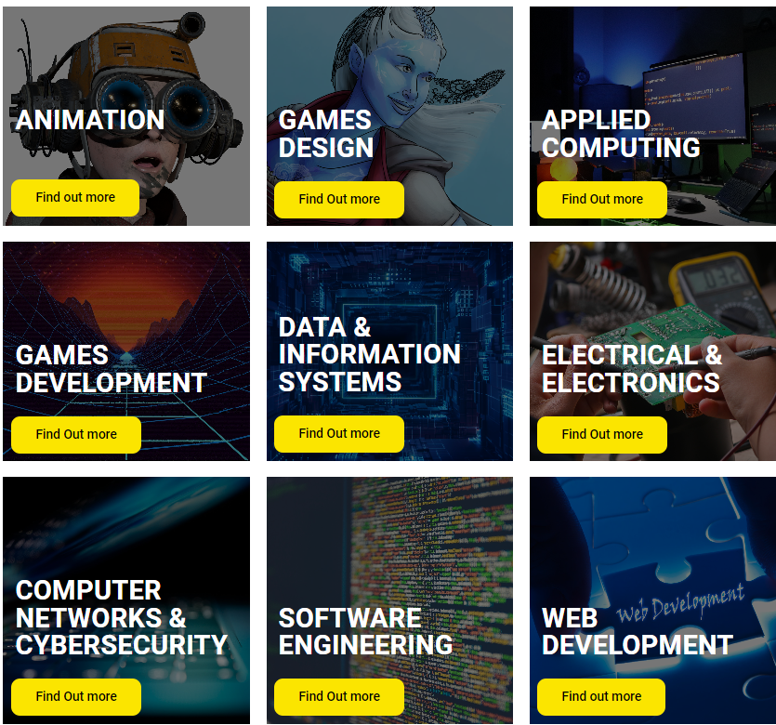

View the ideas below to see if any match your areas of interest and give you ideas for your own project idea.
Degree Show sample projects https://stemsummershowsuwtsd.org/computing/
Examples:
Degree show ideas:

Slide 21
Example Project Titles
Go to Moodle and open the word document titled ‘Example Project Ideas’.
Look through the examples in the document to see if any match your areas of interest and give you ideas for your own project idea.

Slide 22
Online Project examples
For some example ideas, review current projects on 1/2 of the following project development sites:
Github.com
GitLab.com
BitBucket.org
SourceForge.net
Explore the categories/technologies and projects of interest to you.

Slide 23
Crowdfunding sites
For further ideas, also explore:
Current projects on Kickstarter & indiegogo to help you with your own idea generation.
Browse the categories and projects of interest to you.

Slide 24
5-10min Activity:
What do YOU want to do?
Document answers to the following questions:
Q. What would you like to create? if you could create anything what would it be?.
Q. What new skill or technology would you like to learn?.
Q. Positive Social Impact: If you could create something to make the world a better place, what would it be?.
Q. What technology or skill would you like to develop that would make you more attractive to potential employers, promotion or other job roles you would like to move into?.
Note: What would you like to do for your Computing Project? Do that. Simple!. Note: It needs to relate to your course.

Slide 25
Activity: What do YOU want to do?
Q. What would you like to do for your final year Project? Document what comes to mind.
Use this module to come with an idea and start the planning, preparation and design work.

Slide 26
This week’s Activities:
Lecture-tutorial 1:
Brainstorm and consider some project ideas that you would like to take forward and add these to your mind map.
Tutorial 2:
Q&A.
Select a project idea that you would like to take forward and add this to the mind map.
Include your answer to task 1 on a page in your OneNote research proposal.

Slide 27
Register.
Tutor note: Download participant list.

Slide 28

Questions.
Q&A.

Slide 29


Session 2
Support & Study time
Overview slide
Activity slide
Q&A
Register
Time for students to complete Activity / Assignment task.

Slide 30
Overview: The 3Ps of ideation & Innovation
Passion: Follow your passion / do what you love and care about.
Problem solving: Solve a problem related to this area.
Personal/Social Need: Help to satisfy a need for yourself and/or others.

Slide 31
This week’s Activities:
Lecture-tutorial 1:
Brainstorm and consider some project ideas that you would like to take forward and add these to your mind map.
Tutorial 2:
Q&A.
Select a project idea that you would like to take forward and add this to the mind map.
Include your answer to task 1 on a page in your OneNote research proposal.

Slide 32
Q&A: Teams

Slide 33

Student Social & Support.

Slide 34
The End.

Slide 35
Archive slides.

Slide 36

Reminder: Q&A Etiquette
To ensure fairness for all and to ensure everyone equally benefits from answers, if you have a general/module/assessment question, ask during the weekly tutorial session.
Not via email or via Teams.
If you have a personal question that needs to be addressed in private, ask the module tutor privately during or after the class. Or via email and the tutor will get back to you asap. However due to the current number of modules and students being taught at the moment, it may take a little while. Sometimes, it is not possible to answer emails in-between lecture/tutorials sessions. If this is the case, please ask during or after the next Lecture-tutorial.
For general questions, ask during the Lecture-tutorial Q&A time.
This Photo by Unknown Author is licensed under CC BY-NC-ND

Slide 37
Changemakers Computing Innovation Project
Your project should help you to develop new up-to-date skills.
Your project should be of interest to you and Computing related.
Your project will need to have a positive purpose and add value to yourself / society in some way.
Due to the time limitations, be careful to limit the scope of your project.

Slide 38

The Key to Success
The key to success in this module is to try and make Weekly progress.
You will not be able to leave it until the last minute.

