Slide 1
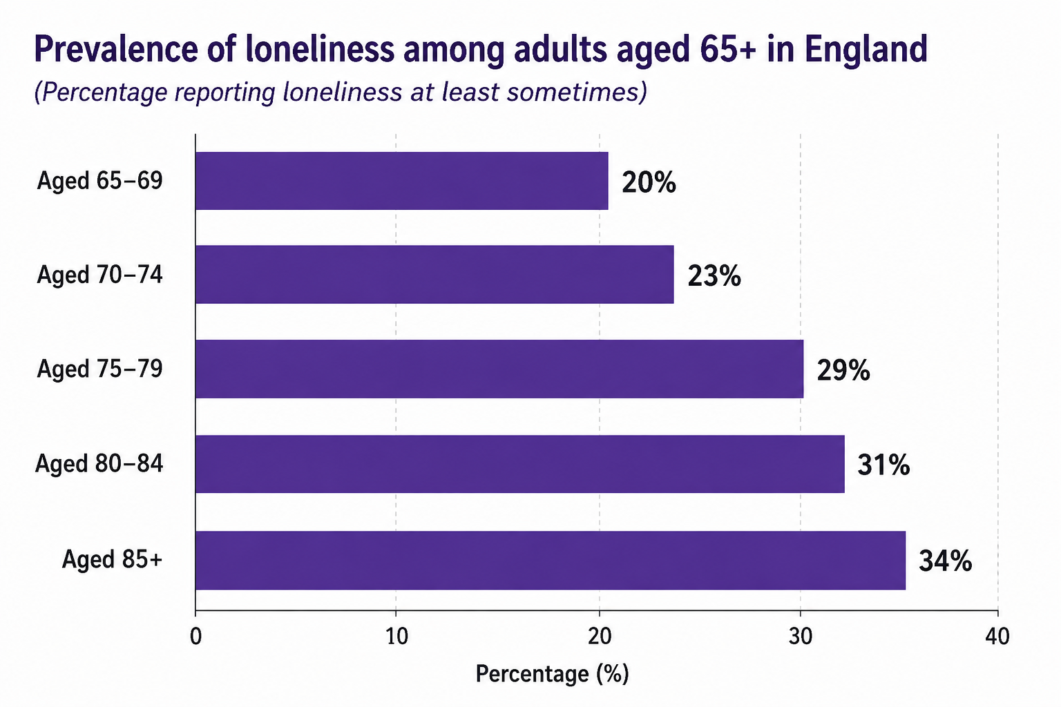
The Impact of Social Isolation on the Mental and Physical Health of Older Adult in UK
Paula Latorre Restrepo | 2231782@student.uwtsd.ac.uk | Practice-Based Research (LCHS7008)
1. INTRODUCCTION/ RATIONALE
Social isolation is now considered one of the main public health challenges for all older adults globally, impacting the wellbeing of one in two of the older adult population (WHO, 2023)
RESEACRH QUESTION
How does social isolation affect the
mental and physical health of older
adults living In the UK?
AIM
To explore the impact of social isolation
on the mental and physical health of
older adults living in the UK.
2. PREVALENCE
Social isolation and loneliness are common among older adults in the UK
Health consequences linked to social isolation
Cardiovascular Depression Cognitive Weaker Higher Premature
disease & decline & immune hospital mortality
anxiety dementia function admissions
3. RESEARCH IMPACT
This research will generate important evidence to inform policies, practice and interventions aimed at reducing social insolation among older adults in the UK.
Support better health outcomes: By understanding the impact of social isolation, we can improve mental and physical health and wellbeing of older adults (WHO,2023)
Reduce health inequalities and costs: By addressing social isolation, we can reduce preventable illness, hospital admissions and healthcare costs.
Improve quality of life and wellbeing: Promote social inclusion, independence and dignity in later life.
Guide public health policy: Findings can contribute to evidence-based policies that prioritise social connection and healthy ageing (DHSC, 2023)
Assist health and social care professionals: Improve early identification of socially isolated individuals and promote person-centred care.
Inform and strengthen interventions: Evidence will support the development and evaluation of community programmes and social prescribing initiatives.
With an ageing population and a rise in older adults living alone, more people in the UK are susceptible to loneliness and illness (ONS, 2024)
Research has also highlighted that social isolation can have profound impacts on an individual’s risk of depression, anxiety, dementia, cardiovascular disease, and even premature death (Holt-Lunstad et al., 2015)
Social interventions like social prescribing and community programmes are being implemented nationwide to combat social isolation and loneliness, but little is known about their long-term effects (NHS England, 2024).
1.4
Millon
Older adults experience chronic loneliness in England (Age UK ,2024)
2+
Millon
People aged 75+ live alone in England
29%
Increased risk ok premature mortality with social isolation
2-3X
Higher risk of depression and anxiety among socially isolation older adults.
OBJECTIVES
1. To identify the main factors contributing to social isolation among older adults
2. To examine the impact of social isolation on mental health
3. To investigate the effects of social isolation on physical health and quality of life
4. To explore current public health interventions designed to reduce social isolation
5. To provide recommendations for health and social care professionals to improve social connectedness.
Loneliness increase with age, with the highest levels reported in those age, 85+ (NHS England, 2024)
REFERENCES
Age UK (2024) Loneliness in Later Life. Available at: https://www.ageuk.org.uk/our-impact/policy-research/loneliness-research-and-resources/ (Accessed: 20 June 2026).
Cacioppo, J.T. and Cacioppo, S. (2018) The Growing Problem of Loneliness. Oxford: Oxford University Press.
Courtin, E. and Knapp, M. (2017) 'Social isolation, loneliness and health in old age: A scoping review', Health and Social Care in the Community, 25(3), pp. 799–812.
Department of Health and Social Care (2023) Major Conditions Strategy: Case for Change and Strategic Framework. London: DHSC
Donovan, N.J. and Blazer, D.G. (2020) 'Social isolation and loneliness in older adults: Review and commentary', The American Journal of Geriatric Psychiatry, 28(12), pp. 1233–1244
Holt-Lunstad, J., Smith, T.B., Baker, M., Harris, T. and Stephenson, D. (2015) 'Loneliness and social isolation as risk factors for mortality: A meta-analytic review', Perspectives on Psychological Science, 10(2), pp. 227–237.
NHS England (2024) Social Prescribing. Available at: https://www.england.nhs.uk/personalisedcare/social-prescribing/ (Accessed: 21 June 2026).
Office for National Statistics (2024) Loneliness in Great Britain. Available at: https://www.ons.gov.uk (Accessed: 20 June 2026).
Victor, C.R. and Yang, K. (2012) 'The prevalence of loneliness among adults: A case study of the United Kingdom', International Psychogeriatrics, 24(10), pp. 1549–1561.
World Health Organization (2023) Social Isolation and Loneliness. Available at: https://www.who.int/teams/social-determinants-of-health/demographic-change-and-healthy-ageing/social-isolation-and-loneliness (Accessed: 19 June 2026).
Campaign to End Loneliness (2023) The Facts on Loneliness. Available at: https://www.campaigntoendloneliness.org (Accessed: 29 June 2026).
NHS (2024) Mental Health and Wellbeing in Older People. Available at: https://www.nhs.uk (Accessed: 29 June 2026)
National Institute for Health and Care Excellence (NICE) (2023) Older People: Independence and Mental Wellbeing. London: NICE.
Public Health England (2021) Health Profile for England. London: PHE
United Nations (2021) World Population Ageing 2020 Highlights. New York: United Nations.
METHODOLOGY (OVERVIEW)
DESING
Secondary qualitative research using a systematic literature review approach
DATA SOURCES
Peer-reviewed journals, NHS reports, government documents and charity publication
INCLUSION CRITERIA
1. Studies from the las 10 years.
2. Focus on adults ages 65+
3. UK context
ANALISY
Thematic synthesis of findings to identify patterns, impacts and effective interventions
ETHICS
Secondary data; Ethical use of sources and accurate referencing

