Slide 1
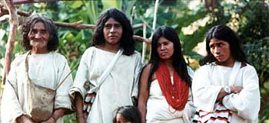
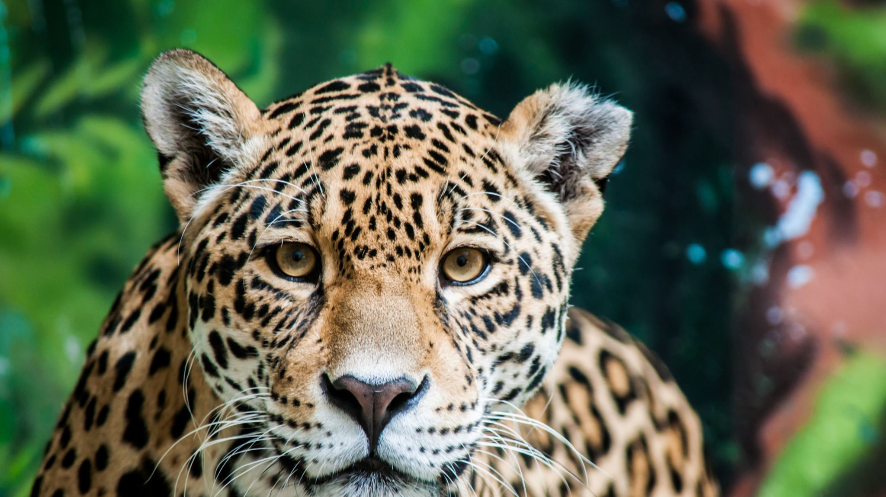
The Kogi
“Jaguar”(Ereira, 2012)
From:
Sierra Nevada of Santa Marta
Northern Columbia (Godrèche,2013)
By: Julia Jones October 2021.
This Photo by Unknown author is licensed under CC BY-SA-NC.
Notes:
‘Kagaba’ - Indigenous tribe - Highest costal mountain range in world – Aztec/Inca peoples – cotton, food, crops, farm cattle.

Slide 2
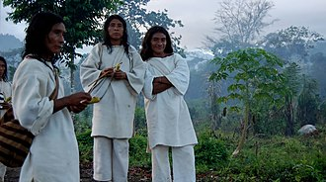
They believe:
In – “Mother Earth” (Ereira, 2012)
It is – “Their job to care for the world”
(Ereira, 2012)
“We are mutilating the World and we need to change or Nature itself will finish us off” (Ereira, 2012)
This Photo by Unknown author is licensed under CC BY-SA.
Notes:
Spiritual leaders – MAMOS – Knowledge of healing – live in darkness,18, to connect with ALUNA The Governing force of the World. Elder Brothers of Humanity, younger brothers come back destroy.

Slide 3
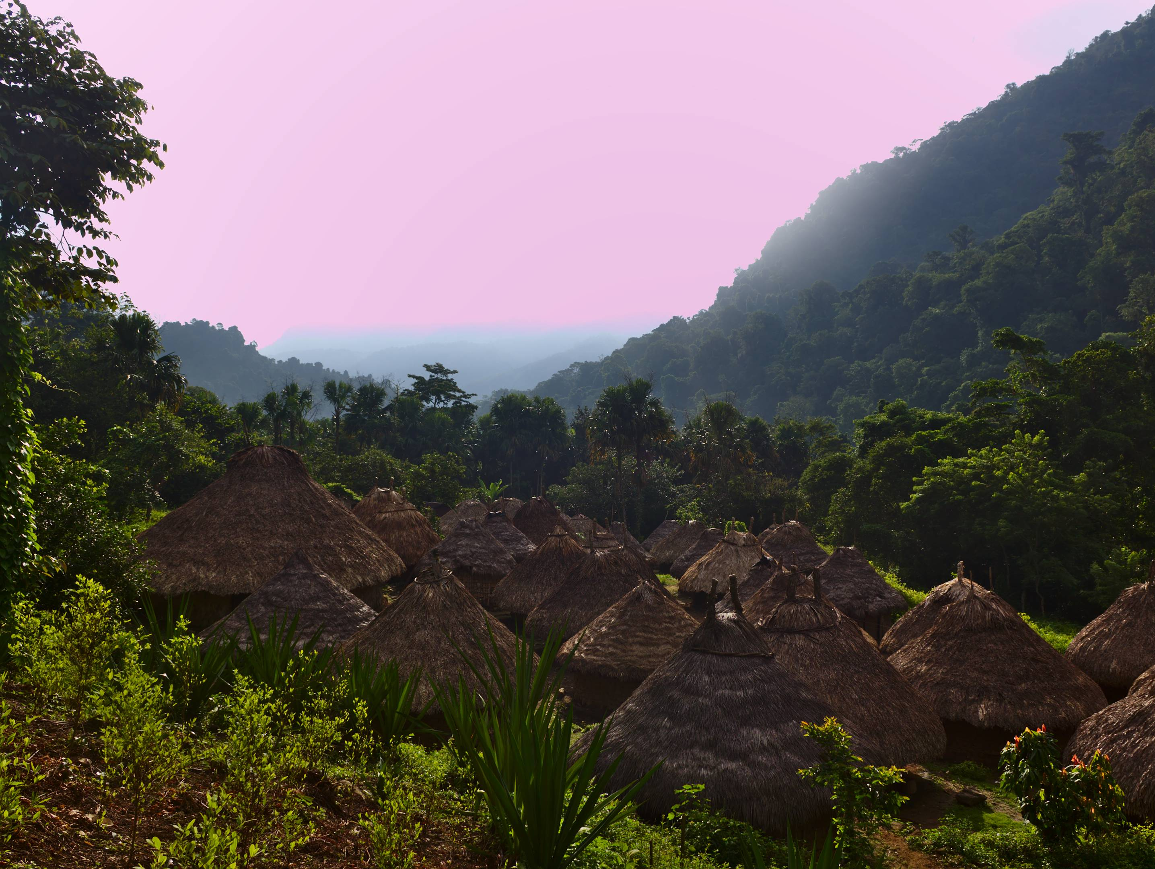
Landscape and Environment
How a cycle of digging and building without consideration is depleting their water and food supplies. (Ereira, 2012)
Power plants and water ways going against the Kogi’s way of giving and receiving to the earth. (Ereira, 2012)
Their mindful approach being poisoned/drowned out by modern living. (Ereira, 2012)
They listen, see and feel the changes in the environment, helpless to stop the cause. (Ereira, 2012)
This Photo by Unknown author is licensed under CC BY-ND.

Slide 4
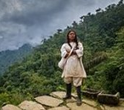
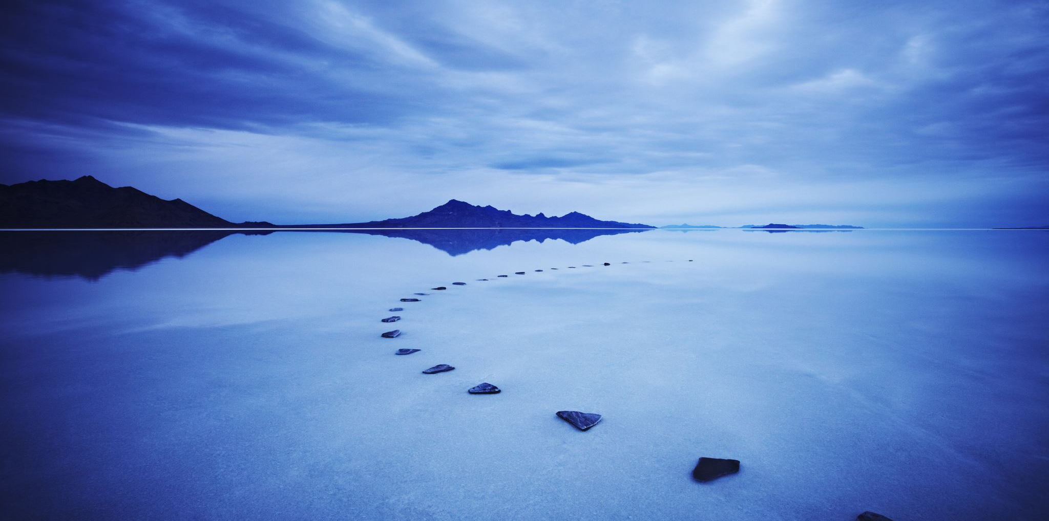
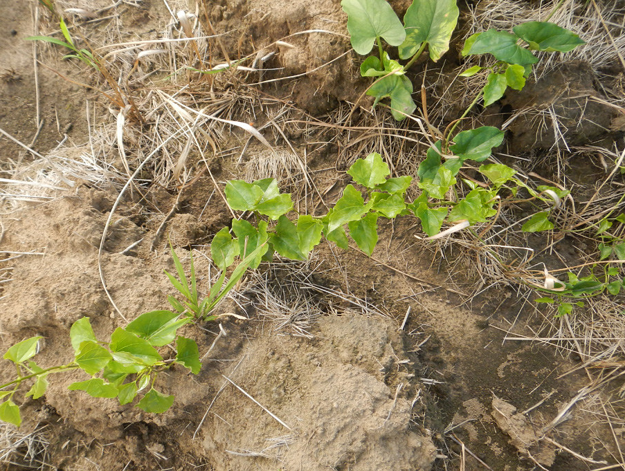
How change is effecting the Kogi ?
Their cycle is being broken and their lines crossed.​
They are being bruised alongside their Mother Earth.
Tourism, logging, mining, road, building, drug dealers, guerrillas and looters to contend with (Godrèche , 2013)(Reddy, 2013)
Conclusion.
The environment is being affected by people changing the landscape which in turn affects the environment - naturally designed to work together.
This Photo by Unknown author is licensed under CC BY-NC.

Slide 5
Reference List
‘Aluna,’ ‘A Journey to Save the World’. 2012. Directed By Alan Ereira. Sun Stone films.
‘Heart of the World: ‘The Elder Brothers Warning’. 1990. Directed by Alan Ereira. BBC
Godrèche, D. 2013. “The Kogi Fight to preserve their Ancient Wisdom”. Indian Country Today. [Online article].Available at: https://indiancountrytoday.com/archive/the-kogi-fight-to-preserve-their-ancient-wisdom (Accessed: 8-09-2021).
Reddy, J. 2013. ‘What Colombia's Kogi people can teach us about the environment’, Health and Wellbeing. The Guardian (29th October). [Online article]. Available at: https://www.theguardian.com/sustainable-business/colombia-kogi-environment-destruction (Accessed : 08-09-2021)
Uribe, C.A., 1990. We, the elder brothers: continuity and change among the Kaggaba of the Sierra Nevada de Santa Marta, Colombia (Doctoral dissertation, University of Pittsburgh).

