Slide 1


Preparing for the Role of Constable Domestic Abuse Recap
Week 5 Part 1

Slide 2

Today’s objectives……
Define
Domestic Abuse
Explain
Police Officers’ first response actions in relation to Golden Hour enquiries

Slide 3
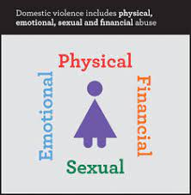

What is domestic abuse?

Slide 4
Overview of Domestic Abuse Act 2021
29th April 2021, Domestic Abuse Act 2021 became law
Aim is to ensure that DA is properly understood & that it is unacceptable & will be challenged
New legal definition of DA
Children as victims of DA
Extension of coercive control offence
Domestic Abuse Protection Orders (DAPOs)
Domestic Violence Disclosure Scheme (Clare’s Law) now on a statutory footing
Domestic Abuse Commissioner
Notes:
The new Act supports the view that DA can take many forms. The legal definition now incorporates a range of abuses beyond physical violence including emotional, coercive and controlling behaviour and economic abuse. The abuse can be behaviour consisting of a single incident or course of conduct.
Victim and perpetrator must be personally connected. The definition ensures that different types of relationships are captured including ex-partners and family members. The definition is gender neutral to ensure that all victims and all types of DA are sufficiently captured. The definition does not extend to paid and unpaid carers, unless they are personally connected.
It will also provide further protection to the millions of people who experience DA, as well as strengthen measures to tackle perpetrators
DA is for over 16years, if abusive behaviour were directed to under 16 years old, it would be dealt with as child abuse rather than DA. However, for the first time a child who sees or hears, or experiences the effects of DA and is related to the person being abused or the perp, is also to be regarded as a victim of DA in their own right. This will help ensure that services address the needs of children affected by DA. (this will be one of the functions of the DA Commissioner to encourage good practice and the provision of protection in relation to the ID of children affected by DA)

Slide 5
Definition of ‘Domestic Abuse’
Behaviour of person A towards another person B is domestic abuse if -
A & B are each aged 16 or over & are personally connected to each other, & the behavior is abusive
Behaviour is ‘abusive’ if it consists of any of the following – physical or sexual abuse, violent or threatening behavior; controlling or coercive behavior; economic abuse, psychological, emotional or other abuse;
And it does not matter whether the behavior consists of a single incident or a course of conduct
Notes:
Definition of “personally connected”
(1)For the purposes of this Act, two people are “personally connected” to each other if any of the following applies—
(a)they are, or have been, married to each other;
(b)they are, or have been, civil partners of each other;
(c)they have agreed to marry one another (whether or not the agreement has been terminated);
(d)they have entered into a civil partnership agreement (whether or not the agreement has been terminated);
(e)they are, or have been, in an intimate personal relationship with each other;
(f)they each have, or there has been a time when they each have had, a parental relationship in relation to the same child (see subsection (2));
(g)they are relatives.
(2)For the purposes of subsection (1)(f) a person has a parental relationship in relation to a child if—
(a)the person is a parent of the child, or
(b)the person has parental responsibility for the child.
(3)In this section—
“child” means a person under the age of 18 years;
“civil partnership agreement” has the meaning given by section 73 of the Civil Partnership Act 2004;
“parental responsibility” has the same meaning as in the Children Act 1989 (see section 3 of that Act);
“relative” has the meaning given by section 63(1) of the Family Law Act 1996. (4)Economic abuse” means any behaviour that has a substantial adverse effect on B’s ability to—
(a)acquire, use or maintain money or other property, or
(b)obtain goods or services.
(5)For the purposes of this Act A’s behaviour may be behaviour “towards” B despite the fact that it consists of conduct directed at another person (for example, B’s child).
3Children as victims of domestic abuse
(1)This section applies where behaviour of a person (“A”) towards another person (“B”) is domestic abuse.
(2)Any reference in this Act to a victim of domestic abuse includes a reference to a child who—
(a)sees or hears, or experiences the effects of, the abuse, and
(b)is related to A or B.
(3)A child is related to a person for the purposes of subsection (2) if—
(a)the person is a parent of, or has parental responsibility for, the child, or
(b)the child and the person are relatives.
(4)In this section—
“child” means a person under the age of 18 years;
“parental responsibility” has the same meaning as in the Children Act 1989 (see section 3 of that Act);
“relative” has the meaning given by section 63(1) of the Family Law Act 1996.
Controlling behaviour is: a range of acts designed to make a person subordinate and/or dependent by isolating them from sources of support, exploiting their resources and capacities for personal gain, depriving them of the means needed for independence, resistance and escape and regulating their everyday behaviour.
Coercive behaviour is: an act or pattern of acts of assault, threats, humiliation and intimidation or other abuse that is used to harm, punish, or frighten their victim

Slide 6
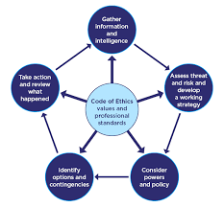
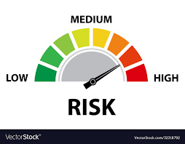

Slide 7

High Risk Victim
There are identifiable indicators of risk of serious harm.
The potential event could happen at any time and the impact would be serious.
Serious Risk of Harm
"A risk which is life threatening and or traumatic and from which recovery, whether physical or psychological can be expected to be difficult or impossible".

Slide 8

Medium Risk Victim
There are identifiable indicators of risk of serious harm.
The offender has the potential to cause serious harm but is unlikely to do so unless there is a change in circumstances, for example, failure to take medication, loss of accommodation, relationship breakdown, drugs or alcohol abuse.

Slide 9

Standard Risk Victim
Current evidence does not indicate likelihood of causing serious harm

Slide 10


Repeat Victim
A repeat victim is someone who has reported two or more domestic abuse incidents to the police within a rolling 12-month period, accepting that this could an incident and/or a crime.

Slide 11
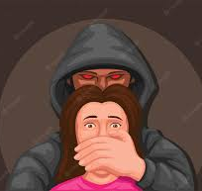
Repeat Perpetrator
A repeat perpetrator is someone who has been reported to the police as having committed or threatened domestic abuse against the same victim more than once in the last rolling 12- month period. This includes current or former intimate partners and family members.

Slide 12
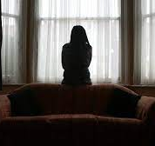
Serial Perpetrator
A serial perpetrator is someone who has been reported to the police as having committed or threatened domestic abuse against two or more victims. This includes current or former intimate partners and family members.

Slide 13

Preserve Life
Risk
Safeguarding
Officer Safety
Medical Assistance
Police Protection
Powers of entry
Decision Making

Slide 14
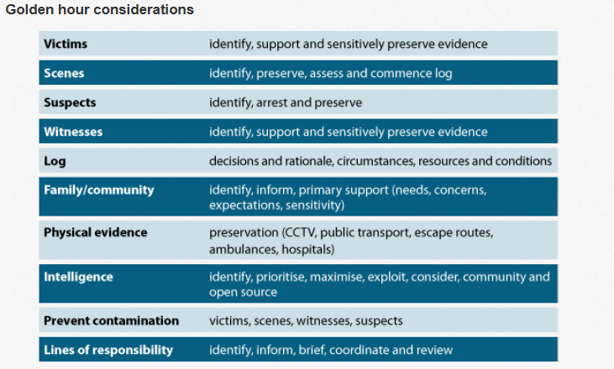
College of Policing (2022)
Notes:
GOLDEN HOUR:
Testimony of victims and witnesses can be obtained while the offence is still fresh in their mind.
Physical evidence secured and not disposed of or lost to the investigation.
Suspects located earlier, maximising opportunities to recover property and forensic evidence.
CCTV footage and other data can be collected before it is deleted.
Scenes are identified and secured before they become contaminated.
Interview of suspect, CPS advice and Charge/Remand completed sooner.
(Reducing time, money and safe guarding victim/witnesses)
Corroborative evidence obtained (Injuries, demeanour, first accounts etc.)
Improve levels of response & investigation to deliver an excellent service to the public (FORCE PRIORITY)
House to house.
Separate / Positive Action

Slide 15

DASH Model
Domestic Abuse, Stalking, Harassment
(including Honour-Based Abuse)
Risk identification, Assessment and Management

Slide 16
The DASH model seeks to……
Help front line practitioners & specialist staff identify high risk DA, stalking & harassment & HBV
Help staff to identify dangerous & serial perpetrators
Decide which cases should be referred to MARAC, & what other support might be required. A completed form becomes an active record
A common tool for agencies that are part of MARAC process & provides a shared understanding of risk in relation to DASH & HBA
Enable agencies to make defensible decisions based on the evidence from extensive research of cases, including domestic homicides & ‘near misses’ which underpins most models of RA

Slide 17

PPN: Public Protection Notification

Slide 18
Risk Levels of DA
STANDARD
Current evidence does not indicate likelihood of causing serious harm
MEDIUM
There are identifiable indicators of risk of serious harm. Offender has potential to cause serious harm but unlikely unless there is a change of circumstances
HIGH
There are identifiable indicators of risk of serious harm, which could happen at anytime.

Slide 19

Multi Agency Risk Assessment Conference (MARAC)
MARAC is a gathering of agencies who aim to:
Safeguard adult victims
Link with other PP Agencies in relation to children, perpetrators & other VA’s
To safeguard agency staff
To address the behaviour of perpetrators

Slide 20

A PPN form must be submitted in every Domestic Abuse and Stalking and Harassment incident
The PPN is used to update partner agencies and share information they may be aware of in order for them to provide further assistance to the victims and other vulnerable persons

Slide 21

PPN
The PPN lists 29 questions which are used to identify, assess & manage risk in relation to DA
All 29 questions must be asked for every DASH incident
All decisions & actions must be reviewed, recorded & updated
The risk identification process remains dynamic & must be kept under review

Slide 22
PPN Referral Pathway Example…
PPN completed by Officer
Officers tasks DAU box according to RA made on PPN
PPU Risk Assessor
Social Services
IDVA
Education
Health
3rd Sector Agencies

Slide 23

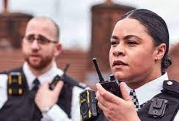
There are 18 Specific
HIGH RISK questions
However, there is the need to use professional judgement
- a person who engages in an activity with competence and skill and being able to make an informed decision based on a balanced viewpoint.
Notes:
Such situations may include:
• There are extreme levels of fear.
• Cultural barriers to disclosure such as in cases of ‘honour based violence’ and female genital mutilation.
• Extreme levels of control and/or isolation.
• Obsessive stalking behaviour.
• Where the perpetrator is abusing more than one partner.
• Fear of loss of financial support, or losing children, house etc.
• Remind the delegates that if they are not so experienced – and therefore not so confident with their professional judgement, they should speak to a supervisor or someone more experienced in this area - a specialist/domestic abuse officer, for example.
• Using the sum total of your knowledge, experience and skill, you have concerns about this person’s risks and the risk of serious harm is high. A question the delegates should ask themselves here would be “What do I feel that I cannot walk away from?”

Slide 24

S75A Serious Crime Act 2015 – Strangulation or Suffocation
75A(1) A person (‘A’) commits an offence if-
(a) A intentionally strangles another person (‘B’), or
(b) A does any other act to B that –
(i) affects B’s ability to breath, &
(ii) constitutes battery of B
75A (2) It is a defence to an offence under this section for A to show that B consented to the strangulation or other act
75A(3) But subsection (2 ) does not apply if-
(a) B suffers serious harm as a result of the strangulation or other act, &
(b) A either –
(i) intended to cause B serios harm, or
(ii) was reckless as to whether B would suffer serious harm
Notes:
****A new piece of legislation has come into force concerning non-fatal strangulation, meaning abusers will now face up to five years behind bars.
The offence, created as part of landmark domestic abuse legislation, applies to perpetrators who strangle or intentionally affect their victim’s ability to breathe in an attempt to control or intimidate them. The Domestic Abuse Act 2021 amends the Serious Crime Act 2015, introducing 2 new sections — section 75A and 75B— which will create a new and specific criminal offence of non-fatal strangulation and suffocation.
It came into force on Tuesday (June 7) in England and Wales and will also apply to British nationals who are overseas.
The move follows concerns that abusers were avoiding punishment as non-fatal strangulation does not always leave visible signs of injury.
Signs to look out for include bloodshot eyes, or bleeding in the ear or jaw pain or a swollen tongue instead of marks around the neck.

Slide 25
The Entrapment Process
Stage 1
Grooming/ Conditioning
Stage 2
Normalisation
Stage 3
Entrapment
Notes:
Please see entrapment process handouts

