Slide 1
Mental Health in the Elderly

Slide 2
What is Mental Health?
Mental health includes our emotional, psychological, and social well-being.
It affects how we think, feel, and act.
It also helps determine how we handle stress, relate to others, and make choices.
Mental health is important at every stage of life, from childhood and adolescence through adulthood and old age.
(MentalHealth.gov, 2017)

Slide 3
What is Mental Health?
If a person experiences mental health problems, their thinking, mood, and behaviour could be affected. Many factors contribute to mental health problems, including:
Biological factors, such as genes or brain chemistry
Life experiences, such as trauma or abuse
Family history of mental health problems
(MentalHealth.gov, 2017)

Slide 4
Mental Health Problems in Later Life
It is commonly thought that older people are more likely to suffer from depression and anxiety but…
Other than dementia, the risk of psychiatric disorders declines after age 65
Later life depression and mental health is hard to diagnose and can also be misdiagnosed due to other factors including normal ageing
(Pachana, 2016)

Slide 5
Mental Health Problems in Later Life
Depression -most common MH problem (1 in 5 older people) but most treatable
This figure doubles in the presence of physical illness and trebles in hospitals and care homes.
Anxiety disorders are present in one in twenty people and very frequently along with depression.
Less than one in ten people present with bipolar disorder in older age
1 in 20 older people present with psychotic symptoms
Older people more frequently have symptoms of depression or dementia than late-onset schizophrenia.
(NHS, 2017)

Slide 6
World Health Organisation
(WHO)
Key facts
Globally, the population is ageing rapidly. Between 2015 and 2050, the proportion of the world’s population over 60 years will nearly double, from 12% to 22%.
Mental health and well-being are as important in older age as at any other time of life.
Mental and neurological disorders among older adults account for 6.6% of the total DALYs (disability adjusted life years) for this age group.
Approximately 15% of adults aged 60 and over suffer from a mental disorder.
(WHO. 2017)

Slide 7
World Health Organisation
(WHO)
The most common mental and neurological disorders in this age group are dementia and depression, which affect approximately 5% and 7% of the world’s older population, respectively.
Anxiety disorders affect 3.8% of the older population
Substance use problems affect almost 1%. and are often overlooked or misdiagnosed.
Around a quarter of deaths from self-harm are among people aged 60 or above
Mental health problems are under-identified by health-care professionals and older people themselves, and the surrounding stigma makes people reluctant to seek help.
(WHO, 2017)

Slide 8
Risk Factors for Mental Health Problems among Older Adults
Significant ongoing loss in capacities and a decline in functional ability
Reduced mobility, chronic pain, frailty or other health problems
Critical life events such as bereavement, or a drop in socioeconomic status with retirement
Isolation, loneliness or psychological distress
Mental health has an impact on physical health and vice versa
(WHO, 2016)

Slide 9
Risk Factors for Mental Health Problems among Older Adults
Older adults with physical health conditions such as heart disease have higher rates of depression than those who are healthy
Untreated depression in an older person with heart disease can negatively affect its outcome.
Older adults are also vulnerable to elder abuse - including physical, verbal, psychological, financial and sexual abuse; abandonment; neglect; and serious losses of dignity and respect.
Current evidence suggests that 1 in 6 older people experience elder abuse which can lead not only to physical injuries, but also to serious, sometimes long-lasting psychological consequences, including depression and anxiety
(WHO, 2016)

Slide 10
Elderly Mental Health in the UK
Half of adults aged 55 and over have experienced common mental health problems
Nearly half of adults (7.7million) aged 55+ say they have experienced depression
7.3 million have suffered with anxiety

Slide 11
UK cont…
In a recent NHS/Age UK study older people stated that their poor mental health was caused by…
The death of loved ones 36%
Ill health of themselves 24%
Financial worries 27%
Also, 35% say they did not know where to go for help and support
(NHS England, 2017)

Slide 12
UK cont…
25% said they felt it was more difficult for older people to discuss mental health issues such as anxiety or depression, compared to younger people because…
When older people were growing up, society didn’t recognise depression or anxiety as a health condition
Depression and anxiety used to be seen as a weakness, so it’s not something the older generation are comfortable discussing
The older generation were taught to approach life with a “stiff upper lip”
(NHS England 2017)

Slide 13
GPs…
Depression
Anxiety
Late-onset Schizophrenia
Delirium
Charles Bonnet syndrome
Hoarding disorder and Diogenes syndrome
Seasonal Affective Disorder (SAD)
Elder abuse
Alcohol
Personality problems
(NHS, 2017)

Slide 14
Depression and Anxiety
Having depression or anxiety is like a physical health condition, and it can be successfully treated

Slide 15
Depression
Being depressed can show itself in different ways and each person’s experience will be different. Symptoms include:
lack of interest and unable to enjoy things you normally enjoy
being reluctant to engage in usual activities or leave your house
feeling tired
sleeping too much or too little
loss of appetite or eating more than usual
(AgeUK 2019)

Slide 16
Depression
losing or gaining weight over a relatively short time
losing confidence in yourself and feeling life is pointless
being self-critical and feeling guilty
having suicidal thoughts.
For every 100 people with depression, only 50 seek treatment and only 25 are diagnosed.
Older people with depression usually experience more physical symptoms – such as tiredness, weight loss, and problems sleeping
(AgeUK 2019)

Slide 17
Anxiety is a feeling a worry or fear that everyone experiences from time to time symptoms include:
Anxiety
feeling restless or ‘on edge’
irritability
racing heartbeat
dry mouth
nausea
sweating
Individuals may experience depression and anxiety separately, or have both together

Slide 18
Late-onset Schizophrenia
High risk factors- Female- Socially Isolated-Sensory Impairment-
Common symptoms are- Persecutory delusions- Auditory hallucinations
About a fifth of older adults with late onset psychosis suffer from visual, tactile or olfactory hallucinations
Treatments include- Low dose anti psychotics- Social interventions-
Psychological treatments are often declined
(NHS, 2017)

Slide 19
Treatments and Interventions
Drug Treatments
Psychological TreatmentsSocial Interventions
Electroconvulsive Therapy (ECT)
https://www.youtube.com/watch?v=1Izmyru5T_w
https://www.youtube.com/watch?v=2KxU3dPeink

Slide 20
Mind Matters-Mental Health for Older People
https://www.youtube.com/watch?v=63f0lRvdB5s

Slide 21
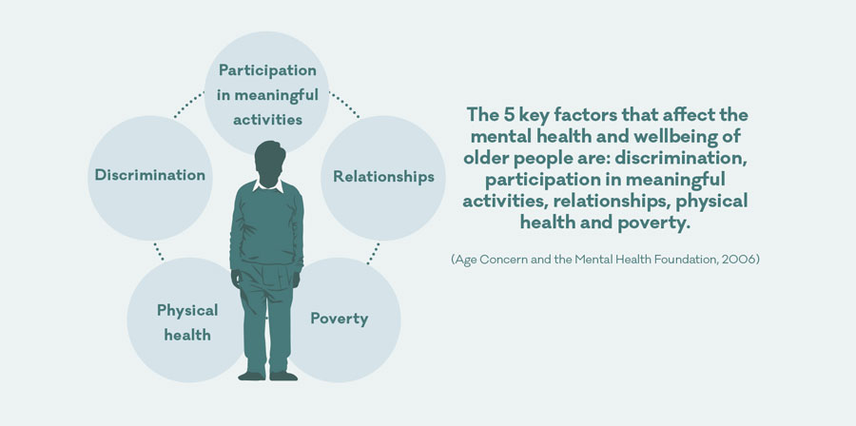
Mental Health and Wellbeing

Slide 22

The fulfilment of belongingness and love needs contributes to good mental health
Esteem needs- personal worth, value, self esteem are a priority for health and well being in older people
(RVS, 2015)
(JRF, 2009)

Slide 23
Policies Relating to Mental Health in Older People
The Care Act (2014)
Mental Capacity Act, (2005) DoLS
Health and Social Care Act (2012)
Equality Act (2010)
Strategy for Older People in Wales (2013)

Slide 24
REFERENCES
AgeUK, (2019) Depression and Anxiety Available at: https://www.ageuk.org.uk/information-advice/health-wellbeing/conditions-illnesses/depression-anxiety/ (Accessed: 20th March 2019).
JRF, (2009) Older People’s Vision for Long Term Care. Available at: http://www.cpa.org.uk/ltc/older-people-vision-for-care-full.pdf (Accessed: 8th March 2019).
MentalHealth.gov, (2017) What Is Mental Health? Available at: https://www.mentalhealth.gov/basics/what-is-mental-health (Accessed: 20th March 2019).
NHS, (2017) Mental Health in Older People A Practice Primer Available at: https://www.england.nhs.uk/wp-content/uploads/2017/09/practice-primer.pdf (Accessed: 20th March 2019).
NHS England, (2017) Half of Adults Aged 55 and Over have Experienced Common Mental Health Problems, say Age UK Available at: https://www.england.nhs.uk/2017/10/half-of-adults-aged-55-and-over-have-experienced-common-mental-health-problems-say-age-uk/ (Accessed: 22nd March 2019).
Pachana, N. (2016) Ageing. A Very Short Introduction Oxford: Oxford University Press.
RVS, (2015) Feeling well and overcoming loneliness. Available at: http://www.royalvoluntaryservice.org.uk/get-help/advice-and-support/feeling-well-and-overcoming-loneliness?gclid=CN3PgqbWt8UCFUHmwgodhV8AQA (Accessed: 24th March 2019).
WHO, (2017) Mental Health of Older Adults Available at: https://www.who.int/news-room/fact-sheets/detail/mental-health-of-older-adults (Accessed: 20th March 2019).

