Slide 1
Remote sensing and imaging
Lecture 3
Sensor Systems

Slide 2
Contents
Having looked at the basic physics concepts underlying remote sensing we can now start applying that knowledge
  Static, aerial and satellite survey missions
  Cameras
  Scanners
  Current Systems

Slide 3
Platforms
Sensors used for earth observation can be operated at anything from a few centimetres above the ground to tens of thousands of kilometres above sea level
The sensors are attached to a platform of some type
Most platforms are moving platforms – satellites, spacecraft, aircraft, drones, balloons
Some platforms are static – e.g. pole-mounted systems used for monitoring reflectance over the day

Slide 4
Moving platforms
Survey aircraft operate at up to 20km altitude
  Commonly used between 500m and 8km
Fixed wing are used for photomapping, thermal imaging and laser scanning
  Cameras are heavy and bolted to a stabilised mount in the floor of the craft
  Speeds are as low as 150 km/s, but even this low speed requires blur correction when the data is processed
  Airborne laser scanners are now light enough to also use on helicopters
Helicopters can fly low and slow, leading to high-resolution imaging (resolution = cost)
Microlights can be used in urban areas where helicopters cannot be used
  These use lighter small-format cameras

Slide 5
Moving platforms
UAVs are popular for scanning potentially dangerous areas (e.g. cannabis farms in the Netherlands)
High Altitude Long Endurance (HALE) UAVs bridge the gap between aircraft and satellites
  Ultralight mass and load
  Fly for months on end at around 20km altitude
Aerial surveys are very flexible
  Can get any required resolution by dropping lower to capture data
  Can get the data when it is needed – targeted in both time and location
  Better resolution than civilian satellite imaging – resolution below 5cm is possible

Slide 6
Satellite Platforms
Satellites are launched into space on rockets and have an operational life of 5-12 years, orbiting the Earth in a pre-defined orbit
The choice of the orbit depends on the mission but altitudes of 600km to 1000 km are common
  At 200km satellites begin to hit the atmosphere, which promotes the decay of their orbit
  Most Earth observation satellites are in orbits at about 700km in sun-synchronous polar orbits with periods of approximately 100 minutes
  Sun-synchronous orbits cover about 25 degrees in each pass
  Geosynchronous orbits at 36000km keep about a third of the Earth’s surface in view all of the time
Satellites have high temporal resolution (new pictures every few minutes) but low spatial resolution

Slide 7
Aerial Survey Missions
Modern airborne sensor systems include both Global Positioning Systems (GPS) and Inertial Measuring Units (IMU) to provide accurate location data
  Civilian GPS is accurate to 2-3m, military systems (precise positioning system or PPS) are better, to about 1m
  IMU improves the coordinates received by GPS, allowing continuous monitoring of the position of the sensor in real time
  A GPS-IMU Position Orientation System (POS) are needed for line cameras and scanners but not frame cameras
GPS jamming is common in conflict areas (https://gpsjam.org/)
GPS spoofing uses an earthbound transmitter to send signals that cause GPS receivers to report incorrect positions
  “Navigational warfare” - https://www.gpsworld.com/spoofing-in-the-black-sea-what-really-happened/

Slide 8
Satellite Missions
The monitoring capabilities of a satellite mission are heavily dependent on its orbit
Different type of orbit are needed for continuous monitoring (meteorology), global mapping (land cover mapping) or selective imaging (urban areas)
Orbital altitude
  Distance from the satellite to the Earth’s surface; this affects the spatial coverage and the spatial resolution
Orbital inclination angle
  Angle between the orbital plane and the equatorial plane; this, together with the field of view (FOV) of the camera limits what the satellite can see
  A low Earth Orbit (LEO) with an inclination of 60° cannot see features in the polar regions

Slide 9
Satellite Missions
Orbital period
  The time (in minutes) taken to complete one full orbit, e.g. 101 minutes for a polar orbit at 806km altitude
  The platform speed influences the equipment needed and the type of data collected
  A high-speed LEO mission needs a camera with a short exposure time to prevent speed blurring
Repeat cycle
  The time (in days) between two successive identical orbits
  The revisit time is determined by the repeat cycle and the pointing capability of the sensor
  Modern satellites have the ability to move the sensor independently of the orientation of the satellite
  Independent pointing allows the operator to reduce the time between observations of the same area, or to produce stereoscopic images

Slide 10
Satellite Orbit Profiles
Polar orbit
  Between about 80° (launched eastwards) and 100° (launched westwards)
  Generally 600km to 100km altitude
Sun-synchronous
  A near-polar orbit chosen so that the satellite is always overhead at the same time of day
  Most cross the equator at about 10:30am to optimise shadows for terrain relief images
Geostationary orbit
  Orbital inclination 0° at an altitude of about 36,000km
  The satellite appears to be in a fixed position as the orbital period is exactly one day
  Used for meteorological and telecommunications satellites

Slide 11
Satellite downlinks
Early satellites such as the Russian SPIN-2 used film cartridges that were dropped to a designated landing area on the earth
Modern systems downlink the data to a ground station either directly or via a geostationary communications satellite
  Goonhilly, Madley
  Deep Space Network (Canberra/Goldstone/Madrid)
    https://eyes.nasa.gov/dsn/dsn.html
Various militaries operate satellite sensing systems
  UK Space Command at RAF High Wycombe and RAF Fylingdales
  Over the next 30 years RSI will increasingly become a multi-planet operation
Portable PC-based systems are also available with small dishes

Slide 12
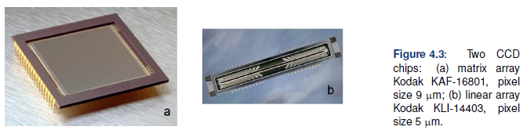
Cameras
A simple digital camera consists of a box containing a lens, a focal plane array of CCDs and a data storage unit
The CCD array can either be one or more linear arrays or a matrix array
Each CCD element has multiple channels (generally red, green, blue, near IR (NIR)) which are generally long elements fitted next to each other to form a square colour pixel
Above each element is a filter of the appropriate colour to allow only that colour to pass to the element below

Slide 13
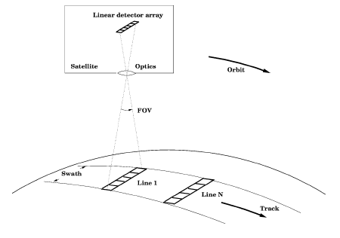
Cameras
Aerial surveys generally use cameras with either frame or line array CCDs
Satellites use reflecting telescopes rather than camera lenses and line arrays rather than frame CCDs
Line arrays build up an area image by taking repeated images of a narrow band of land (the swath) which is then stitched together into a larger picture
Most satellite imaging platforms have multiple arrays
One points straight down, others point slightly ahead or behind this
  Allows for stereoscopic imaging
‘Pushbroom’ technique

Slide 14
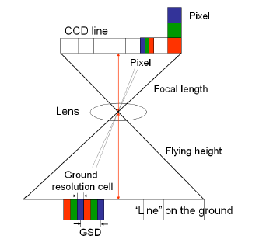
Cameras
For a CCD system, whether aerial or satellite, the maximum resolution of the camera depends on the focal length of the camera and the flying height of the platform
The ground resolution cell is the width of the smallest pixel element
The ground sampling distance is the size of the full pixel
Satellite resolution can be as high as 41cm per pixel (GeoEye-1 panchromatic/monochrome)
Visible-NIR CCDs are made from silicon and are much more sensitive to light than film
CCDs respond to about 70% of incoming light as opposed to 2% for film

Slide 15
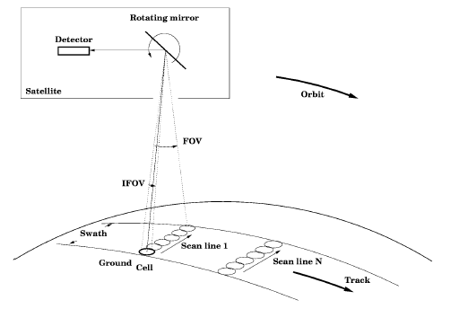
Scanners
An optical scanner is a remote sensor with a mechanical scanning device
The optical sensor has a very limited field of view (FOV) called the instantaneous field of view (IFOV) or cell
A mirror is used to move the IFOV from side to side to build up a scan line across the swath moving along the track
These are generally used for broad spectral ranges
The incident light is split into bands using either a prism or a grating and each wavelength of interest is deflected into a separate detector
‘Whiskbroom’ technique

Slide 16
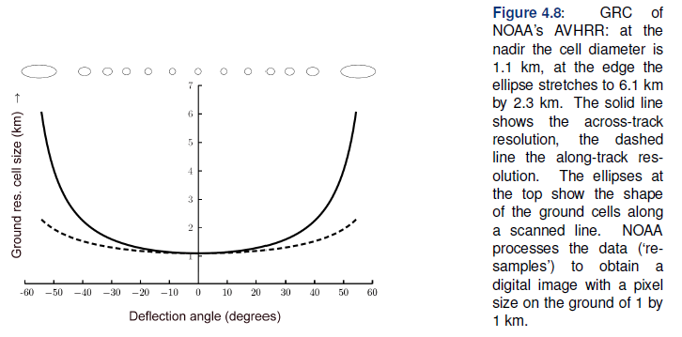
Scanners
Reading out the detector is done at a fixed interval, the sampling interval
  If the sampling interval is less than the speed of the moving mirror then the cells imaged may overlap
As the IFOV moves from side to side the cell becomes distorted towards the edges of the swath
  This affects the overall resolution of the image

Slide 17
Exercise
Landsat 8, AVHRR/3, LANDSAT, METEOSAT, MODIS, GOES, SPOT, SKYSAT, and ASTER are all significant remote sensing platforms
For each system find the following information
  Altitude
  Orbital period
  Orbital inclination angle
  Repeat time
  Orbit type
  Main data use
  Main sensors
  Something interesting discovered through its data
Prepare no more than 3 Powerpoint slides on your designated system and present them at the end of the session

Slide 18
Summary
Topics covered
  Static, aerial and satellite survey missions
  Cameras
  Scanners
  Current Systems

Slide 19
Coming soon
Next session: Geometric Corrections
Homework: Read chapter 4 of Principles of Remote Sensing

