Slide 1
Academic Skills

Slide 2
Table of Content
Introduction
“The main products and services”
“How the company manages to compete in this market”
“At least two appropriate strategies on how the products or services of this company can be improved to gain additional customer satisfaction win in this competitive market”
Conclusion
References

Slide 3

Introduction
Asda is multinational grocery and food retailer.
Founded in 1949 by the Asquith family
Total revenue stands at £22 billion for 2022 (Fengyi, 2021).
Report will analyse the products and services
Strategies will include ansoff matrix and marketing strategies
Quality management and Omni channel Customer Service analyses
Notes:
Introduction
Asda is a multinational grocery and food supply chain company with its headquarters in Leeds, UK. The company was founded in 1949 by the Asquith family which later merged with the association of dairy companies located in Yorkshire. Since then the company has formed a large customer base acquisition and has gained customer loyalty. The company also generated revenue of £22 billion in the year 2022. The company also employs more than 145000 employees throughout the UK. the company also ranks 4th in the UK on the basis of revenue and supply in the market. In this report, a detailed analysis of the main products and the services of the Asda company will be discussed (Fengyi, 2021). Along with the products, the strategies and the factors which help the company to compete against the competitors for the Asda company will be analysed. The strategies such as the market segmentation, product diversification, strong crisis management, technology, and sustainability management will be analysed in this report. The report will also analyse the impacts of the marketing strategies such as the Quality Management System and the Omnichannel Customer Service Strategy which also be analysed. These two marketing strategies will analyse the impact and the implication of the company. The report will use this strategy to analyse the how the strategy impacts the products and the services of the company which can help to gain better customer acquisition

Slide 4

“The main products and services”
Company has more than 630 stores
Mainly deals in grocery, food and pre packed food
Provide services in cafe, pharmacy, travel and many other
Merger with fashion hub George
Deal with 800000 customers in week
George has associated with 560 stores
Notes:
“The main products and services”
Asda mainly deals in the multinational grocery sector and food retailers for customers. The company has over 630 stores located in the whole of the UK which includes general shops and supermarkets of the company. The company's main products segment lies in the food sector and the pre-packed food which includes 60% of the total turnover. Milton Keynes is one of the largest suppliers and distributors of the Asda products and its services. Asda contributes 69% of positive opinions within the retail and the supermarket. In the supermarket and the retailers of the company, the services provided by the company are cafe, pharmacy, travel services, decathlon and many other food services (Jones and Comfort, 2022). The company also deals in garment and apparel merchandise. The company has merged with leading and popular apparel merchandise George. The apparel merchandise has over 560 stores in the UK and is recognised as one of the fastest growing fashion brands. The company avail their devices to more than 800000 customers in a week which shows the popularity of the brand.

Slide 5
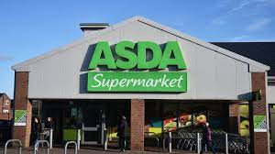
Increase in sales because of diversification
Grocer contribute 21% of the revenue
Food and pre packed food contribute 40% of revenue
Deals with many food item like pizza sauce, curry and many other.
Wellness products and hygienic products
Notes:
The sales and the services to the customers increased the brand value and the sales growth of the company. The revenue of the company also tends to increase which has a positive impact on sales. The Grocer shopping is one of the integral parts of the company as this contributes about 21% of the company's revenue. The food and the pre packed food from various brands which have merged with Asda also grow significantly. The food and the pre packed food contributes about 40% of the total revenue for the company. The company provides excellent service in the field (Bentham, 2018). The company provide the services of recipes and curry both online shopping and the tutorial on how to produce them. The company sells its own chicken curry, ready made pizza sauce, tails espresso martini vodka cocktails and much other food related items and beverages. Asda company also deals with the wellness of an individual such as shower gel for both men and women, washing liquid detergent and many more.

Slide 6
Company has its pharmacy and doctor consultancy.
Official website with various recipes
Associated with express delivery
Online shopping and home delivery
Notes:
The company has its own pharmaceutical farms which deal with various medical and its services such as online doctor consultation and prescription. Apart from the products and the supermarket, the company also provided the services of various online delivery. The company has its own website where customers can place their orders. The company has associated with express delivery services to deliver the products to their doorsteps irrespective of the remote area of the country. The online delivery also provides various offers and discounts for the customers which can help them to avail the services of the company at large (Despoudi, 2020). The online services which the company provides through its websites are health insurance, pet insurance, car insurance and the home insurance for the customers.

Slide 7

Company also supply petrol
First to supply red bull in the supermarket
Company has official bakery shops and services
Aligned with various famous brands
E.g. head & shoulders, Colgate, oral b and so on.
Notes:
The customers also engage and avail of the services of the company. The company also started to provide the service and the supply of the petrol and natural gas to customers in 2012. Since then the company has been continuously providing the services of the petrol to the vehicles. Asda was the first supermarket service in the UK to deliver the service of the Energy drinks like Rebull to the customers. The company has recently started the services and the manufacture of the bakery item and the materials related. The company aims to sell bakery products in the market during the Christmas to accumulate a huge customer base acquisition and brand value (Christopher, 2018). The company has also acquired the toiletries and the beauty sector for the market. The company has acquired various influential brands such as Colgate, head & shoulders, oral b and many other brands that deal with this sector.

Slide 8

“How the company manages to compete in this market”
Compeitors like Tesco, Saintbury, Waitrose
Oligopoly market structure for the company
Difficulty in new entry
Prefect knowledge of the market
Differentiated prices
Notes:
Asda is one of the biggest retailing sectors in the UK. The company has many competitors like Tesco, Saintbury, Waitrose and many more. The retailing sector mainly indulges in the oligopoly market. The oligopoly market is characterised as a market where there are free sellers but a large number of customers. This type of market is generally considered as the price maker for this seller. The seller has the perfect knowledge of the market and aims to maximise their profit through sales and promotion. The competitors of the company also face the same level of market structure which is an oligopoly (Bamford, 2018). For any new entrant, it is difficult for them to compete with giant brands like Asda and its competitors. Product differentiation also lies in the oligopoly market structure. The competitors of Asda have distinct and different products than the company, making its product a differentiated market. Though the price of the products is almost the same for every product sector within the organisation and the oligopoly sector. The company has made various changes and plans in the company and its marketing and sales strategies to compete with the competitors.

Slide 9
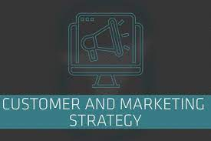
Market segments:
Focused on food and prepacked food
Has fashion and apparel segment
Garment both men and women
George fashion hub is the recognized brand
Notes:
Market segments: the company focuses mainly on the food, prepacked food and the grocery sector as these consist of 60% of the total revenue. The company also deals with the garment sector of both women and men which allows the company to diversify its fields. The garment sector which merged with George company deals with 800000 customers in a week which increases the interaction between the company and the customers(Czinkota et al., 2021). This helps the company to increase its brand value and the sales of the company, resulting in a boost in revenue.

Slide 10

Strong Crisis Management
Plan for crisis and its management
Eliminating any obstacle
Donation during outbreak ( Bambi, 2021).
Food and required material donation
Notes:
Strong Crisis Management: the recent outbreak of the pandemic, corona virus resulted in a crisis for the company in every department. The company has now planned to deal with and take steps regarding any crisis or obstacle which might hinder the supply of the business. The company has increased its website traffic and has rolled out the faculty of e-commerce of the grocery and the food department. This can help the company to increase the capacity and also the range of the customer ( Bambi, 2021). The company has donated millions of donations in food security and the food supplements to the locals during the pandemic, which created sustainable development in the company.

Slide 11

Product and format diversification
Products diversification within the organization
Services in many different sectors(Gurjanov et al., 2021).
Encourages more customers interactions
Increment in revenue.
Notes:
Product and format diversification: the company like its competitors has diversified the range of its products and the services. Asda has introduced groceries, clothing, mobile products, insurance and petroleum products which have a high range of adaptability in general (Gurjanov et al., 2021). This products and service diversification can help the company to engage more with the customers and increase the brand value and revenue of the company.

Slide 12

Technology:
Recognisation of technicality and up gradation
Official website with different options
Unique recipe and tutorials
Feedback and suggestion option on website
Notes:
Technology: the company recognises the importance of technology and the upgradation of heavy machinery. To compete with competition Asda company needs to modify its technology. The company has provided various unique recipes and tutorials for the groceries. This makes the customers attracted towards the website of the company which increases the web traffic. The customers recognise the company's products and its services and remain loyal to them (Mekruksavanich, 2020). In this way, the company can improvise the product and the services through feedback and the relative polls conducted by the company.

Slide 13

Sustainability
Helps in attaining sustainable development
Recognisation in the eyes of the customer
Company aims to achieve carbon emission
Recyclable material can be used at home
Aims for non wastage and toxin material
Notes:
Sustainability: the company recognise the importance of the sustainable development within an organisation. The sustainable development can help the company to form an image of a responsible company in the eyes of the customers and this can increase the company’s reputation. Asda has made its objective to control land emissions and degradation and since 2020 the company has eliminated the wastage of food and has sustained zero land emissions. The company has also eliminated the carbon emission from their factory and has maintained the sustainable development in curbing levels 1 and 2 of carbon emission. This can helps the company recognise the importance of the environment and help them to create a sense of belongingness in the market (Fathi et al., 2021). The company has also maintained recyclables in the home which aims to eliminate any wastage which can be a toxin for the nature. This sustainability can help the company to attain the customer satisfaction and help them to compete in the market

Slide 14

Ansoff matrix for Asda
Penetration of the market with existing products
Allows growth in sales
Provides discount and offers
with the aim to increase customer intersection
Notes:
Ansoff matrix for Asda
Market Penetration Asda works on the importance of the penetration of the products in the markets. The supermarkets and the retailers who supply the products should be encouraged to sell more Asda products so that the growth of sales is maintained. Asda offers many discounts, offers and schemes which allow the buyers to attract to the products and the services of the company. This helps to increase customer loyalty for the company and also increases customer satisfaction (Schawel and Billing, 2018). The oligopoly market structure allows the Asda Company to diversify more of their products as the risk of new entrants is negligible.

Slide 15
Market Development
New market plan and development
Company recognise customers influence
Aims to develop the marketing strategy
Development of sales stargey
Notes:
Market Development the company always promotes their existing products into new developmental plans. The company makes new n to develop their marketing strategies which help them to grow more in the market. The company also recognises the customer's influences and demand in the market which helps them to develop the plan and products and services according to the demand of the market (Schawel and Billing, 2018). The company recognise the development in every sector so they included the online grocery delivery system to capture more customer base acquisition.

Slide 16
Product Development
Development of existing product
Changes according to customers preferences
Aims for better sales through this changes
Customers prefaces is priority
Notes:
Product Development the company launches different products of different brands after developing them regularly. The company acknowledges the feedback of the customer and changes the products according to the feedback. The development of the product helps the company to gain an edge over other competitors and the customers recognise this product differentiation and choose the Asda product over others. The company also changes the outlook of the product to make it look different from the previous version (Schawel and Billing, 2018). The company always develops the product strategy as to how to demonstrate it to the general public and the strategies relating to sales of these products

Slide 17
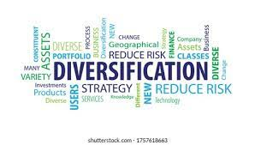
Diversification
Diversification in the product segment
Aims to increase the sale and the customers acquisition
Increase the brand value
E.g. grocery, food, garment and apparel, petroleum products,
health and wellness and many other products
Notes:
Diversification the company diversify its products and the range of products into a different segment. The company previously dealt mainly in grocery, food and pre packed food after diversification they change their segment into different sectors. The company now deals with grocery, food, garment and apparel, petroleum products, health and wellness and many other products. This helps the company to sustain itself in the market and help them gain more customers and increase its brand value which boosts the revenue of the company. The diversification also helps the company to serve more customers and occupy their loyalty and deliver its services to them.

Slide 18
Omnichannel Customer Service Strategy
Sales channel is observed in this strategy
Customers preference is fulfilled
Helps to increase the sale of the company
Notes:
Omnichannel Customer Service Strategy is the strategy that enables the customers to connect with the company’s website, products, sales, email and everything that is associated with the company. This enables customers to move seamlessly between these channels without encountering any dead ends (Cai and Lo, 2020). There are four pillars which are associated with the omnichannel customer service strategy such as sales channels, marketing and advertising, operations, and shipping and fulfilment.
Sales channel Asda has one of the best supply chains in the retailing industry behind Tesco. The supply chain allows the company to give the supply in surplus. The customer's preference is fulfilled due to this supply chain allowing the sale for the company to increase. The sales of the company also increase due to the diversification of the products within the company. The customers tend to demand more products which increases the sales of customers (Abrudan et al., 2020). The garment brand George also helps to increase the sales growth of the company as about 800000 customers avail the services of the company.

Slide 19
Marketing and Advertising
Helps to promotes the product
Increase the customer and company interaction
Advertisement through social media and different website
Identification of the products to customers
Notes:
Marketing and Advertising help the company to promote and penetrate the market with its products. The advertisement of the products through different social media, campaigns and events helps them to increase the brand value and the interaction of the company with the customers. The marketing of different products can help the company to compete with the competitors and help the customers distinguish the Asda products. The marketing of the products and the services can also ignite the sales growth of the company (Cai and Lo, 2020). The advertisement of the product through different social media platforms, television, and journal and the influencing them through different entertainers can help them to achieve growth. In both finance and the brand identity of the company.

Slide 20

Operations
Helps to improve the production
Human resource management increase the efficiency
Training and conducting seminars and events
Aims to increase the efficiency through skills
Notes:
Operations of the company such as the human resource management and the managerial part of the company can help them to achieve the objective of the company. The company's vision is to offer shoppers the best possible value, this can be achieved through precise operation planning and strategies of the company (Abrudan et al., 2020). Human resources management can also contribute to developing the operational plan and the pathway of executing them which can be beneficial for the customers. The training and the conduction of seminars can help the employee to train their skills and attributes which can help them to improve the efficiency of the productivity.

Slide 21
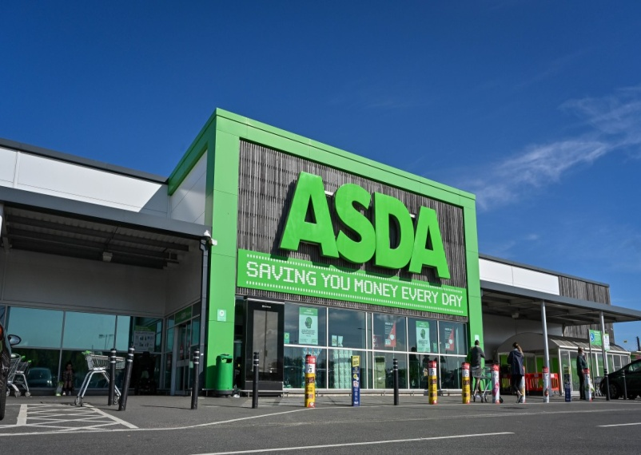
Strategy to improve service and win competition
It is important for Asda to bring further improvement in its offering
Meet the needs of the customer but also enhances their satisfaction level
Asda can implements is a “Quality Management System (QMS)”
Notes:
It is important for Asda to bring further improvement in its offering to enhance the satisfaction level of the customer and gain a competitive edge in the highly competitive retail market of the UK. It has now become important for the company to bring further improvement in their product as there is huge competition within the retail sector and the changing preference of the customer. Since the outbreak of the global pandemic of covid 19, customer has now become more health conscious which the company have to take into consideration to meet the needs of the customer. The company doing so will not only help meet the needs of the customer but also enhances their satisfaction level (Borkovskaya et al., 2018). As a result, the company will gain a huge customer base which allows them to generate huge revenue and profit while also gaining a competitive edge in the extremely competitive retail industry of the UK. Thus, there are different strategies which can help Asda to improve their product to enhance the satisfaction level of customers while also gaining a competitive advantage. One of the strategies that Asda can implements is a “Quality Management System (QMS)” as it can help to improve the quality of the products they offer to the customer to meet their needs while also enhancing customer satisfaction (Pacana and Ulewicz, 2020).

Slide 22

Quality Management System
Formalised for the “document process, procedures and responsibilities for achieving quality objectives and policies”
Contributes to improving the efficiency and effectiveness of the organisation on a continuous basis
Notes:
A Quality Management System (QMS) can be defined as a system which is formalised for the “document process, procedures and responsibilities for achieving quality objectives and policies”. This objective helps the company to direct and coordinate the activities of the organisation which help to meet the needs of the customer while also meeting the regulatory requirements. It also contributes to improving the efficiency and effectiveness of the organisation on a continuous basis.

Slide 23

Quality Management System
The most prominent approaches for quality management systems
It collects the “process, policies, documents and record procedures”
Looked at by the “international organisation for standardisation 9001 (ISO)”
Notes:
It is one of the most prominent approaches for quality management systems as it sets the standard which specifies the requirement for improving the quality of the product or service of the company (Carey et al., 2018). The standards are set in a Quality Management System as it collects the “process, policies, documents and record procedures” which help the company to achieve and deliver the products and services as per the needs of the customer. The quality management system is also looked at by the “International Organisation for Standardisation 9001 (ISO)” which is agreed upon by the majority of members of the countries involved within this organisation. Thus, it allows the business organisation implementing the Quality management system to accept the gold standard for the process to be used for offering the product and service to meet the needs of the customer and enhance their satisfaction (Ong et al., 2020).

Slide 24
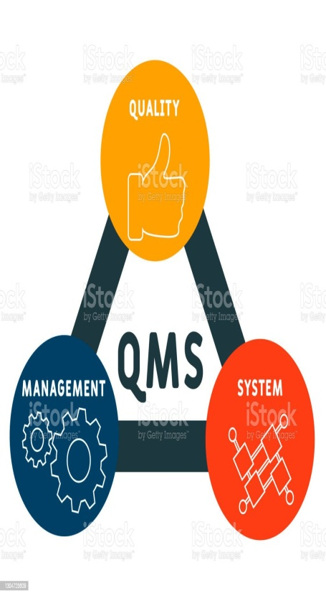
Benefits of Quality Management System
It can increase the overall performance of the company
It allows the company o instil confidence within the organisation
Understand the requirements of the customer while also meeting the requirements of the organisation
Notes:
Asda applying the strategy of a Quality Management System can be beneficial for every aspect of the performance of the organisation as it can increase the overall performance of the company. Since Asda does not sell its own product, thus, it helps to focus on improving its service by providing the requirements of the customer as per their needs. Thus, it allows the company o instil confidence within the organisation and help to gain “more customers, sales and repeat business”. It happens as the company will be able to understand the requirements of the customer while also meeting the requirements of the organisation which is compliance with the provision and regulation of services.

Slide 25
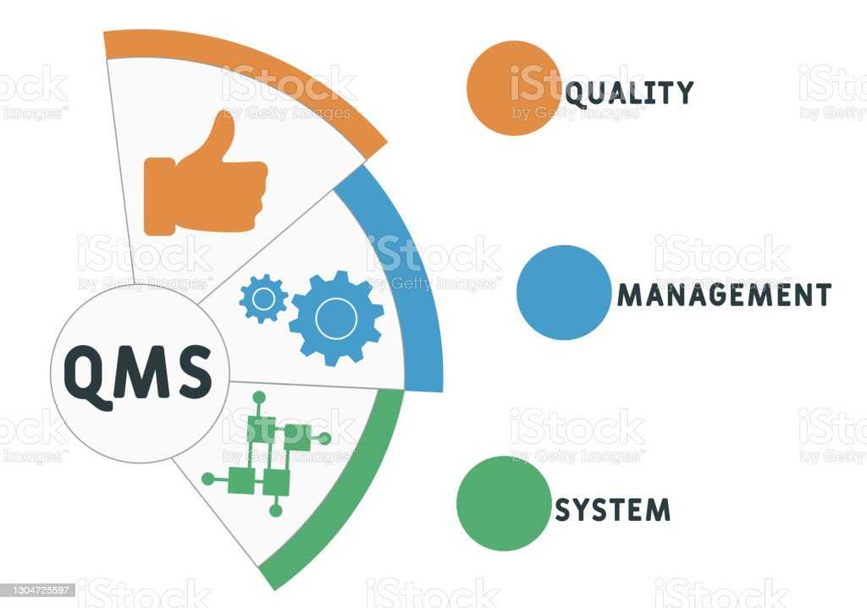
Benefits of Quality Management System
creates room for growth, expansion and profit as Asda
“control, improve and define” the process of offering service to enhance the
Identify and facilitate opportunities for training and serve the organisation in a “wide direction while also communicating the readiness of service with a consistent result”. satisfaction level of the customer
Notes:
It also creates room for growth, expansion and profit as Asda will be able to regulate resources and cost in an efficient manner which can help them to gain a competitive edge in the highly competitive retail industry of the UK (Zgirskas et al., 2021). Thus, the company will be able to “control, improve and define” the process of offering service to enhance the satisfaction level of the customer while also preventing mistakes. Asda will also be able to lower the cost of operation while also reducing waste and engaging staff more. The Quality Management Service also allows Asda to identify and facilitate opportunities for training and serve the organisation in a “wide direction while also communicating the readiness of service with a consistent result”. Thus, it will also help the company not only improve the satisfaction level of the customer but also to win in the highly competitive retail market of the UK (Echour and Nbigui, 2020).

Slide 26
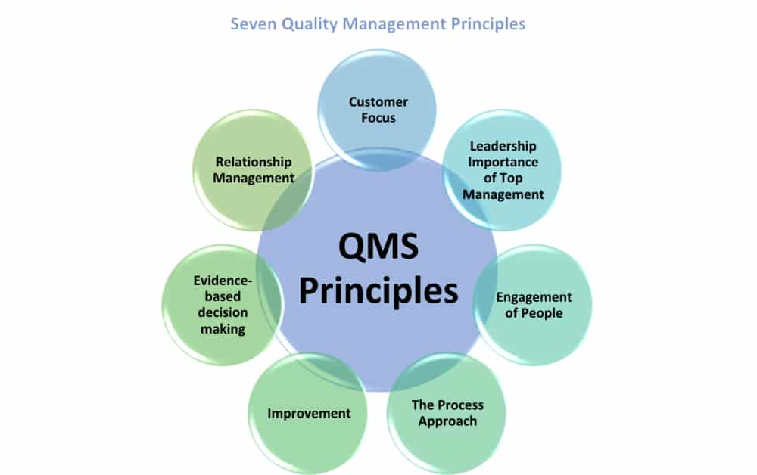
Principles of Quality Management System
Even principles of the quality management service are “customer focus, leadership, engagement of people, process approach, improvement, evidence-based decision making and relationship management”
Customer focus allows the company to focus on the needs and wants of the customer to meet their needs
Notes:
There are seven principles of a quality management system Asda needs to follow to improve its service and enhance customer satisfaction while also gaining a customer competitive edge in the market. The seven principles of the quality management service are “customer focus, leadership, engagement of people, process approach, improvement, evidence-based decision making and relationship management”. Asda needs to follow these principles of QMS which can help to enhance the customer satisfaction level and gain a competitive edge in the highly competitive retail market of the UK. The first principle of QMS, which is customer focus allows the company to focus on the needs and wants of the customer to meet their needs. This acts as a foundation for enhancing the satisfaction level of the company. Thus, to do so, the company can research the market more and understand the needs of the customer by doing surveys and allowing customer feedback (Tricker, 2019).

Slide 27
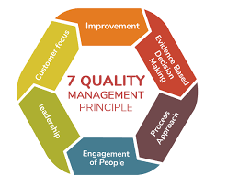
Principles of Quality Management System
Leaders of asda act as the second principle of the quality management system
Enhance the engagement of the people as they act as a vital asset
The company to improve its relationship with its suppliers which also plays a crucial role in delivering the service to improve customer satisfaction
Notes:
The leaders of Asda act as the second principle of the Quality Management System as the leaders are responsible for providing adequate resources and funds to improve the service of the company. Thus, the adequate resources and funds provided by the top management of the company allow them to improve their service and enhance the satisfaction level and gain loyal customers who make repetitive purchases. Asda will be able to enhance the engagement of the people as they act as a vital asset to improve customer satisfaction. The company doing so also helps to enhance the overall performance which also helps them to gain a competitive advantage. The company will then take a process approach and bring improvement to its service offering. Thus, the company will also be able to make evidence-based decisions making to improve the process and service while also aiming to improve relationship management. This allows the company to improve its relationship with its suppliers which also plays a crucial role in delivering the service to improve customer satisfaction and gain a competitive advantage (Derii et al., 2020).

Slide 28

Conclusion
Report analyses the asda and its marketing strategies
The report also analyses the brand and market segment
Different types of marketing strategies
The use of tools like ansoff matrix
Implication and the advantage of these marketing strategy.
Notes:
Conclusion
In this report, a details analysis of the products and the services of Asda has been analysed. The products and services which the company provides to its customers such as the online delivery, and various brand segment products. The company mainly deals with grocery, food and prepacked foods, along with these products the company also has acquired the fashion brands like George. The company also has many brands and its products under its names such as Colgate, head & shoulders, oral b and many other brands that have a huge customer base acquisition (Fengyi, 2021). The services like the home delivery and the online tutorial classes are also very prevalent for the company. Online shopping of the grocery and curry like chicken curry, specialised vodka, and many other things. In this report, different types of marketing strategies and the factors which can be used by the company have been analysed. The factors such as the market segmentation, product diversification, strong crisis management, technology, and sustainability management have been discussed. The impact of these factors on the customers and ton the company has been analysed. The report has also analysed the two appropriate strategies the quality management system and the Omni channel service strategy has been analysed. This strategy is applied to demonstrate the product and the services of the company and how they can be improved to gain surplus customer satisfaction in the market. The report has also analysed the implication of the marketing strategies and how they can benefit the company in their sales and revenue.

Slide 29
References
Abrudan, I.N., Dabija, D.C. and Grant, D.B., 2020. Omni-channel retailing strategy and research
agenda. Perspectives on consumer behaviour, pp.261-280.
Bambi, A., 2021. Crisis-management in the European Union How emergency politics affect EU
decision-making.
Bamford, C.G., 2018. The internationalization of logistics in the UK. In Global Logistics and
Distribution Planning (pp. 301-313). Routledge.
Bentham, J., 2018. Business and Economics in the News–Sainsbury&#39;s and Asda-the decade&#39;s
mega-merger. Teaching Business &amp; Economics, 22(3), pp.11-12.
Borkovskaya, V., Degaev, E. and Burkova, I., 2018. Environmental economic model of risk
management and costs in the framework of the quality management system. In MATEC web of
conferences (Vol. 193, p. 05027). EDP Sciences.
Cai, Y.J. and Lo, C.K., 2020. Omni-channel management in the new retailing era: A systematic
review and future research agenda. International Journal of Production Economics, 229,
p.107729.
16
Carey, R.B., Bhattacharyya, S., Kehl, S.C., Matukas, L.M., Pentella, M.A., Salfinger, M. and
Schuetz, A.N., 2018. Practical guidance for clinical microbiology laboratories: Implementing a
quality management system in the medical microbiology laboratory. Clinical microbiology
reviews, 31(3), pp.e00062-17.
ChrIStoPhEr, M., 2018. Supply management chain risk 09. Leading Procurement Strategy:
Driving Value Through the Supply Chain, p.162.
Czinkota, M.R., Kotabe, M., Vrontis, D. and Shams, S.M., 2021. Market Segmentation,
Positioning, and Branding. In Marketing Management (pp. 283-340). Springer, Cham.
Derii, V.A., Parkhomets, M.K., Kovbasa, O.M., Hryzovska, L.O. and Karabanyk, S.M., 2020.
Modeling business processes based on logistics concepts and quality management system
principles.
Despoudi, S., 2020. Green supply chain. In The Interaction of Food Industry and Environment
(pp. 35-61). Academic Press.
Echour, S. and Nbigui, T., 2020, December. Motivations related to the quality management
system and benefits of its implementation in the company: state of the art. In 2020 IEEE 13th
International Colloquium of Logistics and Supply Chain Management (LOGISTIQUA) (pp. 1-5).
IEEE.
Fathi, M., Nourmohammadi, A., Ghobakhloo, M. and Yousefi, M., 2020. Production
sustainability via supermarket location optimization in assembly lines. Sustainability, 12(11),
p.4728.
Fengyi, Z., 2021. The Analysis of Asda-Sainsbury’s Merger/Acquisition. Journal of Finance
Research, 5(1), pp.1-6.
Gurjanov, A.V., Zharinov, I.O. and Zharinov, O.O., 2020, November. Diversification of lean
manufacturing for actual innovation. In Journal of Physics: Conference Series (Vol. 1661, No. 1,
p. 012172). IOP Publishing.
Jones, P. and Comfort, D., 2022. Modern slavery statements and the UK’s leading food retailers.
Geography, 107(2), pp.107-110.
Mekruksavanich, S., 2020, March. Supermarket shopping system using rfid as the iot
application. In 2020 Joint International Conference on Digital Arts, Media and Technology with
ECTI Northern Section Conference on Electrical, Electronics, Computer and
Telecommunications Engineering (ECTI DAMT &amp; NCON) (pp. 83-86). IEEE.
17
Ong, F., Purwanto, A., Supono, J., Hasna, S., Novitasari, D. and Asbari, M., 2020. Does Quality
Management System ISO 9001: 2015 Influence Company Performance? Anwers from
Indonesian Tourism Industries. Test Engineering &amp; Management, 83, pp.24808-24817.
Pacana, A. and Ulewicz, R., 2020. Analysis of causes and effects of implementation of the
quality management system compliant with ISO 9001. Polish Journal of Management Studies,
21.
Schawel, C. and Billing, F., 2018. Ansoff-Matrix. In Top 100 Management Tools (pp. 31-33).
Springer Gabler, Wiesbaden.
Tricker, R., 2019. The seven principles of quality management. In Quality Management Systems
(pp. 131-136). Routledge.
Zgirskas, A., Ruževičius, J. and Ruželė, D., 2021. Benefits of Quality Management Standards in
Organizations. Standards, 1(2), pp.154-166.

Slide 30

Thank You

